Slide 1

Legal Process
Lecture 4 - The Law Makers Continued

Slide 2
Aims and Outcomes of the Lecture
Continuing with the law-making institutions in the ELS.
Explain the purpose of secondary legislation and the main types of secondary legislation
Brief introduction to Taxation
Understand the concept of judicial review
Describe the functions of parliamentary committees and outline the purpose of parliamentary questions and debates.
Understand the role of the Executive
Introduction to Prerogative Powers
Understand the impact of devolution in Wales on the ELS

Slide 3
Re-Cap
In the last lesson we looked at how a Bill becomes an Act of Parliament
The process between the two Houses – the Commons and the Lords
We discussed in the tutorial how an MP gets voted in and who represents us all as out local MP.

Slide 4
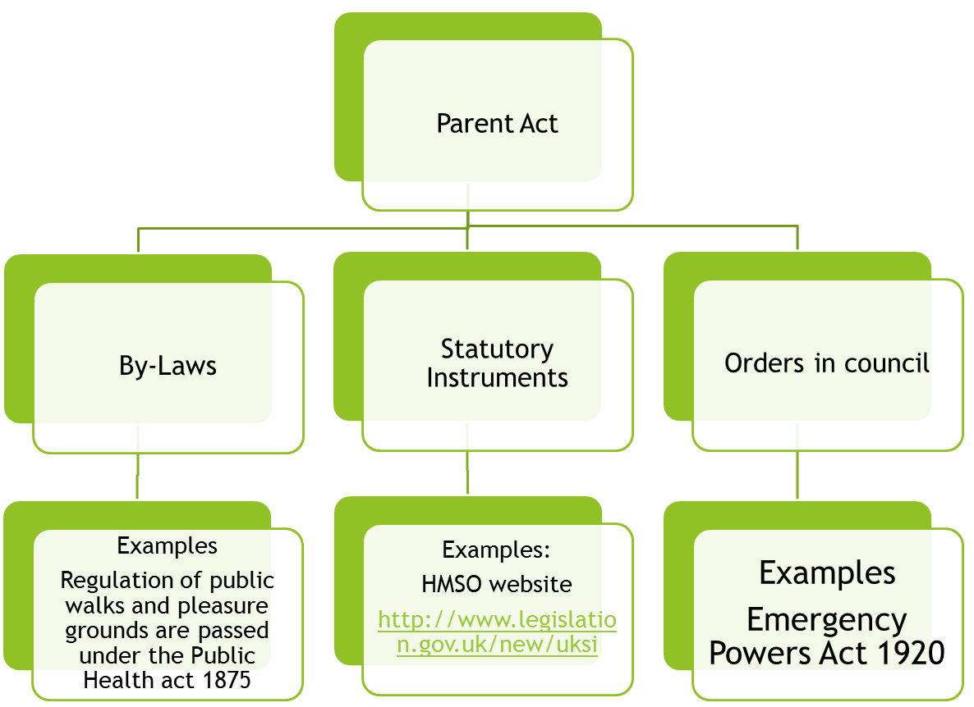
Delegated Legislation
Parliament has the power to give or ‘delegate’ power to another body

Slide 5
Judicial control of delegated legislation
The judiciary cannot normally review legislation but can review delegated legislation. – Judicial Review.
Procedural Ultra Vires
Substantive Ultra Vires
R v Sec of state for education and Employment ex p National Union of Teachers 2000
  Education (school Teacher’s Pay and conditions) (No2) Order 200
  S2 School Teachers Pay and conditions Act 1991

Slide 6
Delegated Legislation
Advantages | Disadvantages
Expertise | Democratic accountability
Time | Sub-delegation
Flexible | Publishing

Slide 7
Taxation
It is a primary function of Parliament to oversee the expenditure of money by the executive in the discharge of its functions.
The Treasury, which is headed by the Chancellor of the Exchequer, has departmental responsibility for management of the national economy and, in particular, for tax policy. Governments plan public spending some years in advance.
Although Parliament discusses these plans in the autumn, governments are unlikely to change them.
Taxes are collected by HM Revenue & Customs. All revenue raised by the Crown requires the consent of Parliament (Bill of Rights 1689 and Bowles v Bank of England [1913]).

Slide 8
Taxation continued
Before 1913, Parliament used to approve budget tax increases by a mere resolution.
Bowles successfully challenged this on the ground that only an Act of Parliament can authorise taxation.
The Provisional Collection of Taxes Act 1913 – which has been replaced by the Provisional Collection of Taxes Act 1968 – was then passed, which authorised taxation until the annual Finance Bill is passed.
The Budget Speech is made by the Chancellor in the House of Commons. The budget is accompanied by a white paper which contains a financial statement and commentary on the budget itself. Debate on the budget will continue for several days before the Finance Bill is published and begins its path through the House. The role of the House of Lords is purely formal; the Commons alone introduces and oversees the Finance Bill. The government majority ensures that the Finance Bill is approved.

Slide 9
Parliamentary Committees
The House of Commons has the power to set up independent select committees.
These are committees of up to 15 members, and their composition reflects the relative strength of political parties in the House of Commons.
There are select committees for each government department.
Their job is to shadow, or scrutinise and report on, specific issues relating to the major Departments of State.
There are also committees with wider, or cross-departmental remits, such as the Delegated Legislation Committee and the Standards and Privileges Committee.
The House of Lords has its own select committees, though none of these shadow departments in the way that Commons committees do.

Slide 10
Activity
Read the Parliament website dealing with select committees at https://www.parliament.uk/about/how/committees/select/#jumplink2.
What are the key differences between House of Commons and House of Lords select committees?

Slide 11
Parliamentary Questions
Parliamentary questions are a key mechanism through which Members of Parliament hold the executive to account.
MPs can ask both oral and written questions. An MP may ask only two questions requiring an oral answer per day, and the types of questions which may be asked are strictly regulated. There must be a question, so an MP cannot simply stand up and make a statement.
Questions are usually addressed to ministers, but can be put to any MP with a responsibility. If the member who is subject to the question is a minister, the question itself must concern:
public affairs;
proceedings pending in Parliament; or
the administration of that minister’s department.
In addition, it must ask for information or action.

Slide 12
Reflective Question
Watch the Prime Minister’s Question Time on Wednesday 24 March 2021 at https://www.parliamentlive.tv/Event/Index/8b967353-095d-4123-8aac-4c4a4cfa5857.
How effective do you think the MPs questioning the Prime Minister were at obtaining new information and challenging the Prime Minister?

Slide 13
Debates
The Commons may debate anything, whether an international, national, localised or constituency matter.
Debates always take place on the contents of the Queen’s Speech, which outlines the government’s legislative proposals for the coming session, and on the budget.
A motion of no confidence in the government also leads to a debate.
Each year, three Estimates Days are allocated to debate the government’s spending estimates.
20 Opposition Days are allocated for the Opposition to raise and debate matters of policy and administration of their choice.

Slide 14
Debates continued
Emergency debates are possible but require the agreement of the Speaker.
Private members can bring up subjects for debate when the House is discussing adjournment for holidays.
The Speaker decides which MPs get a chance to speak.
It is also possible to bring up a topic for debate when the House is about to adjourn for the night (i.e. for the last 30 minutes of the sitting).
This is known as an Adjournment Debate.
Order in debate is maintained by the Speaker, who has the power to remove unruly MPs, interrupt speakers and request them to keep to the point.

Slide 15
Debates continued
There are three devices for limiting time in debate. Although they are proposed by an MP, a majority is required. A government can therefore use them to cut short debate. The devices are as follows:
closure – an MP moves during debate that “the question be now put”. It is then up to the Speaker to decide. If it is accepted, a decision is taken immediately;
guillotine – this is a motion by an MP that debate on a particular issue be limited to a specified time, and this must be put prior to the debate; and
kangaroo – this procedure applies only to the committee and report stages of a Bill. Under it, the Speaker or chairperson has power to select which amendments or new clauses will be discussed. The other amendments must be voted upon without discussion, thus saving the need to go through the whole Bill clause by clause.

Slide 16
The Executive
The Prime Minister is the head of government in the United Kingdom.
In constitutional terms, the Prime Minister is appointed by the monarch, and the choice is hers (or his).
However, in practice, the monarch’s choice of Prime Minister is strongly controlled by convention, to prevent her being drawn into political controversy.
Usually, the choice of Prime Minister is straightforward: the monarch will appoint the leader of the party which has won a general election by gaining an overall majority of seats in the Commons.

Slide 17
Sometimes, the Prime Minister will resign without having lost a general election and while their political party continues to have a majority in the House of Commons.
The resignations of Tony Blair in 2007 after 10 years in office, David Cameron after the Brexit referendum, and Theresa May in 2019 all took place for different reasons outside general elections.
In such circumstances, the internal party processes for choosing a new leader are effectively what determines the next Prime Minister.
These differ between political parties and change over time.

Slide 18
The Role of the PM
The Prime Minister’s role and functions will, to an extent, depend on the character and style of leadership of each Prime Minister, though the main function is to form a government and preside over the Cabinet. Other functions include:
making appointments to ministerial office;
allocation of the tasks of government to various departments;
presiding over Cabinet meetings;
representing the government in Parliament;
leading the party and keeping control through government whips;
keeping the monarch informed of government affairs through a weekly audience;
supervising security and intelligence matters; and
making or recommending appointments, including life peers and top civil servants.

Slide 19
The Cabinet
The Cabinet comprises the Prime Minister and other senior ministers (most heading government departments) appointed by the Queen upon the advice of the Prime Minister.
The Cabinet, assisted by junior ministers and civil servants, essentially runs the country.
It is the forum where major policy decisions are decided, and it controls the legislative agenda of Parliament.
The Cabinet, like the Prime Minister, must enjoy the confidence of a majority in Parliament and is thus accountable to Parliament.

Slide 20
The Cabinet continued
Membership has consisted of between about 18 and 23 ministers who fill the major posts of government.
The Prime Minister decides which offices will form the Cabinet, and these may vary from one government to another.
Certain offices – such as the Home Secretary, Foreign Secretary and Chancellor of the Exchequer – are always included.
These are usually supplemented by the other Secretaries of State and ministers in charge of the major departments.
Other non-Cabinet ministers and, for example, the Law Officers of the Crown, may attend Cabinet meetings for particular matters.

Slide 21
The Cabinet continued
Practical and political considerations in the main determine the composition.
By convention, a Cabinet member must be a member of the House of Commons or House of Lords (unless the person is seeking election at a by-election or is to be created a life peer).
The leader of the majority opposition party in the House of Commons, currently the Labour Party, appoints senior politicians to shadow, post for post, the Cabinet itself.
These shadow ministers will take the lead in parliamentary debates relating to their role and in developing party policy.

Slide 22
Activity
Find the current Secretary of State for Business, Energy and Industrial Strategy in the list of Cabinet ministers at https://members.parliament.uk/Government/Cabinet.
Which constituency does he or she represent?
Are there any members of the House of Lords in the current Cabinet?

Slide 23
The Wider Government
The Crown discharges most of its functions through ministers.
A Minister of the Crown is a member or supporter of the party in power who holds political office in the government.
They are appointed by the Crown on the advice of the Prime Minister.
By convention ministers must be Members of Parliament (either House of Commons or House of Lords).
There is an upper limit on the number of ministers who can be members of the House of Commons (95) and on the number of ministers who can receive a salary (109). The limits aim to reduce the influence the executive has over Parliament, the thinking being that otherwise the executive could “buy” support from MPs by offering jobs as ministers.

Slide 24
There are several grades of minister.
(1) Cabinet ministers – who may or may not hold departmental responsibility. They may be Secretaries of State or ordinary ministers.
(2) Secretaries of State – who head major departments. Less important departments are headed by Ministers of State.
(3) Parliamentary Undersecretaries of State – who assist with the parliamentary work of the department, and who retain some administrative responsibility. They are the lowest ranking “junior ministers”.
Secretaries of State will be assisted by Ministers of State and Parliamentary Undersecretaries of State. In a department headed by a Minister of State, the minister will be assisted by Parliamentary Undersecretaries of State. Ministers of all ranks are assisted by Parliamentary Private Secretaries. These are MPs or Lords who are not paid an additional salary for this work.

Slide 25
Activity
Read the Institute for Government “explainer” on government ministers at https://www.instituteforgovernment.org.uk/explainers/government-ministers.
What is the work of junior ministers?
Why do many departments include a minister from the House of Lords?
Often, statutes confer duties simply on a Secretary of State. This means that any Secretary of State may perform those duties, but in practice the powers will be exercised by the particular ministers chosen to discharge those functions.

Slide 26
Appointment of ministers who are not members of the Commons or Lords
The Prime Minister may wish to appoint a minister from outside Parliament; in such a case he or she will usually recommend that that person be given a life peerage in order that their functions can be fulfilled.
The Prime Minister appoints ministers for political reasons. Although ministers are Crown servants, they clearly are not civil servants. They can remain in office for the duration of the government, but, during the lifetime of the government, there may be a number of reshuffles.
The Prime Minister also has power by an Order in Council to reorganise the functions of the various ministers.
Moreover, in exercising this authority, the Prime Minister can actually change the format of the department itself. The structure and organisation of government departments is thus constantly evolving to reflect the needs and priorities of the state.

Slide 27
For many years, issues relating to farming and food production were the responsibility of the Ministry of Agriculture, Fisheries and Food (MAFF).
Following successive food safety scandals, MAFF was replaced by the Department for Environment, Food and Rural Affairs.
New departments have been created, such as the Department of Digital, Culture, Media and Sport, and the Department for Exiting the European Union.

Slide 28
Reflective Activity
Read the Institute for Government discussion on direct ministerial appointments to the House of Lords at https://www.instituteforgovernment.org.uk/explainers/direct-ministerial-appointments-house-lords, noting, in particular, the criticisms of this practice.
Do you think individuals who have not been elected should be appointed to the House of Lords to enable the Prime Minister to appoint them ministers?

Slide 29
Civil Servants
The day-to-day functions of departments are exercised by civil servants.
These are government staff employed in a civil capacity.
Judges are employed by the government, but their independence is protected, and they are not civil servants.
Civil servants include administrative, professional, technical and public officials.
Senior civil servants advise ministers on policy options, provide them with information (which will be used when there are questions in Parliament) and brief them on how to deal with the media.

Slide 30
Civil Servants continued
The civil service is designed to be politically neutral, and its personnel does not change when the government changes.
Positive neutrality is an important underlying principle of the civil service. Civil servants have a sometimes difficult balancing act between giving support to ministers and still providing independent advice.
The effectiveness of a government department is strongly influenced by the degree of trust between individual ministers and their civil servants.

Slide 31
Civil Servants continued
Civil servants occupy an unusual legal position. They are officers of the Crown, governed primarily by Orders in Council made by prerogative powers and by regulations issued by the Civil Service Department.
The Crown may be vicariously responsible for their conduct under the Crown Proceedings Act 1947. It is the minister who is sued, not the civil servant.
In theory, the Minister for the Civil Service (who is the Prime Minister) controls the day-to-day conduct of the service, although in practice much of the administration is performed by the Civil Service Department.
Under the Constitutional Reform and Governance Act 2010 (CRGA 2010) the Minister for the Civil Service is responsible under CRGA 2010 for creating a Civil Service Code, Diplomatic Service Code and a Special Advisers’ Code.

Slide 32
The Crown
“The Crown” is the legal term which is used to refer to the monarch and their position and powers as head of state. It is not to be confused with a physical crown worn by a monarch (or indeed, the popular tv series!).
Formally, each branch of government within the UK is linked to the Crown.
(1) Judges are formally appointed by the Crown, and the Crown is the prosecutor in criminal cases.
(2) Government ministers are ministers of the Crown.
(3) The legislature is the Queen in Parliament (which is why a valid Act of Parliament requires Royal Assent as well as the consent of the House of Commons and House of Lords).

Slide 33
Royal Prerogative
The Royal Prerogative, or “prerogative powers”, are the residual powers of the Crown.
Historically, these were personal powers of the monarch, but over time, the exercise of most prerogative powers has transferred from the monarch to the Ministers of the Crown (that is, the government).
Historically, the monarch had extensive personal power.
This power derived from the prerogative, rather than from statute: it was power vested in the monarch as ruler, and had its roots in the common law.
Over time, the prerogative power of the monarch has been curtailed as Parliament and the executive have grown in importance.

Slide 34
Prerogative powers are residual.
No new prerogative powers can be created.
In the Case of Proclamations [1611] Chief Justice Coke confirmed that “the King hath no prerogative, but that which the law of the land allows him”.
In other words, the monarch cannot claim new prerogative powers, and any extension of the monarch’s powers would need to be granted by statute.

Slide 35
Legislative Prerogative
The right to summon, prorogue (suspend) and dissolve Parliament is a prerogative power, though the dissolution of Parliament is now circumscribed by the Fixed-Term Parliaments Act 2011.
Note also R (on the application of Miller) v The Prime Minister; Cherry and Others v Advocate General for Scotland [2019] where the Supreme Court limited the Prime Minister’s power to prorogue Parliament on the grounds of parliamentary sovereignty.
The monarch grants Royal Assent to legislation under prerogative powers, and there is prerogative power to legislate by Order in Council.

Slide 36
Executive Prerogative
The appointment and dismissal of the Prime Minister and Cabinet are prerogative powers of the Crown. So too is the conferring of honours, including peerages.
The Crown has a residual prerogative power to take emergency action at times of emergency, though much of this is now regulated by the Emergency Powers Act 1964 and Civil Contingencies Act 2004.
Significant powers in relation to the conduct of foreign affairs derive from the prerogative.
The declaration of war; the deployment of the armed forces; and the ratification of international treaties are all prerogative powers.
The grant or refusal of a passport is a prerogative power.

Slide 37
Judicial Prerogative
The legal system operates in the name of the Crown.
Criminal cases are named R (Regina–Queen) v [Defendant’s name].
Historically, the appointment of judges was in the personal gift of the monarch but, over time, the exercise of this prerogative power passed to the Prime Minister and the Lord Chancellor.
Under the Constitutional Reform Act 2005, the Judicial Appointments Commission now makes recommendations regarding the appointment of senior judges, although the actual power of appointment is still exercised on behalf of the Queen by the Prime Minister or the Lord Chancellor.

Slide 38
The Royal Prerogative of mercy allows the granting of a pardon for criminal offences. Pardons are usually granted only where the person is subsequently found to be innocent of the offences.
The Crown historically had immunity from legal proceedings. This has been limited by statute, especially the Crown Proceeding Act 1947, but some immunities remain. The monarch is immune from prosecution.
Prerogative powers are derived from common law, and like other common law, may ultimately be displaced by statute. Where a prerogative power and a statute overlap or conflict, the statutory power will prevail, in recognition of the doctrine of parliamentary supremacy.

Slide 39
Attorney-General v De Keyser’s Royal Hotel [1920] concerned events during the First World War. The Crown requisitioned De Keyser’s hotel as headquarters for the Royal Flying Corps under the Defence of the Realm Act 1914. De Keyser disputed the amount of compensation payable. The Crown then claimed that the requisition had been under the Royal Prerogative and no compensation was payable. The House of Lords held that the statute had limited the prerogative, and that the government could only act in accordance with the statutory provisions; compensation was payable.

Slide 40
The Ministerial Code
The conventions concerning ministers are supplemented by the written rules of behaviour set out in the Ministerial Code, the most recent version of which was published in August 2019.
The code is not legally binding, but a minister who breaches it may be expected to resign.
The decision about this however, rests not with Parliament, but with the Prime Minister.
Arguably, the Prime Minister may be influenced by inappropriate political considerations in their unchecked decision: put bluntly, they might retain or sack a colleague depending on what is politically expedient.
John Prescott, when Deputy Prime Minister, was not obliged to resign for indiscretions including an affair with a secretary of his department.

Slide 41
The Ministerial Code includes the principles of collective and individual responsibility, but also contains other key principles.
Importantly the Ministerial Code requires that ministers be accurate and truthful to Parliament and correct any errors of fact as soon as possible. A minister who knowingly misleads Parliament is expected to resign. Ministers should also disclose as much information to Parliament and the public as possible, subject to public interest and relevant law, including the Freedom of Information Act 2000.

Slide 42
Provisions of the code also cover financial interests of ministers. Ministers have access to a range of confidential information, which potentially might be used for financial benefit. A minister must avoid acting (or appearing to act) so as to favour themselves or personal associates. There are also rules concerning the receipt of gifts, and efficient use of official cars and other publicly funded travel.
The Ministerial Code is enforced by the Independent Adviser on Ministers’ Interests, who will investigate and report on complaints about ministers’ behaviour. The Independent Adviser on Ministers’ Interests is appointed by the Prime Minister.

Slide 43
Activity
Read the following Guardian article about the breach of the Ministerial Code by the Home Secretary Priti Patel at https://www.theguardian.com/politics/2020/nov/20/priti-patel-bullying-inquiry-why-was-it-held-and-what-did-it-find.
What breaches of the code did she commit?
What was the decision of the Prime Minister?

Slide 44
Devolution
1997/8 devolution in Wales, Scotland and Northern Ireland.
Government of Wales Act 1998 created a Welsh Assembly (legislative body) but not a separate executive.
Government of Wales Act 2006 created a new National Assembly for Wales with power to legislate on a wider range of matters
The Wales Act 2017 expanded the scope of Welsh devolution still further, adopting a “reserved powers” model similar to Scotland’s where all policy areas are assumed to be devolved unless they have been specified as remaining with the UK government.
The Senedd and Elections (Wales) Act 2020 changed the name of the National Assembly for Wales to Senedd Cymru or Welsh ­Parliament when it came into force in May 2020.
Agriculture, forestry, animals, plants and rural development
Ancient monuments and historic buildings
Culture
Economic development
Education and training
Environment
Fire and rescue services and fire safety
Food
Health and Health Services
Highways and transport
Housing
Local government
National Assembly for Wales
Public administration
Social welfare
Sport and recreation
Tourism
Taxation
Town and country planning
Water and flood defence
Welsh language

Slide 45
Task 1 :
Welsh Government
https://gov.wales/cabinet-members-and-ministers
Who is your local Member of Senedd?
What party are they in?

Slide 46
Task 2
The Law Commission also makes suggestions for legislation: the Law Commission is a politically independent organisation which reviews and reforms the law.
Go to the Law Commission’s website and its list of current projects at https://www.lawcom.gov.uk/project/.

