Slide 1
Chapter 6: Quality of Service
Connecting Networks
Notes:
Cisco Networking Academy Program
Connecting Networks
Chapter 6: Quality of Service

Slide 2
Chapter 6 - Sections & Objectives
6.1 QoS Overview
  Explain the purpose and characteristics of QoS.
6.2 QoS Mechanisms
  Explain how networking devices implement QoS.
Notes:
2

Slide 3
6.1 QoS Overview
Notes:
Cisco Networking Academy Program
Connecting Networks
Chapter 6: Quality of Service

Slide 4
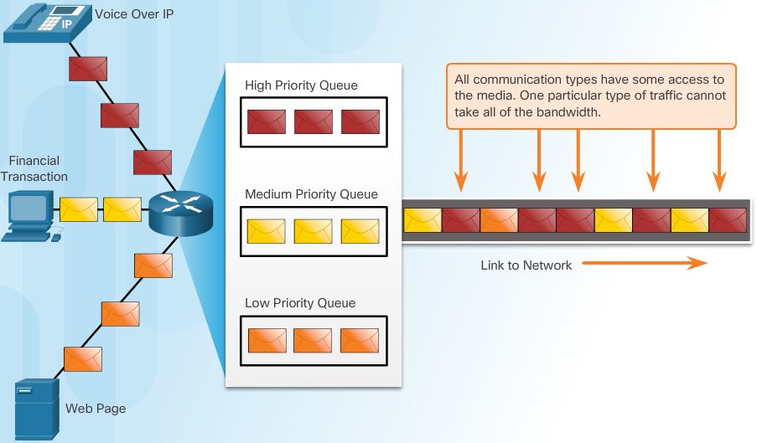
QoS Overview
Network Transmission Quality
Prioritizing Traffic
  Queuing packets causes delay because new packets cannot be transmitted until previous packets have been processed.
  If the number of packets to be queued continues to increase, the memory within the device fills up and packets are dropped.
Notes:
6.1 - QoS Overview
6.1.1 – Network Transmission Quality

Slide 5
QoS Overview
Network Transmission Quality
Bandwidth, Congestion, Delay, and Jitter
  Network congestion causes delay.
  Delay is the time it takes for a packet to travel from the source to the destination.
  Jitter is the variation in the delay of received packets.
Packet Loss
  When congestion occurs, network devices such as routers and switches can drop packets.
  Packet loss is a very common cause of voice quality problems on an IP network.
  In a properly designed network, packet loss should be near zero.
  Network engineers use QoS mechanisms to classify voice packets for zero packet loss.
Notes:
6.1 - QoS Overview
6.1.1 – Network Transmission Quality

Slide 6
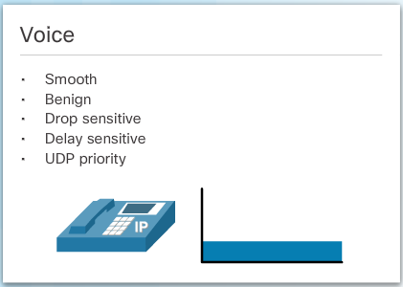
QoS Overview
Traffic Characteristics
Network Traffic Trends
  The type of demands voice, video, and data traffic place on the network are very different.
Voice
  Voice is very sensitive to delays and dropped packets; there is no reason to re-transmit voice if packets are lost.
  Voice packets must receive a higher priority than other types of traffic.
  Voice can tolerate a certain amount of latency, jitter, and loss without any noticeable effects.
Notes:
6.1 – QoS Overview
6.1.2 – Traffic Characteristics

Slide 7
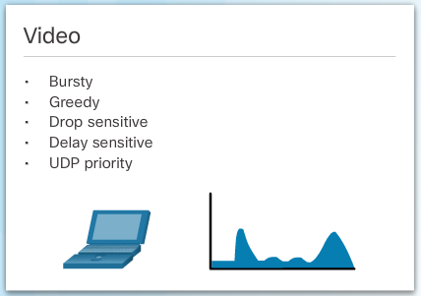
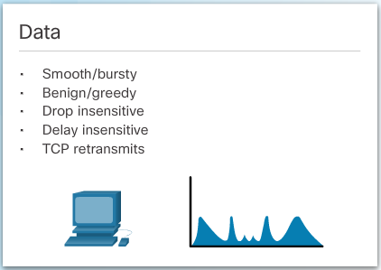
QoS Overview
Traffic Characteristics
Video
  Compared to voice, video is less resilient to loss and has a higher volume of data per packet.
  video can tolerate a certain amount of latency, jitter, and loss without any noticeable affects.
Data
  Data applications that have no tolerance for data loss, such as email and web pages, use TCP to ensure that, if packets are lost in transit, they will be resent.
  Data traffic is relatively insensitive to drops and delays compared to voice and video.
Notes:
6.1 – QoS Overview
6.1.2 – Traffic Characteristics

Slide 8
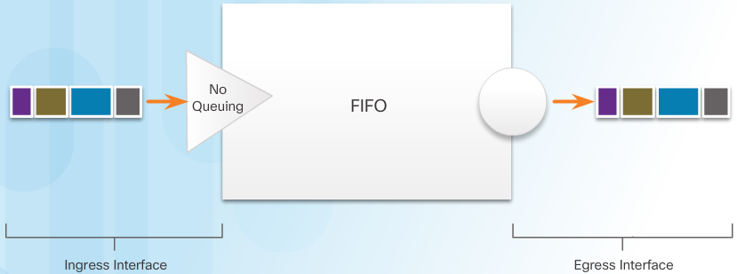
QoS Overview
Queueing Algorithms
First In First Out (FIFO)
  FIFO has no concept of priority or classes of traffic and consequently, makes no decision about packet priority.
  FIFO, which is the fastest method of queuing, is effective for large links that have little delay and minimal congestion.
Notes:
6.1 – QoS Overview
6.1.3 – Queueing Algorithms

Slide 9
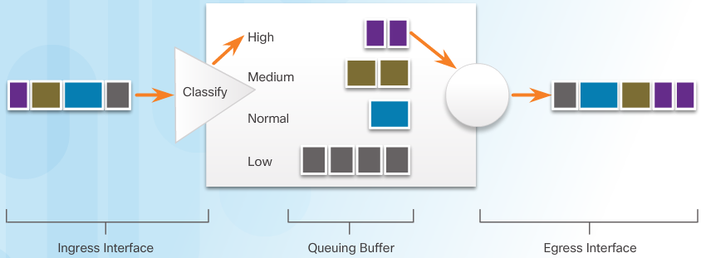
QoS Overview
Queueing Algorithms
Weighted Fair Queuing (WFQ)
  An automated scheduling method that provides fair bandwidth allocation to all network traffic.
  Applies priority, or weights, to identified traffic and classifies it into conversations or flows.
  WFQ is not supported with tunneling and encryption because these features modify the packet content information required
Notes:
6.1 – QoS Overview
6.1.3 – Queueing Algorithms

Slide 10
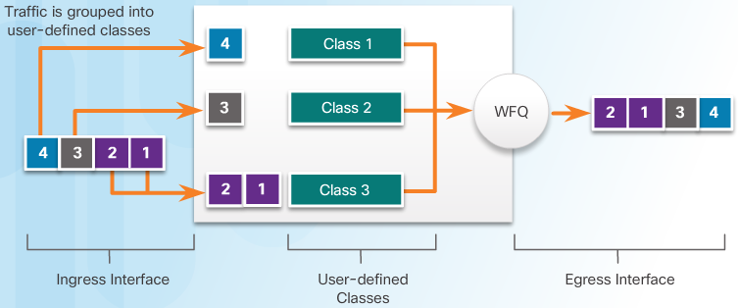
QoS Overview
Queueing Algorithms
Class-Based Weighted Fair Queuing (CBWFQ)
  Extends the standard WFQ functionality to provide support for user-defined traffic classes.
  To characterize a class, you assign it bandwidth, weight, and maximum packet limit.
  You also specify the queue limit for that class, which is the maximum number of packets allowed to accumulate in the queue for the class.
  Packets belonging to a class are subject to the bandwidth and queue limits that characterize the class.
Notes:
6.1 – QoS Overview
6.1.3 – Queueing Algorithms

Slide 11
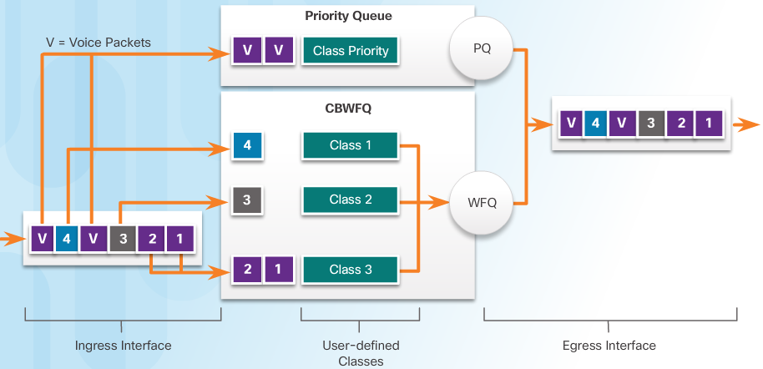
QoS Overview
Queueing Algorithms
Low Latency Queuing (LLQ)
  LLQ provides strict priority queuing for CBWFQ, reducing jitter in voice conversations.
  The bandwidth assigned to the packets of a class determines the order in which packets are sent.
  Without LLQ, all packets are serviced fairly based on weight; no class of packets may be granted strict priority.
  LLQ allows delay-sensitive data such as voice to be sent first.
Notes:
6.1 – QoS Overview
6.1.3 – Queueing Algorithms

Slide 12
6.2 QoS Mechanisms
Notes:
Cisco Networking Academy Program
Connecting Networks
Chapter 6: Quality of Service

Slide 13
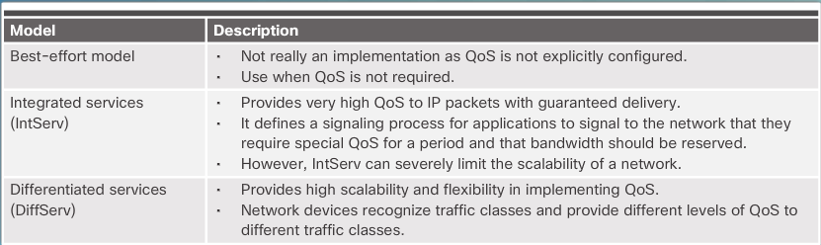
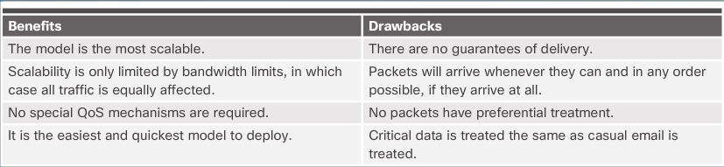
QoS Mechanisms
QoS Models
  Selecting an Appropriate QoS Policy Model
  Best-Effort
Notes:
6.2 – QoS Mechanisms
6.2.1 - QoS Models

Slide 14
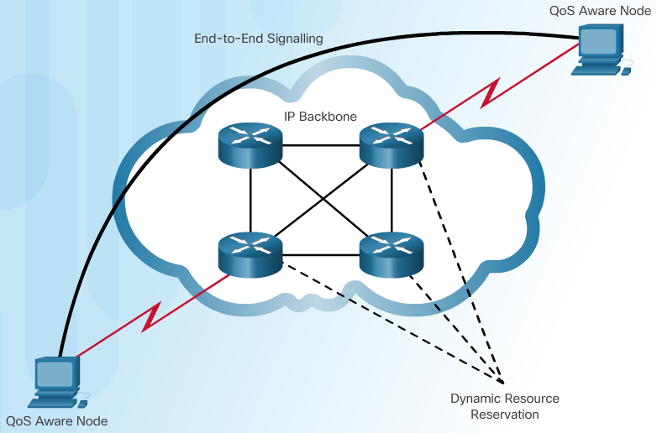
QoS Mechanisms
QoS Models
Integrated Services (IntServ)
  Uses resource reservation and admission-control mechanisms as building blocks to establish and maintain QoS.
  The edge router performs admission control to ensure that available resources are sufficient in the network.
  The IntServ standard assumes that routers along a path set and maintain the state for each individual communication.
  If network devices along the path can reserve the necessary bandwidth, the originating application can begin transmitting.
  If the requested reservation fails along the path, the originating application does not send any data.
Notes:
6.2 – QoS Mechanisms
6.2.1 – QoS Models

Slide 15
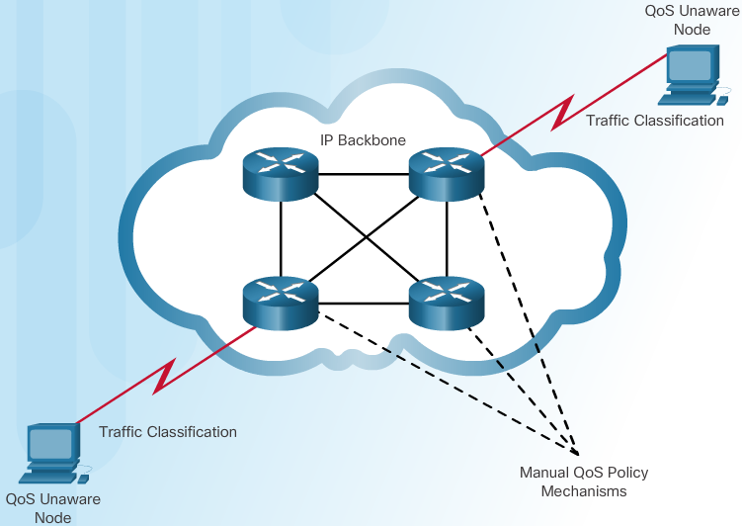
QoS Mechanisms
QoS Models
Differentiated Services (DiffServ)
  Specifies a simple and scalable mechanism for classifying and managing network traffic and providing QoS guarantees on modern IP networks.
  DiffServ can provide an “almost guaranteed” QoS while still being cost-effective and scalable.
  DiffServ uses a “soft QoS” approach. It works on the provisioned-QoS model, where network elements are set up to service multiple classes of traffic each with varying QoS requirements.
  DiffServ divides network traffic into classes based on business requirements.
  Each of the classes can then be assigned a different level of service.
Notes:
6.2 – QoS Mechanisms
6.2.1 – QoS Models

Slide 16
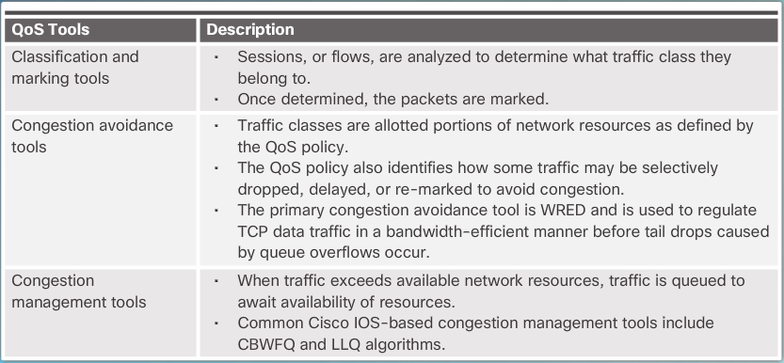
QoS Mechanisms
QoS Implementation Techniques
Avoiding Packet Loss
  Dropped TCP segments cause TCP sessions to reduce their window sizes.
  Some applications do not use TCP and cannot handle drops.
QoS Tools
Notes:
6.2 – QoS Mechanisms
6.2.2 – QoS Implementation Techniques

Slide 17
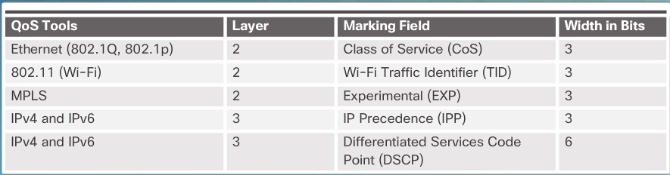
QoS Mechanisms
QoS Implementation Techniques
Classification and Marking
  Before a packet can have a QoS policy applied to it, the packet has to be classified.
  Methods of classifying traffic flows at Layer 2 and 3 include using interfaces, ACLs, and class maps.
Notes:
6.2 – QoS Mechanisms
6.2.2 – QoS Implementation Techniques

Slide 18
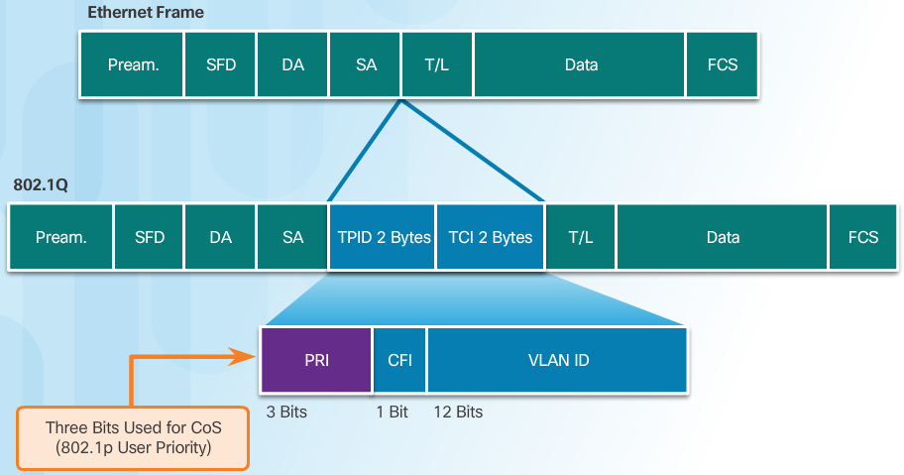
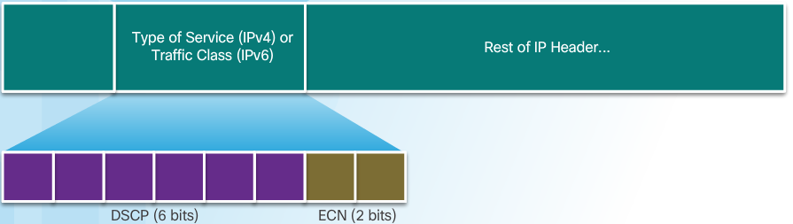
QoS Mechanisms
QoS Implementation Techniques
Marking at Layer 2
Marking at Layer 3
Notes:
6.2 – QoS Mechanisms
6.2.2 – QoS Implementation Techniques

Slide 19
QoS Mechanisms
QoS Implementation Techniques
Trust Boundaries
  Traffic should be classified and marked as close to its source as technically and administratively feasible.
Congestion Avoidance
  When the queue is below the minimum threshold, there are no drops.
  As the queue fills up to the maximum threshold, a small percentage of packets are dropped.
  When the maximum threshold is passed, all packets are dropped.
Shaping and Policing
  Traffic shaping retains excess packets in a queue and then schedules the excess for later transmission over increments of time.
  Policing is applied to inbound traffic on an interface.
  When the traffic rate reaches the configured maximum rate, excess traffic is dropped (or remarked).
Notes:
6.2 – QoS Mechanisms
6.2.2 – QoS Implementation Techniques

Slide 20
6.3 Chapter Summary
Notes:
Cisco Networking Academy Program
Connecting Networks
Chapter 6: Quality of Service

Slide 21
Chapter Summary
Summary
The quality of network transmission is impacted by the bandwidth of the links between the source and destination, the sources of delay as packets are routed to the destination, and jitter or the variation in delay of the received packets. Without QoS mechanisms in place, packets are processed in the order in which they are received. When congestion occurs, time-sensitive packets will be dropped with the same frequency as packets that are not time-sensitive.
Voice packets require latency of no more than 150 milliseconds (ms). Jitter should be no more than 30 ms, and voice packet loss should be no more than 1%. Voice traffic requires at least 30 Kb/s of bandwidth.
Video packets require latency no more than 400 milliseconds (ms). Jitter should be no more than 50 ms, and video packet loss should be no more than 1%. Video traffic requires at least 384 Kb/s of bandwidth.
For data packets, two factors impact the Quality of Experience (QoE) for end users:
  Does the data come from an interactive application?
  Is the data mission critical?
Notes:
6.3 - Chapter Summary

Slide 22
Chapter Summary
Summary Continued
The four queuing algorithms discussed in this chapter are as follows:
  First in First Out (FIFO) - Packets are forwarded in the order in which they are received.
  Weighted Fair Queuing (WFQ) - Packets are classified into different flows based on header information including the ToS value
  Class-Based Weighted Fair Queuing (CBWFQ) - Packets are assigned to user-defined classes based on matches to criteria such as protocols, ACLs, and input interfaces. The network administrator can assign bandwidth, weight, and maximum packet limit to each class.
  Low Latency Queuing (LLQ) - Delay-sensitive data such as voice is added to a priority queue so that it can be sent first (before packets in other queues).
The three queuing models discussed in the chapter are as follows:
  Best-Effort - This is the default queuing model for interfaces. All packets are treated in the same way. There is no QoS.
  Integrated Services (IntServ) - IntServ provides a way to deliver the end-to-end QoS that real-time applications require by explicitly managing network resources to provide QoS to specific user packet streams, sometimes called microflows.
  Differentiated Services (DiffServ) - DiffServ uses a soft QoS approach that depends on network devices that are set up to service multiple classes of traffic each with varying QoS requirements. Although there is no QoS guarantee, the DiffServ model is more cost-effective and scalable than IntServ.
Notes:
6.3 - Chapter Summary

Slide 23
Chapter Summary
Summary Continued
QoS tools include the following:
  Classification and Marking - Classification determines the class of traffic to which packets or frames belong. Marking means that we are adding a value to the packet header. Devices receiving the packet look at this field to see if it matches a defined policy.
  Congestion Avoidance - Congestion avoidance tools monitor network traffic loads in an effort to anticipate and avoid congestion. As queues fill up to the maximum threshold, a small percentage of packets are dropped. Once the maximum threshold is passed, all packets are dropped.
  Shaping and Policing - Shaping retains excess packets in a queue and then schedules the excess for later transmission over increments of time. Shaping is used on outbound traffic. Policing either drops or remarks excess traffic. Policing is often applied to inbound traffic.

Slide 24


Slide 25


