Slide 1
Disease and Death in Ancient Egypt: What can modern techniques of archaeological analysis on Ancient Egyptian mummies from royal and common backgrounds reveal about the state of health and hygiene of the civilisation?
Dissertation Presentation: AHSK6002
Kayleigh Cole 1502512

Slide 2
Disease and Death in Ancient Egypt: What can modern techniques of archaeological analysis on Ancient Egyptian mummies from royal and common backgrounds reveal about the state of health and hygiene of the civilisation?

Slide 3
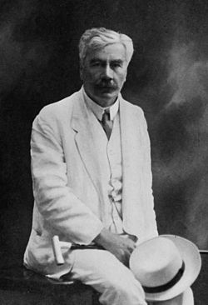
Scientific Background
PALEOPATHOLOGY – The Scientific Term which deals with the pathological conditions (disease or illness) that is found within ancient bodies
Armand Ruffer
Modern Analysis of mummies
Armand Ruffer

Slide 4
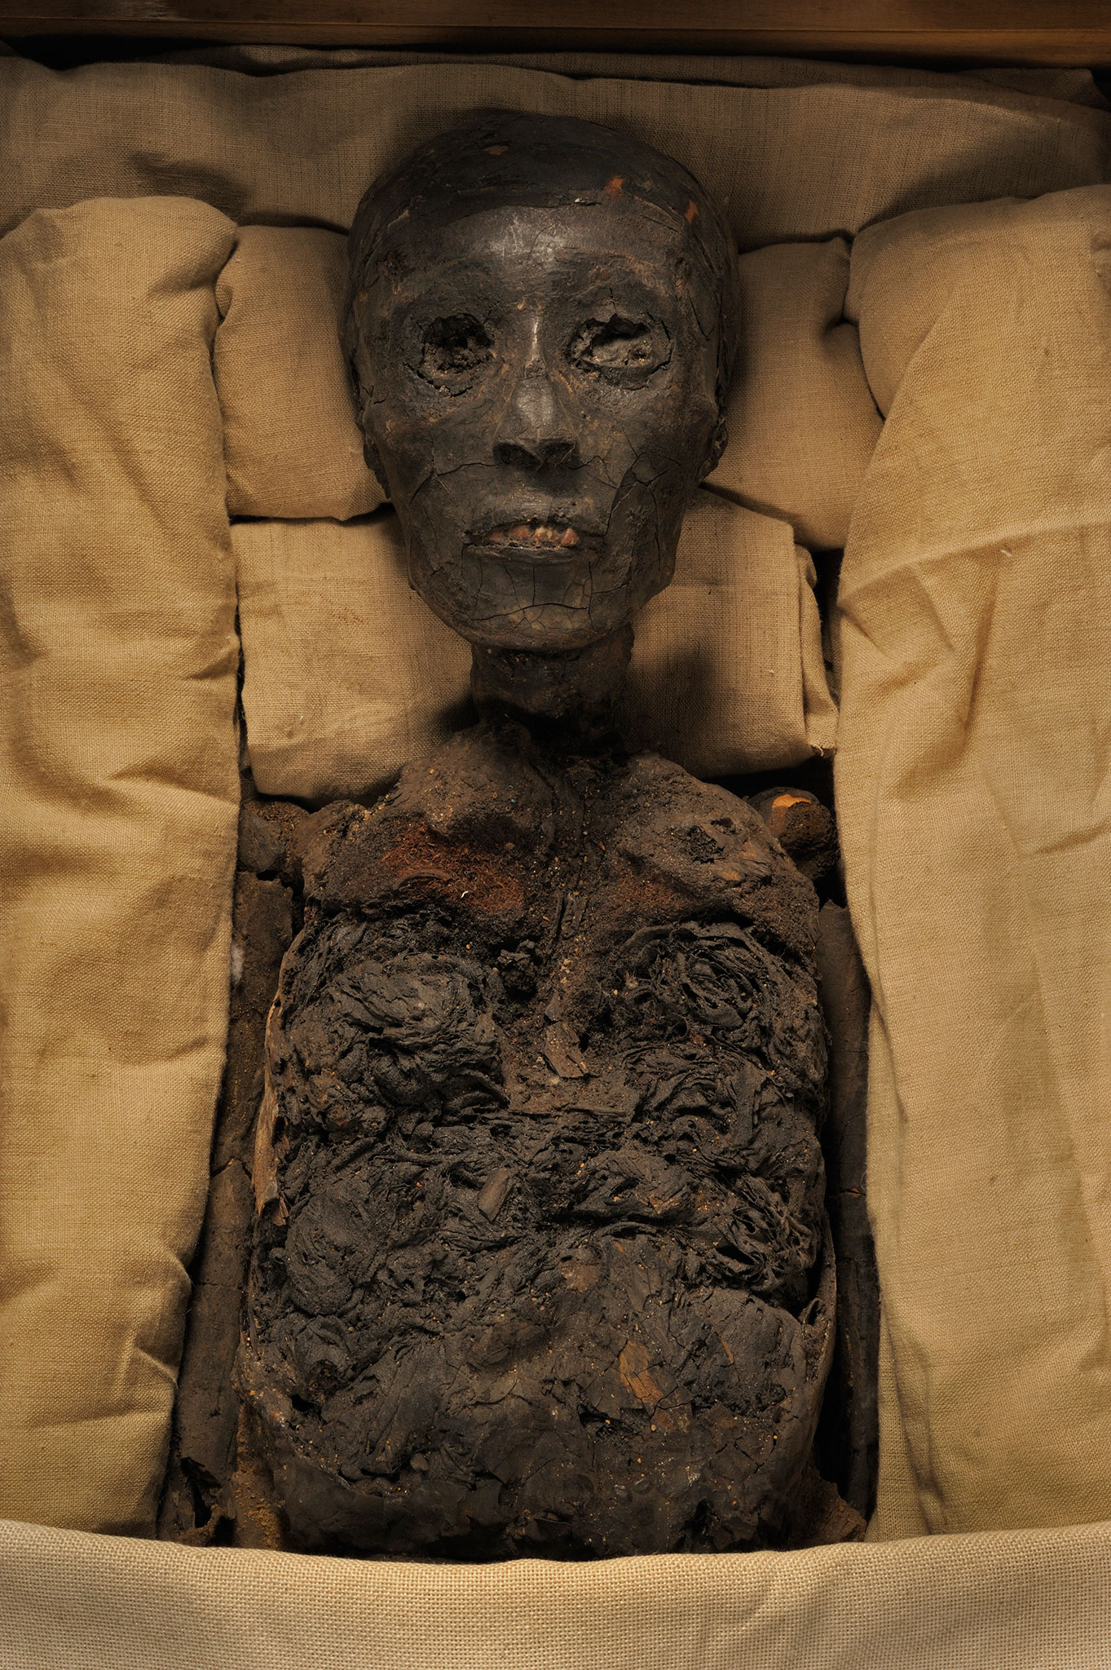
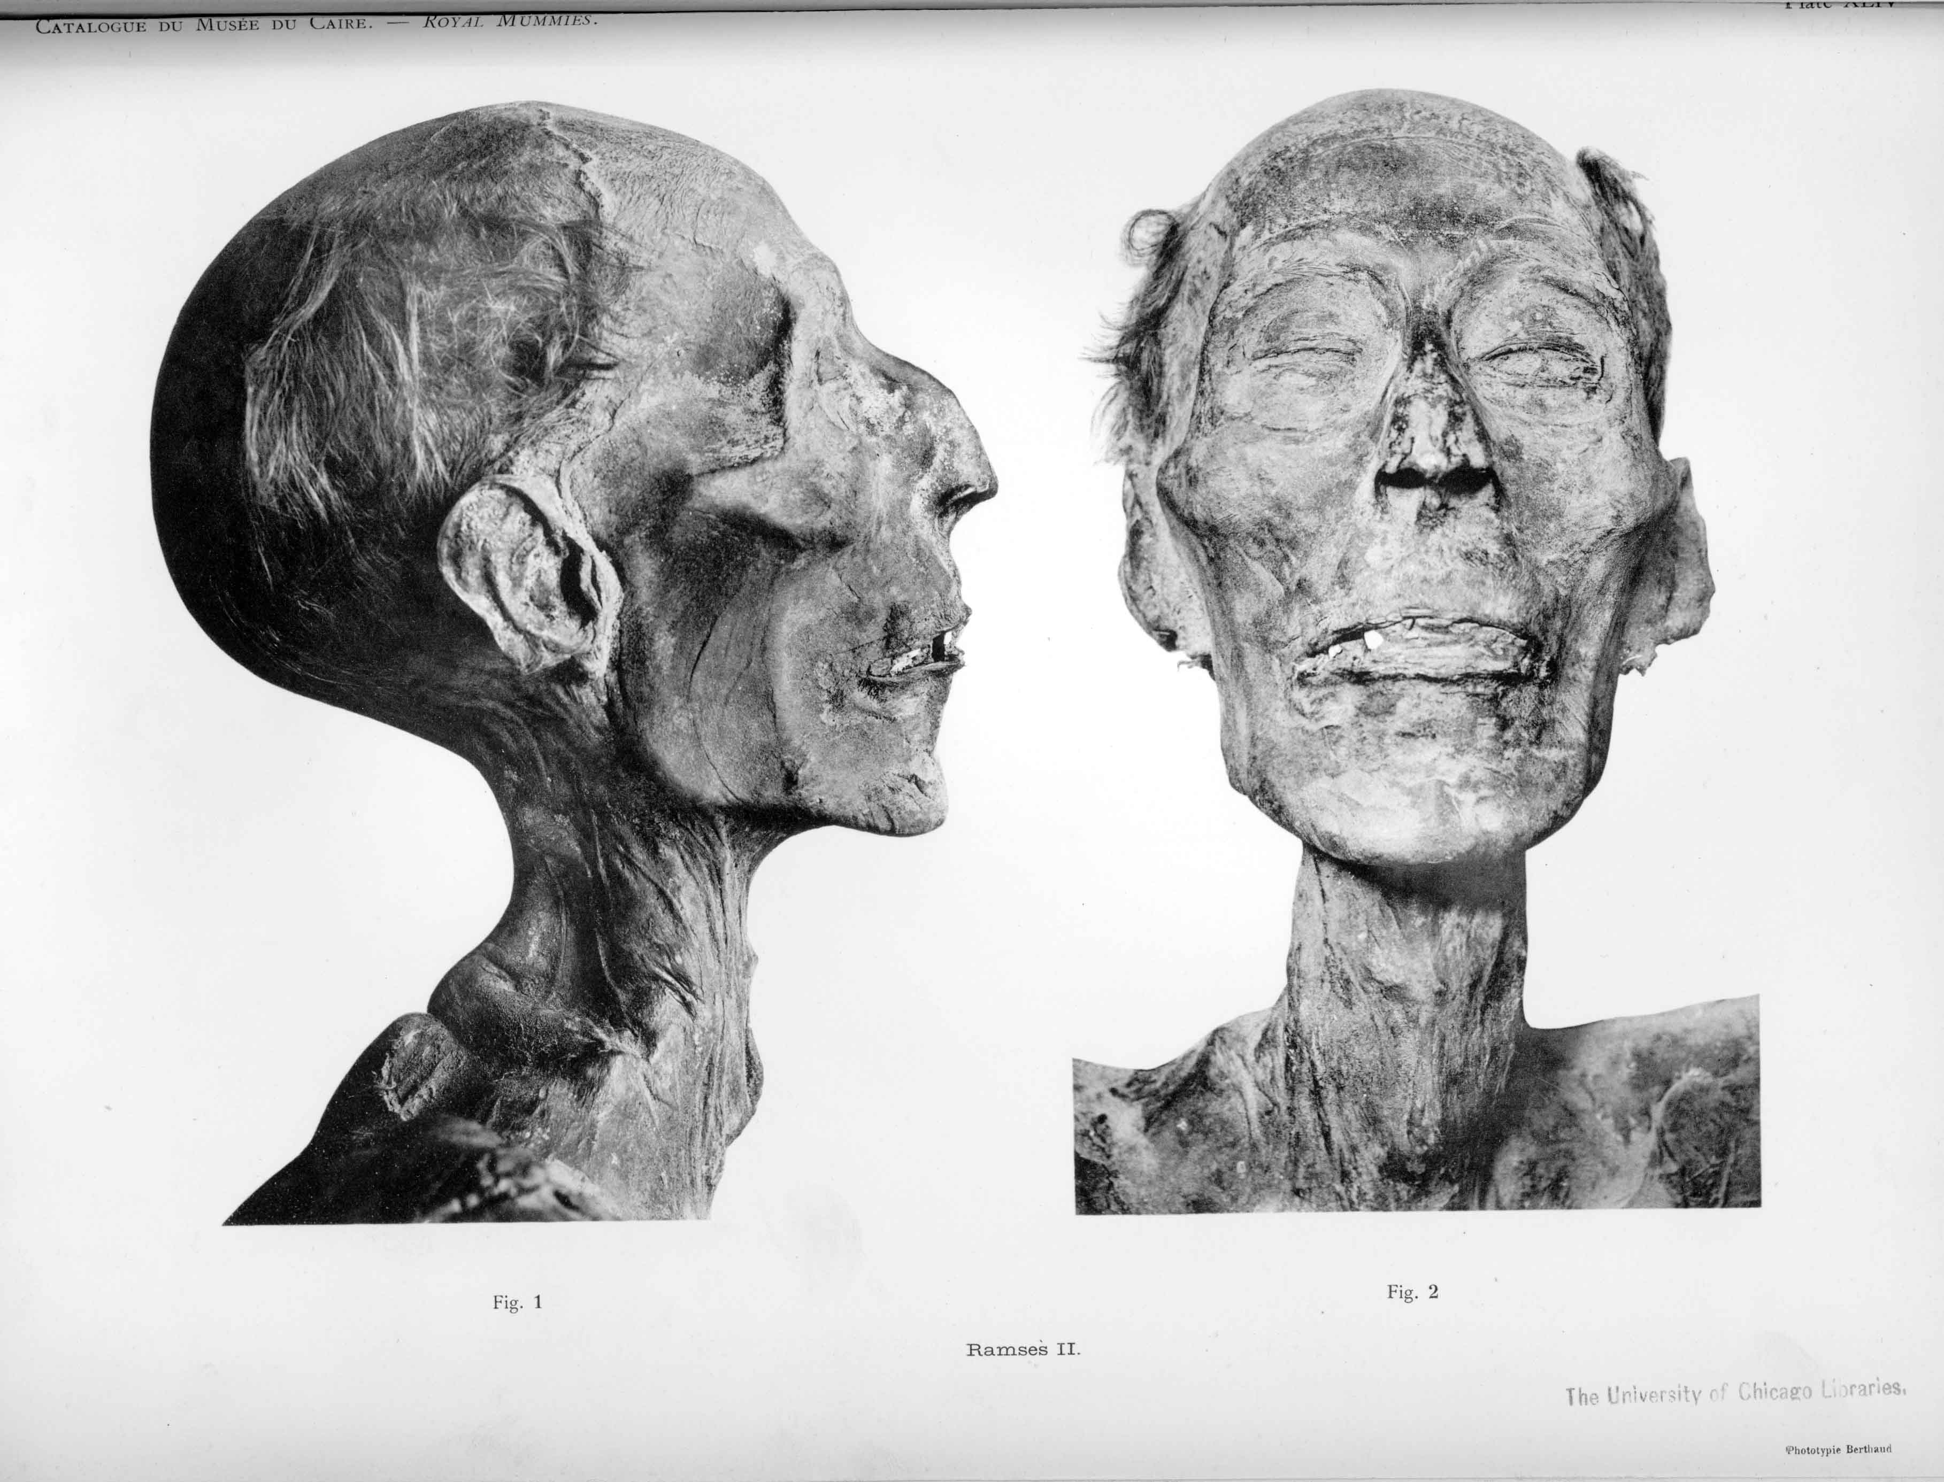
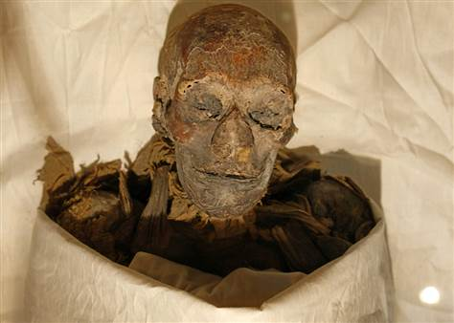
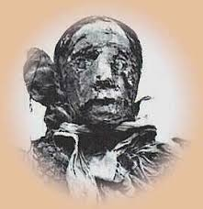
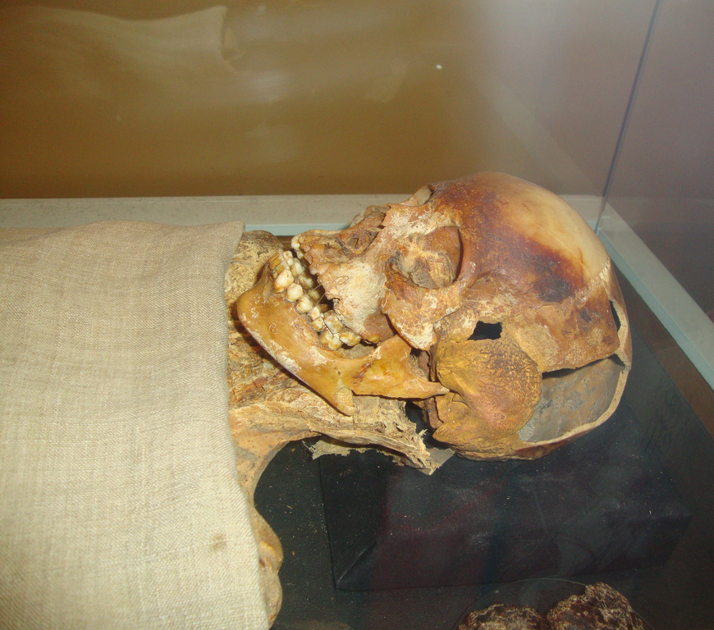
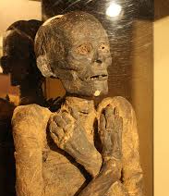
6 mummies I am researching
King Tutankhamun
Ramesses II
Queen Hatshepsut
King Siptah
Nakht (ROM I)
PUM II

Slide 5
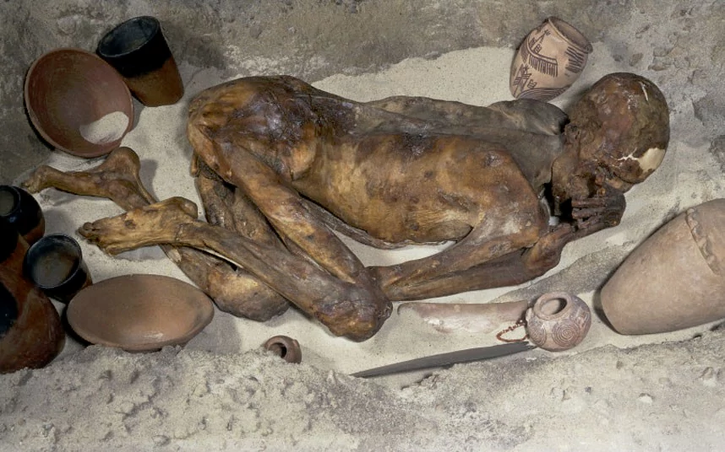
What I wanted to do…
Pre-dynastic period vs. New Kingdom
Poor vs. Rich
Gebelean Man B (British Museum): Pre-Dynastic Period

Slide 6
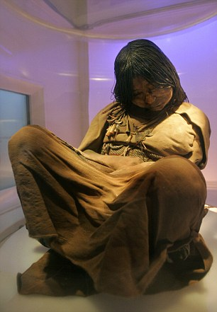
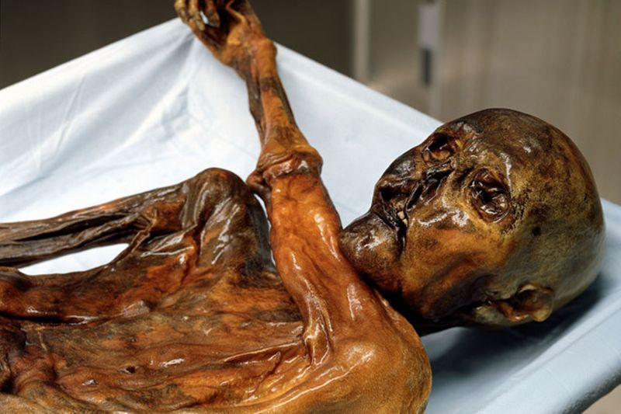
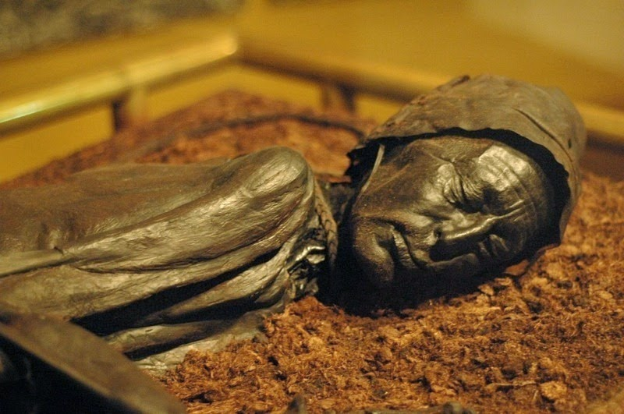
Possible mentions/direction
Otzi the Ice Man (Italy – 2400 y/o)
Tollund Man (Denmark (dates to 4th Century BCE
The Inca Ice Maiden (Peru – 500 y/o)

Slide 7
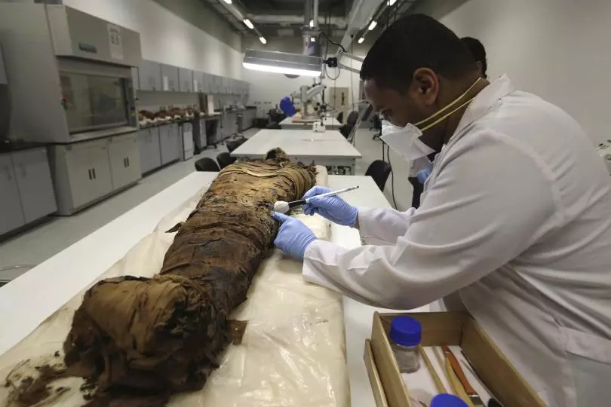
Limitations of this topic
Not analysing an actual mummy in a laboratory first hand…
Completely reliant on other people’s findings and research on the topic…

Slide 8
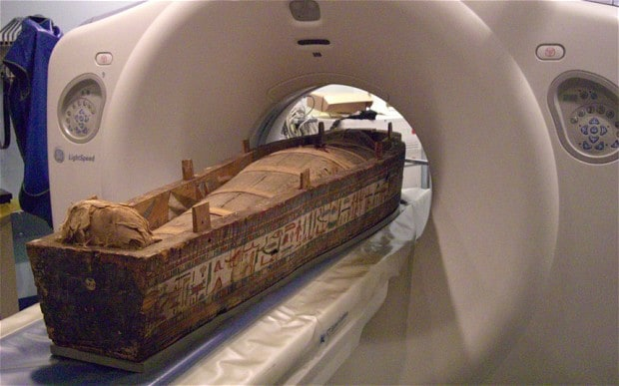
How far I’ve gotten in the writing process
Finding appropriate articles for my research is going well…
End Results are becoming evident

Slide 9
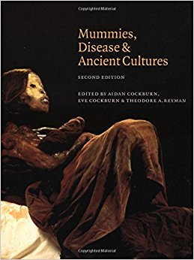
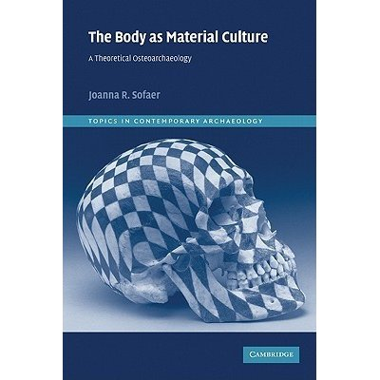
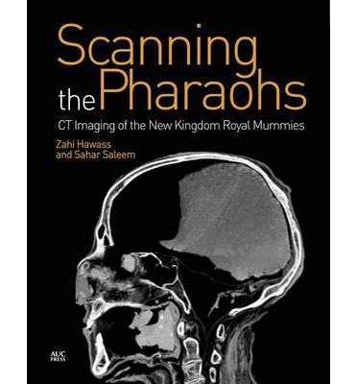
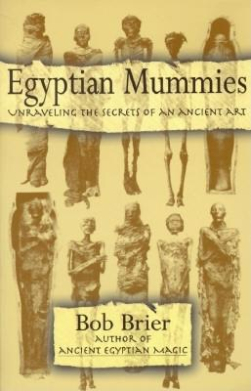
Helpful Readings and Litereature

Slide 10
What I need to do to develop my dissertation further
Section writing…
Structure needs to be organised…
Organised topics?

Slide 11
Any Questions?

