Slide 1

Session: 7
Working Capital Management

Slide 2
Learning Outcomes of the Session
The nature of working capital
Sources of working capital
Working capital cycle
Management and Strategies for working Management and Strategies for Working Capital
Liquidity and working capital

Slide 3
Lesson Plan
Review and Bridge-In: Financing engineering projects requiring capital and particularly working capital for daily opertaions
Learning objectives: What is Working Capital (WC), WC Cycle and how and why working capital should be managed
Teaching points and content input strategies: Definition, calculation and sources of working capital, working capital cycle, scale, Nature of Working Capital Decisions, management of working capital, components of working capital needs, liquidity
Formative Assessments: In-Class exercises, calculations
Link to outcomes and summative assessment: Working Capital requirement planning

Slide 4

Working capital
Working capital is the fund (money) a company has available to cover its day-to-day operating expenses and short-term debts.
Calculation
Working Capital = Current Assets – Current Liabilities
Current Assets: Examples include cash, accounts receivable, and inventory.
Current Liabilities: Examples include accounts payable, short-term loans, and accrued payroll.

Slide 5
What It Indicates
Positive working capital indicates a company has enough short-term assets to cover its short-term debts and expenses.
Negative working capital can suggest a company is struggling to meet its immediate financial obligations.
Managing working capital is crucial for a company's liquidity, operational efficiency, and ability to seize growth opportunities.

Slide 6
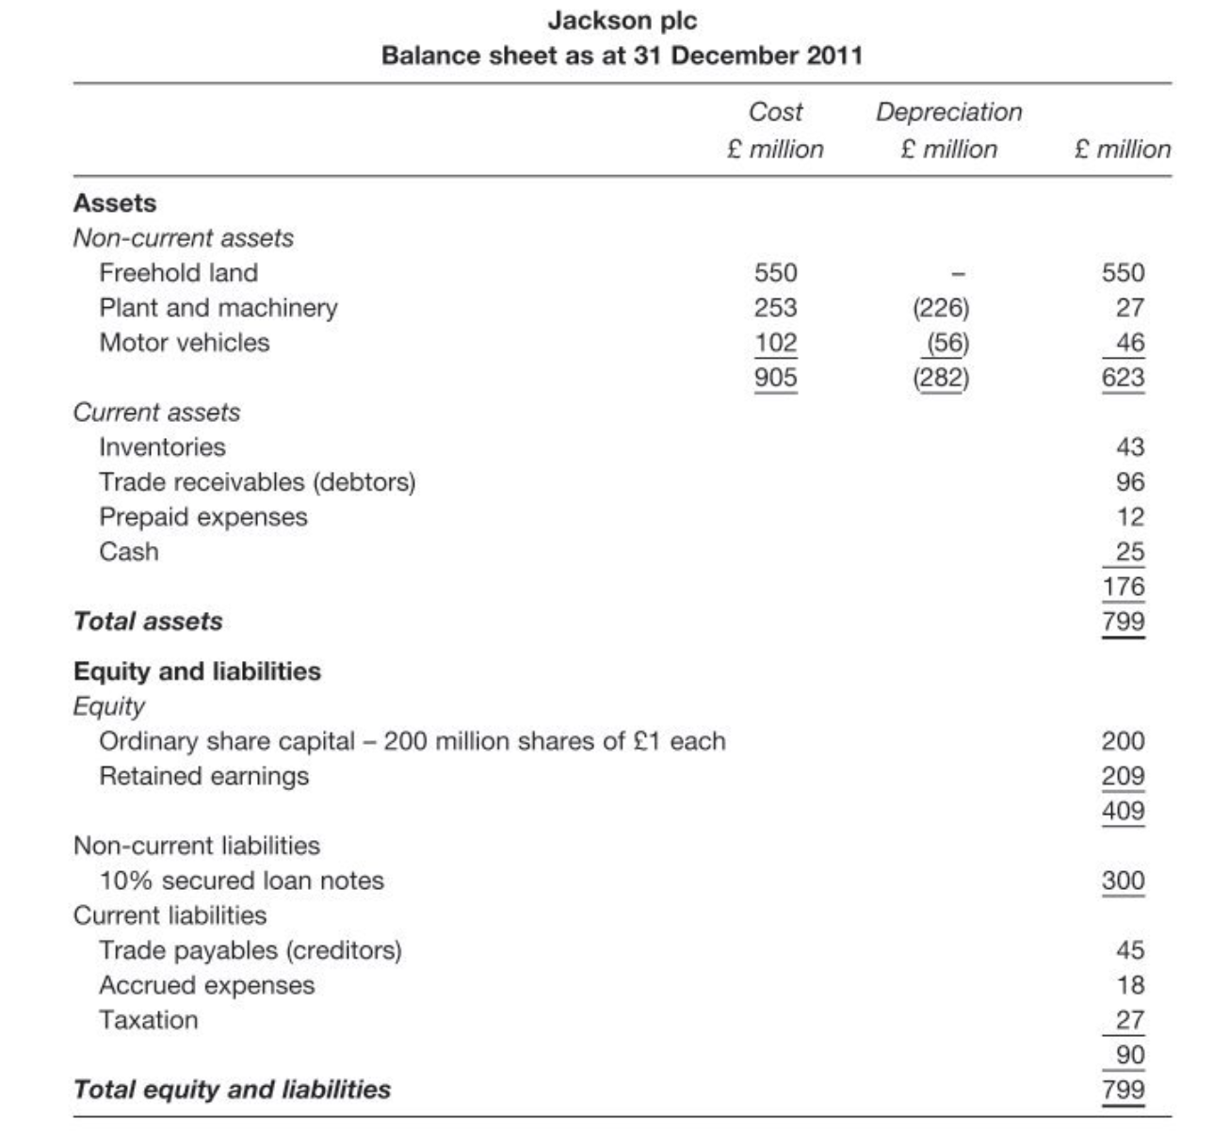

Slide 7
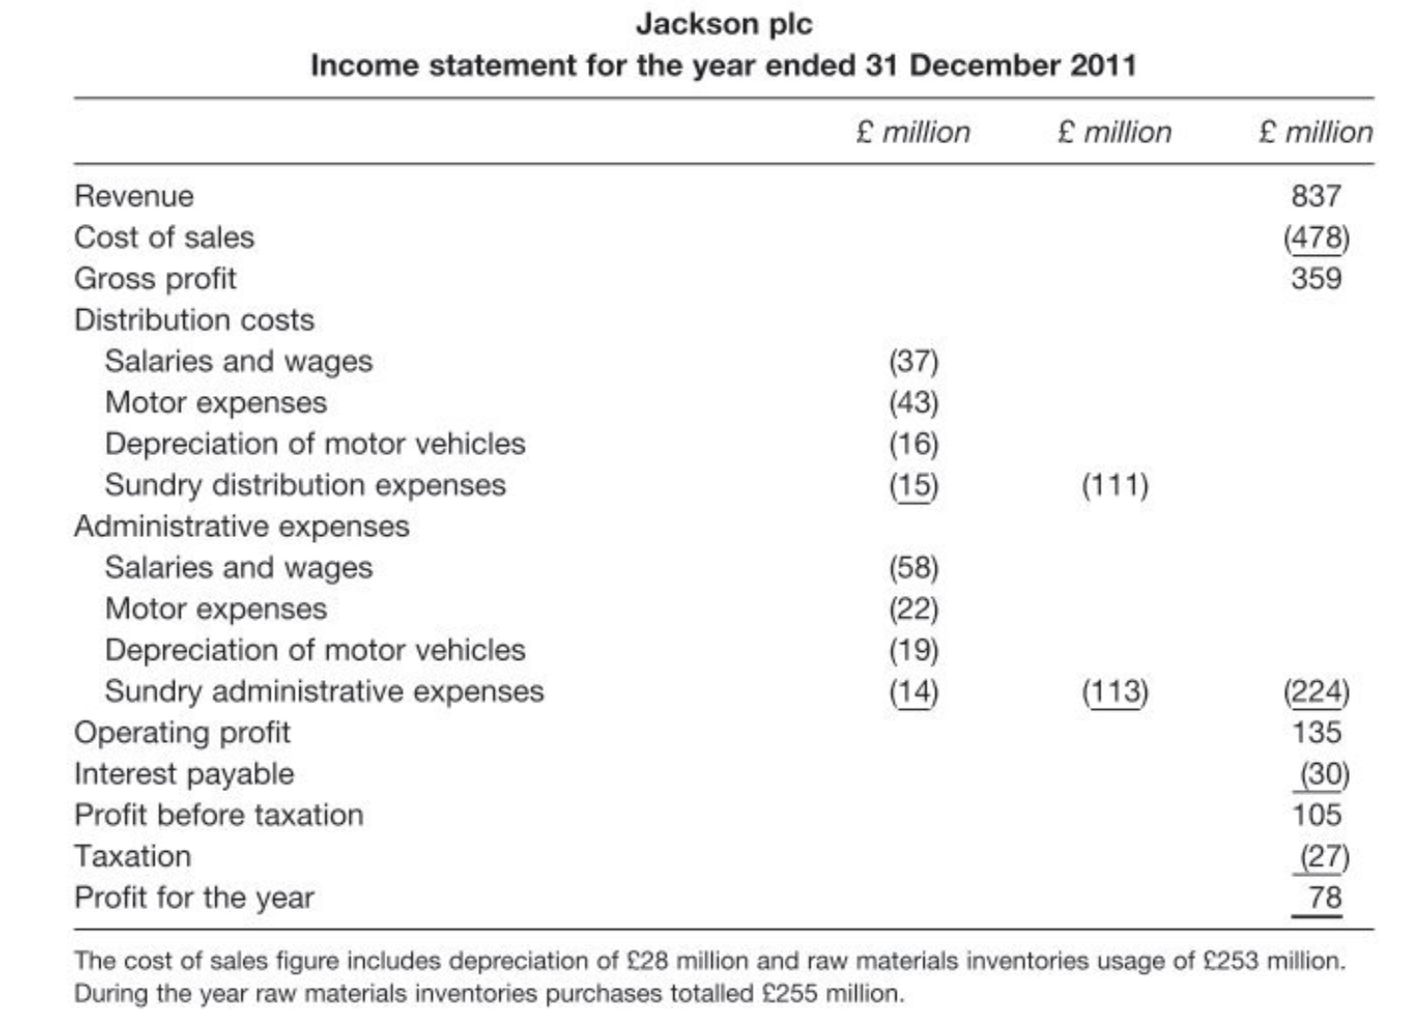

Slide 8

Working Capital Management
Working capital management is the process of efficiently managing a company's short-term assets and liabilities to ensure it has enough cash to meet its daily operating expenses and short-term debts.
This involves optimizing cash flow, accounts receivable, accounts payable, and inventory to maintain liquidity and operational efficiency, which helps a business succeed and handle financial challenges.

Slide 9

Investment Decisions – Beyond the Initial Cost
Key Point:
When businesses invest in assets like machinery or buildings, they must consider more than just the purchase price.
Also consider:
Working capital requirements
Operational expansion costs
Ongoing financial commitments
🧠 Investment is not just a one-time expense—it’s a gateway to broader financial implications.

Slide 10

Expansion and Working Capital Needs
Increased activity leads to increased needs:
Raw materials → More inventory required
Work in progress → Higher production levels
Finished goods → Stockpiling for future sales
📦 Growth demands more resources at every stage of production.

Slide 11
Sales Growth and Receivables
More sales = More receivables
Higher revenue often means more credit sales
This leads to increased trade receivables
Cash inflow is delayed, even if sales rise
💡 Revenue growth can strain liquidity if receivables aren’t managed well.

Slide 12
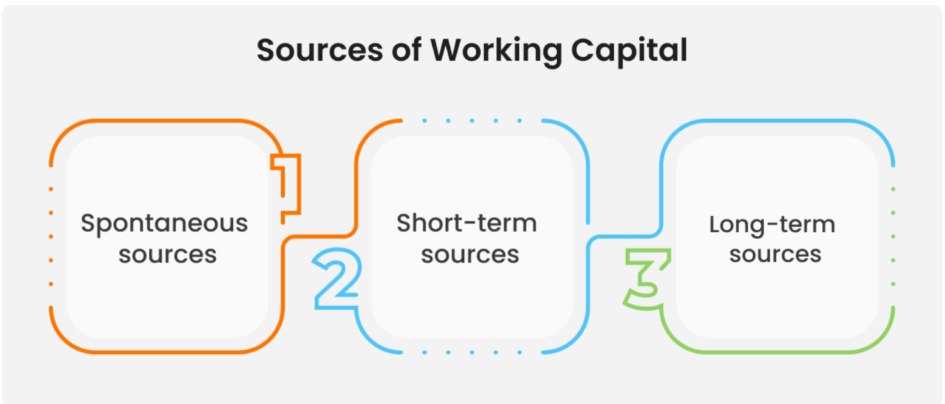

Slide 13
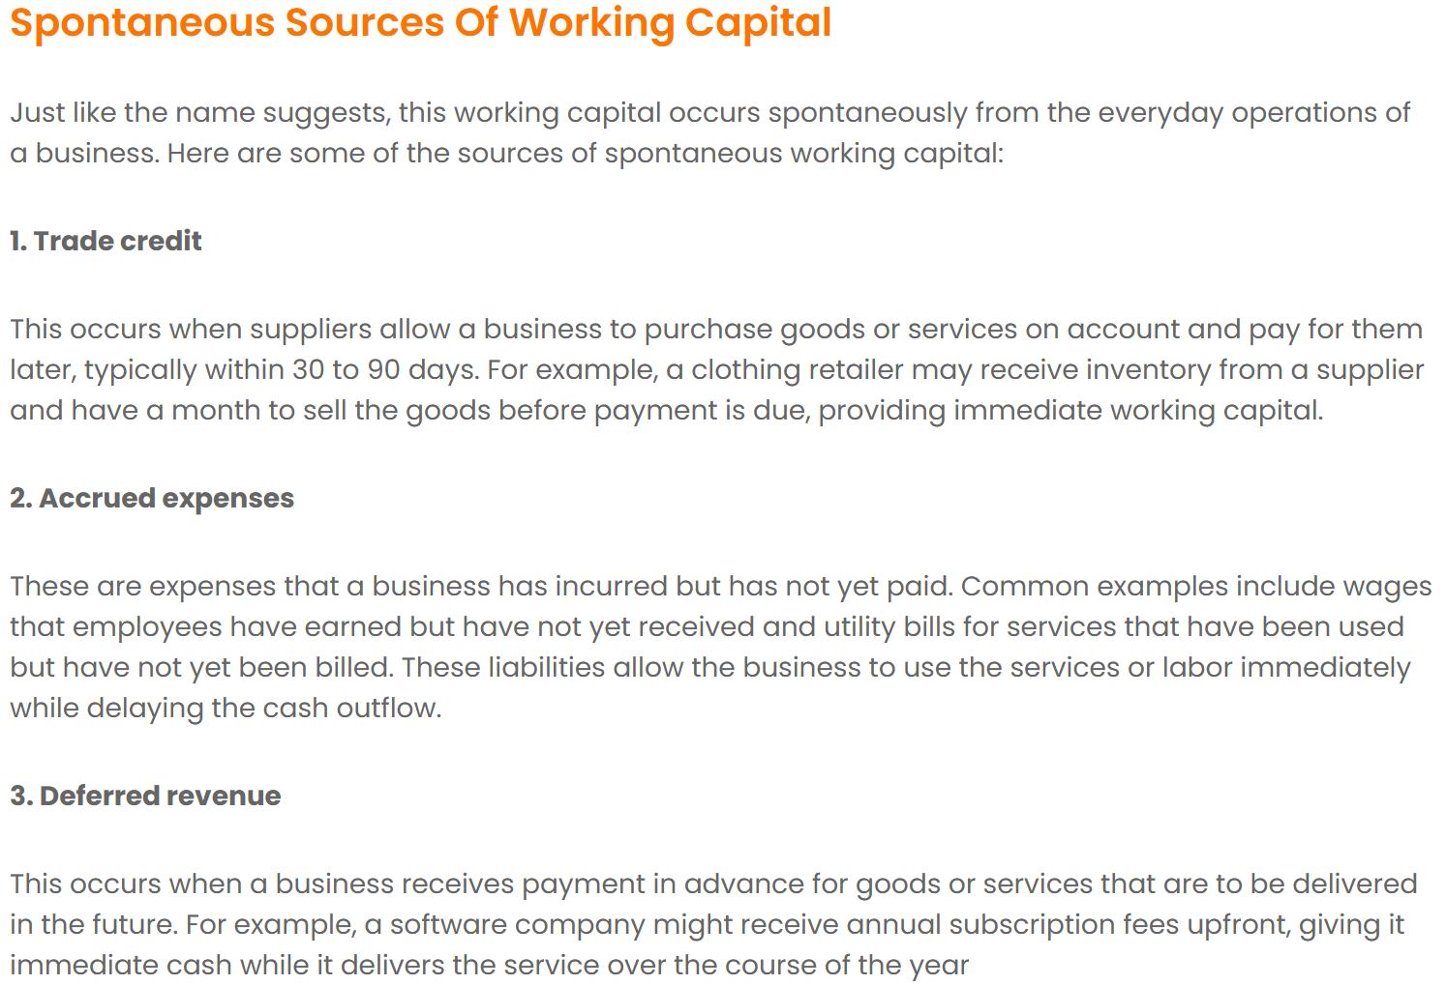

Slide 14
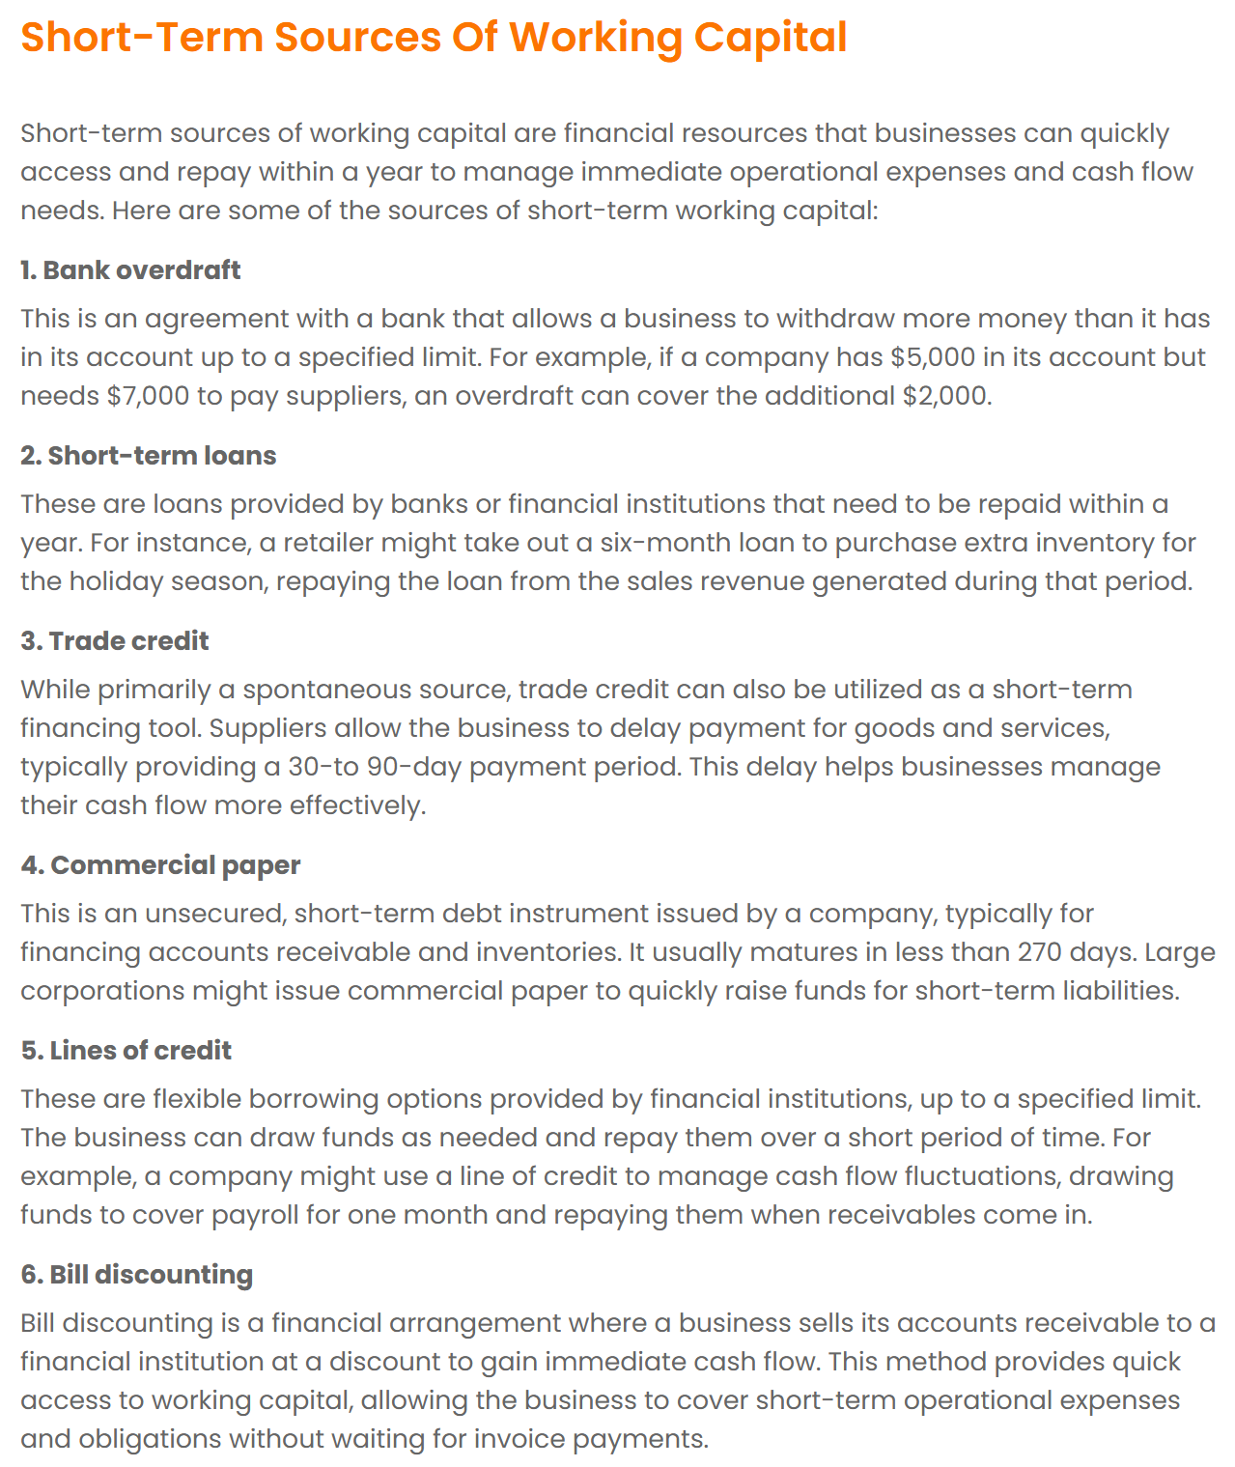

Slide 15
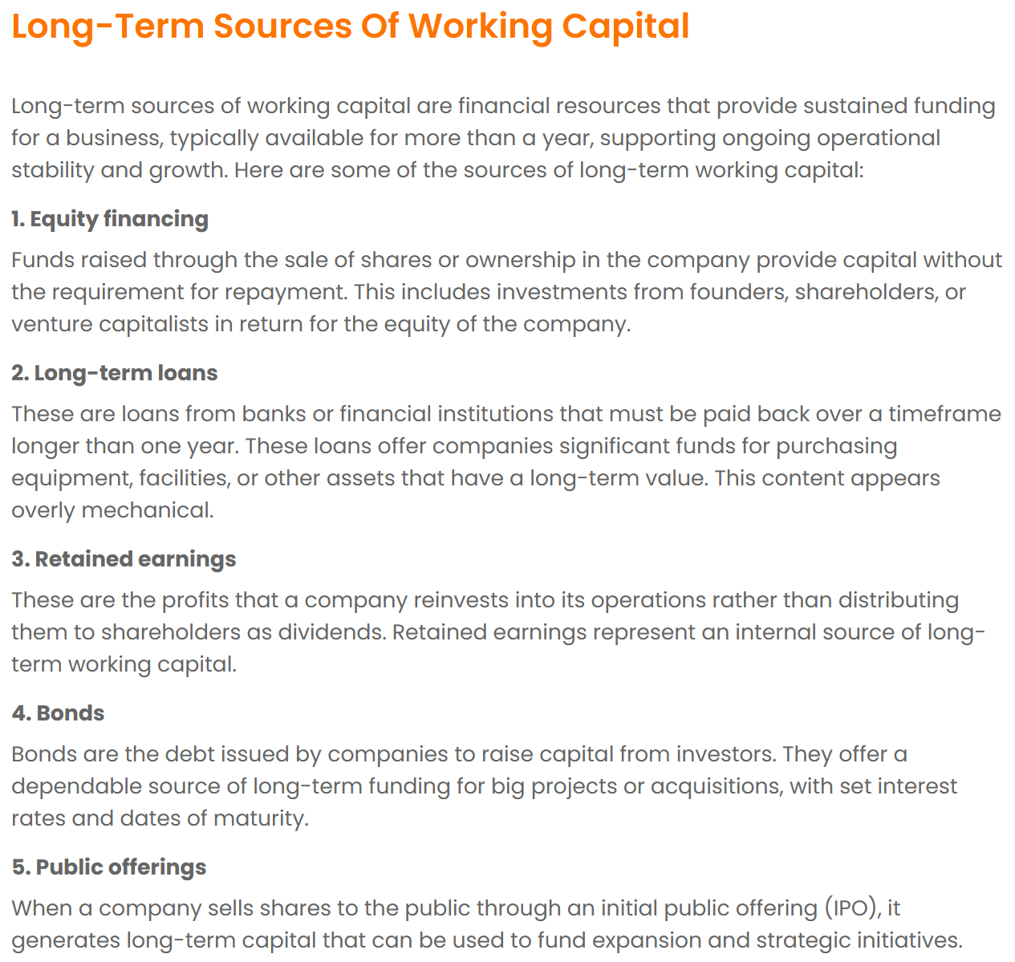

Slide 16
Balancing Long-Term and Short-Term Finance
Why use both?
Long-term finance covers core assets
Short-term finance supports day-to-day operations
⚖️ Effective working capital management requires the right mix of funding sources.

Slide 17

Integrating Working Capital with Financial Strategy: Strategic Context
Working capital should not be isolated from broader investment decisions
Similar to the integration of short-term and long-term finance
Strategic alignment ensures liquidity and operational efficiency

Slide 18
Rationale for Joint Management of Current Assets & Liabilities
Systematic and frequent decision-making required
Strong interdependence between assets and liabilities
Often netted to form a single metric: working capital

Slide 19
Operational Features of Working Capital
High frequency of decisions (e.g., inventory, receivables, payables)
Requires dynamic monitoring and adjustment
Impacts day-to-day liquidity and cash flow

Slide 20
Financial Objective of Working Capital Management
Enhancing Shareholder Wealth
Same goal as long-term finance: maximize shareholder value
Achieved by optimizing positive cash flows
Balance between cost, revenue, and risk

Slide 21
The Dynamics of the Working Capital Cycle
Working capital cycle tracks the flow of cash through operational stages
Begins with acquisition of raw materials on credit
Ends with cash inflow from customer payments
Critical for managing liquidity and operational efficiency

Slide 22
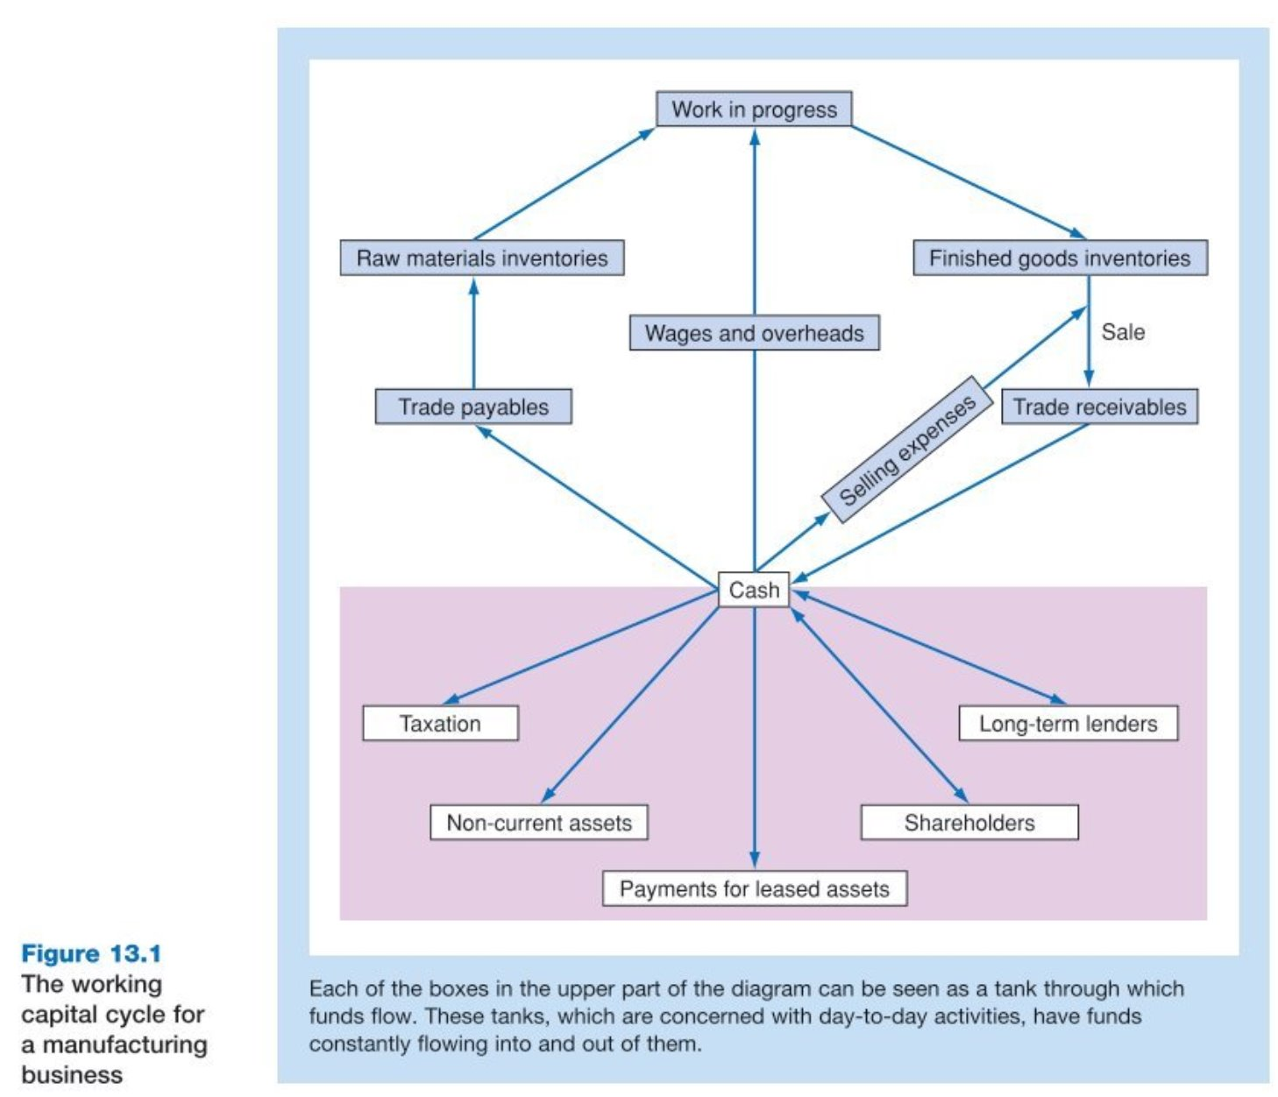

Slide 23

The Working Capital Cycle Overview
Visualizes the cycle as a flow of funds through “tanks”
Begins with purchasing raw materials on credit
Ends with cash inflow from customer payments

Slide 24
Inventory Flow in Manufacturing
Raw Materials → Work-in-Progress (WIP) → Finished Goods
Each stage requires time, labor, and overheads
Inventory management affects liquidity and efficiency

Slide 25
Trade Payables and Receivables
Trade Payables: Credit from suppliers; must be paid eventually
Trade Receivables: Credit extended to customers; converts to cash
Timing mismatch creates need for working capital

Slide 26
Cash Management
Cash is the final output of the cycle
Can be positive (inflow from receivables) or negative (outflow to payables)
Critical for meeting obligations and investing in growth

Slide 27
The “Tank” Analogy
Each component (inventory, receivables, payables, cash) = a tank
Funds flow in/out of tanks
Managers must balance tank levels to avoid inefficiencies

Slide 28
Sectoral Differences
Manufacturing: All elements present
Retail: No raw materials or Work in Progress (WIP)
Services: May have WIP, but no physical inventory
Cycle concept applies across sectors with variations

Slide 29
Managerial Decisions and Optimization
Why do these tanks exist?
How much should be held in each?
Trade-off: Cost of holding too much vs. risk of holding too little
Goal: Optimize working capital for operational and financial health

Slide 30
Descriptive vs. Quantitative Representation of Working Capital Cycle
Descriptive View (Previous Figure): Shows the flow of working capital elements.
Quantitative View (Following Figure): Measures time taken by each component.
Applicable to manufacturing and non-manufacturing businesses.
Focus: Time duration from raw material purchase to cash receipt.

Slide 31
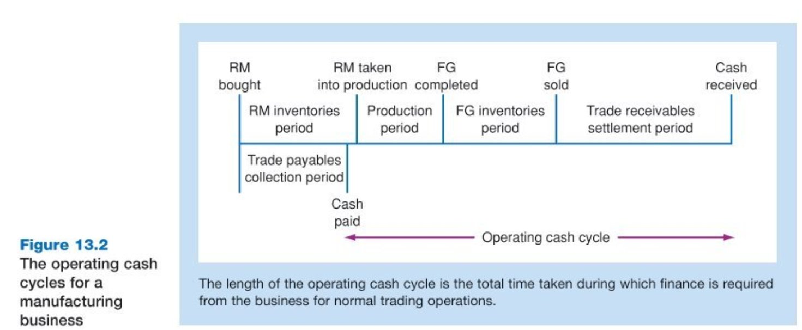

Slide 32
Components of the Operating Cash Cycle
Key Elements in the Cycle
Raw Materials Inventory (RM): Held before production begins.
Work-in-Progress (WIP): Includes RM + labor + overheads.
Finished Goods Inventory: Held until sold.
Trade Receivables: Awaiting customer payment.
Cash Receipt: Final stage completing the cycle.
📊 Each stage contributes to the total length of the operating cash cycle.

Slide 33
Financial Implications
Why the Operating Cash Cycle Matters?
Financing Needs: Longer cycles require more working capital.
Liquidity Management: Shorter cycles improve cash flow.
Shareholder Value: Efficient cycles enhance wealth.
Strategic Objective: Minimize cycle length without compromising operations.
💡 Finance teams aim to reduce cycle time to free up cash.

Slide 34
Strategic Focus for Optimizing the Operating Cash Cycle
Shorter cycles = less financing = better returns.
Action Points:
Improve inventory turnover.
Accelerate receivables collection.
Streamline production processes.
Final Thought: A well-managed operating cash cycle is a cornerstone of financial health.

Slide 35
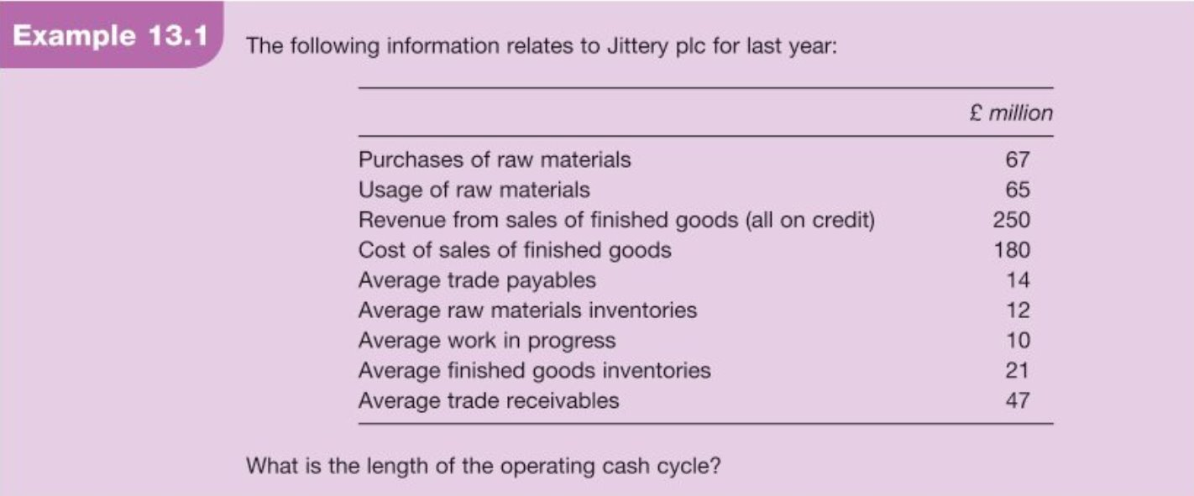

Slide 36
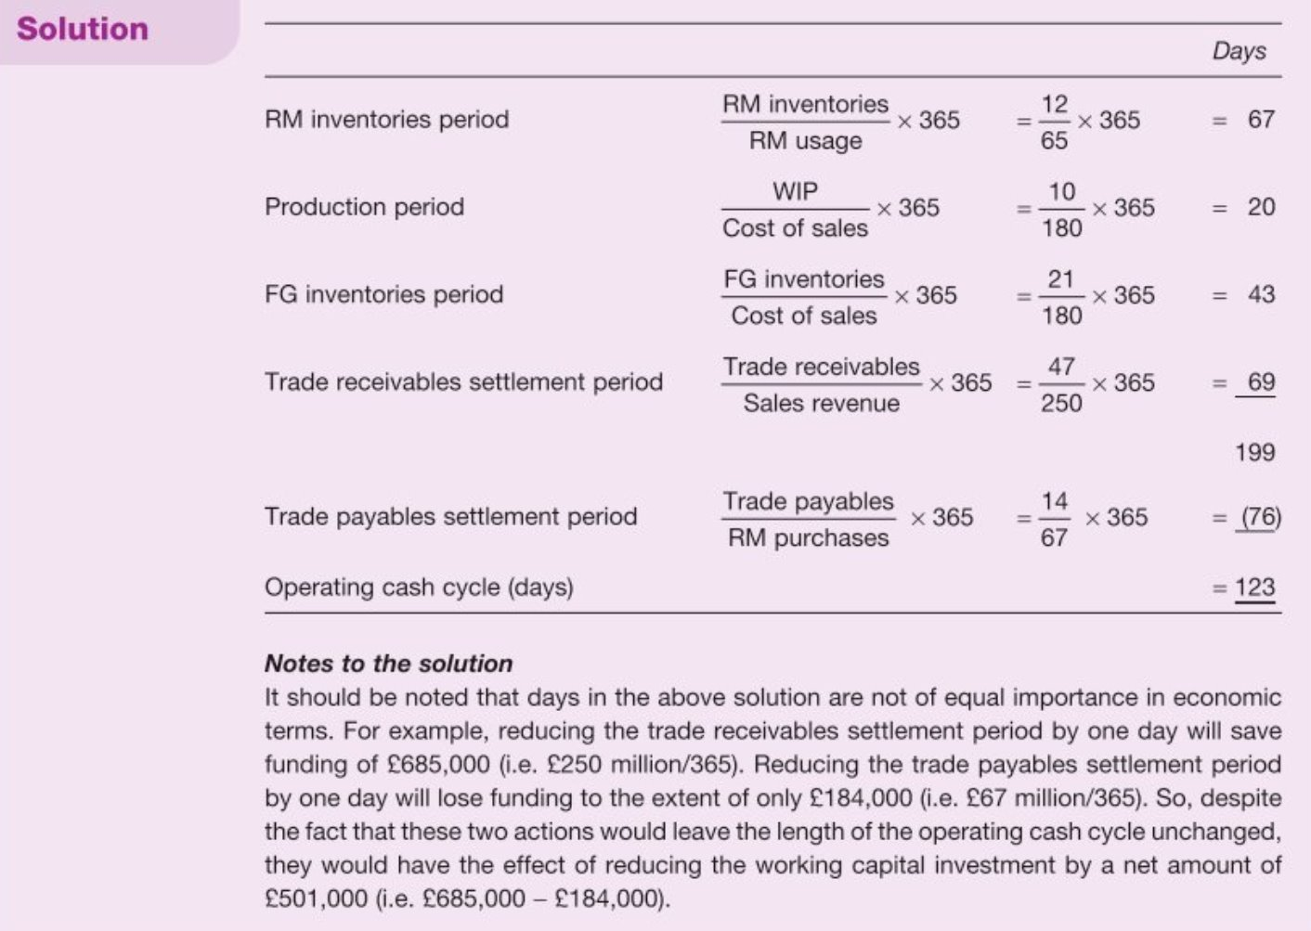

Slide 37
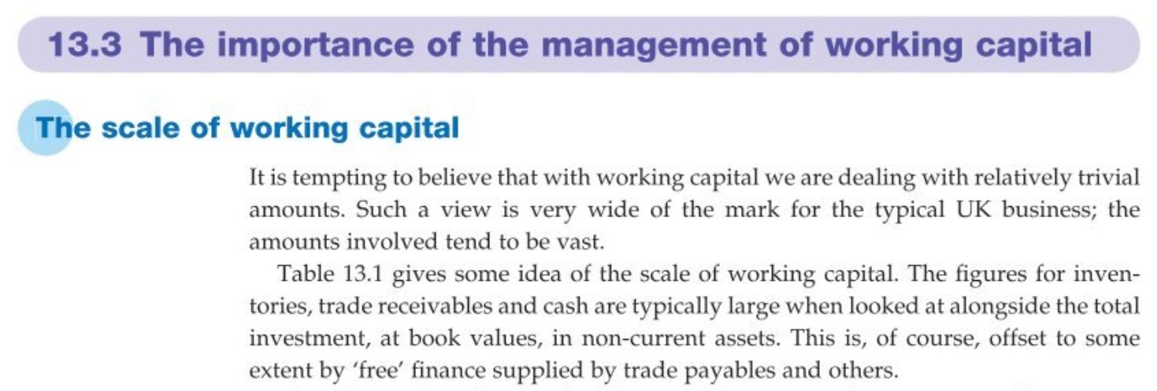

Slide 38
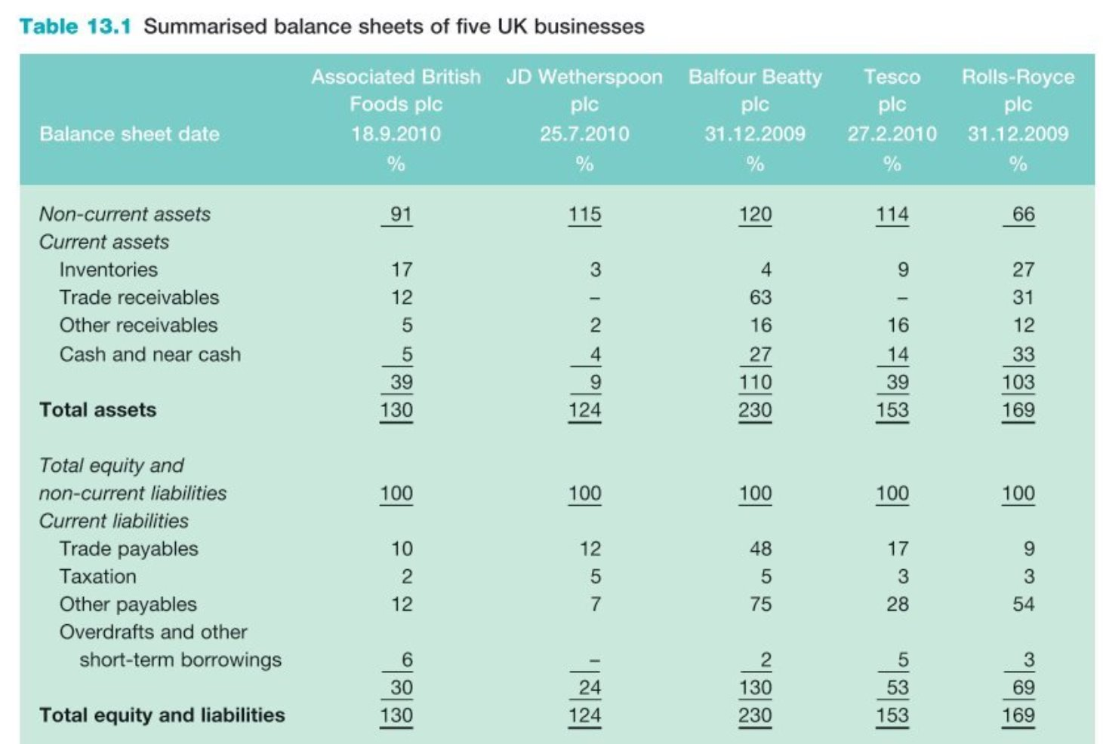

Slide 39
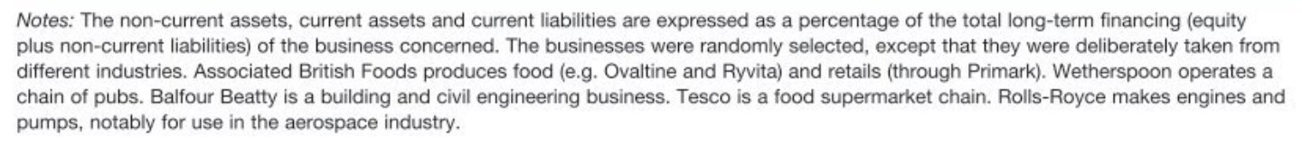

Slide 40
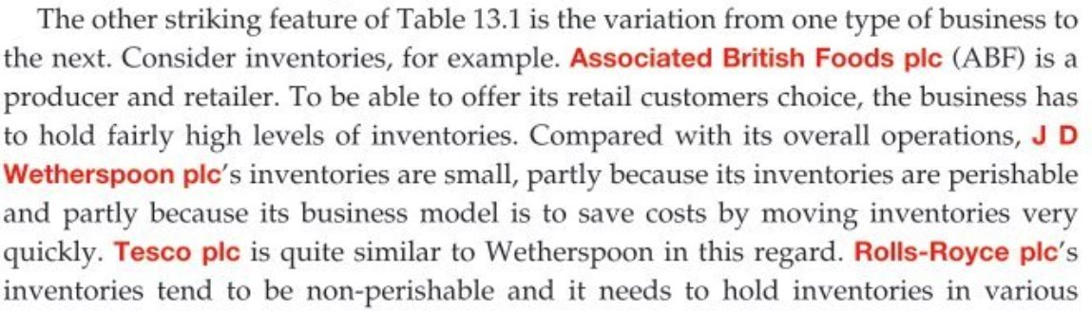
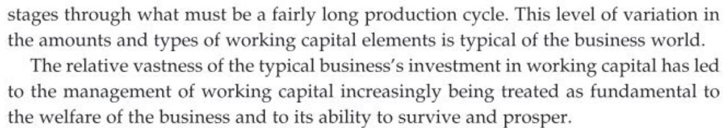

Slide 41
Understanding the Nature of Working Capital Decisions
Working capital decisions differ from long-term asset and finance decisions not by size, but by time horizon and reversibility.
Typically short-term, frequently made, and reversible.
Examples: inventory levels, receivables, payables.
Discussion Prompt:
Why might short-term decisions require more frequent attention than long-term ones?

Slide 42

Frequency and Repetitiveness of Decisions
Working capital decisions are often routine and repetitive.
Businesses rely on established policies to streamline decision-making.
Example: Credit approval for customers.
Advanced Insight:
Repetitive nature allows for automation and delegation within the management hierarchy.

Slide 43

Role of Policies and Decision Frameworks
Policies create decision rules that guide day-to-day operations.
These rules enable quick, decentralized decisions.
Example: Credit scoring formula for customer evaluation.
Strategic Implication:
Well-designed policies reduce cost and improve responsiveness.

Slide 44

Delegation and Efficiency in Decision-Making
Formula-based decisions can be made lower in the hierarchy.
Benefits: Speed, cost-efficiency, and consistency.
Risks: Over-reliance on rigid rules may ignore context.
Discussion Prompt:
What are the risks of delegating financial decisions too far down the hierarchy?

Slide 45

Aligning Policies with Business Objectives
Decision rules must be aligned with strategic goals.
Poorly aligned policies can lead to inefficiencies or missed opportunities.
Example: Overly strict credit policies may reduce sales.
Advanced Insight:
Use data analytics to refine and align working capital policies.

Slide 46

Policy Review and Continuous Improvement
Policies must be periodically reviewed to remain effective.
Business environments change: inflation, interest rates, customer behavior.
Continuous improvement ensures adaptability and competitiveness.
Discussion Prompt:
How often should working capital policies be reviewed in a dynamic market?

Slide 47
Budgeting as a Strategic Tool for Working Capital Control
Budgets provide detailed plans for managing working capital elements (e.g., cash, inventory, receivables).
Advance assessment of demands allows managers to ensure adequate resource availability.
Enables proactive decision-making rather than reactive crisis management.
Strategic Benefit:
Enhances liquidity planning, reduces risk of shortfalls, and supports operational continuity.
Budget → Forecasted Demand → Resource Allocation → Working Capital Stability

Slide 48

Managing Seasonal Variability Through Budgeting
Working capital needs are rarely uniform throughout the year.
Influenced by seasonal cycles, promotional periods, and market fluctuations.
Budgets help anticipate peak demand periods and prepare accordingly.
Advanced Insight:
Use rolling forecasts and scenario planning to adapt budgets dynamically.
Discussion Prompt:
How can businesses use historical data to improve seasonal working capital forecasts?

Slide 49
Strategic Objective of Working Capital Management Policy
Aim: Minimize current assets while maximizing benefits from short-term finance.
Rationale: Reducing idle assets frees up capital; short-term finance is often cheaper.
Caveat: Must avoid excessive minimization that disrupts operations or increases risk.
Discussion Prompt:
How can a business determine the optimal level of current assets without compromising liquidity?

Slide 50
Balancing Credit Policy – Cost vs. Competitiveness
Granting credit incurs opportunity costs (e.g., lost interest).
Not offering credit may lead to lost sales and competitive disadvantage.
Credit policy must balance financial prudence with market realities.
Advanced Insight:
Use credit scoring models and customer segmentation to tailor credit terms.

Slide 51

Risk of Extremes in Working Capital Strategy
Extreme policies (e.g., zero credit or excessive inventory cuts) can be financially damaging.
Working capital elements often involve high monetary value.
Poor decisions can lead to cash flow crises, lost customers, or even business failure.
Discussion Prompt:
Can you think of a real-world example where poor working capital management led to business failure?

Slide 52

Aggressive Strategies
Aggressive strategies (focus on maximizing profit)
Accelerate accounts receivable:
Invoice customers immediately and enforce strict payment terms.
Offer early-payment discounts to encourage faster payment.
Implement automated reminders and digital payment options to reduce the time it takes to collect cash.
Extend accounts payable:
Negotiate longer payment terms with suppliers.
Pay suppliers on their due dates rather than early, unless significant discounts are available.
Explore supply-chain financing to extend flexibility with suppliers.
Minimize inventory:
Use just-in-time (JIT) inventory systems to receive goods only as they are needed.
Improve demand forecasting to avoid overstocking.
Clear out obsolete stock to free up capital.

Slide 53

Conservative Strategies
Conservative strategies (focus on maximizing liquidity)
Maintain high levels of cash: Hold more cash than is strictly necessary for immediate operations.
Increase inventory: Maintain higher inventory levels to buffer against unexpected demand spikes and avoid stockouts.
Shorten accounts payable: Pay suppliers promptly, even if it means forfeiting potential discounts, to maintain good relationships and ensure a stable supply chain.
Conservative: Prioritizes financial safety and liquidity, making the company less vulnerable to external shocks but potentially sacrificing opportunities for higher profits due to capital being tied up in less productive assets like excess inventory or cash.

Slide 54

Progressive Strategies
Accounts receivable
Accelerate collection: Invoice customers immediately after delivering a product or service.
Offer incentives: Provide discounts for early payment.
Automate reminders: Use automated systems to send reminders for overdue payments.
Monitor and enforce: Critically analyze your accounts receivable and consistently enforce payment terms.
Accounts payable
Extend payment terms: Negotiate longer payment periods with suppliers, but avoid damaging relationships.
Pay on time, not early: Pay suppliers on their due date unless there is a compelling early payment discount.
Utilize supply chain financing: Explore options to improve flexibility without straining your suppliers.

Slide 55
Progressive Strategies
Inventory
Implement just-in-time (JIT): Minimize excess inventory by using a JIT system, which reduces storage costs.
Improve forecasting: Carefully forecast demand to avoid overstocking or stockouts.
Reduce obsolete stock: Clear out slow-moving or obsolete inventory to free up capital.
Increase turnover: Increase the inventory turnover rate by buying in smaller quantities more frequently.
Cash and forecasting
Forecast cash flow: Create rolling cash flow forecasts to anticipate potential shortages or surpluses and make adjustments.
Monitor cash flow directly: Improve indirect cash flow reporting and create a direct cash flow statement.
Improve data transparency: Use technology to get a clear, real-time view of your financial data.

Slide 56
Progressive Strategies
Technology and processes
Leverage automation: Use automation for tasks like invoicing, payments, and reminders to reduce errors and improve efficiency.
Streamline operations: Identify and eliminate inefficiencies in your processes to free up capital.
Monitor KPIs: Keep a close eye on key performance indicators to track and improve working capital management.

Slide 57
Dynamic Policy Adjustment and Strategic Alignment
Working capital policies must be flexible and responsive to changing conditions.
Regular reviews ensure alignment with business strategy and market conditions.
Tools: Cash flow forecasting, scenario analysis, benchmarking.
Advanced Insight:
Integrate working capital KPIs into broader performance management systems.

Slide 58
Working Capital and Business Failure
Working Capital: The Lifeline of Business Survival
Working Capital Defined: Current assets minus current liabilities.
Failure Link:
  Most business failures stem from working capital deficiencies.
Root Causes:
  Poor profitability
  Inefficient cash flow management
  🧠 Conclusion: Strong working capital management is essential to avoid liquidation.

Slide 59

Nature of Working Capital Needs
Working Capital is Not Static
Working capital requirements fluctuate weekly for most businesses.
Only a minority of businesses need constant working capital.
Influenced by:
  Seasonal demand patterns
  Changes in sales revenues, inventories, and receivables

Slide 60
Components of Working Capital Needs
Fixed vs. Fluctuating Working Capital
Fixed Part: Minimum working capital required year-round.
Fluctuating Part: Varies with business cycles and seasonal trends.

Slide 61
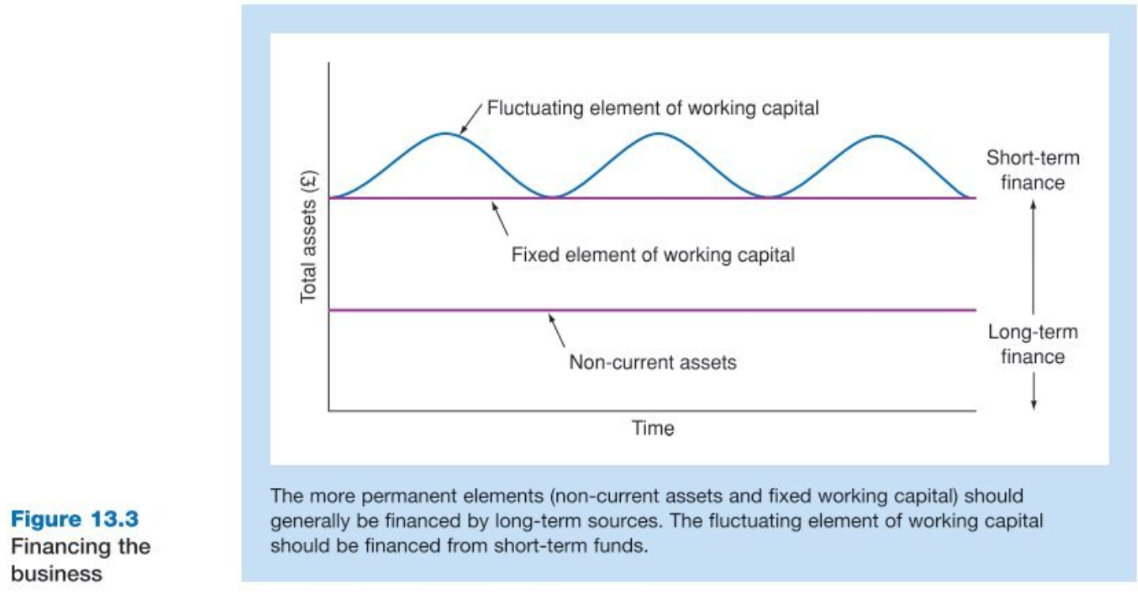

Slide 62

Matching Capital Needs with Financing Sources
Fixed Needs → Long-term financing (Equity, Long-term loans)
Fluctuating Needs → Short-term financing (Bank overdrafts, credit lines)
Aligns with the previous Figure principle of matching asset duration with funding duration.

Slide 63
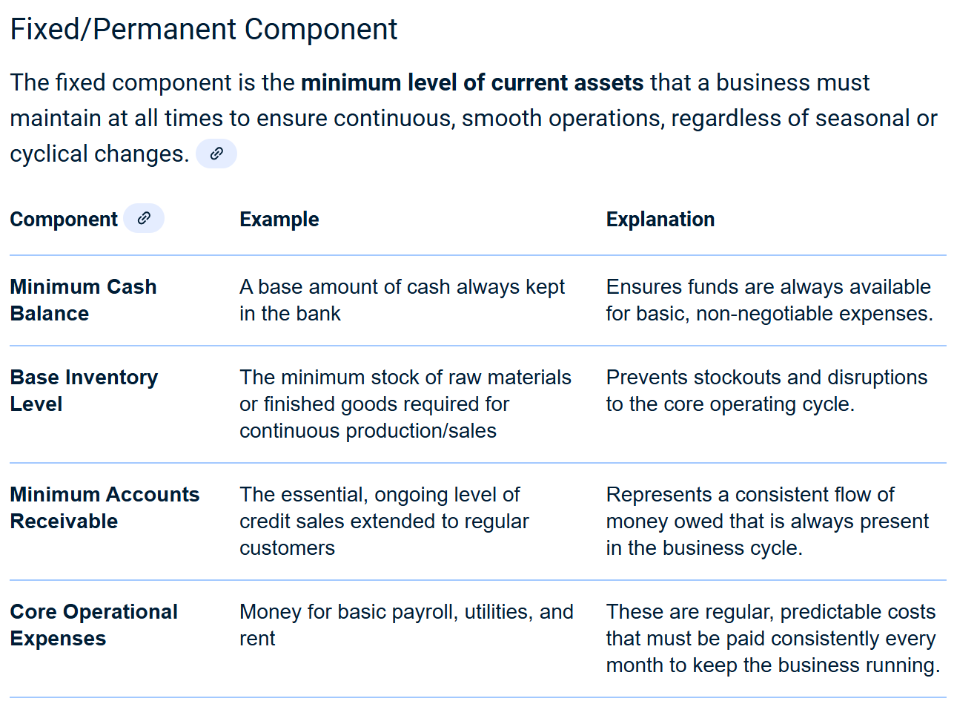

Slide 64
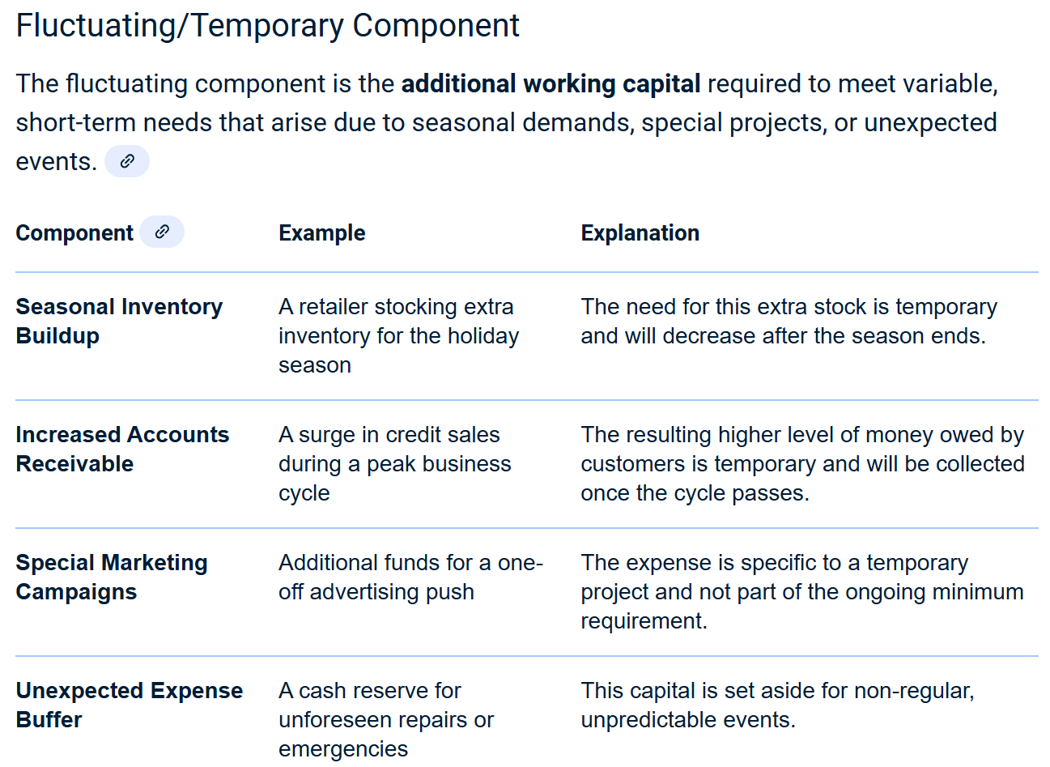

Slide 65
Practical Implications with Real-World Considerations
Businesses may undergo:
Expansion or contraction
Structural changes
These affect both working capital needs and financing patterns
Flexibility in financing is crucial for adapting to operational changes.

Slide 66
Key Insights for Financial Planning
Separate working capital into fixed and fluctuating components.
Use appropriate financing sources for each.
Monitor and adjust financing strategy as business evolves.
Seasonal and structural factors must be anticipated and planned for.

Slide 67
Key Liquidity Ratios in Working Capital Management
1. Current Ratio
Formula:
Current Ratio = Current Assets/Current Liabilities
Interpretation: Measures the ability to cover short-term obligations with short-term assets.
Benchmark: A ratio > 1 indicates more assets than liabilities, but excessively high values may suggest inefficient use of resources.

Slide 68
Key Liquidity Ratios in Working Capital Management
2. Acid-Test (Quick) Ratio
Formula:
Quick Ratio = Liquid Assets/Current Liabilities
Excludes: Inventory and prepaid expenses.
Use: More stringent test of liquidity than the current ratio.
3. No Credit Period Ratio
Formula:
No Credit Period = Liquid Assets/Average Daily Cash Running Costs
Purpose: Indicates how many days a business can operate using only its liquid assets.

Slide 69
Strategic Use of Liquidity Ratios
Monitoring Liquidity Health
Ratios provide early warning signals of liquidity issues.
Enable real-time tracking of financial resilience.
Benchmarking Approaches
Internal Standards: Historical performance, budgeted targets.
External Comparisons: Industry averages, competitor analysis.
Hybrid Models: Combining internal and external benchmarks for nuanced insights.

Slide 70
Strategic Use of Liquidity Ratios
Managerial Actions
Adjust credit policies.
Optimize inventory levels.
Renegotiate supplier terms.

Slide 71
Maintaining Liquidity & Stakeholder Confidence
Why Liquidity Matters to Stakeholders
Suppliers: Need assurance of timely payments.
Lenders: Assess repayment capacity.
Investors: View liquidity as a proxy for financial health.
Consequences of Poor Liquidity Management
Strained supplier relationships.
Increased borrowing costs.
Risk of default and reputational damage.

Slide 72
Maintaining Liquidity & Stakeholder Confidence
Best Practices
Regular ratio analysis and trend monitoring.
Scenario planning and stress testing.
Aligning liquidity strategy with business cycles and risk appetite.
Key Insight: Liquidity is not just a financial metric—it’s a strategic asset that underpins trust and operational continuity.

Slide 73
Understanding the Need for Liquidity
Liquidity: The ability of a business to meet its short-term obligations as they fall due.
Working Capital Management: Balancing current assets and current liabilities to ensure operational efficiency and financial stability.
Why Liquidity Matters:
Ensures smooth day-to-day operations.
Prevents insolvency and potential liquidation.
Enhances credibility with suppliers and creditors.
Discussion Prompt:
Why might a company with high profits still face liquidity issues?

Slide 74
The Liquidity Trade-Off
Balancing Act:
Too much liquidity: Idle resources, lower returns.
Too little liquidity: Risk of default, damaged reputation, potential bankruptcy.
Strategic Considerations:
Optimal use of current liabilities (e.g., trade payables, short-term loans).
Avoid over-reliance on short-term finance due to:
  Volatility in credit terms.
  Risk of sudden repayment demands.
  Case Insight:
  Consider a retail chain that delays supplier payments to fund expansion. What risks does it face?

Slide 75
The Consequences of Liquidity Failure
Immediate Impact:
Inability to meet short-term claims.
Legal rights of creditors to initiate liquidation proceedings.
Liquidation Outcomes:
Forced sale of assets (often below market value).
Loss of control over business operations.
Destruction of shareholder value.
Real-World Example:
Think of a company that collapsed due to a liquidity crunch despite having valuable assets. What went wrong?

Slide 76

Theoretical vs. Real-World Perspectives
In Theory:
If bankruptcy costs = 0 and asset markets are efficient:
Liquidation ≠ loss of shareholder wealth.
Shareholders recover full market value.
In Reality:
Bankruptcy costs are significant:
Legal fees, administrative costs, reputational damage.
Asset markets are imperfect:
Fire-sale discounts.
Illiquidity of non-current assets.
Conclusion:
Effective liquidity management is not just about survival—it's about preserving long-term shareholder value.

Slide 77
Introduction to Liquidity Risk and Liquidation
Understanding Liquidity Risk in Business Finance
Liquidity Risk Defined: The danger of not having enough cash to meet short-term obligations.
Liquidation Trigger: Inability to pay current liabilities can lead to forced asset sales or business failure.
Preventive Strategy: Maintain sufficient liquid assets to avoid sudden cash shortfalls.
💡 Key Insight: Liquidity issues often precede business failure, regardless of profitability.

Slide 78
Strategy – Holding Cash in Short-Term Deposits
Using Short-Term Interest-Bearing Deposits
Mechanism: Keep cash in short-term deposits to access funds quickly.
Advantage: Immediate liquidity to meet unexpected liabilities.
Condition for Effectiveness:
Funds must originate from long-term sources.
Avoid creating new short-term liabilities.
⚠️ Caution: Solving liquidity with short-term borrowing may worsen the problem.

Slide 79
Capital Market Constraints
Challenges in Using Long-Term Finance for Liquidity
Interest Rate Mismatch:
Long-term borrowing rates > Short-term lending rates.
Market Reality:
Businesses often pay more to borrow than they earn from deposits.
Implication:
Maintaining liquidity this way is costly and often unsustainable.
📉 Result: The ideal liquidity strategy is economically inefficient for most firms.

Slide 80

Practical Business Approach
Striking a Balance Between Assets and Liabilities
Real-World Practice:
Balance current assets vs. current liabilities.
Short-Term Finance:
Often cheaper but riskier.
Risk Management:
Avoid over-reliance on short-term funding.
⚖️ Goal: Optimize liquidity without incurring excessive costs or risks.

Slide 81

Strategic Takeaways
Working capital management is a strategic tool, not just an operational concern
Requires integrated, frequent, and balanced management
Directly contributes to financial performance and shareholder value
Representing liquidity, efficiency, and value creation concerns

Slide 82
Exercises
Calculate:
Current Ratio
Acid-Test (Quick) Ratio
No Credit Period
What will happen, when a retail chain delays supplier payments to free up cash for expansion

Slide 83
Video
Working capital management
Working Capital Management: Mistakes to Avoid and Best Practices to Follow

