Slide 1

Effective Practices with Young People
Ash Lewis
2017412

Slide 2

Content
Introduction
Skills
Different Approaches
What tools we can use
Interventions
Pros and Cons of Interventions
Conclusion
Reference List

Slide 3
Introduction
To work effectively with young people, as youth workers we need to have an array of skills and tools to be able to engage them in effective work.
Things Needed: Right skills
Effective Tools
Different approaches
Able to adapt and change the way we work with individuals.

Slide 4
“The role of the youth worker is key to the success of any successful youth group and you need to ensure that the people you engage have the right qualities and skills and that they understand the responsibilities that being a youth worker brings.” (Youth Scotland, 2022)

Slide 5
Skills
Counselling Skills
Organisational Skills
Interpersonal skills
Wider skills: Team building, Problem solving
Communication skills
Promotes team-work skills
Leadership Skills

Slide 6
Five Pillars
Empowering
Inclusive
Educative
Expressive
Participative
Youth Work in Wales: Principles and Purposes (2018).
“Promote opportunities and access for all young people whatever their race, gender, sexual identity, language, religion, disability, age, background or personal circumstances.”

Slide 7
Working with young people
Within youth work settings there will be similarities with counselling skills but it is important to note that youth workers are not trained counsellors.
Similarities: Communication
Active Listening
Building relationships
Empathetic
Supportive
Differences: The qualifications
Being able to signpost when required

Slide 8
Different Approaches to Youth Work
School Based
Outreach
1:1 Work
Groupwork
Residentials
Detached
Activities
Issue Based

Slide 9
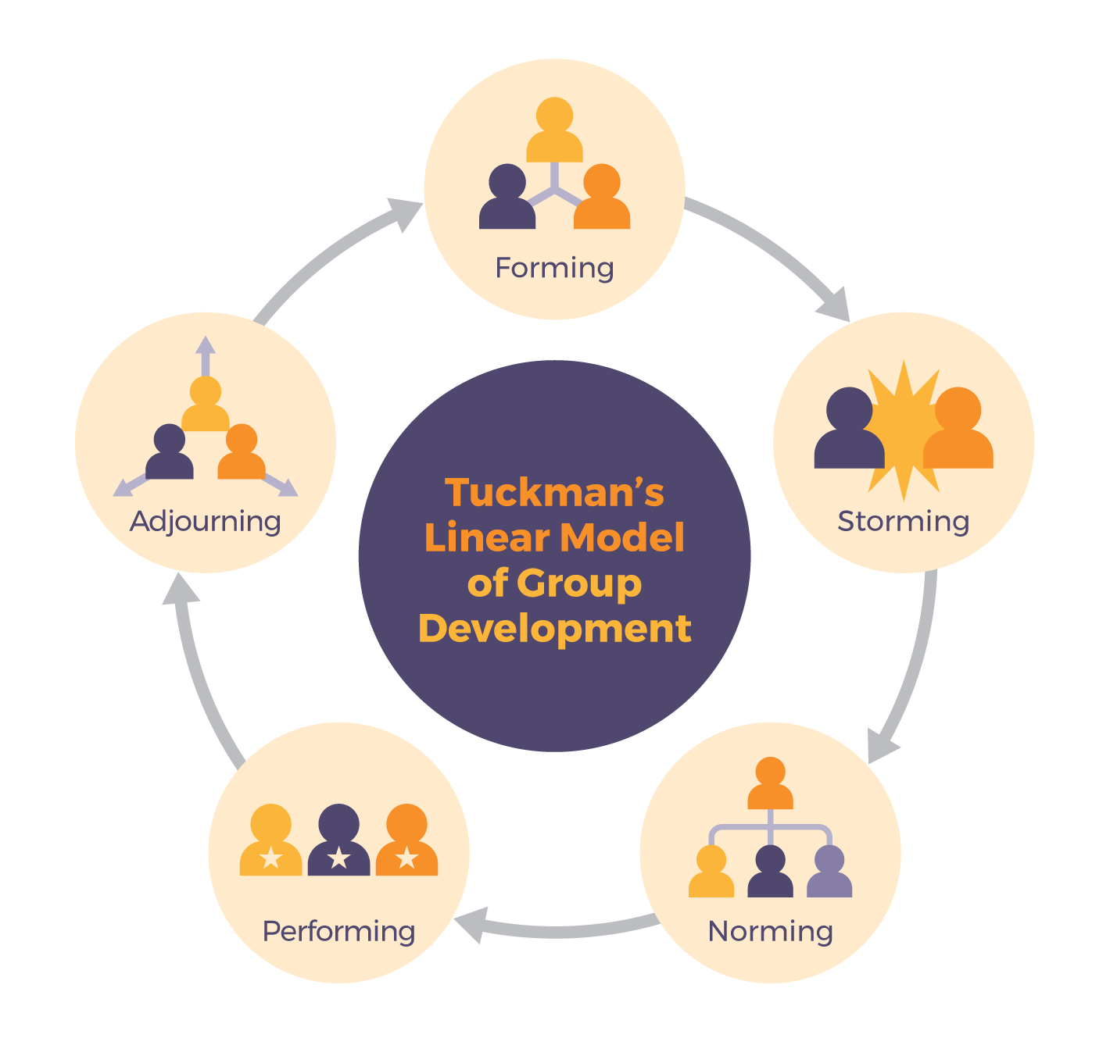
Groupwork
“The importance of equity, diversity and inclusion is one of the values which youth workers are expected to know about and apply when working with groups of young people.”
NOS(2019)
Image 1

Slide 10
Activities
Sport
Art
Music
Mindfulness
Games
Drama
Residentials
Community Work
Quizzes
Cooking
Team-Building
Five ways to Wellbeing
Connect
Be Active
Take Notice
Learn
Give
Mind,2022.

Slide 11
Intervention
Looking at some of the activities we can use to effect successful youth work, I have practised several examples of how to intervene and to promote education, change and being a positive role model to the young people. These have been through workshops, meditation and quizzes. I will now demonstrate an activity I have completed with young people.

Slide 12
What was the outcome?
Better understanding of the language they use
How using words incorrectly can hurt people
Educating about diversity and equality
Being more self-aware as a young person
“To help ensure young people are able to thrive, we need to ensure we are creating safe spaces and youth work cultures that are caring, inclusive and understanding, and which build trust and a sense of belonging.” (WG, 2018)

Slide 13
Conclusion
Young people will look at youth workers as role models and this will help build and maintain relationships as they develop into assured adults. We can help facilitate informal education, participation and empowerment by discussing their rights with them (UNCRC,2018). We can help them become valued members of their communities and to help them grow as individuals.
“enable young people to develop holistically, working with them to facilitate their personal, social and educational development, to enable them to develop their voice, influence and place in society and to reach their full potential.” (NOS,2019).

Slide 14
REFERENCE LIST
Education Wales (2019) Youth Work Strategy for Wales. Available at: The Youth Work Strategy for Wales english (gov.wales) (Accessed 18 July 22).
Image 1. Available at :Tuckman_CC.png (1420×1361) (Accessed 18 July 22).
Mind (2022) Five ways to Wellbeing. Available at: Five ways to wellbeing – Mind (Accessed 18 July 22).
National Occupational Standards. (2019) Combined Youth Work. CLD Standards Council.
Unicef (2022) How we protect children’s rights with the UNCRC. Available at: https://www.unicef.org.uk/what-we-do/un-convention-child-rights/ (accessed 21.03.22).
Youth Scotland (2022) The Role of the Youth Worker. Available at: The Role of the Youth Worker (youthworkessentials.org) (Accessed 18 July 22).
Youth Work in Wales Review Group. (2018) Youth Work in Wales: Principles and Purposes, Cardiff: Youth Work in Wales Review Group.

