Slide 1

CHANGEMAKERS: CREATIVITY AND VALUE CREATION
BMHP5014_BIRM
E-PORTFOLIO EVIDENCE OF LEARNING:
Elevator style pitch
Supporting flyer
Conference poster
STUDENT: RAMONA ROBU (1913214)
LECTURER: DR AZORA HURD

Slide 2

Task description
TASK 3.
Create a 2-minute elevator style pitch of your idea and a supporting flyer. The pitch should be written in a format that enable you to present it to an audience. Your flyer can be produced using PowerPoint. The flyer should be double sided A5 or trifold and be designed to engage potential contributors/buyers of the benefits of your idea. For example, if you have an awareness raising idea, your flyer should concisely portray the issue and how you would like people to get involved. A list of references should be included with the pitch and flyer. The resources in Unit Three of this module will help you to complete this task.
Please be as creative as possible in the design of your flyer using PowerPoint format. Ensure you use images, colors, boxes and written text to make it visually appealing. (27 Marks)
TASK 4.
Create a conference poster showcasing your project. Your poster should refer to the learning covered in Unit Four of the module. A list of references should be included with the poster. Consider your audience when designing the poster and the kind of messages you wish to portray to promote your idea. You can include some of the messages and images used in the flyer in task 3 so long as you focus on generating a conference poster which will promote your idea to encourage individuals to attend. The resources in Unit Four of this module will help you to complete this task. (27 Marks)
Please be as creative as possible in the design of your conference poster using PowerPoint format. Ensure you use images, colors, boxes and written text to make it visually appealing. It is important that you create one document for tasks 3 and 4 and submit it into Turnitin as one document. It is essential that you reference correct using the University’s Harvard referencing guidance and that you spell check your work, that you have correctly referenced the websites which you may be using to put imagery into your work.
PARTICIPATION AND CONTRIBUTION IN THE ONLINE ACTIVITIES This mark will be awarded based on your tutor’s assessment of your active participation in, and contributions to, the learning activities throughout the module. Tutors will award marks for completing specified tasks and for the output you produce and submit (e.g., completion of activities, messages posted in discussion threads, active participation in discussions). This mark relates to both participation and contribution, so simply completing all module study activities is not a guarantee that you will receive the full 10 marks. If your tutor does not feel you have participated in these activities, the 10 marks will be lost. (10 marks). Please refer to the guidance for students in the completion of tasks section to support your work.

Slide 3

Task3
Hello everyone, it is a pleasure to be here with you today. My name is Ramona Robu, and I will talk about the importance of spreading awareness related to the new purpose of Pulse Oximeter.
This "little" innovation can do great things. It is a small electronic device, simple, relatively cheap, and once clipped onto a finger, measures the oxygen saturation in your blood and your heart rate. Because low oxygen saturation can be a sign of Covid-19, Pulse Oximeter can detect early deterioration in people with confirmed or possible Covid-19. The most affected age group by Covid-19 is age 60+ (Kaplan, 2020).
My main goal is to spread the information about this device as much as I can, starting with this conference and then through traditional channels all over the world. Why traditional channels? People aged 60+ who are the most vulnerable in front of this virus are rather watching television, listening to the radio, reading newspapers and magazines, than using today's new technologies like social media.
Together we can do it !!!
Elevator style pitch
Spread the information

Slide 4
Together we can do it !!!
By informing people about what this little device can do and knowing that the oxygen saturation level under 95% is considered dangerous and warrants urgent treatment, once provided, they will be able to ask for help from their health care provider in time. In this way, their health care providers can manage and treat their condition before it is too late.
As I mentioned in my latest blog, I contact the World Health Organization (WHO) who has the necessary power and resources to make this project work. Working together as a team and putting passion into our work, we can spread the information all over the world and help our beloved.
Each of you can spread awareness of how Pulse Oximeter can save lives by sharing/spreading the information to your family, friends, neighbours and everyone you know.
From this project we are all getting benefit from it, not just the people aged 60+, because we can keep our beloved ones safer and get the chance to spend more time together.
Thank you for listening to me, and keep in mind that together we can do it!
Take care of your health!
Spread the information

Slide 5
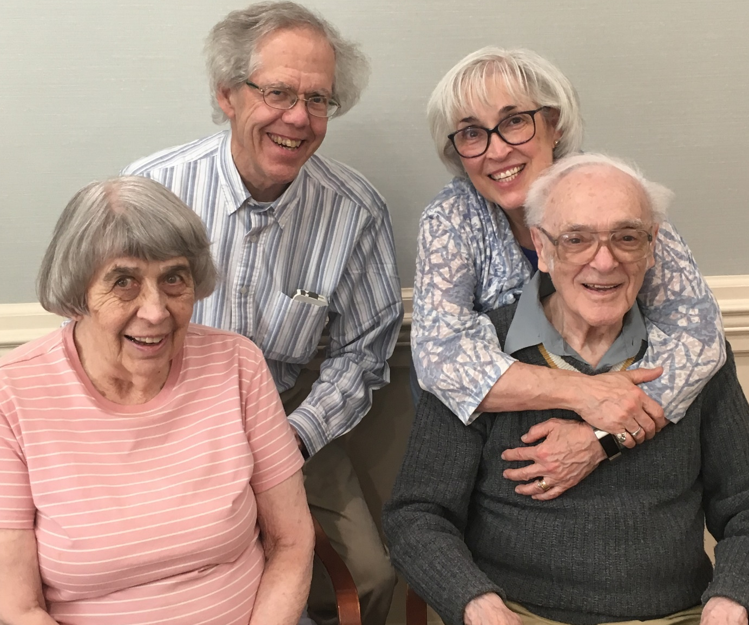
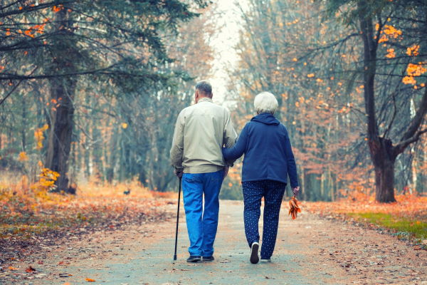
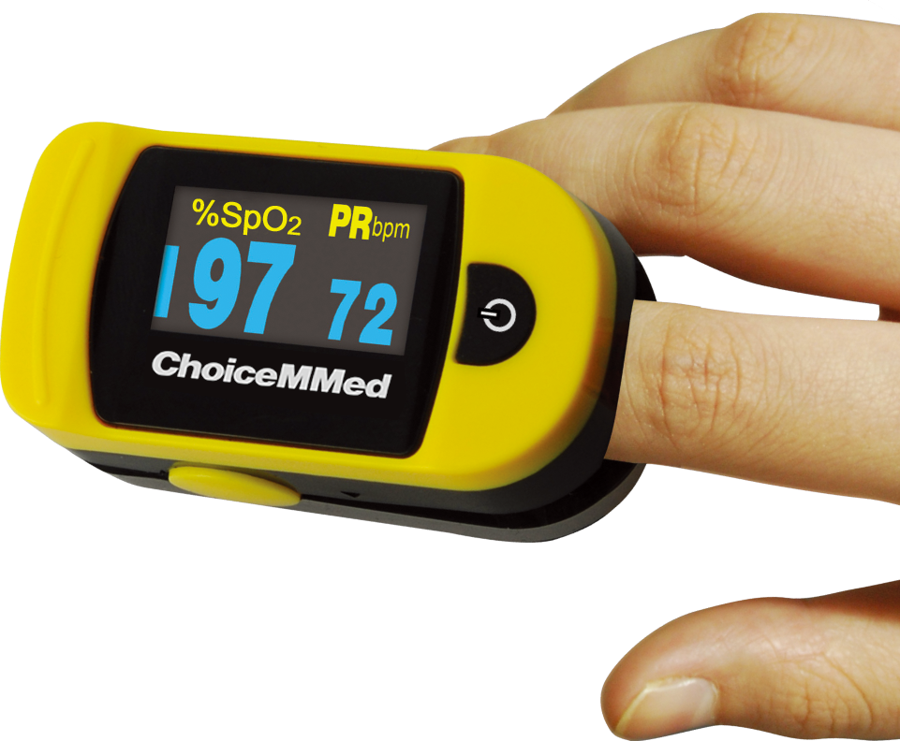
Task 3
SPREAD THE INFORMATION
SHARE INFORMATION TO HELP
SHARE INFORMATION TO HELP
PULSE OXIMETER – COVID-19 & PEOPLE AGE 60 AND ABOVE
What is Pulse Oximeters new purpose ???
Detects an early deterioration for those who are tested positive or possible Covid-19
(Elderly couple walking-away, 2020)
(Dad-birthday, 2020)
Why use it ???
Because HELPS to watch over your health
Why is important especially for the older age group ???
Because people 60+years are at a higher risk than the younger age group of getting infected with Covid-19
WHAT TO DO !!!!
Share the information to your parents, grandparents, relatives, friends, neighbours and you can save lives !!!
Why to spread the information???
Because by spreading the new purpose of Pulse Oximeter, more people will use it. That means they can notice in time a deterioration in their health, and they will get the treatment at the right time !!!
(Pulse Oximeter, 2020)
If you have any questions or need more information, feel free to write at: 1913214@student.uwtsd.ac.uk

Slide 6

Together we can do it !!!
The Pulse Oximeter purpose
It measures the oxygen level of the blood
It measures your pulse rate
It is easy to use and to read the percentages
When to ask help
If the percentage of oxygen level is below 95% it indicates that there is a problem, and you should ask help from your GP or tell your family, friends, neighbours
Spread the information
APPROVED BY NHS
NHS approved the use of Pulse Oximeter and set out on their website, documents to help people with confirmed or possible Covid-19 how to monitor and use it (NHS England, 2020)
Who benefits from sharing the information
The people aged 60/+years with confirmed/possible Covid-19 that could be your dad/mom, grandad/grandma, uncle, cousin, brother/sister
Think about it !! By sharing the information our beloved ones can get help in time before it could be too late!!!!
Telephone number: 07821262126 Website: http//ramonarobu.ac.uk

Slide 7

Task 4
AWARNESS CONFERENCE
1 thing to do: SHARE/SPREAD the information about the
new purpose of Pulse Oximeter and save lives !
26 of March 2021
2 pm – 3 pm
Organized by Ramona Robu
At UWTSD BIRMINGHAM CAMPUS
WHY ?
HOW IT HELPS ?
WHO WILL BENEFIT ?
Answers will be given
(Happy elderly couple, 2021)
Telephone number: 07821262126 Website: http//ramonarobu.ac.uk

Slide 8
References:
Dad-birthday, (2020). Available at: https://asourparentsage.files.wordpress.com/2020/05/dad-birthdyay.jpeg (Accessed: 5 March 2021).
Elderly couple walking-away, (2020). Available at: https://i0.wp.com/fabiusmaximus.com/wp-content/uploads/2020/04/Elderly-couple-walking-away-AdobeStock_289536235.jpg?ssl=1 (Accessed: 5 March 2021).
Happy elderly couple, (2021). Available at: https://live.staticflickr.com/909/27999711698_fcb1bbb74c_b.jpg (Accessed: 5 March 2021).
Kaplan, D.A., (2020) At-Home Pulse Oximeters: The 'It' Gadget of the COVID-19 Outbreak. Managed Healthcare Executive, 30(6), pp. 24-25.
NHS England, (2020). Available at: https://www.england.nhs.uk/coronavirus/publication/pulse-oximetry-to-detect-early-deterioration-of-patients-with-covid-19-in-primary-and-community-care-settings/ (Accessed: 7 March 2021).
Pulse Oximeter, (2020). Available at:
https://upload.wikimedia.org/wikipedia/commons/b/b5/OxyWatch_C20_Pulse_Oximeter.png (Accessed: 6 March 2021).

