Slide 1
Week 4:
Scales
Chords
and Melody

Slide 2
WHAT IS A SCALE?

Slide 3
A MUSICAL SCALE IS A SERIES OF PITCHES IN A DISTINCT ORDER

Slide 4
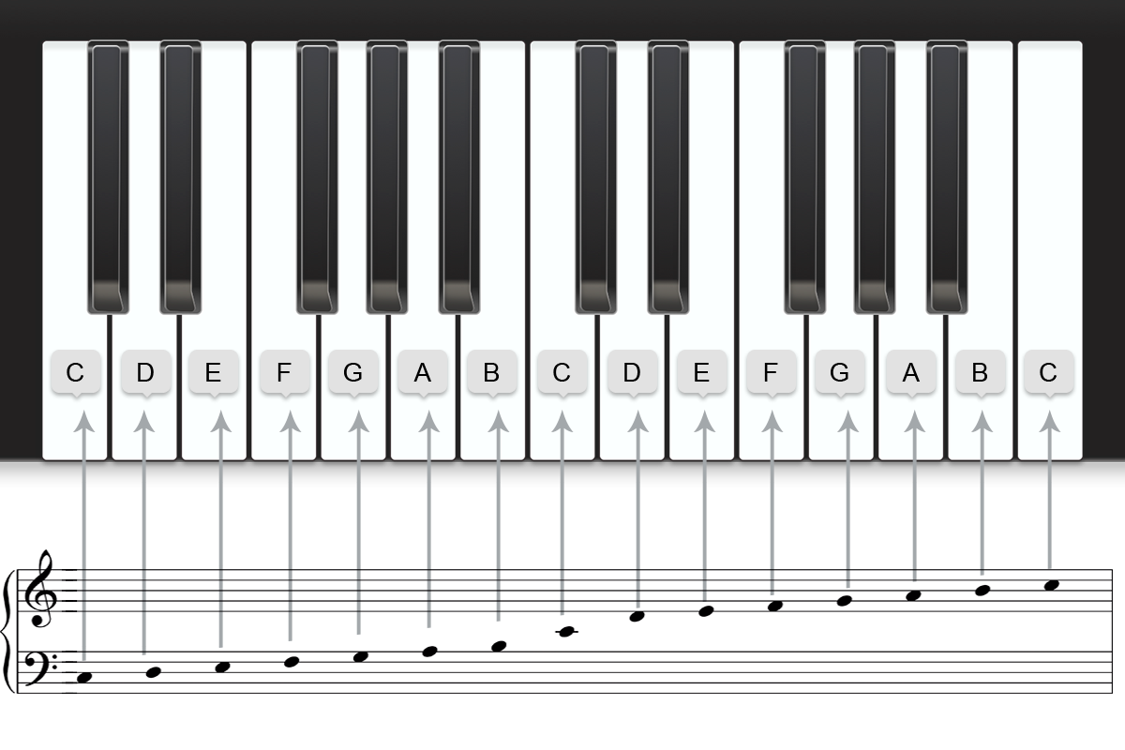

Slide 5
How many types of
scale are there?

Slide 6
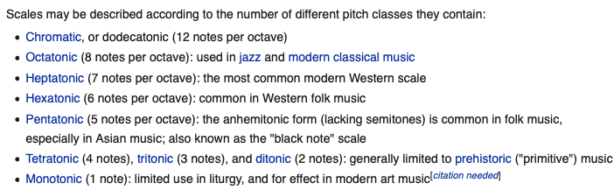
Different types of scale
More Information: https://en.wikipedia.org/wiki/Scale_(music)

Slide 7
DIATONIC (Heptatonic) SCALE
(FIVE WHOLE TONES AND TWO HALF STEPS)
More Information: https://en.wikipedia.org/wiki/Diatonic_scale

Slide 9
SCALE DEGREEs
(Name of Notes)

Slide 10
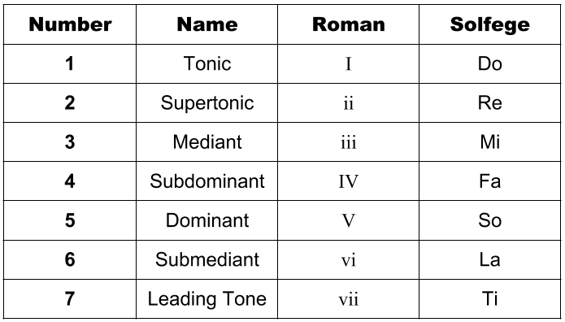

Slide 11
The sequence of INTERVALS is the same in every major scale

Slide 12
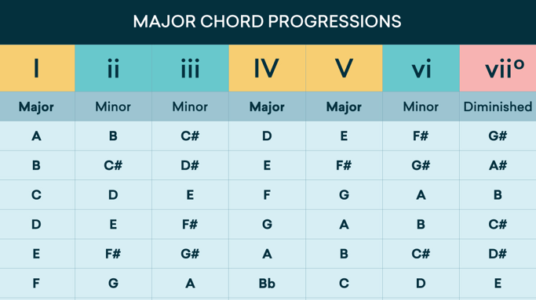

Slide 13
The Sequence of INTERVALS is the same in every Minor scale

Slide 14
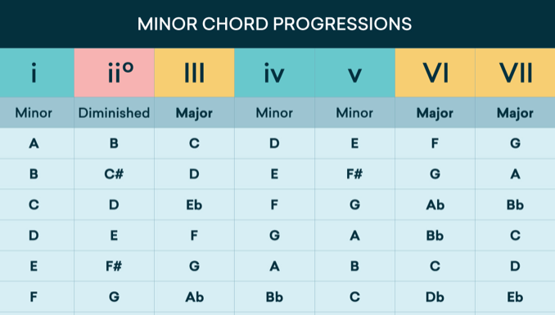

Slide 15
Modes
1. Ionian
2. Dorian
3. Phrygian
4. Lydian
5. Mixolydian
6. Aeolian
7. Locrian
(I don’t Particularly Like Modes A Lot)
More Information: https://learningmusic.ableton.com/advanced-topics/modes.html

Slide 16
Modes:
Audio Examples
Audio Examples: https://blog.landr.com/music-modes/

Slide 17
Chords:
What is a Chord?

Slide 18
Three of more notes that combine harmoniously
Chord comes from the French word for agreement, accord, so in music it means sounds that go together, or agree with each other.

Slide 19
Chords
(in C Major)

Slide 20
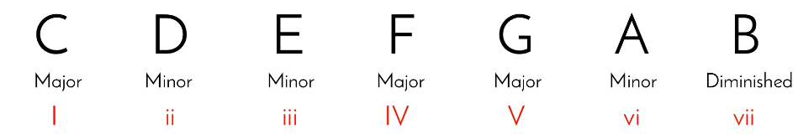

Slide 21
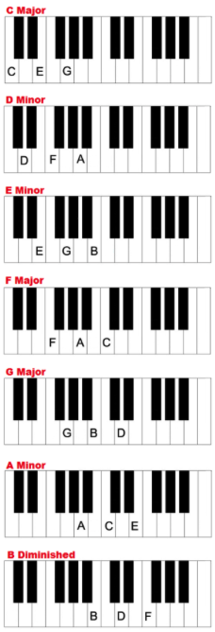

Slide 22
Each note in a scale/chord has a different characteristic
PRO TIP:
It is useful to become familiar with the characteristics of the different chords

Slide 23
The relationship between different note/chord characteristics
Cadence: https://www.musictheoryacademy.com/how-to-read-sheet-music/cadences/

Slide 24
Sequencing Chords
Creates chord progression

Slide 25
Common Chord Progression in
popular music
I - V - VI - IV
1st
5th
6th
4th

Slide 26
Common Chord Progression in
popular music
I - V - VI - IV
C
Major
G
Major
A
Minor
F
Major

Slide 27
Common Chord Progression in
popular music
The Axis of Awesome – 4 Chords:
https://www.youtube.com/watch?v=oOlDewpCfZQ&frags=pl%2Cwn

Slide 28
Online Resource for Exploring Chord Progressions
in popular music:
https://www.hooktheory.com/theorytab/common-chord-progressions

Slide 29
Example of writing a Simple Chord progression

Slide 30
altering (or inverting) the chord structure

Slide 31
Class Task (A):
Create a chord progression for piano
You may use the following example and fill in the blanks:
I - ? - ? - V
1st
5th

Slide 32
Class Task (B):
Add rhythm to the Chord Progression
For Example: Arpeggiate or
Create an Ostinato Rhythm

Slide 33
Class Task (C): ADAPT/Arrange the chord progression for brass quartet
2 x Trumpet
Trombone
Tuba

Slide 34
Example of chords being played on brass instruments
Blue Devils - Space Chords:
https://youtu.be/2EDIDCdy5Es?t=48

Slide 35
Composing a Melody

Slide 36
Start with the scale

Slide 37
Define Rhythm
Use Repetition
use Silence

Slide 38
Class Task (D): compose a melody over the Brass Quartet chord progression

Slide 39
FURTHER INFORMATION: https://www.youtube.com/watch?v=iEKFuSQndhs

