Slide 1
Welcome
To
The presentation

Slide 2
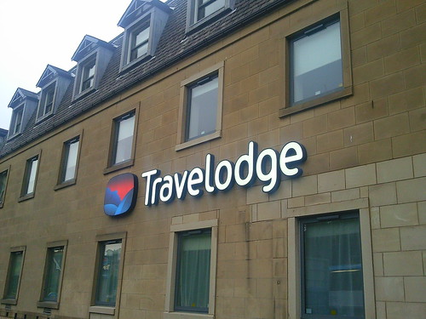
Introduction
In this presentation, the marketing plan of Travelodge will be highlighted. This will show how the marketing plan can be implemented considering the case of the UK’s hotel or resort business sector.

Slide 3
SMART Objectives
Specific | Measurable | Attainable | Realistic | Time-bound
To increase customer loyalty program | To increase profit or sales by 10% | Different digital marketing tools and techniques | This business has gained success from its market survey and campaign | By the end of October 2023

Slide 4
Situational Analysis
SWOT
Customers
Collaborations
Competitors
Brand image
PESTEL
Quality services
Skilled staff
Unsatisfied customers
Providers of low rating
Hilton,
Marriott
Bathon House
Partnership with Uber, Disney, and so on
Brexit and war
Inflation rate
Change in taste pattern
E-payment and digital
CSR
Different laws
Notes:
.

Slide 5
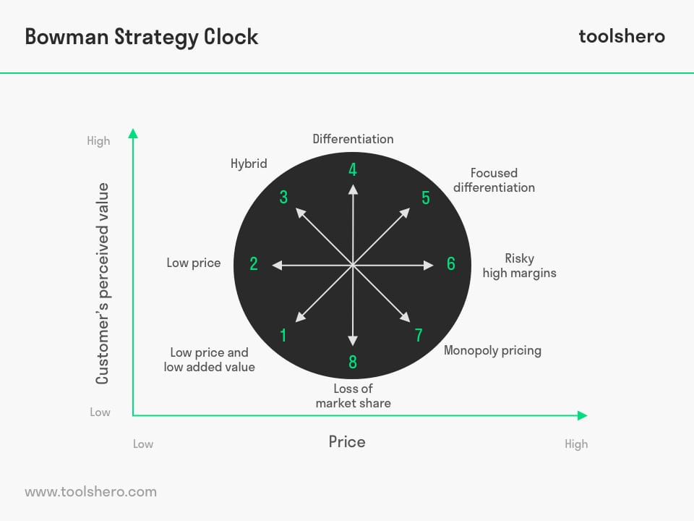
Value Proposition
Travelodge follows a hybrid marketing that combines different marketing strategies.
Figure: Bowman Clock Strategy
Source: (Grewal & Levy, 2023)

Slide 6
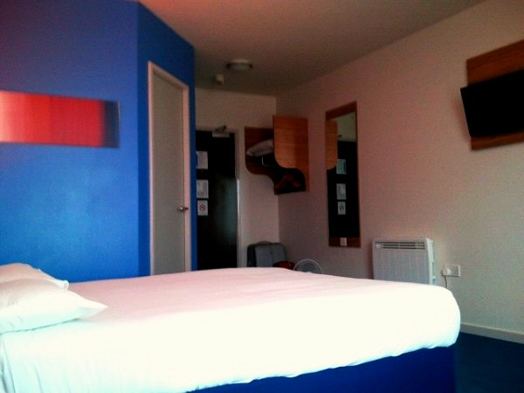
Marketing mixes
Products | Resort and hotel business
Price | Premium pricing
Place | Global.
Promotion | Traditional and digital marketing

Slide 7
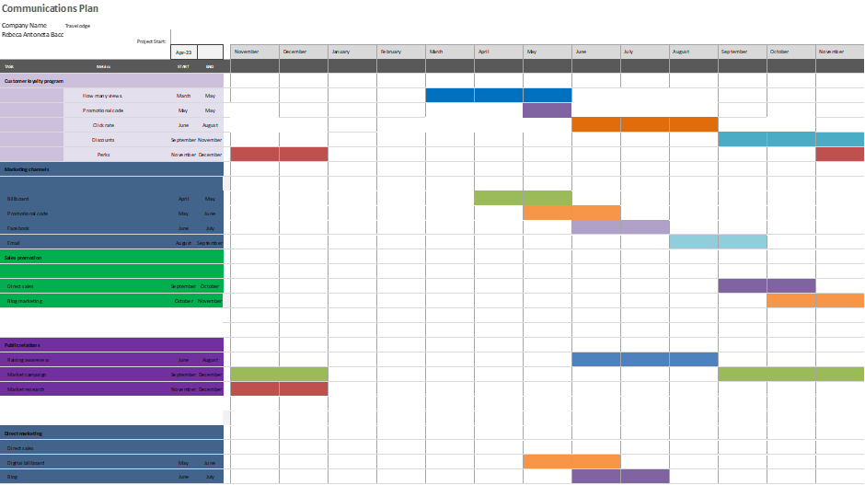
Gantt chart

Slide 8
Conclusion
The major challenges are to target the customers and based on which appropriate actions can be undertaken.
Recommendations
• Travelodge’s market analyst should conduct a market survey and campaign,
• It should focus on representing an effective customer loyalty program,
• It should explore secondary channels including email marketing, blog marketing, and social media marketing.

Slide 9
References
Antcliff, K. (2019) Here is where you’ll find the closest Travelodge to Notts Attractions, NottinghamshireLive. Available at: https://www.nottinghampost.com/whats-on/whats-on-news/need-cheap-hotel-stay-nottingham-2049145 (Accessed: 08 May 2023).
Baines, P., Rosengren, S. and Antonetti, P. (2022) Marketing. Oxford, United Kingdom: Oxford University Press.
Baker, T. (2023) Travelodge completes first phase of hotel renovation rollout, CoStar. Available at: https://www.costar.com/article/2126613458/travelodge-completes-first-phase-of-hotel-renovation-rollout (Accessed: 08 May 2023).
Eva M Smith, S.C. (2015) ‘Hotel revenue management strategies during fall foliage travel season’, Journal of Hotel & Business Management, 04(01). doi:10.4172/2169-0286.1000111.
Foster, G.S. and Grannell, C.J. (2022) ‘Analysis / customers’, Essential Management Models, pp. 33–65. doi:10.4324/9781003038276-4.
Grewal, D. and Levy, M. (2023) Marketing. Vancouver, B.C.: Langara College.
Ieva, M. (2019) ‘Managing customer experience to foster customer loyalty’, Loyalty Management, pp. 125–153. doi:10.4324/9780429022661-6.
Jackson, E. (2018) Hotel Management. New York, NY: Larsen & Keller.
Mol, H. (2014) Moving into tourism and hospitality. Reading England: Garnet.
Nurcahyo, B. (2016) ‘The role of customer satisfaction in a relation of experiential marketing and customer loyalty’, Advances in Social Sciences Research Journal, 3(1). doi:10.14738/assrj.31.1774.
O’Fallon, M.J. and Rutherford, D.G. (2011) Hotel Management and Operations. Hoboken (N.J.): J. Wiley.
Sewell, C. (2022) Travelodge release thousands of rooms for under £35 in the lead up to Christmas, Northamptonshire Telegraph. Available at: https://www.northantstelegraph.co.uk/read-this/travelodge-release-thousands-of-rooms-for-under-ps35-ahead-of-christmas-how-to-book-3900540 (Accessed: 08 May 2023).
Wai Lai, I.K. (2019) ‘Hotel image and reputation in customer loyalty--model’, PsycTESTS Dataset [Preprint]. doi:10.1037/t76869-000.
Whitney, M. (2023) 10 Smart Hotel Marketing Strategies to increase bookings, WordStream. Available at: https://www.wordstream.com/blog/ws/2018/09/07/hotel-marketing (Accessed: 08 May 2023).
Yu, L. (2016) The International Hospitality Business: Management and Operations. New York: Routledge.

