Slide 1

Sidecar Speed Record Attempt
Iriney Svilen Georgiev
1900719
Hybrid Powertrain and Control
ACEA7007
Swansea
December 2022
Course
MSc Motorcycle Engineering
Lecturer
Ryan James

Slide 2
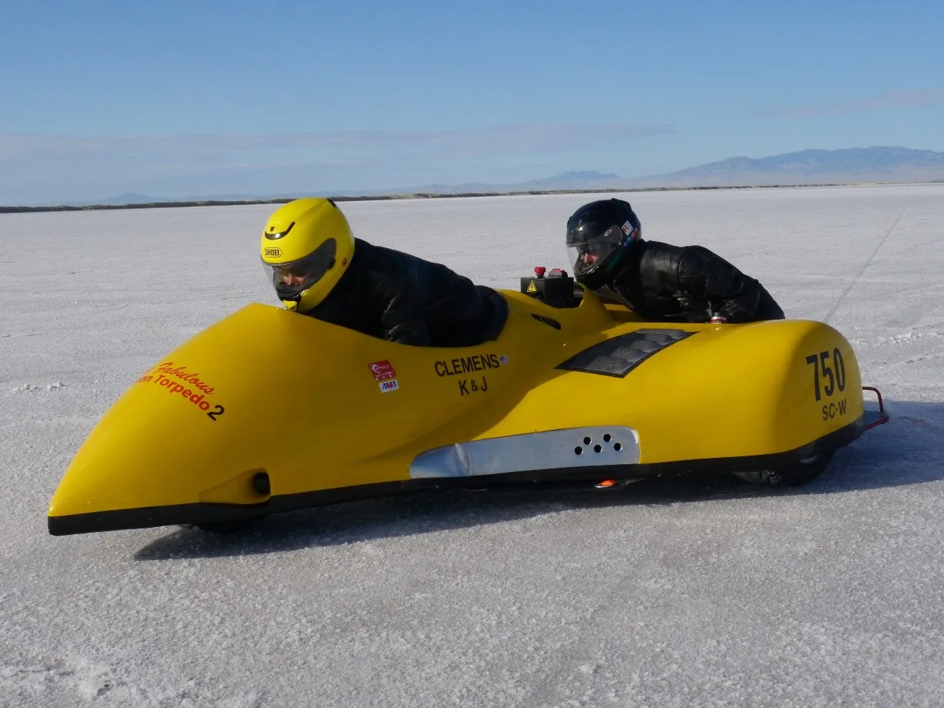
Introduction
The current FIM land speed record for electric vehicles is 174.612km/h over a distance of 1 mile. The record was set by Kevin Clemens at the Bonneville salt flats in 2016. The vehicle used to achieve the land speed record was a Baker Formula One Sidecar, which falls under Group B1, Division B, Type 4 [1]. This record has stood for several years and remains unchallenged to this day.
This study aims to break the current FIM electric land speed record by approximately 5.4 km/h within the same racing category. For this study, an F1 sidecar equipped with an internal combustion engine (ICE) will be used. The ICE unit of the car is replaced with an Emrax 268 medium voltage electric motor and a Sevcon Gen4 Size10 AC motor controller [2,3]. Different energy storage systems are assessed and sized according to the motor's electrical requirements. Additionally, cooling systems are also taken into consideration, since Kevin Clemens stated in [4] that the temperature of the motor ruined the potential for setting an even higher speed. Theoretical calculations are performed using MATLAB software.
Figure 1: August 2016, speed record attempt with the Bakes Sidecar equipped with twin AC motor drive and half of a Nissan Leaf battery pack [4].

Slide 3
Methodology
For this study, potential approaches are identified by reviewing the FIM regulations. This project aims to beat Kevin Clemens' world record for a distance of one mile.
1. FIM Regulations
"Flying starts" are required for short distance world records.
This sidecar is classified as Division B - Partially streamlined.
A passenger may not be carried.
Minimum weight of the sidecar is 300kg.
Free choice of tyres.
Energy regeneration system is allowed.
The electrical circuits must not exceed a nominal voltage of 500 Volts.
Voltage across capacitors should fall below 65 Volts within 5 seconds.
Recharging batteries during the record attempt or replacing them is allowed.
Batteries with fuel cells are not allowed. [5]
Notes:
According to the regulations [5], 1 mile is considered a short distance world record. This requires the vehicle to accelerate from 0 to maximum speed, enter the first speed trap, and maintain its speed for more than one mile. The procedure is repeated twice, traveling in one direction, stopping and traveling in the other direction as a pause of up to two hour is allowed between each trip. In both runs, the average speed between the first and second traps is effectively the vehicle's land speed [5].
The sidecar is classified as partly streamlined, meaning that the rider can be seen from both sides and from above, except for the hands and wrists. The front and rear wheels must remain partially exposed [5].
The driver may choose either a passenger or a ballast of 60 kg which must be securely attached to the sidecar [5].
The rider/team is solely responsible for ensuring that tires are rated for the targeted top speed and for inspecting the condition of tires before and after each run [5].
Recovering energy generated by the kinetic energy of the vehicle is permitted [5]. For this experiment, no regenerative braking system has been provided with the sidecar.
Limits of the electrical systems are set, hence the motor controller must keep the circuit voltage within the 500V region.
Batteries can be recharged or replaced between attempts as long as the type and quantity is kept the same.
Batteries with fuel cells are not an option or this study.

Slide 4
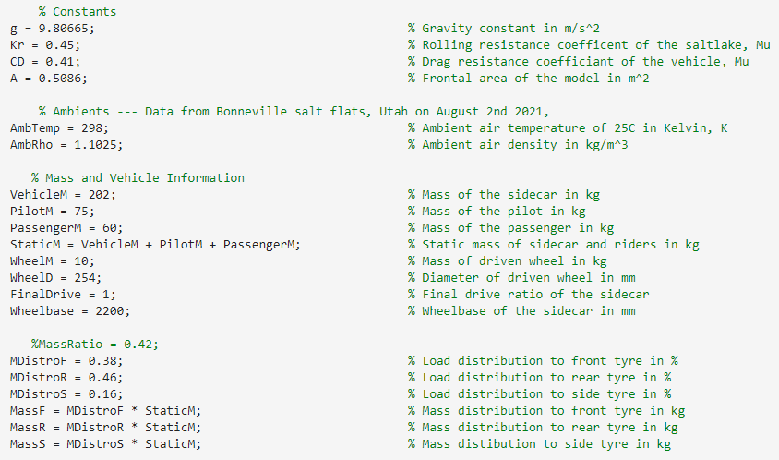
Methodology
2. Constants
A vehicle's original weight is 270 kilograms, of which 68 kilograms are composed of its engine and gearbox.
The coefficient of rolling resistance and drag coefficient are specific to the Bonneville salt flats […,6].
Based on the physical measurements obtained in the UWTD workshop, a total area measurement was conducted with SolidWorks software [7].
Three identical tyres are mounted on the sidecar with dimensions of 10/21-14 and a diameter of 254mm, as calculated by source [8].
Figure 2: Condition and vehicle parameters listed in MATLAB.
Notes:
To identify what information is available for this project, constants are reviewed.
It is assumed that the weather conditions are no wind and 25 degrees Celsius. Slat flats differ by 90% from the international air density standard in terms of density altitude. In view of the fact that there will be no passengers on board, the ballast option is adopted. The wheel mass is measured manually as tyre wear is not considered. Despite the fact that the final drive ratio may not be true in reality, no further information has been located regarding this issue.

Slide 5
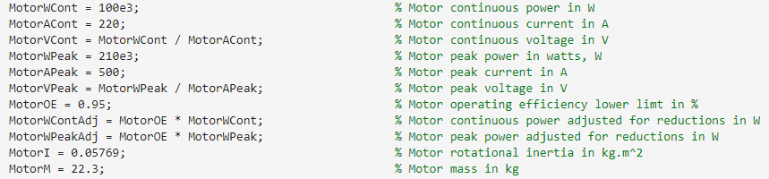
Methodology
3. Electric Motor
An Emrax 268 medium voltage motor must be used, which is a compact axial flux permanent magnet synchronous electric motor. The Emrax 268 motor is available in three different cooling options: Air Cooled (AC), Liquid Cooled (LC), and Combined Cooled (CC) [2]. The LC type motor has an IP65 rating [9] (ingress protection) which means it would be more suitable for the selected environment since it will prevent dust ingress for 2-8 hours and will be able to withstand jets of water for three minutes.
Figure 3: Liquid Cooled (LC) Emrax 268 Medium Voltage Electric Motor parameters listed in MATLAB

Slide 6
Methodology
4. Cooling System
Table 1: Decision matrix for selecting the right liquid cooling system [1].
 | Two-phase Liquid Immersion Cooling | Two-phase Liquid Immersion Cooling | Heat exchanger & Pump
Structural Complexity | 4 | 2 | 10
Installation Cost | 2 | 3 | 8
Cooling Efficiency | 9 | 10 | 10
High-density Performance | 8 | 10 | 8
Reliability | 7 | 10 | 6
Deployment Flexibility | 8 | 10 | 10
Weight | 5 | 7 | 6
Space | 7 | 9 | 8
Total | 50 | 61 | 66
Notes:
According to …[10], liquid cooling systems for electric motors can be divided into three types:
-One phase immersion.
-Two phase immersion.
-Heat exchangers and pumps.
A single phase immersion cooling system and a dual phase immersion cooling system both involve the motor being fully immersed in a tank containing nonconductive liquid. Meanwhile, a heat exchanger and an electric pump cooling system requires a radiator to cool the medium, an electric coolant pump to circulate coolant, as well as appropriate mounting brackets, fittings, and hoses. Due to practical considerations, it was decided that the Emrax 268 motor would make use of an electric coolant pump with a minimum flow capability of 6 litres per minute and a temperature rating of 45°C.
Regardless, a decision matrix is used to evaluate and prioritize options.
A heat exchanger and electric pump cooling system will ensure that the motor remains within a safe operating temperature throughout the record attempt, according to investigation. An electric coolant pump, the Bosch PAD2, is proposed for use in the cooling system.

Slide 7
Methodology
5. Energy Storage System
The primary source of power for almost all electric vehicles and hybrids is the lithium-ion battery, also known as the Li-I battery [11]. In addition, ultracapacitors do not rely on chemical reactions and can operate safely at temperatures up to 85°C as there is no risk of thermal runaway.
Table 2: Decision matrix for selecting the right electrical storage system [11].
 | Lead Acid Batteries | Li-ion Batteries | Ultracapacitors
Cycle | 5 | 5 | 10
Self-Discharge Rate | 3 | 3 | 10
Voltage | 7 | 10 | 2
Energy Density | 8 | 10 | 1
Power Density | 4 | 7 | 9
Weight | 1 | 8 | 10
Cost | 10 | 4 | 7
Total | 38 | 47 | 49
Notes:
According to table 2, lithium batteries and ultracapacitors are relatively close in terms of their total scores, but they differ considerably in terms of their specifications. A kinetic regenerative system (KERS) would have been greatly enhanced by ultracapacitors due to their fast charging capabilities. Due to the fact that the battery pack can be entirely changed after the first run, a KERS will not be integrated into the F1 sidecar. As the run takes approximately a minute and a half and the motor's peak power is maintained for approximately two minutes, capacitors could be used in the beginning until the vehicle reaches speed and then the motor to switch over to lithium batteries.

Slide 8
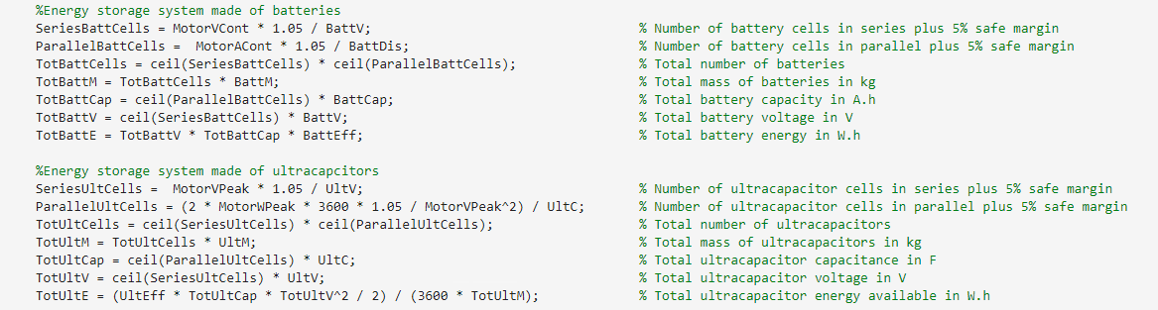
Results
1. Sizing Energy Storage Pack
In this project, Samsung INR18650-35E batteries are selected since they offer a high-spec nominal capacity and voltage, which explains their widespread use in electric vehicles today. Because of its high cost-to-capacitance ratio, the ultracapacitor is a Maxxlell BCAP1200.
Figure 4: Energy storage sizing calculations in MATLAB
Notes:
Ultracapacitors will be discharged at the beginning of the run, from peak motor power, and must be able to comply with the required voltage and power of 420 volts and 210 kW respectively. Based on the formulas presented on Figure 4, the total number of cells is 1312 and the total mass that the vehicle must carry is 34.12 kilograms.
In the event that the ultracapitors reach their last 5% of energy, the electric controller will turn the motor on continuous power and will start drawing energy from a lithium battery pack. The selected side car requires 3856 battery cells, which is equivalent to 186.3 kilograms of batteries, in order to power a continuous motor of 100kW.

Slide 9
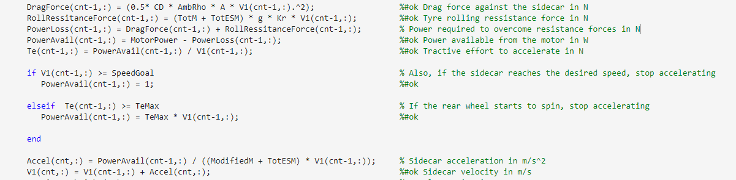
Results
2. Main Calculation
Effective moment of inertia of the wheels is calculated based on mass and diameter by using the formula provided in [22]. In addition, the aerodynamic drag force and rolling resistance force are calculated as shown in figure 5. Consequently, some energy is lost before the vehicle even begins to move. Bigger energy storage packs would cause more weight and hence more energy losses It is critical to achieve a balance between the two.
Figure 5: Energy losses, tractive effort and acceleration calculations in MATLAB
Notes:
The MATLAB code was initially run only with batteries on continuous power, and the vehicle was not able to achieve the land speed record due to its heavy mass. The experiment was then repeated, but the motor operated at peak power, causing the vehicle to beat the record, but the time it took was unreasonable due to the risk of overheating the motor.

Slide 10
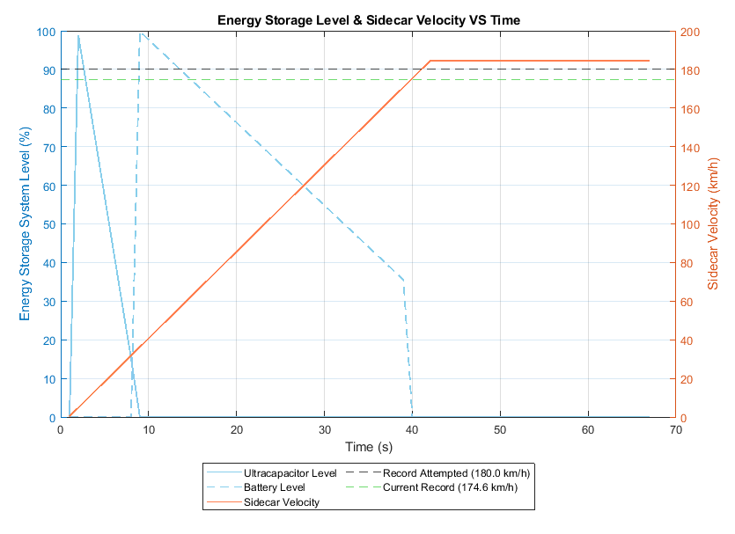
Results
3. Theoretical land speed record
Figure 6: Energy storage levels and sidecar theoretical velocity
Notes:
Certain constraints are established when calculating the tractive effort of the vehicle. In order to avoid rear tyre spin, for example, the motor will stop supplying additional power when the tractive effort exceeds the traction force provided by the rear tyre. As a result, the velocity profile on figure 6 has a linear shape. When the ultracapacitor is discharged, the motor should switch to continuous power, resulting in a slight drop in power after the first 8 seconds. Upon reaching the desired speed, the motor attempts to maintain its power for 1 mile. In theory, if the motor continues to provide power, the vehicle will reach a much higher speed, but overheating is a risk, so the second attempt has failed.
A limitation of this MATLAB model is the way the battery level was calculated. When the vehicle reaches a constant velocity, the model thinks it has stopped because the resistance forces stay the same but in reality the motor still consumes enerfy over time. As the batteries are calculated to last for approximately four minutes, figure 6 is not realistic in this regard.

Slide 11
Conclusions
An ICE F1 sidecar has been successfully converted into an electric vehicle and has managed to beat the land speed record on theory by approximately 6 km/h over one mile. According to the study, the ground was assumed to be perfectly flat and the wind was assumed to be imperceptible, which is not accurate. It was stated that batteries will need to be replaced after the first run, but from a cost-effective perspective, this is not a good strategy. In this case, it would be easier to recharge them and lose some efficiency, but the chances of still beating the record are still high.

Slide 12
Conclusions
1] “Home | FIM.” https://www.fim-moto.com/en/ (accessed Dec. 11, 2022).
[2] “Sporting Appendices: 1. Provisional Course/Track Map 2. Rider Entry Application form-Short distance 3. Rider Entry Application form-Long distance 4. Template Timing Sheet for results 2.20.”
[3] “Results - World records.” https://results.fim.ch/wrecord/wrframe?idwrc=109 (accessed Dec. 11, 2022).
[4] “EU l support@emrax.com l +386 82053853 EMRAX 268 High Voltage EMRAX 268 Medium Voltage EMRAX 268 Low Voltage AC = Air cooled LC = Liquid cooled CC = Combined cooled (Air + liquid)”.
[5] BorgWarner, “Explore our Technologies AC Motor Controller Gen4 Size 10,” 2016. [6] “Axair-fans-IP-guide.jpg (900×1266).” https://www.axair-fans.co.uk/wp-content/uploads/2022/01/Axair-fans-IP-guide.jpg (accessed Dec. 11, 2022).
[7] “What is Peak Power? - Sunpower UK.” https://www.sunpower-uk.com/glossary/what-is-peak-power/ (accessed Dec. 11, 2022). [8] “Two-phase and Single-phase Liquid Immersion Cooling - GIGABYTE Global.” https://www.gigabyte.com/Article/two-phase-and-single-phase-liquid-immersion-cooling (accessed Dec. 11, 2022).
[9] “PAD2 electric coolant pump.” https://www.bosch-mobility-solutions.com/en/solutions/pumps/electrical-coolant-pump-pad2/ (accessed Dec. 11, 2022). [10] “Extra-large liquid cooler for gokart, atv and bikes.” https://evea-kartmasters.fr/en/radiators-and-fans/868-240mm-radiator-for-liquid-cooling-of-electric-motors.html (accessed Dec. 11, 2022).
[11] “LS Materials Ultracapacitor Alternatives to Maxwell | RELL Power.” https://www.rellpower.com/manufacturers/ls-materials/ultracapacitor_alternatives_maxwell/ (accessed Dec. 11, 2022). [13] “Setting a Land Speed Record with a Sidecar Motorcycle - IEEE Spectrum.” https://spectrum.ieee.org/setting-a-land-speed-record-with-a-sidecar-motorcycle (accessed Dec. 11, 2022).

