Slide 1
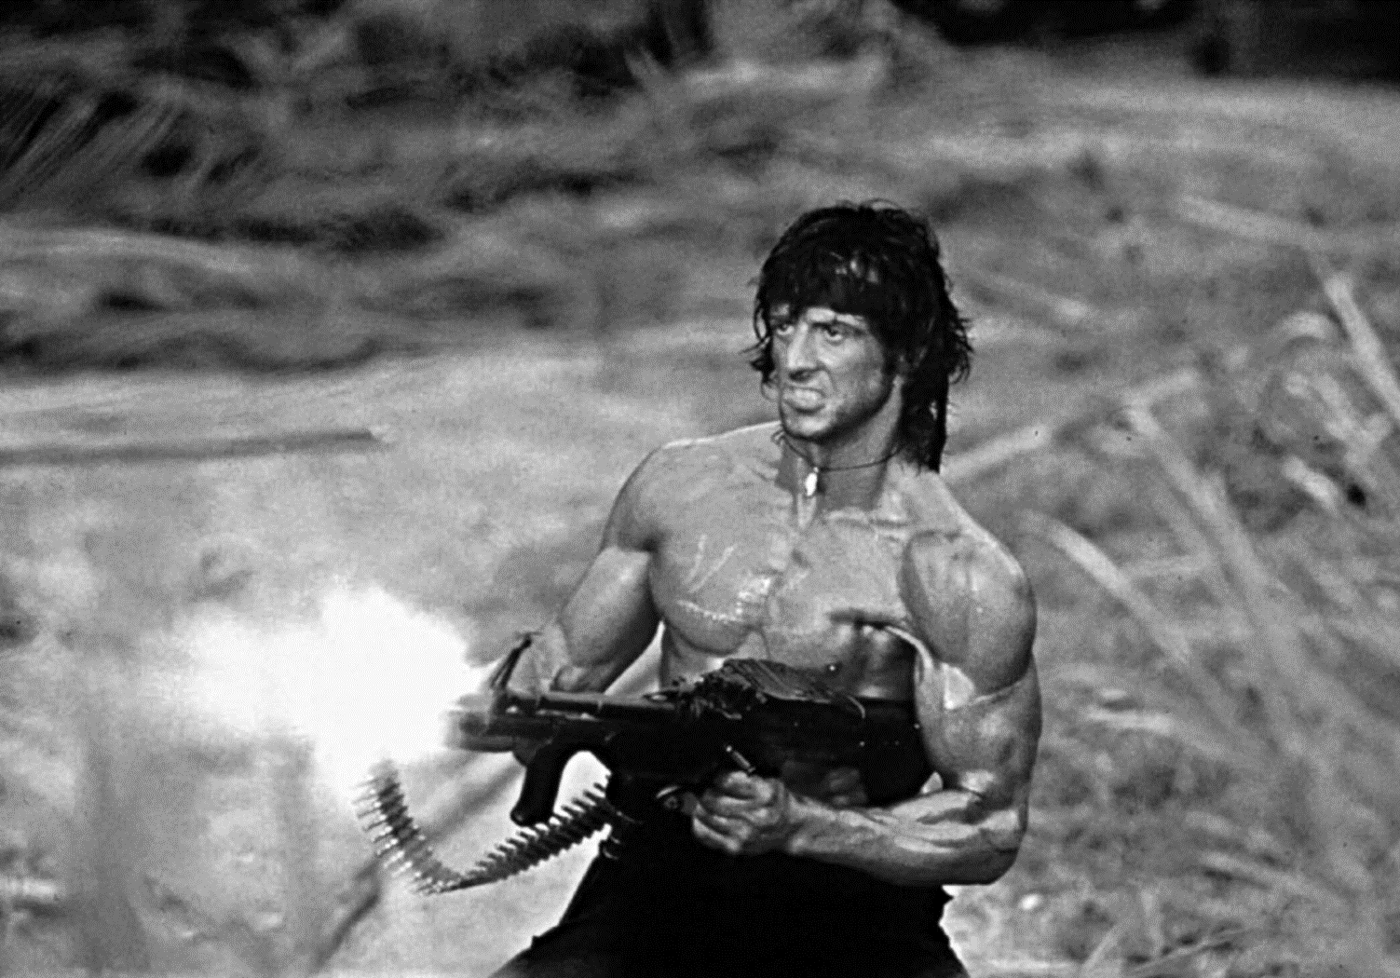
Week 2 Tuesday: Hollywood in the 1980s
Hours 2–3 – Hard Bodies: The Reaganite Action Hero

Slide 2
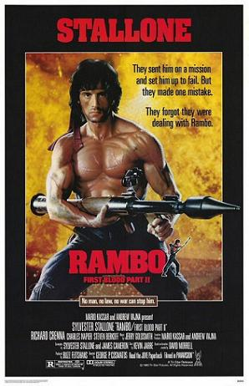
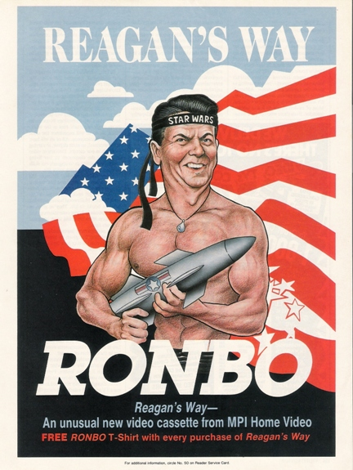
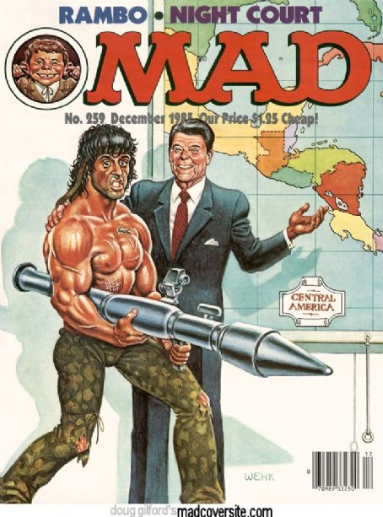
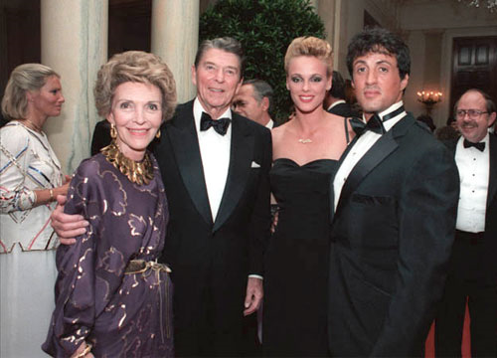
Ronbo
‘Do we get to win this time?’
Mad magazine cover, December 1985; satirical advert, 1986; President and Nancy Reagan posing with Sylvester Stallone and Brigitte Nielsen, October 1985

Slide 3
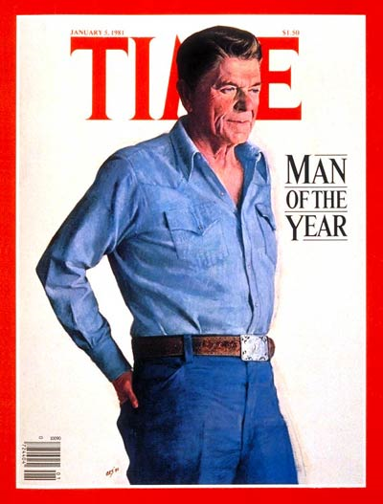
Reaganite Masculity
“The nation sought a fantasy to redeem its manhood, and it would find no better ringmaster than the great fabulist himself, Ronald Reagan … [Reagan=] a full-blown remake of post-war masculine history … a throwback to an old-fashioned manhood, splitting logs on his ranch, espousing small-town virtues, displaying a stoical and self-deprecating humour … the fantasy elder come to lead his sons in the triumphal battle against the Evil Empire.”
Susan Faludi, Stiffed: The Betrayal of Modern Man (London: Chatto & Windus, 1999), pp. 360–362, 407.
Notes:
It follows, too, that Ronald Reagan can be seen as an appropriate paterfamilias for eighties America, denoting, in the words of Susan Faludi, “a throwback to an old-fashioned manhood, splitting longs on his ranch, espousing small-town virtues … the fantasy elder come to lead his sons in the triumphal battle against the Evil Empire.”

Slide 4
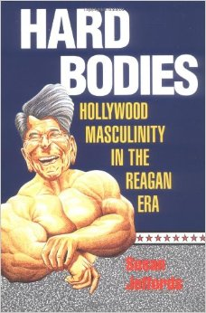
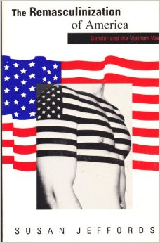
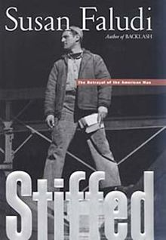
Eighties Masculinity
Faludi’s discussion of Reagan part of a broader theorisation of a late 20th-century ‘crisis in masculinity’
Susan Jeffords posits that the United States underwent a process of remasculinization post the Vietnam War, with Vietnam-themed literature and films betraying an obsession with male homo-sociality and father-son relationships, and latent hostility to women and perceived ‘feminine’ norms, values and attributes
Notes:
Indeed, the gender politics of representations the Reagan era more generally– have attracted extensive commentary from feminist critics – of whom I am going to speak about two: Susan Jeffords and Susan Faludi.
Perhaps the most influential early work in the field, Susan Jeffords’ 1989 book The Remasculinization of America: Gender and the Vietnam War, as its title implies, argued that the post-Vietnam War period saw a hardening of male gender norms in US culture and politics – citing representations of the war in film, literature and other media as constitutive elements of this.
For Jeffords, Vietnam-themed narratives exhibit an acute preoccupation with male homo-sociality and father-son relationships, as well as latent hostility to women and perceived ‘feminine’ attributes.
As evidence here, one might point to the recurrence of scenes of violence directed against women – and most often Vietnamese women at that – in Vietnam War films, or the peculiar claim by Charlie Sheen’s character Chris in Platoon that he was born of “two fathers.”

Slide 5
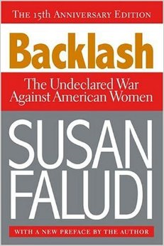
Backlash against Second Wave Feminism
“To be a woman in America at the close of the 20th century – what good fortune. The barricades have fallen, politicians assure us. Women have ‘made it,’ Madison Avenue cheers. Women’s fight for equality has ‘largely been won,’ Time announces. And yet ...
“Behind this celebration of the American woman's victory, behind the news, cheerfully and endlessly repeated, that the struggle for women's rights is won, another message flashes. You may be free and equal now, it says to women, but you have never been more miserable.
“This bulletin of despair is posted everywhere – at the newsstand, on the TV set, at the movies, in advertisements, doctors’ offices and academic journals. Even founding feminist Betty Friedan has been spreading the word: she warns that women now suffer from a new identity crisis and new ‘problems that have no name.’”
Susan Faludi, Backlash: The Undeclared War Against American Women (London: Vintage, 1993 [1991]), p. 1

Slide 6
Backlash against Second Wave Feminism
“The prevailing wisdom of the past decade has supported one, and only one, answer to this riddle: it must be all that equality that's causing all that pain. Women are unhappy precisely because they are free. Women are enslaved by their own liberation.
“ … Publications from the New York Times to Vanity Fair to the Nation have issued a steady stream of indictments against the women's movement, with such headlines as ‘when feminism failed’ or ‘the awful truth about women's lib.’
“ … In the Reagan and Bush years, government officials have needed no prompting to endorse this thesis. Reagan spokeswoman Faith Whittlesey declared feminism a ‘straitjacket’ for women, in the White House's only policy speech on the status of the American female population, entitled ‘Radical Feminism in Retreat.’”
Susan Faludi, Backlash: The Undeclared War Against American Women (London: Vintage, 1993 [1991]), pp. 2, 4.

Slide 7
Eighties Masculinity
Jeffords’ analysis is that the remasculinization of America stemmed from a crisis of masculinity prompted (in part) by male veterans of the Vietnam War being denied the laurels of victory afforded to previous generations of US servicemen
Susan Faludi links this to wider uncertainties about manhood in late-20th-century US: decline of (‘masculine’) ‘hard’ labour; rise of (‘feminine’) service industries
Notes:
This line of argument risks downplaying another contribution of the critiques forwarded by Faludi et al, however.
Whilst the male images presented in Vietnam-themed films and literature may seem to express an outward confidence and assuredness about traditional gender norms, Faludi and Jeffords suggest the contrary: PAUSE rather, that they actually betray and uncertainty about the role of men in late twentieth-century America – that they are expressions of a so-called crisis in masculinity.
Jeffords sees this crisis as stemming from the perceived affront to American masculinity posed by servicemen’s defeat in the Vietnam War; PAUSE whereas Faludi links it to more broad-ranging social and economic changes – specifically the decline of supposedly ‘masculine’ forms of ‘hard’ labour in the United States, and the reorientation of its economy towards service sector industries onetime figured to be a female preserve.
Significantly, in Faludi’s eyes the disturbance of the material, socioeconomic basis of men’s lofty position within patriarchy gave rise to a cultural redefinition of masculinity which exaggerated the surface signifiers of manhood.

Slide 8
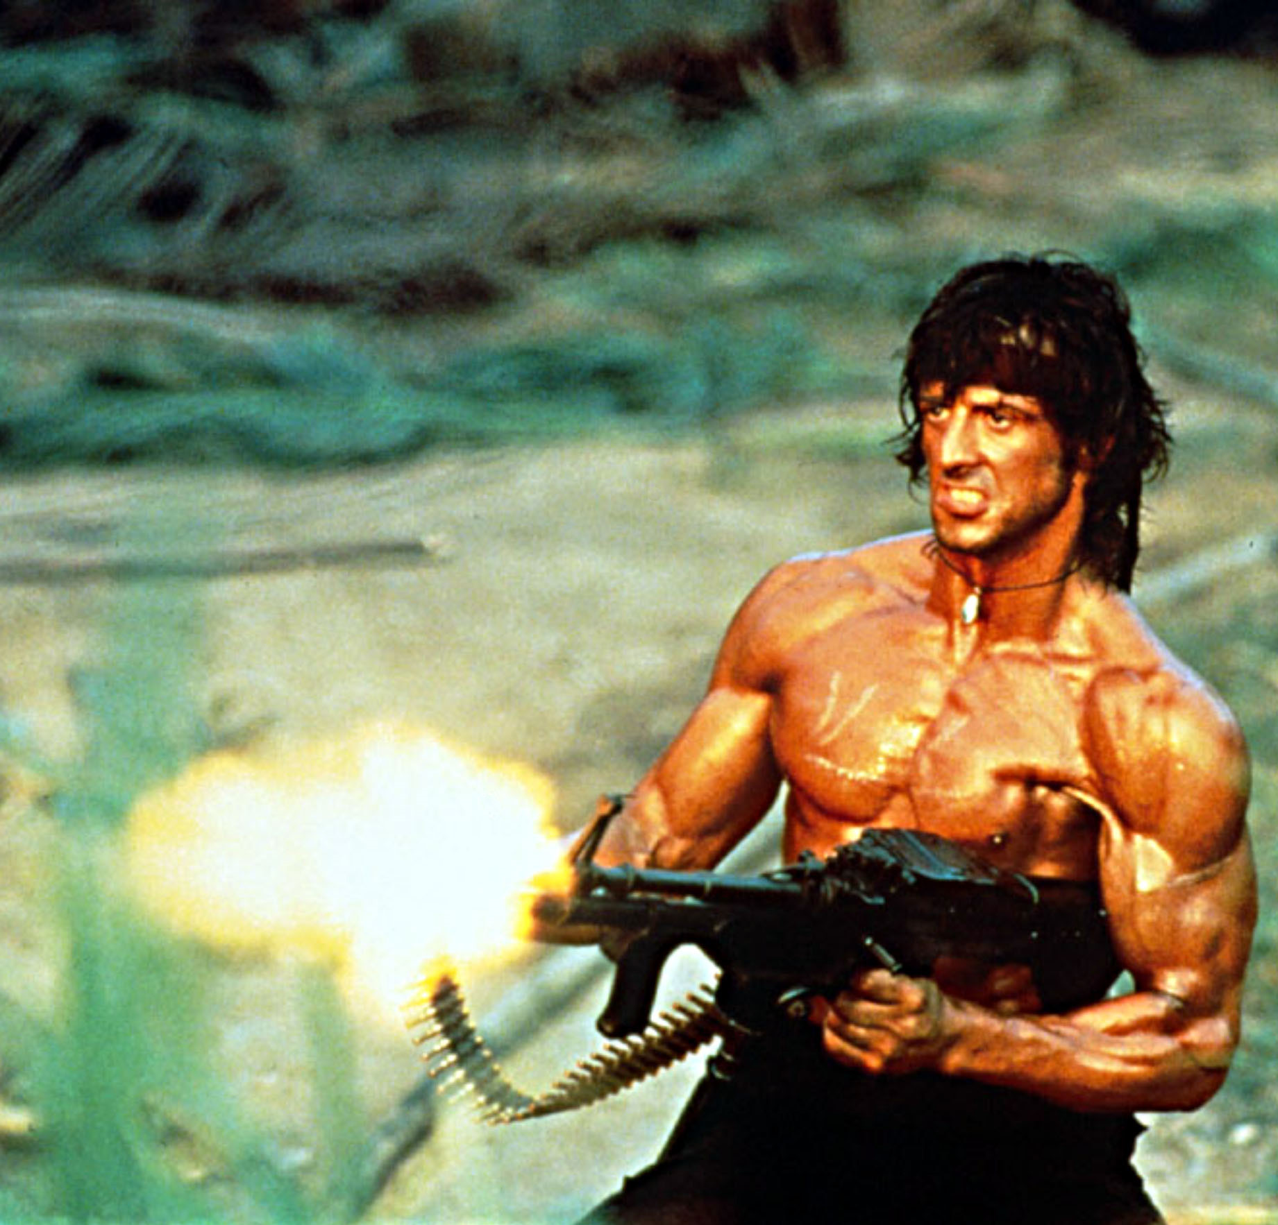
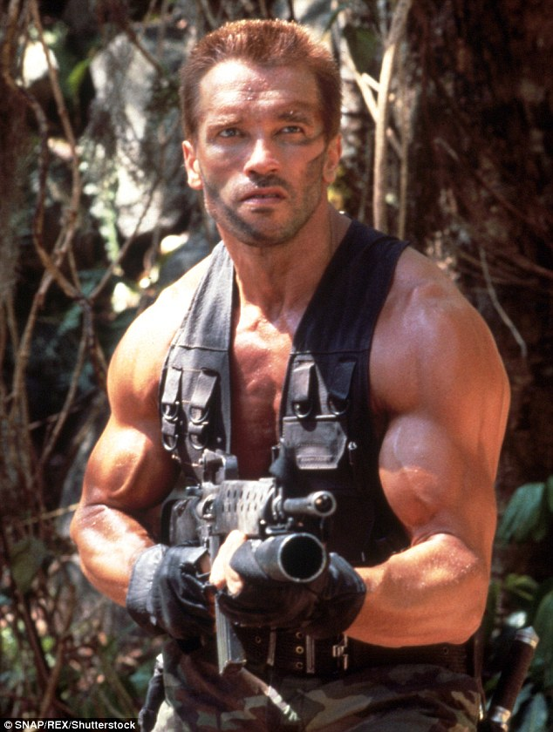
Eighties Masculinity
“The ordinary man … knows he can’t be Arnold Schwarzenegger. Nonetheless, [ornamental] culture reshapes his sense of manhood by telling him that masculinity is something to drape over the body, not drawn from inner resources … What poses for the essence of masculinity is being extracted and bottled and sold back to men.”
Faludi, pp. 34–35
Notes:
The image of masculinity embodied by action heroes like John Rambo adds to Faludi’s point here.
Faludi argues that the movie personae of a Sylvester Stallone or an Arnold Schwarzenegger helped “reshape manhood” in 1980s, exposing it as be “something to drape over the body, not drawn from inner resources’
In Hollywood movies and other media, she continues “what poses for the essence of masculinity is being extracted, bottled and sold back to men.”
Following this line of thinking, films like First Blood Part II are less the celebration of real male bodies, than the fetishization of a cartoon-like exaggeration; to use Faludi’s lexicon, Rambo’s rippling biceps and phallic weaponry promote a consumable, “ornamental” masculinity

Slide 9
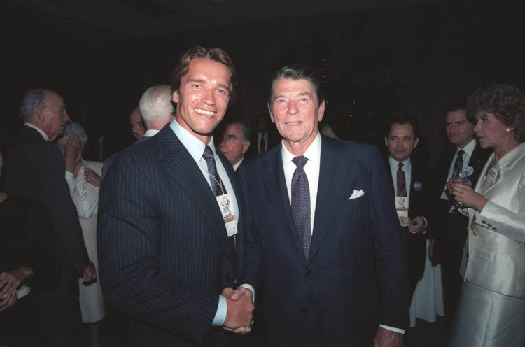
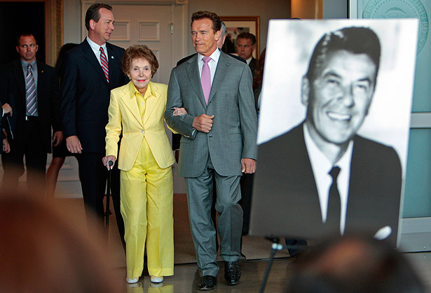
Eighties Masculinity
Arnold Schwarzenegger with Nancy Reagan at signing of bill to institute State of California ‘Ronald Reagan Day,’ 2010;
Notes:
If all this seems a bit of a stretch from my earlier discussion of Reagan, one only needs to recall that Arnold Schwarnegger did in fact go on to be his successor in the governor’s house in California.

Slide 10
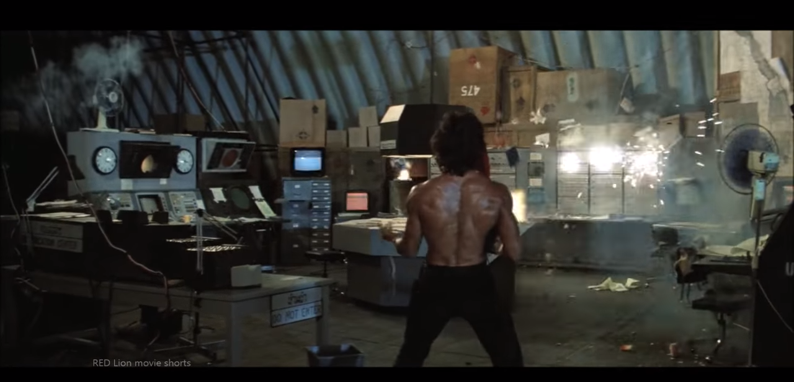
Rambo vs. State Bureaucracy (and the Service Economy)

Slide 11
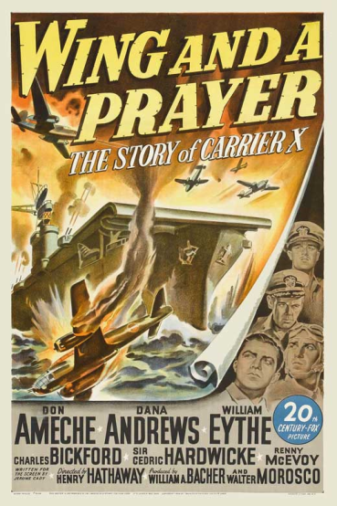
A Life in Movies
Reagan diagnosed with Alzheimer’s disease in 1994; speculation he was showing signs of dementia while still in office
Reagan had a highly complex psychology and a selective memory e.g. rewriting his first wife, Jane Wyman, out of his life-story received (just 29 words in a 748-page autobiography); once introduced himself to his own son, Michael at a high school graduation ceremony
Reagan known exponent of phenomenon known as “source amnesia”: misattribution of details derived from external sources and integrating them into one’s own biography
  In the 1980 Presidential campaign, Reagan told a story about giving a medal to a WWII fighter pilot that actually matched the plot of the film Wing and a Prayer (1944)

