Slide 1


The role and importance of quality service, hospitality, and guest services within the hotel industry
Andreea Balanescu
Student ID:2211130
Hospitality and Guest Services BMIH4003
Lecturer: Kathryn Flynn
Date: 10.2.2023

Slide 2

Content table
Introduction Marriott International -The Ritz-Carlton
The Ritz-Carlton Hotel’s main consumers
Nature, scope and role of the guest services and facilities
Role and function of guest services
Importance of hospitality
Reference list
2

Slide 3


Introduction
Marriott International owns 30 brands with more than 8000 hotels all around 139 countries offering memories and unique treatment to their guests, one of their luxury brands is The Ritz-Carlton( Marriott International, 2023). The company’s inspiration comes from Cezar Ritz who gave a great guest experience caring for the customers, perfectionism and passion for excellence, the king of hoteliers (Michelli, 2008, p.17,18,19).
Albert Keller was the one who brought and franchise the name The Ritz-Carlton Investing Company in the United States, starting 1900’s with an impressive history of creating luxury hotels that expand quickly and in 1998 Marriott International purchase the brand, that continue to grow (The Ritz-Carlton Hotel Company, 2022). As an example, I choose to present one of The Ritz-Carlton destinations in Indonesia Bali.
The Ritz-Carlton
3

Slide 4
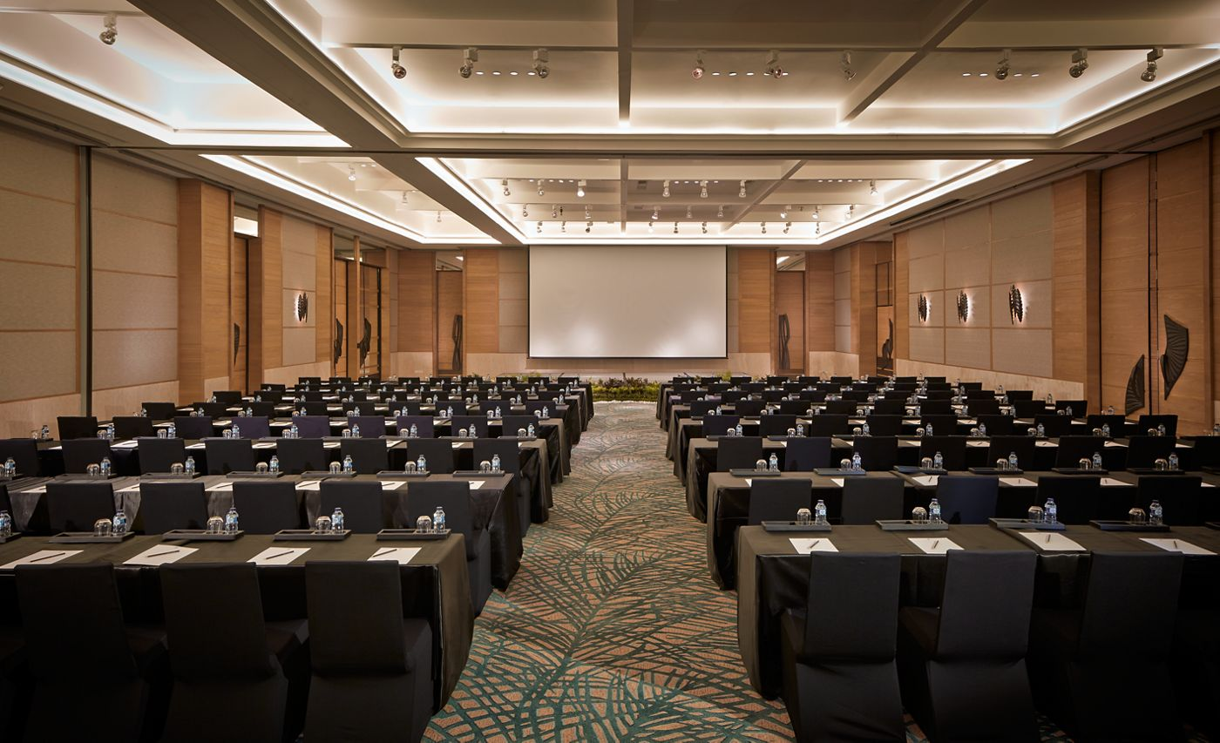


Main consumers
The Ritz-Carlton Motto: “We are Ladies and Gentlemen serving Ladies and Gentlemen”
Experience is what guests are looking for in our days, looking for adventures, excitement, and inspiring the guests to feel like no other better place to be (Solomon, 2016).
Perfect for couples, honeymoons, weddings and memorable events
For all the guests who like a unique experience for the upper and middle class, best for business, meetings, and events.
Ritz Kids- for a memorable experience like exploring the sea life through a glass-bottomed boat, cooking and hiking developing kids' curiosity to the maximum, aquatic - Little mermaid, Kite activities, glamping (The Ritz –Carlton, Bali, 2022).
Luxury family-friendly environment vacation.

Slide 5
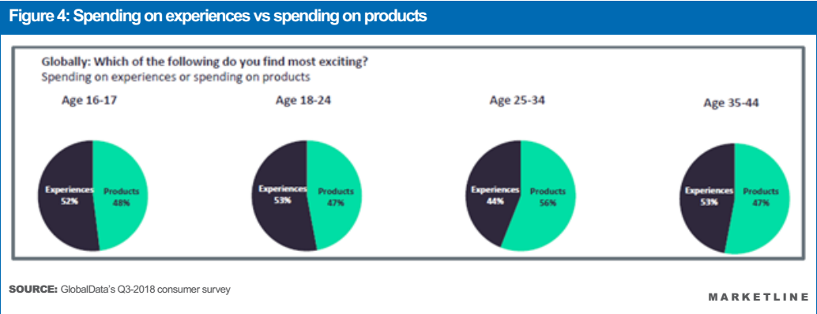
Luxury hotels attract the most important customers, and every hotel is looking for differentiation, in our time people are interested in experience more than product, especially the younger generation, hotels must focus on their needs( MarketLine, 2019, p.10).
5

Slide 6

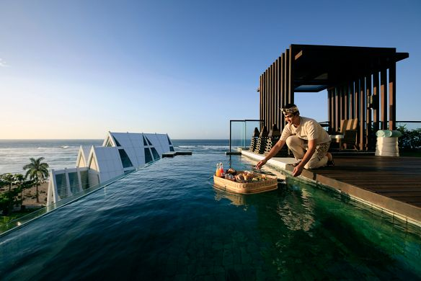

Guest service and facilities
Delivering quality service is the most important for the success of a hotel, guests are those who increase brand loyalty, they not only pay for the service they buy memories, meal experiences, and customer satisfaction (Cousins and Weeks, 2020).
Looking at the luxury resort in Bali discover a culinary experience, room service, floating breakfast, private chef, and a luxury experience prepared by an award-winning chef that will make it a feast for the senses (The Ritz- Carlton, Bali, 2022).
The hotel uses a tracking system for the guest preferences, customized for everyone (Mystique system), delivering a good experience wherever around the world, they listen and observe the guest preferences, tracking each detail, the customer service at Ritz-Carlton gives experience tracking along with preparation and execution, increasing guest loyalty(Solomon,2016).
6

Slide 7

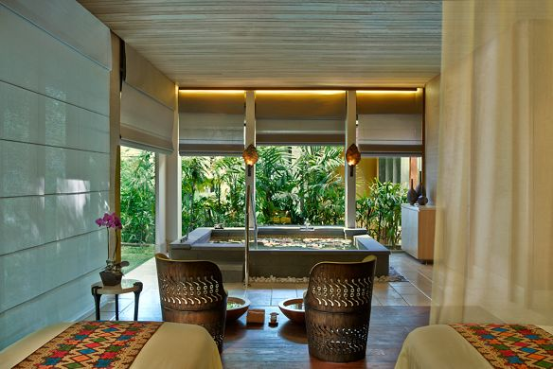

Luxury and hotel resorts focus on colour and touch in the guest room to create a good mood and to please the senses, the interaction between employees and customers is important for quality service, personalized service and modern offerings (Baek, Choe and Ok, (2020).
YOGA
SPA
FITNESS CENTER
HIDRO-VITAL POOL
SPA TREATMENTS
PERSONAL BUTLER SERVICE
SOUL PURIFICATION RITUAL
CONCIERGE SERVICE
PRIVATE POOL, BATHTUBS
SAUNA
BABYSITTING /CHILDCARE
7

Slide 8

Guest satisfaction leads to guest loyalty and profit, the service is almost intangible, each person can have his requests, Ritz–Carlton employees are empowered to spend £2000 per day for each guest to resolve a guest problem without the manager’s permission, corporate philosophy, focus on guests” Spirit to serve” (Walker, 2021, p.34-39).
The Ritz –Carlton Hotel Company received the most important awards in the hospitality industry, the best luxury hotel chain the first and only to win Malcolm Baldrige National Quality Award, and the first service company won two times 1999 and 1992 (Walker, 2021, p.78).
8

Slide 9
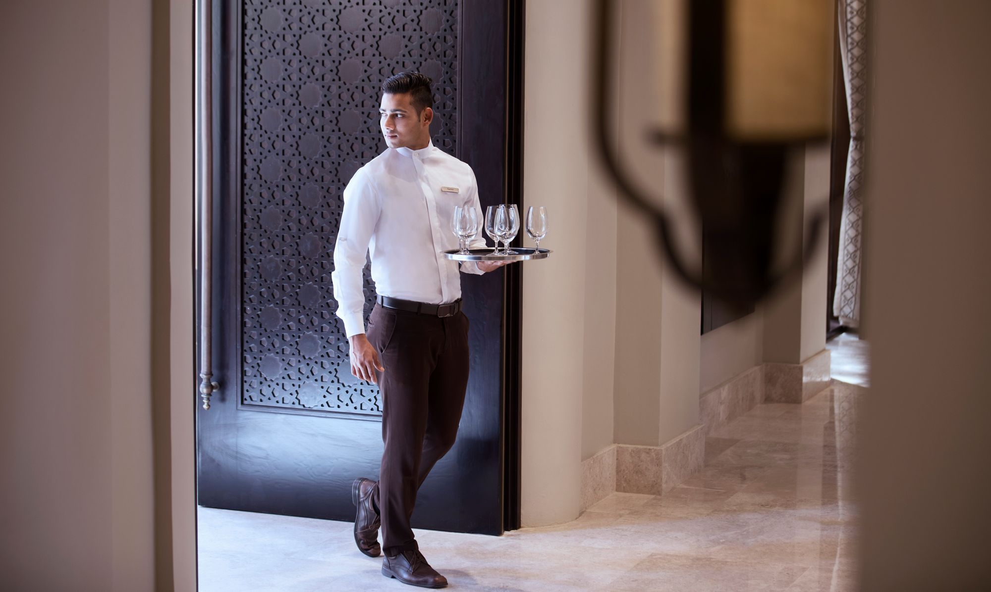

GOLD STANDARDS:
The Credo
Motto
Three Steps of Service
Service Values
The 6th Diamond
The Employee Promise
The Ritz-Carlton offer to their Ladies and Gentlemen a warm greeting using their name and built a strong relationship with their guests, the most important resource(The Ritz-Carlton, 2022).
The gold standards define the company, make a big difference from competitors, caring along a credo card, the most important mission is delivering care and comfort for guests, the best experience to deliver service excellence, The motto gives enormousness esteem “We are Ladies and Gentlemen serving Ladies and Gentlemen”, respect of service and culture, escorting the guests an overuse the word “My pleasure” focusing on each individual guest, service values and emotional engagement (mystique), empower through thrust placing guests needs above their own (Michelli, 2008).
9
Notes:
In one letter received by Simon Copper(Ritz-Carlton President), a customer that wanted to offer gratitude for the employee, the guest took the elevator with one employee pressed the button of 6th floor and the employee press none , instead of getting of the employee said “Have a nice day” and the guest asking where is he going the employee said he goes back to 5th floor (Michelli, 2008, p.63).

Slide 10



Anticipating the needs and tracking guest preferences, a database can reveal historical guests, able to create a special experience, customized, detail-oriented delivering the WOW experience, emotional connection, memorable service, wow stories involving customer service excellence, value for guests (Michelli, 2008).
People with a service spirit can make a memorable experience, people travel for a lot of reasons and is necessary for a lot of professions to meet their needs and wants ( Walker, 2017, p.47).
The hospitality industry is in a continuum change from service to e-service where the technology takes part in a hyper-personalised system, customer relationship management, guest mobile technology and providing services depending on guest profile ( Gustavo, 2022).
10
Notes:
A guest at the San Francisco property similarly shares how personal service helped him not only stand out from the crowd but also offered him an extended sense of belonging and comfort. “I travel for business and have stayed all over the world. When I was sent to San Francisco for a work assignment, I was happy but not excited to be away from the East Coast for 30 days. In essence, the Ritz-Carlton was going to be my home for a month. I had a car pick me up at the airport, and when I walked in, two employees welcomed me by name and said they were excited to have me here. How did they know me?” The guest was particularly affected by the genuine concern demonstrated by employees, including one who met him at the door and handed him his room key and took him directly to his room without a stop at the front desk. The guest went on to note that advanced consideration of his needs gave him the assurance he would be well cared for. “When I entered my room, I found they had stocked everything I would ever need. Since I was staying a month, they did research and found out my favorite snacks, magazines, movies, and music. Everything was there for me. I had a bowl of fruit (a favorite snack of mine) and a box of chocolates with my name spelled out on the pieces. They even created business cards for me using the Ritz-Carlton address,
Michelli, Joseph A.. The New Gold Standard: 5 Leadership Principles for Creating a Legendary Customer Experience Courtesy of the Ritz-Carlton Hotel Company : 5 Leadership Principles for Creating a Legendary Customer Experience Courtesy of the Ritz-Carlton Hotel Company, McGraw-Hill Education, 2008.

Slide 11

Summary
Importance of hospitality
Future of hospitality: The Ritz-Carlton uses emotional intelligence (empathy, creative thinking) and artificial intelligence (data analytics) to provide individualized service, empowering staff to accommodate all requests from guests, and exceed expectations by understanding their needs and wants. Artificial Intelligence service quality increases customer loyalty and satisfaction (Wei and Prentice, 2022). Hotels strive to meet and exceed guests' expectations to better understand their value and gain a competitive advantage over rivals, promote quality excellence, quality service, emphasis on guests, core value, service standards providing an intangible experience.
11

Slide 12
Reference list:
Cousins, J. and Weekes, S. (2020) Food and beverage service. 10th edition. London: Hodder Education Group.
Baek, J., Choe, Y. and Ok, C.M. (2020) ‘Determinants of hotel guests’ service experiences: an examination of differences between lifestyle and traditional hotels’, Journal of Hospitality Marketing & Management, 29(1), pp. 88–105. doi:10.1080/19368623.2019.1580173.
ISPA, (2022) Images. Available at: https://www.ispasearch.net/emotional-intelligence/ (Accessed date: 2 February 2023).
Gustavo, N. (2022) Optimizing digital solutions for hyper-personalization in tourism and hospitality. Hershey, PA: IGI Global.
MarketLine, (2019) Hotel brand differentiation. Available at: https://advantage-marketline-com.ezproxy.uwtsd.ac.uk/Analysis/ViewasPDF/hotel-brand-differentiation-how-major-companies-are-using-an-array-of-brands-to-appeal-to-all-76970 (Accessed date 20 January 2023).
Marriot International (2023) About us. Available at: https://www.marriott.com/marriott/aboutmarriott.mi (Accessed date 30 January 2023).
Michelli, J.A. (2008) The new gold standard: 5 leadership principles for creating a legendary customer experience courtesy of the Ritz-Carlton Hotel Company. 1st edition. New York: McGraw-Hill.
Solomon, M. (2016) The heart of hospitality: great hotel and restaurant leaders share their secrets. First edition. New York: SelectBooks, Inc.
12

Slide 13
Reference list:
The Ritz-Carlton, Bali (2022) Images Available at: https://www.ritzcarlton.com/en/hotels/indonesia/bali/dining/experiences (Accessed date 22 January 2023).
The Ritz-Carlton, Bali (2022) Images. Available at: https://www.ritzcarlton.com/en/hotels/indonesia/bali/hotel-overview (Accessed date 22 January 2023).
The Ritz-Carlton Hotel Company (2022) Gold Standards. Available at: https://www.ritzcarlton.com/en/about/gold-standards (Accessed date 27 January 2023).
Walker, J.R. (2017) Introduction to hospitality. Seventh edition. Harlow: Pearson.
Walker, J.R. (2021) Introduction to hospitality. Eight, Global edition. Harlow, England: Pearson.
Wei, H. and Prentice, C. (2022) ‘Addressing service profit chain with artificial and emotional intelligence’, Journal of hospitality marketing & management, 31(6), pp. 730–756. Available at: https://doi.org/10.1080/19368623.2022.2058671.
13

Slide 14
Thank you
Andreea Balanescu​
2211130@student.uwtsd.ac.uk

