Slide 1
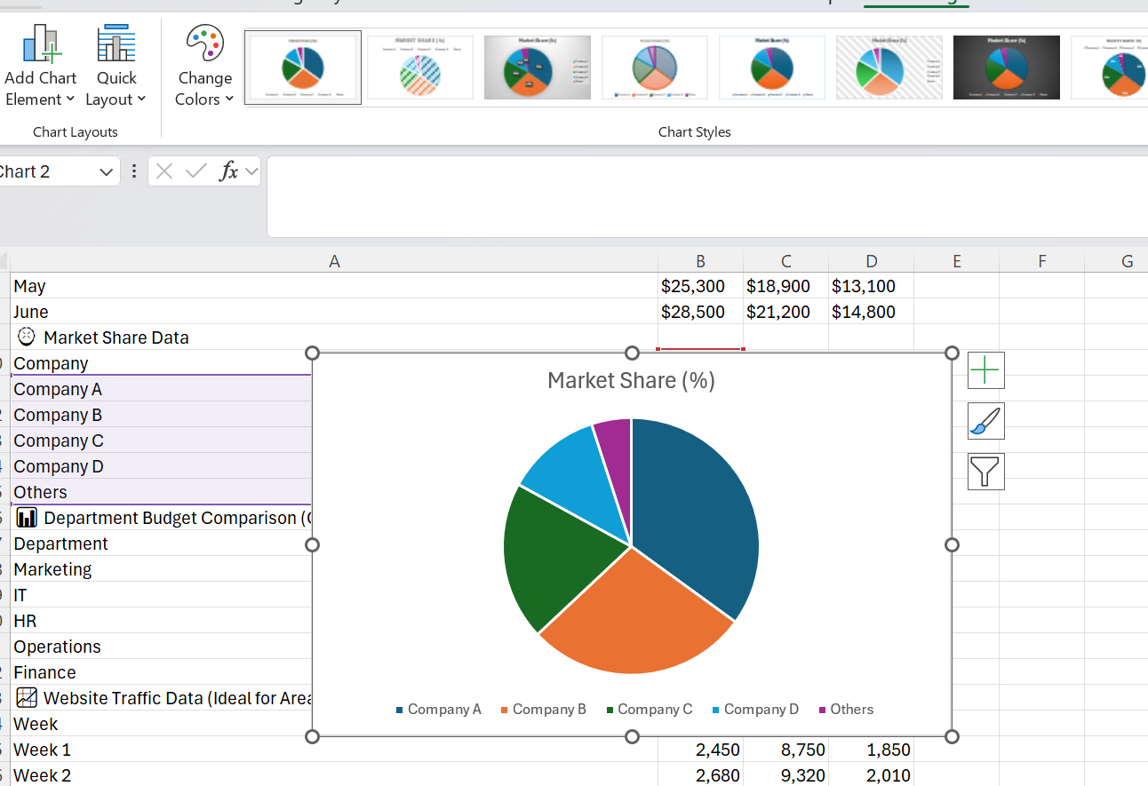
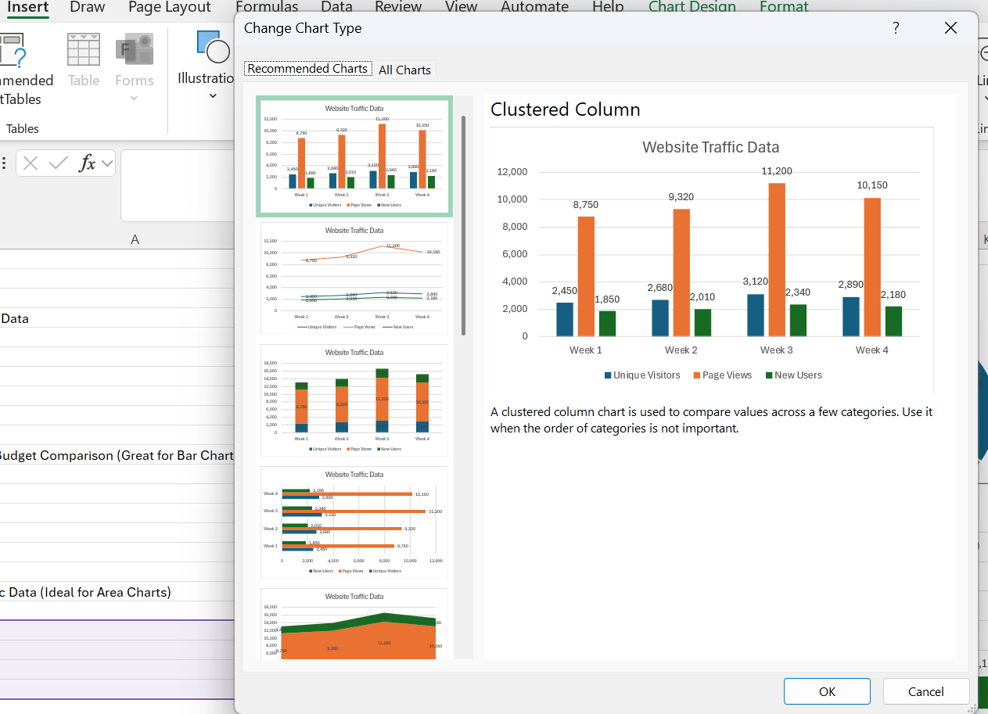
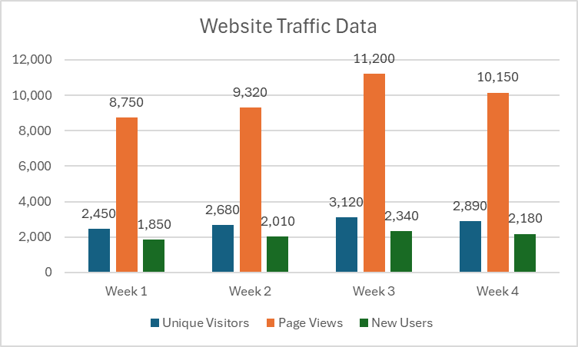
Digital Skills LCLM4002
📊 How to Create a Chart in Word
Transform your data into visual insights
Why Charts in Word?
Data is well represented through charts and presentations are quite exciting. When you introduce visuals in your documents, difficult information will be made more accessible to your audience. Here are just a few easy steps to get you up and running to be able to create professional charts in your own word documents without requiring the addition of a separate software.
Chart Tools Design & Format are customizable tabs
Pro Tips to Awesome Charts
To make charts efficiently, it is essential to keep a number of significant details in mind which may also enhance their efficacy and readability by a great margin. Remember to give your charts descriptive titles so that they can easily be recognized and comprehended by the viewer on what is being expressed. You must be consistent in using your color and this is very important especially when your chart must conform to the theme of your document or your branding standards.
Having the labels on your data easy to read and interpretable saves you confusion and keeps your audience in a position to read and understand what you are trying to say. The main form of chart selection is the key element of successful communication, thus, think of what your statistics says to choose the right one. It is important to remember that you can always double-click on any chart and jump back to the data editing mode, and right clicking gives you quicks access to most commonly used formatting options to customize a chart quickly and easily.
Go to Insert Tab
So open up your Word document, and make sure you see the ribbon menu, at the top of your screen. Next, you will have to select the tab that is labeled Insert, where all the tools used to insert several elements into your document are located such as charts, pictures, and other objects.
Tap Chart Icon
After you have opened the Insert ribbon, you should find the method to insert a graphic termed Chart button in the Illustrations group. This is the button specifically created to add a lots of different charts and graphs to your paper. The Illustrations group normally appears in the middle of Insert ribbon and consists of tools of visual objects.
Choose Type of Chart
It will pop up a dialog box that will offer you a wide range of chart types to choose from such as Column charts used in comparing value, Line charts to illustrate changes over a period, Pie charts to show the parts of a whole, Bar charts which are the horizontal comparison charts, and Area charts which are the cumulative types of charts. Pay attention to your data and choose what particular kind of chart is going to be the best way to inform your audience with these
Key In Your Data
Upon choosing your chart type, the excel will automatically open in an independent window or pane having sample data already filled. You will find that you must remove this place holder data and place your own in there by typing into the cells. Each row usually corresponds to a different piece of data and each column corresponds to different categories or time designations depending on what kind of a chart you are doing.
After entering your data, you may make your chart look prettier by using the Chart Tools that appear when you select your chart. These tools contain Design and Format tabs which would enable you to change the colors, implement various styles, add or edit titles, change layouts and refine other visual properties. Once you are done editing your chart, all you have to do is close the Excel application to take you back to your Word document, with the final chart in it.

