Slide 1
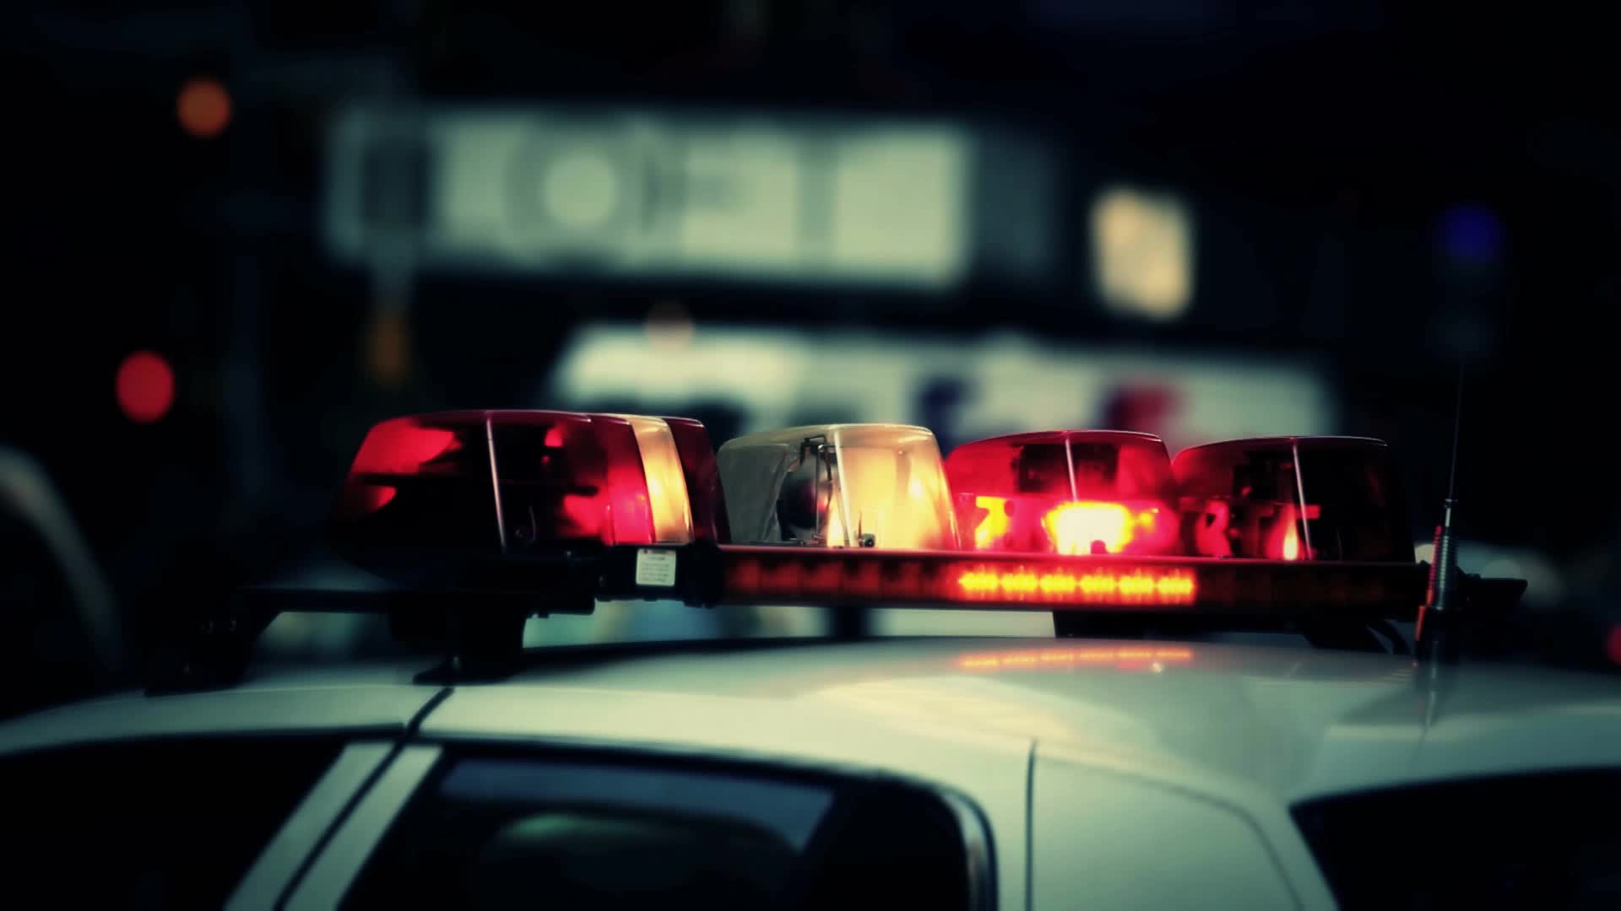
Roads Policing
Week 4 Part 2

Slide 2
Aims and Objectives
Identify the offence of ‘driving without due care and attention’ and ‘without reasonable consideration’ contrary to Section 3 Road Traffic Act 1988.
2. State the definition of the terms ‘driving’, ‘mechanically propelled vehicle’, ‘road’, and ‘public place’ in relation to the Road Traffic Act 1988.
3. Describe the terms ‘without due care and attention’, ‘without reasonable consideration’ including any defences.
4. Describe the offence of ‘wanton and furious driving’ contrary to Section 35 Offences Against the Person Act 1861. 5. Recognise the offence of ‘Causing death by careless driving whilst under the influence of drink/drugs contrary to Section 3A Road Traffic Act 1988.

Slide 3

Recap
What did we cover last week?
What is the definition of Section 1 RTC 1988 – Death by Dangerous Driving?

Slide 4
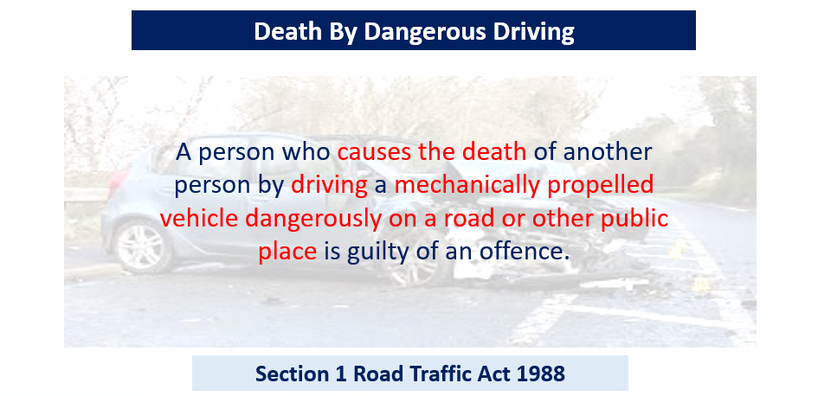
Notes:
Indictment: maximum 14 years imprisonment. Obligatory disqualification Obligatory endorsement - licence endorsed three to eleven penalty points. Note: The vehicle may be forfeited.

Slide 5
What is the time frame for the death ?

Slide 6
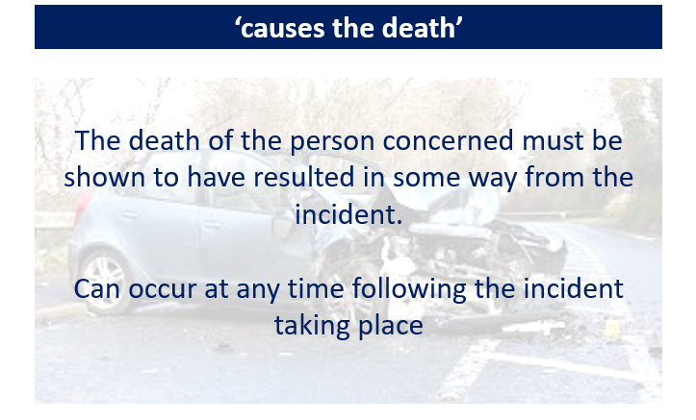
Notes:
The death of the person concerned must be shown to have resulted in some way from the incident to which the charge relates, however, does not have to be a major or substantial cause. There is no longer a requirement that death must occur within a year and a day of the incident.

Slide 7
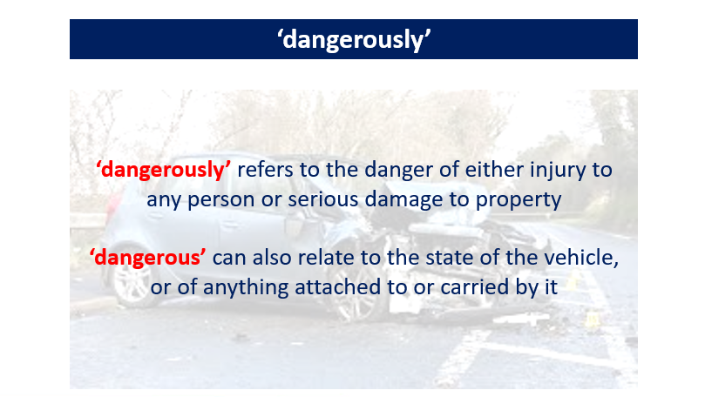
Notes:
The danger must relate to either injury to any person OR serious damage to property

Slide 8
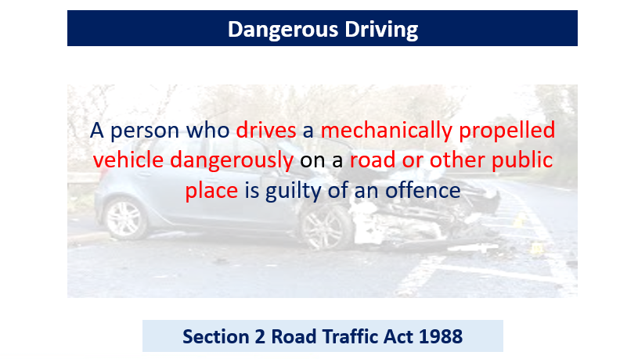
Notes:
Either Way Summary – 6 months imprisonment and/or fine Indictment: 2 years imprisonment and/or fine Obligatory Disqualification Obligatory Endorsement with 3 – 11 penalty points Serious injury – in this section the term ‘serious injury’ means physical harm which amounts to grievous bodily harm for the purposes of the Offences Against the Person Act 1861.
Notes The offence has two distinct parts and two separate questions for the jury or magistrates to answer. First, there is the actus reus (guilty act) of the offence. They must consider whether a defendant's driving fell far below the fixed and objective standard of a competent and careful driver, irrespective of their experience. The standard expected is the same for a learner driver holding a provisional licence as it is for a driver who has passed his driving test or even an experienced professional driver. Although the standard of driving required is fixed and objective in the sense that it must always be that of the competent and careful driver, it may vary according to road and driving conditions. It is perfectly possible for driving to be held to be competent and careful in one situation and to have fallen below that standard in another. The weather, visibility and traffic conditions are examples of factors which affect the degree of care required. For this reason, juries and magistrates decide each case on its own facts. The standard of driving required, and failure to reach it is easier to recognise in practice, than to define generally. Any aspect of a defendant's driving (control of the vehicle) may fall far below the standard expected, whether it be by excessive speed, failure to comply with a road sign, etc. The second question for the jury or magistrates is whether it would be obvious to a competent and careful driver that driving in the way the defendant drove would be dangerous

Slide 9
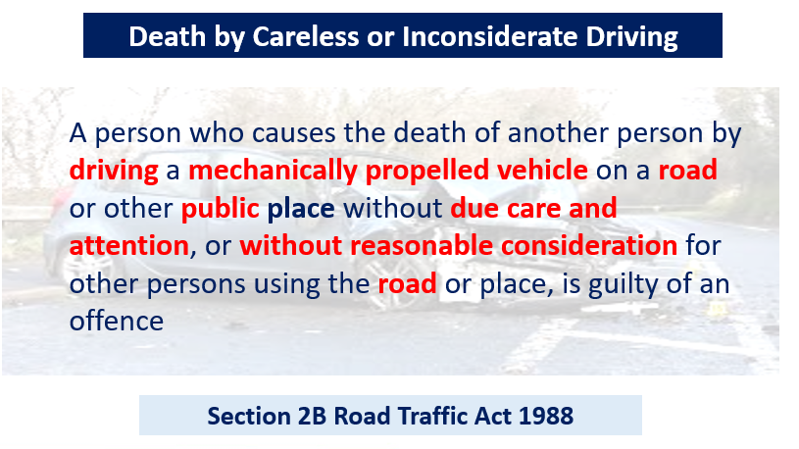
Notes:
Either way Summary: maximum 12 months imprisonment and/or fine. Obligatory disqualification and obligatory endorsement with 3-11 penalty points Indictment: maximum 5 years imprisonment and/or a fine. Obligatory disqualification and obligatory endorsement with 3-11 penalty points This offence may be an alternative verdict to an offence under Sec 1 (Death by dangerous driving)

Slide 10

What is Section 3 of the Road Traffic Act 1988?
Research and write down the points to prove.

Slide 11
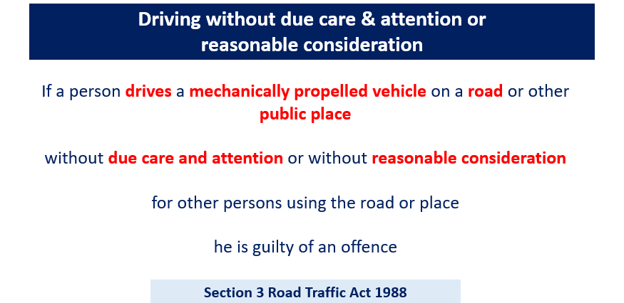
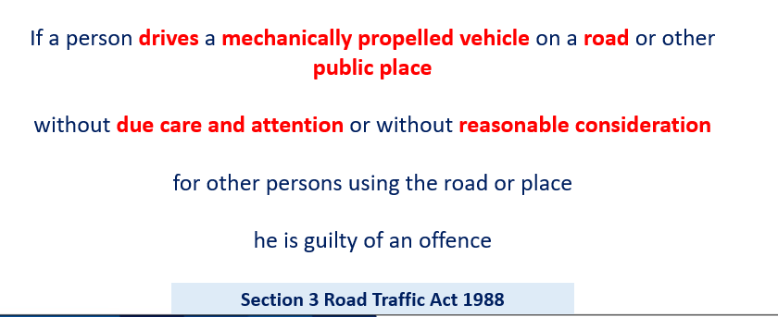
Driving without due care & attention or reasonable consideration.

Slide 12
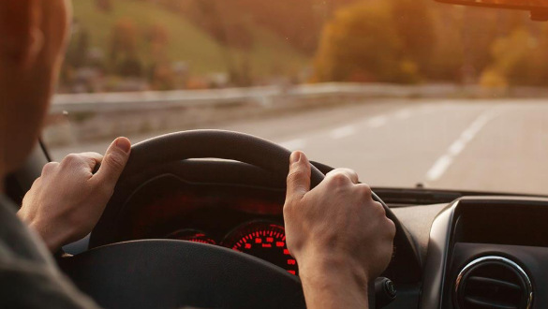
Recap – what is the definition of drives?
Drives – not defined under the RTA 1988 – generally accepted as ‘having control of the propulsion, steering and brakes’
Notes:
Mechanically Propelled Vehicle – any vehicle that is propelled mechanically Road – any highway or any other road to which the public has access and includes any bridges over which a road passes.
Public place – for the purposes of the Road Traffic Act 1988, the term ‘public place’ has been defined as ‘any place to which the public have open access is a public place, even if payment must be made to gain entry

Slide 13
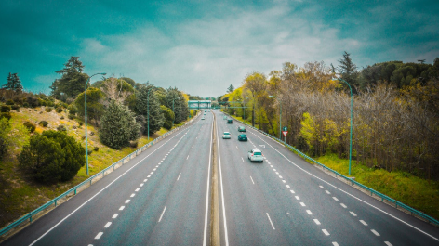
What is the definition of a Road?

Slide 14
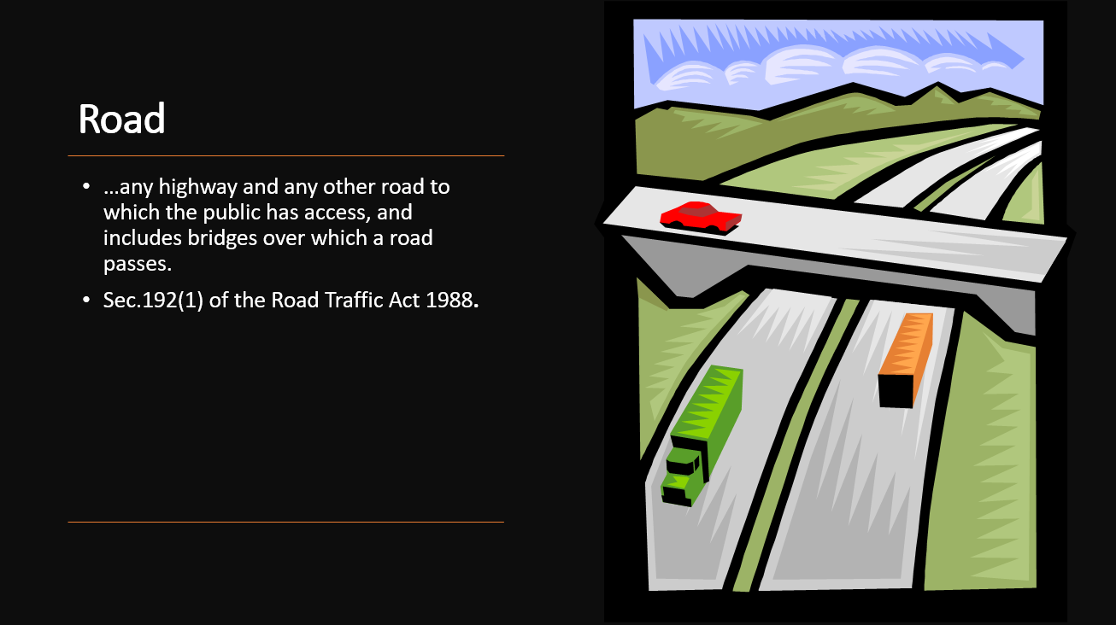

Slide 15

What does SEPDOG stand for?

Slide 16
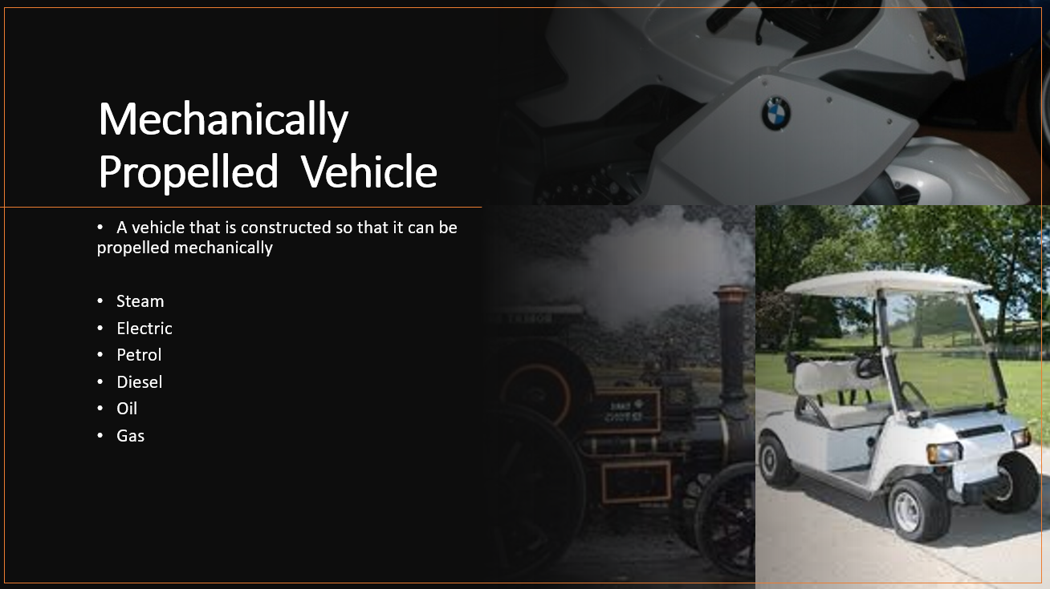

Slide 17
What is driving without due care and attention?
Notes:
Discuss and students to provide examples.

Slide 18
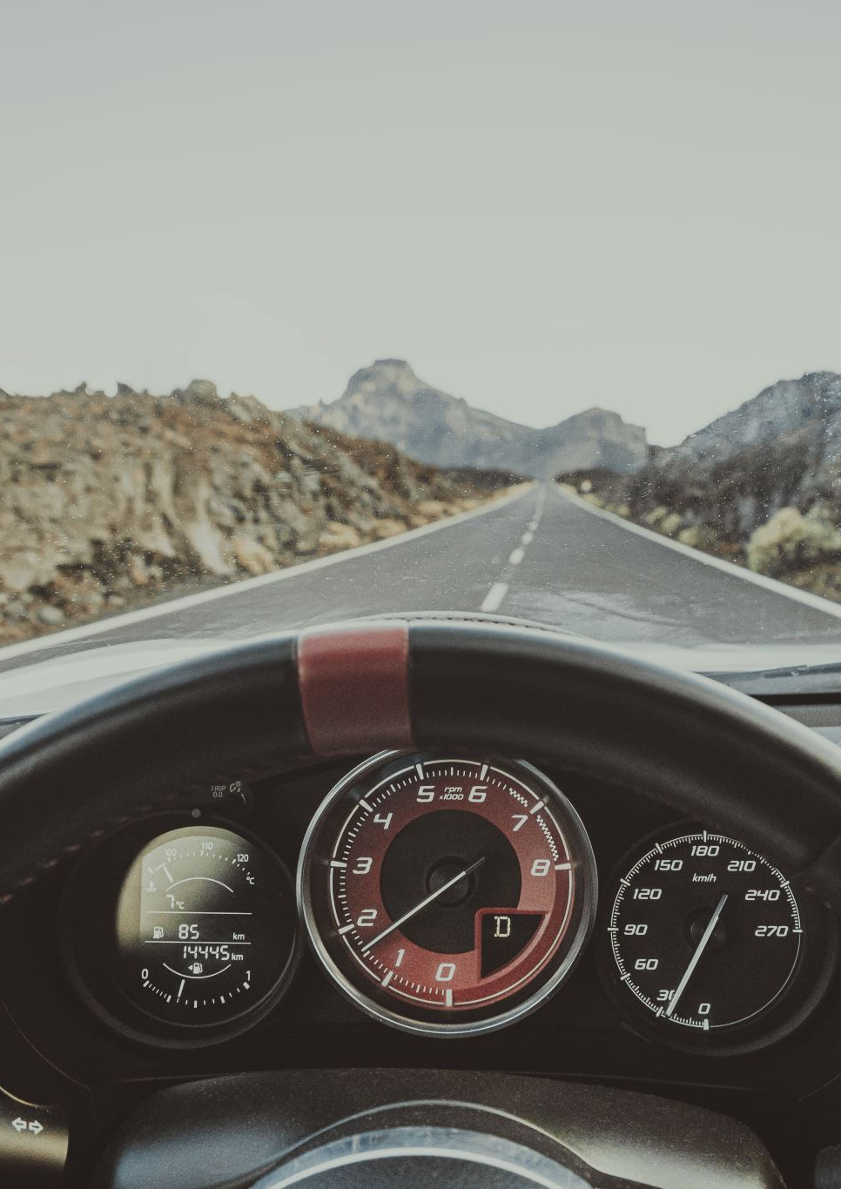
Without due care and attention.
A person is regarded as driving without due care and attention if (and only if) the way he/she drives falls below what would be expected of a competent and careful driver.
The standard of care and attention is an objective one and in no way related to the degree of proficiency or experience attained by the individual driver.
The standard is the same in the case of a driver who is a learner holding a provisional licence as it is in the case of the holder of a full driving licence.
Notes:
The application of this standard enables the offence to cover cases ranging from momentary lapses in concentration or minor errors of judgment to deliberately bad or dangerous driving which falls short of a Section 2 offence. The element that distinguishes dangerous driving from careless driving is that the dangerous driver falls far below the required standard while the careless driver merely falls below the required standard.

Slide 19
overtaking on the inside;
driving too close to another vehicle;
driving through a red light by mistake;
turning into the path of another vehicle;
the driver being avoidably distracted by tuning the radio, lighting a cigarette etc.
flashing lights to force other drivers to give way;
misusing lanes to gain advantage over other drivers;
unnecessarily staying in an overtaking lane;
unnecessarily slow driving or braking;
dazzling other drivers with un-dipped headlights
Notes:
CPS - 2025

Slide 20
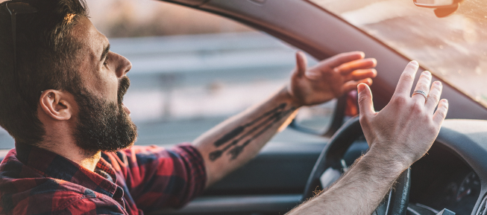
Without reasonable consideration
To drive “without reasonable consideration, it is necessary to cause some actual inconvenience to another road user.
Notes:
The full phrase referred to in this part of section 3 of the Road Traffic Act 1988 is 'without reasonable consideration for other persons using the road'. It is a subjective test that has to be decided by the court on the evidence before it. The other persons can include other drivers, passengers in the vehicle, or pedestrians and cyclists. It can include leaving a turn indicator on too long to give a misleading signal, or a bus driver taking a corner too fast so that passengers are thrown out of their seats and injured. On a procedural note it is good evidence to ask the driver if he knows what action the Highway Code recommends in the situation.

Slide 21
The full phrase referred to in this part of section 3 of the Road Traffic Act 1988 is 'without reasonable consideration for other persons using the road’.
It is a subjective test that must be decided by the court on the evidence before it.
Other persons can include other drivers, passengers in the vehicle, or pedestrians and cyclists.
It can include leaving a turn indicator on too long to give a misleading signal, or a bus driver taking a corner too fast so that passengers are thrown out of their seats and injured

Slide 22
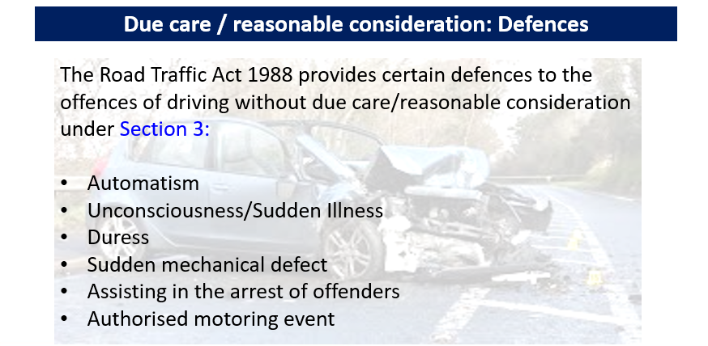
Notes:
Students to discuss what these are recapping previous lesson

Slide 23
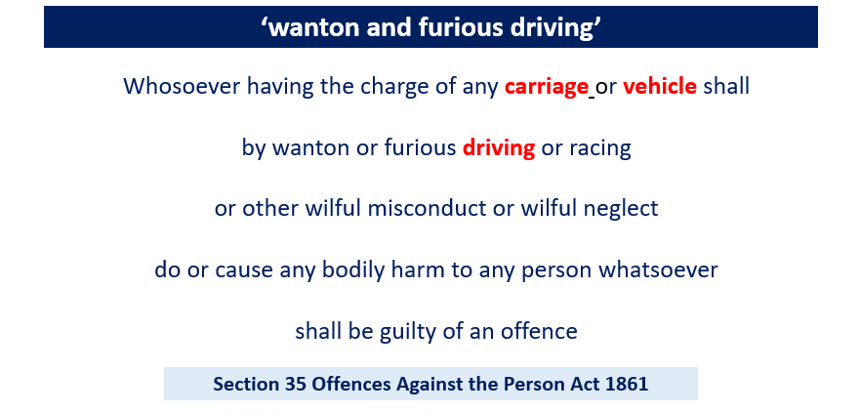
Notes:
Indictment – Maximum 2 years imprisonment
Note that this offences uses the term ‘vehicle’. This can be taken in its widest context and will include such things as cycles and horse drawn carriages. In most instances normal assault or driving charges should be considered rather than this offence, however, it does have an advantage in that it can be committed anywhere by any vehicle or carriage. This offence does not carry endorsement or disqualification, therefore it should normally only be used on occasions when it is not possible to prosecute for an offence under the road traffic legislation, for example: incidents on private premises or incidents not on highways at all (such as dirt tracks or country trails). ‘Vehicle’ should be given its everyday ordinary meaning and includes motor vehicles.

Slide 24
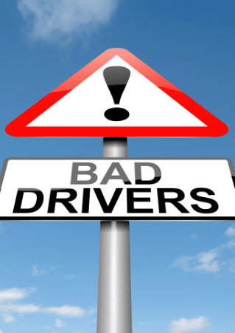
Points to prove examined
‘Bodily harm’ in this section has its ordinary meaning and includes any hurt or injury calculated to interfere with the health or comfort of the victim.
‘Wanton’ may be described as: "without any lawful motive and being thoughtless as to the possible consequences

Slide 25
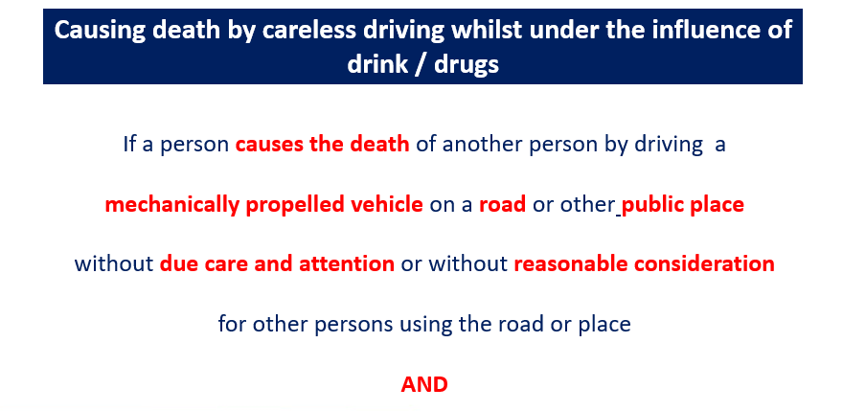
Notes:
Indictment: maximum 14 years imprisonment and/or fine Obligatory disqualification Obligatory endorsement - licence endorsed three to eleven penalty points The term ‘causes the death’ is the same as that specified in the Sec 1 offence of causing death by dangerous driving.

Slide 26
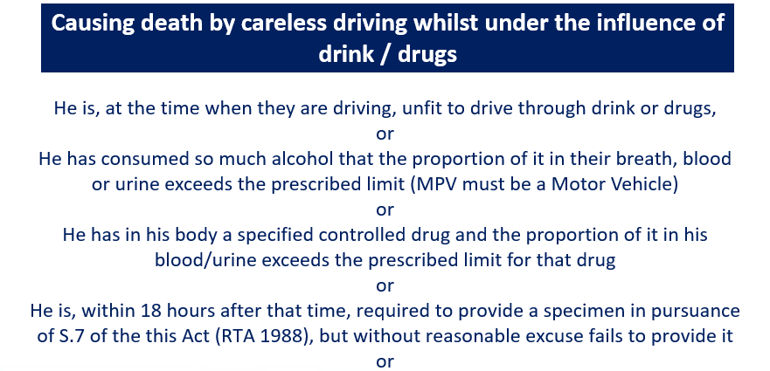

Slide 27
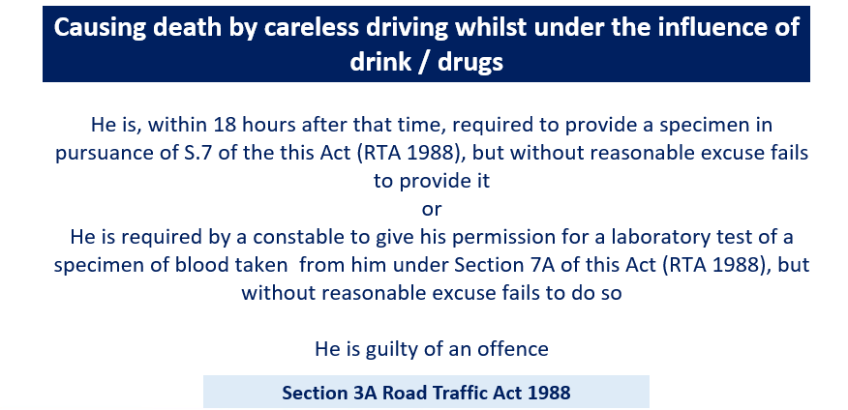

Slide 28
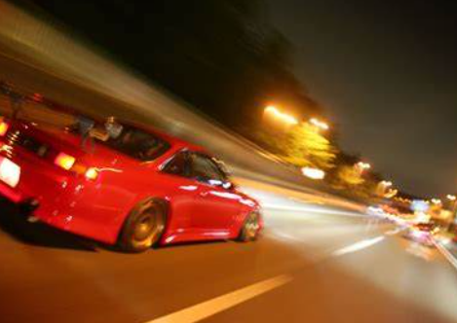
Using Vehicles to Cause Alarm, Distress and Annoyance
Anti –Social Use of Vehicles

Slide 29
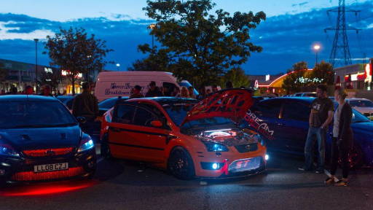
What is anti social use of a vehicle?

Slide 30

Examples
Street Cruising
Racing
Tricks and stunts
Misuse of off – road vehicles
Noise pollution

Slide 31
Street cruising
Street cruising is when a group of vehicle owners form a convoy and drive up and down a street or around a neighbourhood – usually to show off their cars or bikes. They’ll often drive slowly and may even take up both sides of the road. This can hold up traffic behind and make things really difficult for other road users.

Slide 32
Misusing vehicles off-road
While quad bikes, three-wheeled bikes, trail bikes and some other two-wheeled vehicles are built for off-road use, it is against the law to ride them in public parks or on publicly-owned land without permission from the local authority.
As with unlicensed powered vehicles, these can only be used on private roads or land with the road or land-owner’s permission.

Slide 33

What is the impact?
The effect of dangerous or reckless use of a vehicle can lead to criminal damage of roads, other vehicles and surrounding property.
Drivers and riders also risk injuring themselves, other road users, cyclists and pedestrians as they do not have full control of their vehicle and their full attention on their surroundings.
Driving or riding in this way can also be used as a form of intimidation, either to other road users or the community. Loud noise from engines and music and deliberately creating large amounts of exhaust or tyre smoke can also be seen as an aggressive act.

Slide 34
Section 59 of the Police Reform Act 2002 provides Police with the powers to deal with anti social use of vehicles.
The driving must amount to careless or inconsiderate driving.
Unlawful off-road driving.
Unlicenced street racing.
It must cause/likely to cause alarm, distress or annoyance to other people.

Slide 35
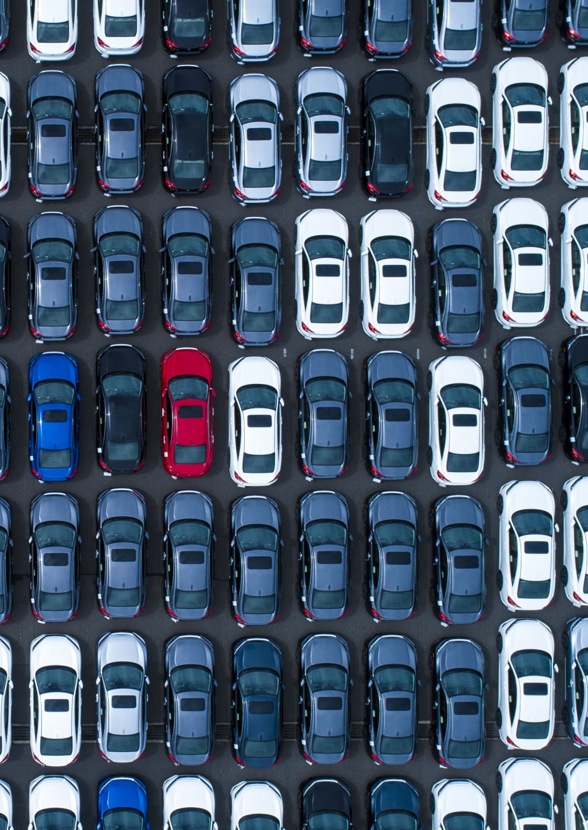
What can the police do?
Require a moving vehicle to stop – S 59 (30 (A).
Seize and remove the vehicle after warning the driver – S 59 (3) (b).
Failure to stop is a summary offence under S 59 and the penalty is a fine.
If a S59 warning is issued to a driver – it stays with them for 12 months- and applies regardless of the vehicle they are driving in future occasions.

Slide 36
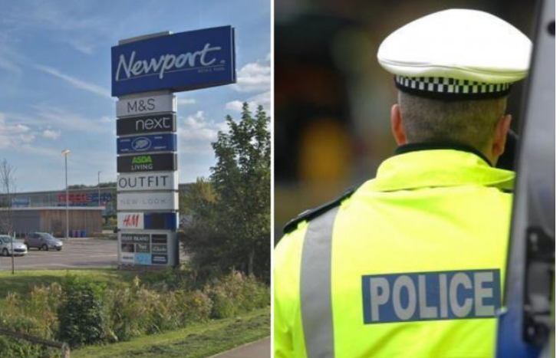
Case Example – Newport 2019
A driver had their car seized for “causing alarm, distress or annoyance” to members of the public at Newport Retail Park after being slapped with a Section 59 notice.
Notes:
The keeper of the vehicle will be liable to recovery/storage costs before they get their vehicle back. When the driver has already received a Section 59 warning notice within the preceding 12 months or it is impracticable to give a warning, their car can be confiscated.

Slide 37
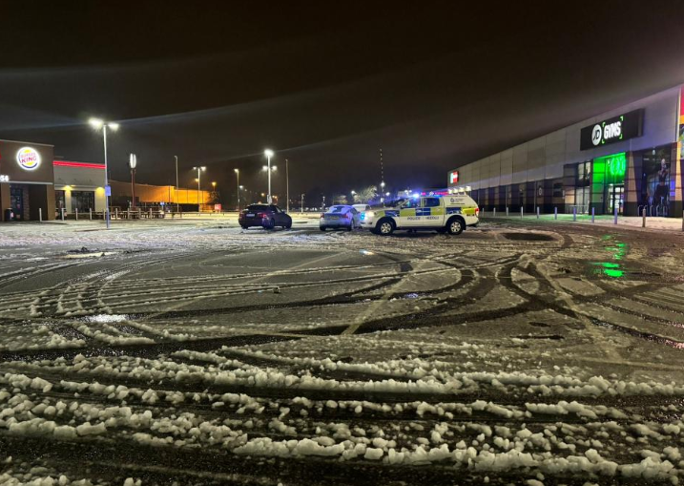
Case Example – Newport 2025
GWP seized two vehicles in after they were seen to be driving dangerously in poor weather conditions in Spytty Retail Park.
Both vehicles were seized using Sec 59 powers.

Slide 38

Directed reading

Slide 39

Read USE, CAUSE and Permit offences

Slide 40

Any Questions?

