Slide 1

3. National Considerations
BMPO7003D
Policing and the Political Landscape

Slide 2
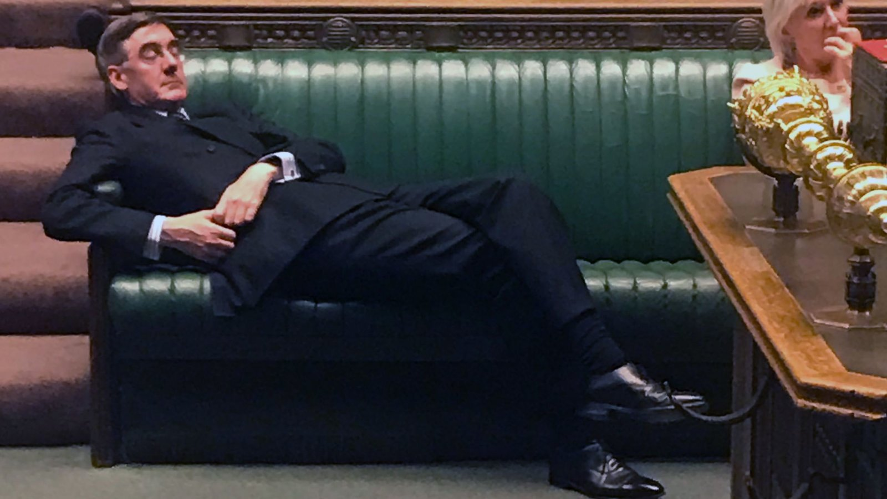
Objectives
Educational and social background of Members of Parliament
Mayors and Commissioners
With his body language throughout this evening,” Mr. Rees-Mogg “has been contemptuous of this house and of the people,” Caroline Lucas, a Green Party lawmaker, said on Tuesday night.
For the benefit of the written parliamentary record, Ms. Lucas said she wanted to describe her view: “The leader of the House has been spread across around three seats, lying out as if that was something very boring for him to listen to tonight.”
He hardly moved, raising his eyebrows and adjusting his rimless glasses to jeers of “sit up!” from around the chamber.

Slide 3
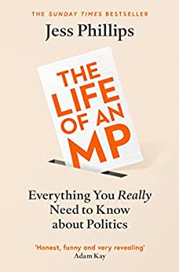
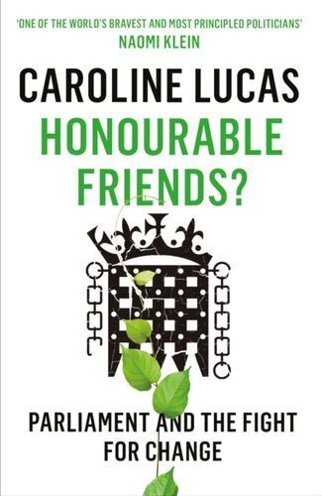
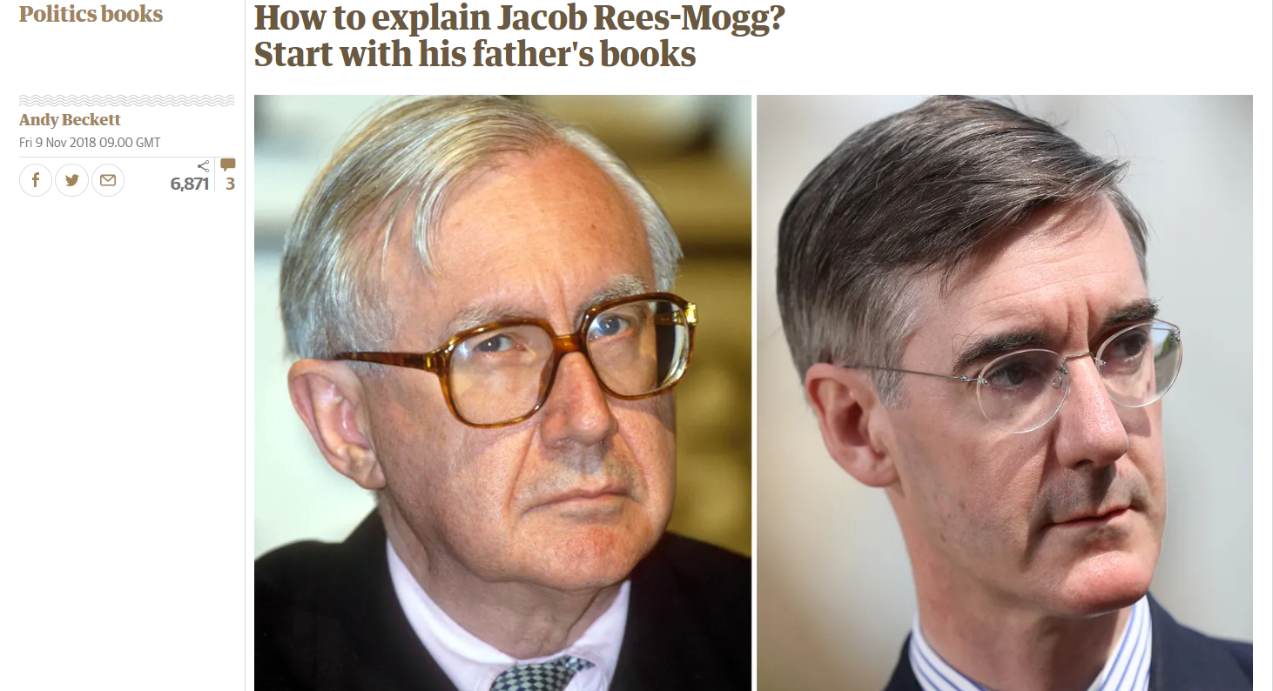
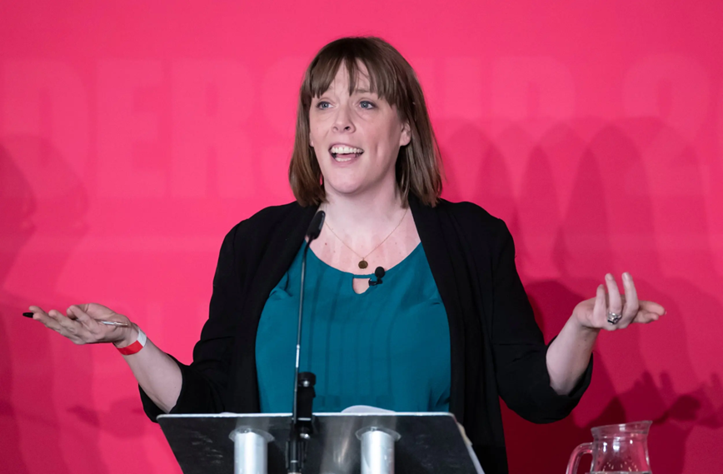
Educational Background of Members of Parliament

Slide 4
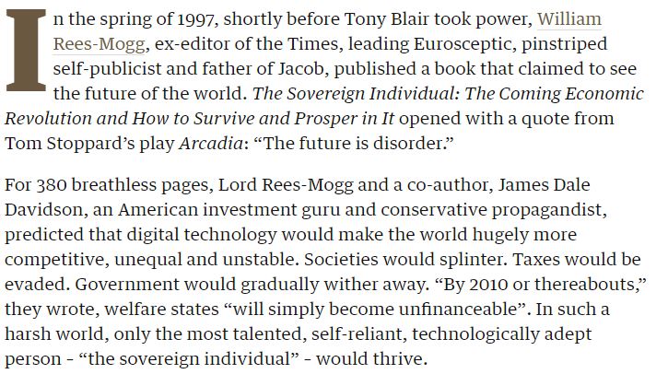
Sovereign Individuals?

Slide 5
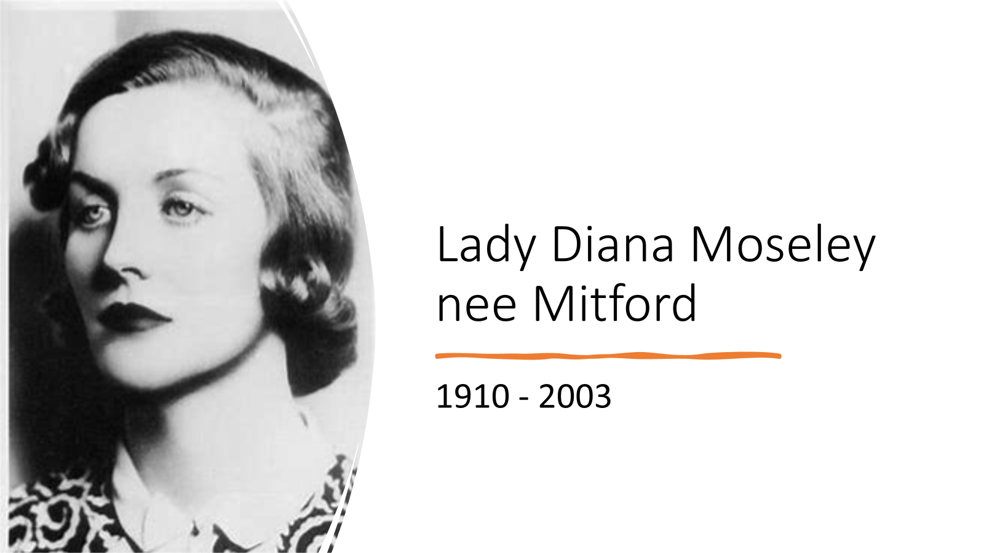
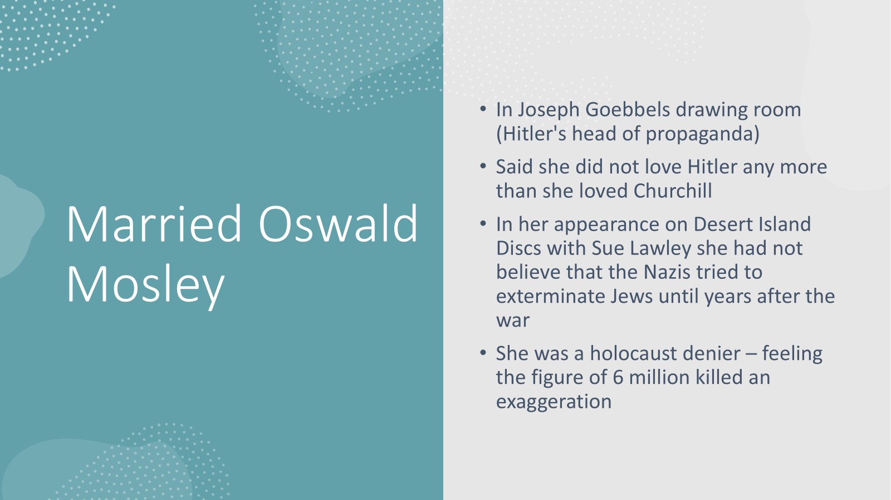
Old money and new money
Hereditary power and wealth v. those riding the wave of technological revolution
Technology – wealth – media control – political manipulation - power
Is the class system alive and well in modern Britain?
Does the King and the aristocratic network still wield huge power and influence?
Who are the modern powerful?

Slide 6
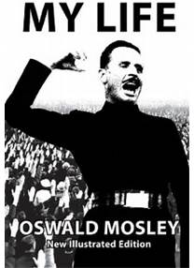
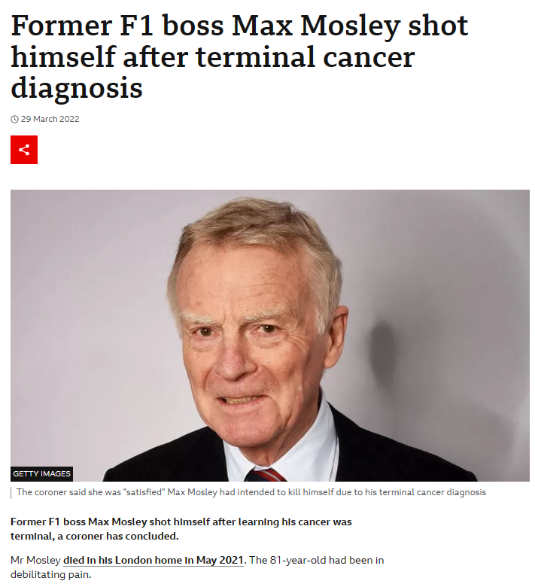
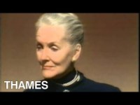
British Fascists

Slide 7
Why is the background of MPs significant?
One issue is whether comprehensively educated pupils have equal access to learn about and become engaged in politics at school
Top schools provide extensive opportunities to learn about politics
Sutton Trust: in 2017, 3% of MPs were educated at Eton – they have regular talks from MPs and political journalists
  Strong focus on public speaking, understanding arguments and debating societies
  25% of MPs had previous experience working in politics
  Research of Conservative candidates suggested personal expenses of £34,000 prior to the election

Slide 8
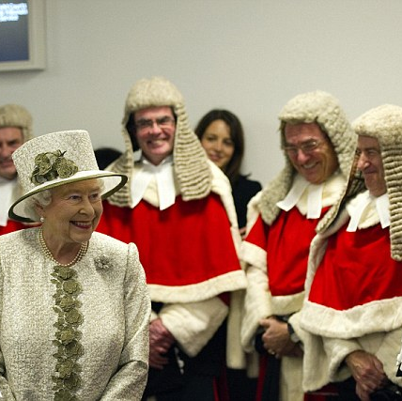
Privilege and Power
7% of UK students are privately educated but 44% at Oxford and 38% at Cambs went to public schools
The Sutton Trust aims to highlight the importance of social mobility and has concerns from all parts of society may not be represented
MPs have responsibility for the state education system, but in the past many had no experience of it

Slide 9
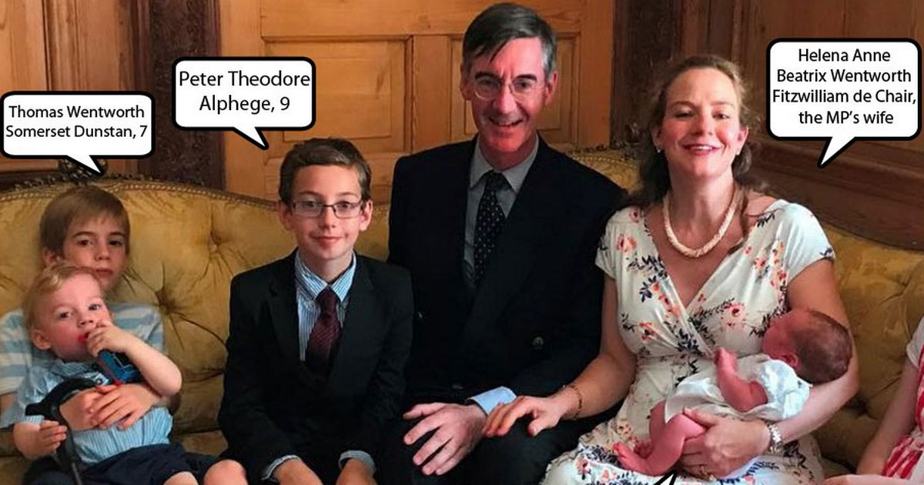
Public School Proportions
74% of High Court judges
61% of top doctors
52% of senior bankers
51% of leading journalists
48% of civil servants

Slide 10
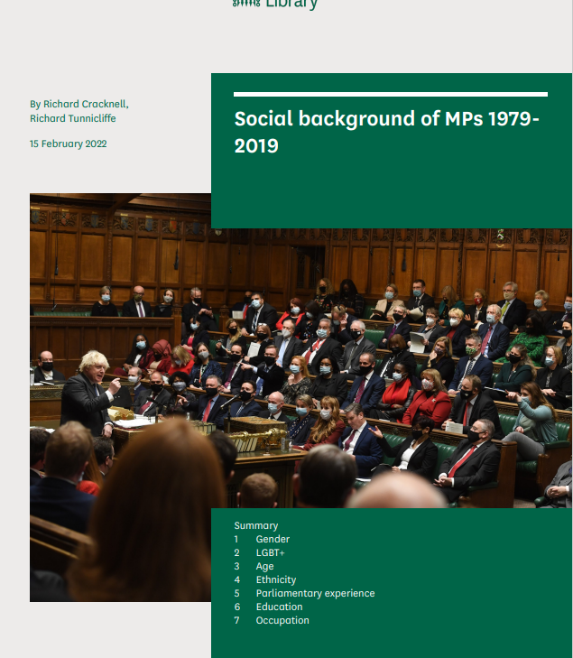
Social Background of MPs 1979-2019

Slide 11
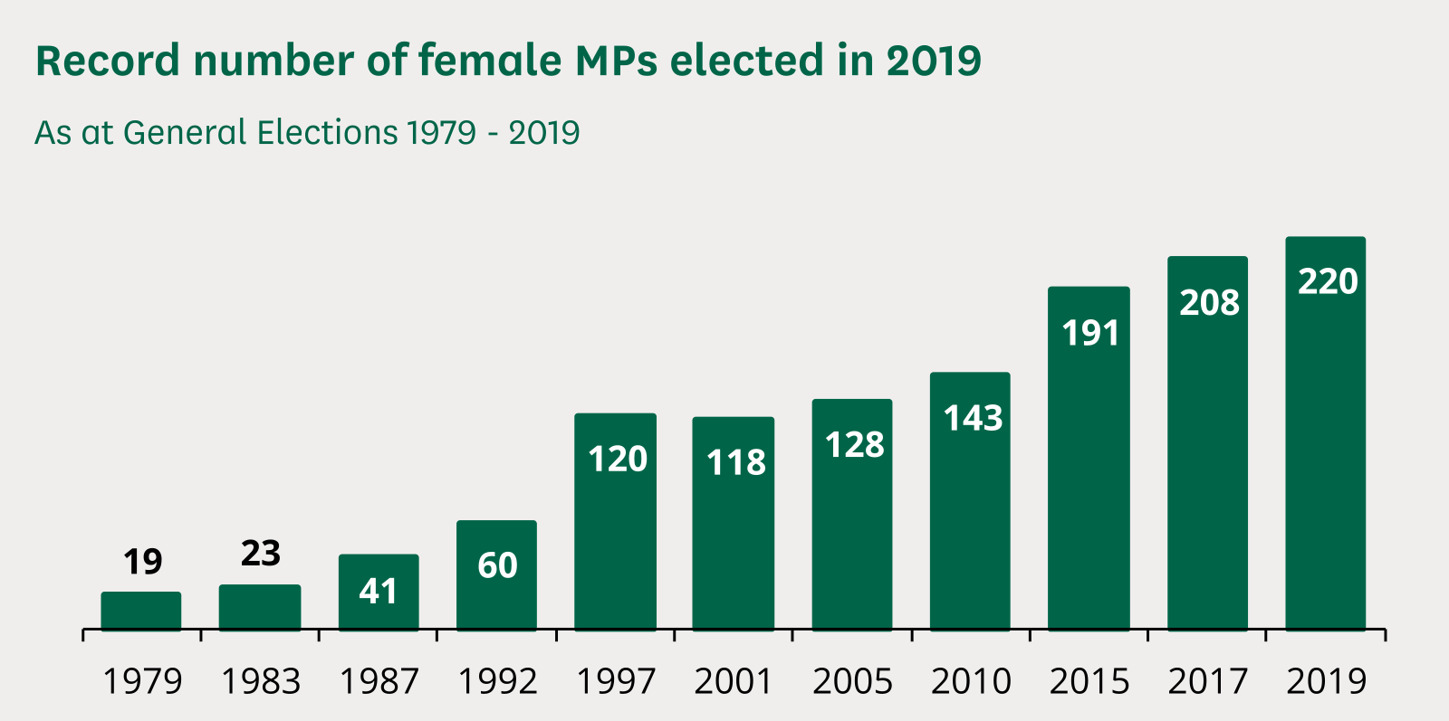

Slide 12
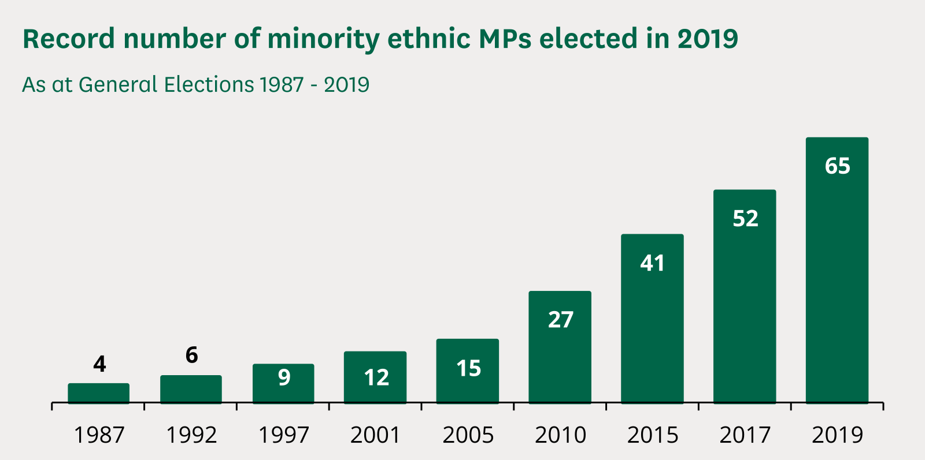

Slide 13
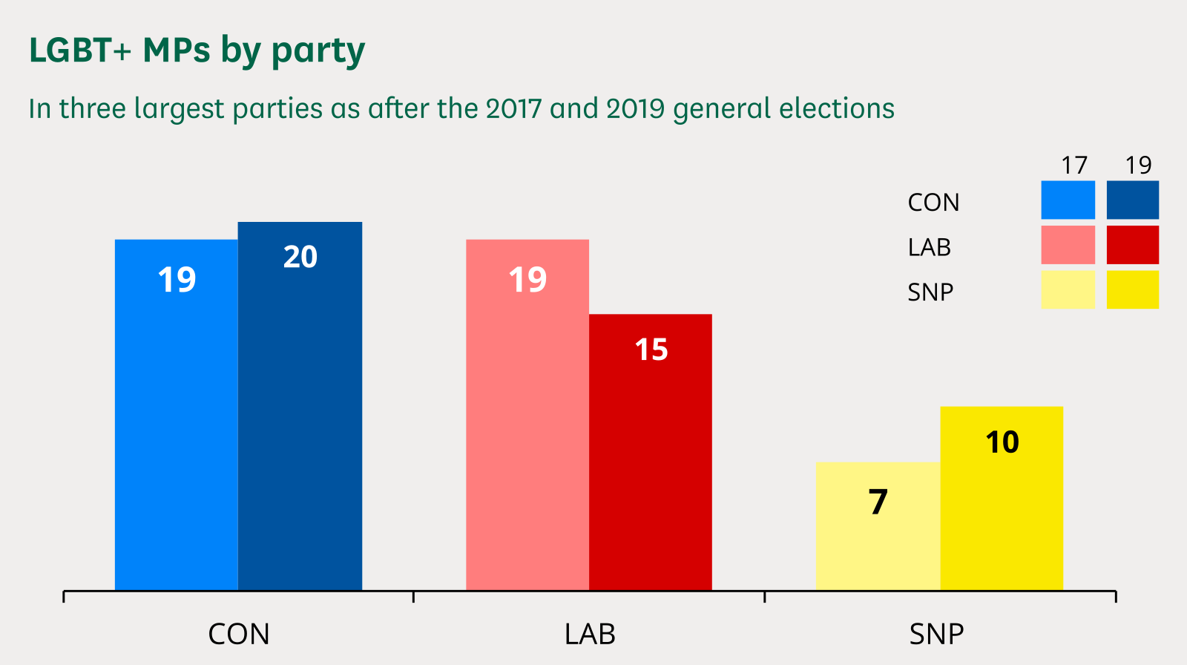

Slide 14
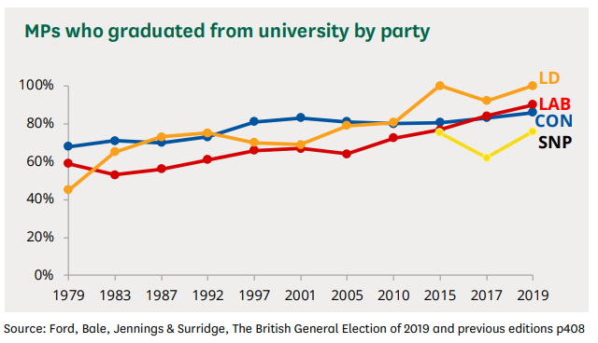

Slide 15
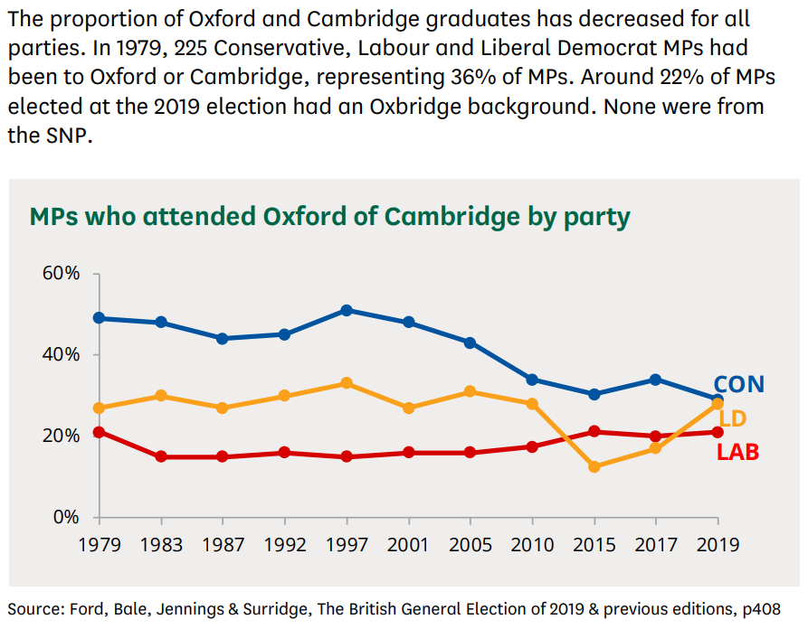

Slide 16
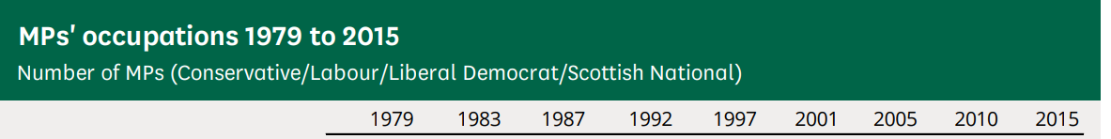
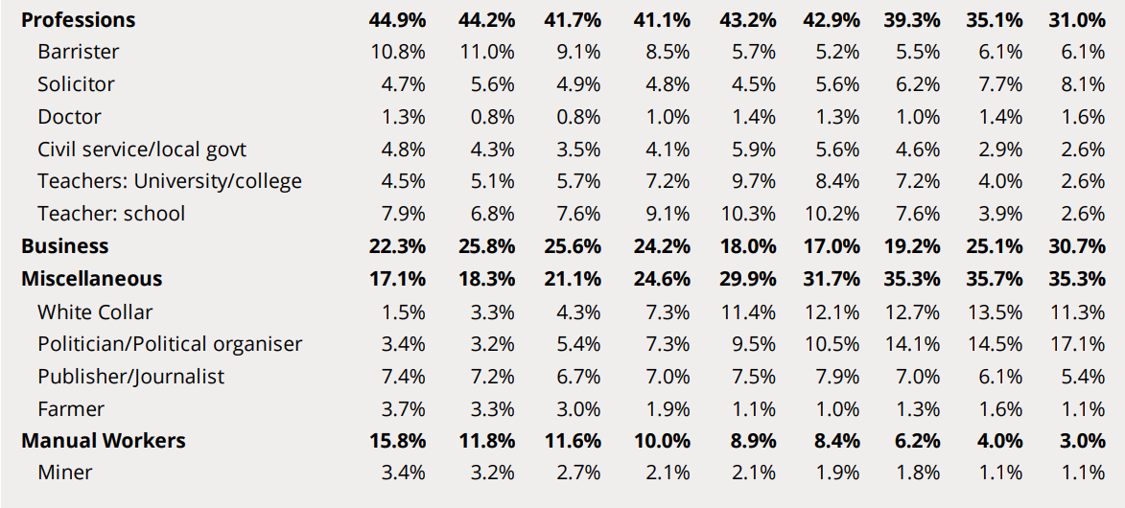

Slide 17
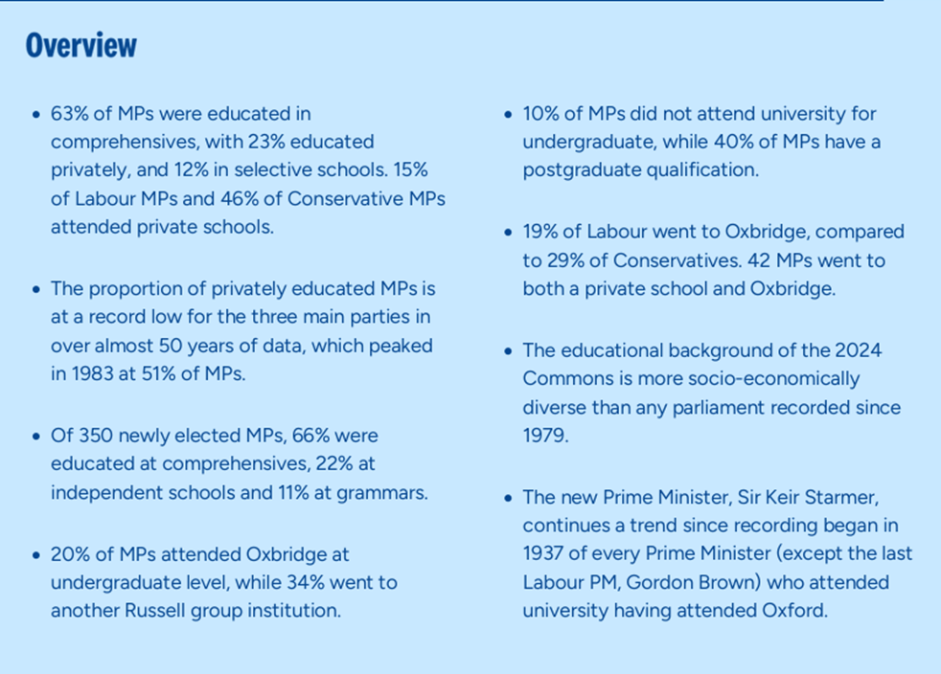

House of Commons 2024

Slide 18
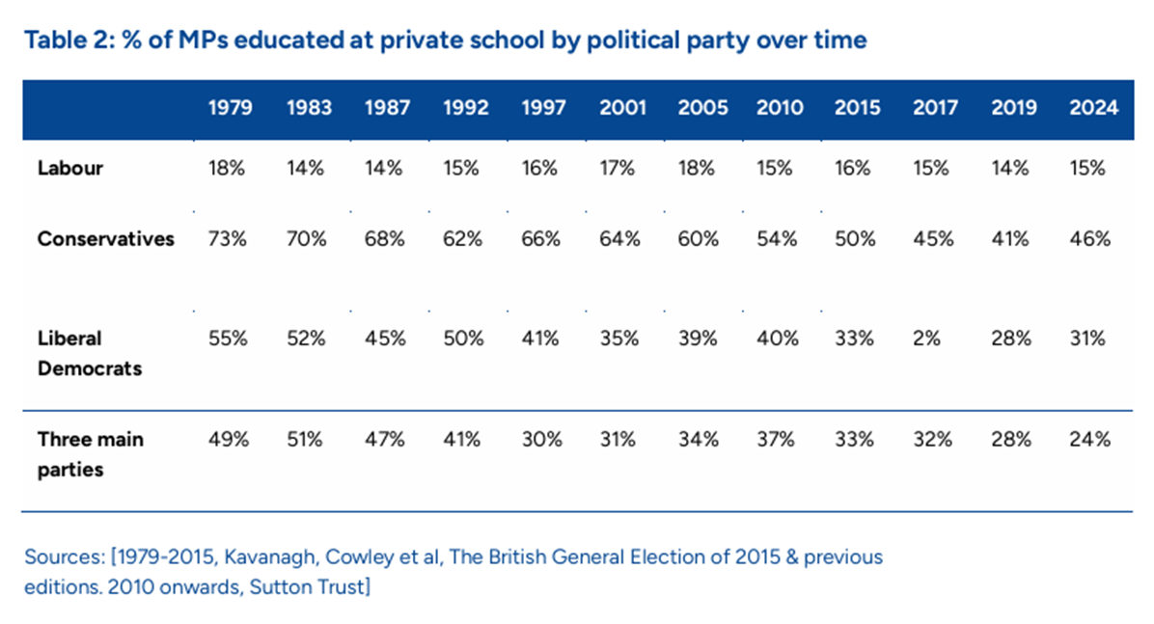

Slide 19
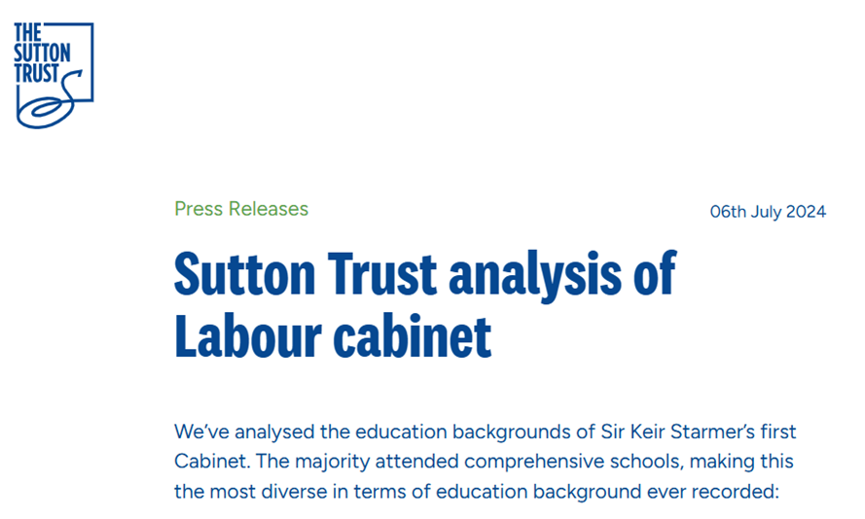
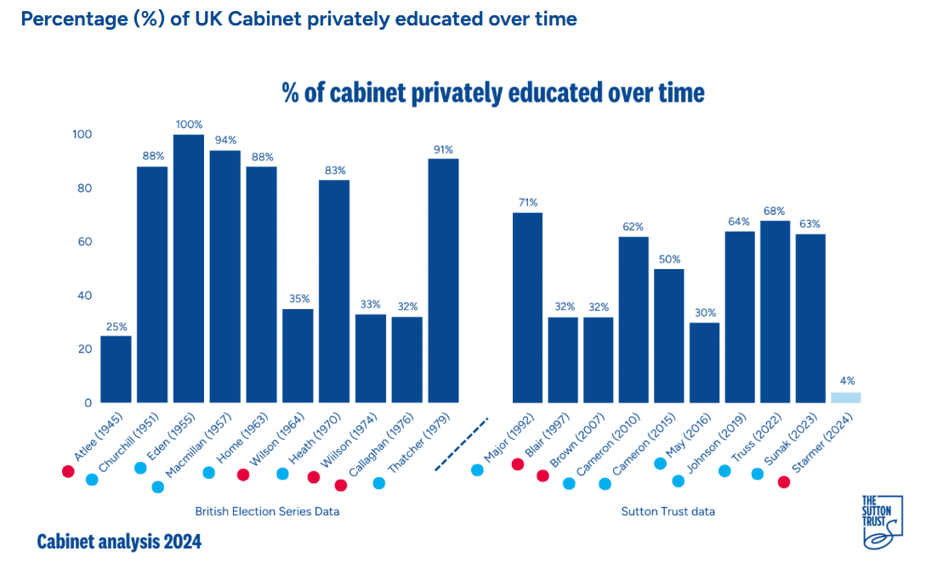

Slide 20
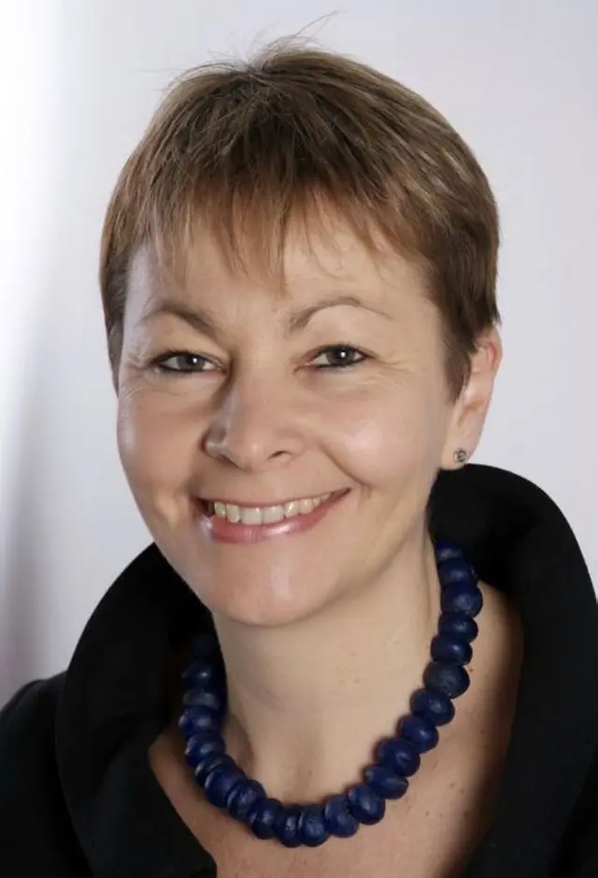
Wealth in the Coalition Government
“Over half the members of the Cameron cabinet went to private school.
Over half went to Oxford or Cambridge universities.
Over half of them have substantial wealth - that is, over £1 million without taking their family home into account
and in 2012 the total wealth of the [then] current cabinet was estimated at nearly £70 million ... and a third of the cabinet are in some way connected to the nobility, through descent or marriage.”
Dangerous to have MPs from such a narrow pool
Lucas 2015: 27/8

Slide 21
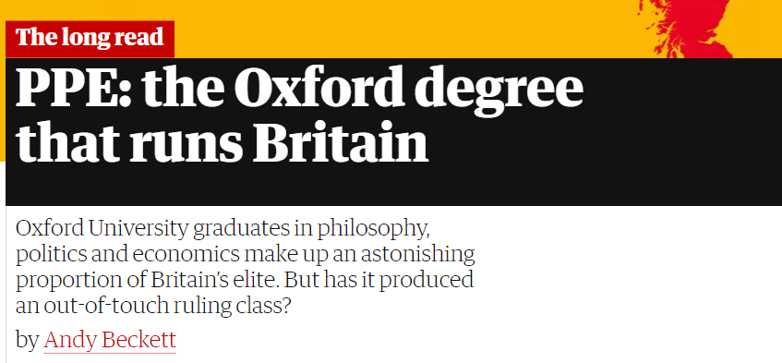
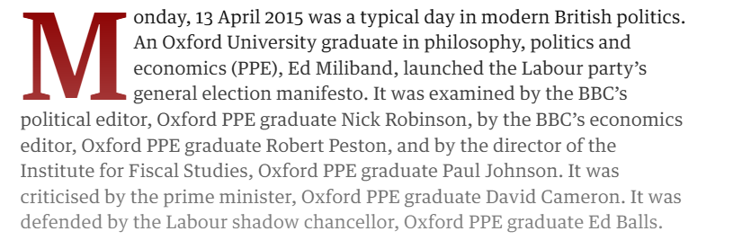

Slide 22
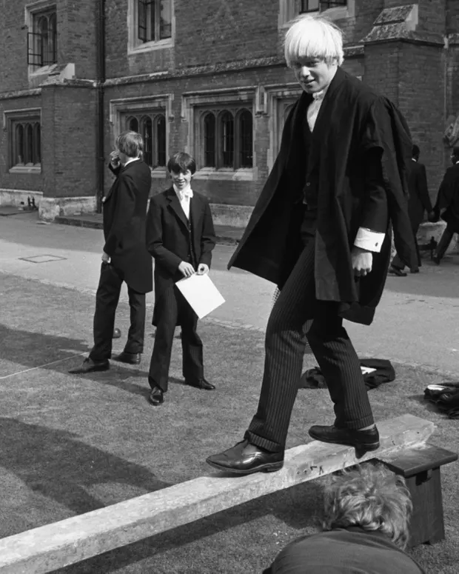
Alexander Boris de Pfeffel Johnson was born on 19 June 1964 in New York and is still known by his family as Al
Wanted to be ‘world king’ as a child
Moved 32 times up to 1978
Dad, Stanley, was super-competitive
Eton: developed a flamboyant personality to combat bullying over Turkish heritage
Oxford: Bullingdon Club; SU President
Connections: first wife very wealthy; god-mother the wife of Lord Longford

Slide 23
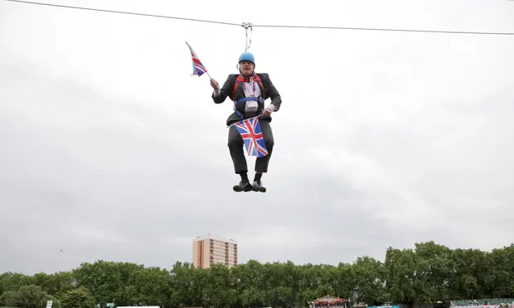
Sacked as graduate trainee with the Times for making up a quotation
At 25, Brussels correspondent with the Telegraph. He developed a popular, critical EU strand
At 30, assistant editor and chief political columnist, column for the Spectator (edited at 35)
Varying cited to have said he had no political beliefs, and that lying was acceptable
The Guppy issue: Darius Guppy wanted Johnson to arrange for a journalist to be beaten up!
At 34, guest host of Have I Got News for you. Huge popularity
MP: failed 1997; succeeded 2001
2008: Mayor of London with few if any plans
Olympics 2012 and the zip wire. Again, huge publicity
Cultured his ‘man of the people’ image (Red Boris – Purnell 2019)
Leave Campaign: positioned himself with a swing to the right in the Tory party
Set himself against PM Cameron (Remain), thought the PM position was his
PM May made him Foreign Secretary, acknowledged to have been ill-prepared and disastrous
Trump consistently saw him as a future PM

Slide 24
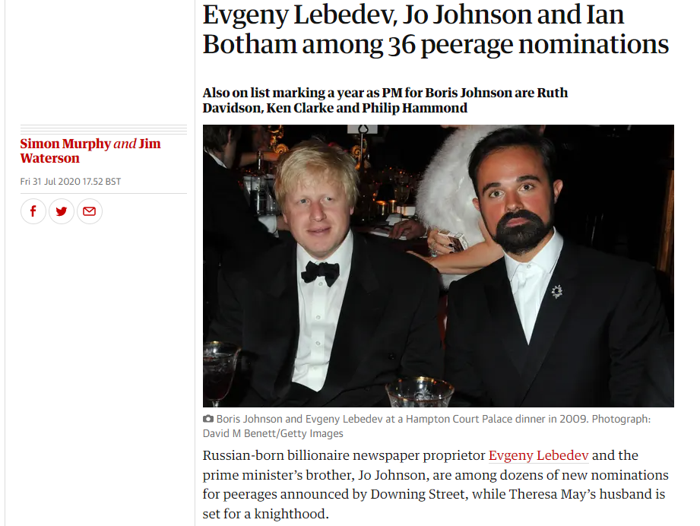
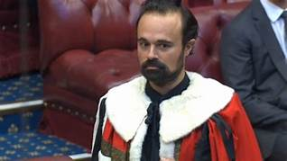

Slide 25
Reflection
How significant are the social and educational backgrounds of MPs in the process of creating law, implementing policies and funding public services?
Can the most privileged people in society understand the pressures on those who are the lower end of the socio-economic tier?
Do professionals in people-facing public services like policing, understand the lives of the people we serve?

Slide 26
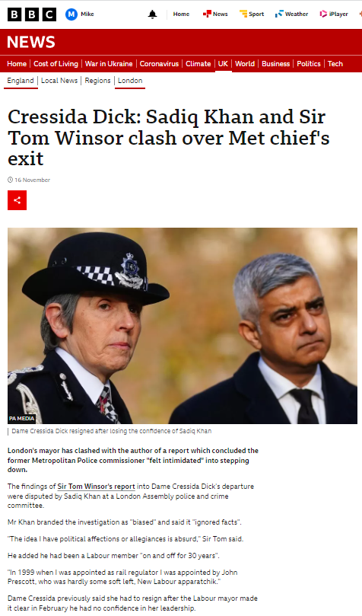
Mayors and Commissioners
London Assembly Police and Crime Committee 16.11.22
Mayor of London as Occupant of the Mayor’s Office for Policing and Crime - MOPAC
Questions around the resignation of the former Commissioner Dame Cressida Dick, and the Mayor’s actions
Mayor of London Sadiq Khan
Sir Tom Winsor, HMCIC to April 2022

Slide 27
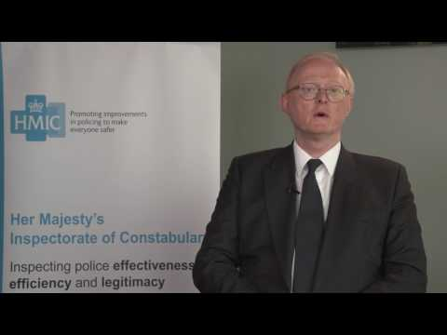
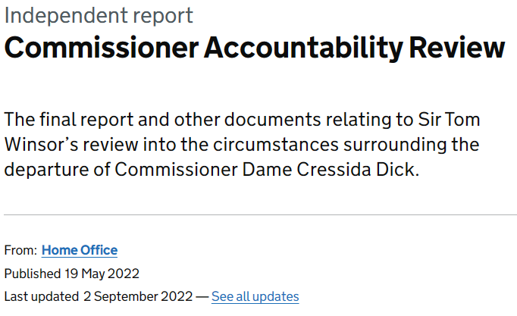
https://www.gov.uk/government/publications/commissioner-accountability-review

Slide 28
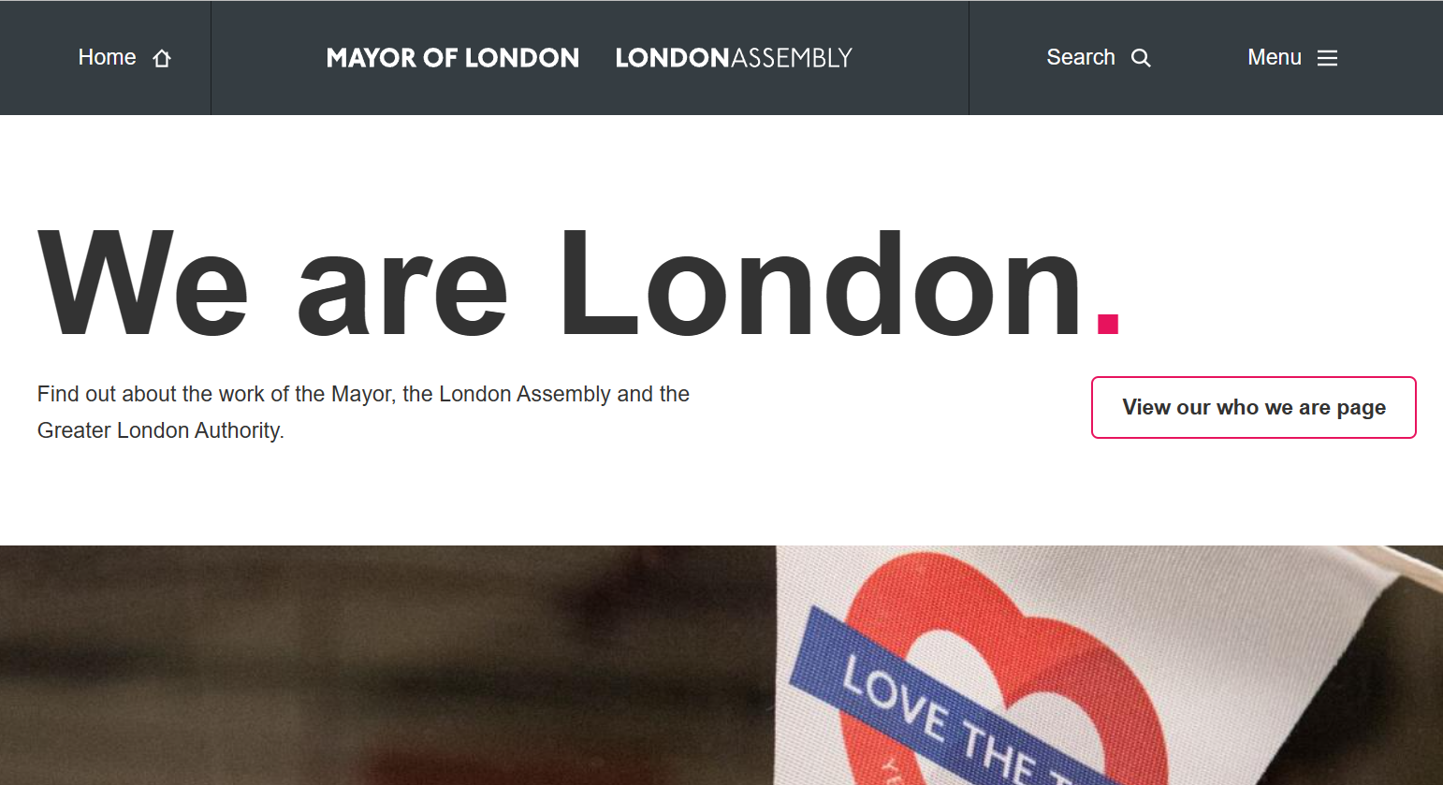
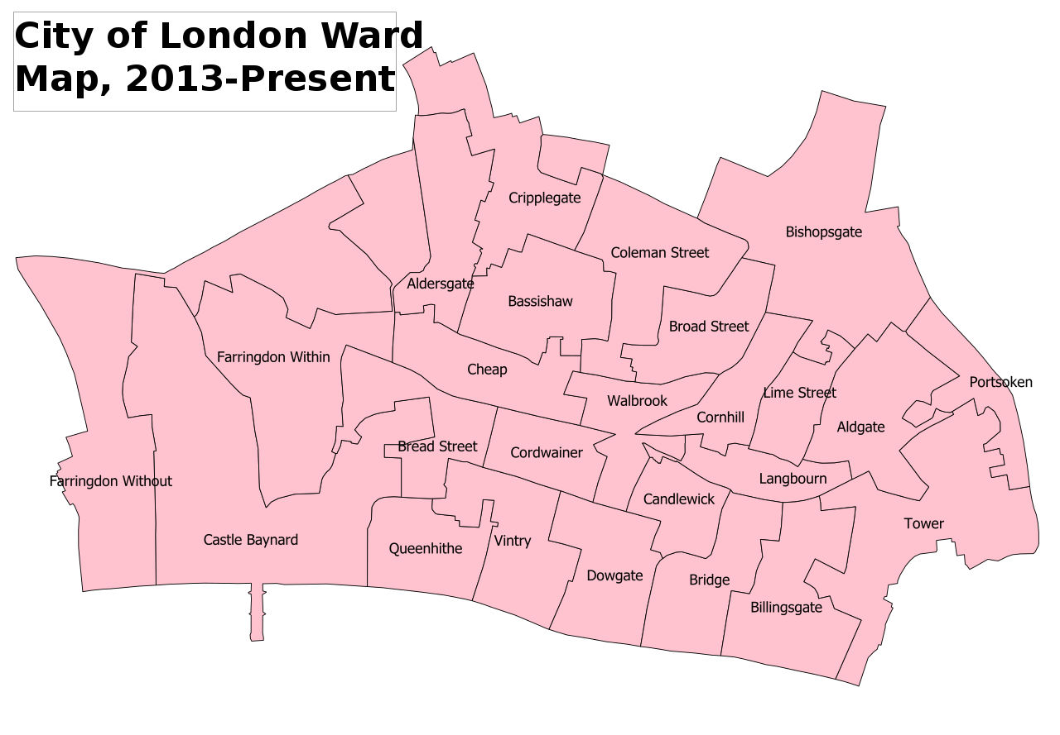
Excludes the City of London
The City: one square mile
25 wards, 9,401 residents
500,000 work there
CoL Authority
CoL Police
Commissioner Pete Doherty
Home page (london.gov.uk)

Slide 29
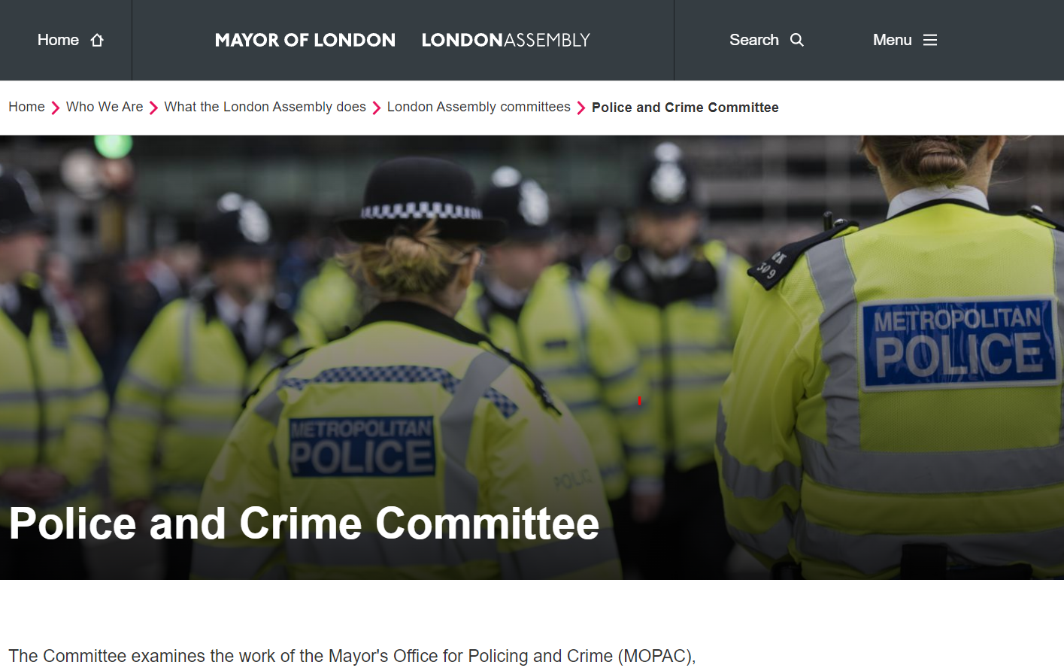

Slide 30
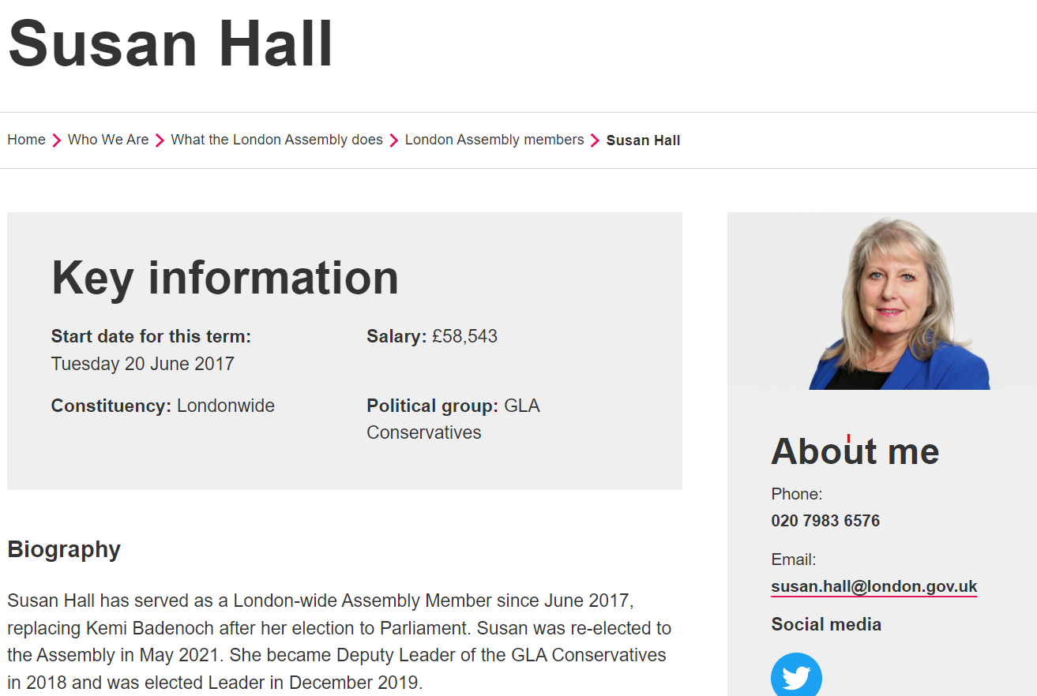

Slide 31
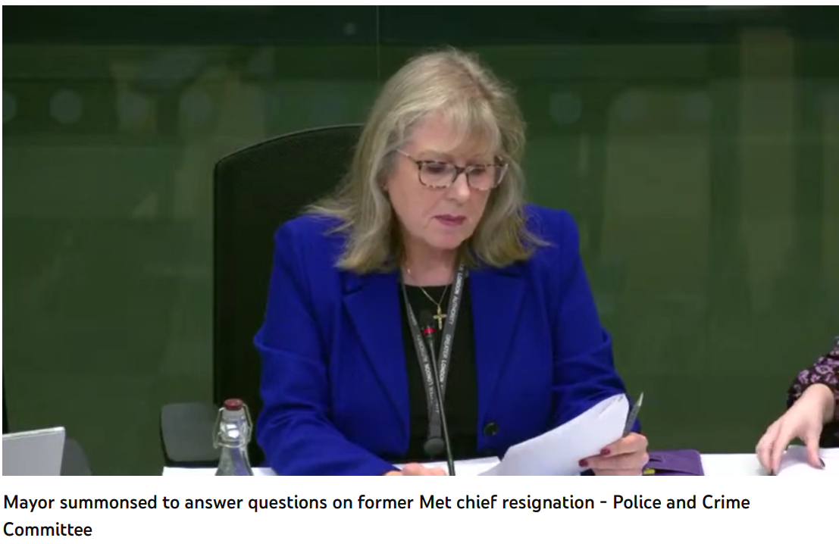
Can politicians say whatever they like regardless of the truth, the facts and stated, confirmed processes?
What authority do we have over politicians?
Starts at 7m 30s
Full recording of the three-hour London Assembly Committee meeting
https://youtu.be/b2VNrrFq1Gk

Slide 32
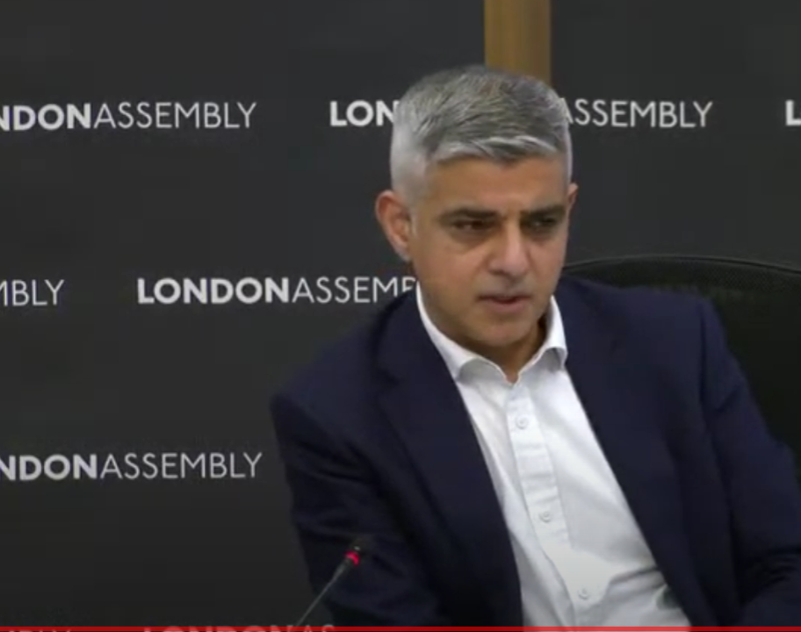
Sadiq Khan
Criticised Sir Tom Winsor’s investigation
Process flawed
Investigation is biased – ignored many facts
Close association with Cressida Dick
Close association with former Home Secretaries
More weight given to police officers than others
Conclusions no surprises

Slide 33
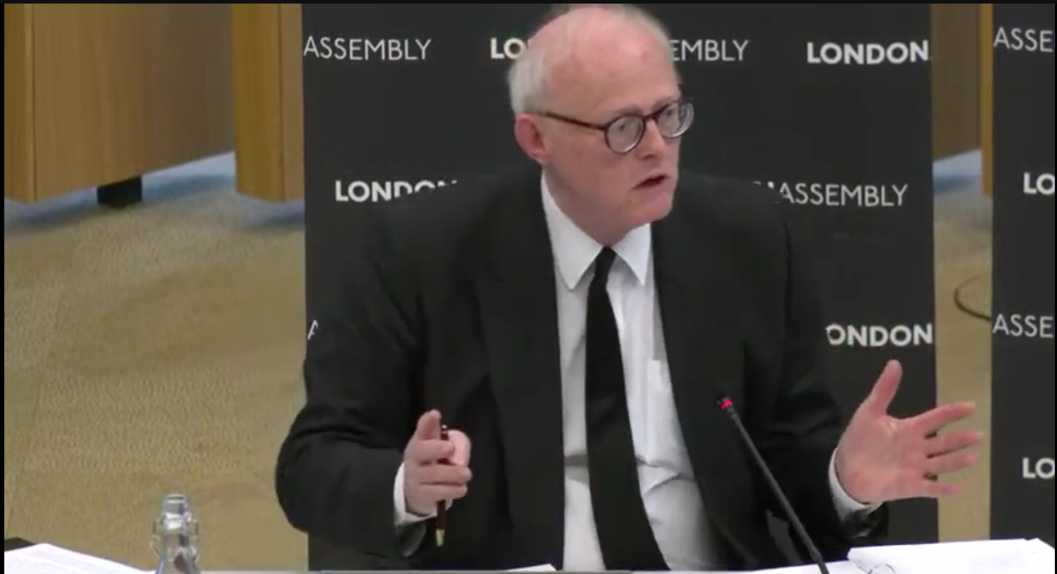
Sir Tom 10m 30s
These points are absurd
Facts have been explored painstakingly
The Mayor failed properly to engage until very late in the day
Nine requests for interviews were made
Late details from the Mayor’s Office caused him to revise his report
The process is exactly in accord with ToR
Process took 22 weeks rather than 6 due to Mayor delays

Slide 34
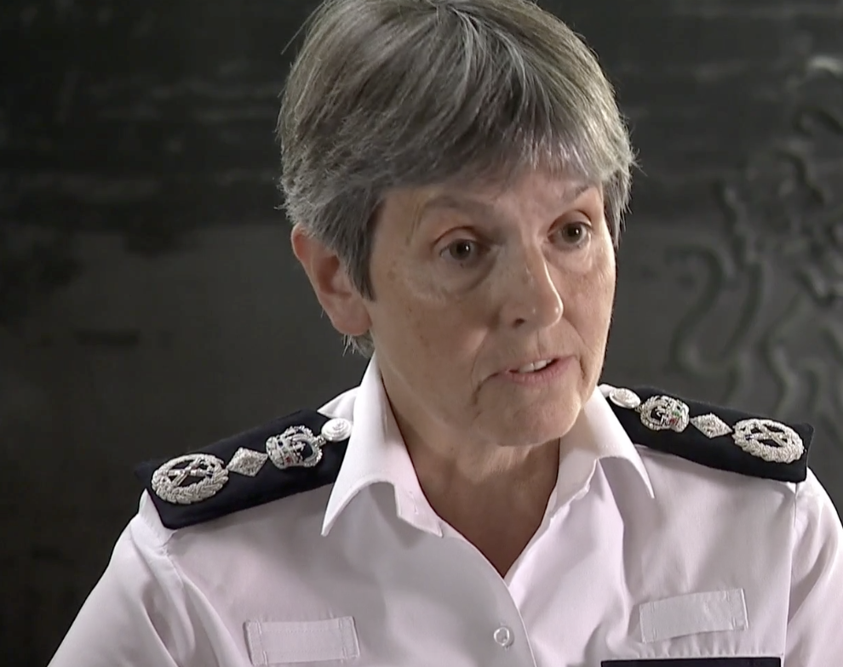
Close associations?
No close association with Cressida Dick
One social meeting with her after 12 years of service
Home Secretaries: has close associations with Labour members
Sir Tom’s mentors: Donald Dewar, John Smith, Clare Short
John Prescott appointed him as Rail Regulator
Absurd to suggest affections and allegiances

Slide 35
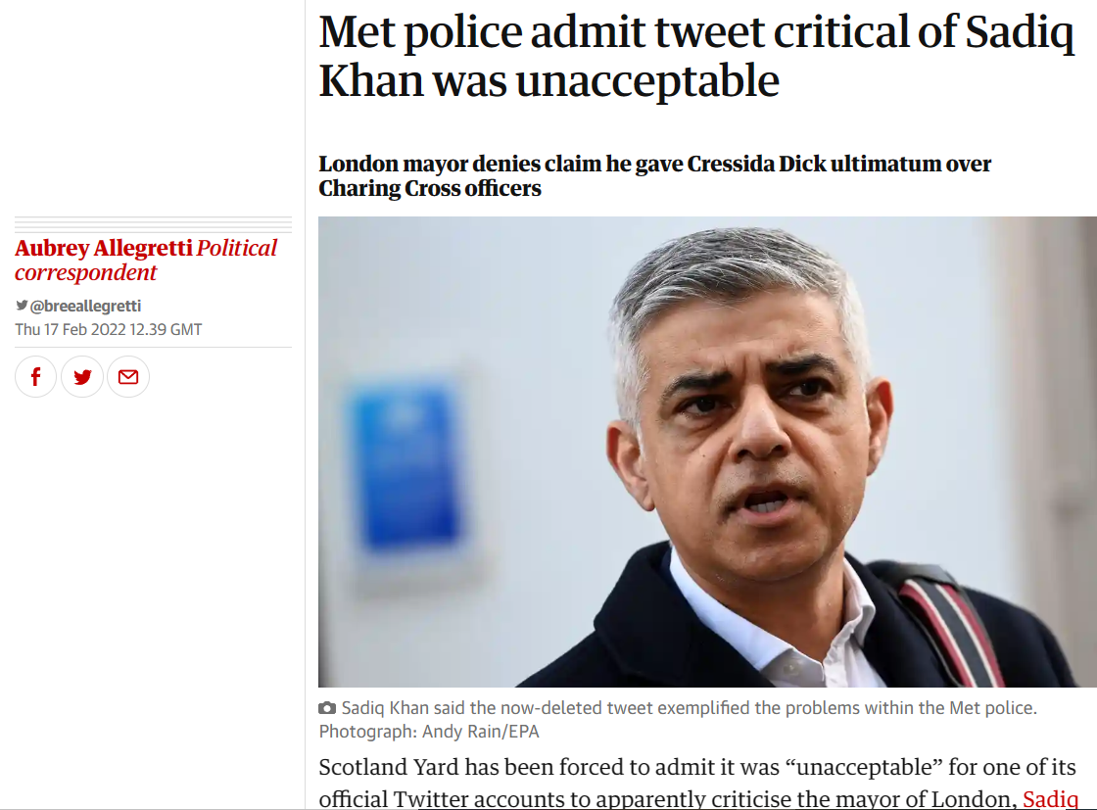
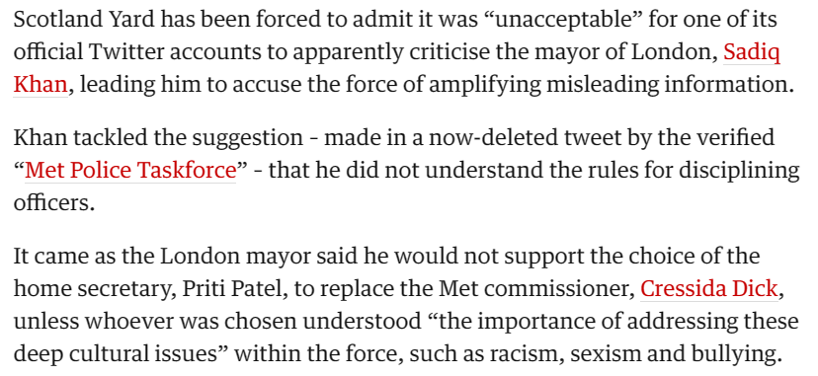
19th January 2022
– 32m
Sir Tom re. Sadiq Khan expresses confidence in the future of the Met
At the committee he could not be more critical
Sarah Everard vigil. Legal flaws before but policing during the event was exemplary

Slide 36
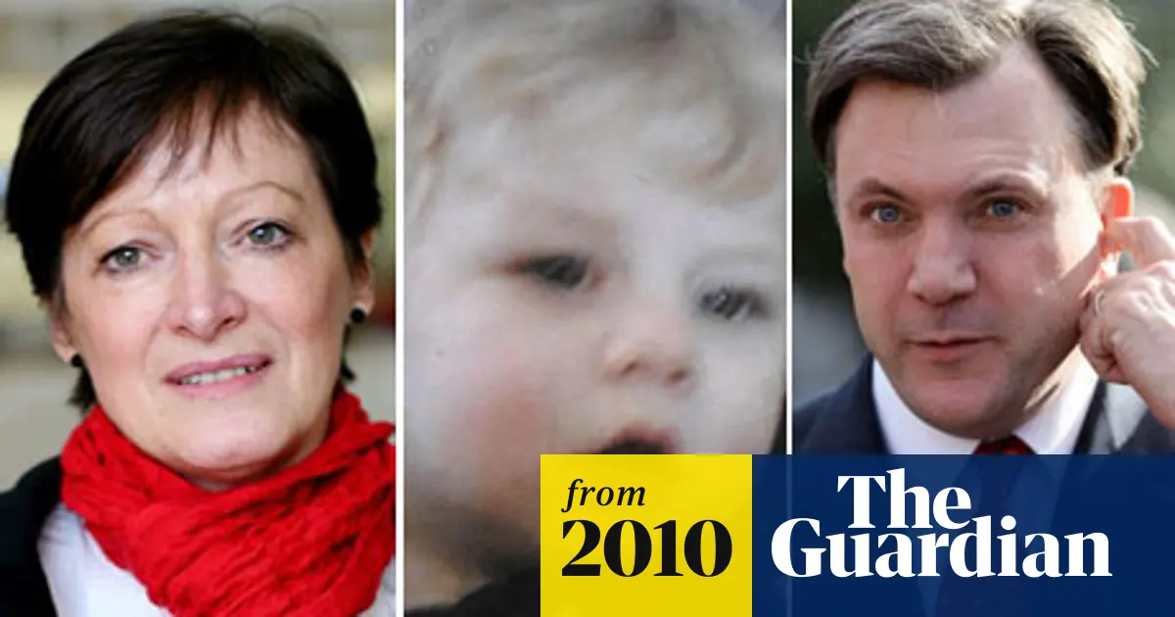
Chair 2:32 and Ed Balls/ Baby P
Sir Tom clarifies a major event:
One-to-one between Commissioner and Mayor
Mayor said Commissioner should have acted as Ed Balls had acted regardless of the consequences of the civil law
Mayor knew a large settlement had to be made – £600k, and said it did not matter as long as the public would understand
Commissioner said she had no power to dismiss
What impact would this have on the morale of the MPS if the Commissioner unlawfully dismissed due to political pressure

Slide 37
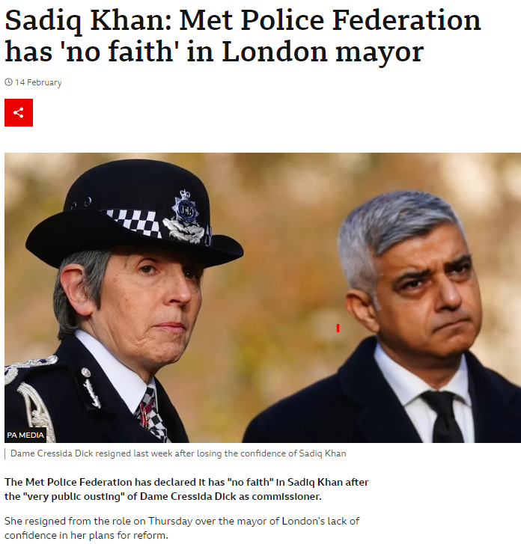
Sir Tom
It was an abuse of power
A political ambush
Para 210 – he accepted that the Mayor had not completely closed his mind to the Commissioner staying in post
Actions did not follow due process – oppressive, unreasonable and brutal with threats and improper behaviour, threatening the stability of the MPS

Slide 38

Summary & Reflection
How does this incredible case highlight hey issues with the way in which politicians work with police forces?
Does this show how single-minded politicians are or can be?
Do you see differences at the highest – London and national level compared with the regional and local level?
What was Khan’s motivation: doing the right thing – following law and correct procedure; or securing a headline in the popular media?

Slide 39
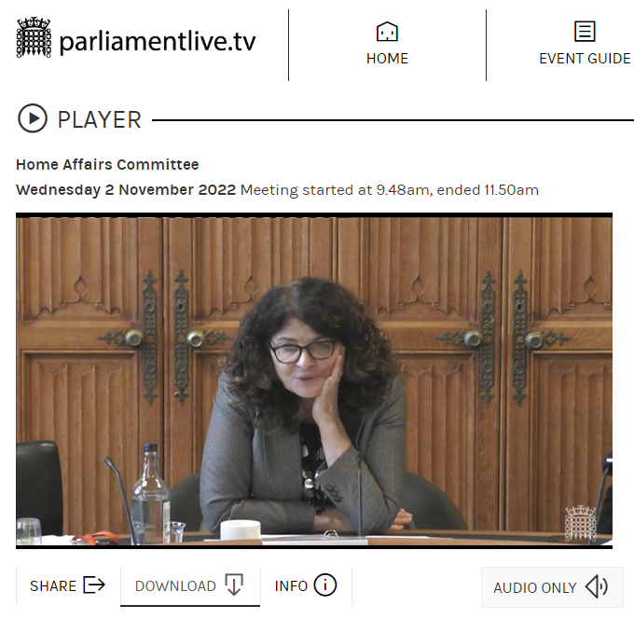
Home Affairs Committee
2nd November 2022
https://parliamentlive.tv/event/index/53e7e655-3088-48e6-b9a1-94a5c499801f#player-tabs

Slide 40
Policing Priorities
Chair: Dame Diana Johson
First Panel: Dr Rick Muir, Director, Police Foundation
Second Panel:
Martin Hewit QPM, Chair, NPCC
Festus Akinbusoye, Lead for Prevention, APCC
Andy Marsh QPM, CEO, College of Policing
Inquiry Remit
What a modern police service should look like
What balance should forces strike between preventing and solving crime, and carrying out their other functions
https://parliamentlive.tv/event/index/53e7e655-3088-48e6-b9a1-94a5c499801f#player-tabs

Slide 41
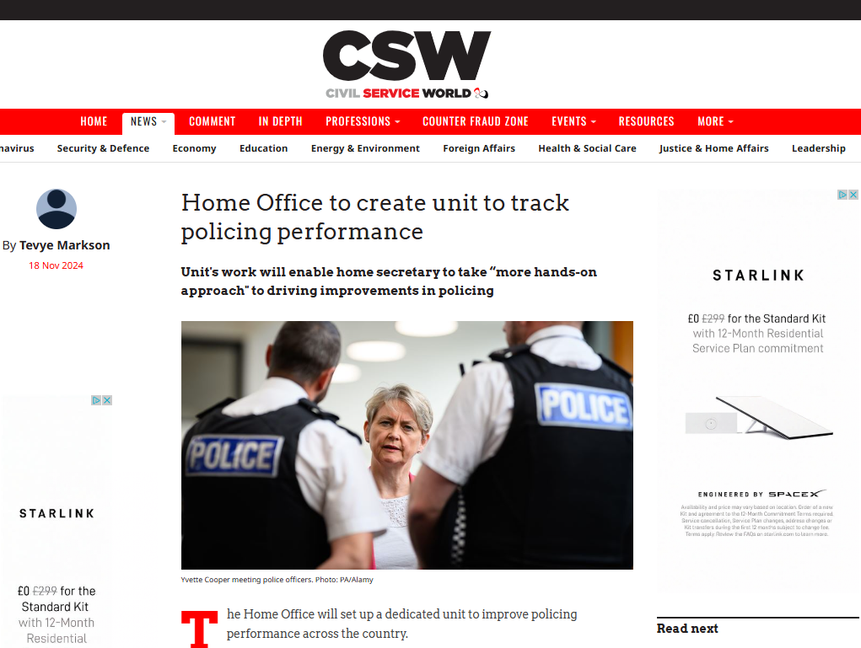
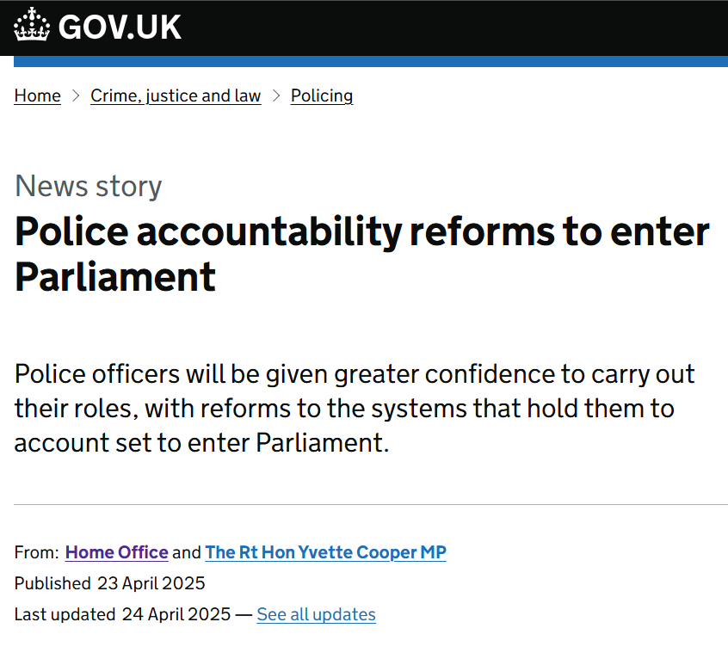

Slide 42
References
Home Affairs Committee (2022) Policing Priorities, 16th November 2022, available at https://parliamentlive.tv/event/index/53e7e655-3088-48e6-b9a1-94a5c499801f#player-tabs
Home Office (2022) Independent Report Commissioner Accountability Review 19th May 2022 https://www.gov.uk/government/publications/commissioner-accountability-review
House of Commons Library (2022) Social background of Members of Parliament 1979-2019, available at https://commonslibrary.parliament.uk/research-briefings/cbp-7483/
Holt-White, E. (2024) Sutton Trust Report: Parliamentary Privilege, available sat https://www.suttontrust.com/our-research/parliamentary-privilege-2019/
London Assembly (2022) Police and Crime Committee 16th November 2022, available at https://www.youtube.com/watch?v=b2VNrrFq1Gk
Lucas, C. (2015) Honourable Friends: Parliament and the Fight for Change. London: Portabello Books.
Holt-White, E. (2024) Parliamentary Privilege: Educational backgrounds of the new House of Commons. Sutton Trust, available at https://www.suttontrust.com/wp-content/uploads/2024/07/Parliamentary-Privilege-2024-1.pdf

