Slide 1
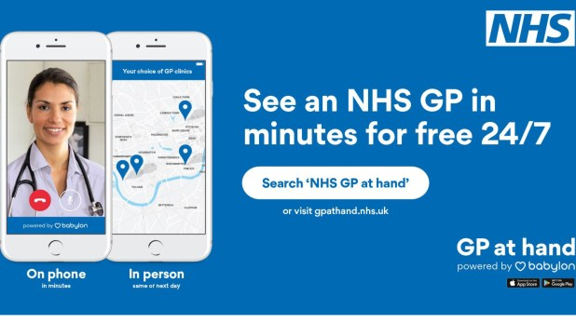

Student Name: Olufemi Idowu Afolabi Odubitan
Student Number: 2321211
Digital First Primary Care Transformation through eMed GP at Hand

Slide 2
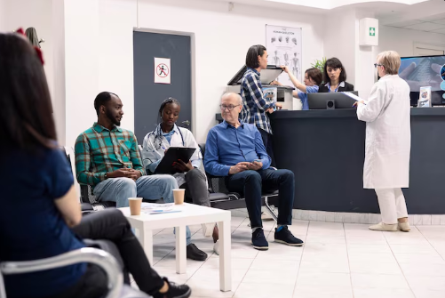
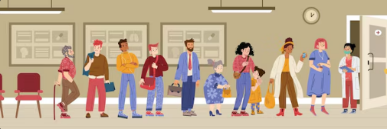
Why Primary Care Needed Change
Rising patient demand placed sustained pressure on GP services across England
Patients experienced long telephone queues and difficulty securing appointments
Workforce shortages increased clinician workload and reduced consultation time
NHS policy encouraged digital solutions to improve access and system efficiency
Digital innovation emerged as a response to structural pressures rather than technological experimentation
NHS England (2019); Baird et al. (2018)

Slide 3
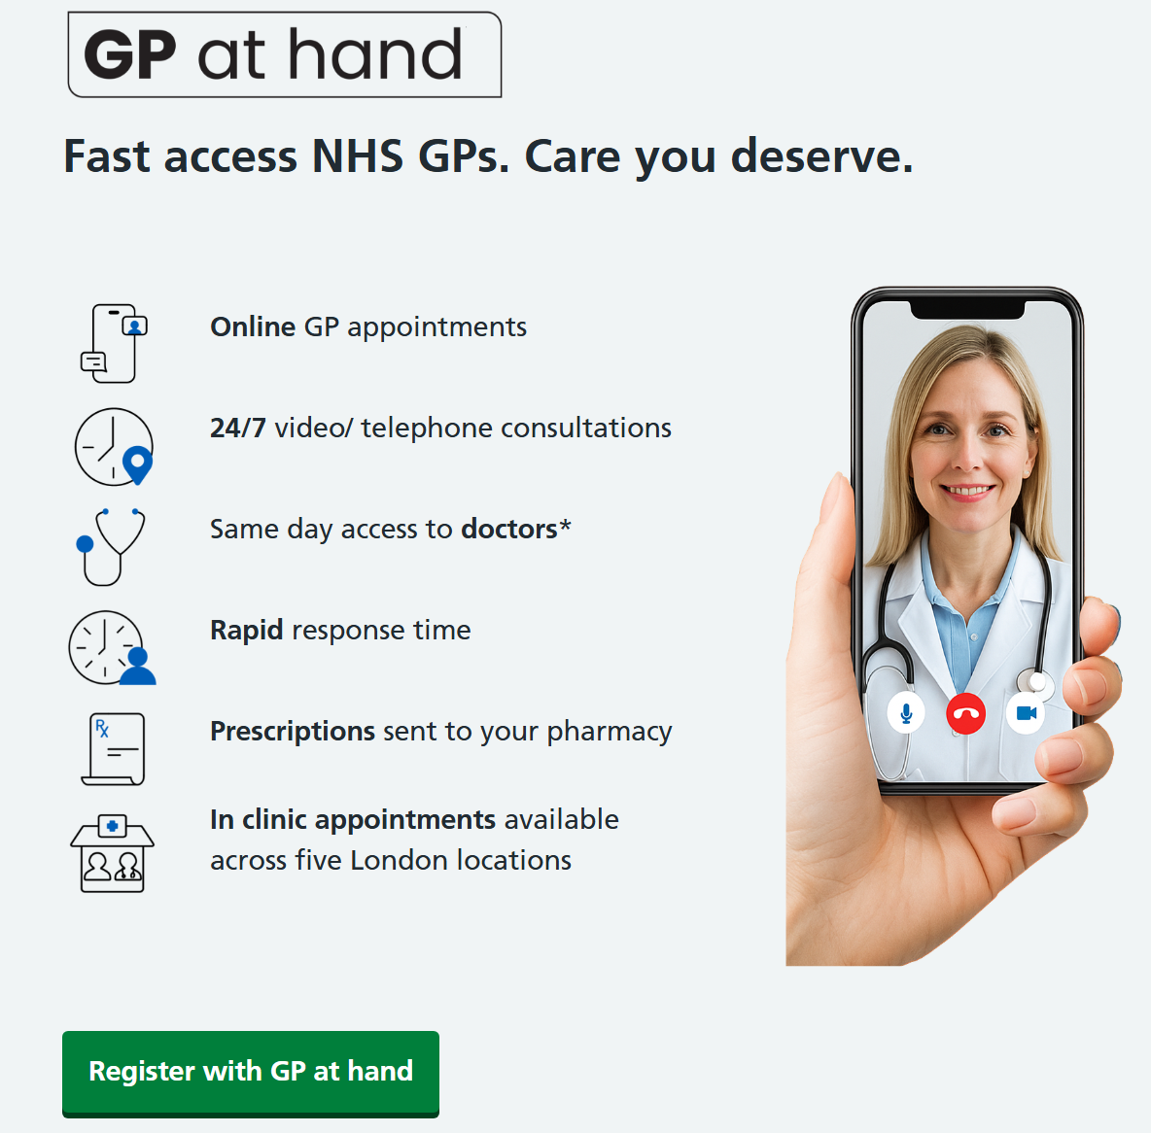
GP at Hand: A Digital-First Model
GP at Hand introduced app-based registration and online triage within NHS primary care
Patients could request consultations through smartphone platforms instead of reception booking systems
Care delivered through video consultation, messaging and remote clinical assessment
Designed to provide faster access while reducing administrative workload
Later transitioned into eMed GP at Hand following organisational restructuring
Shahzad & King (2026), GP at Hand, 2024; & Lacobucci, 2019

Slide 4
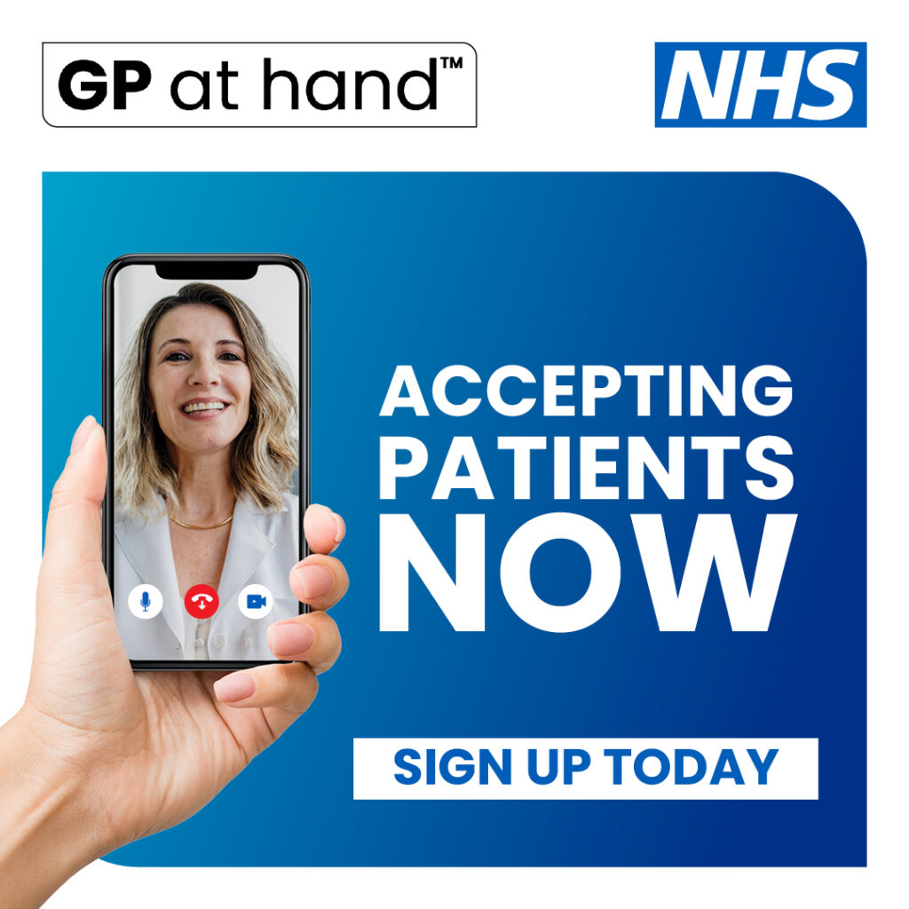
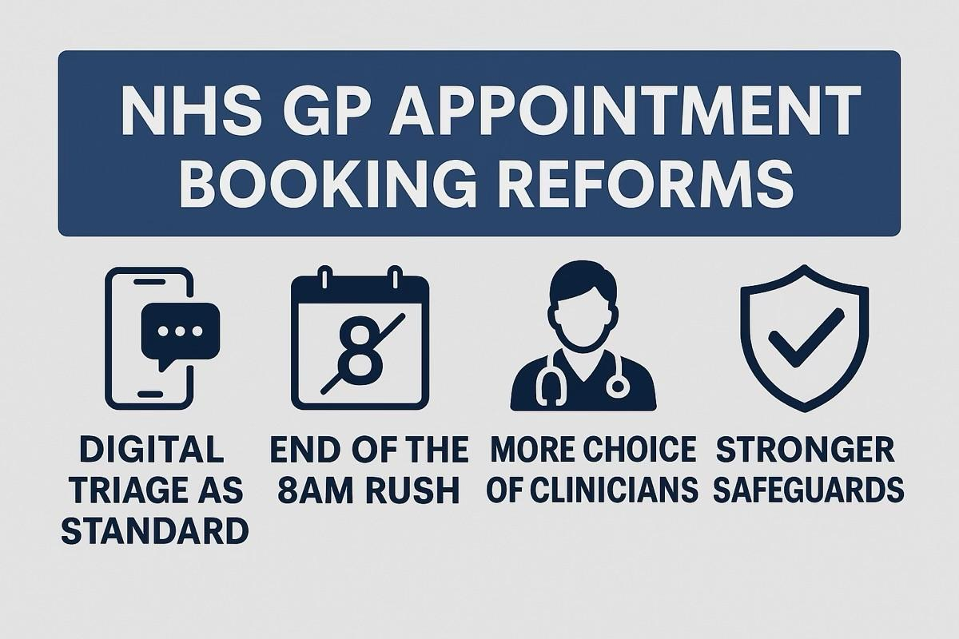
Redefining Access to Healthcare
eMed GP at Hand replaced traditional appointment booking with app-based clinical entry into NHS primary care
Patients submitted symptoms digitally before clinician contact, allowing prioritisation of care needs
Remote consultations enabled access without attendance at a local surgery
The model shifted GP services from geographically bound practices toward digitally coordinated care
Faster consultation access became a defining feature of the eMed GP service model
Murphy et al. (2021); NHS England (2019)

Slide 5
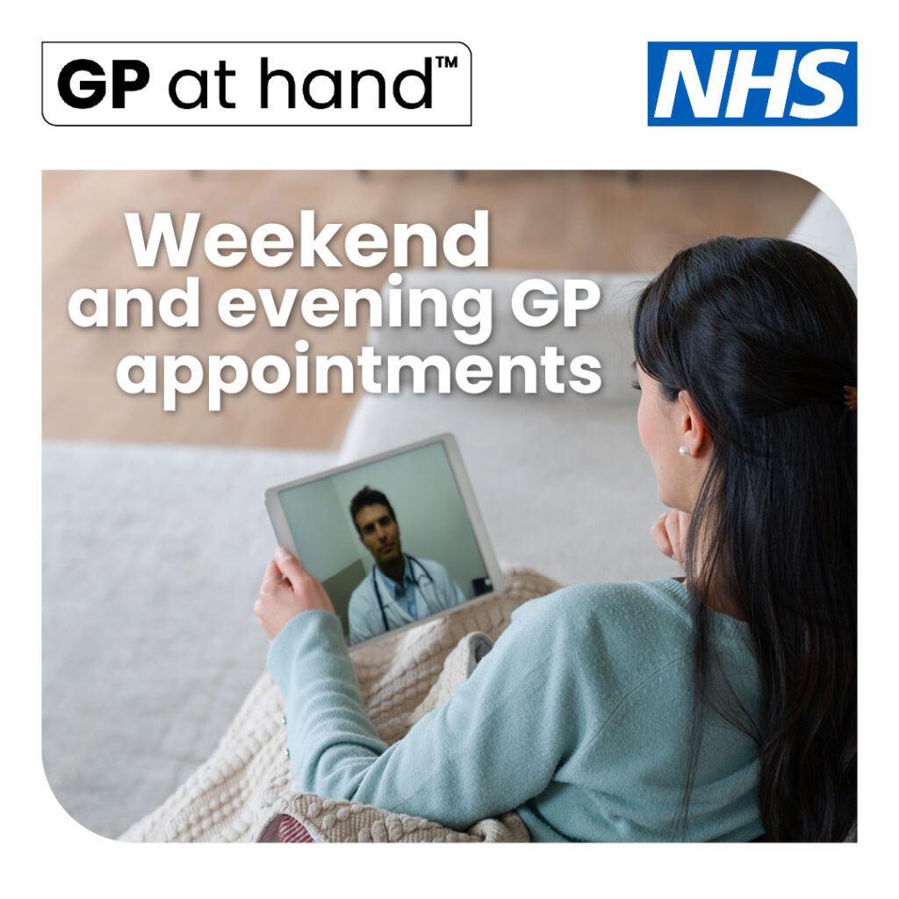
Transforming Clinical Work and Professional Roles
Remote consultations shifted part of clinical practice from physical examination to digital interaction
Clinicians required new competencies in digital communication and remote decision-making
Online triage redistributed workload by filtering administrative and minor clinical requests
Reduced visual examination sometimes increased clinical uncertainty
Workforce adaptation became essential for safe digital service delivery
Greenhalgh et al. (2020); RCGP (2020); Murphy et al. (2021)

Slide 6
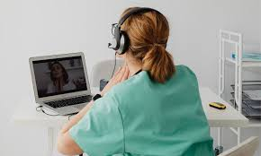
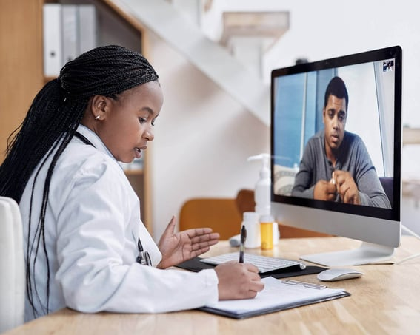
Reorganising Service Delivery
GP services moved from location-based appointments toward demand-responsive digital access
Algorithm-supported triage directed patients to appropriate care pathways
Remote consultations improved speed of initial clinical contact
Some digital consultations generated follow-up visits when physical assessment was required
Efficiency gains depended on appropriate integration with traditional care systems
Atherton et al. (2018); Newbould et al. (2024); Ladds et al. (2023)

Slide 7



Changing Patient Expectations
Patients reported high satisfaction linked to convenience and rapid access
Reduced travel and waiting time improved healthcare engagement
Digital consultations suited individuals balancing employment or education commitments
Younger and healthier populations adopted digital-first services more frequently
Concerns emerged regarding continuity of care in episodic remote interactions
Nuffield Trust (2019); Salisbury et al., (2020); & Shahzad & King (2026)

Slide 8


Community and Population Implications
Digital registration challenged traditional locality-based GP service organisation
Unequal digital literacy influenced who benefited most from online services
Older adults and disadvantaged groups showed lower uptake of remote consultations
Risk of widening health inequalities without inclusive digital strategies
Community planning increasingly required system-level coordination rather than individual practice responses
NHS England (2023); Ladds et al. (2023); Aminu et al. (2025)

Slide 9

Innovation Versus Sustainability
GP at Hand improved access but generated funding and workforce debates within the NHS
Patient redistribution affected financial stability of neighbouring practices
Algorithm-driven assessment raised questions about balancing efficiency with patient-centred care
Organisational restructuring highlighted limits of rapid digital expansion
Digital innovation produced both progress and unintended system pressures
Nuffield Trust (2019) & Shahzad & King, (2026)

Slide 10


What Healthcare Systems Must Learn
Technology alone does not transform healthcare without workforce readiness
Digital models must support clinical judgement rather than replace professional expertise
Equity considerations are essential when implementing digital services
Hybrid models combining digital and face-to-face care appear most sustainable
Successful innovation requires alignment between technology, policy and community needs
NHS England (2023); Greenhalgh et al. (2020); Baird et al. (2018)

Slide 11
References
Aminu, A.Q., Sinclair, D.R., Davies, K., Hall, A., Wiedemann, M., O'Neill, T.W., Clegg, A. and Todd, C. (2025) ‘Disparities in the use of remote general practice consultations: learning from the COVID-19 pandemic, an analysis of 19 million electronic health records using OpenSAFELY’, BMC Medicine, 23(1), p.673. Available at: https://doi.org/10.1186/s12916-025-04469-1 (Accessed: 15 February 2026).
Atherton, H., Brant, H., Ziebland, S., Bikker, A., Campbell, J., Gibson, A., McKinstry, B. and Salisbury, C. (2018) The potential of alternatives to face-to-face consultation in general practice. NIHR Health Services and Delivery Research. Available at: https://www.journalslibrary.nihr.ac.uk/hsdr/hsdr06200/ (Accessed: 19 February 2026).
Baird, B., Charles, A., Honeyman, M., Maguire, D. and Das, P. (2018) Understanding pressures in general practice. London: The King’s Fund. Available at: https://www.kingsfund.org.uk/publications/pressures-in-general-practice (Accessed: 19 February 2026).
GP at Hand (2024) GP at Hand patient service information. Available at: https://www.gpathand.nhs.uk/ (Accessed: 26 February 2026).
Greenhalgh, T., Wherton, J., Shaw, S. and Morrison, C. (2020) ‘Video consultations for COVID-19’, BMJ, 368, p.m998. Available at: https://doi.org/10.1136/bmj.m998 (Accessed: 26 February 2026).
Lacobucci, G. (2019) ‘GP at Hand: patients are less sick than others but use services more’, BMJ, 365, l2333. Available at: https://www.bmj.com/content/365/bmj.l2333 (Accessed: 15 February 2026).
Ladds, E., Khan, M., Moore, L., Kalin, A. and Greenhalgh, T. (2023) ‘The impact of remote care approaches on continuity in primary care: a mixed-studies systematic review’, British Journal of General Practice, 73(730), pp.e374–e383. Available at: https://doi.org/10.3399/BJGP.2022.0398 (Accessed: 15 February 2026).
Murphy, M., Scott, L., Salisbury, C., Turner, A., Scott, A., Denholm, R., Lewis, R., Iyer, G., Macleod, J. and Horwood, J. (2021) ‘Implementation of remote consulting in UK primary care following the COVID-19 pandemic’, British Journal of General Practice, 71(704), pp.e166–e177. Available at: https://bjgp.org/content/71/704/e166 (Accessed: 15 February 2026).
Newbould, J., Hocking, L., Sidhu, M. and Daniel, K. (2024) Digital first primary care for those with multiple long-term conditions: a rapid review of stakeholder views, Health and Social Care Delivery Research, 12(21), pp.1–68. Available at: https://doi.org/10.3310/AWBT4827 (Accessed: 15 February 2026).
NHS England (2019) Digital first primary care. Available at: https://www.england.nhs.uk/gp/digital-first-primary-care/ (Accessed: 17 February 2026).
NHS England (2023) Inclusive digital healthcare: a framework for NHS action on digital inclusion. Available at: https://www.england.nhs.uk/long-read/inclusive-digital-healthcare-a-framework-for-nhs-action-on-digital-inclusion/ (Accessed: 15 February 2026).
Nuffield Trust (2019) Digital-first primary care: what is GP at Hand and what does it mean for the NHS? Available at: https://www.nuffieldtrust.org.uk/research/digital-first-primary-care (Accessed: 15 February 2026).
Royal College of General Practitioners (2020) Remote consultations guidance for GPs. Available at: https://www.rcgp.org.uk (Accessed: 19 February 2026).
Salisbury, C., Quigley, A., Hex, N. and Aznar, C. (2020) ‘Private video consultation services and the future of primary care’, Journal of Medical Internet Research, 22(10), e19415. Available at: https://doi.org/10.2196/19415 (Accessed: 15 February 2026).
Shahzad, I. and King, M. (2026) ‘A systemic longitudinal case study of the eMed GP at Hand digital first primary care model’, Discover Health Systems, 5(1), p.10. Available at: https://doi.org/10.1007/s44250-026-00344-9 (Accessed: 15 February 2026).

