Slide 1

Stereo Microphone techniques
Adam-James Laveaux

Slide 2
Stereo recording
In order to hear width, depth and spaciousness we need to hear in two-channel stereo.
Our brain uses different cues to detect localization:
Time.
Level.
Spectral.

Slide 3
Types of stereo setups
Spaced
Near-Coincident
Coincident

Slide 4
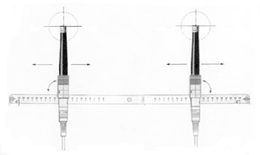
Spaced
A-B Stereo
Two spaced (often omnidirectional) microphones.
Optimal microphone spacing of between 40 and 60 cm.
An increase in microphone spacing will decrease the system's ability to reproduce the signals from sound-sources positioned directly between the microphones.
Low mono-compatibility.
(Dpamicrophones.com, 2015)

Slide 5
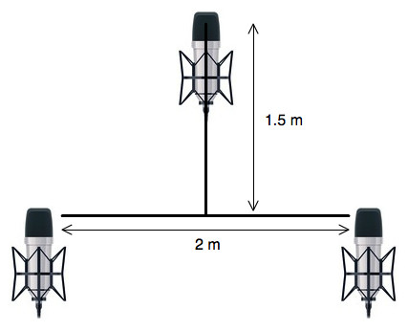
Spaced
Decca Tree
3 omnis in a triangle.
The two outside microphones are so far apart that a "hole in the middle" will occur without adding the centre mic.
The centre mic should be mixed in to fill up this hole.
Outer distances are seen from 60 cm to 120 cm.
The third, in the centre, can be slightly lower than and in front of the outside pair.
(Dpamicrophones.com, 2015)

Slide 6
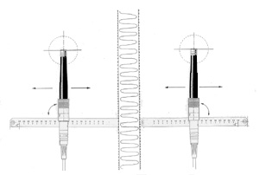
Spaced
Baffled Stereo (Jecklin)
When placed between the two microphones in a spaced stereo set-up like A-B stereo, the shadow effect from the baffle will have a positive influence on the attenuation of off-axis sound sources and thereby enhancing the channel separation.
Most common form is the Jecklin Disc.
Baffle should be made from an acoustic absorbent and non-reflective material.
(Dpamicrophones.com, 2015)

Slide 7
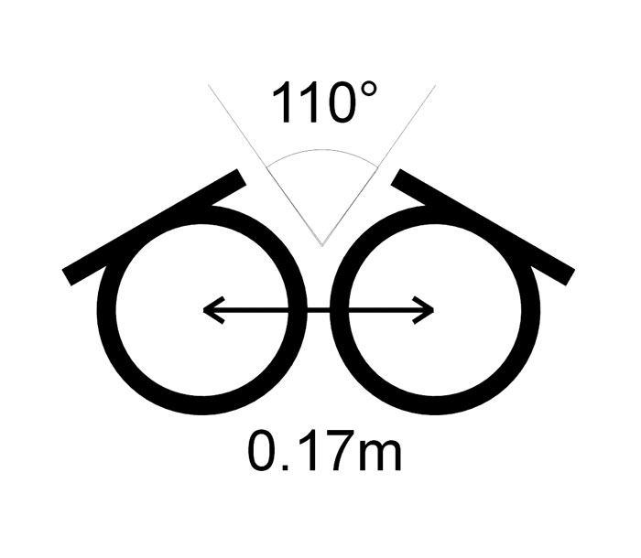
Near Coincident
ORTF
Two cardioid microphones with a spacing of 17 cm between the microphone diaphragms, and with an 110° angle between the capsules.
The spacing of the microphones emulates the distance between the human ears.
The angle between the two directional microphones emulates the shadow effect of the human head.
(Dpamicrophones.com, 2015)

Slide 8
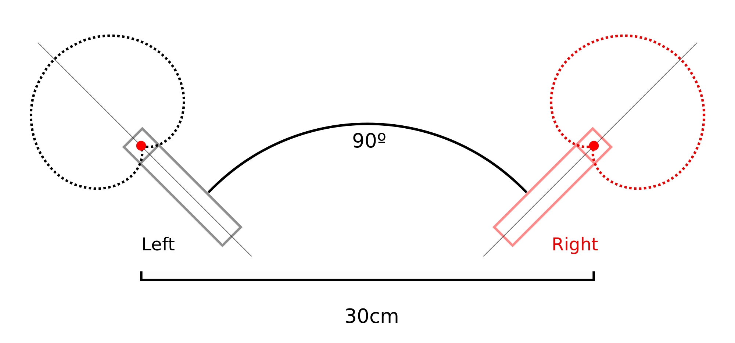
Near Coincident
NOS Stereo
Two cardioid microphones spaced 30 cm apart and angled at 90° to create a stereo image.
If used at larger distances to the sound source the NOS stereo technique will lose the low frequencies.
More useful at shorter distances, for example on piano, small ensembles or used for creating stereo on a instrument section in a classical orchestra.
(Dpamicrophones.com, 2015)

Slide 9
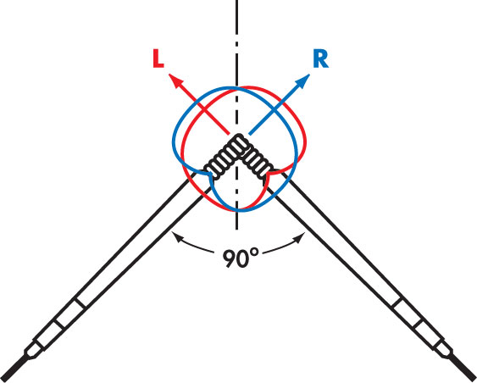
Coincident
XY Stereo
Two microphones (cardioids) in the same point (coincident) and angled to create the stereo image.
Angled at typically 90°
XY stereo is a difference-in-level stereo.
Opening angles of 120° to 135° or even up to 180° between the capsules are also seen, which will change the recording angle and stereo spread.
Often a close-miking application choice.
(Dpamicrophones.com, 2015)

Slide 10
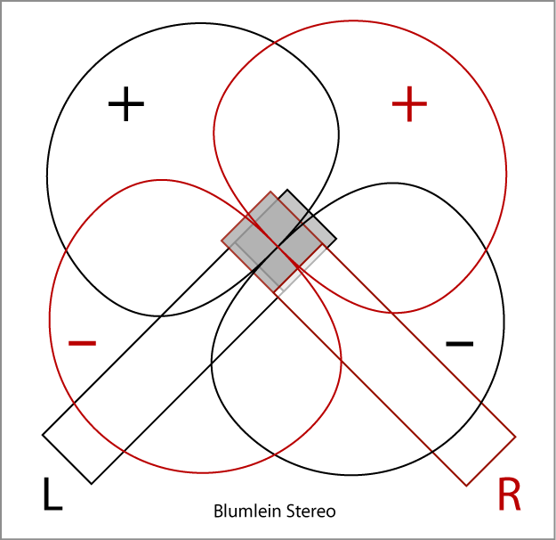
Coincident
Blumlein Pair
Two bi-directional microphones placed in the same point and angled 90° creating the stereo image.
It has a higher channel separation than the XY stereo
Has the disadvantage, that sound sources located behind the stereo pair also will be picked up and even be reproduced with inverted phase.
(Dpamicrophones.com, 2015)

Slide 11
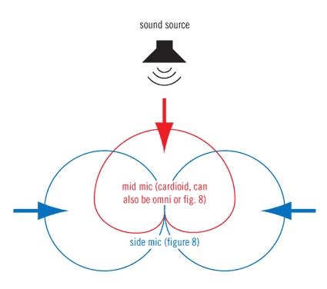
Coincident
M-S Stereo (Mid-Side)
One cardioid microphone and one bi-directional microphone in the same point and angled 90° creating a stereo image.
M means Mid mic and S means Side mic.
Well suited for stereo recordings where a good mono-compatibility is needed
Requires an inverted copy of the Side mic in order to achieve the stereo image.
(Dpamicrophones.com, 2015)

Slide 12
Summary
Spaced | Near-Coincident | Coincident
A-B | ORTF | X-Y
Decca Tree | NOS | Blumlein Pair
Baffled | DIN (Similar to NOS) | MS (Mid-Side)
Dpamicrophones.com, (2015). DPA Microphones :: Microphone University: Stereo Techniques. [online] Available at: http://www.dpamicrophones.com/en/Mic-University/StereoTechniques.aspx [Accessed 25 Oct. 2015].

