Slide 1

Problem Solving and Decision Making

Slide 2
Table of Contents
INTRODUCTION
Task 1: Identifying Nature and Scope of Problem through 5W2H Analysis
Task 2: Interpreting External Factors through PESTLE Analysis
Task 3: Cause-and-Effect Analysis and diagram
CONCLUSION
REFERENCES

Slide 3

INTRODUCTION
Problem solving is an overall process of finding solution to a certain problem that business is facing.
While decision making is an act of choosing most effective option from many solution (Heerkens, and Van Winden, 2021).
Green Haven Florists was once thriving independent flower shop in Norwich, UK, founded by Liam and Priya Patel in 2016, business quickly built reputation for their bespoke arrangements and a strong commitment to sustainable practices.
Notes:
The presentation will include identify the problem and explain the nature and scope of the problem in detail through 5W2H method and identify and interpret external factors impacting the company using a PESTEL analysis and produce and cause-and-effect analysis which identifies the roots of the problem

Slide 4
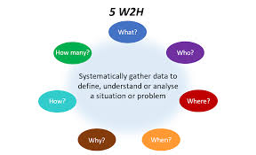
Task 1: Identifying Nature and Scope of Problem through 5W2H Analysis
5W2H analysis is a problem solving technique that uses seven of questions What, Who, Where, When, Why, How and How to gain deep understanding of problem and situation which further help in root cause analysis (Perdana, and Putro, 2024).
What is the problem?
The core problem for Green Haven is significant decline in their revenue and profitability and Green Haven Florists have suffered a 30% drop in their in-store sales over the last year while online orders have seen a slight increase.
Notes:
What is the problem?
However, it is not nearly enough to offset this massive loss in foot traffic, revenue decline is worsened by rising operational costs primarily from inflation.

Slide 5
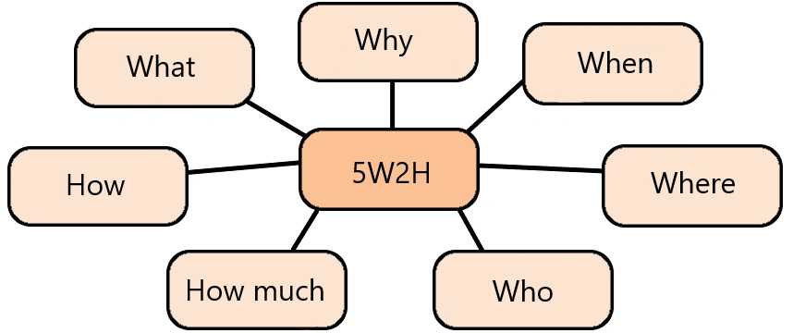
Continue
Why is this a problem?
This situation is serious threat to the financial viability and long-term sustainability of Green Haven a 30% reduction in a major revenue stream is unsustainable and if it is left unaddressed this can lead to the business's closure.
Who is affected?
Founders of shop are directly impacted as they are facing immense financial and emotional pressure due to their business struggling to stay afloat.
Notes:
Why is this a problem?
This happened due to decreased foot traffic in high street and outdated online website of the shop with increasing prices.
Who is affected?
They are also struggling to adapt to new digital first market and feeling out of their element with modern marketing strategies.

Slide 6

Continue
Where is this happening?
The problem is happening in to places one is physical shop in Norwich and their online platform also sees this decline.
When did this start?
The decline became noticeable over the last 12 months which coincides with rising inflation and new competitors entering the market.
Notes:
Where is this happening?
The decline in foot traffic is a specific problem at the physical location while the online presence is weak and ineffective due to an outdated website and poor marketing.
When did this start?
This has accelerated the shift towards online shopping of flowers from the new retailers at cheaper cost.

Slide 7
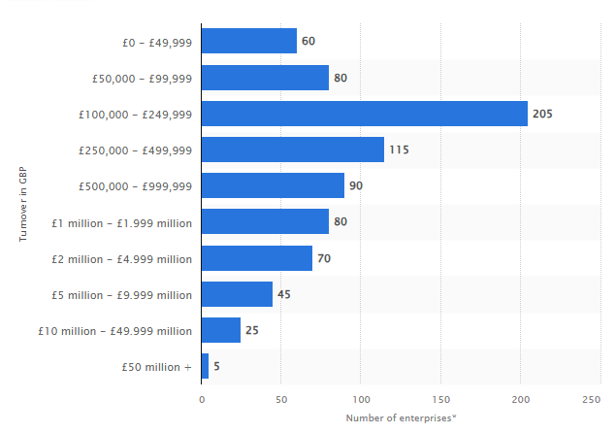
Continue
How did this happen?
This happened because Green Haven failed to evolve their model with changing consumer behaviour.
How much is the impact?
The impact is significant because a 30% drop in in-store sales financially means a major reduction in cash flow and profits.
Interpretation: This bar chart shows that the number of UK plant propagation enterprises across different turnover ranges and the highest concentration of businesses falls within the £100,000 to £249,999 turnover bracket
Notes:
How did this happen?
Mainly the online purchasing and owner’s lack of digital marketing expertise also left them unable to compete with more tech-savvy rivals.
How much is the impact?
And it also represents loss of market share, brand image and customer loyalty in the market for Green Haven florist.

Slide 8

Task 2: Interpreting External Factors through PESTLE Analysis
PESTLE is crucial for identifying the external macro-environmental factors as it helps manager in anticipating trends and identify opportunities, eliminate threats and inform strategic planning in structured way (Dunaievskyi, 2022).
Political: Fluctuations in foreign trade policies and tariffs impact the cost of imported flowers, like orchids and tulips which is already seeing price hikes
Economic: Inflation is a major driver of rising operational costs for Green haven which is squeezing their profit margins (Batayneh, Al Salamat, and Momani, 2021). Accoridng to IBISWorld, (2024), UK florist industry saw its revenue decline at a compound annual growth rate of 0.6% over the five years leading up to 2025 which shows that market size decreased by 10.3% in 2024, to an estimated $1.1 billion.
Notes:
Political: While Green Haven’s locally sourced items may be insulated from some trade issues but their reliance on imports for variety exposes them to political and trade instability.
Economic: Global supply chain issues have increased the price of fresh flowers while imported flowers are particularly affected which has also impacted the variety provided by Green haven to their customers.

Slide 9
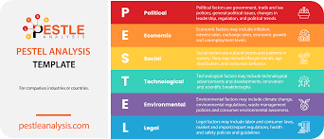
Continue
Social: The major social factor here is changing customer behaviour and their interest toward online delivery and large retailers.
Technological: Green Haven's outdated website which is difficult to navigate is repelling the customer away with increasing trend of online flower delivery traditional model with just a physical shop is not appealing customers.
Environmental: While Green Haven's commitment to sustainable materials is brand asset but it is also increasing their budget cost and straining finances
Legal: changes in legal regulations may increase operations cost for founders and may present legal problems as well. The major law that regulated this industry is general health, safety, and employment laws, such as the Health and Safety at Work Act 1974 (Health and Safety Executive, 2025).
Notes:
Social: Plus reduced activity in high street due to the closure of nearby businesses and a general shift toward online shopping.
Technological: Their reliance on word of mouth marketing and lacking social media posts puts business at severe disadvantage against competitors with strong digital marketing strategies and social media presences.
Environmental: Importing flowers from different locations is exposing shop to supply chain vulnerability and potential environmental disruptions.
Legal: Evolving environmental regulations can have negative impact on Green Haven

Slide 10
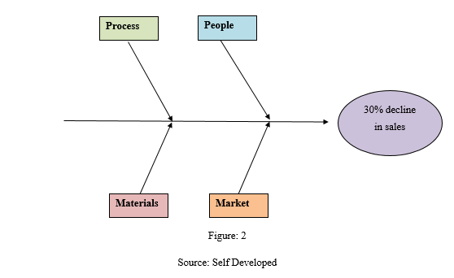
Task 3: Cause-and-Effect Analysis
This is a visual tools which is also known as fishbone diagram help in providing approach to root cause analysis and help in organise potential causes into categories and help in improving problem solving effectiveness (Kumah, and et al. 2024).
There are combinations of factors which is contributing to the declining sales at Green Haven Florists.
People
Management: Owners lack digital marketing skills is hindering their online growth.
Process
Technology: their outdated is providing poor user experiences which is causing less online sales.
Market
Competition: New competitors and trendy social media florist and large retailers with cost leadership are increasing market pressure.
Notes:
Process
Operations: their lack of modern day fast delivery services and being unable to meet evolving customer demands is one the cause.
Market
Environment: Reduced local foot traffic in high street and inflation are external forces which is impacting the sales and costs.
Materials
Cost: increasing cost of sustainable materials and imported flowers due to supply chain issues are decreasing profits for Green Haven Florist.

Slide 11

CONCLUSION
This presentation concluded by finding the various factors driving the declining sales crisis of Green Haven Florists which included external market pressures and internal strategic weaknesses.
The steep 30% declines sales entailed about major deeper level problems such as failure to embrace digital commerce.
Notes:
Increasing competition and mounting cost pressures due to supply chain issue and inflation. This highlighted how their traditional business model which once brought then success is not sufficient anymore.

Slide 12
REFERENCES
Books and Journals
Heerkens, H. and Van Winden, A., (2021). Solving managerial problems systematically. Routledge.
Perdana, I.K.W.Y. and Putro, U.S., (2024). Applying An Analytical Hierarchy Process For Strategic Decision-Making Of Business Solution To Address Sales Decline In SMEs:(Case study: TB. Buyung Mas Putri). Jurnal Manajemen Bisnis, 11(2). pp.2006-2022.
Dunaievskyi, S.S., (2022). Pestle Analysis: An Important Business Analysis Tool. Ministry Of Education and Science of Ukraine Vn Karazin Kharkiv National University, p.57.
Kumah, A., and et.al (2024). Cause-and-effect (fishbone) diagram: a tool for generating and organizing quality improvement ideas. Global journal on quality and safety in healthcare, 7(2). pp.85-87.
Notes:
Batayneh, K., Al Salamat, W. and Momani, M.Q., (2021). The impact of inflation on the financial sector development: Empirical evidence from Jordan. Cogent economics & finance, 9(1). p.1970869.
Online
Statista, (2025). Number of enterprises for the wholesale of flowers and plants in the United Kingdom (UK) in 2024, by turnover size band [Online] Accessed through :< Flowers and plants wholesale: UK enterprises by turnover 2024| Statista> [Accessed on 11th October 2025].
IBISWorld, (2024). Flower & Plant Growing in the UK - Market Research Report (2014-2029) [Online] Accessed through :< https://www.ibisworld.com/united-kingdom/industry/flower-plant-growing/55/#:~:text=Flower%20&%20Plant%20Growing%20in%20the%20UK%20industry%20analysis,East's%20climate%20fuels%20flower%20farming. > [Accessed on 11th October 2025].
Health and Safety Executive, (2025). The Health and Safety at Work Act 1974 (HASAWA) band [Online] Accessed through :< https://www.hse.gov.uk/legislation/hswa.htm > [Accessed on 11th October 2025].

Slide 13
Thank you

