Slide 1
Digital Skills & Research Methods
Certificate of Higher Education in Skills for the Workplace
Veronica Osei (1907170); Anita Ajmani (1817900);Wasim Samsudeen (1908197);
Ervin Kompus (1907376)
Course Tutor: Dr Kazeem Oseni
Group 9

Slide 2
Agenda-
Digital Skills & Research Methods
Background of the Organisation – ASDA – (by Veronica Osei)
The challenges before the introduction of modern technology – (Veronica Osei)
Insights to the modern technology introduced (Wasim Saamsudeen)
Impact of the technology introduced – (Anita Ajmani)
Lessons that can be drawn from the case study -( Ervin Kompus)
References

Slide 3

Background of ASDA
ASDA Stores LTD Is a British Supermarket retailer and was founded in 1949
In 1999 ASDA was taken over by American Retail WALMART
ASDA in January 2017 owned a total amount of 631 Stores
ASDA is the Second largest Chain in the UK after Tesco
ASDA have more the 140,000 dedicated Asda Colleagues

Slide 4




ASDA Introduces
Colleague Self Service (CSS) was introduced approximately 2 years ago.
Is a digital system to allow colleagues to access there own portal to allow them to change or update personal information, Bank details, and many more
Before (CSS) was brought to the company there was a Human Resources department. This department done everything manually for the employees
When (CSS) came into action Digital Technology dramatically changed everything.

Slide 5

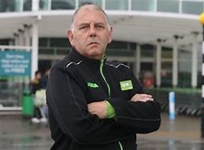
The Challenges before Colleague Self Service
Colleague found technology intimidating and was not looking forward to new system
Hours from Human Resources where taken resulting to job loss
A small minority of colleagues didn’t have access to smart phones or computers at home in order to get to there portal
Colleagues did not know how to use the new technology
There was a lot of technical issues with the website

Slide 6
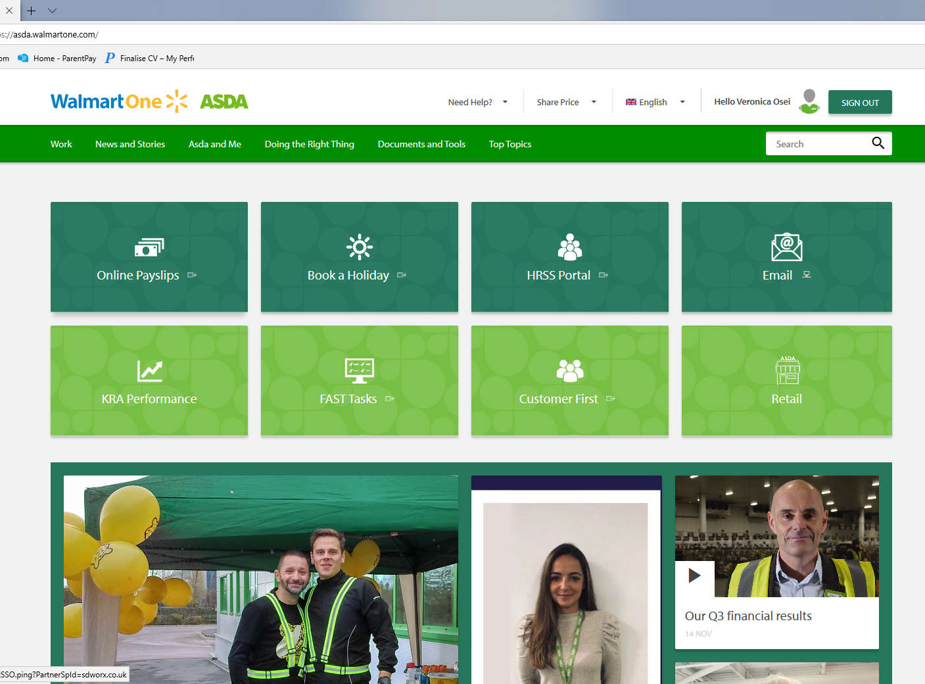
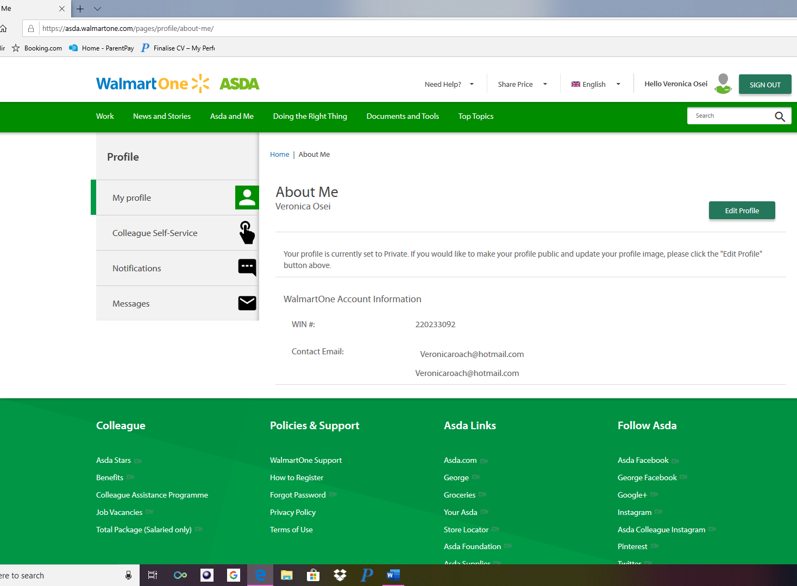
Features of Colleague Self Service
Update your details; such as mobile number, address, bank details
Request for annual leave via portal
Access your Payslips, P60
Access your Emails via Outlook 365
Access Training Materials, Job Specifics, Recruitment Forms
Report IT Issues with the workplace
Request Documentation such as Contract letters, Employment references

Slide 7

Insights to ASDA
Colleague Self Service
Accessible
Informative
Up to Date
Easy to Use
Learning Tool
You can access the website on all your devices with a internet connection
The website is very informative with business updates, & community updates
The Website contains real information and always has system updates if software needs improving
(CSS) is very easy to use when registered and have help line service to assist when needed
Is a great learning tool when training or learning about your department

Slide 8

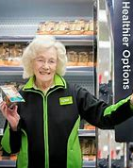
Positive
It is very efficient
It is user friendly
Easy access to Pay slips and hours worked.
It is easy to book holidays
Records are well maintained
Request documentation such as contracts, employment referencing
Employees get education resources for their training and development.

Slide 9


The Impact of ASDA Walmartone
The Impact of Walmart One Technology can be negative as well as positive
Negative
It can be difficult to access information if the internet connection is slow
Its can be HACKED
If someone has access to your password, they can access your information.
It is difficult for elderly people or people with learning difficulties
You might not have a smartphone or PC to access Walmart one.

Slide 10
Lesson that can be drawn from Asda Walmartone
In todays world Modern Technology is very impactful in business. Is it a way to help organise, calculate, present and inform.
Unfortunately although many jobs a have been lost due to Walmartone this portal reduces cost, its quick, and very accessible. Colleagues are now becoming more digital aware, which is beneficial in the upcoming future as technology expands everyday.
Although there are a few negatives about the website, it is very useful to have within the company ASDA. Colleagues are now registered whether new or long service colleagues.
Communication is still an essential part within the business despite the Walmartone portal as colleagues and managers still need to engage to create a good working relationship.

Slide 11
References
Finch, J. (2009) theguardian.com.[Photograph],
https://www.theguardian.com/business/2009/dec/18/asda-sales-up-christmas
Senior, J. (2011, September). www.express.co.uk. [Photograph],Retrieved December 1st, 2019, from https://www.express.co.uk/news/uk/707459/Meet-90-year-old-Asda-worker-NO-plans-retire
Sawers, P. (2011, May 16th). www.thenextweb.com. [Photograph], Retrieved December 1st, 2019, from https://thenextweb.com/uk/2011/05/16/asda-now-offers-cash-for-your-old-gadgets-but-is-it-value-for-money/
[Photograph]Retrieved December 1st, 2019 https://walmartone.onl/asda-walmartone-uk/.
(n.d.). [Photograph], Retrieved December 1st, 2019, from www.sign-in-box.com: https://sign-in-box.com/walmart-login
Walmartone.asda. (2019, November 23rd). www.asda.walmartone.com. Retrieved from https://walmartone.onl/asda-walmartone-uk/

