Slide 1

Student name: Kevin Tomko
Date: 11.07.2025
Research Title: “An In-Depth Analysis of Strategies Used by Managers to Inspire Employee Performance and Enhance Workplace Productivity"

Slide 2

Introduction
Background: Importance of employee motivation in modern organisations; low motivation leads to poor productivity and high turnover (Sultana et al., 2021).
Research Aim: To explore how managers motivate employees to improve performance and productivity.
Research Questions:
How do managers motivate employees?
What motivation theories are applied in practice?
How do employees perceive these motivational efforts?
Relevance: Post-COVID work trends (e.g., remote work, flexible hours) demand new motivation approaches tailored to evolving employee expectations.
Notes:
The effects of motivation on contemporary businesses are the focus of this study. Turnover, low morale, and poor production are all results of uninspired employees. Managers in today's cutthroat corporate world need to be able to motivate their staff to succeed (Sharma, 2025). The purpose of this research is to find out how big of an impact managers have on staff morale and output. Examining the effects of managerial incentive strategies on worker output is the primary goal of this study. The most crucial area of research is how managers may inspire their teams. The key research questions include: how do managers motivate employees? What motivational theories underpin these efforts? And importantly, how do employees respond to these strategies? Employees' motivation is shifting in a COVID-19 workplace due to factors such as remote work, flexible scheduling, and evolving expectations. Companies may better adapt to changing work environments and increase employee engagement by understanding these aspects (de Lucas et al., 2023).

Slide 3
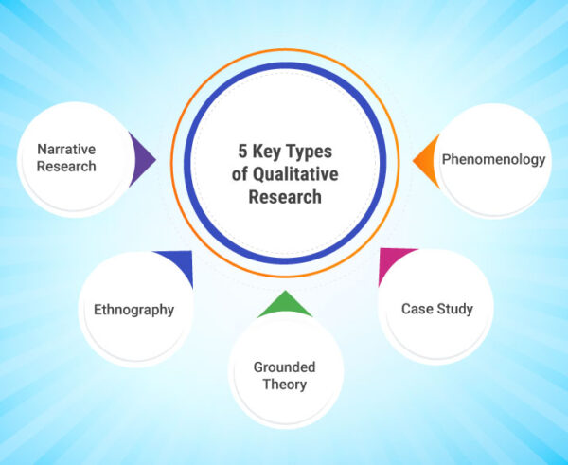
Methodology – Part 1
Research Type: This research adopts a qualitative approach, focusing on exploring behaviours, attitudes, and experiences related to employee motivation in a workplace setting.
1
Data Collection: Respondents will have the opportunity to express their perspectives while maintaining consistency through the use of semi-structured interviews (Buys et al., 2022).
2
Sample: The sample includes 10 employees and 5 managers from a medium-sized organisation, providing insights from both those who motivate and those being motivated.
3
Justification: It is reasonable to use a qualitative approach since it provides a comprehensive and in-depth comprehension of the ways in which motivational techniques are used and experienced in real-world settings (Wang and Huang, 2025).
4
Notes:
A qualitative research technique was selected to explore the intricacy and situational dependence of employee motivation. Qualitative research allows us to examine human experiences, attitudes, and behaviours, whereas quantitative research relies on numerical data. When trying to make sense of actual motivation, this study is fantastic. Methods such as semi-structured interviews will be used to gather data. This approach strikes a good mix between guided questions and the leeway to examine off-the-wall yet pertinent comments. While making sure important topics are addressed regularly, it also gives participants a platform to publicly share their viewpoints. Ten regular workers and five supervisors from a major company participated in this study. This two-pronged strategy allows us to comprehend motivation from the viewpoints of managers and workers alike. Because it depicts the real implementation and perception of motivation in organisational settings, this method is perfect for our research. As a result, the results are more applicable.

Slide 4
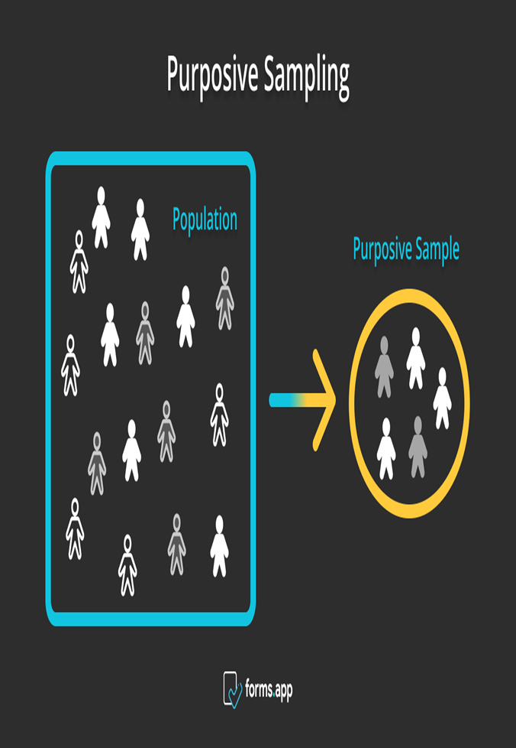
Methodology – Part 2
Sampling Technique: Purposive sampling was used to select participants with relevant experience, ensuring a rich diversity of perspectives on motivation practices (Ahmad and Wilkins, 2025).
01
Reliability: It was decided to employ a semi-structured interview guide in order to guarantee consistency and make room for additional investigation.
02
03
Validity: When triangulating, compare the responses of the employee and the boss. It was possible for participants to validate their statements through the use of member checking (Sridharan, 2021).
Notes:
For this investigation, purposive sampling was utilised. Using this approach, one searches for specialists in the subject who have direct knowledge. This technique guarantees that data that is full, useful, and relevant to understanding workplace motivation is collected. Interview methods that were just semi-structured were utilised so that dependability could be ensured. The participants were able to talk about their own personal experiences, despite the fact that they were all asked the same general topics. This method offers personal insights and ensures that interviews are consistent to one another. In order to boost validity, two primary strategies were utilised. In the beginning, triangulation made it possible to make comparisons by collecting data from all of the employees and management. Furthermore, we incorporated member checking into the process so that participants could verify the accuracy of their interview transcripts. By adhering to these guidelines, you may ensure that the results accurately reflect the experiences and perspectives of the participants.

Slide 5

Ethical Considerations – Part 1
Informed Consent
Participant Awareness: Every individual who takes part in the research is given comprehensive information on the objectives, methods, and rights associated with the study.
Consent Collection: The collection of consent calls for the acquisition of written consent before the beginning of any data collection.
Confidentiality
Identity Protection: Pseudonyms are used in transcripts and reports to protect participant identities.
Anonymity
Data Security: All data is stored on password-protected devices to prevent unauthorised access.
Notes:
It is necessary to take into consideration ethics in order to guarantee that participants are valued, safeguarded, and informed throughout the entirety of this research (Alhabsi, 2024. ). Begin by obtaining authorisation. An information document regarding the research's purpose, methods, data usage, and the participant's ability to withdraw from the study is given to each participant. According to Millum and Bromwich (2021), participants are required to sign a permission form prior to any interviews in order to verify that they are participating voluntarily. Giving everyone a pseudonym is the next step in protecting their privacy. This ensures that their real names are not included in the report that is compiled upon conclusion of the research. The researcher is the only one who can access any and all data that is kept on devices that require a password. Private information will not be disclosed in any way. These methods instill confidence in the participants and uphold intellectual and ethical standards by adhering to the parameters established by the appropriate institution.

Slide 6
Ethical Considerations – Part 2
Protection from Harm
Voluntary participants are made aware of their ability to withdraw from the research at any time without being required to provide a justification or face any kind of punishment associated with their decision.
University Compliance
Ethical Standards: In order to guarantee responsible behaviour, the study adheres exactly to the ethical principles established by the institution as well as the Code of Ethics established by the British Psychological Society (BPS).
Academic Integrity
Referencing and Attribution: All sources are cited using the Harvard referencing style, and participant quotes are properly anonymised and credited.
Notes:
The safety of the participants is the primary ethical issue in this investigation. Everyone who takes part in the research is made aware that their involvement is entirely voluntary and that they are free to quit at any time without incurring any consequences. In a setting that values respect, honest contributions are actively promoted. The research adhered to the institutional and ethical criteria established by the British Psychological Society (BPS). The whole process of the study, from the gathering of data to the reporting of findings, must be conducted in a manner that is professional, honest, and courteous. In order to safeguard the participants and maintain the integrity of the study, rules must be adhered to. At long last, intellectual property is safeguarded. In accordance with Harvard norms, all theoretical and literary sources are credited. The final record of the study includes participant comments that have been anonymised and correctly credited. This guarantees that the findings are verified in an ethical and legitimate manner.

Slide 7

Limitations & Recommendations
Challenges
Small and Purposive: The study relies on a limited number of participants, which may affect generalisability.
Time Constraints: A short research timeline restricted the depth and scope of data collection.
Access Issues: Difficulty in gaining access to multiple organisations reduced variability in responses.
Future Recommendations
Broader Scope: Future studies should involve more diverse organisations, adopt a mixed-methods approach, and allow more time for data collection.
Notes:
Similar to earlier studies, this one has its limitations. Our first concern was the intentionally limited sample size. Results from the purposeful sampling were helpful, however the study may not be generalisable to other industries due to the limited sample size. Problems were exacerbated by the lack of time. I could have improved the data quality by doing more research or following up on ideas, but I was short on time. It was also difficult to gain access to numerous organisations. The research may have benefited from include a wider variety of perspectives and organisational contexts, but it was confined to only one medium-sized business. To increase the study's generalisability, future research should involve other businesses. By combining qualitative insights with quantitative evidence, a mixed-methods approach would enable a more thorough and extensive investigation. Additionally, increasing data collecting would facilitate this (Wallwey and Kajfez, 2023).

Slide 8


Conclusion
Employee motivation in a medium-sized organisation is studied using a qualitative technique. Attitudes, experiences, and actions are the main points of discussion. Using a purposive sample technique, it administers semi-structured interviews to ten workers and five managers. The validity of the results is guaranteed by using a strict interview guide and triangulation. Informed consent, secrecy, data security, and willing participation are all part of the ethical framework. Following the standards set by the organisation and the Code of Ethics of the British Psychological Society, this research aims to provide practical insights into tactics for motivation in the workplace.

Slide 9
References
Ahmad, M. and Wilkins, S., 2025. Purposive sampling in qualitative research: A framework for the entire journey. Quality & Quantity, 59(2), pp.1461-1479. https://doi.org/10.1007/s11135-024-02022-5
Buys, T., Casteleijn, D., Heyns, T. and Untiedt, H., 2022. A reflexive lens on preparing and conducting semi-structured interviews with academic colleagues. Qualitative Health Research, 32(13), pp.2030-2039. https://doi.org/10.1177/10497323221130832
de Lucas Ancillo, A., Gavrila, S.G. and del Val Núñez, M.T., 2023. Workplace change within the COVID-19 context: The new (next) normal. Technological Forecasting and Social Change, 194, p.122673. https://doi.org/10.1016/j.techfore.2023.122673
Wang, D. and Huang, X., 2025. Transforming education through artificial intelligence and immersive technologies: enhancing learning experiences. Interactive Learning Environments, pp.1-20. https://doi.org/10.1080/10494820.2025.2465451
Alhabsi, S.S., 2024. Ethical considerations in obtaining informed consent in research participation. International Journal of Educational Contemporary Explorations, 1(1), pp.22-32. https://doi.org/10.69481/DIVL1152
Millum, J. and Bromwich, D., 2021. Informed consent: What must be disclosed and what must be understood?. The American Journal of Bioethics, 21(5), pp.46-58. https://doi.org/10.1080/15265161.2020.1863511
Sharma, D., 2025. The Impact of Employee Mental Health on the Success of the Organisation. In Prioritizing Employee Mental Health and Well-Being for Organizational Success (pp. 1-28). IGI Global Scientific Publishing.
Sridharan, V.G., 2021. Methodological Insights Theory development in qualitative management control: revisiting the roles of triangulation and generalization. Accounting, Auditing & Accountability Journal, 34(2), pp.451-479.
Sultana, U.S., Abdullah, N.E.T.M., Mok, E.T., Hossain, J., Sherief, S.R., Iskandar, M.L. and Andalib, T.W., 2021. Exploring Motivation and commitment on job satisfaction and employee performance in Work from Home (WFH) perspective. Psychology and Education, 58(3), pp.2411-2424.
Wallwey, C. and Kajfez, R.L., 2023. Quantitative research artifacts as qualitative data collection techniques in a mixed methods research study. Methods in Psychology, 8, p.100115. https://doi.org/10.1016/j.metip.2023.100115

Slide 10
Thank You!

