Slide 1

Vintners Antiques
By Grade one project management LTD
This Photo by Unknown Author is licensed under CC BY-NC

Slide 2

Module: project planning and management in workplace
Module: BMSW5104
Lecturer: Paul Ranson and Ernest Ovia
Mohammed Kammal Hussian

Slide 3
Students names and ID
Syed Moksudul Islam
1709371
Project manager
Sofina Hoque
1711906
Technical manager
Mohammed Kammal Hussian
1711129
Team leader
1711961
1708935
Parbez Ahmed
Finance manager
Mohammed Abdul Amin
Project co-ordinator

Slide 4

Our Company Values
Professional
Creative insight
teamwork

Slide 5

Grade one project management.
About us
We are a highly experienced company of expertise providing project management services in the building and construction services.
Our team of expertise understanding construction process managing project up to a million pound.
Our management team will design and deliver your needs and expectations through our skilled and knowledgeable employees.
We enjoy working with our clients and appreciate the business we receive.
This Photo by Unknown Author is licensed under CC BY

Slide 6
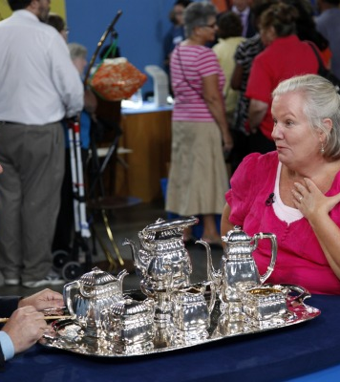
Project overview
Vintners antiques have recently received an offer from Tesco Express for the premises on Stratford road Shirley. Vintners antiques own another property on Stratford road Sparkhill currently used as a warehouse full of stocks. Vintners desire is to mirror Salvage Hunters business model and would like the warehouse to be renovated so it can be used as a showroom, point of collection, repair and refurbishment and storage.
Mohammed Kammal Hussian
This Photo by Unknown Author is licensed under CC BY-SA

Slide 7
Project sponsor and steering group
Denis Vintner
Steering group
Commercial
Doreen Vintner
Project Sponsor
Specialist
Omar King
User
Suhan Madani
Mohammed Abdul Amin

Slide 8
Project sponsor
Denis Vintner
Mohammed Abdul Amin

Slide 9
Project steering group
Commercial
Doreen Vintner
User
Suha Madani
Specialist
Omar King
Mohammed Abdul Amin

Slide 10
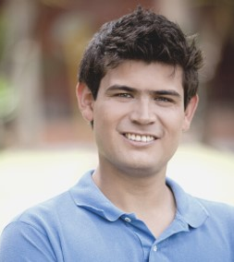
Project sponsor-Denis Vintner’s role
Denis is the decision-maker; his role is to make sure he is involved in the project from the early stage. He will be involved in creating the steering group. As one of the main stakeholder he must oversee the risks, manage problems and support the project so the business visions and objectives are achieved. He is the expert in finding and buying the old antiques.
Mohammed Abdul Amin

Slide 11

Steering group-
Doreen Vintner’s role
Doreen is the financer of the project, as she works in the accounts department in Vintner’s she the most experience in budgets. She will maintain how the money is being allocated within the project. She will supervise the financial side of the project day to day cost of running the business.
Mohammed Abdul Amin

Slide 12

Project sponsor-Omar King’s role
Omar the allrounder, he has the expertise in repairing and restoring old artefacts. With his skills, he plays the central role in maintaining, repairing and getting goods ready for sales. His duty will be to work in the warehouse as he knows where everything is located.
Mohammed Abdul Amin

Slide 13

Project sponsor-
Suha Madani’s role
Suha’s is the popular one with the customers, and her primary role will be to maintain the sales and service with buyers and users of the antiques. She will be working in the sales department making sure customers receive the best sales experience.
Mohammed Abdul Amin

Slide 14

Scope of the project: Building and planning
To draw up a plan and layout for the proposed building and structural work using a architect.
Acquire planning permission from the local council via architect.
Build office space, storage area, warehouse, shelves, reception area and driveaway.
Build a toilet and kitchen area for staffs.
Sofina Hoque

Slide 15
Scope of the project: brick and plastering work.
To build toilet.
To separate office space.
To create kitchen area.
Sofina Hoque

Slide 16
Scope of the project continued: electrical works
Full electrical wiring.
To install tube lights, ceiling lights, wall socket and light switches smoke alarm and fuse box.
Install electrical fan heating.
Sofina Hoque

Slide 17
Scope of the project continued: plumbing and drainage
Full drainage for kitchen and toilets .
Fitting pipework's for kitchen and toilets.
Fitting toilets and sinks.
Fitting kitchen sinks.
Sofina Hoque

Slide 18
Scope of the project continued: decorating and carpentry
Painting internal office area, storage, warehouse, reception area, toilet and kitchen.
Wall paper reception area.
Complete flooring.
Attach doors and skirting.
Build a welcome desk, fit kitchen cupboards and sink.
Sofina Hoque

Slide 19
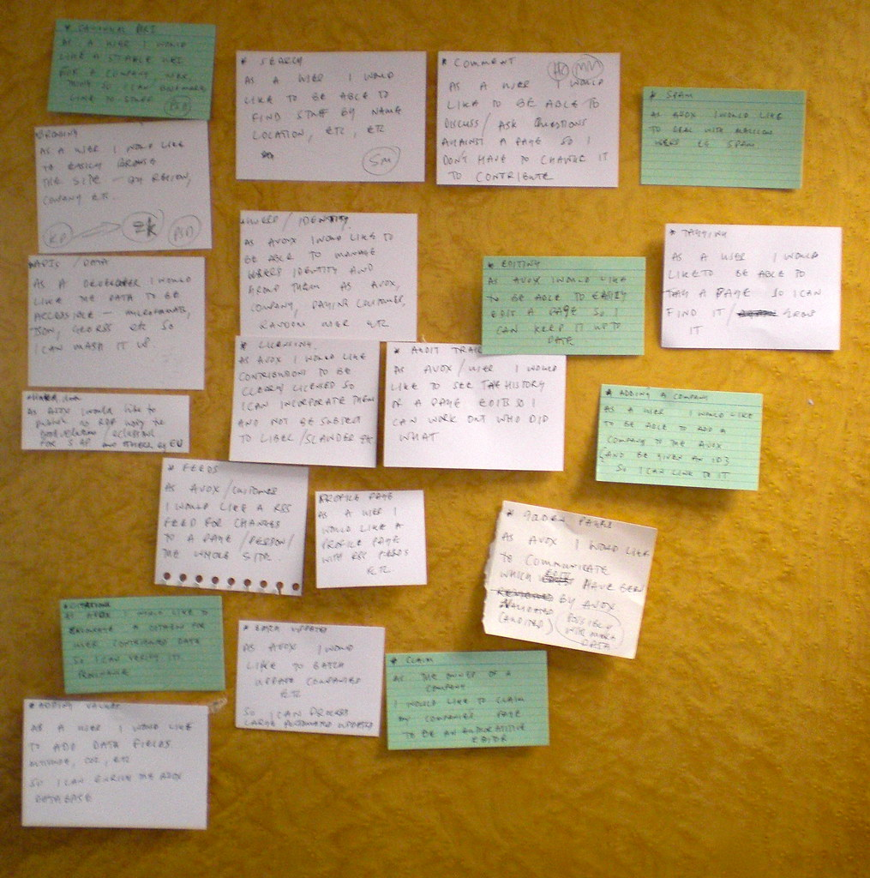
User stories
The Gantt chart was based on user stories supplied by Vintners Antiques.
Parbez Ahmed

Slide 20
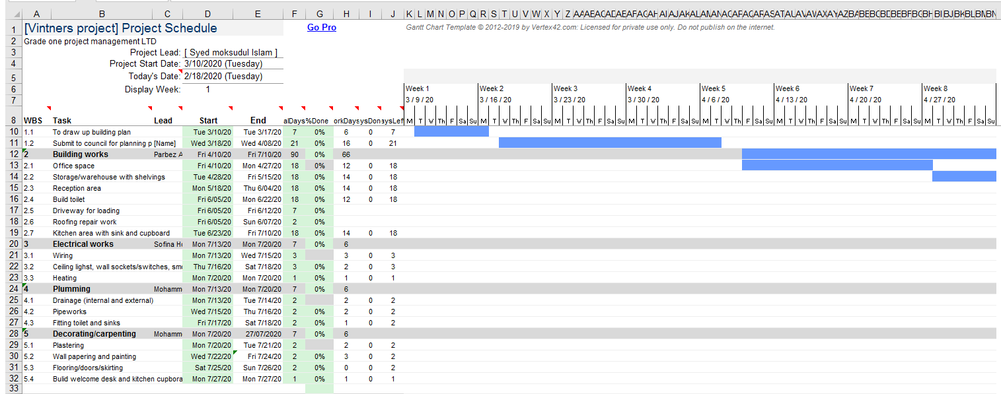
Gantt chart
Parbez Ahmed

Slide 21
Schedules and key dates
Contract sign date:01/03/2020
1
Project start date:10/03/2020
2
Project review dated:01/06/2020
3
Project closing phase:25/07/2020
4
Project delivery date:27/072020
5
Syed M Islam

Slide 22
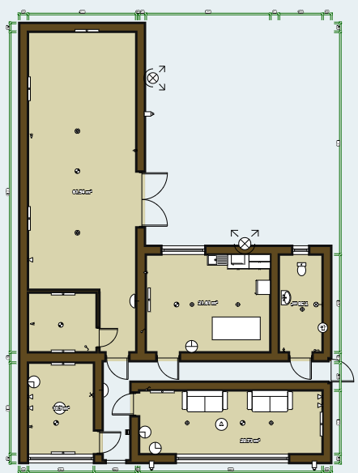
Floor plan
Warehouse
Store room
Toilet
Kitchen
Welcome desk
Office space
Syed M Islam

Slide 23
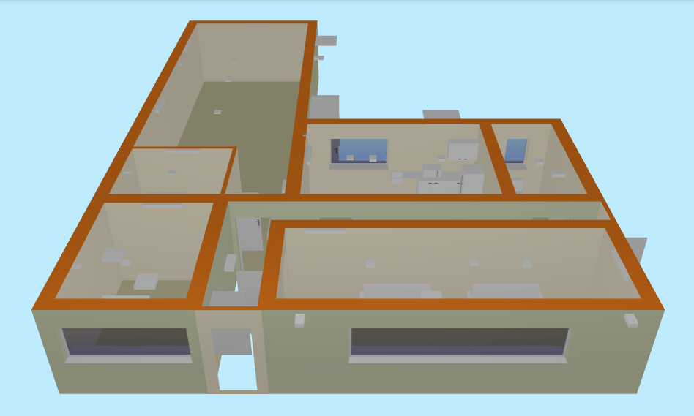
Front elevation 3D
Syed M Islam

Slide 24
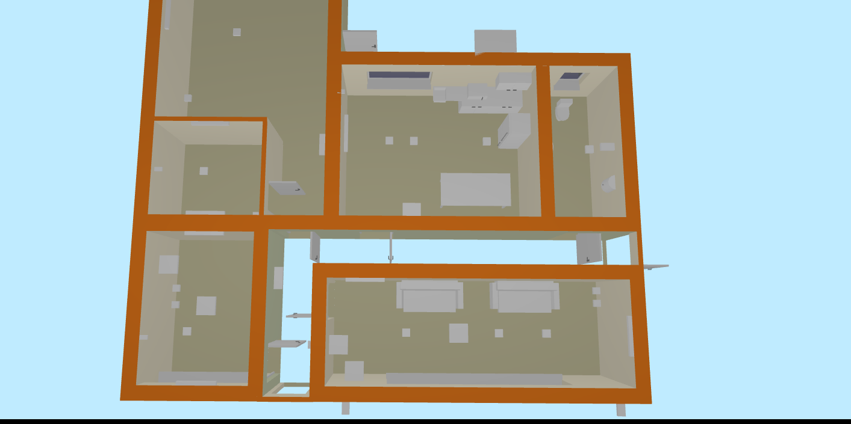
3D floor plan
Syed m Islam

Slide 25
Project outcomes
Complete renovation of building work, make property organised and prepared for trading as Vintners Antiques
Syed M Islam

Slide 26
Communicating with stakeholders
Method used to communicate with stakeholders and mangers:
Give access to Gantt chart for schedule.
Use emails to communicate with stakeholder’s.
Use video calls to give visual progression of work.
Give detail accounts on budget and spending.
Syed M Islam

Slide 27
Cost of the project
Cost of materials and labour
Planning permission: draw up building plan and submit to council for planning permission. | £2000.00
Building works: office space, storage, warehouse, shelving in store room, build reception area, kitchen area with sink cupboards, roofing repair work. | 23,000.00
Driveway | £2000.00
Built toilet | £1500.00
Electrical works: wiring, ceiling lights, wall sockets/switches, smoke alarms and fuse box. | £2000.00
Plumbing works: drainage (internal and external), pipe-works, fitting toilet and sinks. | £2000.00
Decorating and carpentry: plastering, wall papering, painting, flooring, doors, skirting, build welcome desk and kitchen cupboards. | £7000.00
Total cost: | £39,000.00
Syed M Islam

Slide 28
Risks management process
Weather disruption at work site.
Short of supplies building materials & equipment on site.
Risk of injuries at work.
Supplier disruption due to Brexit.
Enough local suppliers, nearest supplier is Wicks half a mile on Stratford road.
Nearest hospital at Solihull town centre.
Can order material's and product in advance with supplier for storage.
Low risk.
Risk low.
Low risk
Low risk.
Two weeks is allocated for any weather disruption.
Syed M Islam

Slide 29

Our company details:
Grade one project management LTD.
We welcome any challenges and wait for your enquiries.
1245 Coventry road Birmingham B10 0eb
GOPM@yahoo.co.uk
0121 344 4000
Syed M Islam

Slide 30

Thank You
This Photo by Unknown Author is licensed under CC BY-SA

Slide 31

Any questions

