Slide 1
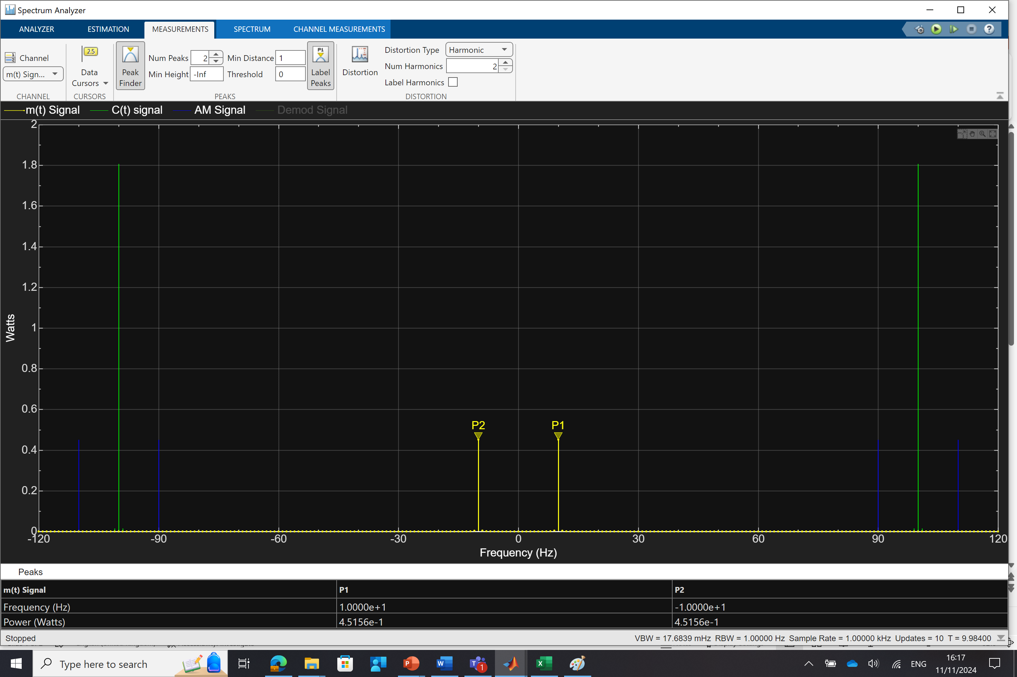
DSBSC Observation- Without AWGN
Message Power

Slide 2
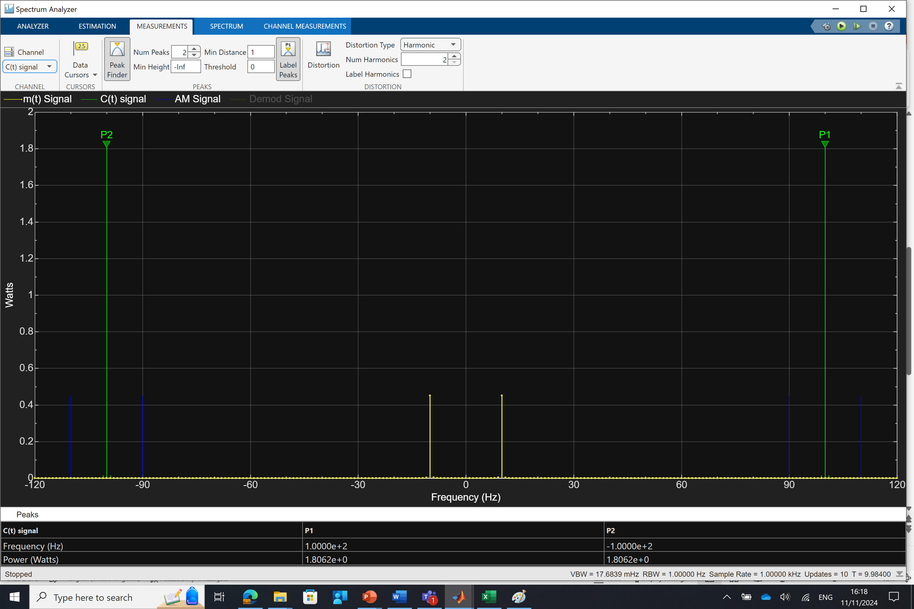
DSBSC Observation- Without AWGN
Carrier Power

Slide 3
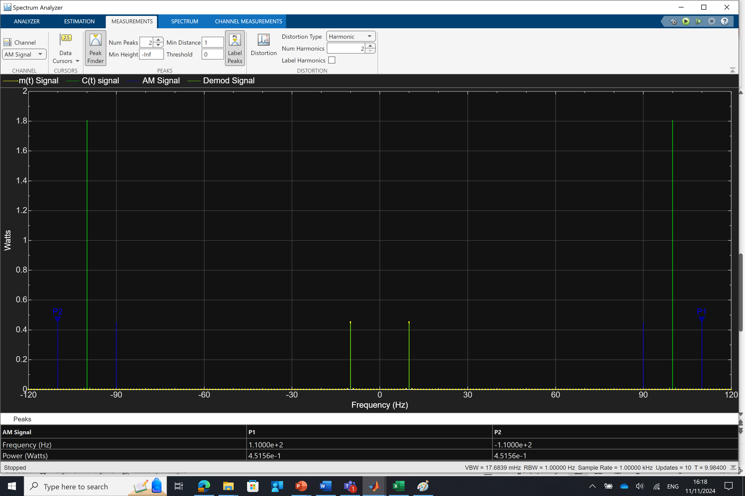
DSBSC Observation- Without AWGN
Transmitter Power

Slide 4
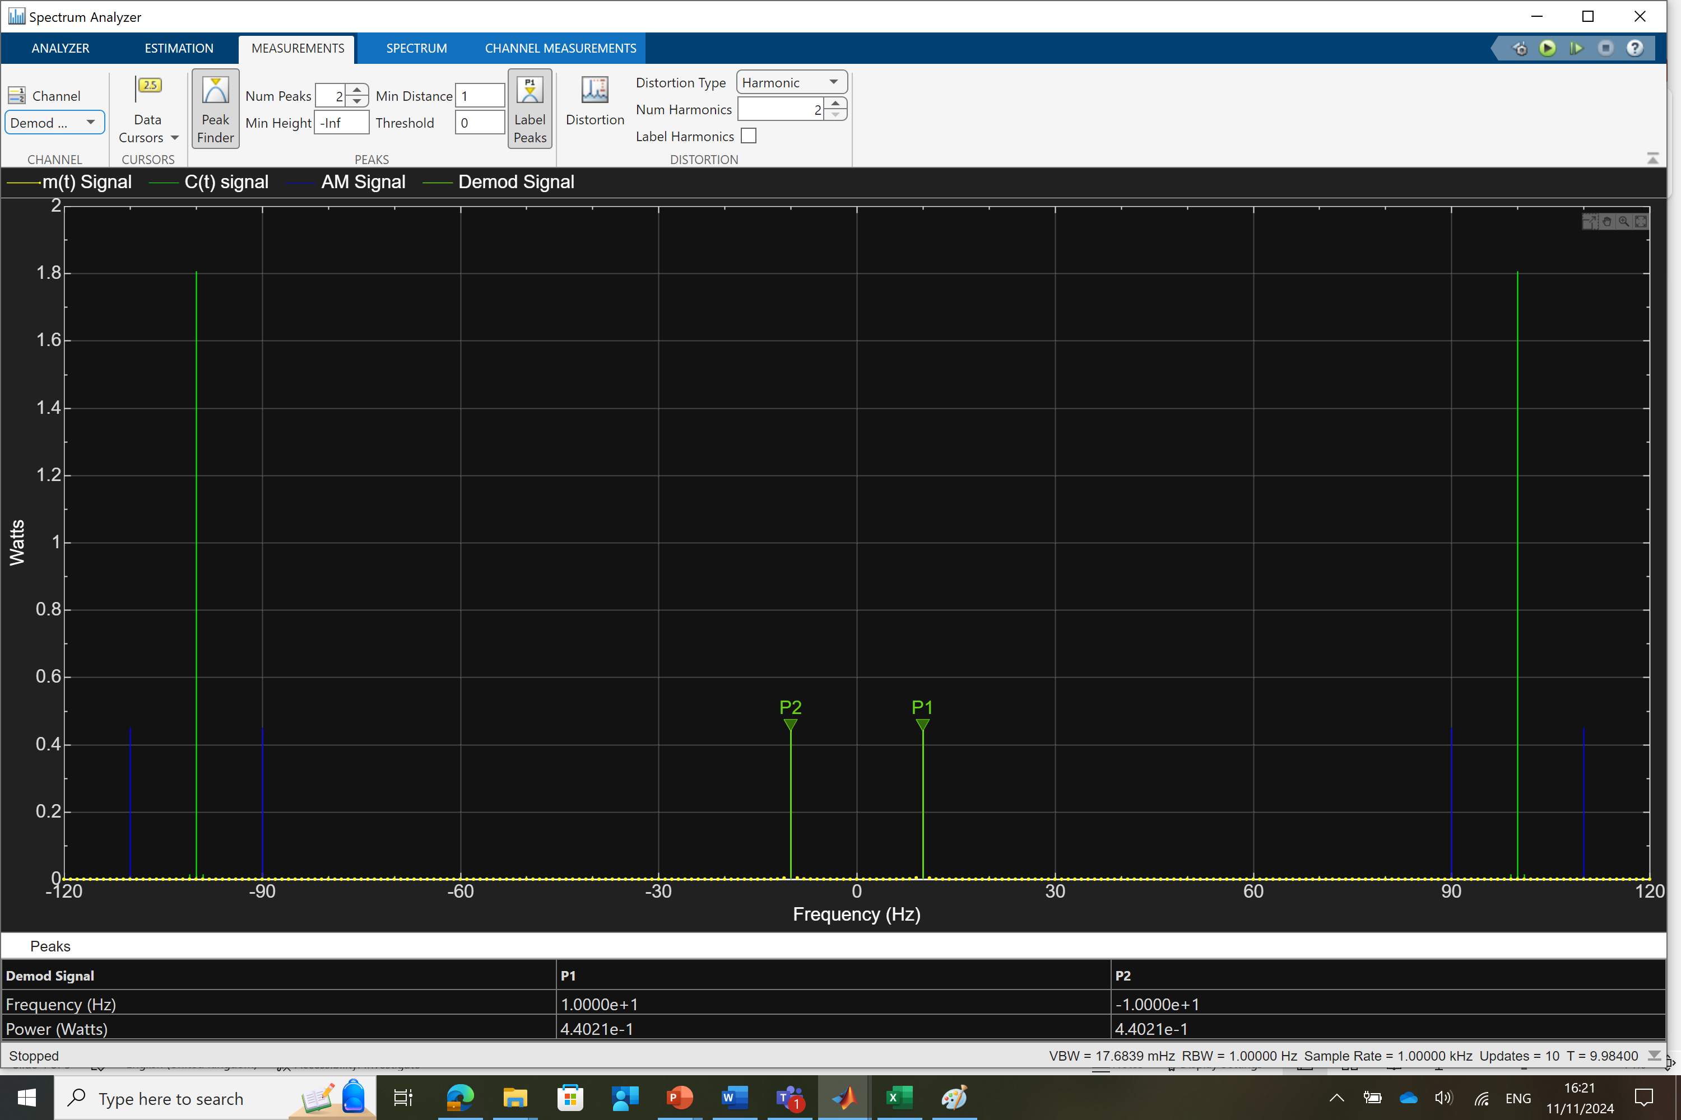
DSBSC Observation- Without AWGN
Received Power

Slide 5
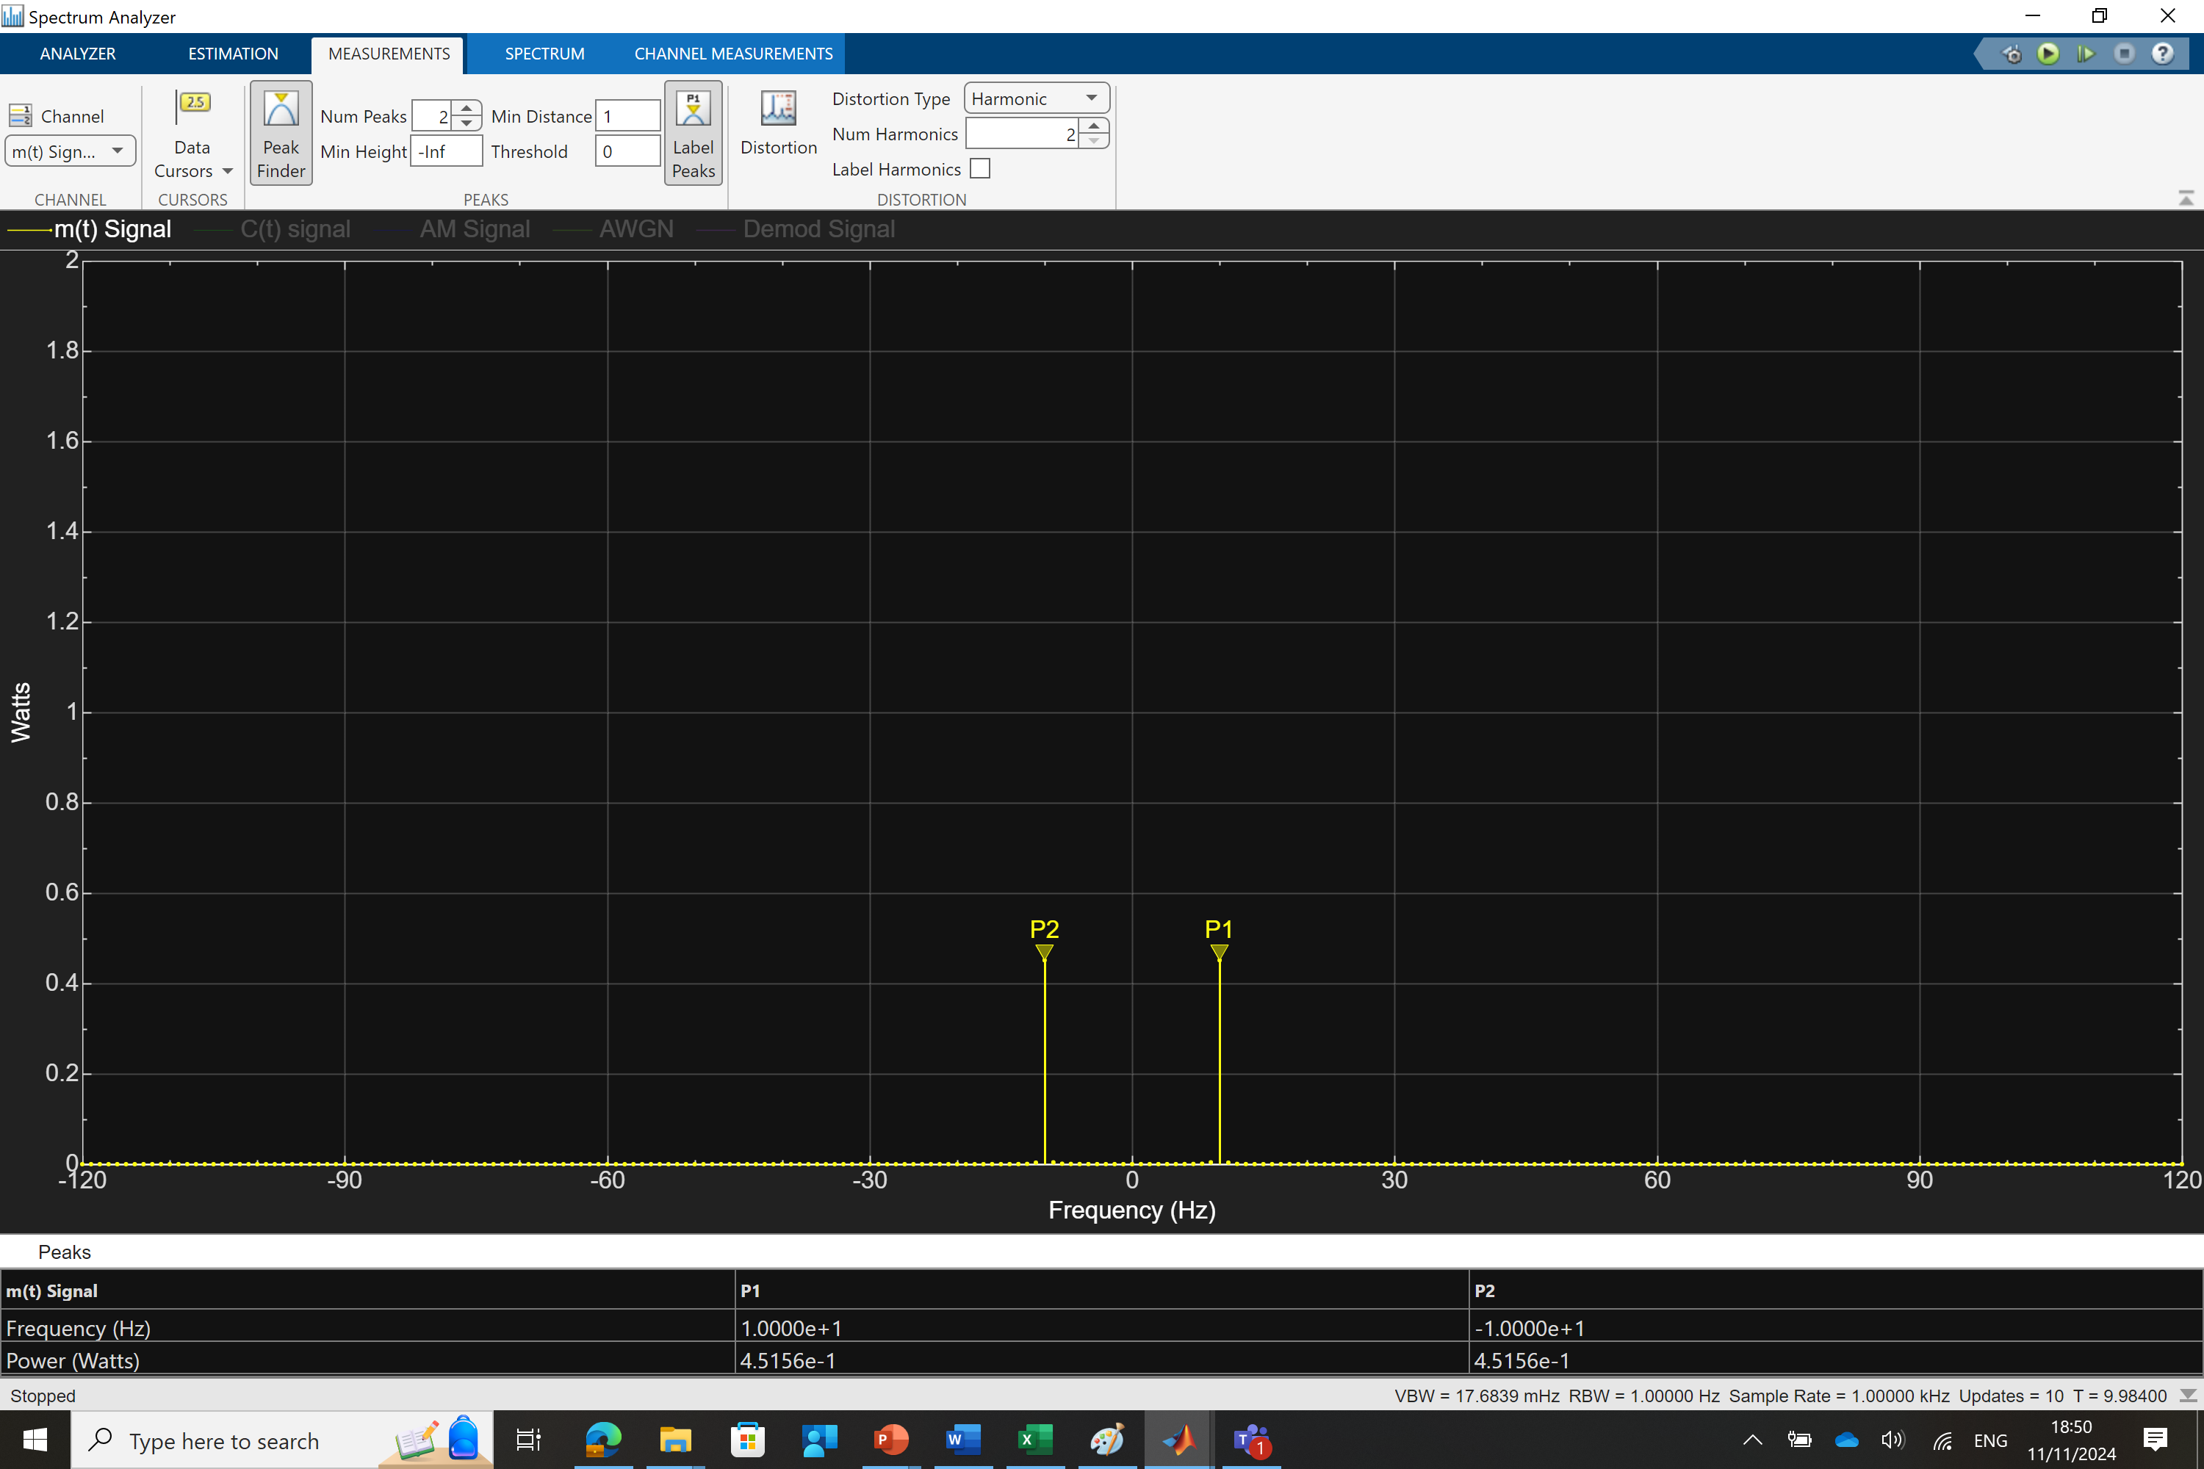
DSBSC Observation- With AWGN
Message Power

Slide 6
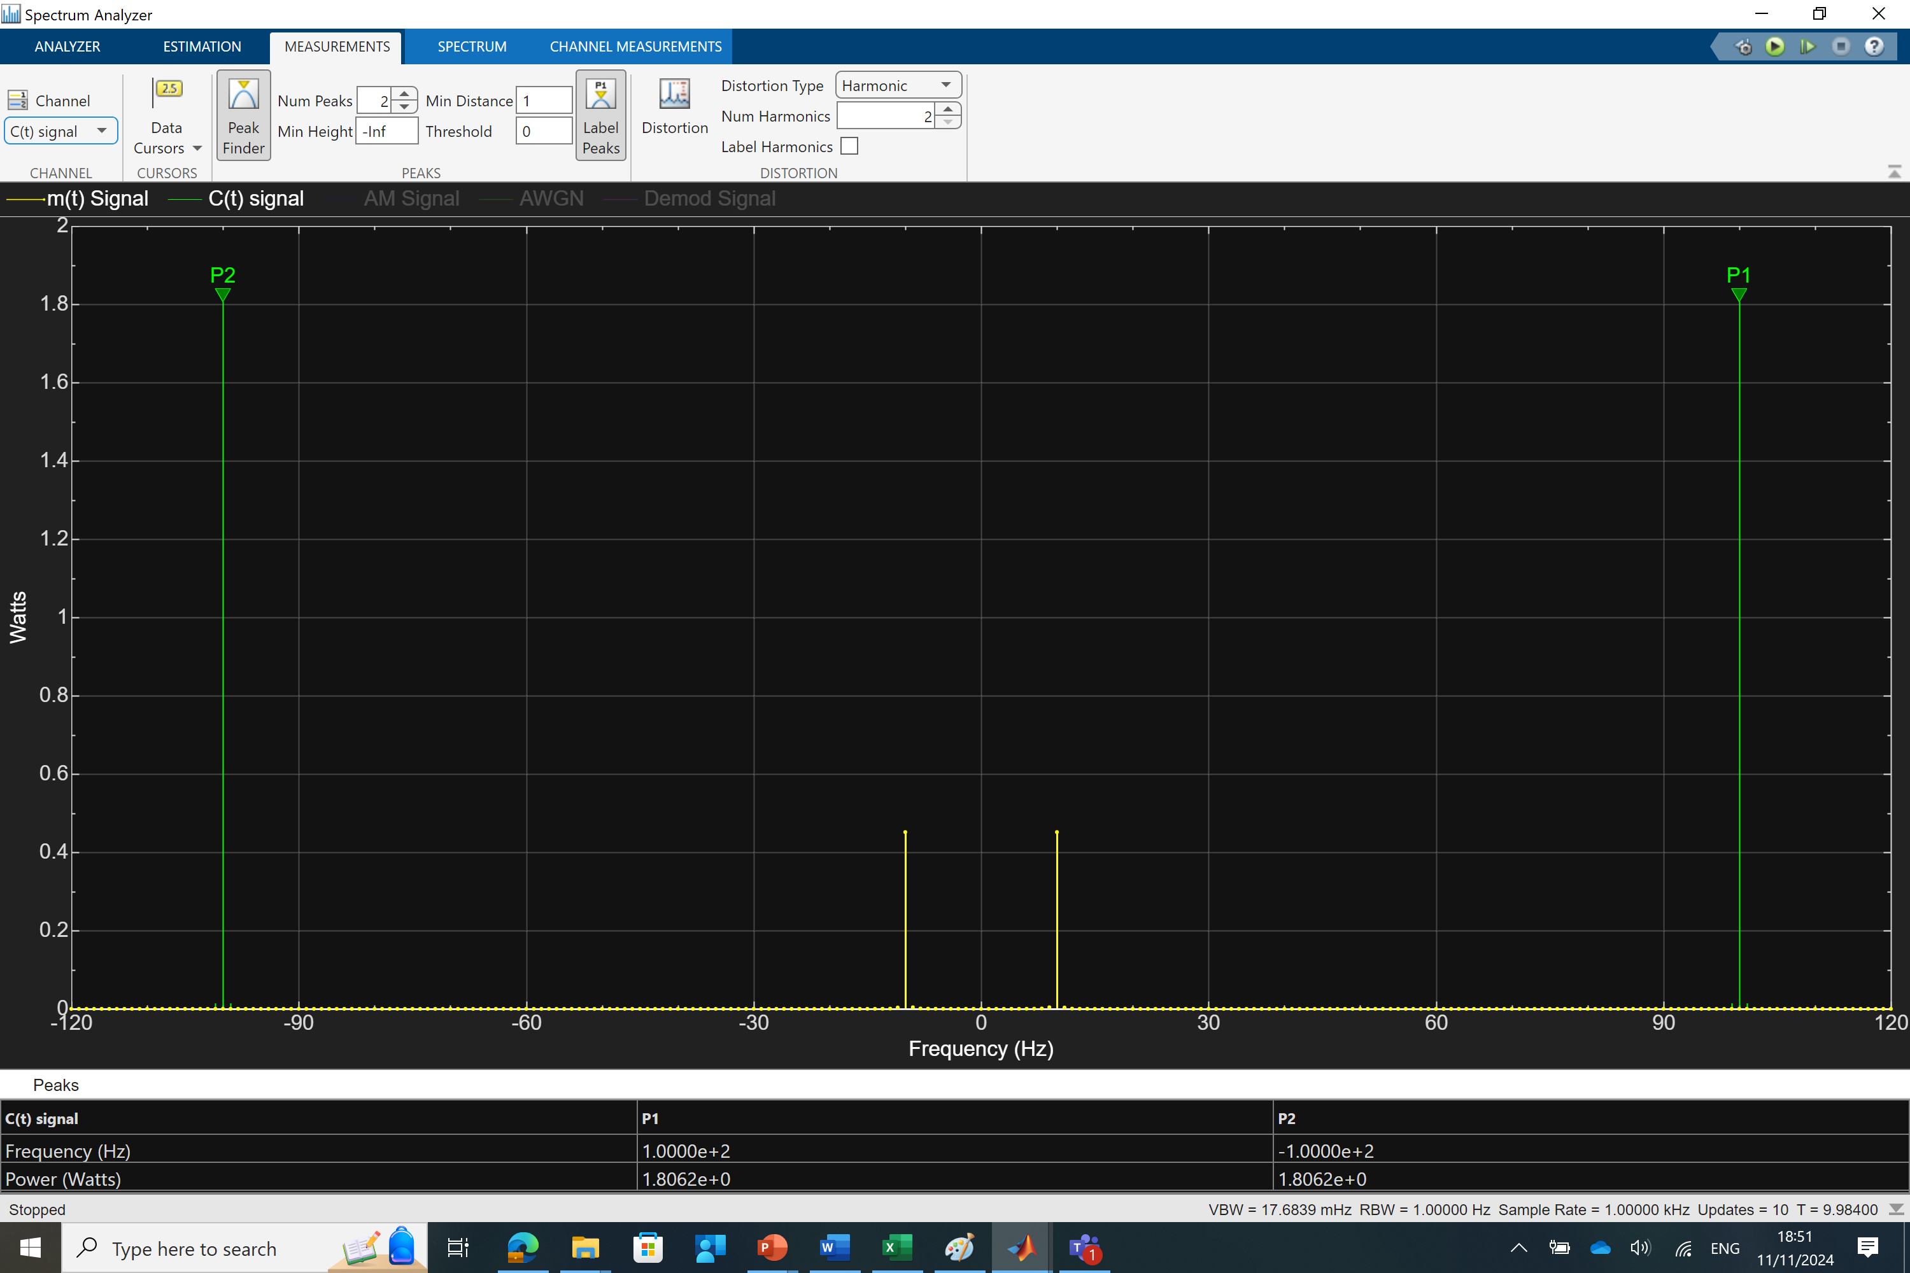
DSBSC Observation- With AWGN
Carrier Power

Slide 7
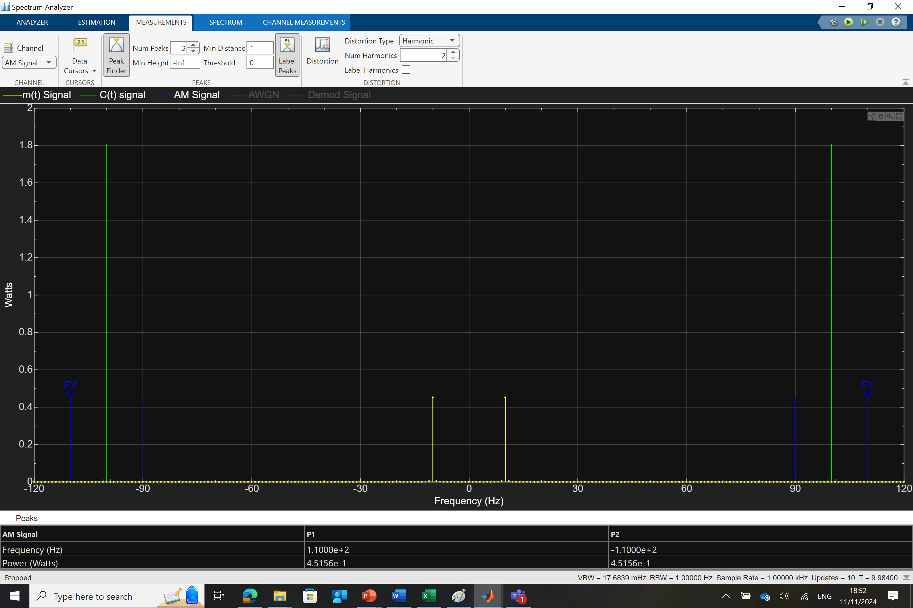
DSBSC Observation- With AWGN
Transmitted Power

Slide 8
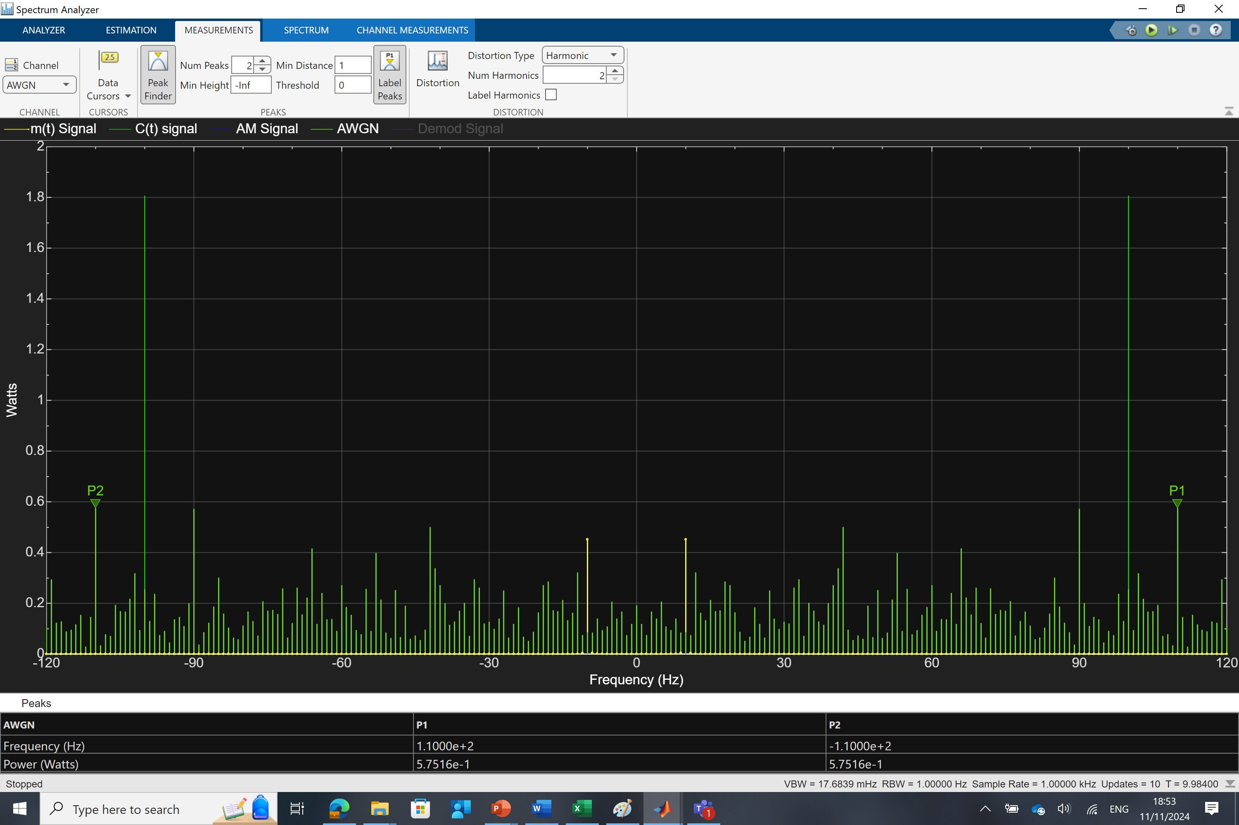
DSBSC Observation- With AWGN
AWGN Power

Slide 9
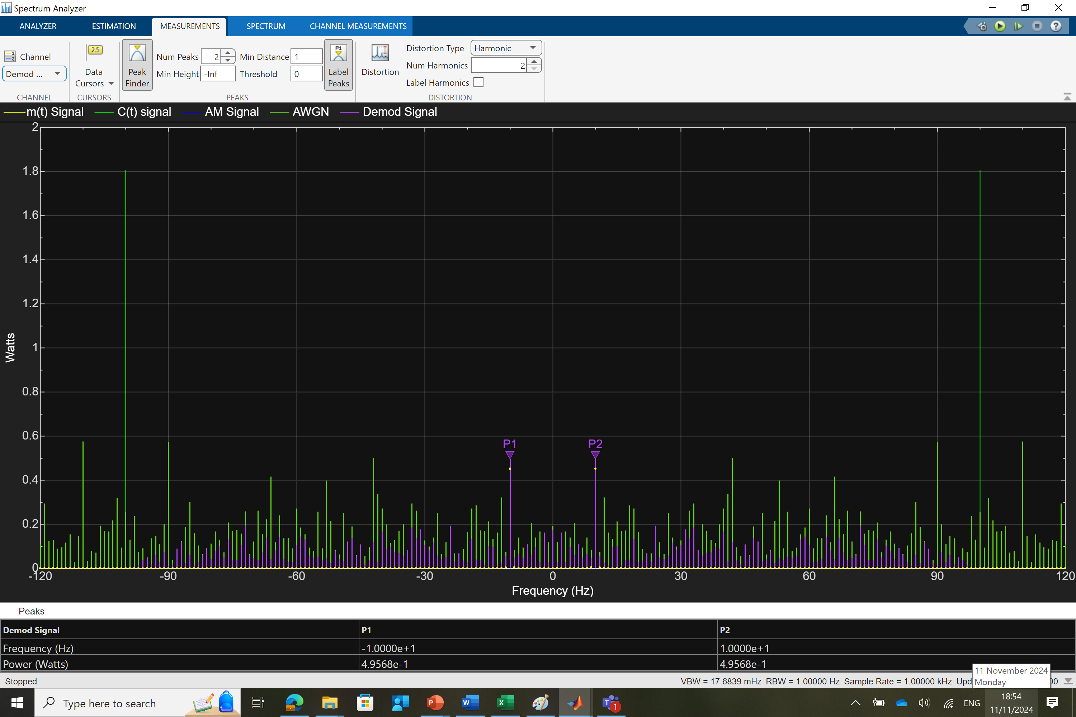
DSBSC Observation- With AWGN
Receiver Power

Slide 10
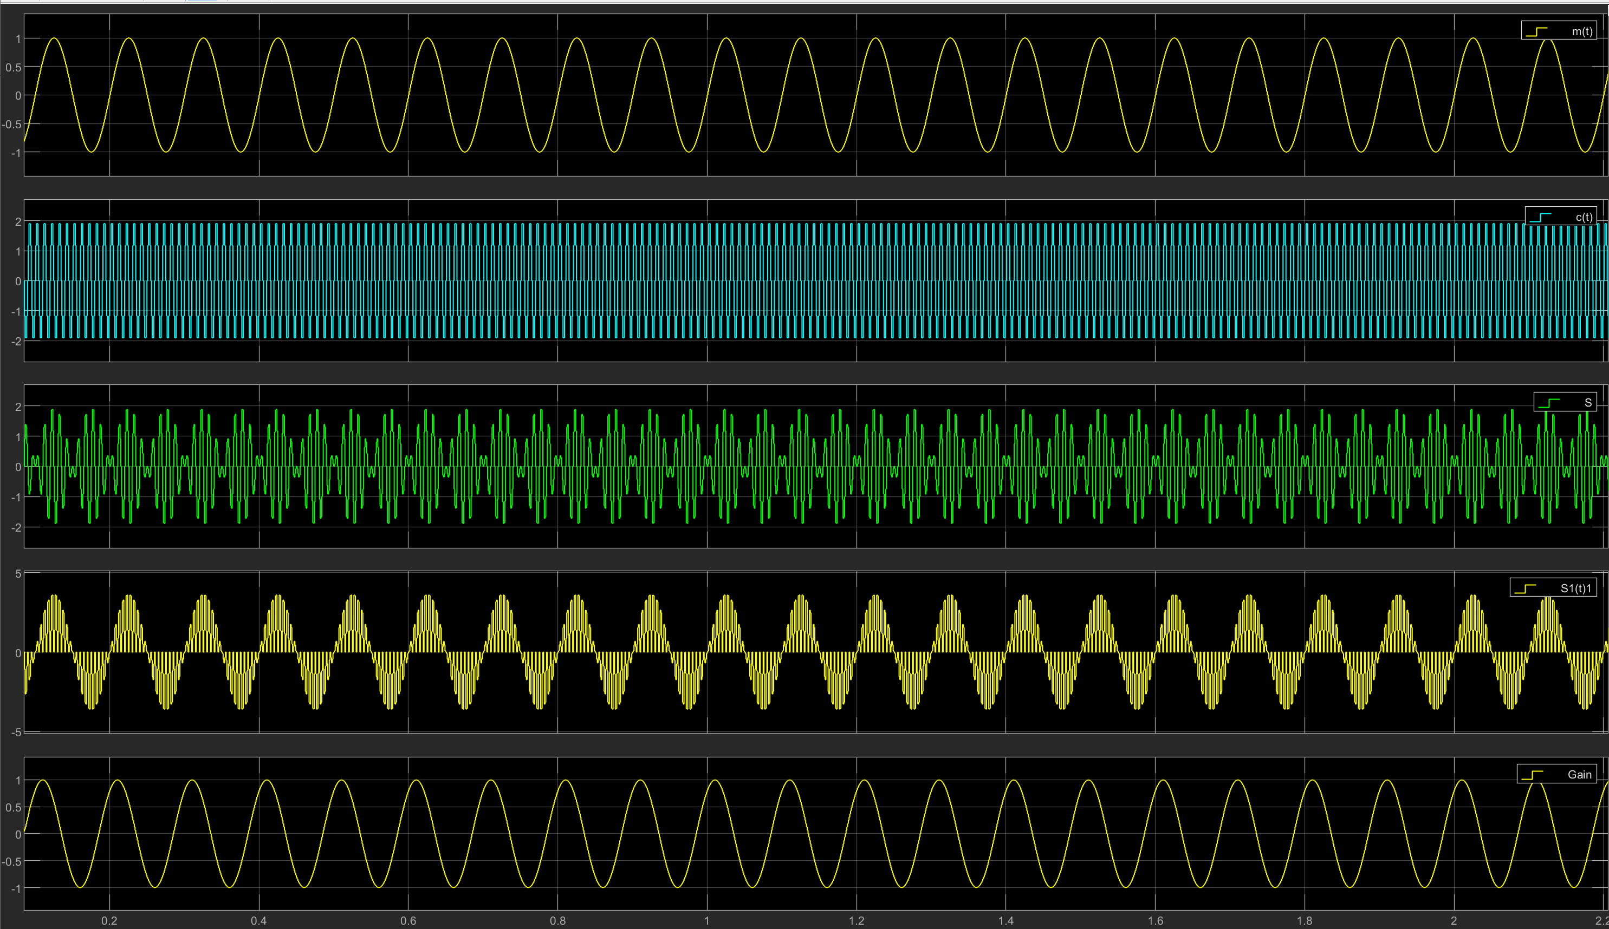
DSBSC Observation(Time Scope)- Without AWGN

Slide 11
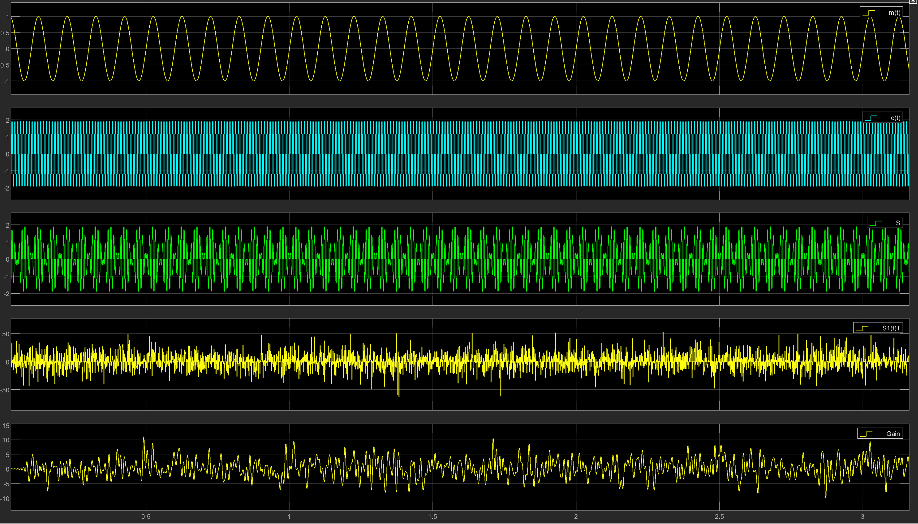
DSBSC Observation(Time Scope)- With AWGN

Slide 12


