Slide 1
Obesity - Introduction
Session 6

Slide 2
Aims
To introduce Obesity as a chronic disease
To discuss factors contributing to the development of the disease
To evaluate ways in which lifestyle modifications can be made to prevent or treat the disease
To evaluate the role that exercise can play in prevention and/or treatment

Slide 3
Overweight and Obesity
Overweight: a body weight that exceeds some average for stature, and perhaps age.
Overfat: condition whereby body fat exceeds an age- and/or gender appropriate average by some predetermined amount.
Obesity: Heavy accumulation of body fat to the extent that it may adversely effect health and can lead to reduced life expectancy and the development of additional diseases/health problems.
  BMI greater than 30.

Slide 4
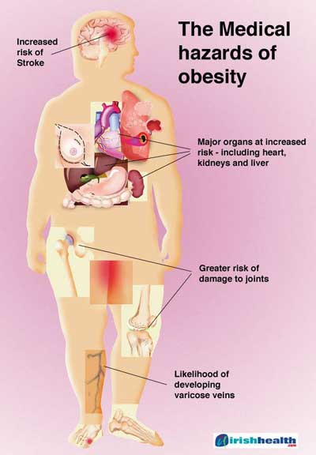
Obesity
Glucose intolerance
Insulin resistance
Dyslipidemia
Type 2 diabetes
Hypertension
Elevated plasma leptin concentration
Increased visceral adipose tissue
Increased risk of CHD & some cancers

Slide 5
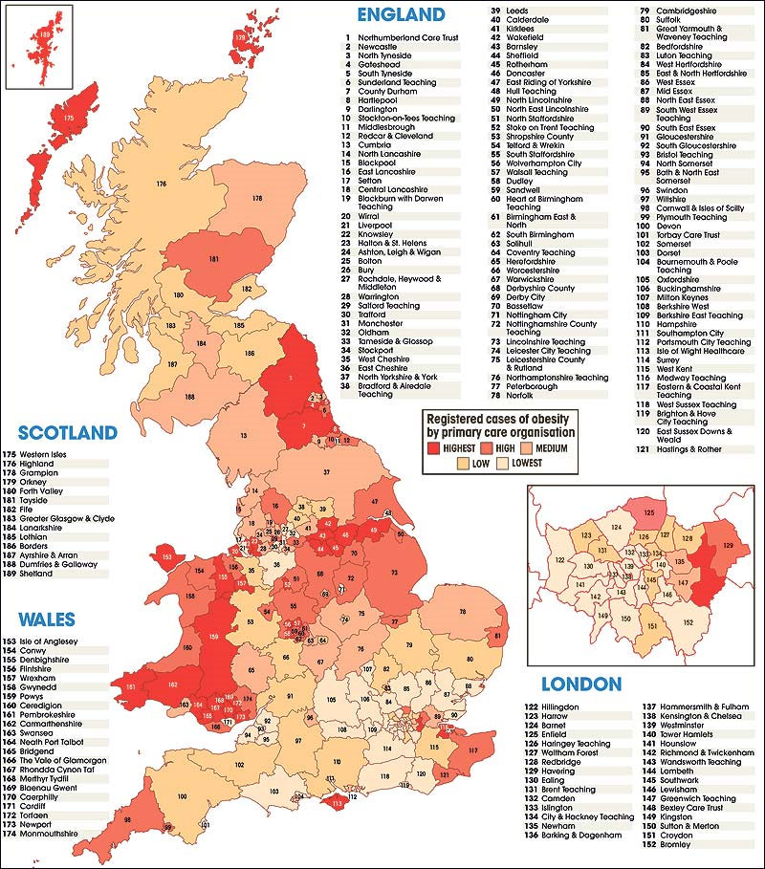
In the UK
Nearly 1 in 4 adults with obesity
In children (2-15 yrs old) 1 in 6 boys and 1 in 7 girls with obesity (NHS, 2008)
UK Obesity ‘fat map’, 2008

Slide 6
WHO – Rates of Obesity
http://apps.who.int/bmi/index.jsp

Slide 7
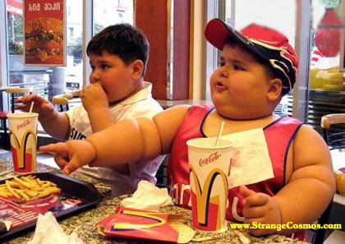
Causes of Obesity
Obesity is a long term process.
Obesity frequently begins in childhood. Obese parents likely have overweight children.
Regardless of final body weight as adults, overweight children exhibit more illnesses as adults than normal children.

Slide 8
Causes of Obesity
Not necessarily overeating.
Factors that predispose a person to gain excessive weight gain.
  Eating patterns Eating environment
  Food packaging Food availability
  Body image Physical inactivity
  Basal body temp Dietary thermogenesis
  Fidgeting Biochemical differences
  Quantity & sensitivity to satiety hormones

Slide 9
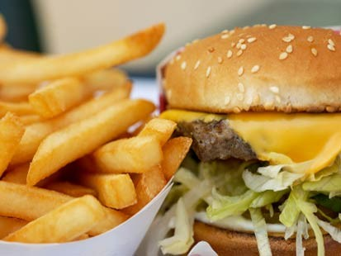
Causes of Obesity
Characteristics of fast food linked to increased adiposity:
  Higher energy density
  Greater saturated fat
  Reduced complex carbohydrates & fiber
  Reduced fruits and vegetables.

Slide 10
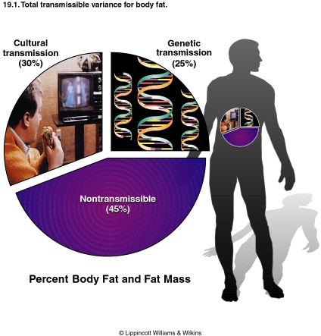
Causes of Obesity – genetics?
Genetics plays a role.
  How much variation in weight gain among individuals can be accounted for by genetic factors?
  Cultural factors play an even bigger role

Slide 11
Causes of Obesity – genetics?
A Mutant Gene?
What is leptin?
  A satiety hormone that influences the appetite control in the hypothalamus.
  Describe the role of the mutant “obese” gene in obesity development.

Slide 12
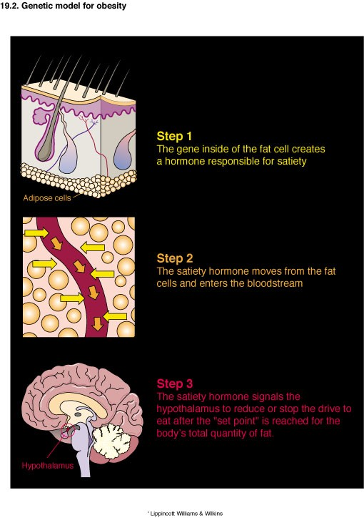
Causes of Obesity – genetics?

Slide 13
Causes of Obesity – genetics?
A defective ob gene causes inadequate leptin production. Thus, the brain receives an under assessment of body’s adipose stores and urge to eat.
In addition to deficient leptin production, scientists also propose the possibility of defective receptor action (via a leptin receptor molecule on brain cells), which increases a person’s resistance to satiety.
See also the theory of the “Thrifty Gene”.

Slide 14
Causes of Obesity
Physical Activity: an important component
For young & middle aged men, physical activity relates inversely to body fat levels.
No relationship between caloric intake and body fat levels.

Slide 15
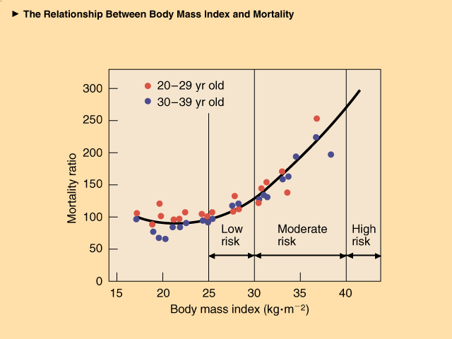
Obesity
Health Risks of Obesity
  Primary risk factor for coronary heart disease.
  Associated with HTN, DM, dyslipidemia, & cerebrovascular disease.
  Estimated cost of obesity in 2007 was £4.2billion, and it is predicted to rise to £6.3billion by 2015

Slide 16
Obesity
How Much Fat is TOO Much?
Three criteria for evaluating a person’s level of ‘fatness’.
  % Body Fat
  Fat Patterning
  Fat Cell Size and Number

Slide 17
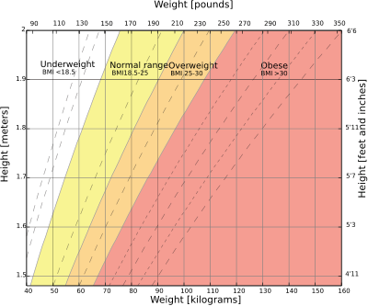
Percent Body Fat

Slide 18
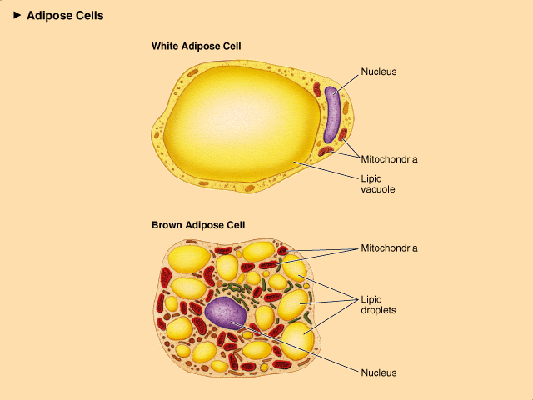
Fat Patterning
Adipocytes from some locations efficiently capture excess nutrients from the blood-stream for storage, while others accumulate TGs but readily release them for use by other tissues.

Slide 19
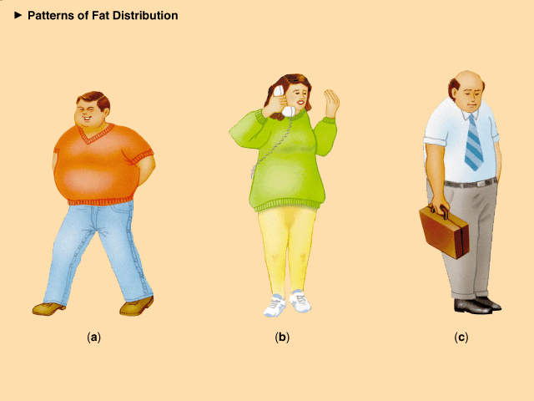
Fat Patterning
Visceral (intra-abdominal) adipose tissue (VAT) relates to an altered metabolic profile.
Abdominal fat described as android has higher health risk than visceral obesity.

Slide 20
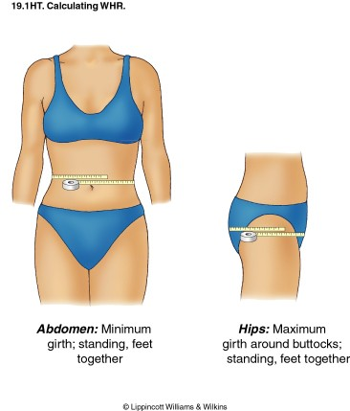
Fat Patterning
An objective standard for establishing male- and female-pattern obesity.
  Male > .95 W:H ratio
  Female > .80 W:H

Slide 21
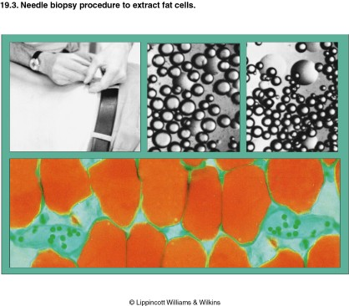
Fat Cell Number and Size
Increases in adipose tissue occurs in two ways:
Fat cell hypertrophy (increase in size)
Fat cell hyperplasia (increase in number)

Slide 22
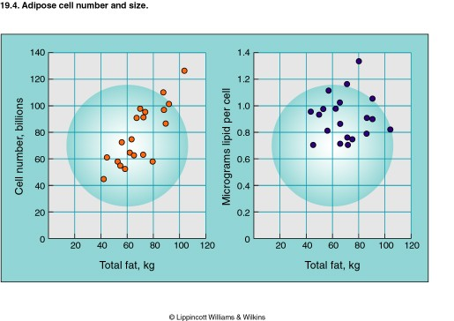
Fat Cell Number and Size
After reaching a biological upper limit for fat cell size, cell number becomes a key factor that determines obesity.

Slide 23
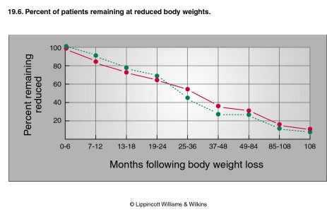
Weight Control
What is the prognosis for long term weight control?
Participants who remain in supervised weight loss program regain almost all within 5 years.

Slide 24
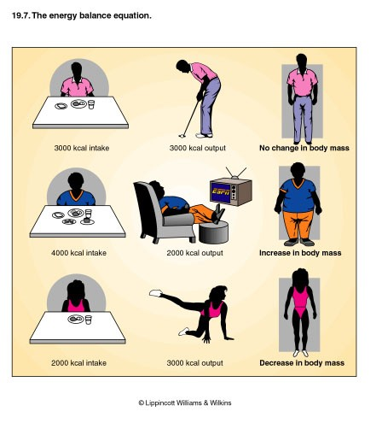
Weight Control
The Energy Balance Equation
Reduce kcal intake
Increase kcal output
Reduce intake & increase output

Slide 25
Dieting to Tip the Balance
Total energy intake (not mixture of macronutrients) determines effectiveness of weight loss with diet.
Why does 1st week of caloric restriction result in large weight loss, but small decrease in body fat?
  Comes mainly from body water loss and glycogen depletion.

Slide 26
Fat Cells After Weight Loss
What happens to fat cell size and fat cell number when adults lose weight?
  Fat cells shrink to a size smaller than adipocytes of non-obese people, number remains same.
The large no. of relatively small adipocytes may relate to appetite control; person craves food, overeats & gains lost weight.
Total number of fat cells increases during 3 general periods:
  Last trimester pregnancy, 1st year life, adolescence

Slide 27
Fat Cells After Weight Gain
In non-obese subjects with moderate weight gain, adipocyte size increased substantially with no change in cell number.
Weight gain among severely obese, new adipocytes develop in addition to hypertrophy of existing cells.

Slide 28
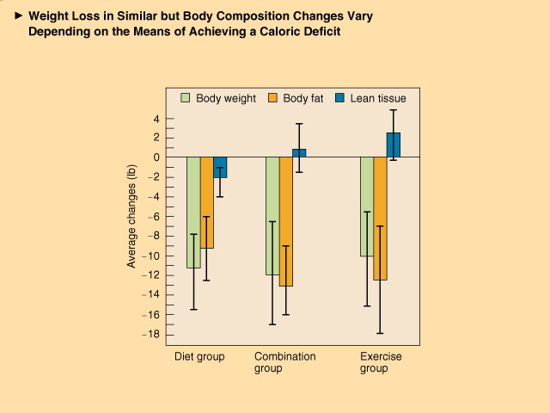
Dieting to Tip the Balance
Dieting for weight loss can be effective if done in prudent manner.
Disadvantages of semi starvation include loss of lean body tissue, lethargy, possible malnutrition, decrease basal energy expenditure.

Slide 29
Exercising to Tip the Balance
Increased physical activity combined with dietary restraint maintains weight loss more effectively than long term diet alone.
For previously sedentary, overweight individual, moderate increase in physical activity doesn’t necessarily increase intake.
Recommend minimum of 30 mins of exercise/physical activity 5 times per week for adults, and 5 x 60 mins for children.

Slide 30
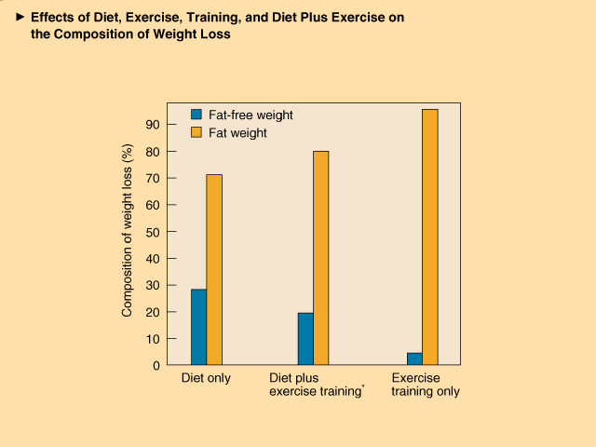
Diet Plus Exercise
The Ideal Combination
Combining exercise & diet offers a flexible yet effective approach to weight control.
Exercise enhances fat mobilization from adipose depots & fat catabolism.
Protects against protein loss; improves insulin sensitivity.

