Slide 1
BUSINESS PLAN
Title: Pulse Apex Garage
Name of the Student: Florentina Damian
ID Number: 2020306
Module: Entrepreneurship LCBB5001
Lecturer Name: Vasilios Tavlaridis

Slide 2
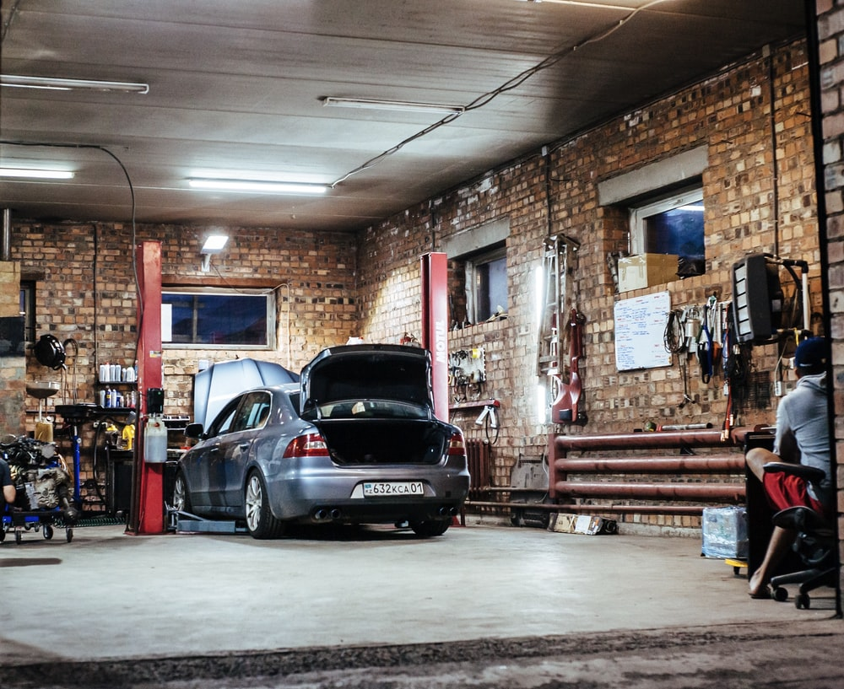
Business/Company Overview
Business idea – Automobile Repair and engine tuning
Pulse Apex Garage
Four-wheeler / Two-wheeler automobile repair, service, cleaning, engine tuning etc.
Partnership with car service and tuning firms.
ECU mapping to upgrade parts
Notes:
My business is….. Pulse Apex garage that deals in automobile repair for two and four wheelers. It provides repairing of body, engine and car assessment for maximum customer satisfaction.
The products will be …. Performance optimization, fuel economizing, racing tuning. Company also offers engine tuning, suspension and body tuning. Company provides services for air filter, wheel bearing, spark plug,
Brake inspection and cleaning using vacuum cleaners and dry chemicals.

Slide 3
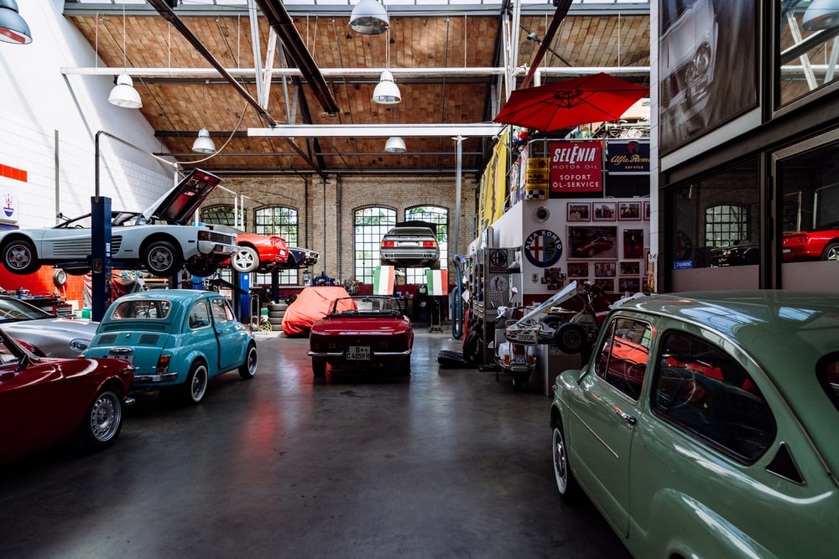
Product or Service
Air filter, brake inspection, wheel bearing, duel filter, spark plug change
Four/ two wheeler service and repair business
Performance optimization, bench tuning, fuel economizing and racing in tuning.
Cleaning – using vacuums, and dry chemicals for internal cleaning
Notes:
As you can see from the picture….
The Business idea is to open an Automobile repair and tuning garage in the UK. Many cars are running on the roads and the company has the opportunity to tap the Auto-car service market. The products are engine tuning, suspension tuning, and body and interior tuning based on automation that gives speed and accuracy.
Four wheeler and two wheeler repair and services. Performance optimization and bench tuning available in Pulse Apex Garage.
Performance optimization, Fuel economizing takes place after the ECU report. Bench tuning, racing tuning. The unique services company also offers like fast and dry cleaning with dry chemicals and vacuum cleaning.
Repair takes place with the help of digital damage assessment and ECU mapping tools. The processes are fast and highly accurate. The customer relationship managers use calls and emails to manage customer relationships. Customers get to know the pick-up and drop-time, assessment details, and estimated price for repair and tuning through emails, messages and phones calls.

Slide 4
Product or Service
Engine tuning, suspension and body tuning.
CRM – Mobile Applications, Auto-Assessment, pickup- drop schedule (Ebrahimi et al, 2019).
Warranty on repairs and services offered for 3 months
Notes:
Body tuning, Engine tuning, suspension and good services maintained with customer relationships well developed in organization.
Assessment report of the damage, and report for the parts that need service in the future. It will also give the resale value of the car and give a list of interested buyers. After service and repair, the company will give a warranty for 3 months.

Slide 5
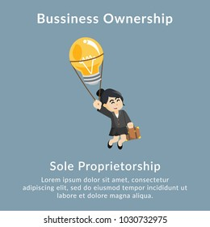
Legal status of business
Sole proprietorship (Kasahun, 2020).
Retain all profit
Final say in decision making
Easy Simple structure
set up
Start up friendly
Flat structure.
Notes:
The sole Proprietorship model for business will be the best one for Pulse Apex Garage. Company owner will be the only decision making person in the business. The start up will have simple structure that is with very less documents. The owner will make all the profits hence it will be a great motivation.
The startup is sole proprietorship with a flat structure. It allows employees and staff to directly report to the owner and make necessary changes.

Slide 6
SWOT analysis
Strengths Deals in Unique product Big market to start . 864,300 people are in automobile sector (statista, 2022). Deals in Two and four wheelers | Weakness Deals only in 4 wheelers cars Low employees Low experience Low customer base
Opportunity Partnership with local automobile services Various countries and regions in the UK (carmagazine.co.uk, 2020). Social media marketing. Adapting fast with consumer needs. | Threat Competitors copying the business model. Lack of modern technology (Benzaghta et al, 2021). Economic crisis – recession.
Notes:
Strengths – Pulse Apex Garage provides all solutions for cars under one umbrella. There are many cars on the roads in the UK. People have a busy lifestyle and seek help in auto servicing. There are 864,300 people employed in UK automobile industry that represents a big market in UK. Conditions are favorable for the startup.
Weakness – the company has low customer base. The company has no expertise in dealing with unique and new technology. It has only 1 unit in the entire UK in London people from other parts of UK will not avail the services. New to market therefore low on experience and channels.
Opportunity – business has the opportunity to service cars for customers who are looking to pay moderately. It can increase the customer base by partnerships with local automobile service firms.
The entire UK has a demand for Auto car repair units, car units are more than 40 million units on UK roads. It can expand in the entire UK to increase its customer base. It can create pages on social media to increase awareness.
Threat – there are chances of competitors copying similar business models, services and quality products. It can disrupt the market of company. Economic crisis like global recession and market crash can decrease the sales.

Slide 7
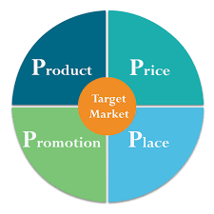
4p’s of marketing
Product – Unique solution for Auto Cars
Price – moderate prices as per the market.
Place – Garages in the UK, London
Promotion – Showrooms, Social media (Lahtinen, Dietrich and Thiele, 2020).
Notes:
Product is a unique solution to cars, services provided are automation based giving high accuracy and speed. The quality services allow customers to customize and modify the application.
The prices are moderate to high as per the market. Prices are also as per the CRM services and automation in repairing and tuning.
The place of launching products and services will be in garages initially in London. In the second phase, garages are likely to expand to the Northeast, Northwest and east of England.
Promotions can take place over social media and WebPages on various platforms. Promotions on physical car accessory stores, and showrooms will be beneficial.

Slide 8
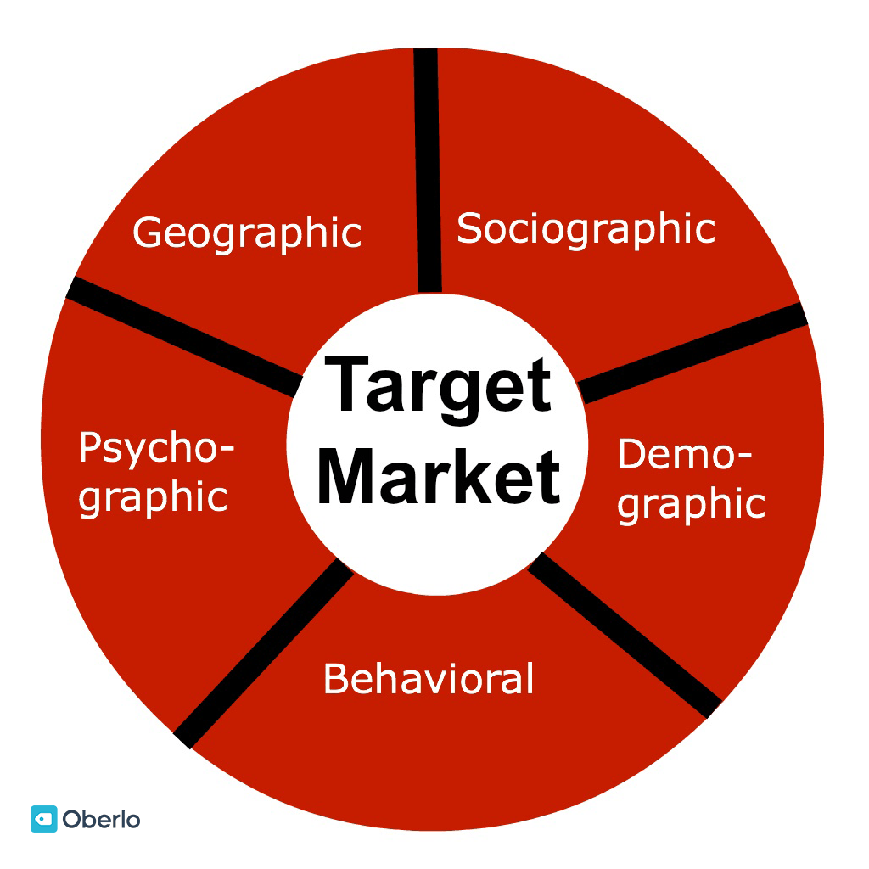

Identifying the target market
Demographics – age group 18 – 70, male and female, income – mid to high, office-goers, doctors, police, businessmen
Psychographics – seeking value, saving time.
Lifestyle – people with a busy life, office goers, businesspersons
Marketing strategies – B2C promotions, Promotional offers, add-on services (Camilleri, 2018).
Notes:
The age group of 18-70 which is a mid to high-income group seeking swift and quality car repair and maintenance services will be the target customer. Businesspersons, doctors, office goers and people with business lifestyles will be the prime target.
The marketing strategies can include promotions directly to the target customer. Email, phone calls, social media and promotional offers to attract the target high-end customers seeking quality and speed.

Slide 9

Conclusion
Engine tuning and Repair will be met with automation
CRM tools will enable maximum customer satisfaction
Opportunity to expand by partnerships
Opportunity to adapt to customer needs.
Need to increase number of skilled employees.
Notes:
Pulse Apex Garage will meet the need of customer with a fast and quality services. It will give more accurate and quality services in a limited time.
Customers will be able to track and customize the parts of services.
It will be automation in tuning and repair that will attract customers in London. ECU mapping will assess and suggest repairs.CRM tools will make services unique and give high customer satisfaction.
Company has opportunity to expand in other regions through partnership. It also has opportunity to make products and services as per customer needs. This can create a large customer base.
Status of car servicing, price of related accessories, delivery time, resale value everything can be requested through the phone calls and fast customer service.

Slide 10
Reference List
Benzaghta, M.A., Elwalda, A., Mousa, M.M., Erkan, I. and Rahman, M., 2021. SWOT analysis applications: An integrative literature review. Journal of Global Business Insights, 6(1), pp.55-73.
Camilleri, M.A., 2018. Market segmentation, targeting and positioning. In Travel marketing, tourism economics and the airline product (pp. 69-83). Springer, Cham.
Carmagazine.co.uk. 2020. Number of cars on UK roads surpasses 40 million for first time (2020). Available at: https://www.carmagazine.co.uk/car-news/motoring-issues/2020/how-many-cars-are-there-in-the-uk/ (Accessed: 18 July 2022).
Ebrahimi, P., Ahmadi, M., Gholampour, A. and Alipour, H., 2019. CRM performance and development of media entrepreneurship in digital, social media and mobile commerce. International Journal of Emerging Markets.
Lahtinen, V., Dietrich, T. and Rundle-Thiele, S., 2020. Long live the marketing mix. Testing the effectiveness of the commercial marketing mix in a social marketing context. Journal of Social Marketing.
Employment in the UK automotive industry | Statista. (2022). Retrieved 23 July 2022, from https://www.statista.com/statistics/867642/automotive-industry-employment-figures/
Kasahun, A.K., 2020. The Impact of Working Capital Management on Firms’ Profitability-Case of Selected Sole Proprietorship Manufacturing Firms in Adama City. Journal of Economics and Finance, 11(1), pp.45-55.

