Slide 1
BA Applied Leadership and Management in the Workplace
Module: BMSK5014
Managing Projects

Slide 2
Blended Learning ​
Session 2

Slide 3
Session 2
Project Methodologies
Initiating a Project

Slide 4
BMSK5004 – Managing Projects in the Organisation
Critically assess the usefulness of project management tools and techniques for managing a project within an organisation;
Plan the implementation of a project of appropriate complexity within a workplace;
Critically evaluate their ability to manage a project.
Common Assessment Criteria
Engagement with Literature Skills. 20
Knowledge and Understanding Skills 30
Cognitive and Intellectual Skills 30
Practical Application Skills 10
Transferable Skills for Life and Professional Practice 10

Slide 5
Project Methodologies
These are processes that define how a project should be managed
The purpose is to provide a common framework so that everyone on the project understand how the project will be managed and the key principles, standard and activities
Key Methodologies include:
PRINCE2
PMBOK
Agile

Slide 6
PRINCE2 Methodology - Overview
Product Based (what are you producing rather than activities)
  Product Breakdown Structure
  Product Flow diagram
  Product Descriptions
    Purpose
    Content/Specification
    Derived from (input products)
    Quality criteria
    Quality verification method
Stage Management
  End stage Assessment (to be passed before next stage)
  Checkpoint (Team to PM)
  Highlight report (PM to Project board)
Notes:
Initially developed by the UK government to manage larger project

Slide 7
PRINCE2 Methodology - Overview
PRINCE 2 defines lifecycle and documents at each stage:
  Starting Up – Project Brief, Project Initiation Document
  Initiating the Project - Project plan, Business Case and risks, controls
  Delivery Stages
    Managing Product Delivery – product description, quality records
    Controlling Stages – End stage assessment, Checkpoint report, highlight report
  Closing the Project – Project review
Identifies Controls to manage
  Quality
  Risk & Issues
  Change management
Notes:
Initially developed by the UK government to manage larger project

Slide 8
PRINCE2 Methodology - Overview
Project Organisation
  Project Board
    Senior User (users of the product)
    Senior Executive (business interests)
    Senior Supplier (designers, implementors)
  Project Team
    Project Manager
    Team Manager
    Team Member
  Project Assurance – provide Project board assurance of adhering to plan
  Project Support – provides project admin eg update plans etc
Notes:
Initially developed by the UK government to manage larger project

Slide 9
PMBOK - Project Cycle
Notes:
Sometimes there are 5 stages shown in a project life cycle
Initiating
identifying team roles as spoken previously this can be done using models such as Belbin's roles – choosing the Leadership (motivational/ Visionary)and supportive management in place (administrative ensuring things are done on time)
Plan
Structure of work – Description of what will be done/ goals and objectives/ what will measures of success be)
Work break down structure – list all the tasks to complete the activities (what budget and resources required (staff)
assigning and delegating responsibilities – this can be done following the Hersey and Blanchard’s (1969) situational leadership model guiding the teams through the various stages of Tuckmans’ effective team model and formulating a schedule
Executing & Monitoring (often considered together)
Guiding / monitoring and controlling the functions
How things are going against the plan and changes to be made to meet the schedule Quality
Ensuring within budget and completed all activities within Time
Completion – de briefing what worked from plan what can be changed for future.
Additionally:
Conception Phase (The Idea)
Definition Phase (The Plan)
Initiation Phase (The Team)
Implementation Phase (The Work)
Evaluation Phase (The Wrap-up)
Conception/definition and initiation phase are all part of the planning process encompassing
project details goals, objectives, deliverables, identifying resources and teams, listing details of work schedule
The implementation phase is the doing and monitoring the progress continuously.
This includes needing to adjust things if need be to maintaining the quality, while remaining in the budget and on time.
Evaluation phase is very important part of the review process to see what worked and what can be improved for future.

Slide 10
Putting it simply - Project Management over a project life cycle is:
Initiate
Plan
Execute
Control
Close
Notes:
A simple life-cycle of a project – there are many others out there but this is a reasonable one.
Initiation – the selection of projects – where do projects come from in your organisation, how are they signed off or rejected?
Planning – the creation of the plan – usually by the Project Manager. We’ll explore more of this later
Execute - the doing
Control – measuring to decide if the project is on-track
Close – lessons learned for next time

Slide 11
Project Management Process Groups
Initiate
Plan
Execute
Control
Close
Notes:
The five step model makes things look very tidy and suggests that each stage is the same.
In practice the cycle probably has Initiate and Close while everything else repeats in a loop, as things are tried and adjusted.

Slide 12
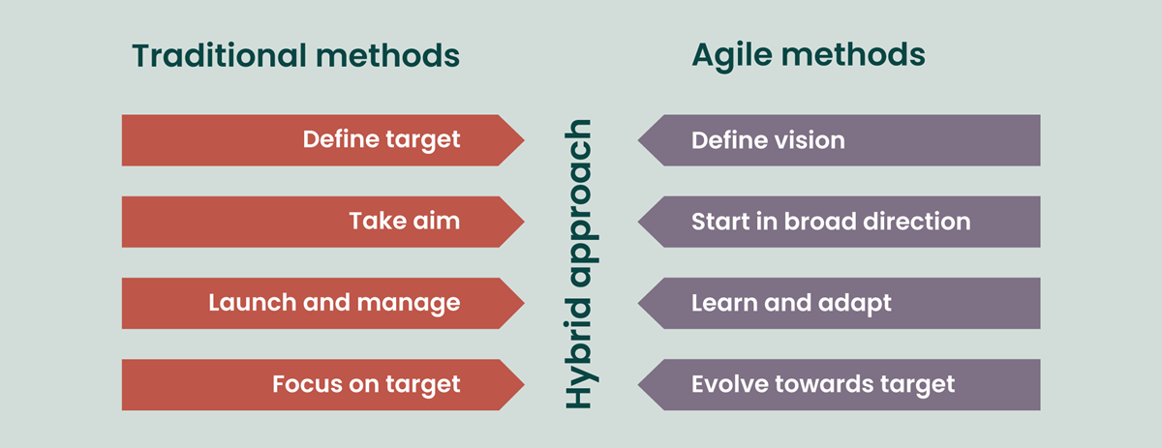
AGILE Project Management
Notes:
Agile project management follows the same general principles of project management but flows in a continuous learning and improvement cycles/iterations toward the end goal

Slide 13
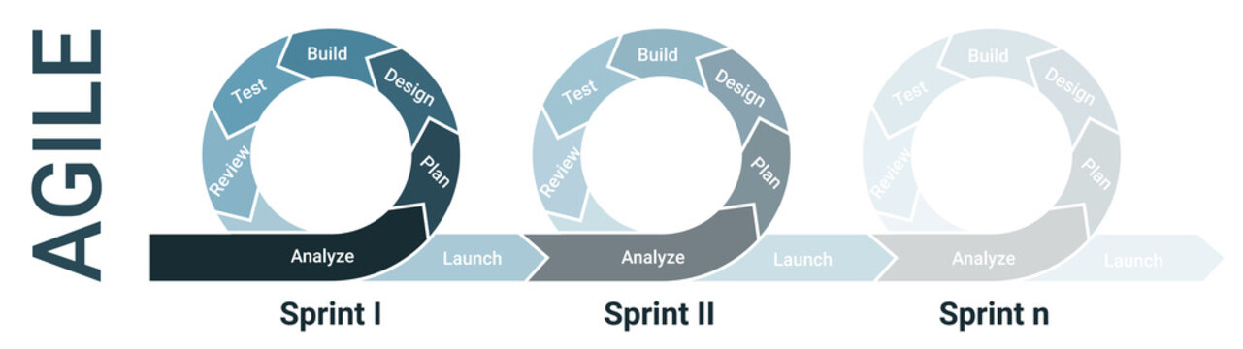
AGILE Project Management
Notes:
Agile project management is well-suited for projects that need to adapt quickly or have uncertain requirements. It can be used on almost any large-scale project in any industry, but it's especially useful for projects that:
Lack clear requirements
Agile is a good choice when a project doesn't have explicit constraints, timelines, or available resources.
Evolve
Agile allows for more flexibility in the budget and timeline as the project develops.
Involve research or testing
Agile's iterative approach to testing allows for regular feedback and rapid adjustments.

Slide 14
Initiation Phase – start up
Develop the Business case for the project
  Starts with a project mandate/charter, or a requirement to change
  Define the desired output and impact of this project
Identify the Stakeholders
  Organisation
  Technical
  Users
  Others
Notes:
Identify product deliverables
Assign people to project roles, ensure they are available when needed. Negotiation may be necessary.
Give and explain all tasks to team members.
Set up systems and accounts to track personnel information and financial expenditure.
Announce the project’s start, what it will produce. When it will start when it will finish
during the Initiation or conceptual phase, project managers are required to develop, e.g. the preliminary scope definition

Slide 15
Plan Phase
Development of the plans
Work Breakdown structure
Project plan
Work Schedules
Budget
Resource requirements
Risk Assessments/Plan
Procurement plan
Communication plans
Notes:
Work Breakdown structure –breaking work into small chunks
Project plan – Schedule of how they link together – remember the dependencies
Budget
Resource requirements
Risk Assessments/Plan - Risks
Procurement plan – Resource requirement
Communication plans – Stake holder analysis

Slide 16
Execute and Control
Doing the activities as laid out in your plan
Regularly comparing the actual performance with the plan, knowing and anticipating when things are not going according to schedule
Fixing problems that arise
Keeping everyone informed
Notes:
Doing the tasks as laid out in your plan
Regularly comparing the actual performance with the plan, knowing and anticipating when things are not going according to schedule
Fixing problems that arise.
Keeping everyone informed

Slide 17
Evaluation Phase – the wrap up or review
Get the customer’s approval of finished product – sign off
Close all issues raised during the project
There may be formal project hand over to the client
Complete any paperwork and documentation
Hold a post project evaluation to recognise achievements and discuss lessons learned
Notes:
Get the customer’s approval of final results.
There may be formal project hand over to the client
Complete any paperwork.
Hold a post project evaluation to recognise achievements and discuss lessons learned
monitoring and evaluation of activities are significantly correlated with project success measures
The use of check list also contributes to the success in terms of completing all relevant paper work with the intended customers to ensure their satisfaction
Evaluating lessons learned and milestone analysis showing significant contribution to project success measures
The use of lessons learned facilitated the learning and knowledge dissemination
The records of what went right, what went wrong and the analysis and response to them will benefit future projects.

Slide 18
A typical project life cycle
Cost and staffing level
Project Initiation
Planning and organisation
Execution and Control
Completion and evaluation
Start Finish
Time
Notes:
A graphical representation of project life cycle Cost vs time showing maximum cost and staffing is required during the end of planning the as the implementation begins until the close to the completing phase – this can help us to plan our resources properly against the time line.

Slide 19
Managing Projects in the Organisation
Questions?

