Slide 1


Student name: Sandra Gorolova
Student ID: 2311229
Module Code: BMSW5010
Date: 02.12.2024

Slide 2
Understanding and Enhancing Managerial Impact on Organizational Culture

Slide 3

Introduction to TechInnovate’s Growth
and Cultural Needs
Fostering Innovation Through Culture
A strong company culture is vital to sustaining TechInnovate's growth. It encourages creativity, collaboration, and adaptability among employees and aligns the workforce with the company's vision (Ajayi and Udeh, 2024). A positive culture drives continuous innovation and resilience in a competitive market.
Enhancing Workforce Satisfaction and Retention
An engaging culture boosts employee satisfaction, reduces turnover, and attracts top talent (Ngozi and Edwinah, 2022). For TechInnovate, this means cultivating a work environment that values personal growth, diversity, and mutual respect, directly contributing to long-term business success.

Slide 4

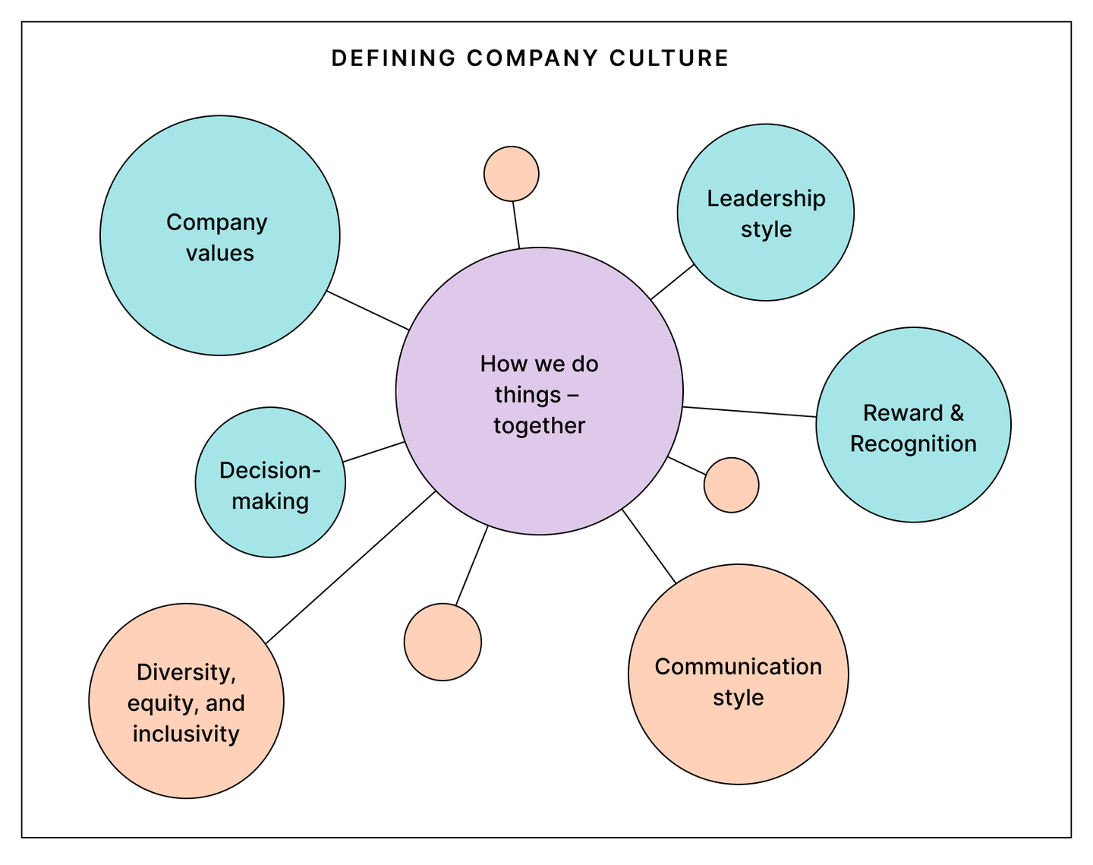
Understanding Company Culture
Defining Company Culture
Impact on Business Performance and Engagement
Retention and Talent Attraction
Company culture encompasses the values, behaviours, and practices that shape employees' daily experiences. It serves as the foundation for how individuals interact, make decisions, and align with organizational goals.
A positive culture boosts engagement and productivity, leading to higher business performance. Employees are more motivated and committed when their values align with those of the organization (Dorta-Afonso et al., 2021).
Strong company cultures enhance retention by creating a supportive, fulfilling environment (Ushakov and Shatila, 2021). This attracts top talent who seek a workplace that prioritizes growth and well-being.

Slide 5

Why Culture Matters in TechInnovate’s Expansion
As TechInnovate expands, managing a growing, diverse workforce requires a culture that respects varied perspectives and promotes inclusivity, ensuring all employees feel valued (Travers, 2020).
Rapid growth can dilute company values, making it essential for TechInnovate to reinforce its core principles consistently across teams and locations.
Employees increasingly expect a positive, supportive work environment. Fulfilling these expectations helps retain top talent and drives overall job satisfaction (Ngotngamwong, 2020).
Scaling demands flexible policies that support work-life balance while maintaining organisational structure, fostering both productivity and employee well-being.

Slide 6
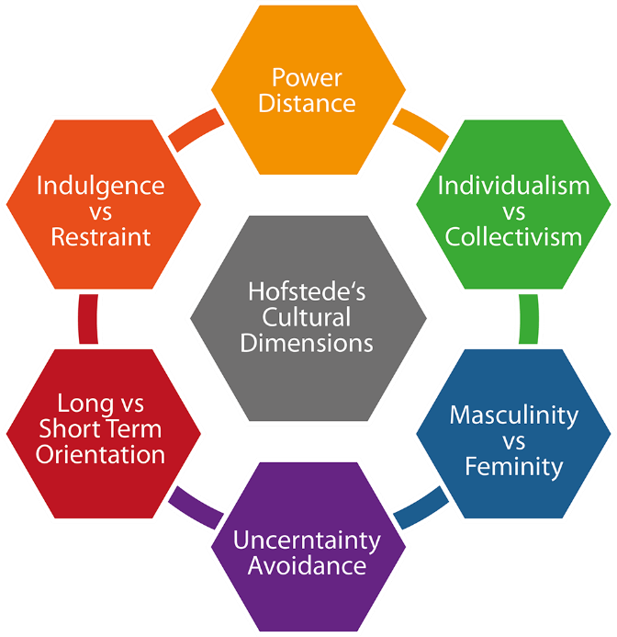
Introduction to the Culture Model: Hofstede's Cultural Dimensions
Defining Hofstede's Model
Hofstede's Cultural Dimensions model identifies six cultural traits that impact action at work. These traits include power distance, individualism, and avoiding uncertainty (Rojo et al., 2020).
Relevance to Workforce Dynamics
TechInnovate needs to understand the different values and communication styles of its employees in order to handle them well (Tupsakhare, 2022).
Guiding Cross-Cultural Integration
Hofstede's ideas can help global teams get past cultural differences and build a more united, welcoming society.

Slide 7

Applying Hofstede’s Model at TechInnovate
Power Distance
TechInnovate management can see how comfortable workers are with hierarchy by using power distance. Higher power distances may need more structure and authority, while power distances that are lower urge people to talk to each other freely.
Individualism vs. Collectivism
People in individualistic cultures like being independent, which affects who owns a project. People in collectivist cultures like working as a team, which affects collaboration (Umuteme and Adegbite, 2023).
Uncertainty Avoidance
Recognising tolerance for ambiguity aids in designing policies. Higher uncertainty avoidance calls for structured processes, while lower levels allow for more flexibility and innovation in problem-solving (Parker, 2024).

Slide 8


Managerial Influence on Culture
Setting Performance Standards and Expectations
Managers establish cultural norms by defining performance expectations, aligning employees with organisational goals, and reinforcing core values through consistent feedback (Newman and Ford, 2021).
Role Modeling and Engagement
By embodying company values and actively engaging with teams, managers influence attitudes, foster collaboration, and enhance workplace morale, driving a positive culture (Obeng et al., 2024).

Slide 9



Strategies for Enhancing Managerial Impact on Culture
Targeted Managerial Training
Equip managers with cultural awareness and leadership training to align their actions with company values, enhancing their impact on team culture.
    Strengthening Communication Skills
    Encourage open, transparent communication practices to foster trust and ensure employees feel heard and valued.
    Promoting Inclusivity
    Train managers on diversity and inclusion to create a respectful, welcoming environment where all employees can thrive.

Slide 10
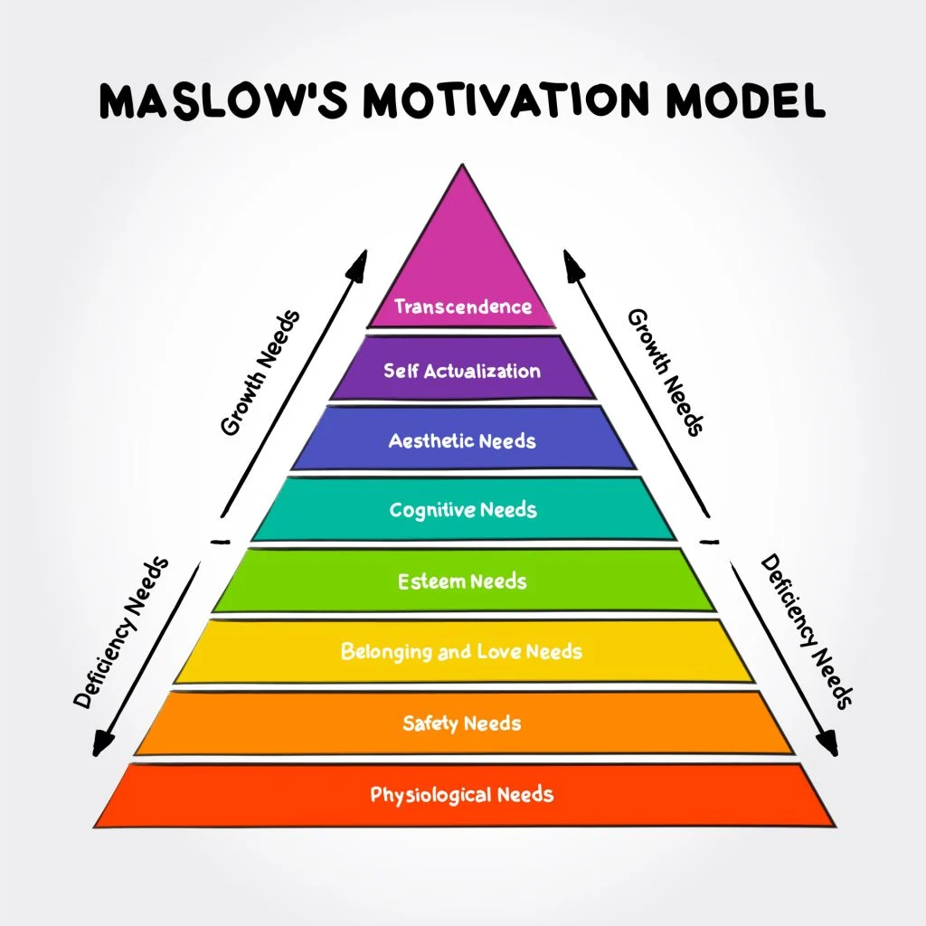
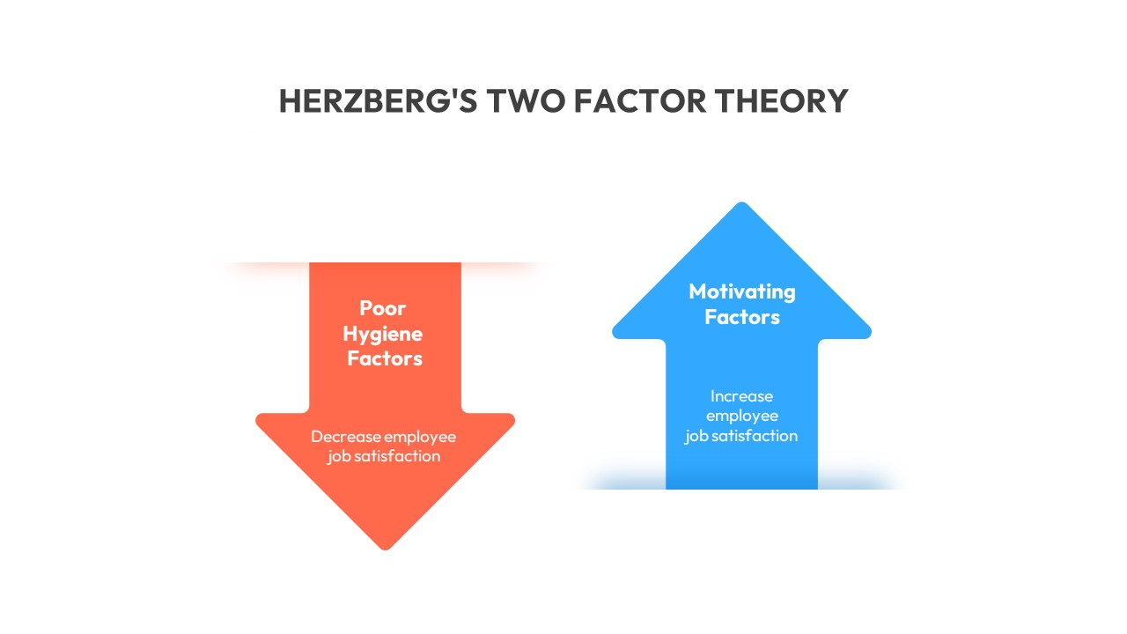
Employee Engagement and Motivation Models: Maslow’s Hierarchy and Herzberg’s Two-Factor Theory
Maslow’s Hierarchy of Needs
Maslow’s model suggests that employees are motivated by a progression of needs—from basic (e.g., job security) to self-actualization (e.g., personal growth), which helps TechInnovate tailor benefits and opportunities.
Herzberg’s Two-Factor Theory
Herzberg identifies “hygiene factors” (e.g., salary) that prevent dissatisfaction and “motivators” (e.g., recognition) that drive satisfaction and engagement.
Creating a Supportive Environment
These models help TechInnovate develop policies that meet foundational needs and boost morale, directly impacting productivity and retention.
Applying the Theories Together
Combining both models provides a comprehensive view of employee motivation, addressing essential needs while fostering growth and recognition to sustain engagement.

Slide 11

Practical Engagement Strategies for TechInnovate
Recognition Programs
Implement regular recognition initiatives to celebrate achievements and foster a sense of value, boosting morale and motivation across teams.
Promoting Work-Life Balance
Offer flexible work options and wellness programs to support work-life balance, reduce burnout, and enhance productivity.
Career Growth Opportunities
Provide clear career pathways, mentorship, and skill development resources, empowering employees to advance within the company and stay engaged.

Slide 12
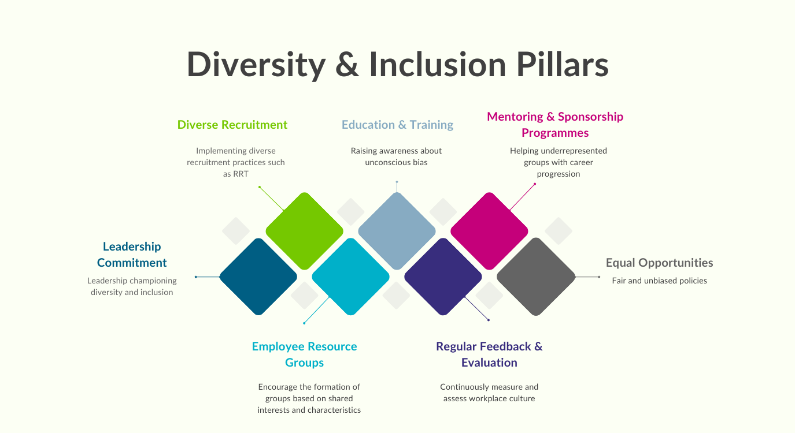

Diversity and Inclusion as Cultural Pillars
Driving Innovation
Diversity introduces varied perspectives, enhancing creativity and problem-solving. Inclusive teams at TechInnovate are more adaptable, driving innovative solutions.
Fostering Inclusive Practices
Implement unconscious bias training and ensure diverse representation in leadership roles to create a welcoming environment for all employees (Onyeador et al, 2021).
Encouraging Open Dialogue
Promote open communication channels where diverse voices are heard and valued, reinforcing a culture of respect and collaboration (Kainde and Mandagi, 2023).

Slide 13
Sustaining and Evolving TechInnovate’s Culture
Mentorship Program:
Establish a mentorship system with specific goals for employee growth, pairing new hires with experienced mentors to foster alignment with TechInnovate’s culture.
Structured Onboarding
Design a comprehensive onboarding process to immerse new employees in core values and expectations within 90 days of hiring.
Continuous Development
Implement quarterly training sessions focused on cultural competencies, ensuring employees consistently engage with evolving cultural priorities and skill development (Hutchins and Goldstein Hode, 2021).

Slide 14

18
Conclusion and Call to Action
TechInnovate grows with the help of a strong, welcoming atmosphere that encourages new ideas, happy employees, and different points of view. These cultural foundations can be strengthened by senior management through planned mentoring, onboarding, and growth. For long-term results and the success of the company, we need to actively strengthen and change our culture.

Slide 15
References
Ajayi, F.A. and Udeh, C.A., 2024. Agile work cultures in IT: A Conceptual analysis of hr's role in fostering innovation supply chain. International Journal of Management & Entrepreneurship Research, 6(4), pp.1138-1156. https://doi.org/10.51594/ijmer.v6i4.1004
Ngozi, D. and Edwinah, A., 2022. Employee engagement and talent retention: a review. South Asian Research Journal of Biology and Applied Biosciences, 4(5), pp.188-197. DOI: 10.36346/sarjbm.2022.v04i05.003
Ushakov, D. and Shatila, K., 2021. The impact of workplace culture on employee retention: An empirical study from Lebanon. The Journal of Asian Finance, Economics and Business, 8(12), pp.541-551. https://doi.org/10.13106/jafeb.2021.vol8.no12.0541
Dorta-Afonso, D., González-de-la-Rosa, M., Garcia-Rodriguez, F.J. and Romero-Domínguez, L., 2021. Effects of high-performance work systems (HPWS) on hospitality employees’ outcomes through their organizational commitment, motivation, and job satisfaction. Sustainability, 13(6), p.3226. https://doi.org/10.3390/su13063226
Newman, S.A. and Ford, R.C., 2021. Five steps to leading your team in the virtual COVID-19 workplace. Organizational Dynamics, 50(1), p.100802. https://doi.org/10.1016/j.orgdyn.2020.100802
Obeng, H.A., Arhinful, R., Mensah, L. and Owusu-Sarfo, J.S., 2024. Assessing the Influence of the Knowledge Management Cycle on Job Satisfaction and Organizational Culture Considering the Interplay of Employee Engagement. Sustainability, 16(20), p.8728. https://doi.org/10.3390/su16208728
Ngotngamwong, R., 2020. A Study of Millennial Job Satisfaction and Retention. Human Behavior, Development & Society, 21(3).

Slide 16
Continued….
Travers, M., 2020. Application of innovation strategies to the development of health information systems (Doctoral dissertation, University of Limerick).
Tupsakhare, P., 2022. Enhancing Agile Methodologies with AI: Driving Efficiency and Innovation. European Journal of Advances in Engineering and Technology, 9(10), pp.66-71.
Rojo, J., Everett, B., Ramjan, L.M., Hunt, L. and Salamonson, Y., 2020. Hofstede's cultural dimensions as the explanatory framework for performance issues during clinical placement: A mixed methods study. Nurse education today, 94, p.104581. https://doi.org/10.4236/jss.2024.129021
Umuteme, O.M. and Adegbite, W.M., 2023. Mitigating the impact of cross-culture on project team effectiveness in the Nigerian oil and gas industry: The mediating role of organizational culture and project leadership. Social Sciences & Humanities Open, 8(1), p.100653. https://doi.org/10.1016/j.ssaho.2023.100653
Parker, L.D., 2024. Third sector crisis management and resilience: Reflections and directions. Financial Accountability & Management, 40(3), pp.326-343. https://doi.org/10.1111/faam.12379
Onyeador, I.N., Hudson, S.K.T. and Lewis Jr, N.A., 2021. Moving beyond implicit bias training: Policy insights for increasing organizational diversity. Policy Insights from the Behavioral and Brain Sciences, 8(1), pp.19-26. https://doi.org/10.1177/2372732220983840
Kainde, S.J. and Mandagi, D., 2023. A systematic review of servant leadership outcomes in education context. EDUKASIA: Jurnal Pendidikan dan Pembelajaran, 4(2), pp.2563-2574. https://doi.org/10.62775/edukasia.v4i2.627
Hutchins, D. and Goldstein Hode, M., 2021. Exploring faculty and staff development of cultural competence through communicative learning in an online diversity course. Journal of Diversity in Higher Education, 14(4), p.468. https://psycnet.apa.org/doi/10.1037/dhe0000162

Slide 17

Thank You!

