Slide 1
Professional career development
Presentation and Interview Skills

Slide 2

Overview of Workshop
Employability
Presentation Skills
Interview Skills

Slide 3
Employability – A Definition
A widely accepted definition of employability is:
“A set of achievements, - skills, understandings and personal attributes – that make graduates more likely to gain employment and be successful in their chosen occupations, which benefits themselves, the workforce, the community and the economy.”
Higher Education Academy (HEA) http://www.heacademy.ac.uk/employability [Accessed: 1 March 2014]
Notes:
Facilitator to position the next slide, which introduces two of the key skills for increasing employability chances.

Slide 4
So, we’ve found the right job….now what?
Presentation skills : for many desirable jobs, and often when seeking investment, you may be asked to do a short presentation – this is an opportunity not a threat….if you do it well!
Interview skills : for any job worth having, or investment worth obtaining, you will be interviewed – this is your chance to shine…don’t waste it!
Notes:
Facilitator to discuss these elements – how do people feel about them? Do we get a shiver? Is it like going to the dentist? Well, we need to master them! Having a great Personal Brand will give us some confidence but we also need technique….lets have a look at these two skills…..starting with Presentation Skills.

Slide 5
What is needed to deliver a good presentation?
In your groups, discuss this question and identify the key things we need to consider to deliver an impressive presentation – to a small or large audience – and be ready for feedback and discussion.
Use any experiences you have had, as a presenter or as an audience member, to help you with your analysis.

Slide 6

Why many presentations fail
Preparation: or rather, lack of! Didn’t take account of the: -
    Objective
    Speaker
    Room
    Audience
    Message
  Being this under-prepared also means the presenter didn’t know their material!
Notes:
After the issues on this slide have been covered, the Facilitator is to choose a couple of students and ask them to stand up – then ask them to deliver a 5 minutes presentation on ‘Moodle’ now! It is likely that the students will be shocked…..after a few moments ask them how they feel? It is likely they are feeling a little stressed and nervous, and don’t know where to start. That is why preparation is so important……it also helps moderate the problems on the next slide…..emotions!

Slide 7
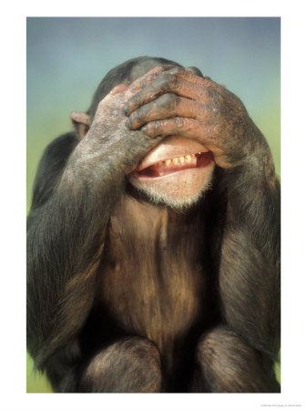
Why many presentations fail
2. Emotions: getting the better of you...nerves
    Stuttering
    Mumbling
    Racing
    Lack of clarity and volume
    Looking down/no eye contact
    Lack of confidence
  Practice, and more practice, coupled with thorough preparation builds confidence and success
Notes:
Ask if anyone has suffered with any of these. How did it make them feel? There is no easy remedy….we will look at how to deliver effective presentations shortly.

Slide 8

Why many presentations fail
3. Information: inappropriately presented…
    Too much
    Not enough
    The wrong sort
    Unintelligible
    Unstructured or structured incorrectly
To be useful, we have to deliver the right information in the right way to make sure that it is understood by our audience – big or small
Notes:
If these are typical reasons why many presentations fail….and there are probably many more…..how can we make our presentations a success? Let’s take a look at some of the key considerations for effective presentations.

Slide 9
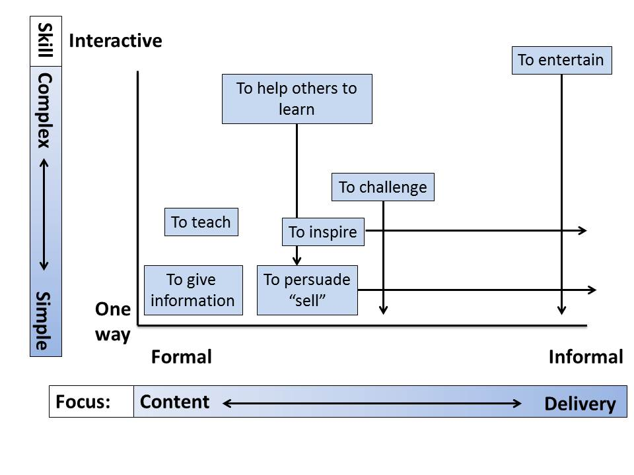
Different Goals and Different Delivery Styles

Slide 10
The Impact of the Audience
Their knowledge and understanding
Their emotions about what you are saying
Their emotions about how you are giving the message
Their general state of health/alertness
How many people there are
Where they are sitting
The information they already have

Slide 11
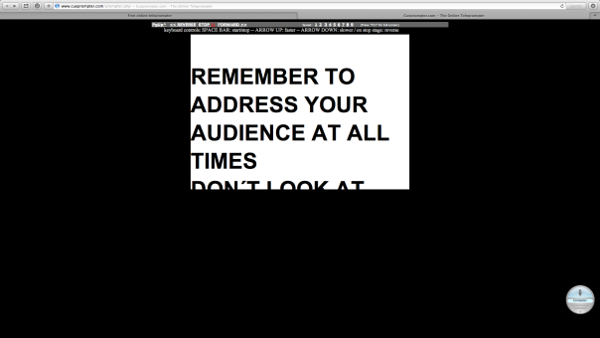
Preparation
Rehearsing
Making notes
Over-preparation
Notes:
Remember to address your audience at all times. Don’t look at….the screen! Oops! As Benjamin Franklin said “Failing to prepare is preparing to fail”! Steve Jobs rehearsed for weeks before delivering keynote presentations – he wrote them himself and then practiced and practiced until he knew ALL the material by heart and could deliver it perfectly….consistently! Many people don’t realise that it takes lots of practice to sound conversational and natural! Making notes is important – but you must make sure that they are notes, not scripts. Facilitators often use small cards with notes, or often ‘bullet-points’ on a PowerPoint, which also act as notes to the presenter! Be aware that sometimes things can go wrong – so prepare for eventualities or plan to avoid them. Over-preparation means being totally committed to one way of doing your presentation, such that if something goes wrong (technical failure) your presentation fails. Maintain a balance – prepare so that if the PowerPoint fails, you can move to a flipchart or plain verbal engagement relatively seamlessly.

Slide 12
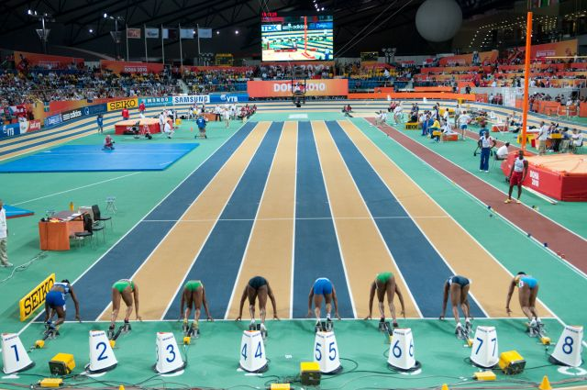
Structuring a Presentation
Introduction
Middle
Conclusion
Notes:
“Tell them what you are going to tell them. Tell them. Tell them what you told them!”

Slide 13
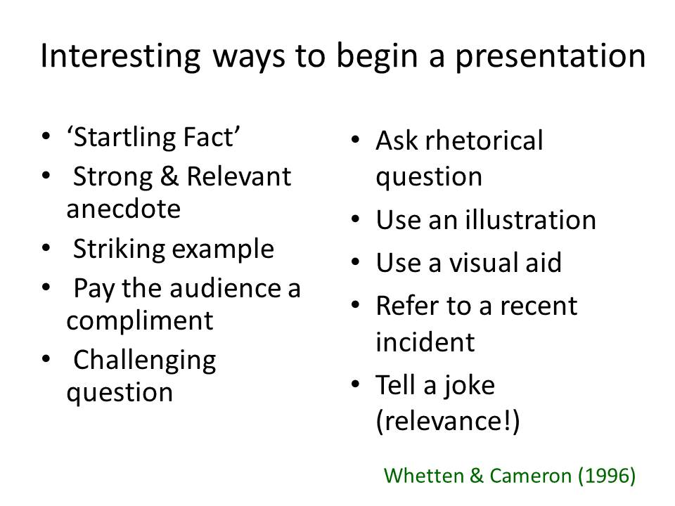
Beginning Your Presentation
Notes:
Facilitator to ask the students for examples of what they could use, before demonstrating some of these themselves.

Slide 14
When delivering a presentation remember:
Audibility
Smiles and facial expressions
Clarity of message
Posture
Tone of voice
Pace and speed of speech
To obtain and maintain interest
To look at the audience

Slide 15
When delivering a presentation remember (Cont.):
To anticipate audience thinking
To handle information well
To ask rhetorical questions
Your dress and appearance
To tell jokes
To keep to time
To be polite, courteous and respectful
To say ‘Thank you’ and invite questions

Slide 16
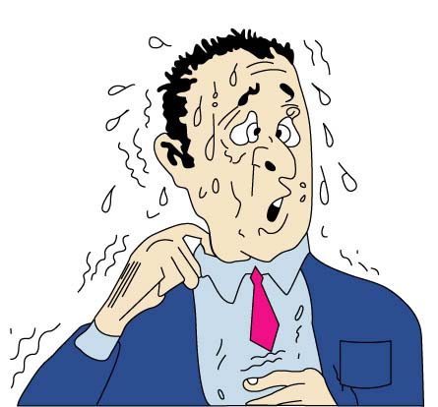
When we are nervous:
We speak too quickly.
We shake – especially when we are holding notes.
We fidget around – with our feet/legs, play with our hair, etc.
We look down and not at the audience.
We forget what we are trying to say.
We become unable to bring our own personality into our delivery.

Slide 17
To deal with nerves:
Consider why we get nervous
Deal with the reasons
Try strategies for handling those nerves:
  give yourself ‘breathing space’
  appear confident
  remember it is a conversation
  do not rely on memory alone
  be yourself
  keep your hands still

Slide 18
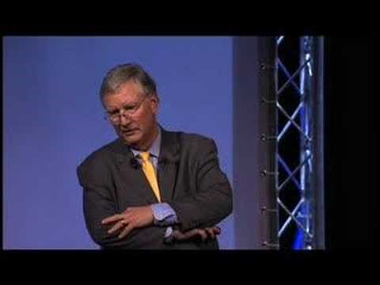
A master at work…
Notes:
Ask the students to watch this brief extract of Tom Peters – what do they think? What techniques does he use?
He uses Analogies, Examples and anecdotes, talks directly to members of the audience, makes eye contact, uses visual aids, no notes, clarifies his points brilliantly, looks relaxed, is passionate! Emphasises key words! Changes his tone and pace…..gets ‘intimate’

Slide 19
Suggestions for Interaction & Visual Aids
Video | Stories
PowerPoint | Handouts
Demonstration | Flipchart/Digital Media
Role-Play | Discussions
Quizzes | Volunteers from the audience
Physical Examples | True/False or Multiple choice questions
 | Pictures

Slide 20
Creativity in presentations:
Variety
Planning
Relevance
Technology
Regularity
Timing
Ability
Overkill
Notes:
Variety – keep your audience guessing
Planning – creative ideas take careful planning….have you got time? What could go wrong? How will you manage this?
Relevance – Think through your ideas…do they add value?
Technology – Be careful…what happens if it fails?
Regularity – overuse of creative activities can lead to your audience switching off because your presentation can become disjointed
Timing- learning can be more powerful when you use an activity to show them something in another way….a different perspective
Ability - do not try and do something you cannot…if you aren’t funny, don’t tell jokes…..if you need physical attributes to demonstrate something and you do not possess them, then ask for a suitable audience volunteer!
Overkill – Too many creative activities in a short space of time for a presentation whose goals do not require creative activities, e.g. technical reports to a management team, can kill a presentation. You do not always have to be creative – you need to communicate effectively.

Slide 21
To avoid death by PowerPoint:
Insert video
Use animations and transitions creatively
Turn off noises
Use colour carefully
Keep the content succinct
Keep it simple and short
Check the spelling throughout

Slide 22
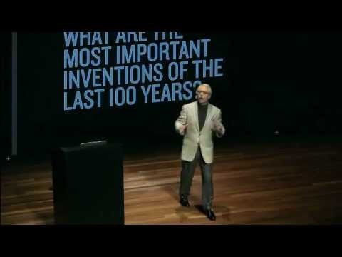
Another master at work…
Notes:
Facilitator to ask the students to make some notes about what Gary Hamel does well. Facilitator to discuss how he too imparts passion, uses no notes, but also is incredibly synchronised with the backing slides behind him – neither this presentation, or the Tom Peters presentation were thrown together – they were planned and practiced to perfection, which allows the presenters to relax and engage the audience with their important messages.

Slide 23
How an Organisation Develops a Selection Process
Screening
Use of selection methods:
      Selection interview
      Psychometric test
      In-basket exercise
      Work sample
      Assessment centre
Notes:
Talk through these elements and explain each of these to the students – have they experienced any of them? Screening is the process of deciding ‘who’ gets an interview, from the many applicants. It is about reviewing application forms, covering letters and CVs and eliminating those that don’t comply….for whatever reason…..and selecting the best ones (or ones that catch your eye) for interview.

Slide 24


So, what about interviews?
What exactly is an interview?
What, therefore, is a ‘selection interview’?
Notes:
Faciltator to ask these questions of the students – wait for answers before moving onto the next slide.

Slide 25
A selection interview is …
‘a conversation with the purpose of deciding whether a candidate has the ability and sufficient experience to perform well in a job role’.
An interviewee will need to convince an employer within 30 to 45 minutes that they are worth taking to the next stage of the selection process.

Slide 26
Performing Well: Employer Objectives
Is this candidate likely to be able to perform well in the role?
Is this candidate likely to be able to perform at an acceptable level within the organisation?
Is this candidate likely to fit into the culture of the organisation?

Slide 27
Performing Well: Interviewee Perspective
Beforehand:
Review your application
Review the job specification
Dress appropriately
Consider the questions you might be asked
Role-play the interview with a ‘Critical Friend’
Find out about the interview

Slide 28
Performing Well: Interviewee Perspective (Cont.)
At the interview:
Reduce nerves
Structure of an interview:
  Welcome and introduction (1–2 mins)
  Questions to you (25–35 mins)
  Your questions (approximately 5 mins)
  Thank you and summary of next steps (1–2 mins)

Slide 29
Performing Well: Interviewee Perspective (Cont.)
Entrance and First Impression
  Shake hands
  Smile
  Eye contact
  Move purposefully

Slide 30
Performing Well: Interview Questions
Question types:
  Open questions
  Probing questions
  Closed questions
  Leading questions
  Hypothetical questions
  Behavioural questions

Slide 31
Knowing Your Strengths and Weaknesses
Consider your relevant strengths and weaknesses carefully, based on the job you are applying for.
Discuss examples of when you have used your strengths.
Identify weaknesses that you can develop, and give examples of when you have developed those skills.
Answer honestly, but in a manner which shows some humility. Even if you are graduating with an MBA, you will still have something to learn

Slide 32
Giving Good Answers
A good answer ‘… is one which provides convincing evidence to an interviewer that you have the capability and potential to do what is needed in the job’.
S.T.A.R.
  Situation: What was happening?
  Task: What needed to be done?
  Action: What did you do?
  Result: What was the impact?

Slide 33
Giving Good Answers (Cont.)
Keep your answers comprehensive but brief
Watch the speed of your speech
Imagine the issues you might face in doing the job, and prepare examples of how you might handle those issues in the workplace
Focus on your contribution to group activities
Be honest
Give relevant answers

Slide 34
Potential Work-related Issues to Ask About
What kind of training might I receive?
What assistance is available for me in terms of finding accommodation?
What is it like to work for this organisation?
Would I be working with a team or largely independently?
How formal are relationships between junior and senior management?
How resistant are people to change in your organisation?
How would my performance in the job be evaluated?

Slide 35
General Behaviour at Interviews
Dress smartly
Go to the bathroom before the interview
Use formal language
Maintain eye contact
Communicate effectively (paralinguistic, non-verbal behaviours and language) and respond appropriately to the interviewer
Sit upright and lean forward
Prepare some questions
Turn your phone off

Slide 36
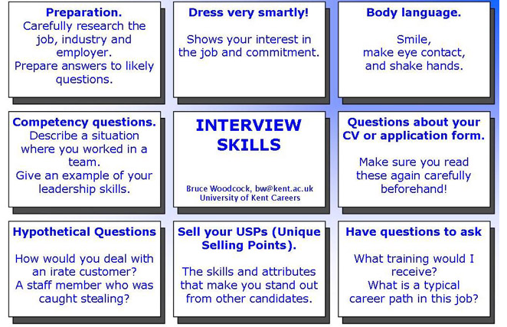

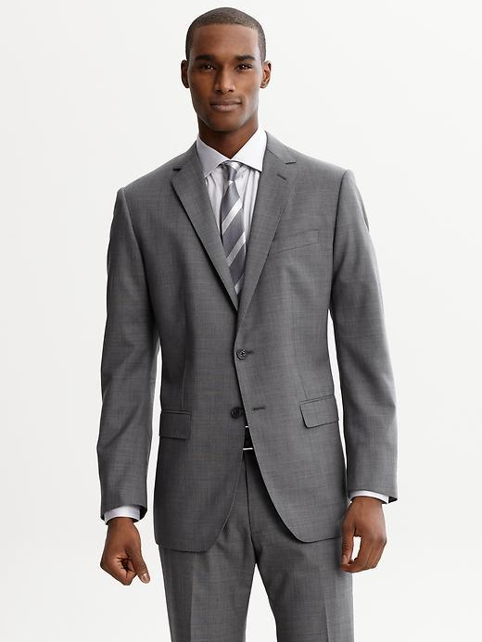
This Photo by Unknown Author is licensed under CC BY-NC-ND
This Photo by Unknown Author is licensed under CC BY-NC-ND

Slide 37
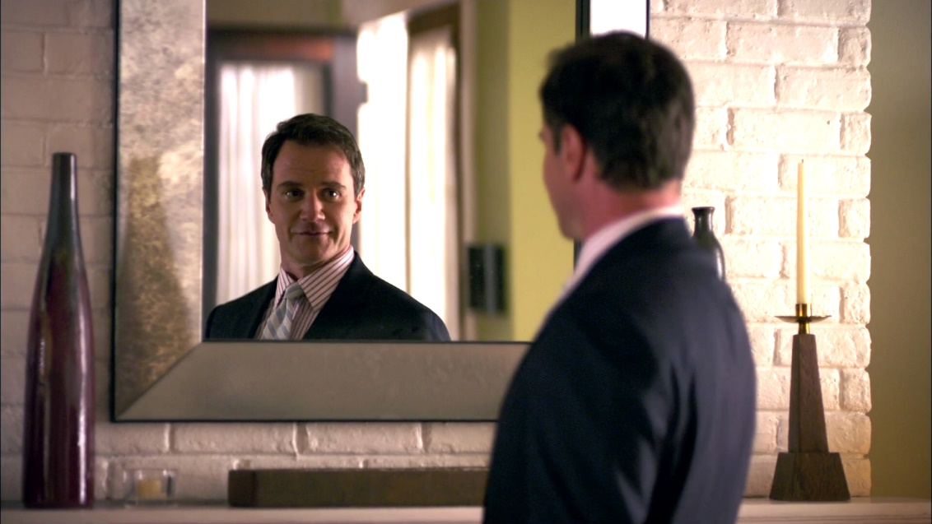
After the whole process is over…
…Reflect…Learn!
What went well?
What didn’t go well?
What have you learned?
What would you do differently next time?
How could you maximise your chances of success?

Slide 38
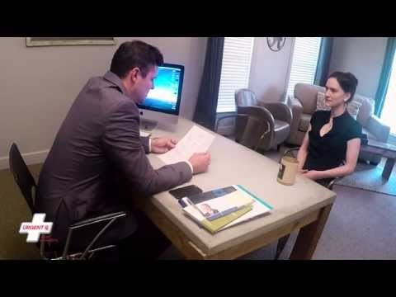
And never interview like this…..

Slide 39
Summary
Take 5 minutes to reflect on the day and summarise your learning from today.

Slide 40
Further Research
Look at other examples of Tom Peters, Gary Hamel, Steve Jobs and others delivering presentations – note how they engage the audience and, importantly, communicate their message!
Start thinking about how you can develop your presentation and interview skills – make it happen!

Slide 41
References
Morgan, P. (2017) The Business Student’s Guide To Study And Employability. London: Sage Publications Ltd.
Whetten, D.A. and Cameron, K. (1996) Developing Management Skills for Europe. Harlow: FT/Prentice Hall

