Slide 1
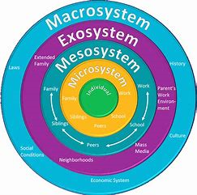




Education Infographic
HEALTH & WELL-BEING
NEW CURRICULUM FOR WALES 2022
(Bronfenbrenner, 1979)
SUPPORTING CHILDREN AND YOUNG PEOPLE REACH THEIR FULL POTENTIAL
(Gov.uk, 2019)
WORKING TOGETHER TO CLOSE THE ATTAINMENT GAPt
70%
67%
53%
HOW CAN SCHOOLS HELP?
Education Lorem
INTERVENTIONS
WORKING TOGETHER
SUPPORT FAMILIES
2019 - % OF POOR CHILDREN IN WORKING FAMILIES
2018 - % OF POOR CHILDREN IN WORKING FAMILIES
% OF POOR CHILDREN AGED 5 AND UNDER
FREE SCHOOL MEALS
PUPIL DEVELOPMENT GRANT
90,662 CHILDREN IN WALES EFSM 2018-19
£1150 FOR CHILDREN IN FULL TIME EDUCATION.
(Statswales, 2020)
14.5M PEOPLE IN THE UK LIVING IN RELATIVE POVERTY
RELATIVE POVERTY
23% PEOPLE LIVING IN WALES ARE IN RELATIVE POVERTY
(Tackling child poverty, 2009,pp4-8)

