Slide 1

Marks and Spencer
Ancuta Nutu - 1918834

Slide 2
Introduction
To analyse the culture and external context of M&S
Determine a future strategy and plan for a culture change
Ethical behaviour
Conclusion
Reference list

Slide 3
Organizational culture and external context
In modern business, organizational culture has become a key element of a company's success (CIPD, 2020).
According to Edgar Schein, an organization's culture is defined by its basic assumptions, followed by the values, which influence practices and behaviors, which constitute the visible component (Kukreja, 2018).
People relate strongly to the concept of culture because it is influential.
Organizational life has deep social and collective aspects that shape people's experiences and behaviors (Hoque, 2013).

Slide 4
Marks and Spencer organizational structure
Marks and Spencer’s organizational structure in the last five years was flat, with a big focus on innovation and customer service and that is because the number of competitors has risen rapidly (Marks and Spencer Group PLC, 2021).
As an example, Marks and Spencer has a large structure with many employees, and management is responsible for the smooth functioning of the company.

Slide 5
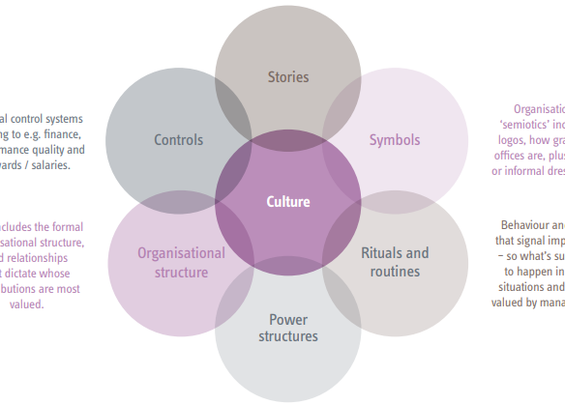
The Cultural Web Model
An organization's Culture Web can be used to map the culture and understand the influences that impact the culture of the organization (Leadership Centre, 2019).

Slide 6
Marks and Spencer organizational culture
Individual behavior also contributes to the positive organizational culture described by Marks and Spencer.
A negative impact of organizational culture on team and individual behaviors, however, has been criticised by Kitchen (2017).

Slide 7
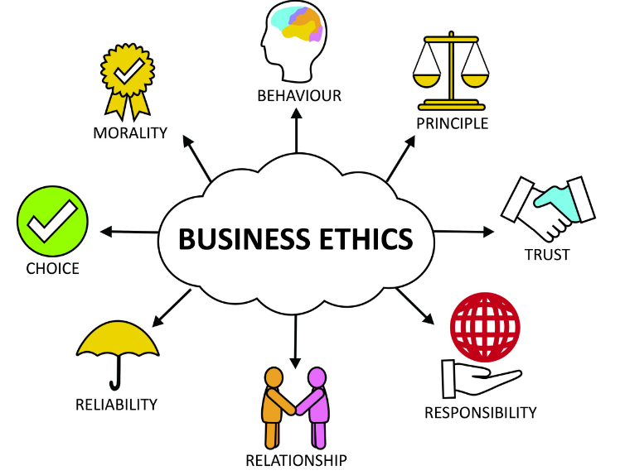
Ethical/ Unethical behaviour
A company's conduct is guided by its business ethics, which are the set of moral principles it adheres to (Indeed Editorial Team, 2021).
The following foundational principles are relevant to a business whenever ethical dilemmas arise, or controversies arise (Vaidya, 2020).

Slide 8
Marks and Spencer’s ethical/unethical behaviour
A move towards more ethical standards has been led by Marks and Spencer.
For example: Among the areas where Marks & Spencer scored highest were environmental reporting, palm oil sourcing, and wood sourcing (Beavis, 2012).
Some research highlights several ethical matters by M&S including workers’ rights, and an irresponsible marketing environment (M&S EST.1884, 2022).
During the organization's research, it was revealed that M&S operated in several countries that Ethical Consumer considered to have oppressive regimes in place.

Slide 9
Reference List part 1
Beavis, Lynn. “M&S: Doing the Right Thing Leads to Change – for the Better.” The Guardian, 30 May 2012, www.theguardian.com/sustainable-business/best-practice-exchange/marks-and-spencer-change-better. Accessed 2 Dec. 2022.
CIPD. “Organisational Culture and Cultural Change | Factsheets.” CIPD, 28 Oct. 2020, www.cipd.co.uk/knowledge/culture/working-environment/organisation-culture-change-factsheet#gref. Accessed 28 Nov. 2022.
Hoque, Arafat. “Definition Of: External Context.” Oil and Gas Drilling Glossary - IADCLexicon.org, 2 July 2013, iadclexicon.org/external-context/. Accessed 2 Dec. 2022.
Indeed Editorial Team. “Business Ethics: Types and Examples.” Indeed Career Guide, 23 Feb. 2021, www.indeed.com/career-advice/career-development/business-ethics. Accessed 2 Dec. 2022.
Kitchin, Duncan. Introduction to Organisational Behaviour for Managers and Engineers - a Gro. Taylor & Francis Ltd, 2017.

Slide 10
Reference List part 2
Kukreja, Sonia. “Edgar Schein’s Model of Organizational Culture | Management Study HQ.” Management Study HQ, 24 Dec. 2018, www.managementstudyhq.com/edgar-schein-model-theory.html. Accessed 2 Dec. 2022.
Leadership Centre. “Cultural Web | Art of Change Making.” Leadershipcentre.org.uk, 2019, www.leadershipcentre.org.uk/artofchangemaking/theory/cultural-web/. Accessed 2 Dec. 2022.
M&S EST.1884. “Leaning on Ethical Trade.” Marks & Spencer, 2022, corporate.marksandspencer.com/leaning-ethical-trade. Accessed 2 Dec. 2022.
Marks and Spencer Group PLC. “M&S Realigns Management Structure – Company Announcement - FT.com.” Markets.ft.com, 18 May 2021, markets.ft.com/data/announce/detail?dockey=1323-14981697-1FE72NV97005ILKAFR82ONRNDC. Accessed 2 Dec. 2022.
Vaidya, Dheeraj. “Business Ethics - Definition, Principles and Importance.” WallStreetMojo, 28 July 2020, www.wallstreetmojo.com/business-ethics/. Accessed 2 Dec. 2022.

