Slide 1

Japanese Hand Gestures and Body Language
And the role they play in communication

Slide 2
Abstract
Every culture has their own unique body gestures when speaking to express certain feelings or situations effectively.
Japanese hand and body gestures are no exception to the rule.
Most Japanese body gestures are unique to the Japanese culture, outside of Japan, people may wonder what they stand for, or even possibly completely misunderstand the true meaning of them.
In the following slides I will present a few Japanese hand and body gestures and a brief explanation.
JapanesePod101, ‘Japanese Hand Gestures and Body Language’, JapanesePod101 Blog, 16 August 2019 japanesepod101.com [accessed 8 July 2026].
Notes:
By learning the hand and body gestures of Japanese culture will not only help us to understand the Japanese culture better but will also make us feel more comfortable communicating with Japanese people.
In non-verbal communication, the Japanese relies more on hand and body gestures than Indonesia.
In Japan what you 'don’t say' is frankly more important than what you 'do say'.
Most language classes teach grammar but ignore body language which is vital for avoiding social mistakes.
Nana, Rahayu, ‘Hand Gestures in Japanese Communication’, SHS Web of Conferences, 173 (2023), 04005 doi.org [accessed 8 July 2026]

Slide 3
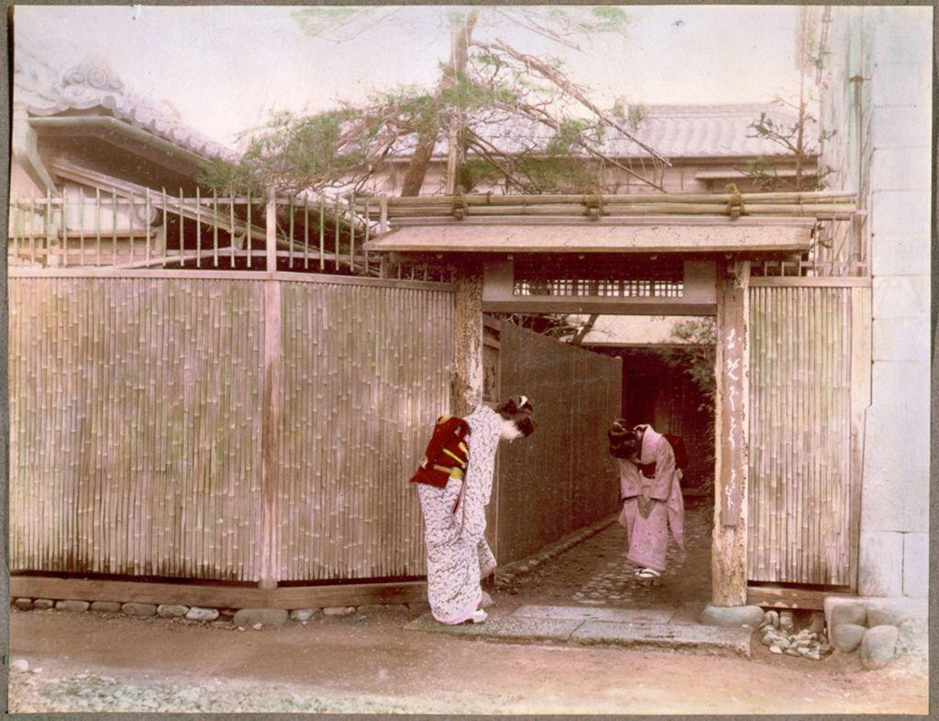
Bowing (ojigi)
There are three styles of bowing in a standing posture.
1.Saikeirei (formal) to bow down deeply, normally at a 45-degree angle while making sure that the tips of the fingers and toes are in alignment and the body tense.
2. Keirei (informal) Normally done at a 30-degree angle, it is normally used in everyday life to greet customers, neighbours etc.
3. Eshaku (casual) This style of bowing is more of a slight nod of the head and more commonly used within intimate groups like family and friends.
Yasuko, Tohyama, 'Aspects of Japanese Nonverbal Behaviour', The Empire of Signs: Semiotic Essays on Japanese Culture, 8 (1991), p.181.
Image unknown. 1875. Two Japanese Women Bowing to Each Other [accessed 7/6/2026 from uwtsd library]
Notes:
Nonverbal communication involves ways in which human beings communicate by means of mannerisms rather than words. Nonverbal actions can include a person's stance, facial expressions, physical demeanor, eye contact and the physical vicinity in which they place themselves when regarding other parties during communication. Voice quality, vocalization, physical contact, all of these relay varied types and amounts of information during human communication.
Yasuko, Tohyama, 'Aspects of Japanese Nonverbal Behavior', The Empire of Signs: Semiotic Essays on Japanese Culture, 8 (1991), p.181.

Slide 4
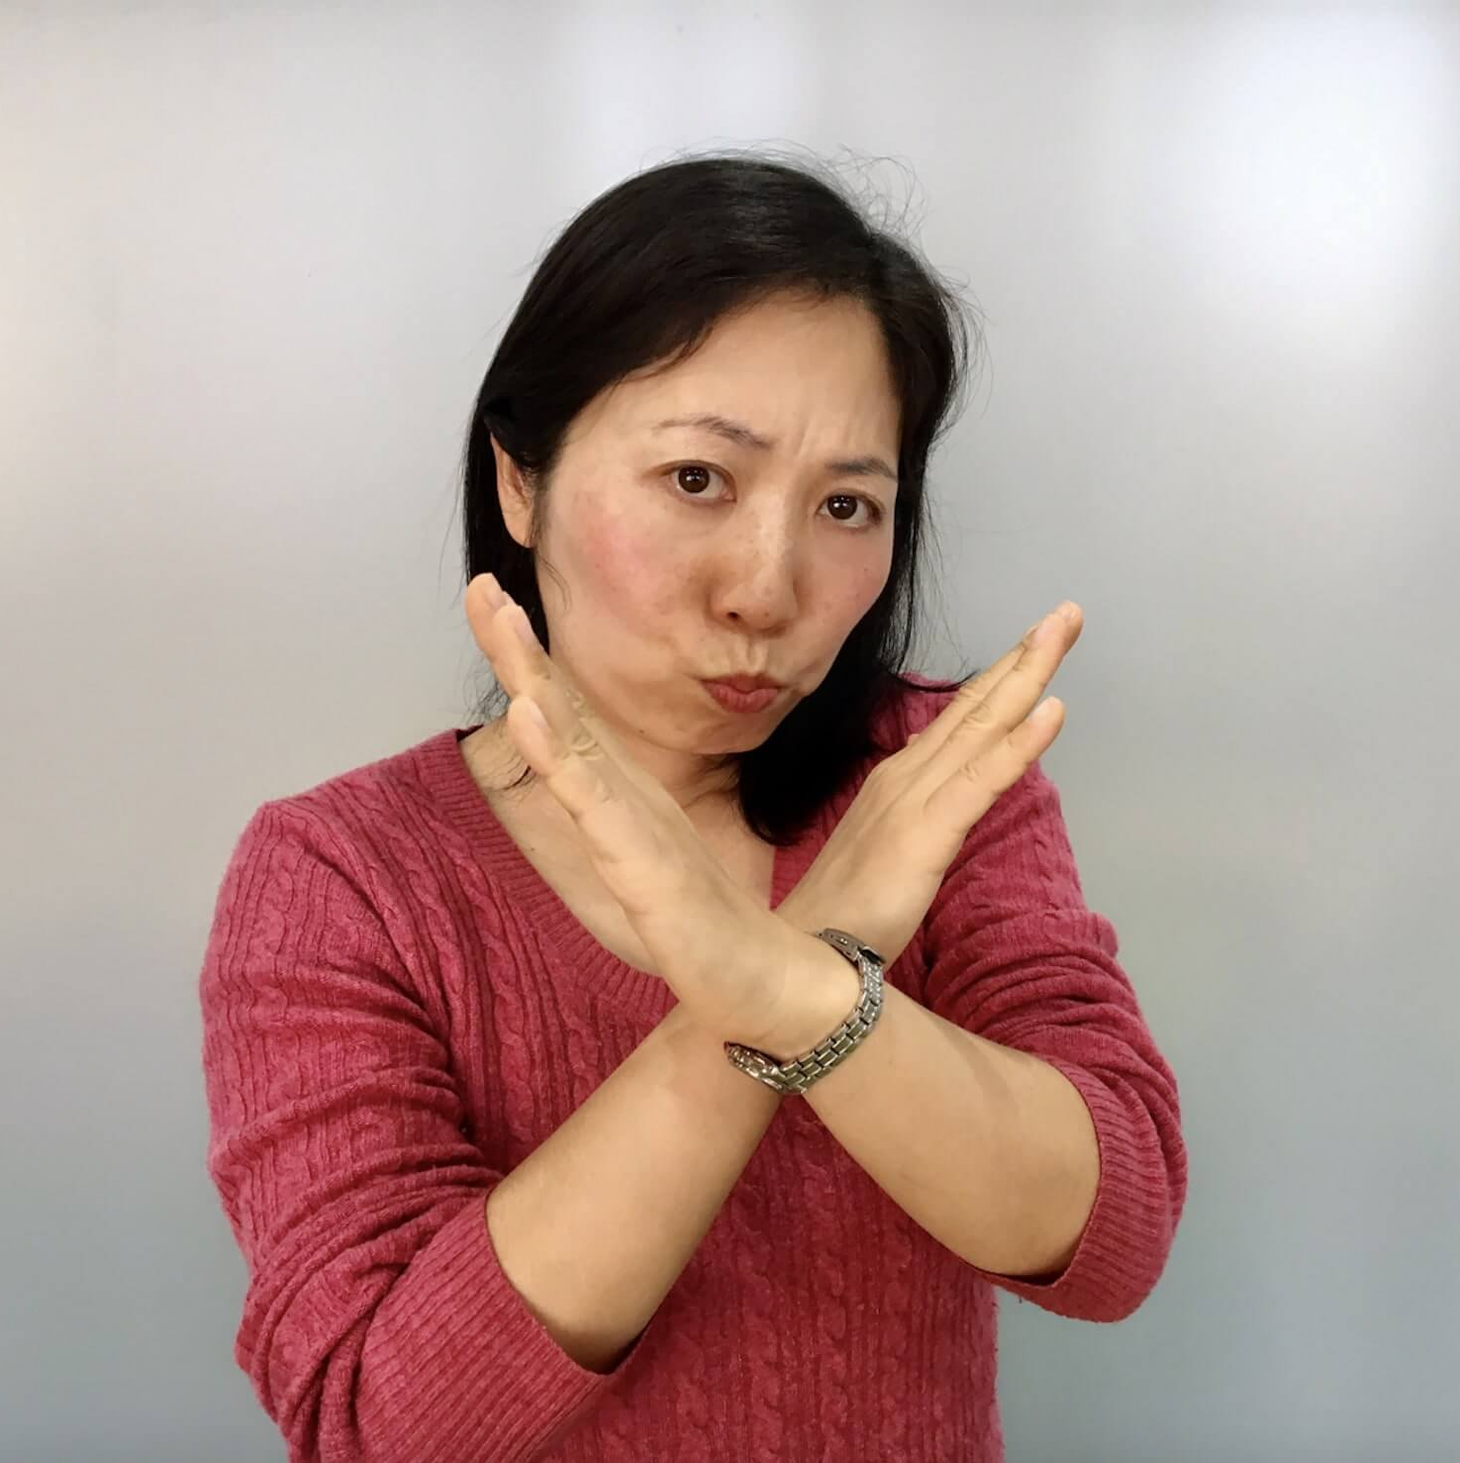
The X (Batsu)
Crossing your forearms or index fingers to form an X indicates that it is wrong, prohibited, incorrect.
It can be used by restaurant staff for example to indicate that the restaurant is fully booked.
The literal word batsu translates to punishment or penalty, which is why the "X" symbol carries a negative or corrective meaning
Notes:
'Batsu' originates from the old government registry system, where a person’s name was physically crossed out with an ink "X" after a divorce.
The Cross-Cultural Clash: Linguists note a deep semantic dissonance between Western and Japanese grading systems. In the West, a checkmark means "correct" or "verified." However, when Western checkmarks were introduced to Japan, Japanese educators naturally mapped the quick slash of a checkmark to the negative batsu. Consequently, in Japanese pedagogy, a checkmark actually means incorrect, which is a frequent source of pragmatic failure in cross-cultural communication
Jenny Thomas, ‘Cross-Cultural Pragmatic Failure’, Applied Linguistics, 4.2 (1983), 91–112 (p. 93).

Slide 5
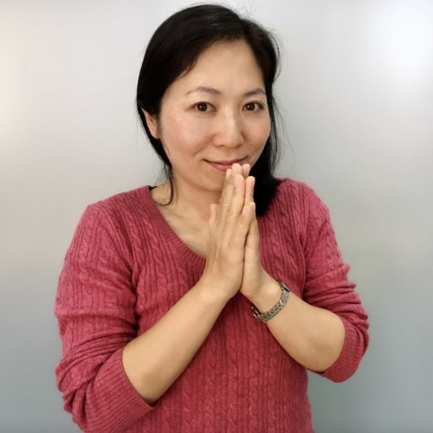
Please (onegai)
This is a very polite gesture in Japanese culture. It is used to ask for something or to make a request.
In Japan, the standard gesture for "please" (onegai) is putting your hands flat together in front of your chest, exactly like a prayer position.
This physical motion goes hand-in-hand with making a polite request or asking for a small favor. To help you seamlessly navigate communication, here are the core physical motions and phrases used alongside this request, followed by other essential everyday Japanese gestures.
How to Use the "Please" (Onegai) Gesture
The Motion: Press both palms completely flat together at mid-chest level, keeping your fingers pointing straight up.
The Meaning: It visually emphasizes a sincere or desperate request, meaning "please do me a favor". It can also double as a casual "I'm sorry" (gomen) when you are bothering someone for help.
'Japanese Gestures and Body Language', JapanesePod101 japanesepod101.com [accessed 8 July 2026].
Notes:
Japanese body language uses small, tight movements rather than wide Western gestures to avoid conflict. Pulling arms and legs close—like pressing hands to the chest or looking down makes a person look smaller. This polite posture shows respect, gestures safety, and respects social status.
P. Richard. Meres, ‘Japanese Nonconfrontational Conflict Strategies and Their Accompanying Nonverbal Behaviors’ (unpublished master’s thesis, University of Montana, 1998), in ScholarWorks at University of Montana https://scholarworks.umt.edu/etd/5388/ [accessed 8 July 2026].

Slide 6
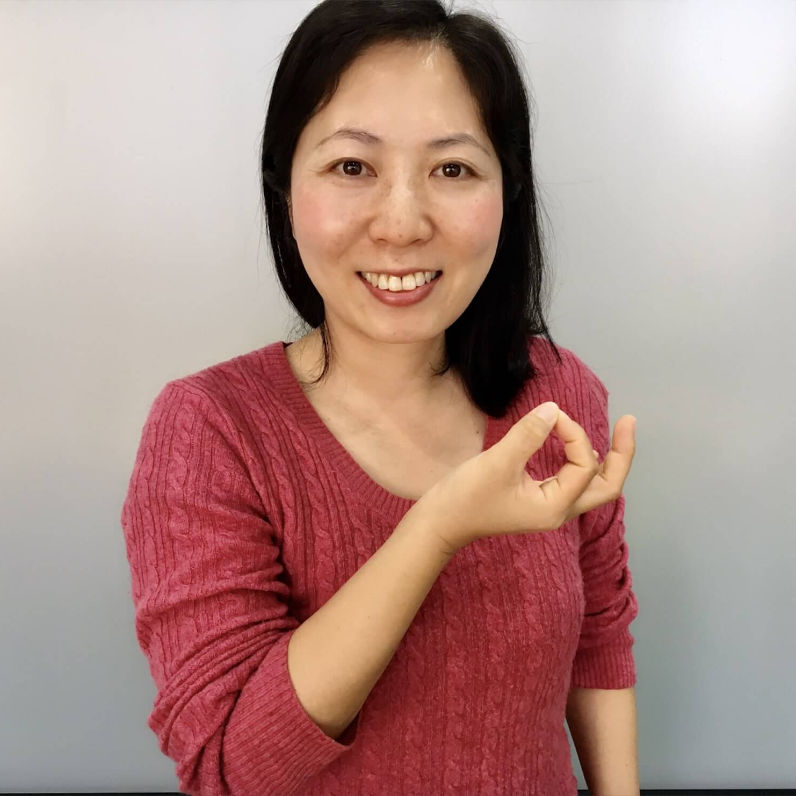
Money (Okane)
This is the hand gesture for asking for money.
In her 2023 research paper, Hand Gestures in Japanese Communication, Nana Rahayu focuses heavily on the contrastive pitfalls of non-verbal cues for foreign language learners.
This gesture could represent a dangerous point of multicultural misunderstanding. Because the exact same physical gesture universally signifies "OK," "good," or "agreement" in Western cultures and parts of Indonesia, foreign speakers often misinterpret the context.
Nana Rahayu, ‘Hand Gestures in Japanese Communication’, SHS Web of Conferences, 173 (2023), 04005 (p. 3) doi.org [accessed 8 July 2026].
Notes:
Core Findings: This contrastive analysis details the physical and spatial differences between the American "OK" sign and the Japanese "Money" sign. Kuroda highlights that while the American approval gesture is typically held high with the palm facing outward, the Japanese Okane gesture is held lower (near the waist) with the palm angled upward or hidden from direct forward view, strictly denoting currency.
Toru Kuroda, ‘English and Japanese Gestures In Contrast’, Journal of Kobe City University of Foreign Studies, 58.4 (2008), 23–39 (p. 27).

Slide 7
Conclusion
Gestures are used to substitute, highlight, repeat, deny or decline, and complete verbal messages. Finger gestures specifically serve the purposes of accentuating on verbal messages, reiteration of verbal messages, and replacement of verbal messages. Arm movements contribute to repeating and emphasizing verbal messages. Arm movements share similar purposes with wrist and palm movements. In conclusion, hand gestures play a meaningful role in Japanese communication, harmonizing and strengthening verbal messages. Finger movements, arm movements, and wrist and palm movements are surveyed in various situations. Learners of the Japanese language should acquaint themselves with these gestures to better comprehend Japanese communication.
Nana Rahayu, ‘Hand Gestures in Japanese Communication’, SHS Web of Conferences, 173 (2023), 04005 (p. 3) doi.org [accessed 8 July 2026].

Slide 8
Bibliography
JapanesePod101, ‘Japanese Hand Gestures and Body Language’, JapanesePod101 Blog, 16 August 2019 japanesepod101.com [accessed 8 July 2026]
Rahayu, Nana, ‘Hand Gestures in Japanese Communication’, SHS Web of Conferences, 173 (2023), 04005 doi.org [accessed 8 July 2026]
Tohyama, Yasuko, ‘Aspects of Japanese Nonverbal Behaviour’, in The Empire of Signs: Semiotic Essays on Japanese Culture, ed. by Yoshihiko Ikegami, Foundations of Semiotics, 8 (Amsterdam: John Benjamins, 1991), pp. 181–201
Thomas, Jenny, ‘Cross-Cultural Pragmatic Failure’, Applied Linguistics, 4.2 (1983), p. 91–112
Meres, Richard P., ‘Japanese Nonconfrontational Conflict Strategies and Their Accompanying Nonverbal Behaviors’ (unpublished master’s thesis, University of Montana, 1998), in ScholarWorks at University of Montana https://scholarworks.umt.edu/etd/5388/ [accessed 8 July 2026]
Rahayu, Nana, ‘Hand Gestures in Japanese Communication’, SHS Web of Conferences, 173 (2023), 04005, p. 3 doi.org [accessed 8 July 2026]
Kuroda, Toru, ‘English and Japanese Gestures In Contrast’, Journal of Kobe City University of Foreign Studies, 58.4 (2008), 23–39, p. 27

