Slide 1


Motorcycle Steering and Rider Control Analysis
Research Project Proposal
by
Alexander Przibylla

Slide 2
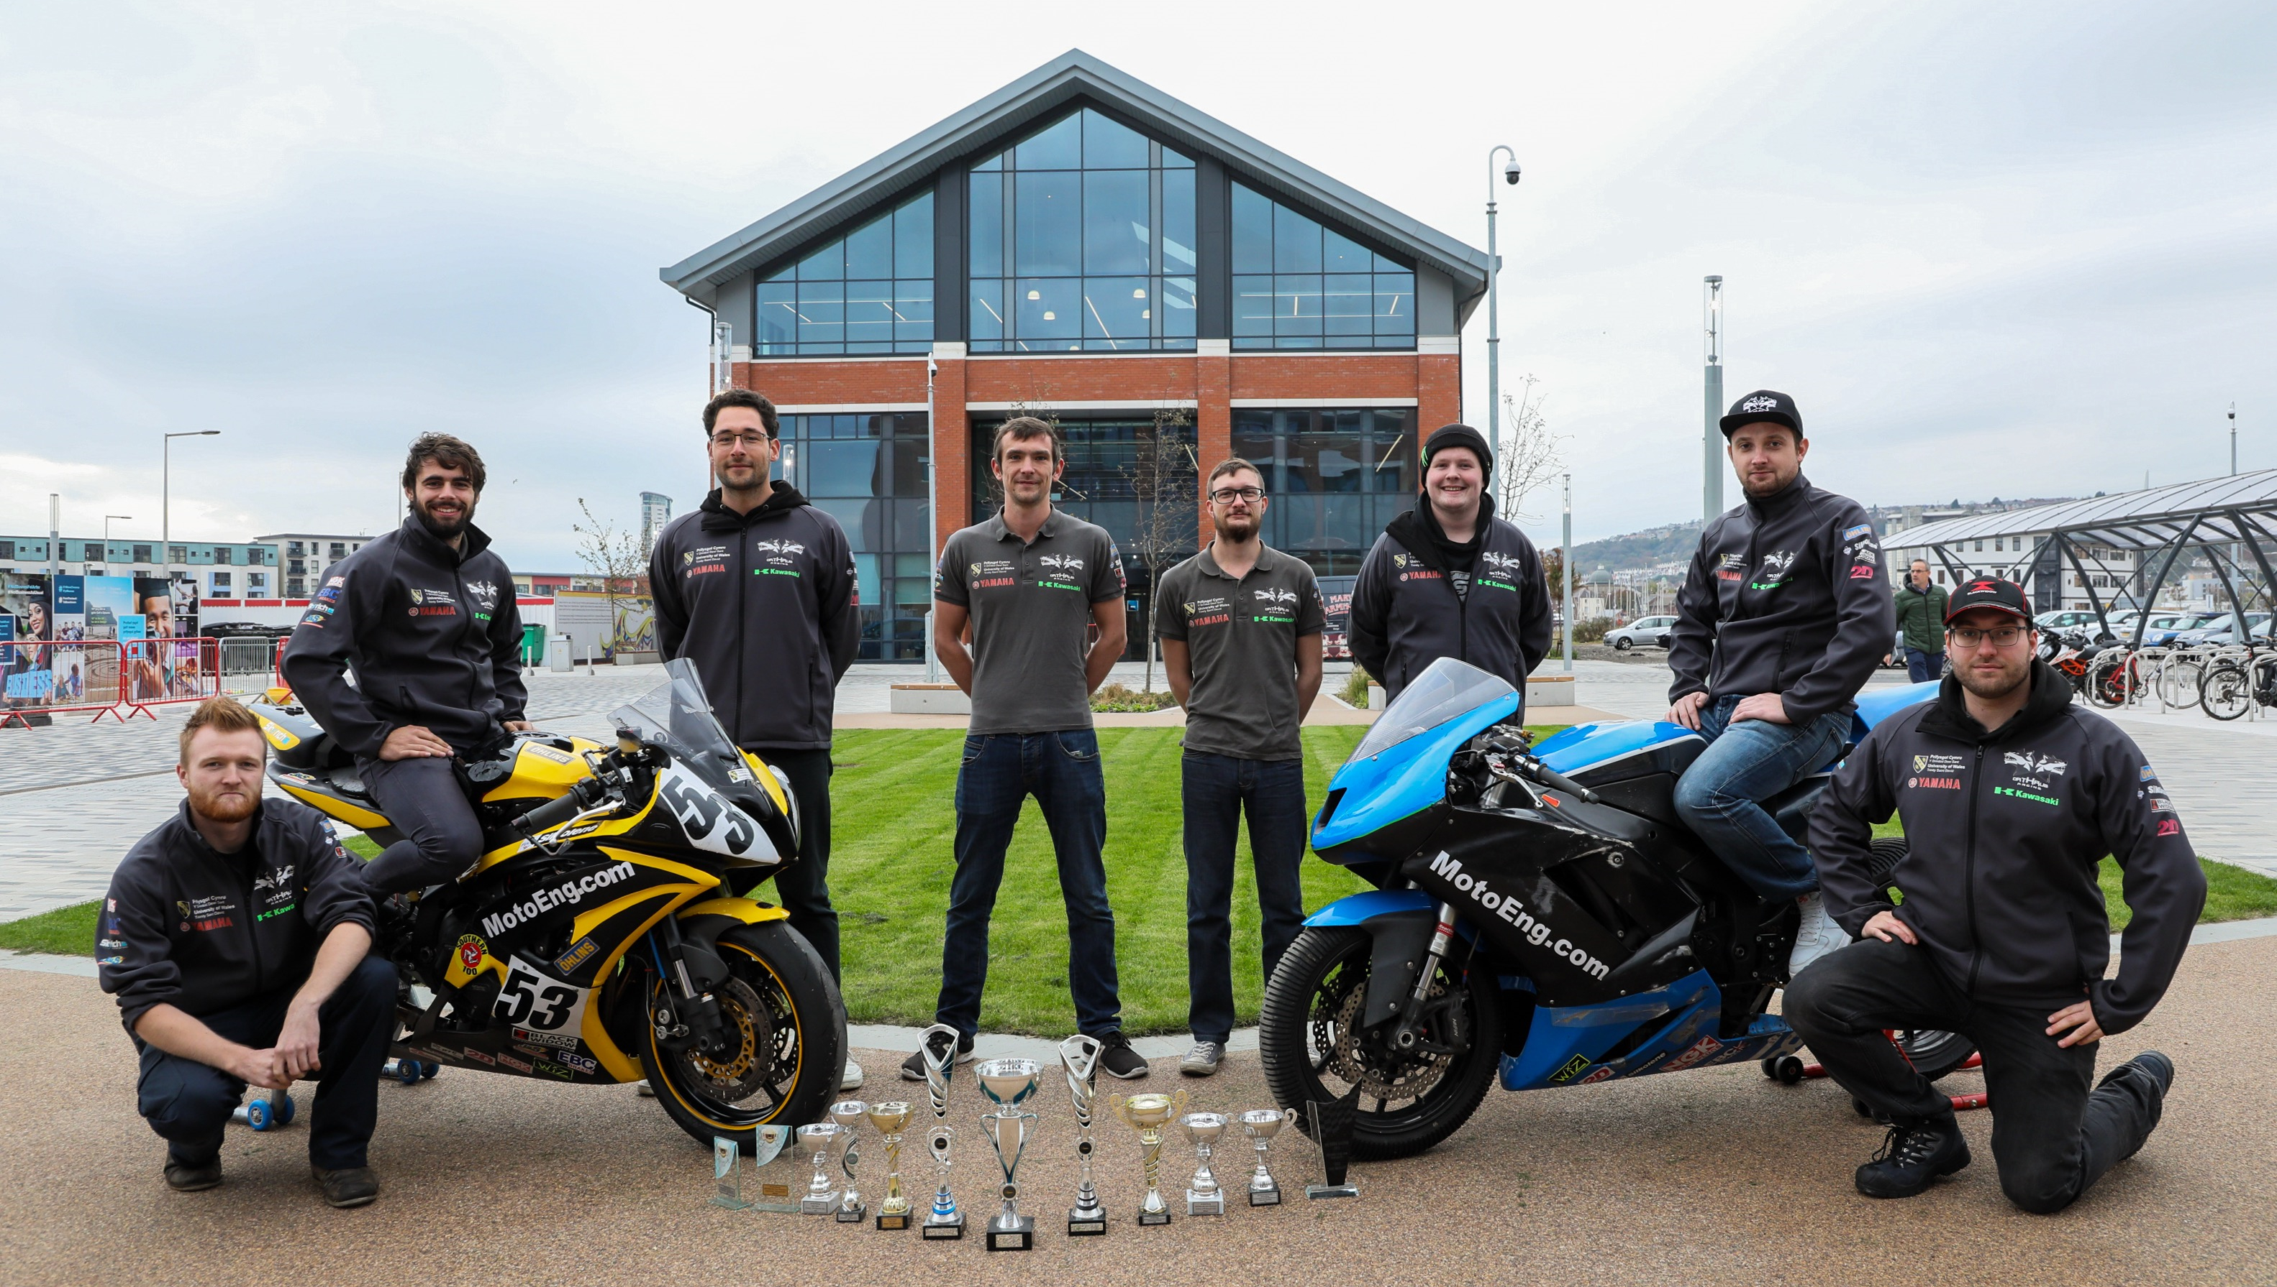
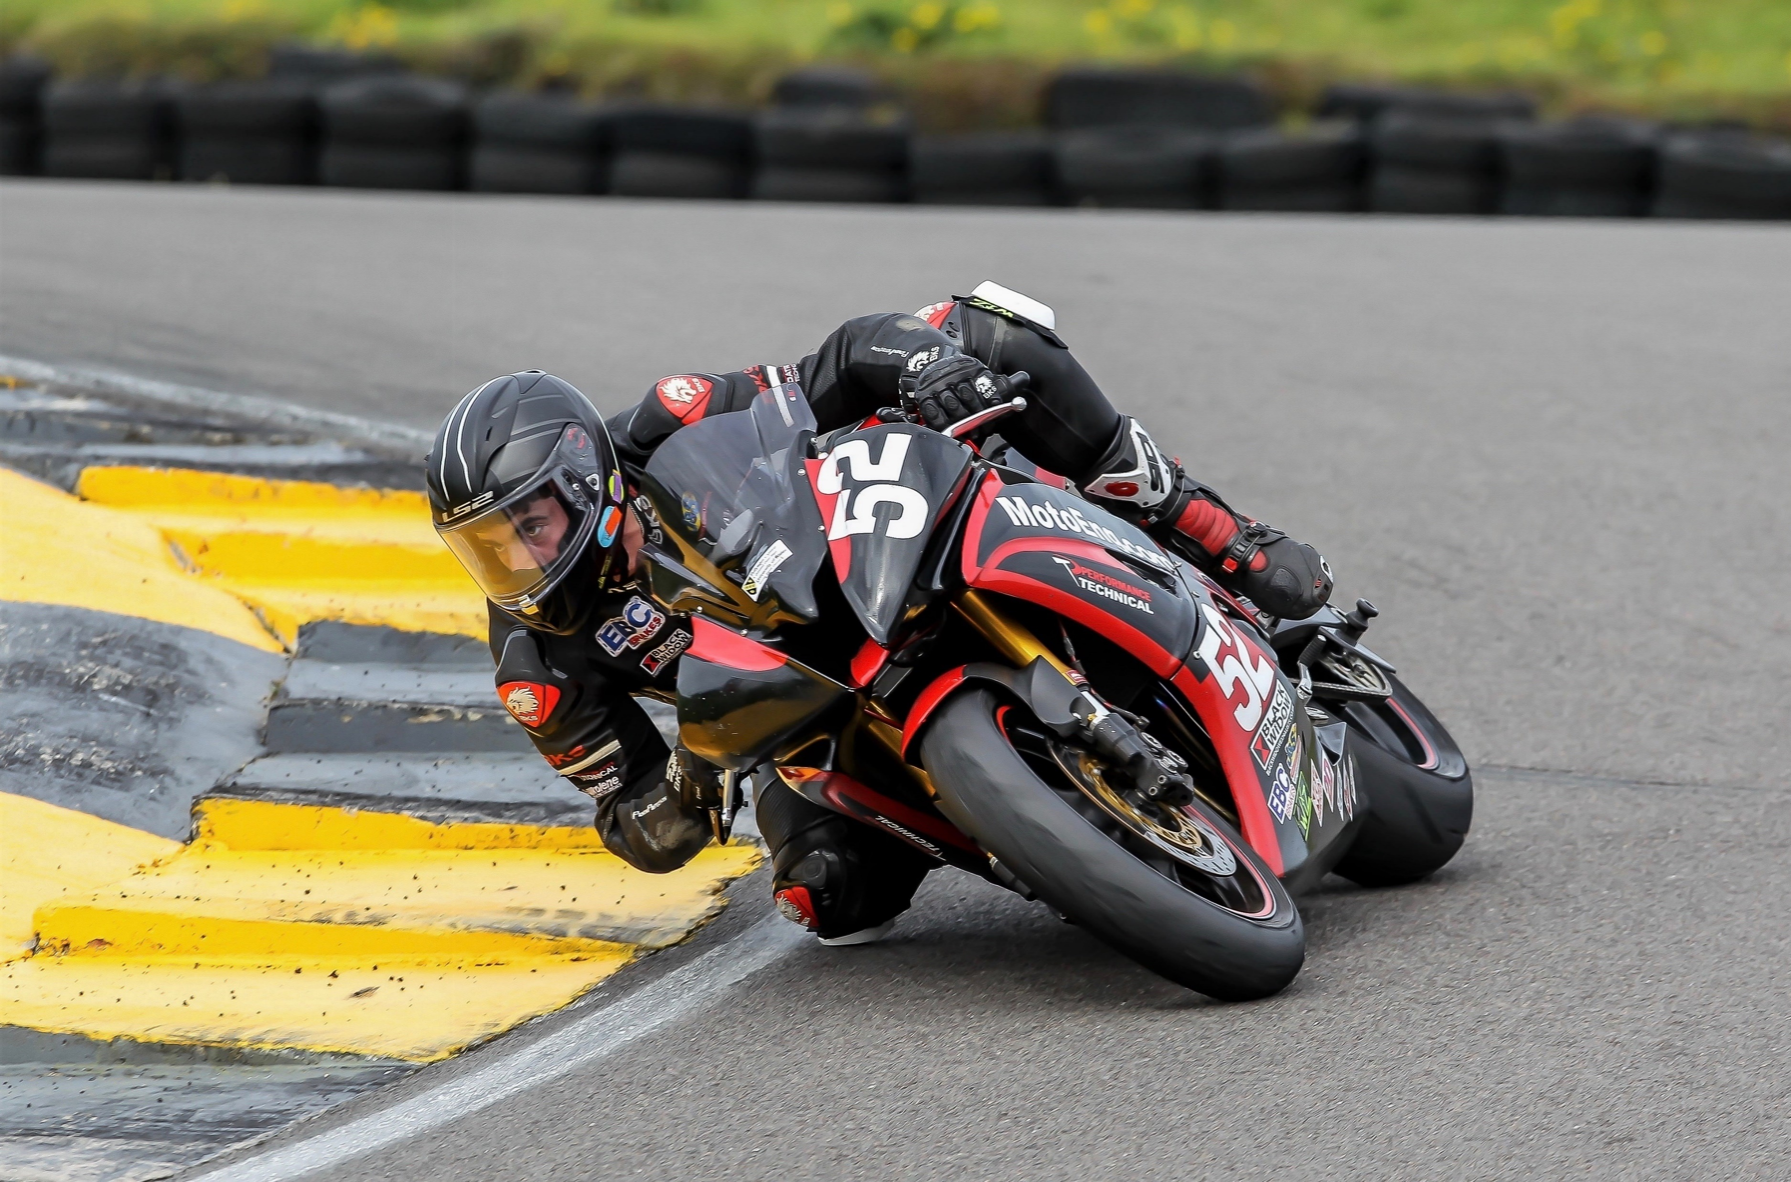
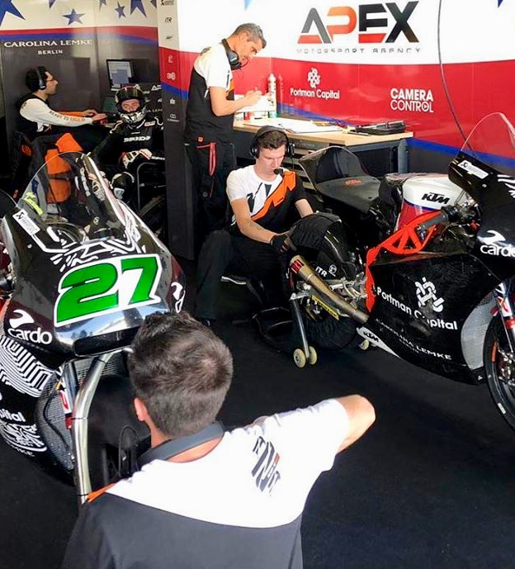
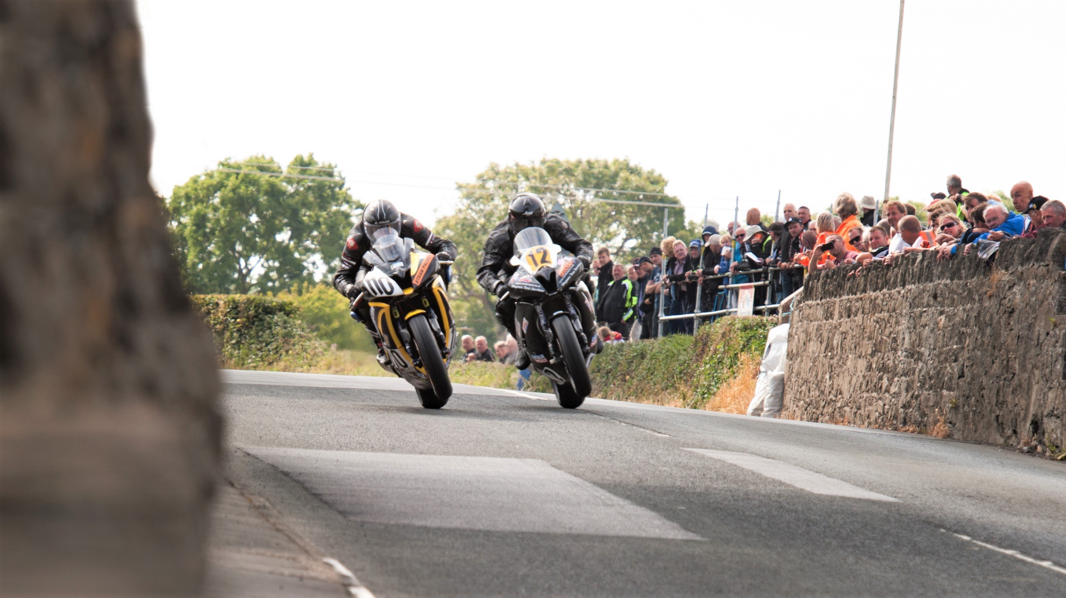

Personal Background

Slide 3
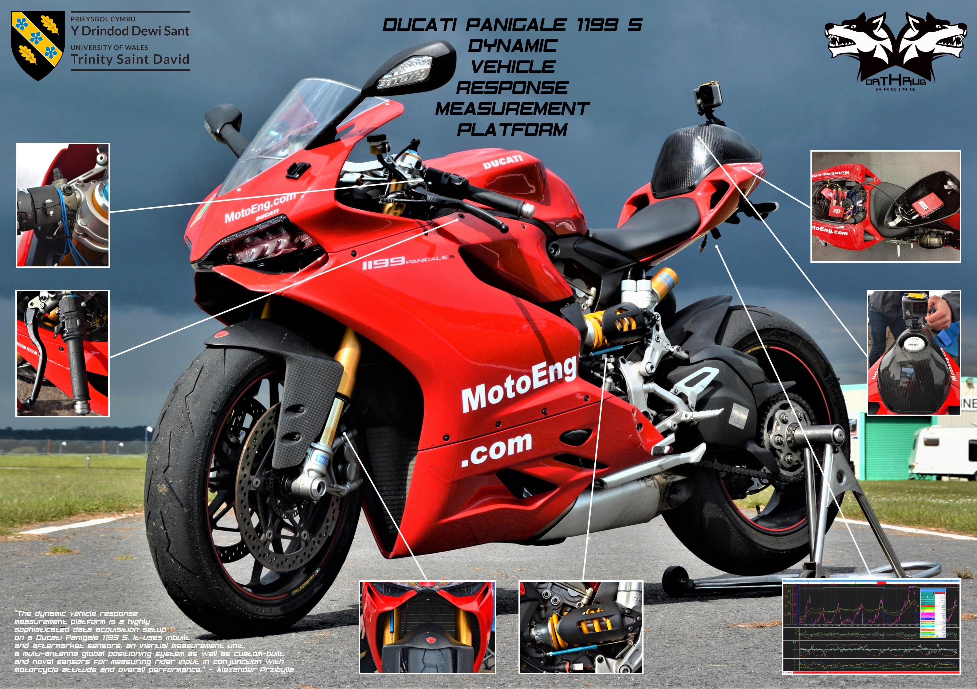

Slide 4
Bibliography
Aoki, A., 1980. Experimental Study on Motorcycle Steering Performance. SAE International, p. 16.
Biral, F., Bortoluzzi, D., Cossalter, V. & Da Lio, M., 2003. Experimental Study of Motorcycle Transfer Functions for Evaluating Handling. Vehicle System Dynamics, 39(1), pp. 1-25.
Corno, M. et al., 2012. Control-Oriented Modeling of Motorcycle Dynamics - 16th IFAC Symposium on System Identification. Brussels, Belgium, The International Federation of Automatic Control.
Cossalter, V., 2006. Motorcycle Dynamics. 2nd ed. Milton Keynes, England, Great Britain: Lightning Source UK Ltd..
Cossalter, V., Doria, A. & Lot, R., 1999. Steady Turning of Two-Wheeled Vehicles. Vehicle System Dynamics, Volume 31, pp. 157-181.
Cossalter, V. & Lot, R., 2002. Multibody System Dynamics Simulations Based on the Natural Coordinates Approach. Vehicle System Dynamics, 37(6), pp. 423-447.
Cossalter, V., Lot, R. & Fabbri, L., 1999. A General Method for the Evaluation of Vehicle Manoeuvrability with Special Emphasis on Motorcycles. Vehicle System Dynamics, p. 25.
Cossalter, V., Lot, R. & Maggio, F., 2003. A Multibody Code for Motorcycle Handling and Stability Analysis with Validation and Examples of Application. SAE 2003-32-0035 JSAE 20034335, p. 8.
Cossalter, V., Lot, R. & Maggio, F., 2004. The Modal Analysis of a Motorcycle in Straight Running and on a Curve. Meccanica, Volume 39, p. 16.
Cossalter, V., Lot, R. & Massaro, M., 2011. An Advanced Multibody Model for the Analysis of Motorcycle Dynamics. Meccanica, Volume 46, pp. 943-958.
Cossalter, V., Lot, R., Massaro, M. & Peretto, M., 2010. Motorcycle Steering Torque Decomposition. London, England, Great Britain, WCE 2010, p. 6.
Cossalter, V., Lot, R. & Peretto, M., 2007. Steady Turning of Motorcycles. Proceedings of the Institution of Mechanical Engineers Part D Journal of Automobile Engineering, Volume 221, pp. 1343-1356.
De Vittori, M., 2011. Modeling and Control of a Motorbike, Lisbon, Portugal: Technical University of Lisbon.
Edelmann, J., Haudum, M. & Plöchl, M., 2015. Bicycle Rider Control Modeling for Path Tracking. IFAC-PapersOnLine, 48(1), pp. 55-60.
Ethier, P. M., 2000. Motorcycle-Rider Servomechanism Steering Theory. Dearborn, Michigan, USA, Society of Automotive Engineers, Inc., p. 15.
Evangelou, S., 2004. Advances in the Modeling of Motorcycle Dynamics. Multibody System Dynamics, Volume 12, pp. 251-283.
Foale, T., 2002. Motorcycle Handling and Chassis Design - The Art and Science. Spain: Tony Foale Designs.
Gallego, M. S., 2011. Analysis of Dynamic Handling of one Motorcycle using Simulations Tools, s.l.: AGH University of Science and Technology.
Giles, C. G., 1985. Motorcycle Steering Behaviour, Leeds, Great Britain: University of Leeds.
Ibbott, A., 2006. Performance Riding Techniques. 3rd ed. Somerset, Great Britain: J H Haynes & Co Ltd..
Kuroiwa, O., Baba, M. & Nakata, N., 1995. Study of Motorcycle Handling Characteristics and Rider Feeling During Lane Change. Detroit, Michigan, USA, Society of Automotive Engineers, Inc., p. 10.
Limebeer, D. J. N., Sharp, R. S. & Evangelou, S., 2001. The Stability of Motorcycles under Acceleration and Braking. Proc Instn Mech Engrs Vol 215 Part C, pp. 1095-1109.
Lot, R. & Massaro, M., 2006. A Combined Model of Tire and Road Surface for the Dynamics Analysis of Motorcycle Handling. RearchGate, p. 11.
Lot, R., Massaro, M. & Sartori, R., 2008. Advanced Motorcycle Virtual Rider. Vehicle System Dynamics, p. 15.
Massaro, M., 2011. A Nonlinear Virtual Rider for Motorcycles. Vehicle System Dynamics, p. 23.
Massaro, M., Cossalter, V. & Lot, R., 2012. A Virtual Motorcycle Driver to Simulate Real Manoeuvres from Experimental Data. Proceedings of the Institution of Mechanical Engineers Part D Journal of Automobile Engineering, p. 19.
Massaro, M. & Lot, R., 2007. Application of Laplace Transform Techniques to Non-Linear Control Optimization. Milano, Italy, Multibody Dynamics 2007, ECCOMAS Thematic Conference.
McGuan, S. P., 1993. Active Human Surrogate Control of a Motorcycle: Stabilizing and De-Stabilizing. Detroit, Michigan, USA, Society of Automotive Engineers, Inc., p. 16.
Pradeepak, R., Bhambri, M. & Rahman, S., 2015. A Parametric Multi Body Approach to Find the Key Elements Influencing the Steering Torque Applied by Rider on a Motorcycle. SAE Technical Paper 2015-01-0641, p. 10.
Rice, R. S., 1979. Rider Skill Influence on Motorcycle Manoeuvring. SAE International, p. 12.
Rowell, S., 2007. Modelling the Control Strategies for Riding a Motorcycle, Nottingham, Great Britain: University of Nottingham.
Schwab, A. L. & Meijaard, J. P., 2013. A Review on Bicycle Dynamics and Rider Control. Vehicle System Dynamics, 51(7), pp. 1059-1090.
Sharp, R. S., 1971. The Stability and Control of Motorcycles. Journal Mechanical Engineering Science Vol 13 No 5, pp. 316-329.
Sharp, R. S., 1978. A Review on Motorcycle Steering Behaviour and Straight-Line Stability. Detroit, USA, SAE Congress and Exposition.
Sharp, R. S., 2009. Dynamics of Motorcycles: Stabilitiy and Control. In: W. Schiehlen, ed. Dynamical analysis of vehicle systems: Theoretical foundations and advanced applications. Udine, Italy: Springer, pp. 183-230.
Sharp, R. S., 2010. Rider Control of a Motorcycle near to its Cornering Limits. Delft, The Netherlands, Proceedings, Bicycle and Motorcycle Dynamics 2010.
Sharp, R. S. & Limebeer, D. J. N., 2001. A Motorcycle Model for Stability and Control Analysis. Multibody System Dynamics, Volume 6, pp. 123-142.
Styles, M. J., 2004. Predictive Engineering Processes for Motorcycle Dynamics, Cranfield, Great Britain: Cranfield University.
Sugizaki, M. & Hasegawa, A., 1988. Experimental Analysis of Transient Response in Motorcycle-Rider Systems. SAE Technical Paper Series 881783.
Tanelli, M. et al., 2009. Control-Oriented Steering Dynamics Analysis in Sport Motorcycles: Modeling, Identification and Experiments. Saint-Malo, France, Proceedings of the 15th IFAC Symposium on System Identification. The International Federation of Automatic Control.
Ueda, J., 2004. Equations of Motion to Describe Motorcycle Handling Torque Characteristic in Time of Steady-State Cornering Motion at a Large Bank Angle. SAE 2004-32-0017 JSAE 20044304, p. 11.
Weir, D. H. & Zellner, J. W., 1978. Development of Handling Test Procedures for Motorcycles. Detroit, Michigan, SAE Congress and Exposition.
Weir, D. H. & Zellner, J. W., 1979. Lateral-Directional Motorcycle Dynamics and Control. SAE International, p. 25.
Wier, D. H. & Zellner, J. W., 1980. Experimental Investigation of the Transient Behavior of Motorcycles. SAE 790266, pp. 962-978.

Slide 5
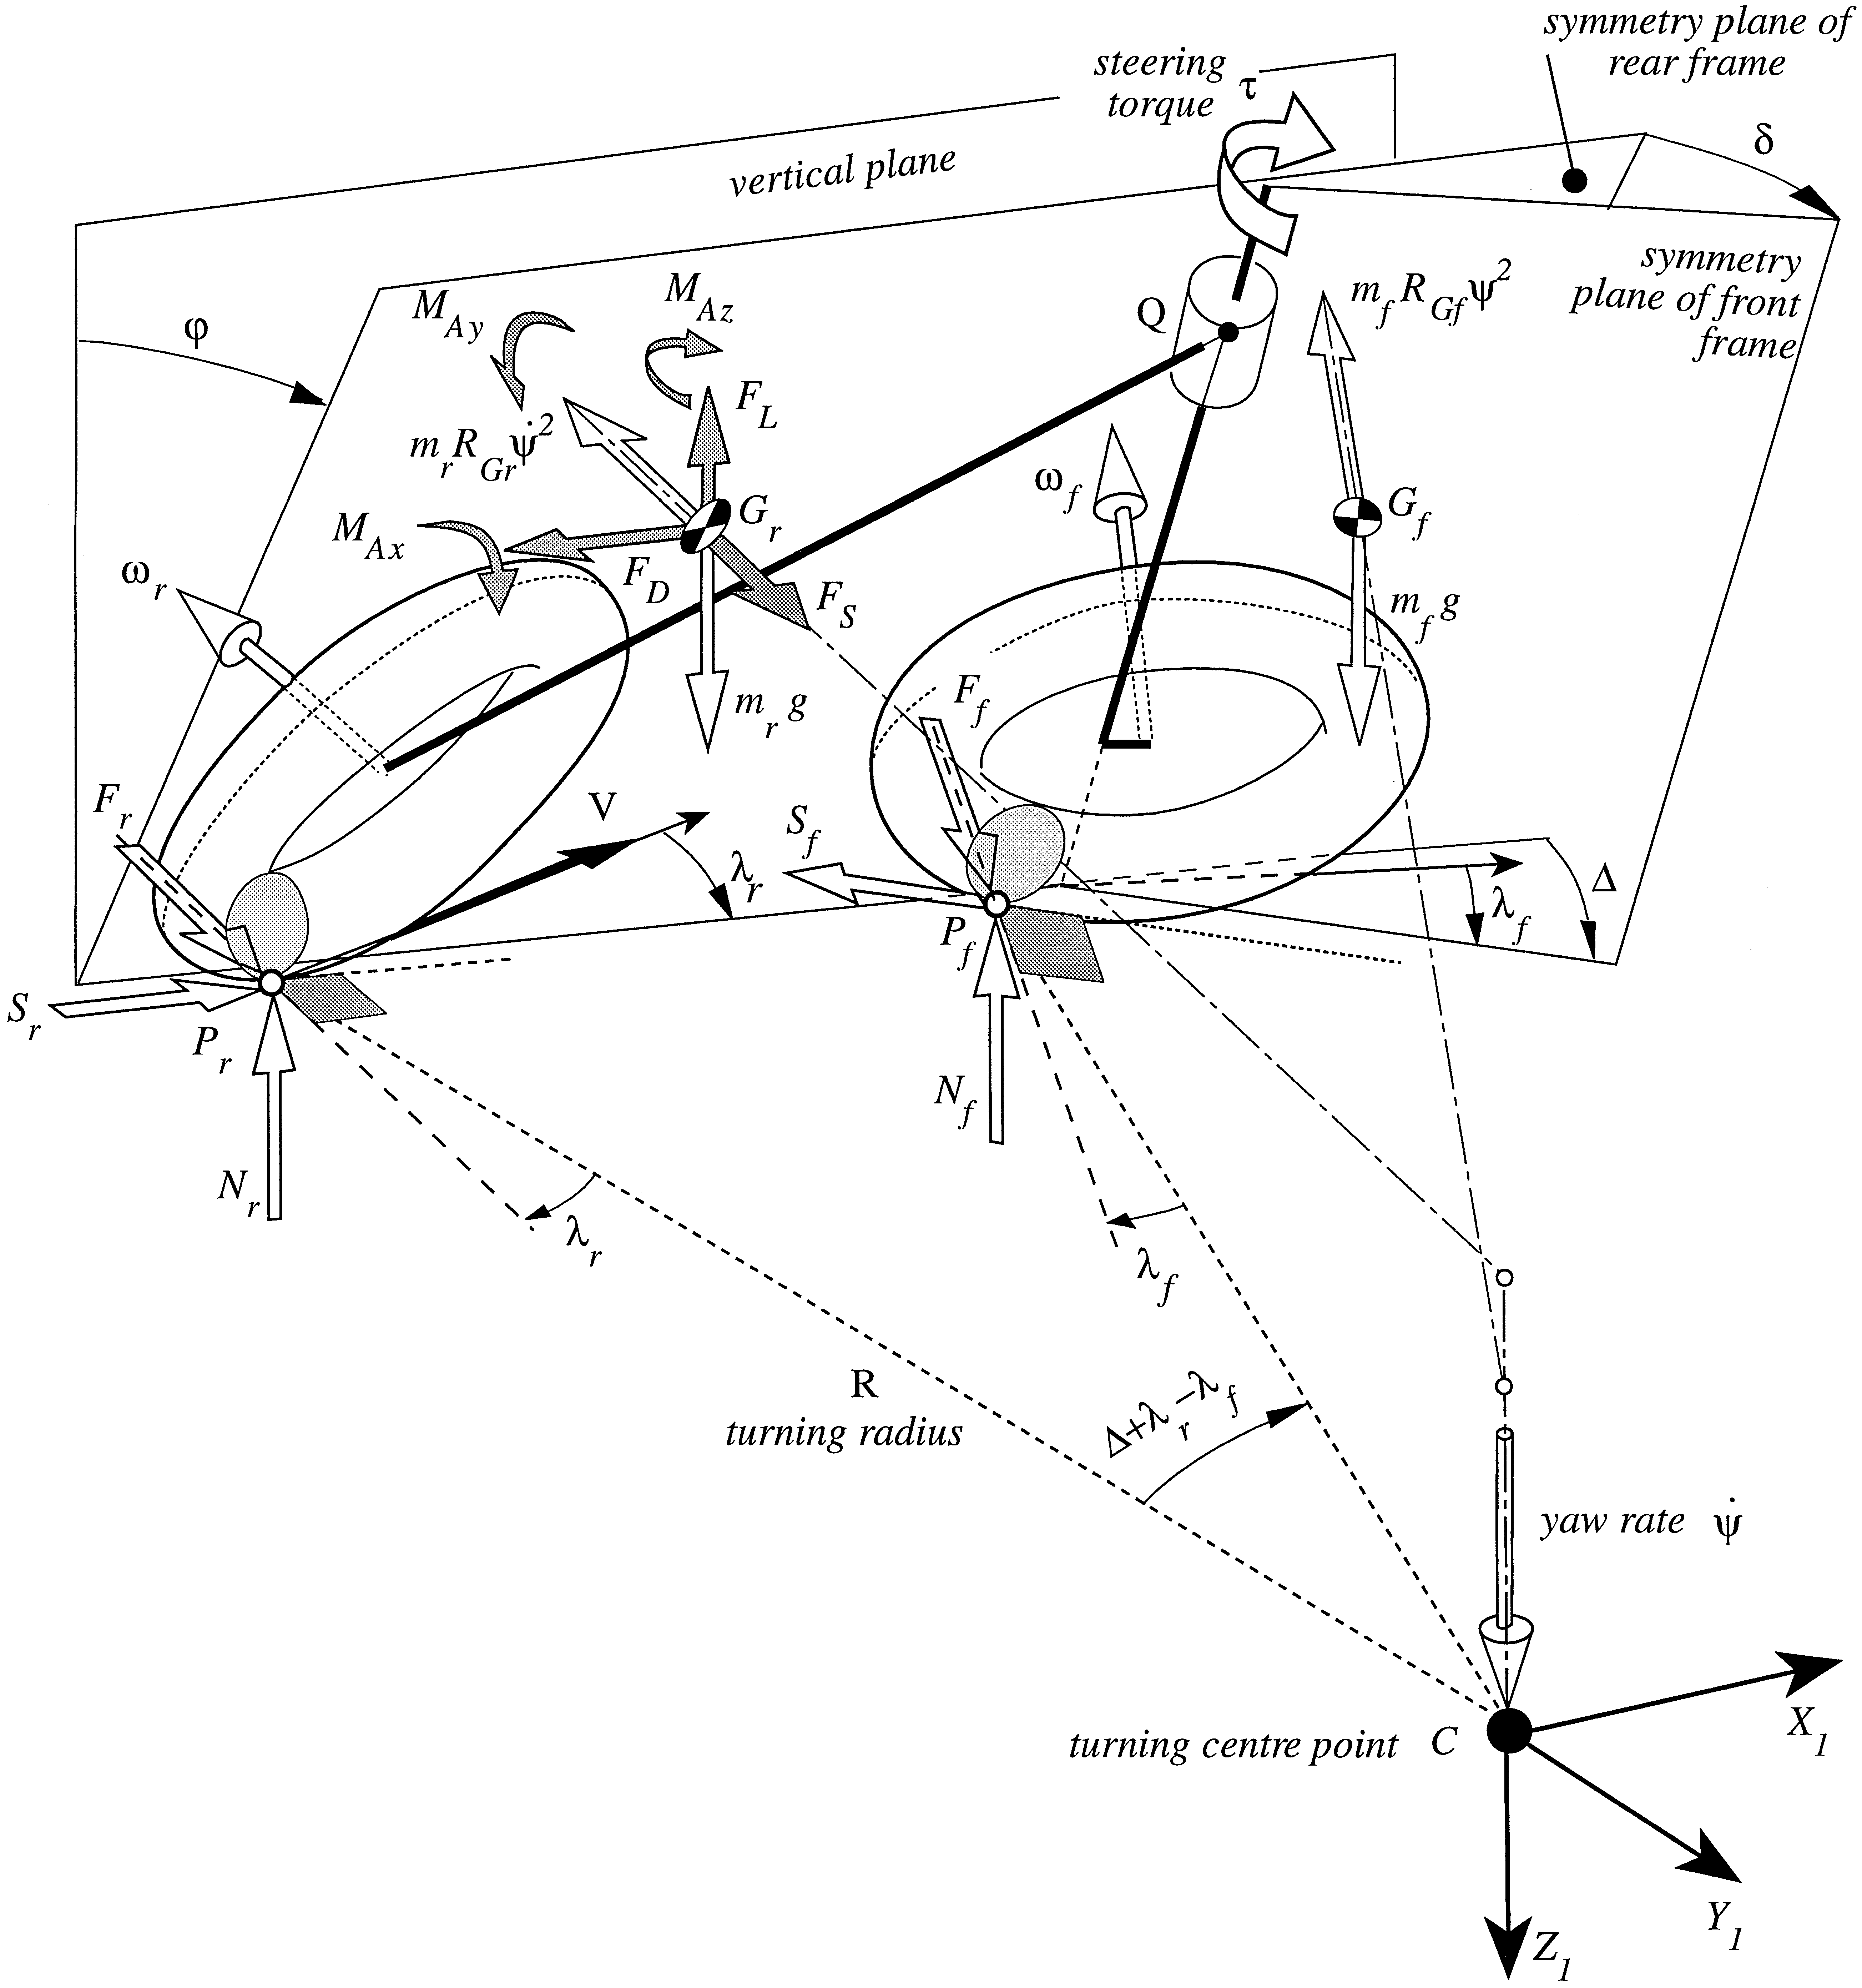
Current Literature
Dynamic behaviour of single-track vehicles is studied and simplified mathematical models are presented
Motorcycle stability and control are investigated by using complex multibody code and sophisticated computational methods
This raises the question: WHAT’S MISSING?
No sophisticated experimental validation or sufficient correlation of input/response calculations in transient state!

Slide 6
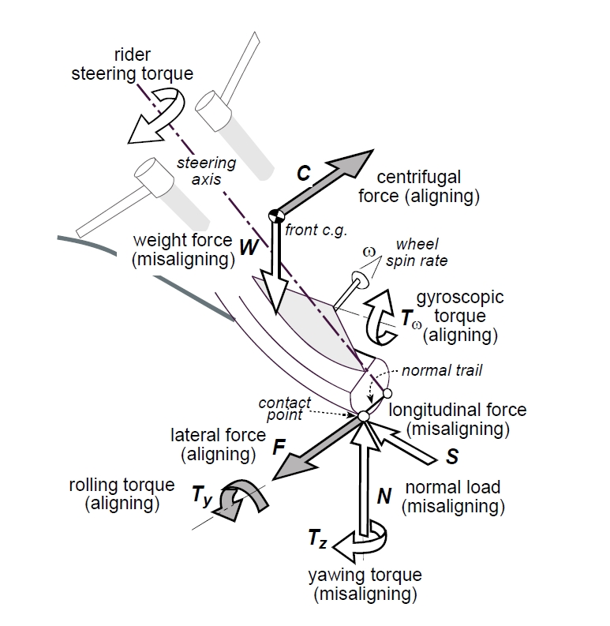
Validation & Enhancement
Personal learning to achieve rigorous and reliable results
Building on current literature and steady-state equations with collected data to provide better transient state analysis
Creating a new paper to constructively contribute to the academic discourse
Applying increased understanding to professional challenges and thereby adding to the field of motorcycle engineering

Slide 7
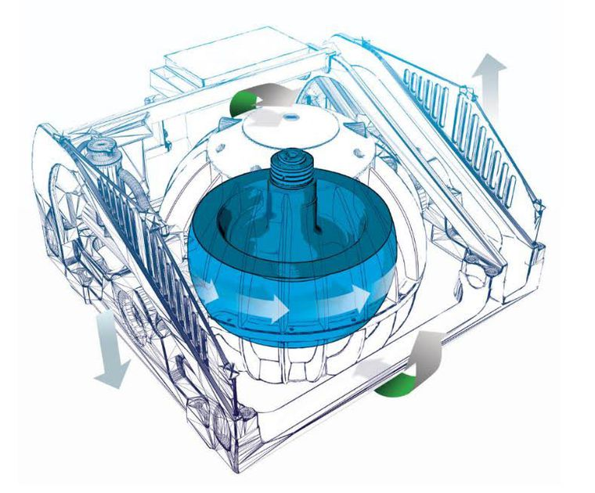
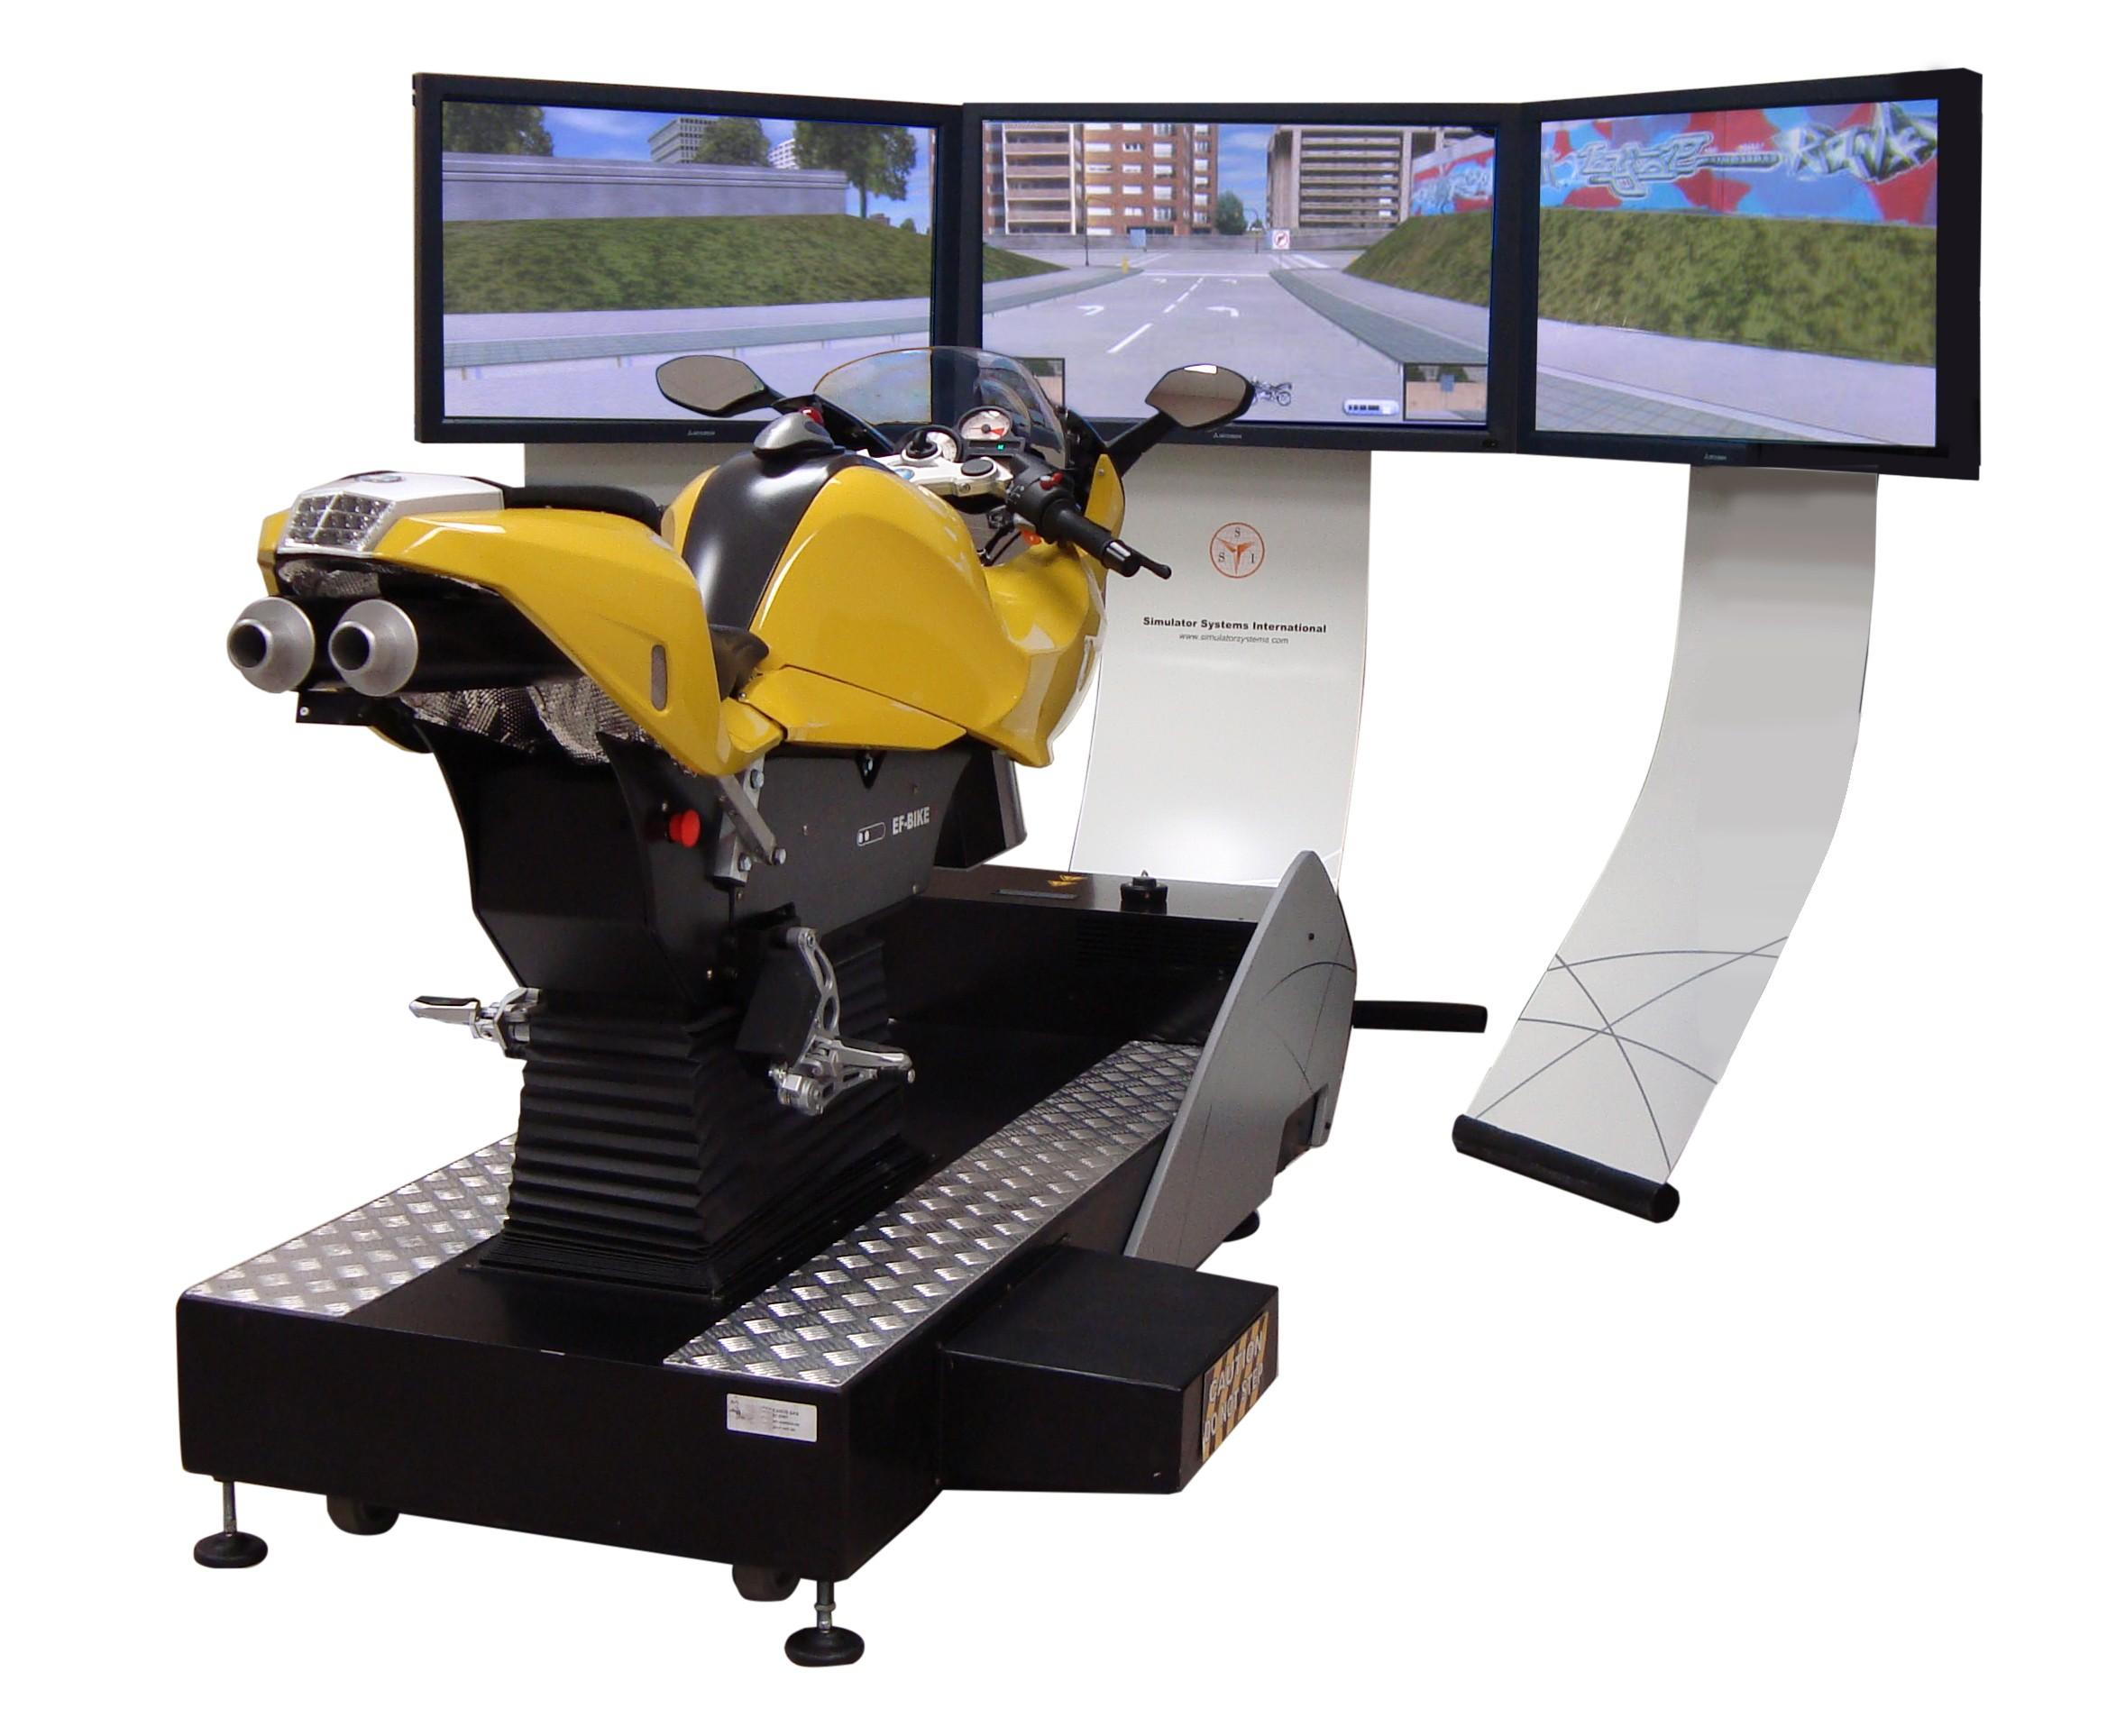
Further Work

Slide 8
Project Progress
TASK | COMPLETION | MARCH |  |  |  | APRIL |  |  |  | MAY |  |  |  | JUNE |  |  |  | JULY |  |  |  | AUGUST |  |  |  | SEPTEMBER
Proposal Presentation | 100%
Literature Survey | 100%
Data Collection | 100%
Steering Torque Computation | 100%
Data Analysis | 100%
Further Data Collection | 0%
Written Project Proposal | 0%
Steering Torque Calculation | 50%
Parameter Refinement | 25%
Additional Experimental Testing | 25%
Dynamics Model Validation | 25%
Dynamics Model Enhancement | 25%
MSc Thesis Writeup | 0%
Research Paper Writeup | 0%
Simulator Development Advise | 0%
New Technological Invention | 0%

