Slide 1
MODULE NAME: Problem Solving and Decision Making
MODULE CODE: LCLM4004
STUDENT NAME: Syrym Bakbergen
STUDENT ID: 2533982
LECTURER: Dr. Thomas Adeyemi
Assignment 1: Presentation

Slide 2
OVERVIEW
Introduction
Company background
Problem: nature and scope
PESTLE ANALYSIS: Basil’s Bakery
Cause and effect analysis: Fishbone diagram
Conclusion
References

Slide 3
Introduction
Analysis of business stagnation at Basil’s Bakery and recommendations for strategic recovery.
We use 5W2H for operational diagnostics, PESTEL for external market analysis, and a Fishbone diagram to identify root causes of performance decline.
Source: Kotler and Keller, 2016; Chartered Institute of Marketing, 2025

Slide 4
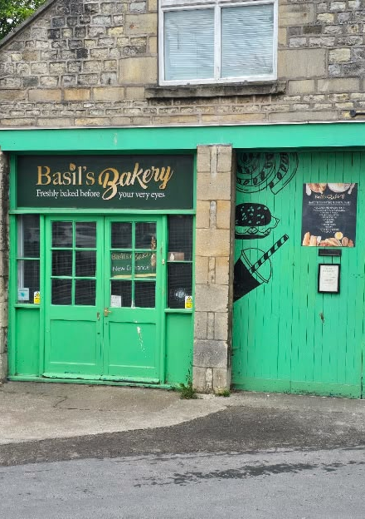
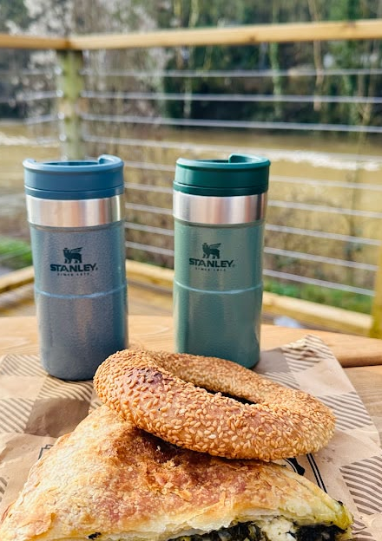
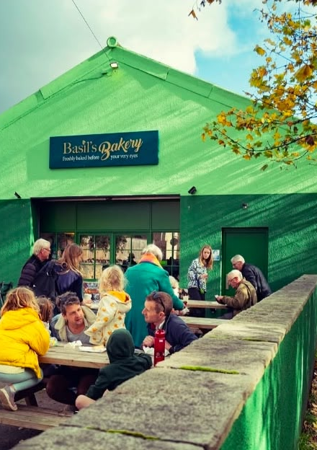
Company background
Basil’s Bakery
Founded in 2015
Owners: Basil, an accomplished artisan baker
Sells High-quality organic contemporary styled cakes, pastries, and breads.
Location: Situated in city Bath
Customer Base: Local shoppers, retail workers, and employees from an adjacent industrial site.
Source: Slack, Chambers and Johnston, 2016

Slide 5
Problem: nature and scope
Who? Basil, retail/warehouse/office staff.
What? 25% sales decline.
Where? Coventry retail park.
When? 2023–2025.
Why? Shift in work/shopping habits.
How? Service bottlenecks.
How much? 25% revenue gap
Source: Johnson, Whittington and Scholes, 2017

Slide 6
PESTLE ANALYSIS: Basil’s Bakery
POLITICAL
  Rising business rates impacting local retail costs.
  Regulatory requirements for small food businesses.
ECONOMIC
  Inflation leading to unpredictable costs for organic ingredients.
  Higher operational overheads including rent and utility bills.
SOCIAL
  Shift to hybrid/home working patterns reducing daily customer visits.
  Loss of loyal customer base due to redundancies in the retail park.

Slide 7
PESTLE ANALYSIS: Basil’s Bakery
TECHNOLOGICAL
  Lack of digital infrastructure for online pre-ordering.
  Inability to manage delivery requests due to manual operational processes.
ENVIRONMENTAL
  Supply chain vulnerability due to reliance on organic crop yields.
  Sensitivity to seasonal agricultural volatility.
LEGAL
  Rising costs associated with mandatory business insurance.
  Compliance with food safety and retail employment standards..

Slide 8
Cause and effect analysis (Fishbone diagram)
Process:
No delivery, inability to answer phone.
Environment:
Decline of retail outlets.
Causes of Stagnant
Sales
Economic:
Increased rent, bills, insurance.
.
Customer:
Redundancies, WFH patterns.

Slide 9
Conclusion
Current state:
The bakery’s current business model is not viable due to changing market habits and reduced footfall.
Key issue:
The 25% sales stagnation is primarily driven by a lack of digital service options and external market pressures.
Strategic recommendation:
The business must undergo digital transformation, specifically by implementing pre-order systems and delivery services to regain competitiveness.
Final thought:
Adapting to hybrid work trends and managing volatile ingredient costs are essential for long-term survival.

Slide 10
References
Chartered Institute of Marketing (2025) Retail Trends in the UK: Post-Pandemic Shifts. London: CIM.
Grant, R.M. (2021) Contemporary Strategy Analysis. 11th edn. Hoboken: Wiley.
Johnson, G., Whittington, R. and Scholes, K. (2017) Exploring Strategy. 11th edn. Harlow: Pearson.
Kotler, P. and Keller, K.L. (2016) Marketing Management. 15th edn. Harlow: Pearson.
Slack, N., Chambers, S. and Johnston, R. (2016) Operations Management. 8th edn. Harlow: Pearson.

Slide 11

Questions

