Slide 1
Data Protection in Cloud Security
Programme | MSc Computing Portfolio
Module | Research Methods and Professional Development
Module Code | ACFA7004
Student Name
Student ID Number

Slide 2
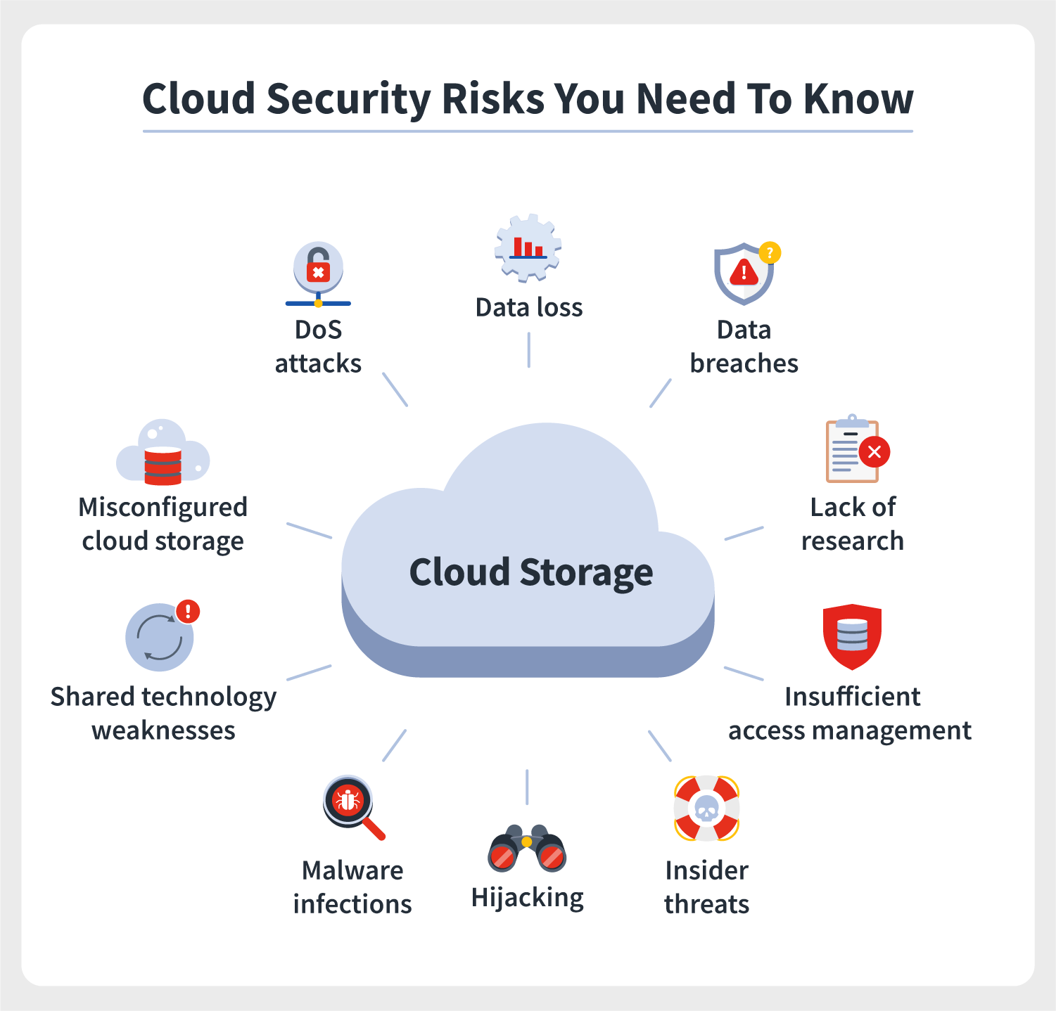
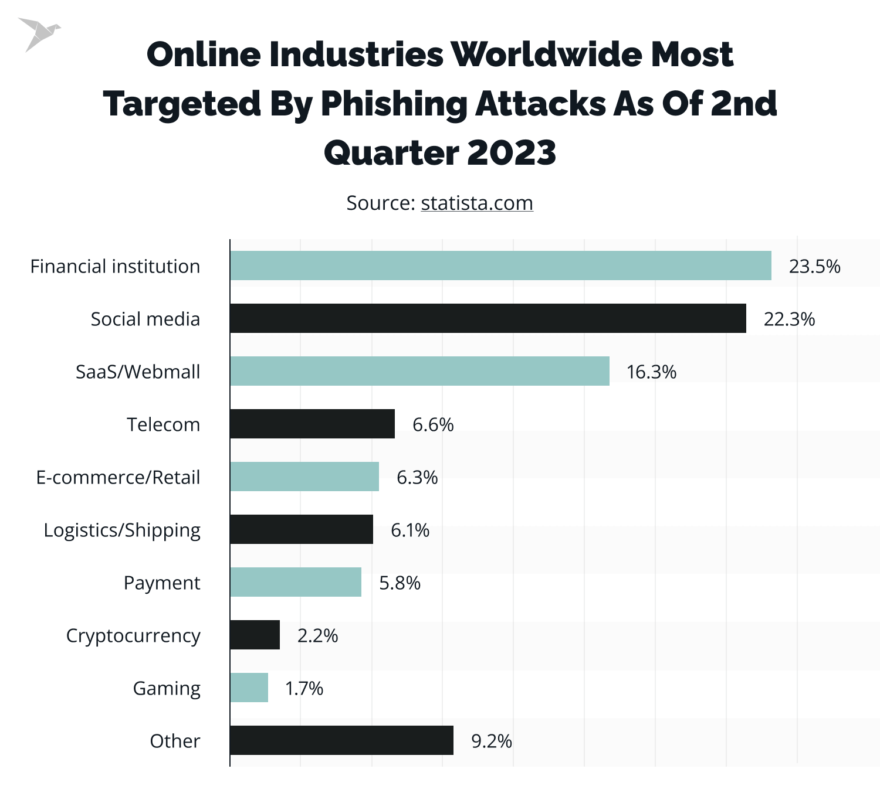
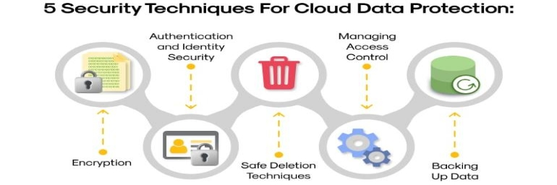
Research Context / Background
Cloud computing has changed the way organisations and people store and use information.
Data is stored online, where it can be easily accessed anytime and from anywhere. This brings flexibility, scalability, and cost savings — but it also creates serious security challenges (Sharma et al., 2019).
As more companies depend on cloud-based systems, issues like unauthorised access, data theft, and privacy violations have become more common (Suryateja, 2018).
Cyberattacks have increased globally, targeting cloud servers used by banks, hospitals, and e-commerce companies (Neprash et al., 2022).
Recent developments in cloud security are mainly focused on strengthening data encryption methods, adopting zero-trust security models, and expanding the use of multi-factor authentication (MFA) to enhance system protection and user verification.
This research looks deeper into how industries can strengthen cloud data protection by studying real incidents and suggesting practical improvements.

Slide 3
Research Problem
Even though cloud computing brings major benefits, it still faces ongoing issues of privacy, security, and trust. Many organisations are vulnerable because of weak encryption systems, poor access control, and limited awareness of data security practices.
Most existing research only focuses on technical aspects and often ignores the fact that different industries face different kinds of threats.
There is a gap in understanding industry-specific challenges and how current tools like encryption and authentication work in real-life contexts.

Slide 4
Research Aim and Objectives
Aim
To explore ways of improving data protection in cloud computing using encryption, access control, and authentication techniques to ensure safer, more reliable, and trustworthy services.
Objectives:
Identify major risks affecting data protection and privacy.
Evaluate the effectiveness of mechanisms like encryption, access control, and MFA.
Analyse how standards such as GDPR and ISO 27001 improve cloud data protection.
Recommend practical strategies to reduce data breaches.

Slide 5
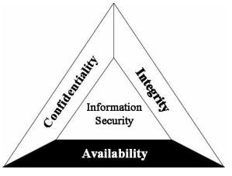
Literature Review
Fundamental Concepts of Cloud Security Management
Key Threats and Problems in Cloud Data Protection
Cloud complexity and unclear shared roles confuse, creating major security vulnerabilities (Alexander, 2025).
Data protection in cloud computing focuses on the CIA triad, meaning confidentiality, integrity, and availability — the key pillars of security (Kashukeev et al., 2020).
Weak passwords, poor encryption, or phishing attacks often lead to serious cloud data breaches (Aljumah and Ahanger, 2020).
Data loss occurs through accidental deletion, hardware failure, or ransomware attacks, blocking access (Taylor, 2021).
Employees or third-party users may misuse authorised access, stealing or leaking sensitive information (Tabrizchi and Kuchaki Rafsanjani, 2020).
Different countries’ data protection laws complicate compliance for cloud-stored information across borders (Tabrizchi and Kuchaki Rafsanjani, 2020).
Hackers continuously develop new attack methods, outpacing current cloud security defences and responses (Alexander, 2025)
Source: Kashukeev et al., 2020

Slide 6
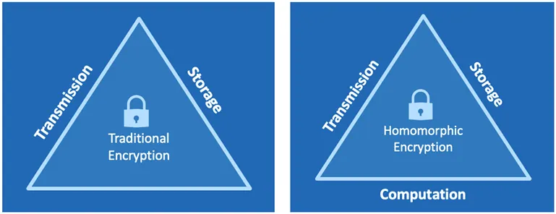
Literature Review
Global Standards and Regulatory Frameworks
Regulations and standards strongly shape cloud data protection practices across organisations:
Evaluation and Understanding Strategies to Strengthen Current Security Mechanisms
GDPR ensures user consent, transparency, and accountability in data handling (Lopes et al., 2019).
ISO 27001 provides structured methods for implementing and maintaining secure information systems (Lopes et al., 2019).
Encryption
Access control
Multi-factor authentication (MFA)
Regular audits, training, and strict policies strengthen system reliability (Oluoha et al., 2022).
Encryption converts readable data into an unreadable format, protecting information both in storage and during transfer (Shukla et al., 2021).
Access control ensures only authorised users can access cloud resources through RBAC and ABAC models (Tahir, 2024).
Multi-factor authentication (MFA) adds extra protection against stolen credentials (Kandula and Kassetty, 2024).
Older encryption systems can be slow and face key management issues; lost keys may expose data (Popat, 2025).
New advancements like homomorphic encryption and quantum-resistant algorithms enhance security against evolving threats (Acar et al., 2018).
Literature Gap
Existing studies mainly focus on technical aspects, often studying encryption or authentication separately. This research combines multiple security measures—encryption, access control, and MFA—to create stronger, industry-wide cloud data protection strategies.

Slide 7
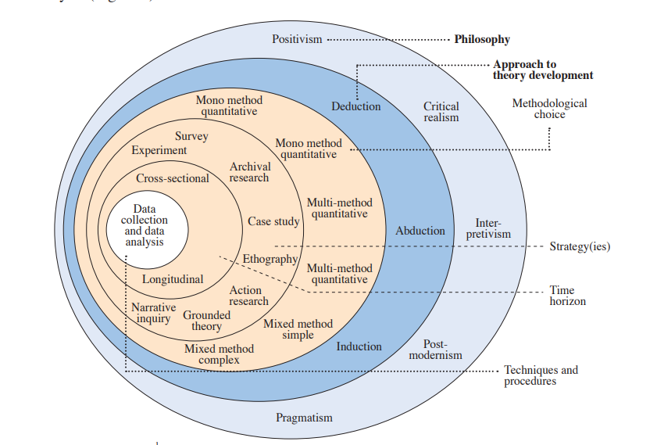
Research Methodology
Research Design
Qualitative research design for a deeper understanding of real-world security challenges (Chivanga et al., 2021).
Research Philosophy
Interpretive philosophy focusing on how people and organisations respond to risks (Melnikovas, 2018).
Research Approach
Inductive approach — concluding case studies and existing data (Alturki, 2021).
Data Analysis
Thematic analysis to identify recurring patterns and Themes (Deshpande and Magerko, 2024). These patterns will assist in evaluating threats and improvements in cloud data protection
Ethics
Only accessible, English-language, non-confidential data of the past 10 years will be used.
Data Collection Method
Secondary data from academic sources:
Google Scholar
ResearchGate
Industry Websites
Government Websites
Credible Online Sources
Source: (Melnikovas, 2018)

Slide 8
Project Planning and Resources
Months | Activities
1 | Define research scope and aims Research Proposal
2 | Define research scope and aims
3 | Collect and organise data
4 | Code and categorise findings
5 | Analyse and interpret results
6 | Write, review, and submit final proposal

Slide 9
Expected Outcomes
Cloud computing offers many advantages but faces ongoing data protection challenges. This study aims to close the gap between research and practice by analysing industry data and proposing realistic, adaptable strategies. By combining encryption, access control, and authentication with global standards, organisations can build more secure cloud systems — ensuring a safer, more trustworthy digital future.

Slide 10
Project Limitations
Based on secondary data — no direct interviews or experiments.
Limited industry data for comparison.
Rapid evolution of technology means findings may need future updates.

Slide 11
References
Acar, A., Aksu, H., Uluagac, A.S. and Conti, M., 2018. A survey on homomorphic encryption schemes: Theory and implementation. ACM Computing Surveys (Csur), 51(4), pp.1-35. Available at: https://dl.acm.org/doi/pdf/10.1145/3214303
Alexander, L., 2025. THE ROLE OF SHARED RESPONSIBILITY MODELS IN MITIGATING CLOUD SECURITY RISKS. Available at: https://www.researchgate.net/profile/Luna-Alexandra/publication/391271139_THE_ROLE_OF_SHARED_RESPONSIBILITY_MODELS_IN_MITIGATING_CLOUD_SECURITY_RISKS/links/6810950460241d51401fb850/THE-ROLE-OF-SHARED-RESPONSIBILITY-MODELS-IN-MITIGATING-CLOUD-SECURITY-RISKS.pdf
Aljumah, A. and Ahanger, T.A., 2020. Cyber security threats, challenges and defence mechanisms in cloud computing. IET communications, 14(7), pp.1185-1191. Available at: https://ietresearch.onlinelibrary.wiley.com/doi/pdf/10.1049/iet-com.2019.0040
Alturki, R., 2021. Research Onion for Smart IoT‐Enabled Mobile Applications. Scientific programming, 2021(1), p.4270998. Available at: https://onlinelibrary.wiley.com/doi/pdf/10.1155/2021/4270998
Chivanga, S.Y. and Monyai, P.B., 2021. Back to basics: Qualitative research methodology for beginners. Journal of Critical Reviews, 8(2), pp.11-17. Available at: https://www.researchgate.net/profile/Shylet-Chivanga-2/publication/392095021_JOURNAL_OF_CRITICAL_REVIEWS_BACK_TO_BASICS_QUALITATIVE_RESEARCH_METHODOLOGY_FOR_BEGINNERS/links/68345451d1054b0207f4c63d/JOURNAL-OF-CRITICAL-REVIEWS-BACK-TO-BASICS-QUALITATIVE-RESEARCH-METHODOLOGY-FOR-BEGINNERS.pdf
Deshpande, M. and Magerko, B., 2024. Holistic Approach to Design of Generative AI Evaluations: Insights from the Research Onion Model. In IUI Workshops. Available at: https://hai-gen.github.io/2024/papers/5120-Deshpande.pdf
Kandula, S.R. and Kassetty, N., 2024. Context-Aware Multi-Factor Authentication in Zero Trust Architecture: Enhancing Security Through Adaptive Authentication. International Journal of Global Innovations and Solutions (IJGIS). Available at: https://openreview.net/pdf?id=rQnceUM80a
Kashukeev, I., Denchev, S. and Garvanov, I., 2020. Data security model in cloud computing. Industry 4.0, 5(2), pp.55-58. Available at: https://stumejournals.com/journals/i4/2020/2/55.full.pdf
Lopes, I.M., Guarda, T. and Oliveira, P., 2019, June. How ISO 27001 can help achieve GDPR compliance. In 2019 14th Iberian Conference on Information Systems and Technologies (CISTI) (pp. 1-6). IEEE. Available at: https://www.researchgate.net/profile/Teresa-Guarda/publication/334485209_How_ISO_27001_Can_Help_Achieve_GDPR_Compliance/links/5fabe947a6fdcc331b9478db/How-ISO-27001-Can-Help-Achieve-GDPR-Compliance.pdf
Melnikovas, A., 2018. Towards an Explicit Research Methodology: Adapting Research Onion Model for Futures Studies. Journal of futures Studies, 23(2). Available at: https://www.researchgate.net/profile/Aleksandras-Melnikovas/publication/333388233_Towards_an_explicit_research_methodology_Adapting_research_onion_model_for_futures_studies/links/5d47c8404585153e593cfbec/Towards-an-explicit-research-methodology-Adapting-research-onion-model-for-futures-studies.pdf?_sg%5B0%5D=started_experiment_milestone&origin=journalDetail&_rtd=e30%3D
Neprash, H.T., McGlave, C.C., Cross, D.A., Virnig, B.A., Puskarich, M.A., Huling, J.D., Rozenshtein, A.Z. and Nikpay, S.S., 2022, December. Trends in ransomware attacks on US hospitals, clinics, and other health care delivery organizations, 2016-2021. In JAMA Health Forum (Vol. 3, No. 12, pp. e224873-e224873). American Medical Association. Available at: https://jamanetwork.com/journals/jama-health-forum/fullarticle/2799961
Oluoha, O.M., Odeshina, A., Reis, O., Okpeke, F., Attipoe, V. and Orieno, O.H., 2022. A Unified Framework for Risk-Based Access Control and Identity Management in Compliance-Critical Environments. Available at: https://www.multidisciplinaryfrontiers.com/uploads/archives/20250408184820_FMR-2025-1-041.1.pdf
Popat, M., 2025. Common Encryption Mistakes and Risks to Avoid in the Cloud. [online] Medium. Available at: https://mihirpopat.medium.com/common-encryption-mistakes-and-risks-to-avoid-in-the-cloud-1affcc08e2e4
Sharma, S., Chang, V., Tim, U.S., Wong, J. and Gadia, S., 2019. Cloud and IoT-based emerging services systems. Cluster Computing, 22(1), pp.71-91. Avaialble at: https://eprints.soton.ac.uk/390585/1/Cloud_based_Emerging_Service_System_accepted.pdf
Shukla, D.K., Dwivedi, V.K. and Trivedi, M.C., 2021. Encryption algorithm in cloud computing. Materials Today: Proceedings, 37, pp.1869-1875. Available at: https://d1wqtxts1xzle7.cloudfront.net/101524459/j.matpr.2020.07.45220230426-1-4zwdar-libre.pdf?1682519817=&response-content-disposition=inline%3B+filename%3DEncryption_algorithm_in_cloud_computing.pdf&Expires=1762719462&Signature=Hv-7RbnF1xKDs2fKLjjrpnv9Fxyb-kTOvfruYv0XtjjXsR~B0vF~XBctD7NJJDZ6yX8LG6wC9pQdFm8dzCFBc5s7b69aSGblyMKmf96JadsivTydNkPP3~qp6iFYMCkHskL~v2VLVt8LO1bamtXm4bh~Ohh8F71tZKE3tFbXQOH3~F5f~TGSKogj-6GX023~vUic-VX2Vz4YN5~5WXxGfmuVnEb~WKZTRj731eAss0dgx5vU5leguesrY8bLniYYTD~6YELOXo7PtaaCzmUYCHLLqYvKbyBWF4sE7OrlzVtyYM-OAajOr97EwpbHWL6M3jqPC5GtL3Fmo51NNl6XMg__&Key-Pair-Id=APKAJLOHF5GGSLRBV4ZA
Suryateja, P.S., 2018. Threats and vulnerabilities of cloud computing: a review. International Journal of Computer Sciences and Engineering, 6(3), pp.297-302. Available at: https://www.researchgate.net/profile/Pericherla-Suryateja/publication/324562008_Threats_and_Vulnerabilities_of_Cloud_Computing_A_Review/links/5ad5bf9d458515c60f54c714/Threats-and-Vulnerabilities-of-Cloud-Computing-A-Review.pdf
Tabrizchi, H. and Kuchaki Rafsanjani, M., 2020. A survey on security challenges in cloud computing: issues, threats, and solutions. The journal of supercomputing, 76(12), pp.9493-9532. Available at: https://facultyweb.kennesaw.edu/lli13/alg/6823/lm11/Cloud%20security%20survey.pdf
Tahir, 2024. Role-Based Access Control (RBAC) and Attribute-Based Access Control (ABAC). [online] Medium. Available at: https://medium.com/@tahirbalarabe2/who-are-you-and-what-are-you-allowed-to-do-13762a009ef0.
Taylor, A.R.E., 2021. Standing by for data loss: Failure, preparedness and the cloud. ephemera: theory & politics in organization, 21(1). Available at: https://ephemerajournal.org/sites/default/files/2022-01/21-1Standby.pdf#page=65

