Slide 1
BA Business Management
Management Economics LCBB5008
Week 6 Lesson 2
The Role of Monetary and Fiscal Policy

Slide 2

At the end of this session you must understand:
1. the role of monetary policy
2. The role of fiscal policy

Slide 3
Objectives of government economic policy
Economic growth
- An increase in National Income in real terms after adjusting for inflation
Balance of Trade Stability - achieve a balance between exports and imports
Control of inflation
-an increase in the general price level of goods and services in an economy. Undesirable effects of inflation:
- Interference in price mechanism (violation of laws of demand and supply laws), redistribution of income and wealth (some will expend and live off their savings and the richer become richer), industrial relations conflicts, Balance of Payments effects (If a country has a higher rate of inﬂation than its major trading partners, its exports will become relatively more expensive and imports into it will be relatively cheaper. As a result, the
balance of trade (export revenue less the cost of imports) may worsen), Speculative buying behaviour
Low Unemployment
-defined as the number of the unemployed working population as a percentage of the total working population i.e those actively seeking employment

Slide 4
Role of government - intervention
Government uses various tools:
- Fiscal policy – taxation, public borrowing and public spending (corporation tax, individual tax, national insurance, government bonds, grants, subsidies)
- Monetary policy – concerned with money supply, interest rates and exchange rates – Bank of England
- Supply-side policies- attempt to increase the level of aggregate supply by
increasing eﬃciency, motivation or productive capacity. Examples include deregulation, re-training, privatisation and cutting corporation tax

Slide 5
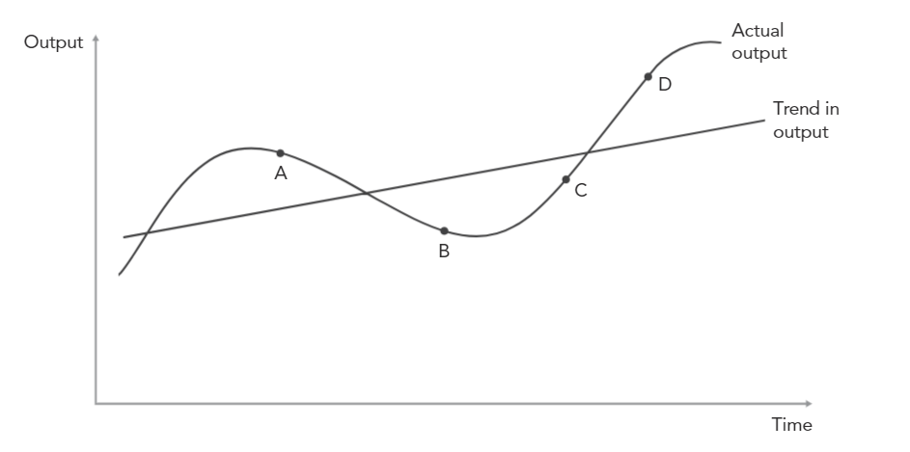
The Trade Cycle
Recession - At point A the economy is entering a recession (normally deﬁned as two consecutive quarters of negative growth). In the recession phase, output is falling. Business failures will occur as ﬁrms ﬁnd themselves unable to sell their goods. Production, investment and employment will fall. This creates a wave of unemployment and falling incomes spreading across the economy as a downward multiplier eﬀect.
Depression - Eventually, in the absence of any stimulus to aggregate demand, a period of full depression. Sets in and the economy will reach point B. This stage may last for a long period of time unless the government can act to stimulate an economic recovery.
Recovery - At point C the economy has reached the recovery phase; this will feature modest rates of economic growth and improved consumer conﬁdence. Rising production, sales and proﬁts will mean that to new investment will be more readily undertaken. This creates a wave of employment and rising incomes spreading across the economy as a multiplier eﬀect kicks in.
Boom - This is shown as point D - As recovery proceeds, the output level climbs above its trend path, in the boom phase of the cycle. During the boom, capacity and labour will become fully utilised
Impact on business decisions.
Business decisions will be aﬀected by the stage of the trade cycle. Key business decisions include:
Investment
Pricing
Recruitment
Production levels

Slide 6
Group task – 20 minutes
Give examples examples of how ﬁscal, monetary and supply-side policies may be used to stimulate economic growth during the trade cycle. Explain how it stimulate economic growth. Share with the class after your discussion.
Fiscal Policy | Monetary Policy | Supply-side Policies

Slide 7
Some key terms
Cyclical unemployment: The type of unemployment that is caused by a decline in the general level of economic activity is called cyclical unemployment.
Structural unemployment: The long-term unemployment that exists even when the economy is growing at a normal rate. It may be due to a general lack of skills, or a lack of appropriate skills (eg due to a collapse in a sector of the economy), or due to wages being set at artiﬁcially high levels (perhaps due to a minimum wage)
Frictional unemployment: This is short-term unemployment due to the time it takes workers to ﬁnd jobs, or due to seasonal factors.
Demand-pull inﬂation: The type of inﬂation that is caused by an increase in the general level of economic activity is called demand-pull inﬂation
Cost-push inﬂation: If ﬁrms are forced to increase prices because of a general increase in their costs, this is called cost-push inﬂation.

Slide 8
End …

Slide 9
Next session:
A closer look at government economic policy (fiscal and monetary) and its effects on businesses

