Slide 2
Hospitality & Guest Services
in the Hotel Industry
[BMIH4003]
Week 1
Introduction to Hospitality & Guest Services

Slide 3
What you will need
Steady internet access
Cameras on
Phones off
Muted

Slide 4
Content
Today’s Aim
Introduction to the Module & Tutor
Introduction of the Students
Module Assignments & Deadlines
What is Hospitality? What is Service? What are Guest Services?
Recap
Next Week’s Content

Slide 5
Today’s Aim is to…
Get to know each other
Learn about this module
Learn about assessments
Set expectations

Slide 6

Introduction to your Tutor
About me…

Slide 7

Introduction of Students
About you…

Slide 8
Tell us about yourself…
…in 2 minutes
Who are you?
Where are you from?
Do you currently work?
Have you previously worked in hospitality?
Your journey

Slide 9
Introduction to the Module
Hospitality & Guest Services
[BMIH4003]

Slide 10
International Hotel Management
Absence Policy
Expects full-time students to attend all lectures and placement on a regular basis.
The University does not sanction students taking holidays during term time.
All absences must be reported in the first instance to their individual module tutor where possible at least 24 hours in advance, or in emergency circumstances prior to the start of the planned lecture.
Students are expected to obtain medical evidence if absence is due to ill-health and to submit that evidence to the Module Tutor, copying in the Programme Manager.
Any student who claims absence due to circumstances beyond their control MUST apply to the University by completing an ECP form (available on the Hwb). The decision as to whether an absence can be condoned will be made by the University not the module tutor nor the Programme Manager.
Students who do not engage in lectures or miss the attendance register will be marked as absent.
If students leave before the end of any timetabled session the module tutor will note that fact on the attendance register and the student will be deemed as not having attended that session.

Slide 11
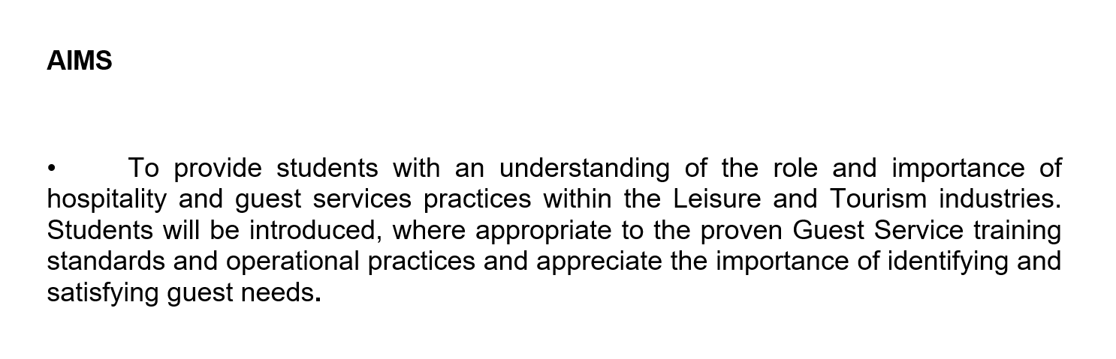

Slide 12
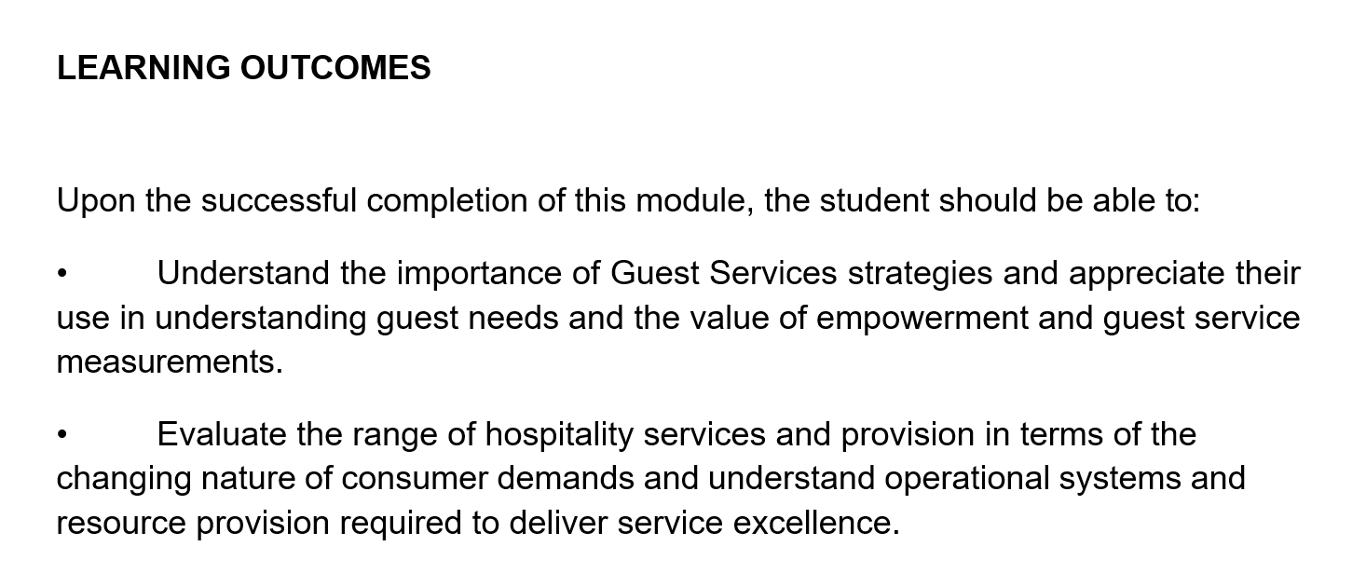

Slide 13
Module Assignments & Deadlines

Slide 14
Assignment Submission
Assignments must be submitted to Moodle via the correct Turnitin portal by the deadlines set.
If you submit your assignment 7 days late you will be capped at 40%. If you submit your assignment more than 7 days late you will receive 0.

Slide 15
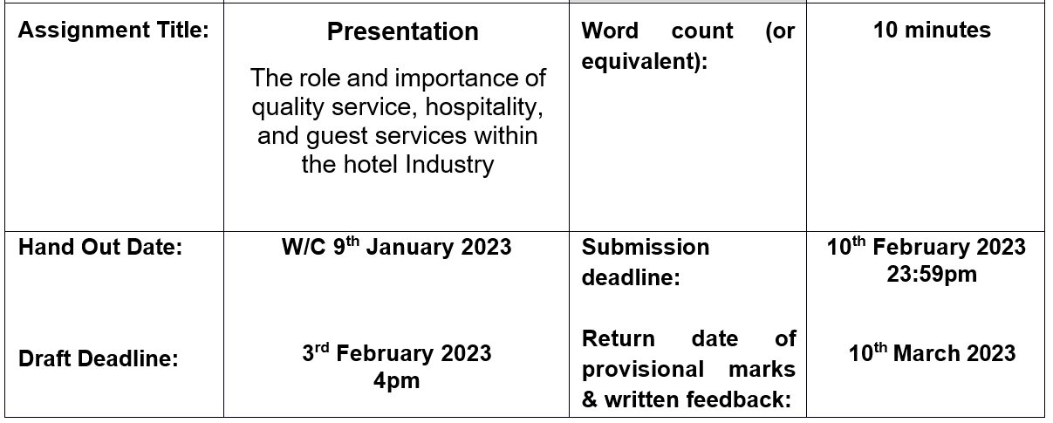
Assignment 1: Presentation

Slide 16
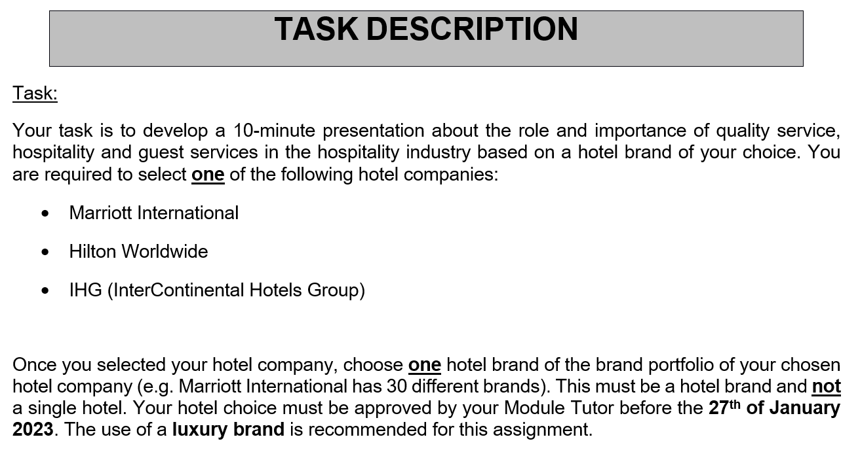

Slide 17
Within your presentation you will need to focus on the following aspects:
Briefly introduce your chosen hotel brand
Identify the hotel brand’s main consumers
Outline the nature, scope and role of the guest services and facilities that are provided to these guests by the hotel brand
Explain the need to consider the role and function of guest services in general
Discuss the importance of hospitality and how hotels meet/exceed guest expectations

Slide 18
Your presentation must fulfil the following criteria:
Focus only on relevant slides that will allow you to complete your presentation within 10 minutes.
A title page, content table and summary/conclusion must also be included.
A reference list with a minimum of ten references from a wide variety of different sources using Harvard Referencing is to be added at the end of your presentation.
The use of images, graphs and tables, if relevant, is recommended. These must also be referenced.

Slide 19
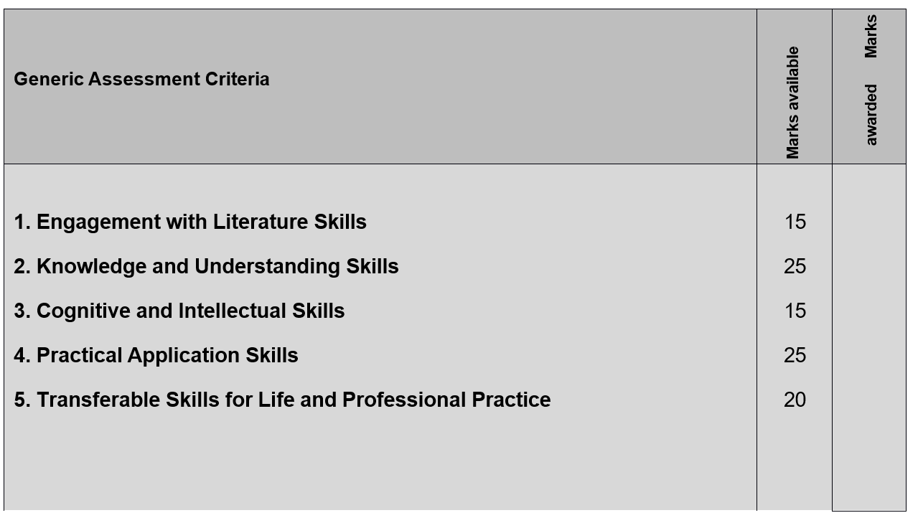

Slide 20
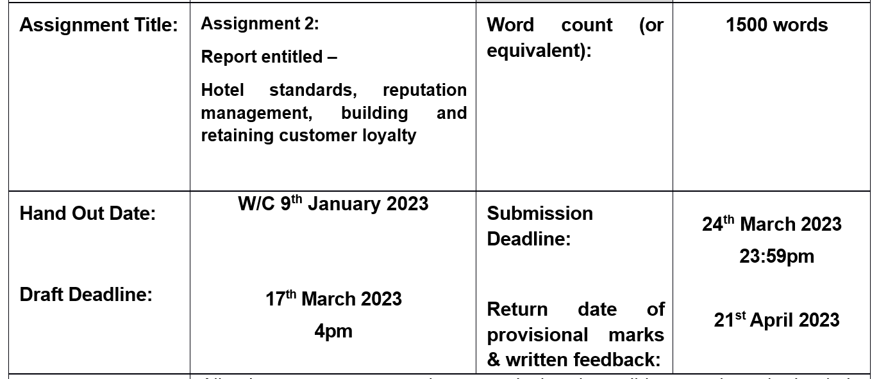
Assignment 2: Report

Slide 21
‘Hotel standards, reputation management, building and retaining customer loyalty’
Background:
The hospitality industry is very competitive, and businesses need to keep up with the latest hospitality trends to avoid being left behind. Additionally, keeping pace with the industry as a whole is a great way to ensure your business delivers the kind of customer experience people want and expect.
Task:
You are tasked with developing a 1,500-word report (+/- 10%).
The following topics must be the focus in your report:
Hotel Standards
Reputation Management
Customer Loyalty

Slide 22
Consider the following questions:
What is the purpose of brand consistency standards? Do all hotels have the same standards?
How can hotels manage their reputation effectively? What is the importance of effective guest reviews management? What is the impact of negative reviews?
How can hotels build and retain customer loyalty (e.g. loyalty programmes)? What is the purpose of this?
What recommendations do you have for hotels regarding market trends? What are the obstacles facing certain businesses?

Slide 23
Ensure you are not being too descriptive. Instead, support your discussion with examples/case studies from the hotel and hospitality industry.
Demonstrate your knowledge and understanding by providing analysis, by making comparisons between different global hotel players (case studies) and by proposing realistic recommendations to the industry.
Your report should follow the structure below:
Title Page
Executive Summary
Content Table
Introduction
Main Findings (including sub-headings)
Conclusion
Recommendations
Reference List (minimum of 15 references is required)

Slide 24
Additional assessment requirements:
Microsoft Word settings: Please use Arial Font 12, 1.5 line spacing, Justify Text
You must include in-text citations (see Harvard Referencing guide) throughout your report.
Industry examples from the hotel/hospitality industry should be referred to throughout your report.

Slide 25
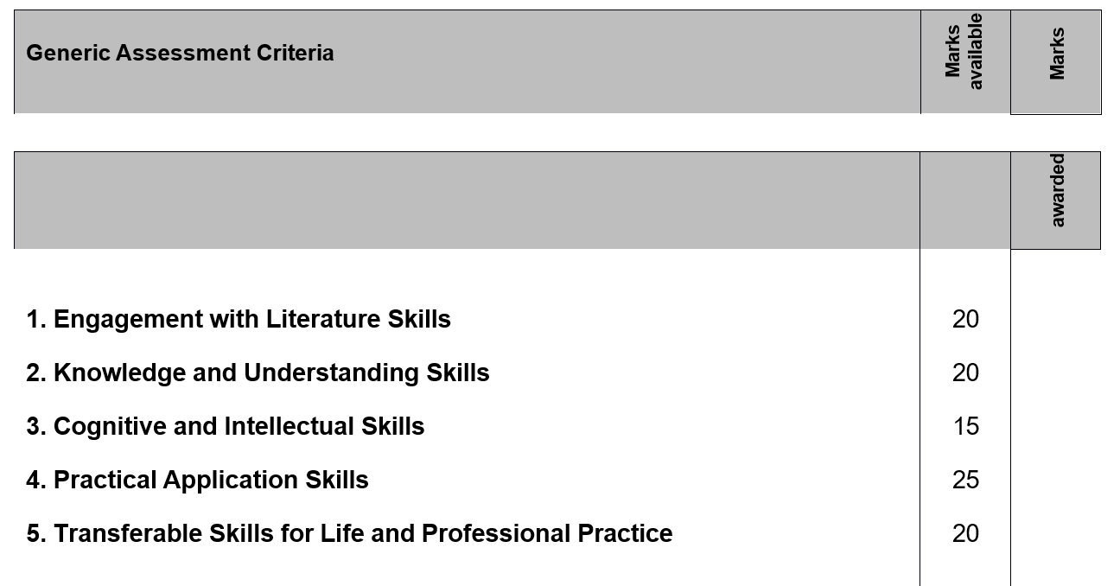

Slide 26
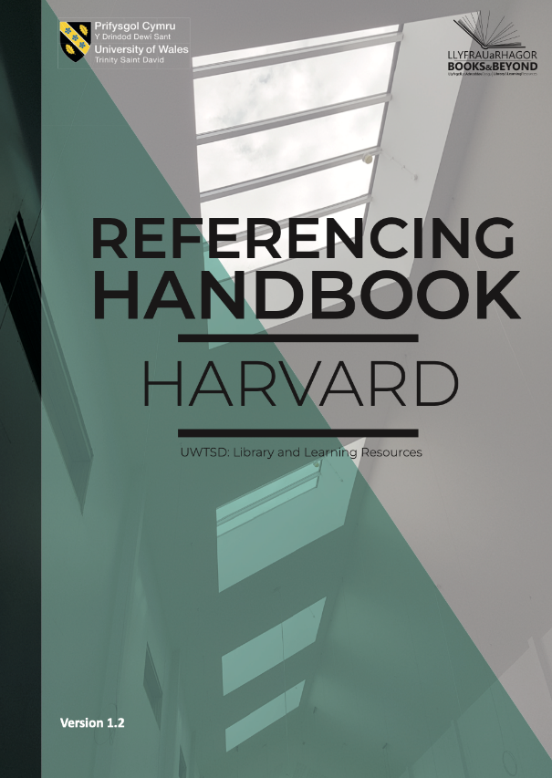
Referencing
Available in Online Library, Moodle & in Teams files
Please refresh your knowledge from the Business Skills module

Slide 27
Credible Sources
IoH Library
UWTSD Online Library
Databases, e.g. NewsBank, MarketLine etc.
Leganto Reading Lists
Google Scholar and Google Books
Academic books and journals
Peer-reviewed

Slide 28
Reminder: Do & Don’ts
Do
Don’t
Credible newspapers
e.g. The Financial Times
Credible websites
e.g. Forbes, VisitBritain
Credible magazines
e.g. The Caterer
Wikipedia
Tabloids
e.g. The Sun, The Daily Mirror
“dodgy websites”

Slide 29
Academic Support
InfoSkills
Finding and using information
Referencing and plagiarism
infoskills@uwtsd.ac.uk
Study skills support is available to all University of Wales Trinity Saint David students who need assistance with their studies.
Academic writing
Avoiding plagiarism
Critical thinking
Exam revision
Planning and organisation
Presentation skills
Referencing
Researching
studyskillsdistance@uwtsd.ac.uk

Slide 30

Academic Misconduct
UWTSD has a strong commitment to academic integrity which reflects the University’s core mission
Academic Misconduct will not be tolerated in any shape or form
If a submission is deemed suspicious, the student will be invited to a Viva prior to an investigation by the Academic Office (AO)
Do not work in teams – if you are found to share your work with another student, you will also be investigated.

Slide 31

Introduction

Slide 32
Hospitality & Guest Services
“A customer is the most important visitor on our premises, he is not dependent on us. We are dependent on him. He is not an interruption in our work. He is the purpose of it. He is not an outsider in our business. He is part of it. We are not doing him a favour by serving him. He is doing us a favour by giving us an opportunity to do so.”
- Mahatma Gandhi

Slide 33
Hospitality & Guest Services
“A customer is the most important visitor on our premises, he is not dependent on us. We are dependent on him. He is not an interruption in our work. He is the purpose of it. He is not an outsider in our business. He is part of it. We are not doing him a favour by serving him. He is doing us a favour by giving us an opportunity to do so.”
Mahatma Gandhi
Group Discussion:
Do you agree with this statement?
Do you disagree with this statement? Why?
Type your answers in the chat box or raise your yellow hand.

Slide 34

What is Service?
Group Discussion:
A time when you received…
Good service?
Excellent service?
Bad service?
Quality service?
Type your answers in the chat box or raise your yellow hand.

Slide 35
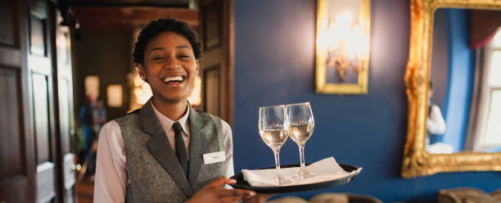
What is Service?
Service is an action or performed task that takes place through contact between the guest and employees of the service organisation
(Ford and Sturman, 2020)
A common way to think of service is the service (intangible) part of the transaction between the guest and employees.

Slide 36
There are two types of asset categories: Tangible and Intangible
Tangible assets are typically physical assets or property owned by a company, such as computer equipment.
Intangible assets do not physically exist, yet they have a monetary value since they represent potential revenue.

Slide 37
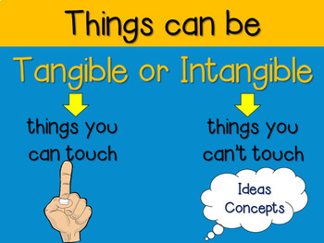
Group Discussion
Think of the hotel industry – what is tangible and what is intangible?
Type your answers in the chat box or raise your yellow hand.

Slide 38

Quality Service
What do we mean by ‘quality service’?
Definition:
Quality service means exceeding your guests’ expectations by paying attention to every detail of the delivery of your products and services.

Slide 39
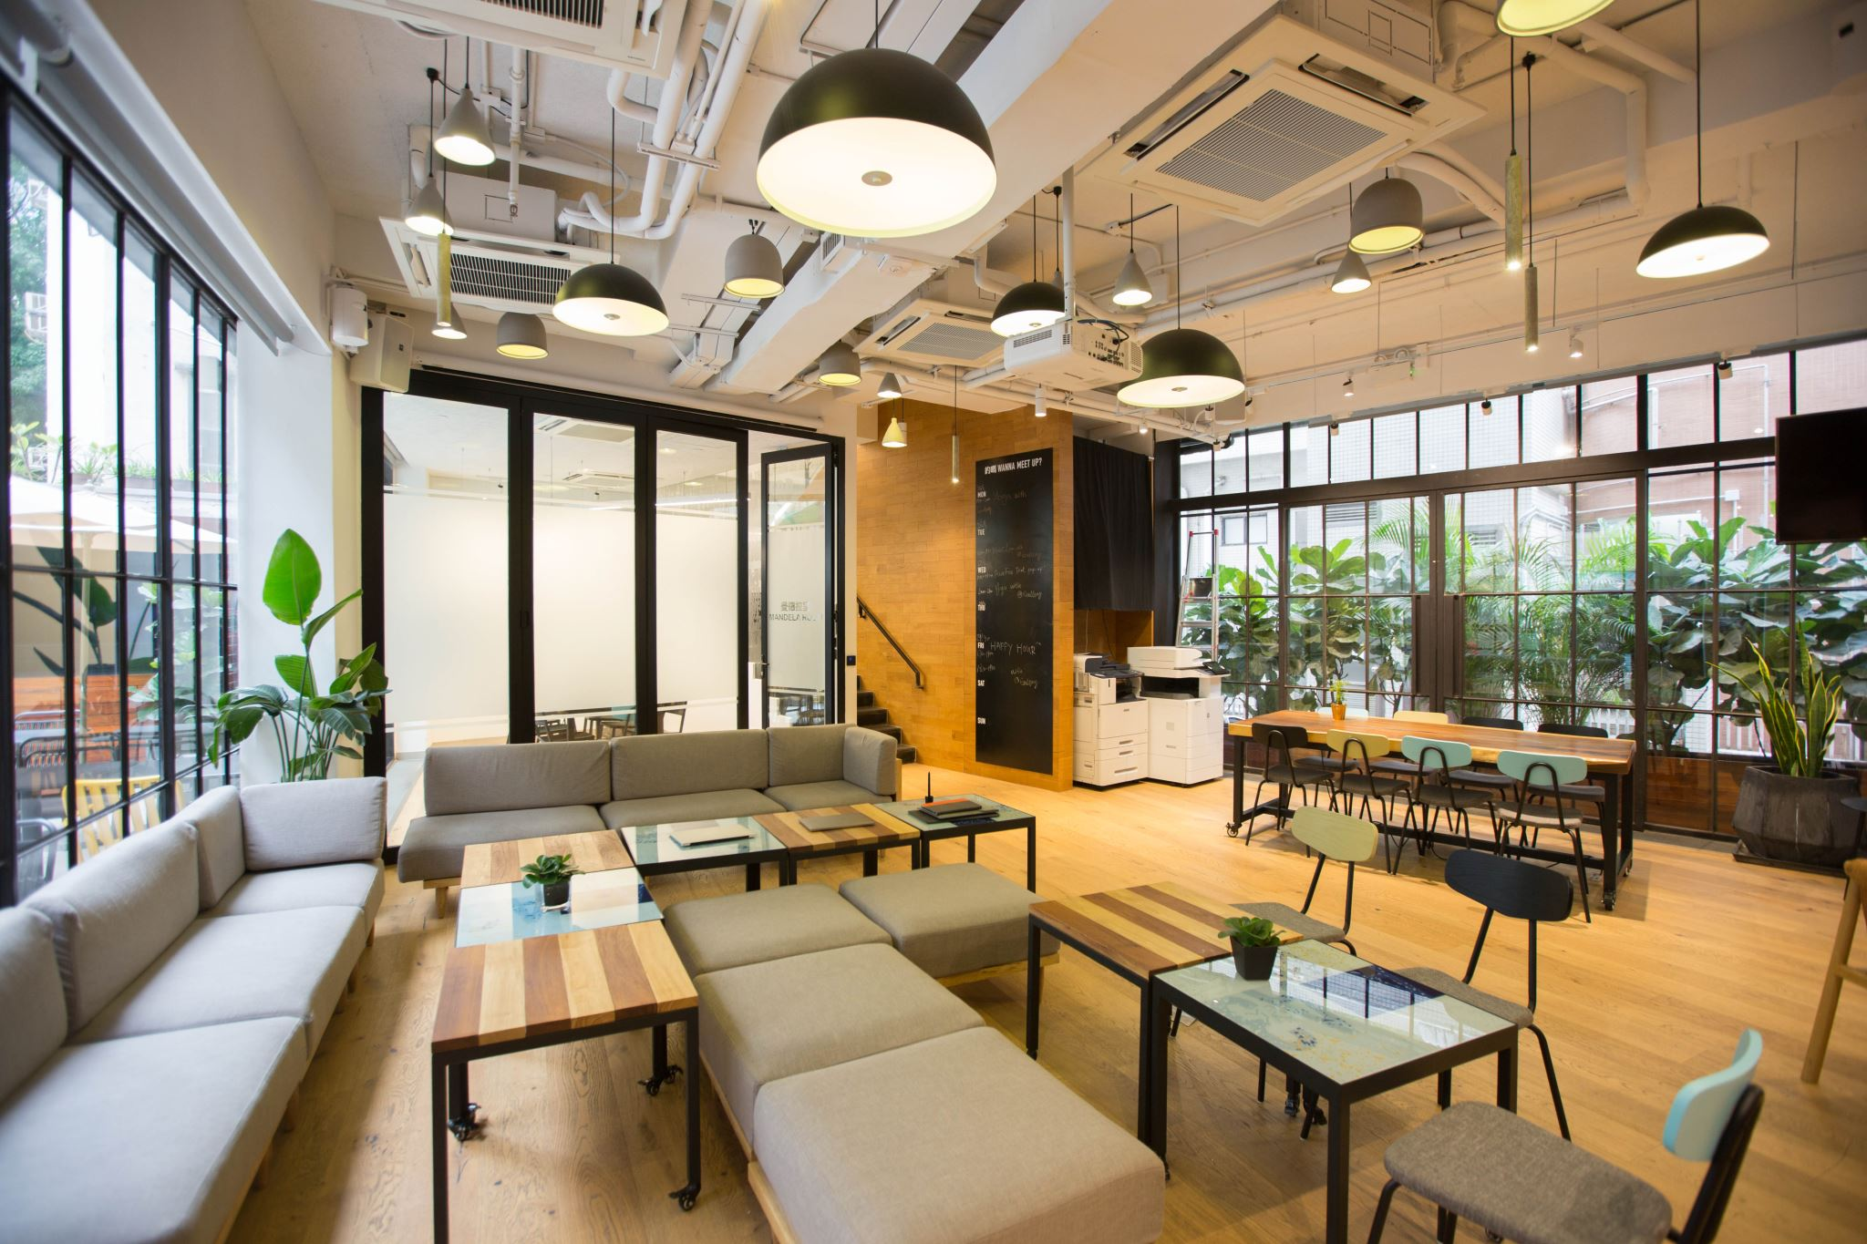
What are Guest Services?
Guest services at a hotel are the services and amenities that the hotel provides for its guests
(Collins Dictionary)
The goal of guest services is to provide customers with an enjoyable experience, primarily in the hotel and spa industry, sports facilities, and event venues.

Slide 40
What are Guest Services?
Examples include concierge, room service, and laundry.
However, in this new service culture we have seen an increase in new and exciting guest services.
Examples include in-elevator bartender, bedtime stories and sleep concierge.

Slide 41

What is Guest Service?
Guest service is providing a professional service to guests.
For example:
Offering front desk services to guests, accommodating unique and general requests and acting as an information source on various matters.
It is the intangible goods provided.

Slide 42
Task: Guest Experience
Think of a time you have stayed in a hotel, and you have…..
Experienced excellent service?
What effect does it have?
When have you experienced poor service?
What effect does it have?
Type your answers in the chat box or raise your yellow hand.

Slide 43
What does Excellence mean?
Service excellence is about delivering to the customers’ expectation and then meeting and exceeding that expectation.
“We’re not servants we’re professionals.
If you want respect, you have to create excellence”
Horst Schulze (2003)
Co-founder of luxury hotel chain The Ritz-Carlton

Slide 44
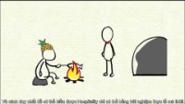
What is Hospitality?

Slide 45
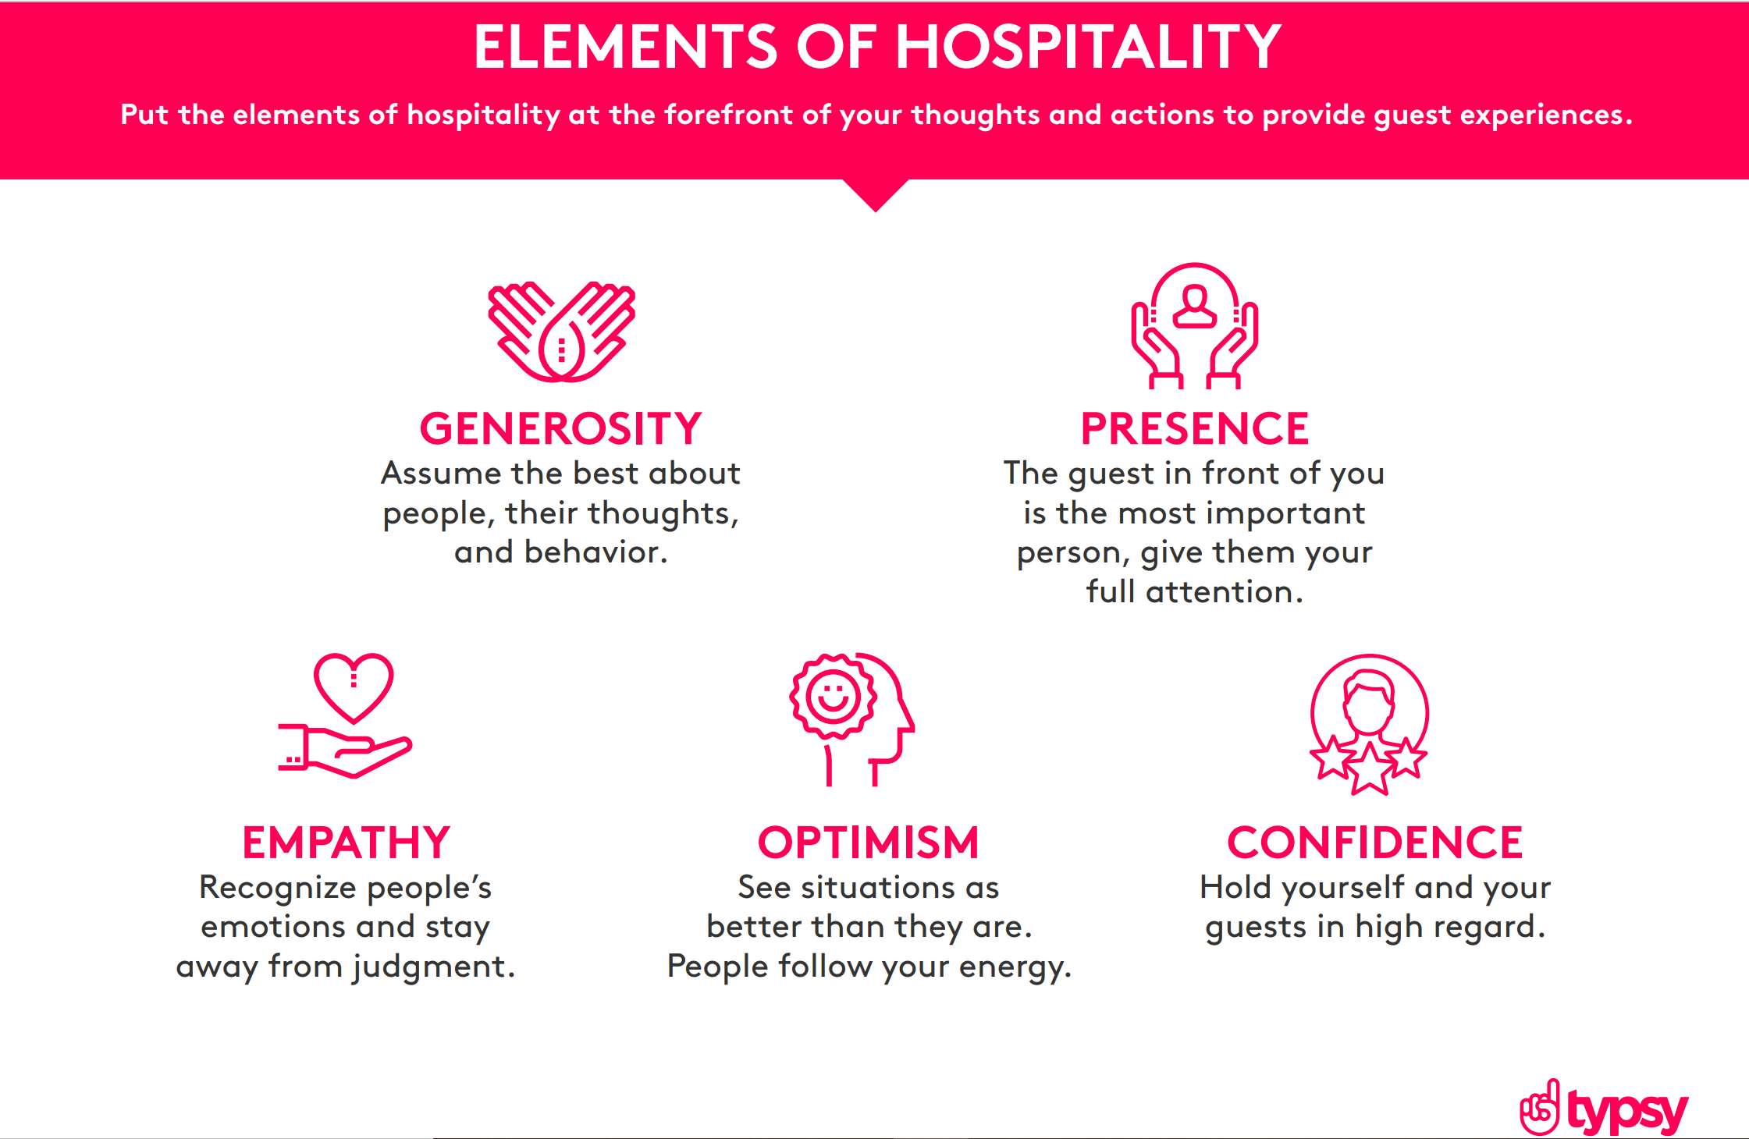

Slide 46

The WOW Factor
According to Solomon (2019) in the book ‘The Heart of Hospitality’ he suggested
‘The Hospitality Industry transforms essentials like a bed, a room, a meal into an experience that is warm, comforting, memorable and even magical’
WOW Factor takes the tangible products, the things we can see and touch and provides an intangible feeling or experience.
In hospitality, to exceed expectations and leave a lasting impression on the guest we must create The Wow Factor.

Slide 47
The WOW Factor
How….
Paying close attention to every aspect of the guest experience
Analysing the experience from the guest’s perspective
Understanding needs and wants
Committing every element of the business, from design to interaction, to the creation of exceptional service.

Slide 48

Set expectations
Introduction to the module
Module assignments and deadlines
Learning resources
Academic integrity
Notes:
-Today, we covered…

Slide 49
What is Service?
What is Guest Service?
What is hospitality?
What is tangible assets in a hotel?
What is intangible assets?
Notes:
-Today, we covered…

Slide 50
Next Week’s Content
The role and function of guest services
Historical developments with guest service and customer care
The structure of the hospitality industry
Service standards
Organisational trends

Slide 51


Slide 52
References
Brand Culture (2021) BrandCulture's Hospitality: How to Cultivate a Culture. Available at: <https://brandculture.com/insights/cultivating-a-culture-brand-culture-hospitality/> (Accessed: 4th of January 2023).
Disney Institute (2020) Be Our Guest. New York: Disney Editions.
Dolce, A. (2018) Service isn’t Hospitality [video]. Available at https://www.youtube.com/watch?v=qkU3uwWyAn8. (Accessed: 4th of January 2023).
Hill Camp (2015) What is Hospitality? Available at: https://www.youtube.com/watch?v=u0bqEeCVI_A (Accessed: 4th of January 2023).
Macdonald, S. (2021) 7 ways to create a great customer experience strategy [Blog]. Available at: https://www.superoffice.com/blog/customer-experience-strategy/ (Accessed: 4th of January 2023).
Montgomery, D. (2016) ‘The Meanings of Destination: A Q Method Approach’, Journal of Travel Research, Vol. 56, No. 6, pp.793-807.
Solomon, M. (2019) Heart of hospitality. New York: SELECT Books INC.
Ukhospitality (2020) Reports. Available at: https://www.ukhospitality.org.uk/page/Reports (Accessed: 4th of January 2023).

