Slide 1
Week 5 - Strategic Thinking: Enhanced Advantage
Integrating Sun Tzu's Art of War with Porter's Competitive Strategy
Xicheng Liu
X.Liu@uwtsd.ac.uk

Slide 2
Introduction
Core Idea: Fighting is a means to an end, not the end itself.
Shih 势 — Enhanced Energy; Power
Porter: Operational Effectiveness and Strategic Positioning

Slide 3
Sun Tzu's Concept of "Shih" (Enhanced Energy)
What is "Shih"?
  The title of the chapter "Enhanced Energy" in The Art of War.
  Can be interpreted as "situation" or "power".
  Sun Tzu's Analogy:
    "The onrush of pent-up water tumbling stones along " and "the momentum of a round stone, which rolls down a mountain from thousands of feet in height".

Slide 4


Sun Tzu's Concept of "Shih" (Enhanced Energy)
  Shih represents a self-intensifying power that grows when used, like a snowball effect.
Example:
  The psychological unity and high morale of an army creates a self-reinforcing system of Shih, allowing a smaller army to defeat a larger one.

Slide 5
The Duality of "Hsing" and "Shih"
Hsing (Tactical Disposition) 形
  Pertains to physical capability.
  Maximized by the clever arrangement and disposition of troops.
  It is the object that is moving.
Shih (Enhanced Energy) 势
  Enhances performance by utilizing the psychological element.
  It is the movement and revealed power of Hsing.
Interdependence
  Hsing is the basis of Shih. Shih is the effect of moving Hsing.
  The creation of Shih depends on the general‘s ability to combine two other forces: Cheng (normal/direct) 正 and Chi (abnormal/indirect) 奇.

Slide 6
Introducing Cheng (Normal) & Chi (Abnormal)
Philosophical Roots
  Sun Tzu's military thinking is deeply rooted in Daoism, which explores concepts of paradoxes and counterbalances (yin and yang).
  The theory of Cheng and Chi is a perfect example of this philosophy.
Study | Explanation | Translation (Cheng vs Chi)
Li Ch’uan | Facing the enemy is Cheng; whereas making lateral diversion is Chi. | Straight forwardness vs. Lateral diversion
Chia Lin | In presence of the enemy, your troops should be arrayed in normal fashion, but in order to secure victory abnormal maneuvers must be employed. | Normal vs. Abnormal
Mei Yao-ch’en | Chi is active, whereas Cheng is passive; passivity means waiting for an opportunity | Passive vs. Active

Slide 7
Introducing Cheng (Normal) & Chi (Abnormal)
Study | Explanation | Translation (Cheng vs Chi)
Ho Shih | We must cause the enemy to regard our straightforward attack as one that is secretly designed, and vice versa; thus Cheng may also be Chi, Chi may also be Cheng | Straightforward vs. Secret (unexpected)
Wei Liao Tzu | Direct warfare favors frontal attacks, whereas indirect warfare attacks from the rear. | Direct vs. Indirect
Cao Cao | Going straight out to join a battle is a direct operation; appearing on the enemy’s rear is an indirect maneuver. | Direct vs. Indirect
Sawyer (2005) | “Orthodox” tactics employ troops in normal, conventional, and therefore predictable ways; “unorthodox” tactics stress ﬂexibility, imagination, and surprise. | Orthodox vs. Unorthodox

Slide 8
Introducing Cheng (Normal) & Chi (Abnormal)
Core Definition
  Cheng (Normal): Refers to normal, regular, or general military methods for handling the enemy. It's the conventional, expected approach.
  Chi (Abnormal): Refers to special, unusual, or irregular methods aimed at confusing the enemy. It's the unconventional, surprising approach.
The Goal:
  To win, one must appropriately combine Cheng and Chi to create and exploit the vital force of Shih.

Slide 9
The Dynamic Relationship of Cheng & Chi
Interdependency
  Sun Tzu: "Generally in a battle, one engages with the normal (Cheng) and gains victory through the abnormal (Chi)".
  This does not mean Chi is superior; it highlights their deep interdependency.
  A weak Cheng (conventional force) will weaken the effect of Chi (surprise manoeuvres).
Mutual Interchangeability
  Cheng can become Chi, and Chi can become Cheng.
  The secret lies in confusing the enemy about your true intentions.
Example: Zhuge Liang's "Empty Fort Strategy"
  Facing a much larger army, Zhuge Liang opened the town gates and calmly played music on the city wall.
  The enemy, fearing an ambush (a conventional trap), retreated.
  A Chi (abnormal) strategy was perceived by the enemy as a Cheng (normal trap) manoeuvre, showcasing their interchangeability.

Slide 10

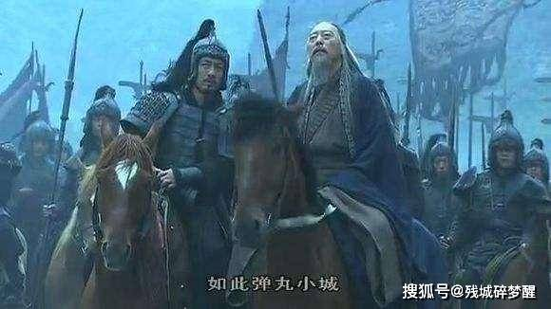

Slide 11
Limitless Combinations
Sun Tzu asserted that combining Cheng and Chi can create countless variations, meaning there is no fixed principle to follow rigidly in a campaign.
Sun Tzu's Analogies for Infinite Possibilities:
  "The musical notes do not exceed five, but the changes of the five musical notes can never be fully heard".
  "The colors do not exceed five, but the changes of the five colors can never be completely seen".
  "The flavors do not exceed five, but the changes of the five can never be completely tasted".

Slide 12
Pivot to Business: Porter's OE & SP
Michael Porter's "What is Strategy?" (1996)
  Introduced two concepts that have shaped modern business strategy: Operational Effectiveness (OE) and Strategic Positioning (SP).
Operational Effectiveness (OE)
  Definition: Conducting activities similar to rivals, but doing them more efficiently.
  Focus: Better utilization of materials, reducing defects, developing products faster.
  Example: Toyota's just-in-time (JIT) production system.
Strategic Positioning (SP)
  Definition: Performing different activities from rivals, or performing similar activities in different ways.
  Focus: Being different and delivering unique value to consumers.
  Example: Tesla Motors using electricity for cars, unlike conventional fuel-based automakers.

Slide 13
The Limits of Operational Effectiveness
Porter's Argument:
  OE is necessary for a company to outperform rivals, but it is not sufficient for long-term advantage.
Why isn't OE enough?
  Imitation: Best practices are easily imitated by rivals and spread quickly throughout an industry.
  Convergence: This imitation makes firms increasingly similar, leading to destructive price competition.
  Beneficiaries: The ultimate long-term beneficiaries of OE are often customers and suppliers, not the firms themselves.

Slide 14
Integrating Sun Tzu and Porter
The Core Connection
  Just as Cheng and Chi are the tools for generating Shih in battle, OE and SP are the methods for generating competitive advantage in business.
A direct relationship can be drawn:
  Cheng (Normal) ↔ Operational Effectiveness (OE)
  Chi (Abnormal) ↔ Strategic Positioning (SP)
Military Strategy (Sun Tzu) | Business Strategy (Porter) | Key Characteristic
Cheng (Normal) | Operational Effectiveness (OE) | Direct confrontation/competition; performing similar activities, but better.
Chi (Abnormal) | Strategic Positioning (SP) | Irregular/unexpected maneuvers; performing different activities or similar activities differently.

Slide 15
Dynamic Relationships & Contrasting Views
Dynamic Nature
  Just as Cheng and Chi are interchangeable, an SP strategy, once widely imitated, can become OE. It loses its uniqueness.
  Sun Tzu stresses the combination of Cheng and Chi for enhanced advantage.
Porter's Preference
  Porter argued firms should primarily secure SP for long-term advantage, viewing it as "true strategy".
  He believed relying on OE leads to destructive competition.

Slide 16
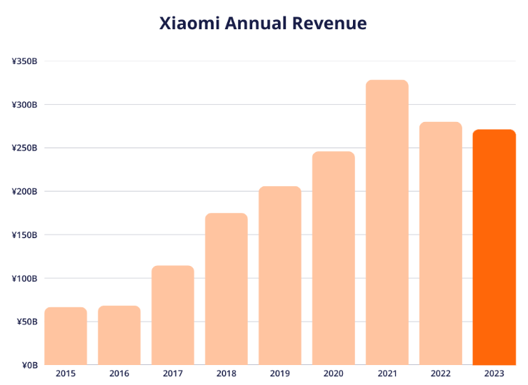

Dynamic Relationships & Contrasting Views
A More Integrated View
  Firms, especially followers, can adopt OE first to build competencies, then secure SP later.
  Firms can also pursue OE and SP simultaneously.
  Example: Xiaomi uses SP in its online-only distribution and unique business model, while using OE to benchmark Apple's hardware at a lower cost.

Slide 17
Business Case: Walmart's Cost Leadership
The Question: How did Walmart maintain its incredible cost advantage over such a long period?
We will analyze Walmart's journey in three distinct stages of development.

Slide 18

Walmart: Stage 1 (1962 – 1992)
Initial Goal: "Offering consumers a wide selection of goods at a discounted price".
Strategy:
  Located stores in small towns with few retail options, avoiding direct competition with established retailers.
  Benefited from lower land prices and created its own economies of scale.
First Walmart store opened in Rogers, Arkansas in 1962.

Slide 19
Walmart: Stage 1 (1962 – 1992)
Analysis:
  Primarily an Operational Effectiveness (OE) strategy.
  As a latecomer, Walmart benchmarked competitors to offer cheap goods more efficiently.
  While the location choice avoided competition, its target customers (low-income, price-conscious) were not fundamentally different from rivals, so it wasn't a full SP strategy.

Slide 20
Walmart: Stage 2 (1993 – 2006)
Motto: "Always low price".
The Twist: During this period, only 15-20% of Walmart's items were actually priced lower than competitors.
Strategy:
  Masterfully manipulated public perception to maintain its low-price image.
  Focused on satisfying customers' core needs by keeping prices of key goods extremely low.
  Customers, satisfied with key prices and convenience, overlooked poorer service or slightly higher prices on other items.
Analysis:
  Still largely a strategy of Operational Effectiveness (OE), refining processes and managing customer perception within the existing retail landscape.

Slide 21

Walmart: Stage 3 (2007 – Present)
The Shift: Facing new pressures, Walmart evolved its strategy.
New Slogan (2007): "Save Money, Live Better".

Slide 22
Walmart: Stage 3 (2007 – Present)
New Initiatives:
  2011: Launched an initiative for healthier food at economical prices to help reduce sodium, sugar, and trans fats.
  2013: Set a goal to reduce packaging by 5%, which protected the environment and lowered business costs (purchasing, transport, waste).
Analysis:
  A shift from primarily OE to incorporating Strategic Positioning (SP).
  Changed its position from just a low-cost provider to a provider of wellness.
  Target group shifted towards those demanding healthier goods, a "needs-based SP".

Slide 23
Walmart's Success: The Power of Combination
The Key Insight:
  While pursuing its new SP (wellness, healthier foods), Walmart did not give up its OE endeavors (e.g., reducing packaging costs).
  Walmart's success shows that OE and SP are complementary, not conflicting.
Sun Tzu's Wisdom:
  Walmart's story is better explained by Sun Tzu's claim that enhanced advantages (Shih) are achieved by jointly employing Cheng (OE) and Chi (SP).
  This combination overcomes the disadvantage of OE (direct competition) by creating a unique, defensible position.
A Caveat:
  This strategy failed in some foreign markets (South Korea, Japan, Germany) where Walmart failed to offer a compelling value proposition compared to local competitors, highlighting the need to adapt the OE/SP mix to the local environment.

Slide 24
Conclusion & Key Takeaways
Sun Tzu's Core Message: Enhanced advantage (Shih) is created by combining Cheng (normal) and Chi (abnormal) strategies.
The Business Parallel: Competitive advantage is generated from Operational Effectiveness (OE) and Strategic Positioning (SP).
  Cheng ≈ OE (Direct competition)
  Chi ≈ SP (Different activities, less direct competition)
The Walmart Case: Demonstrates that a firm can start with OE and later adopt SP, using them in combination to strengthen its long-term leadership position.
The Big Takeaway: True strategic advantage comes not from choosing one path, but from the dynamic, flexible, and synergistic combination of both conventional (Cheng/OE) and unconventional (Chi/SP) approaches.

