Slide 1
ECIE6001
Moving away from the traditional classroom: Outdoor Education and Learning
Darlith 1 / Lecture 1
The Role of Outdoor Education

Slide 2
The module aims:
To appreciate and critically reflect upon the role of outdoor education in Wales and further afield.
To demonstrate understanding of the debates in outdoor pedagogy.

Slide 3
LEARNING OUTCOMES
Upon the successful completion of this module, you should be able to:
Appreciate the importance of outdoor education on protecting our natural resources now and in the future and an understanding of what this means socially, economically and culturally.
Critically reflect upon the approaches to out of classroom learning and real-life experiences in nature, for all ages and abilities.
Critically discuss/evaluate challenges and multiple benefits of bringing the three strands of natural environment, learning and health together.
Organise their knowledge and learning through use of a range of media, and present their work appropriately in a manner that can be understood by specialist and non-specialist audiences.

Slide 4
Aseiniad Assignment
Portffolio
4 Elements
4000 gair
Dyddiad cau 26.04.26, 23.59
Gweler Cefnogaeth Aseiniad sy’n dilyn
Portfolio
4 Elements
4000 words
Hand in date 26.04.26, 23.59
See following Assignment Guidance

Slide 5
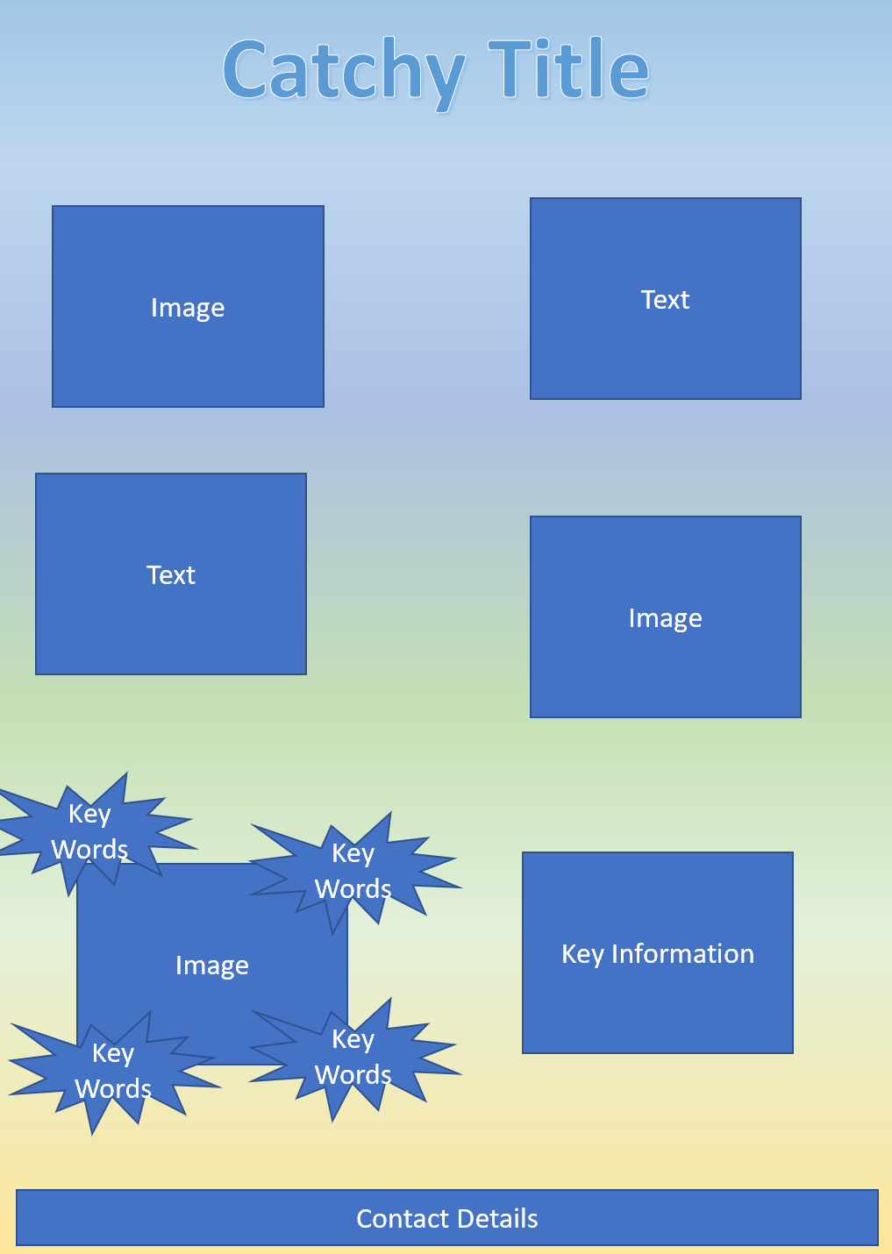
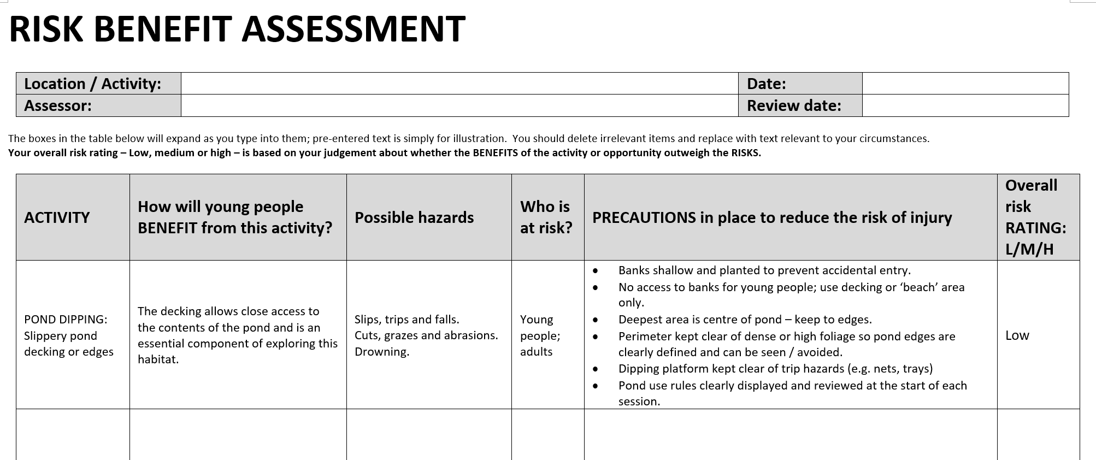
Aseiniad Assignment
Portffolio Portfolio
Essay
‘Compare and contrast the scope and approach to outdoor provision in two types of setting e.g. early years, primary, secondary, PRU, ALN units, etc’
(Approx. 1200 words)
Flyer
(Approx. 500 words)
Risk Benefit Assessment
(Approx. 600 words)
Literature Review
‘The role of Outdoor Education’
(Approx. 1700 words)

Slide 6
Schedule
Week 1:
Draw on recent and relevant literature to identify the role of outdoor education
Week 2:
Analyse the scope and approach to outdoor provision in different settings
Week 3:
Risk and Risk Benefit Assessments/ Create & advertise outdoor learning experiences
Week 4:
Recap theories, policies, best practices/Assignment guidance
or 1:1 Tutorials

Slide 7
What is outdoor learning?
Outdoor learning refers to any structured educational experience that takes place outside the typical indoor classroom. This can include:
Forest school sessions
Nature-based pre-school/early years provision
Outdoor adventure learning
School grounds and community environment projects
Curriculum lessons delivered outdoors utilising the uniqueness of the outdoor environment
Play-based outdoor opportunities (The Muddy Puddle Teacher, 2025)

Slide 8
Role of outdoor education and learning
Impact on positive health and well-being
Improves physical health
Learning about the natural environment and sustainability
Experiential, collaborative, hands-on learning opportunities
Develops personal skills, e.g. self-confidence; risk-taking; problem-solving
(Papadopoulou & Vincent, 2025)

Slide 9
Benefits of outdoor education and learning
Comprehensive Development: Research indicates outdoor learning improves mental health, reduces stress (lower cortisol levels), and enhances social skills, such as cooperation and communication.
Enhanced Academic Outcomes: Outdoor environments make curriculum concepts easier to understand, providing a practical approach that improves academic attainment.
Inclusivity and Engagement: Outdoor lessons are often more inclusive, helping students who may struggle in a traditional classroom setting and encouraging them to engage more with their education.
Improved Connection to Nature: Regular outdoor education fosters a stronger connection to the environment, which is vital for building understanding of sustainability and climate change.
Curriculum Integration: Formal adoption into the curriculum is crucial to maximise these benefits, allowing for regular, planned and progressive experiences rather than sporadic, unstructured time.
(Learning Through Landscapes, 2022)

Slide 10
Benefits of consistent, regular opportunities for
Outdoor Learning
‘Consistent outdoor education significantly enhances children’s social, emotional, and intellectual development by fostering self-confidence, improving mental health, boosting academic engagement, and improving physical skills.
Evidence suggests that for maximum impact, outdoor learning should be formally adopted into the curriculum rather than treated as an occasional activity’ (Learning Through Landscapes, 2022)
By integrating regular outdoor learning into school life, schools can foster a more holistic approach to child development.

Slide 11
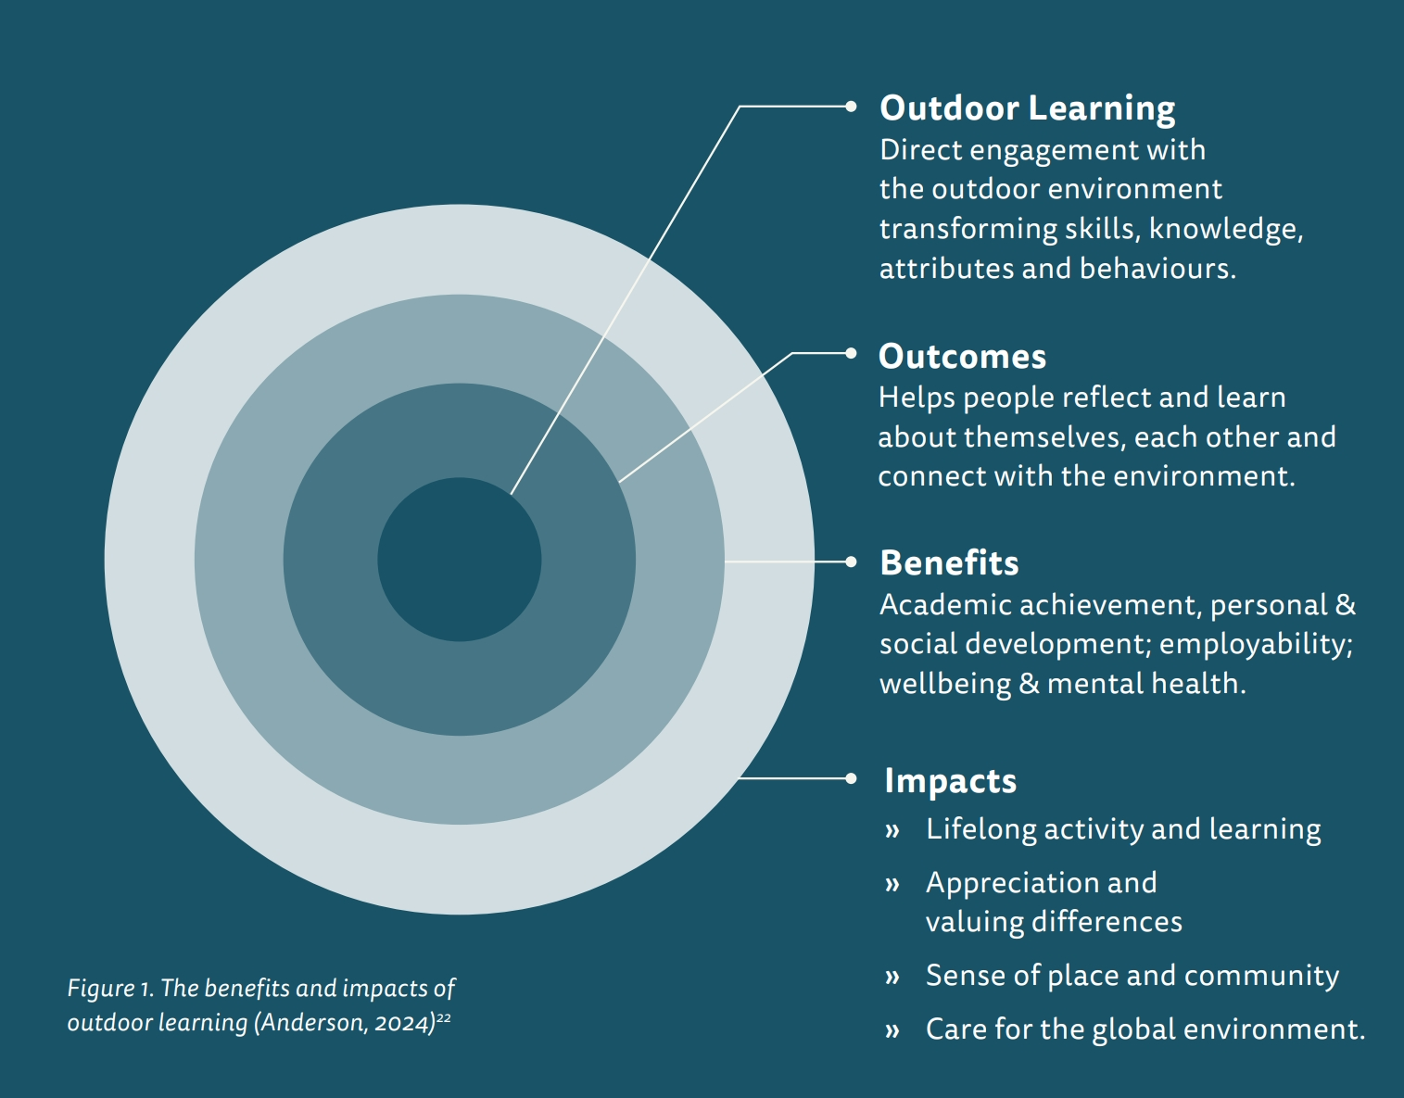
Institute of Learning
High Quality Outdoor Learning (2025)
Evidence of positive impact on building social capital, fostering pride, belonging and community involvement.
Significant return on investment in relation to wellbeing and preventing poor mental and physical health, and positive learning outcomes.
''The available evidence suggests that experiences of nature help children acquire some of the skills, attitudes, and behaviors most needed in the 21st century.” (Kuo et al, 2019)
(Anderson 2024, cited by Institute of Learning, 2025)

Slide 12
Literature review of the role of
Outdoor Education
Promote positive physical and mental health and well-being
Promote engagement with sustainability and ecological awareness
Develop personal skills

Slide 13
Research by Cardiff University (2023)
Around 1 in 5 (approximately 20%) children and young people aged 8 to 24 in Wales were estimated to have a diagnosable mental health condition in 2023.
Nearly a quarter (24%) of young people reported very high levels of mental health symptoms, such as anxiety and depression
This indicates a significant rise from 1 in 10 (10%) in 2004
How can outdoor learning help?

Slide 14
Increase Serotonin!
N Nurture
A Attachment
T Trust
U Understanding
R Resilience
E Education
(Wilderness Way, 2026)

Slide 15
Role of outdoor education on positive mental health & wellbeing
Strong evidence base linking contact with nature and outdoor environments to better mental health in children and young people.
For educators concerned about rising levels of anxiety, low mood and stress, research positions outdoor learning as an evidence-informed part of the solution
New research from the University of East London suggests that taking learning outdoors may offer a simple but powerful solution
– Outdoor learning linked to lower stress and better focus | University of East London (2025)
A 2024 review focusing on children and adolescents concluded that nature has a beneficial effect on mental health and wellbeing, though more research is needed in clinical settings.
– Lomax et al., 2024 – Nature and Youth Mental Health PMC
A Natural England briefing summarising multiple rapid reviews reported strong evidence that time in natural environments is linked to improved mental health, reduced stress and greater life satisfaction.
– Natural England EIN065: Links between Natural Environments and Mental Health (2022)publications.naturalengland.org.uk

Slide 16
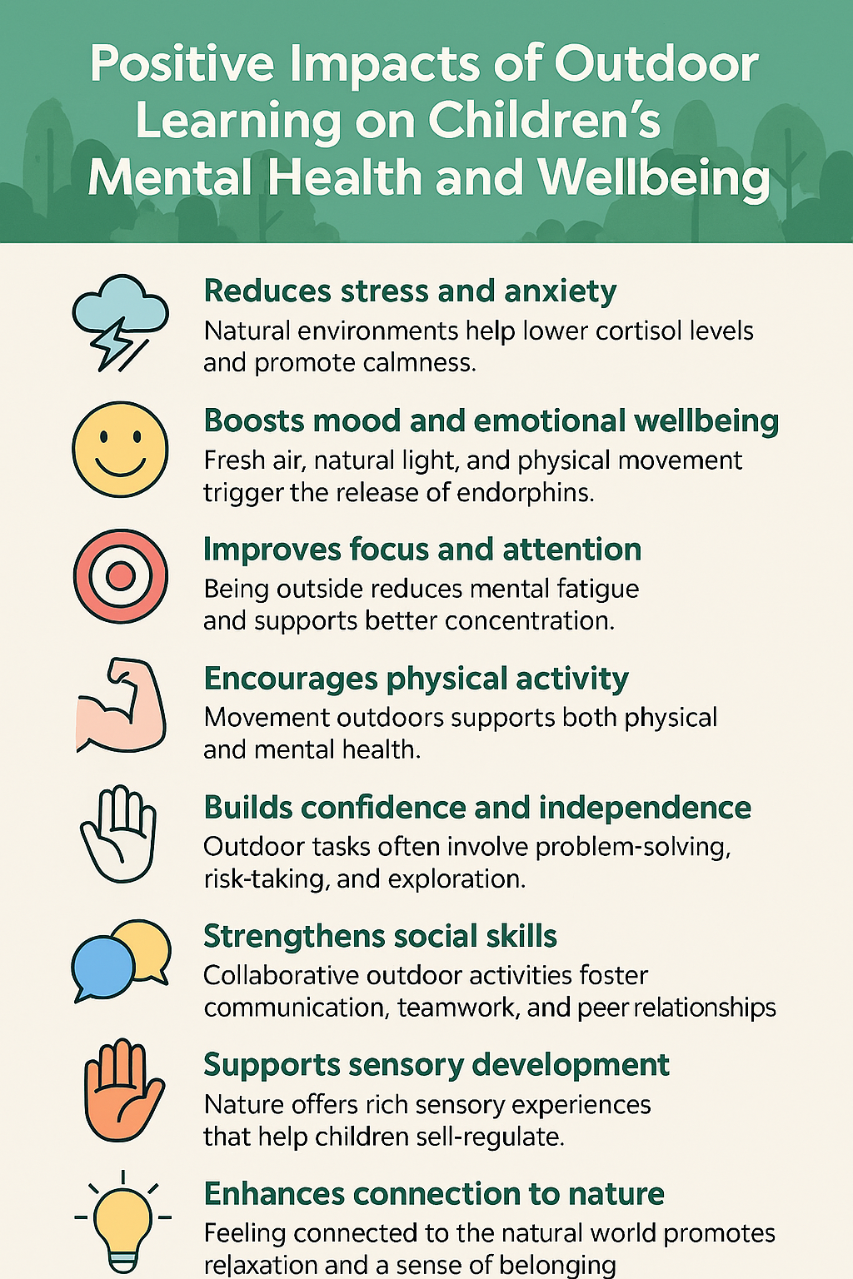
Is this the case for all children and young people? (Poster: UK Youth (2024)
Sensory sensitivities
Preference for structured, predictable environments
Anxieties or fear
Some demographic groups, families or cultures who do not value outdoor time (unfamiliarity affects engagement)
Limited access to safe, good quality outdoor spaces (the outdoors becomes associated with barriers, fear)

Slide 17
Role of outdoor education on engagement with the natural environment and sustainability
Outdoor education provides an excellent opportunity to promote environmental awareness in a fun and engaging way
Can educate learners about nature, conservation and sustainability (real & relevant)
Getting up close to wildlife, learners experience their environment and the natural world surrounding them
Immersing learners in nature connects them with the environment, can spark a love for nature and inspire eco-friendly habits (e.g. gardening, growing food)
Learners are more likely to appreciate the value of protecting the natural world when they have experienced it at first-hand (e.g. habitat awareness and care)
Outdoor education allows learners to see the impact of human activity on the environment, making it easier to understand the importance of sustainability (e.g. how littering and pollution harm wildlife or how deforestation affects the climate).
Active Learning Centres, 2023

Slide 18
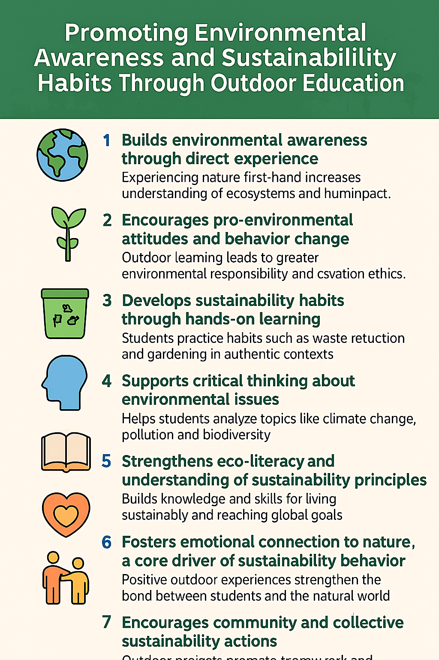
(Poster: Sustainability Learning Centre, 2025)
[N.B. Point 7: Outdoor education promotes a shared sense of responsibility]
However :
Pro-environmental attitudes do not automatically lead to consistent behaviour change e.g. Eco Schools Green Flag awards (Eco Schools, 2023)
Habits formed in school may not transfer to home life without on-going support.
Sustainability behaviours require systemic reinforcement (e.g. school policy, community initiatives, home routines)
Outdoor learning alone is not sufficient. Sustainability should also be embedded in the curriculum, school policy and culture to avoid being tokenistic
Without educator expertise, activities can be superficial
(Gessiou & Mart, 2023)

Slide 19
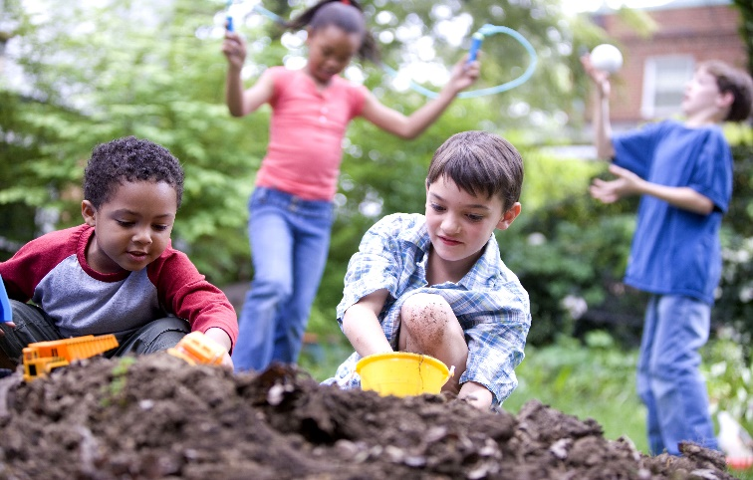
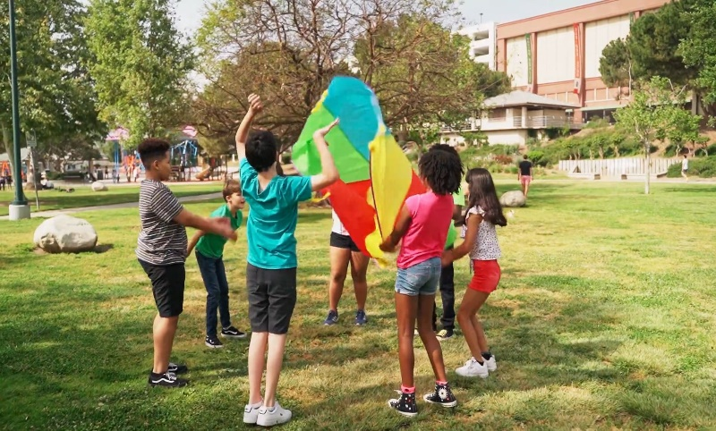
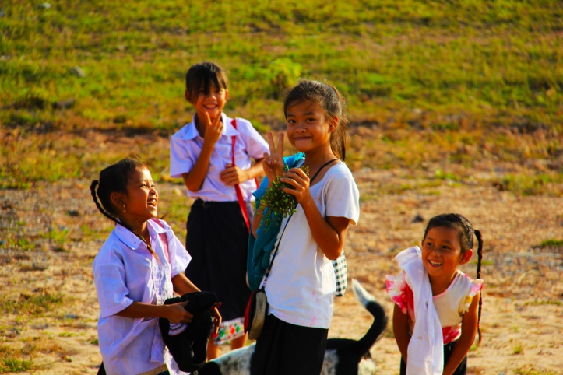
The role of outdoor education in developing personal skills
Play outdoors develops friendships, reduces social isolation and gives children a sense of autonomy and control, all important features of mental health and physical well being (Tinney, 2023)

Slide 20
Personal skills development opportunities presented by outdoor education
Exploration and discovery
Independence
Team building
Problem solving
Self confidence
Motor skills (gross and fine)
Decision making
Creativity/ Imagination
Initiative/motivation
Others?
Experience Extinction?

Slide 21
The role of outdoor education in developing personal skills
Concrete learning opportunities: Young children learn words for things they experience, such as colours, smells, and textures. This allows them to learn vocabulary in context, instead of through a book or programme.
Value of building connections: Studies show that
‘Outdoor learning can help students develop a variety of traits. These include the ability to complete tasks, the capacity to self-direct learning, and the ability to build connections with fellow students. These findings were particularly pronounced for students from ethnic minorities and low-income households.’ Why?
Very Well Mind, 2022

Slide 22
The role of outdoor education in developing personal skills
Ambitious, capable learners, ready to learn throughout their lives
Enterprising, creative contributors, ready to play a full part in life and work
Ethical, informed citizens of Wales and the world
Healthy, confident individuals, ready to lead fulfilling lives as valued members of society. (Welsh Government, 2022)

Slide 23
Barriers to the development of personal skills through outdoor learning
Social & Emotional barriers:
Anxiety, low confidence
Peer pressure, social dynamics that inhibit participation in group activities
Inclusion & Accessibility barriers:
Lack of differentiated activities to ensure all children can engage meaningfully
Motivation & Engagement barriers:
Preference for indoor or digital activities instead of outdoor activities (develops a different set of skills)
Lack of voice or choice in the outdoor activities
(Papadopalou and Vincent, 2025)

Slide 24
On-going challenges and barriers to outdoor learning and education
Risk averse society caused by Health & Safety regulations (e.g. concerns about safety and risk-management; natural hazards; over-excited children; staff: pupil ratios; learners with ALN) (Tinney 2023)
Additional paperwork (e.g. risk assessment plans, consent forms). Passy, 2014
Curriculum pressures (e.g. some subjects such as maths or science can be difficult to study outside and maintain curriculum requirements) (Davies & Hamilton, 2018)
Weather (e.g. not having appropriate clothing for everyone when the weather changes)
Teacher confidence to use outdoors effectively (concerns it wasn’t part of their training) (Tinney, 2023; Maynard & Walters, 2007)
Concerns about how outdoor learning can be evidenced if it’s not written in books and how ‘soft skill’ outcomes such as well-being can be measured (Waite, 2017)
Children became used to staying indoors during Covid-19. The use of technology and busier family lives can mean that children are less likely to play outside or engage comfortably with outdoor education and learning (University of Hull, 2022)

Slide 25
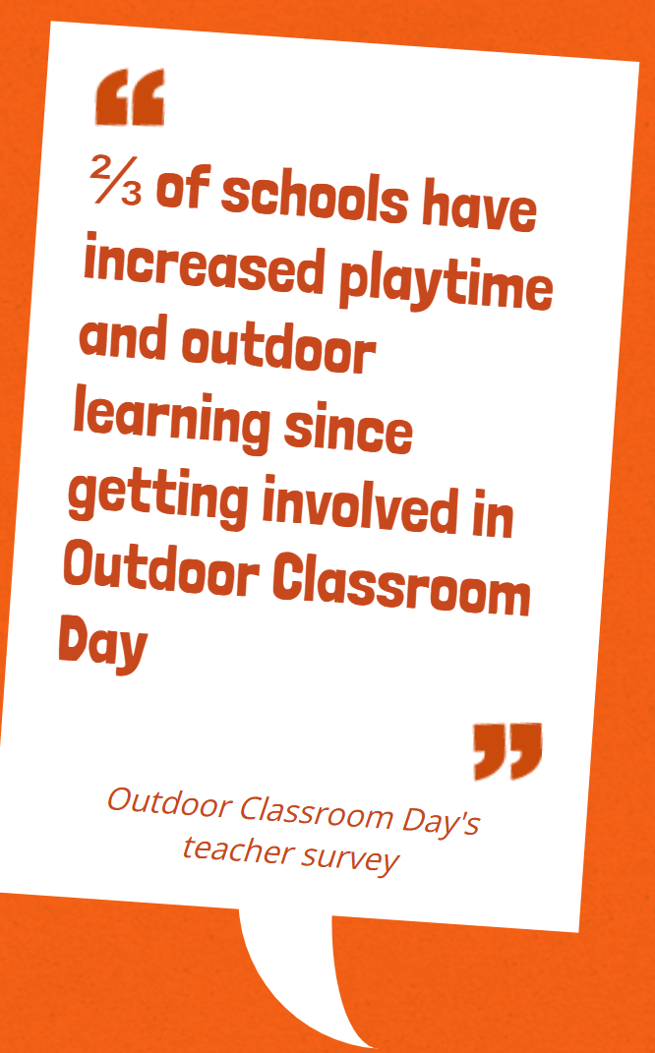

Outdoor Classroom Day
Global movement to make time outdoors part of every child’s day.
On two days of action each year, teachers take children outdoors to play and learn.
All year round, the Outdoor Classroom Day community campaigns for more time outdoors every day. (Outdoor Classroom Day, 2026)

Slide 26
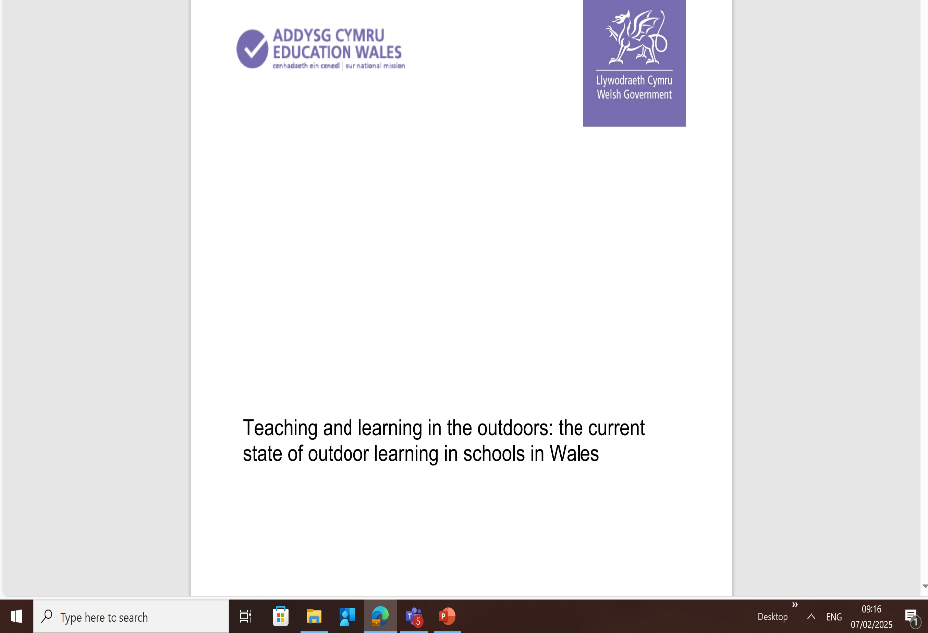
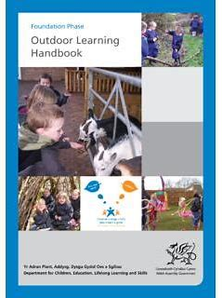
Recap our discussion:
What is the role of outdoor education and learning?
‘Outdoor learning is not just taking indoor activities and doing them outside. It is not letting children outside for play time. Understanding this difference is key to good practice. It is an attitude of mind rather than a bank of lesson plans or resources.’
Welsh Assembly Government, 2009

Slide 27
Theory
Froebel emphasised that ‘children should experience all aspects of nature, not just plants and animals. One of the best ways children can experience nature, he argued, is through their play outdoors in the garden and in the wider natural environment.’ Froebel Trust, 2023
Montessori advocated for children to have ‘unfettered access to the outdoors, saying there must be provision for the child to have contact with nature.’ Montessori Partnership, 2023
Piaget (philosophy of learning through play)
John Dewey (learning by doing)
Maslow (all physical and psychological needs must be met to be ready to learn)
Vygotsky (scaffolding)
Bandura (social modelling)
Bronfenbrenner (community around a child supports/promotes wider learning opportunities)
Steiner – Waldorf (experiential learning)

Slide 28
Legislation and policy
Article 31 is part of the UN Convention on the Rights of the Child. It states that all children have a right to have rest and leisure, to engage in play and recreational activities and to participate in cultural life and the arts. UNCRC, 1989
Seven Core Aims (Wales) Core Aim 4: Have access to play, leisure, sporting and cultural activities Wales Government, 2014
In 2010, Wales became the first country in the world to legislate for play through the Children and Families (Wales) Measure 2010. Section 11 of the Measure places a duty on local authorities to assess and secure sufficient play opportunities for children in their area. Play Wales, 2012
Curriculum for Wales (2022) & your own school policies

Slide 29
Portffolio Portfolio (Approx. 1700 words in total)
Component 4 – Literature review ‘The role of Outdoor Education’
You will need to consider the following issues as part of your literature review:
Introduction: including definitions of outdoor learning and education by key people/ organisations /theorists (Approx. 250 words)
What are the key themes concerning outdoor education? (e.g. physical and mental health & well-being; sustainability/engagement with natural environment; gross, fine and social skills’ development; outdoor experiential learning opportunities)
Discuss approx. 3 of these. Make sure you refer to information and research from several different recent and relevant sources; show criticality by drawing on contrasting opinions. (Approx 350 words for each theme)
In your conclusion, draw together the key themes you have identified and set out what you consider to be the way forward for the role of outdoor education. (Approx 400 words)

Slide 30
References
Active Learning Centres (2023) Blog: How outdoor education promotes environmental awareness. Available at https://activelearningcentres.co.uk/blog/how-outdoor-education-can-promote-environmental-awareness/#:~:text=Outdoor%20education%20allows%20students%20to%20see%20the%20impact,harm%20wildlife%20or%20how%20deforestation%20affects%20the%20climate. (Accessed 17.08.2025)
Cardiff University (2023) Research by School Health Research Network. Available at Nearly a quarter of young people in Wales are reporting very high levels of mental health symptoms following the pandemic - News - Cardiff University (Accessed 06.02.2026)
Eco Schools (2023) What is Eco Schools? Available at https://www.eco-schools.org.uk/about/what-is-eco-schools/ (Accessed 17.08.2025)
Froebel Trust (2023) Children and Nature. Available at https://www.froebel.org.uk/training-and-resources/children-and-nature#:~:text=Froebel%20emphasised%20that%20children%20should%20experience%20all%20aspects,learn%20about%20the%20interrelationship%20of%20all%20living%20things. (Accessed 17.08.2025)
Gessiou, G. and Mart, M. (2023) Outdoor play and learning practices from a comparative case study perspective. Available at Outdoor-play-and-learning-practices-from-a-comparative-case-study-perspective.pdf (Accessed 06.02.2026)
Institute of Outdoor Learning (2025) The Benefits of Outdoor Learning. Available at https://www.outdoor-learning.org (Accessed 07.02.2026)
Kuo, M., Barnes, M. and Jordan, C. (2019) Do Experiences With Nature Promote Learning? Converging Evidence of a Cause-and-Effect Relationship. Front. Psychol. 10:305. doi: 10.3389/fpsyg.2019.00305
Learning Through Landscapes (2022) Five Key Benefits of Outdoor Learning. Available at 5 key benefits of outdoor learning ( Accessed 07.02.2026)
Learning Through Landscapes (2023) How outdoor learning can help you fulfil the 4 purposes of the new curriculum for Wales. Available at https://ltl.org.uk/news/how-outdoor-learning-can-help-you-fulfil-the-four-purposes-of-the-new-curriculum-for-wales/#How%20Outdoor%20Learning%20Can%20Help (Accessed 17.08.2025)
Learning Through Landscapes (2024) Six principles for Outdoor Learning & Play. Available at https://ltl.org.uk/about-us/ (Accessed 07.02.2025)
Lomax, T. Butler, J., Cipriani, A. & Singh, I. (2024) Effect of nature on the mental health & wellbeing of children and adolescents: A meta-review. Available at Effect of nature on the mental health and well-being of children and adolescents: meta-review - PMC (Accessed 14.02.2026)
Maynard, T., and Waters, J. (2007). Learning in the outdoor environment: a missed opportunity? Early Years 27, 255–265. doi: 10.1080/09575140701594400
Montessori Partnership (2023) The Montessori take on nature and outdoor play. Available at https://www.montessoripartnership.com/the-montessori-take-on-nature-and-outdoor-play/ (Accessed 17.08.2025)
Natural England (2022) Links between natural environments and mental health. Available at Natural England EIN065: Links between Natural Environments and Mental Health (2022)publications.naturalengland.org.uk (Accessed 14.02.2026)

Slide 31
References
Outdoor Classroom Day (2026). What is Outdoor Classroom Day? Available at Get children outdoors to play and learn, on Outdoor Classroom Day and all year round! (Accessed 07.02.2026)
Papadopoulou, M. & Vincent, K. (2025) Making the invisible visible: the pedagogical affordances of outdoor learning in a nursery and a primary school, Education 3-13, DOI: 10.1080/03004279.2025.2469724 Available at Making the invisible visible: the pedagogical affordances of outdoor learning in a nursery and a primary school. (Accessed 08.02.2026)
Passy, R. (2014). School gardens: teaching and learning outside the front door. Education 42, 23–38. doi: 10.1080/03004279.2011.636371
Sustainability Learning Centre (2025) The impact of outdoor learning on sustainability awareness. Available at The Impact of Outdoor Learning on Sustainability Awareness – sustainabilitylearningcentre.com (Accessed 06.02.2026)
The Muddy Puddle Teacher (2025) What the research says… Available at What does the research say about Outdoor Learning? (Accessed 07.02.2026)
Tinney, G. (2023) Big changes! The Great Outdoors and the Curriculum for Wales. Available at Big changes! The Great Outdoors and the Curriculum for Wales - Research Repository
UK Youth (2024) Outdoor learning is vital for children’s mental health. Available at Outdoor learning is vital for children's mental health - UK Youth (Accessed 07.02.2026)
United Nations, (1989) Convention on the Rights of the Child. Available at: https://www.unicef.org.uk/wp-content/uploads/2016/08/unicef-convention-rights-child-uncrc.pdf (Accessed: 31 Jan 2023).
University of East London (2025) Outdoor learning linked to lower stress and better focus. Available at Outdoor learning linked to lower stress and better focus | University of East London (Accessed 14.02.2026)
University of Hull (2022) Impact of Covid-19 on outdoor learning among children. Available at https://www.hull.ac.uk/work-with-us/more/media-centre/news/2020/impact-of-covid-19-on-outdoor-learning-among-children-studied-by-university-phd-researcher (Accessed 17.08.2025)
Very Well Mind (2022) Outdoor Learning Benefits Available at https://www.verywellmind.com/outdoor-learning-school-kids-benefits-expert-advice-6455659 (Accessed 17.08.2025)
Waite, S. (2017) Children learning outside the classroom: From birth to eleven. 2nd Edn. London: Sage
Wales Government (2014) Wales: A Play Friendly Country. Available at https://www.gov.wales/sites/default/files/publications/2019-07/wales-a-play-friendly-country.pdf (Accessed 17.08.2023)
Welsh Government (2023) Teaching & Learning in the Outdoors: The current state of outdoor learning in schools in Wales. https://hwb.gov.wales/api/storage/177a33a6-7c70-4843-bb63-903e70a04154/teaching-and-learning-in-the-outdoors-the-current-state-of-outdoor-learning-in-schools-in-wales.pdf (Accessed 07.02.2025)
Welsh Assembly Government (2009) Foundation Phase Outdoor learning Handbook. Available at https://hwb.gov.wales/storage/fcb8539c-9be7-4883-8542-35d7b54b56f2/foundation-phase-outdoor-learning-handbook.pdf#:~:text=Outdoor%20learning%20is%20not%20just%20taking%20indoor%20activities,than%20a%20bank%20of%20lesson%20plans%20or%20resources. (Accessed 17.08.2025)
Welsh Parliament (2022) Children & Young People: Is there a mental health crisis? Available at https://research.senedd.wales/research-articles/children-and-young-people-is-there-a-mental-health-crisis/ (Accessed 17.08.2025)
Wilderness Way (2026) Menal Health and Wellbeing. Available at Health & Wellbeing - Wilderness Way (Accessed 15.02.2026)

