Slide 1
Digital Transformation in Social and Health Care: An Assessment of Digital Stethoscopes in Community Nursing in the UK
Student Name | Alia Farooq
Student ID | 2322737
Module Name | Digital Transformation in Health and Care Professions
Module Code | BMHP6026

Slide 2

Introduction (Why This Innovation Matters)
Problems with NHS staff and increasing need for services (NHS, 2022).
It's important to find health problems early in the community.
AI-powered improvements in digital stethoscopes
Focus on Patients, Staff, and Provision of Services (Topol, 2019)
Notes:
Chronic illnesses and an aging population are increasing pressure on the NHS. Community nurses often take care of complicated patients on their own, without getting quick help from specialists. Heart and lung sounds are made louder, recorded, and sent out using digital stethoscopes. Some versions also use AI to help understand the sounds. I will look at information from NHS England, NIHR trials, and studies reviewed by experts to evaluate how they influence job roles, how services are provided, and the people who use those services today.

Slide 3
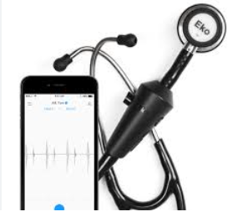

Outline: What is a Digital Stethoscope?
In December 2016, Eko devices introduced digital stethoscopes in the UK market, and AI-powered rollouts came in 2023 (Eko Health, 2025).
Improves and records auscultation.
The AI feature can detect unusual heartbeats.
Sharing data safely
Links to online records.
Traditional Vs Digital Stethoscope
Notes:
Digital stethoscopes are different from regular ones because they can use AI to help with consultation, allow users to listen to recordings, and allow doctors to consult from a distance. According to Topol (2019), using AI tools to help doctors can make their diagnoses more accurate. With this technology, patients can get professional advice at home.

Slide 4

Where and how can a digital stethoscope be applied?
Visits to people’s homes in the community.
Checking on doctors and specialists online.
Heart failure and checking for atrial fibrillation (AF)
Test Projects for Coordinated Health Services
A Nurse using a digital device and consulting with a GP
Notes:
Research from Imperial College London, funded by the NIHR, found that stethoscopes with AI technology help doctors in primary care better diagnose atrial fibrillation and heart failure. However, stopping work caused 70% of practices to stop, highlighting how hard it is to carry out these tasks.

Slide 5
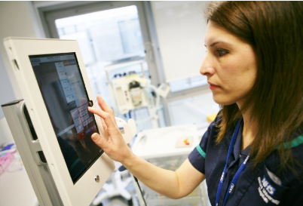
influence on Workforce
Advantages
Validation by remote specialists
Enhanced clinical assurance (Johns et al., 2023)
Efficiency and task shifting
Barriers
Stress from technology
Gaps in training
Disruption of workflow
Limitations in digital skills are a barrier
Solution is Protected CPD time
A nurse using a tablet during a visit to a patient
Notes:
Digital stethoscopes help healthcare practitioners work in collaboration and share expert advice with the community. According to Johns et al. (2023), not using technology properly in everyday tasks often causes things to fail. Time set aside for learning and organised training is very important.

Slide 6
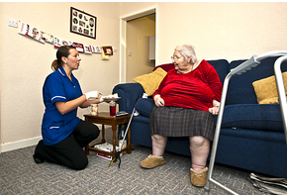
Influence on service delivery
Benefits
Care is provided to patients close to their homes
Lower travel costs
Quicker intervention (RCN, 2025)
Barriers
Problems with trusting AI (Johns et al., 2023)
Problems with keeping data private.
Even though digital stethoscopes are helpful for doctors, using them with digital systems makes people worried about unfair access to technology.
Limitation: People don't trust digital recordings much, and that makes it difficult.
Solution: Clear consent processes
An older lady receiving care at home
Notes:
Staying out of the hospital helps weak people feel better. To maintain people's trust, AI in healthcare should be clear about how it works and who is responsible for it (WHO, 2021). Adoption depends a lot on good ethics and management.

Slide 7

Critical Analysis (Balanced Perspective)
Advantages
Better diagnosis
Giving power to professionals (Dalal et al., 2021)
Supports the NHS plan for the community
Limitations
High rates of quitting
Difficulty of implementation
Workers need to be flexible.
Notes:
This invention helps NHS England move towards providing care in the community. However, growing bigger may be stopped by complicated issues with the organisation, technology, and staff because technology alone doesn't guarantee change.

Slide 8

Recommendations (Evidence-Based Pitch)
Provide online training for workers.
Add clear medical steps.
Improve how different IT systems work together.
Keep track of work tasks and test results.
Notes:
I recommend that top management focus on training the staff according to the RCN digital skills guidelines. The right way to use it should be clearly explained in simple rules. Sustainability means the need to keep checking how the workload affects things and how accurate the tests are.

Slide 9
conclusion
There is a good chance for health checks in the community.
Promotes finding problems early and reduces the need for hospital stays
Training, rules, and teamwork are important for doing well.
AI should support clinical judgment, not take its place.
Notes:
In short, digital stethoscopes are a good new tool for community nurses in the UK. However, being fair, having a ready workforce, and good leadership matter more for their value than just being skilled with technology. When brought together thoughtfully, they can enhance high-quality care focused on the patient.

Slide 10
References
Dalal, H. M., Taylor, R. S., Wingham, J., et al. (2021). A facilitated home-based cardiac rehabilitation intervention for people with heart failure and their caregivers: a research programme including the REACH-HF RCT. NIHR Journals Library.
Eko Health (2025) Eko Health Broadens Global Reach with UK Launch of AI-Powered Stethoscope Platform. Available at: https://www.ekohealth.com/blogs/newsroom/eko-uk-expansion?srsltid=AfmBOooRqb-c1O8vZ880KdwIi_3yYXhro-Hl_PgtLsrdoq-UnLbzz9Hz (Accessed: 20 February 2026).
Johns G, Whistance B, Burhouse A, et al. (2023) Benefits, challenges and sustainability of digital healthcare for NHS Wales: a qualitative study BMJ Open, 13:e069371.
NHS England, (2022) A plan for digital health and social care. Available at: https://www.gov.uk/government/publications/a-plan-for-digital-health-and-social-care/a-plan-for-digital-health-and-social-care (Accessed: 22 February 2026).

Slide 11
References
Royal College of Nursing (RCN) (2025). Digital Nursing. Available at: https://www.rcn.org.uk/library/Subject-Guides/digital-nursing (Accessed: 23 February 2026).
Topol, E. (2019) Deep Medicine: How artificial intelligence can make healthcare human again. New York: Basic Books.
World Health Organization (WHO) (2021) Ethics and governance of artificial intelligence for health. Available at: https://www.who.int/publications/i/item/9789240029200 (Accessed: 25 February 2026).

