Slide 1
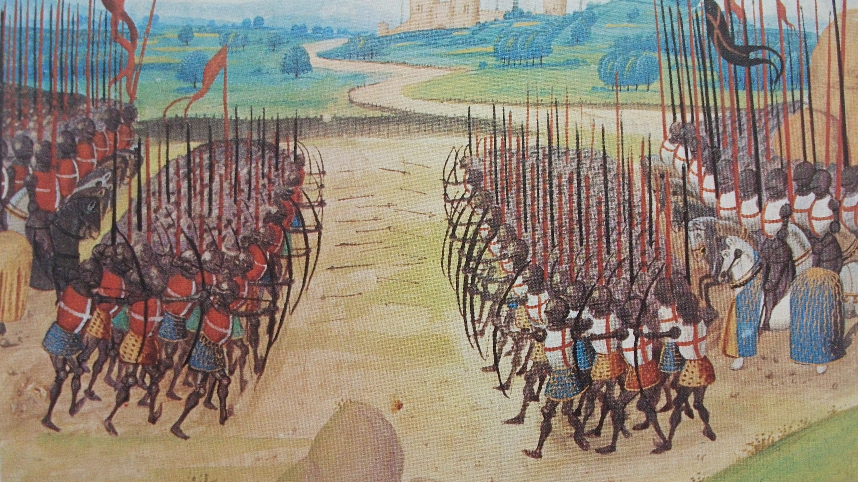
The performance of the longbow against plate armour at the Battle of Agincourt.
Alexander Nichols

Slide 2
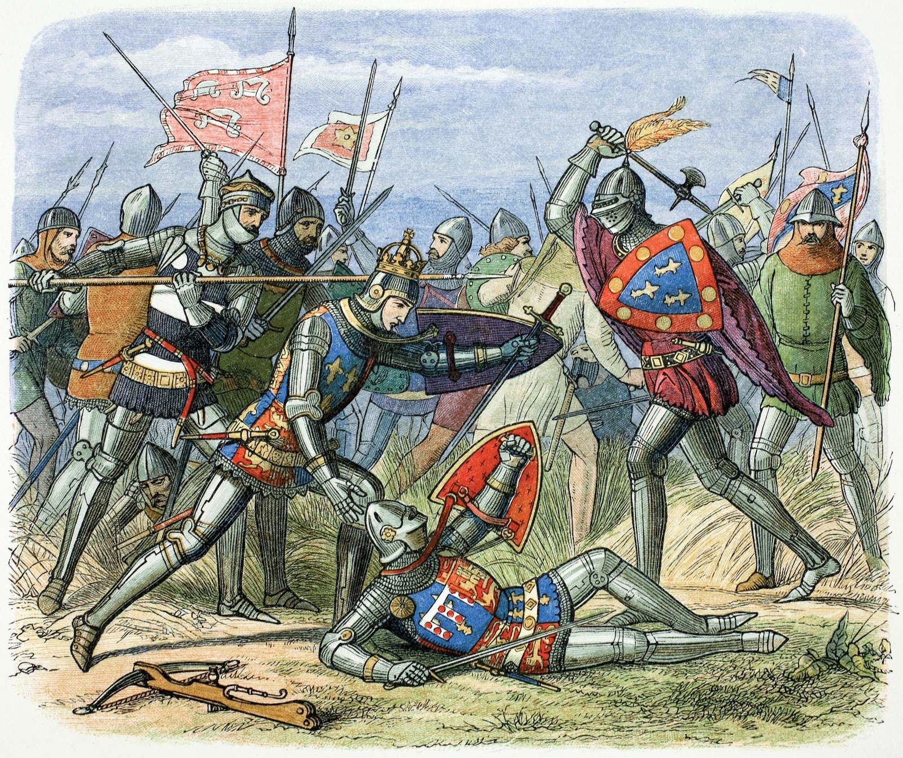
Introduction
The battle of Agincourt was part of the 100 years' war between the Kingdoms of France and England.
The battle took place on 25th of October 1415.
The battle was fought over the line of succession over the crown of France.
Despite being outnumbered the English won the battle achieving a major victory.
Notes:
Last month marked the 608th anniversary of the battle

Slide 3
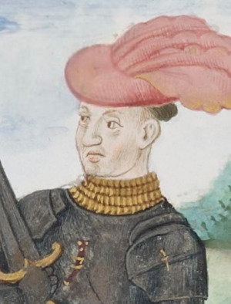

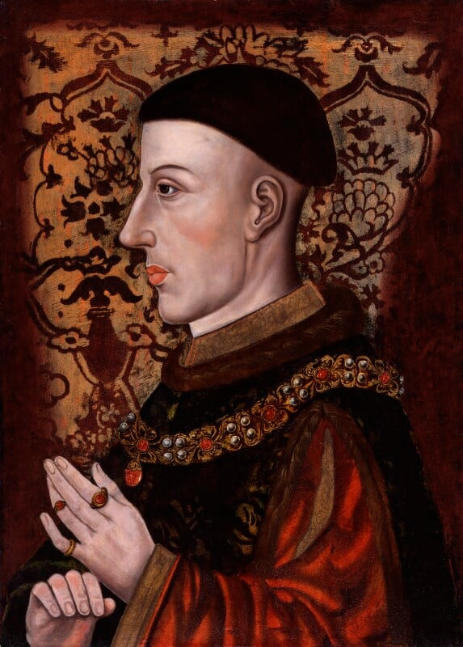
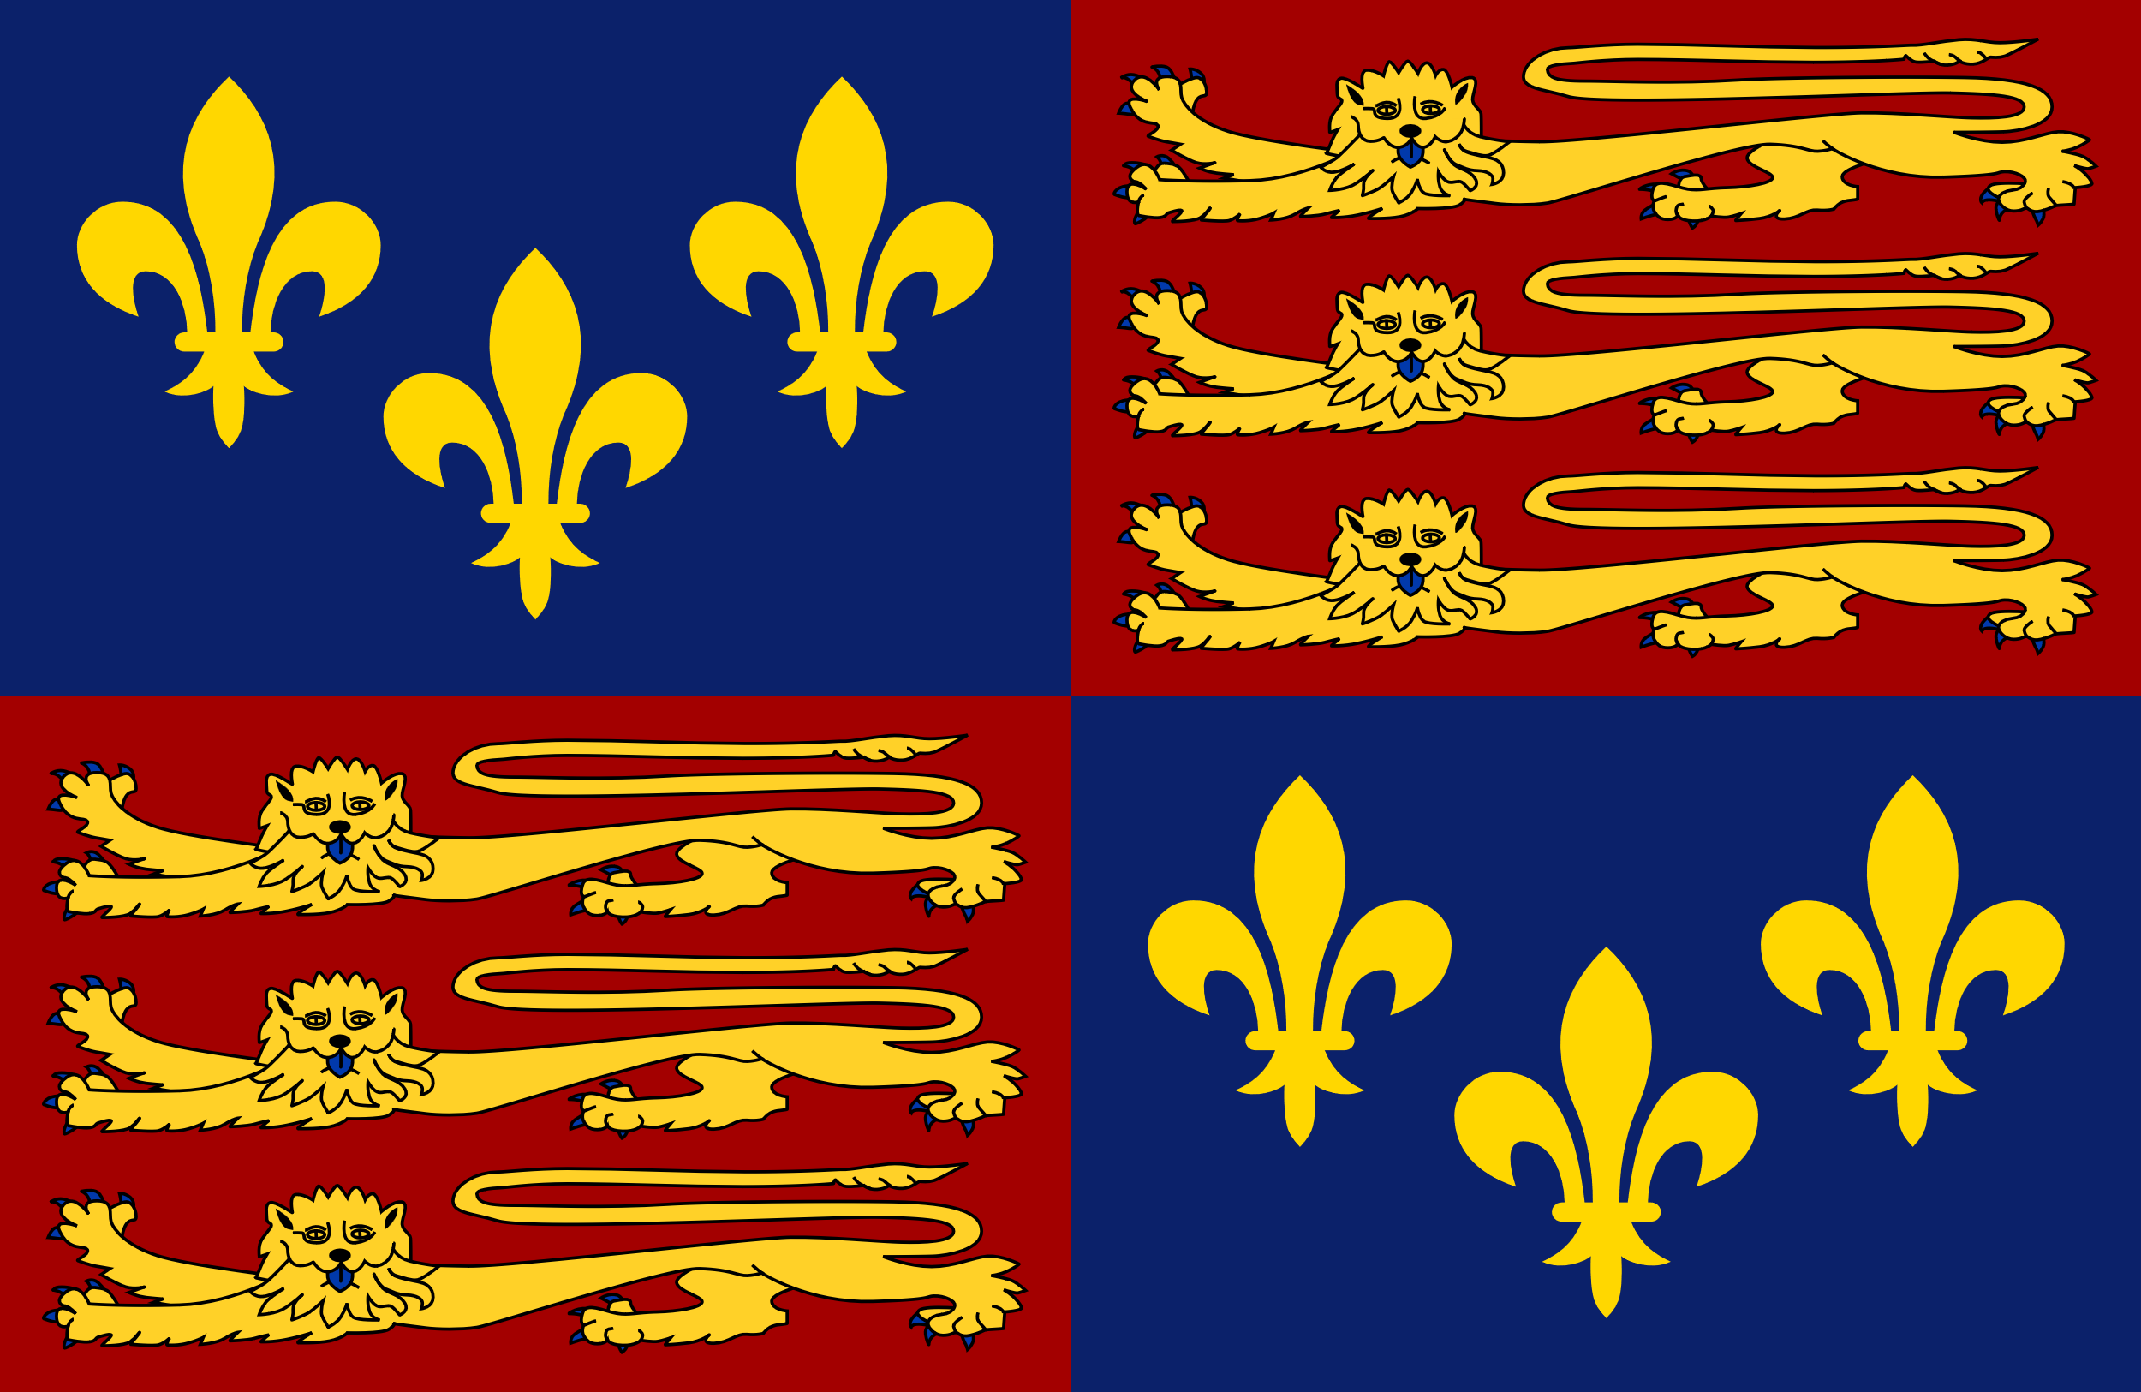
Introduction
Charles I d'Albret Constable of France
Banner of the Kingdom of France
Leading the armies during the battle was the King of England and the Constable of France.
Charles d’Albret commanded the French army in the stead of King Charles VI of France due to a psychotic illness.
Henry claimed the French crown through his great grandfather Edward III who's claim to the crown of France started the 100 years' war.
Henry V King of England
Royal Standard of England
Kingdom of France
Charles D'Albret
Notes:
Edwards Claim to the French throne was based on the King Charles the IV of France dying without any sons or brothers, this made the English king the closest living male heir however as he was related to Charles the IV through his sister and French law prevented the crown from passing through the female line. After the Death of henrys father, he was crowned king of England and re asserted the historic claim to the French throne 87 years after his great grandfather had.

Slide 4
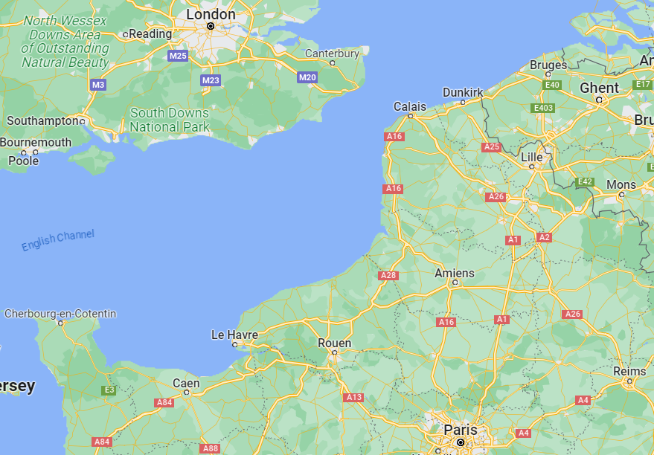
Location of the Battle
Sailing with around 12,000-16,000 men the English sailed from Southampton landing approximately 120 miles at Harfleur
The English laid Sige to the port being successful at great cost with approximately 1000 men dying in the attack and 2000 dying of dysentery.
As autumn began Henry then began to march to the English held port of Calais. Leaving a garrison to hold the port further reducing his numbers.

Slide 5
Background Information
Location of battle
After moving from Harfleur Henrys army was blocked from crossing the river Somme and had to move around the French force.
Approximately 30 miles south of Calais English scouts informed Henry that the French army had blocked the road to Calais.
The French had taken up position near the village Agincourt where the battle would take place
Notes:
During the march, the French force blocked henry from crossing the river and followed the army until the English managed to get ahead of the French and cross the Somme.

Slide 6
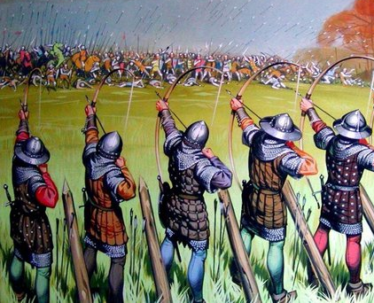
Composition of the armies
The exact size of both armies is still debated however most sources agree roughly on the following.
English Army
6,000 - 9,000 Men total.
900 - 1,500 Men-at-Arms.
5,000 - 7,000 Longbowmen.
Additional unarmed servants
French Army
15,000 – 25,000 Men total.
10,000 Men-at-Arms.
4,000 – 5,000 Crossbow and Archers.
Up to 10,000 Armed servants.

Slide 7
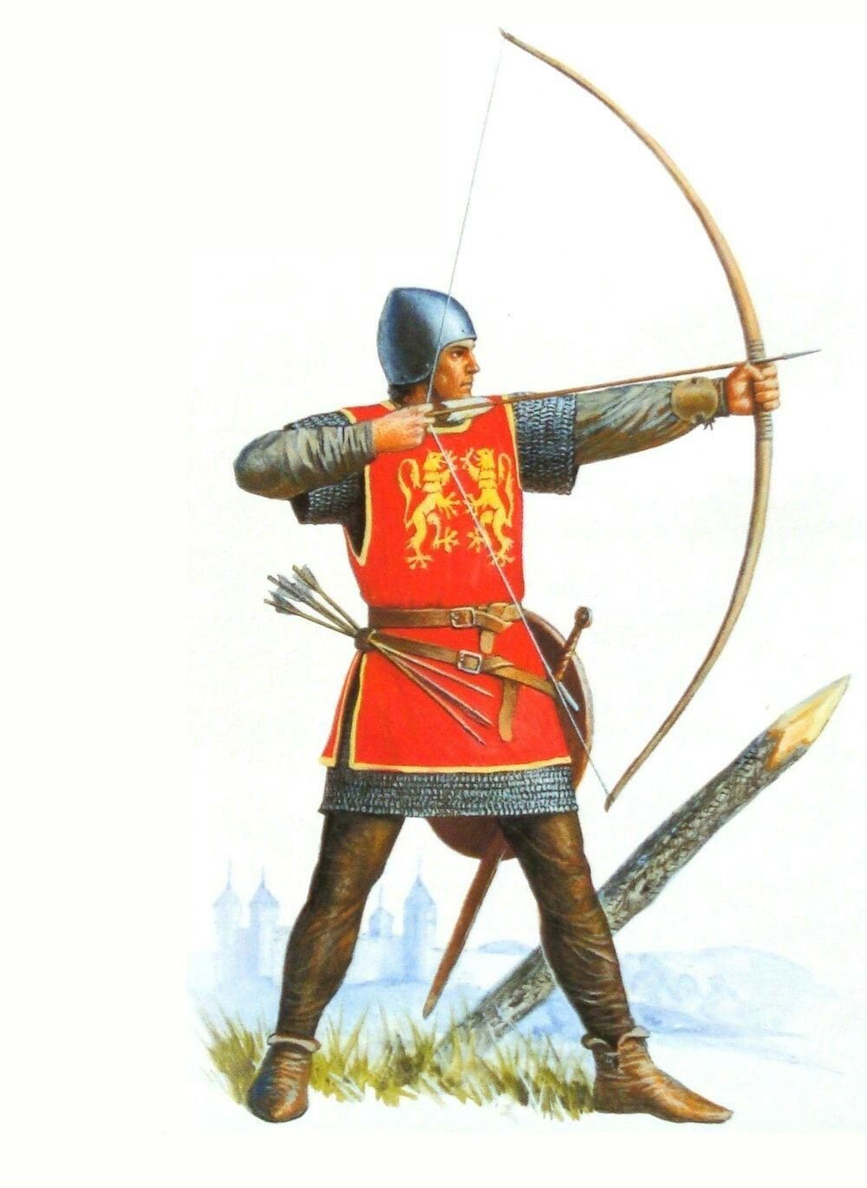
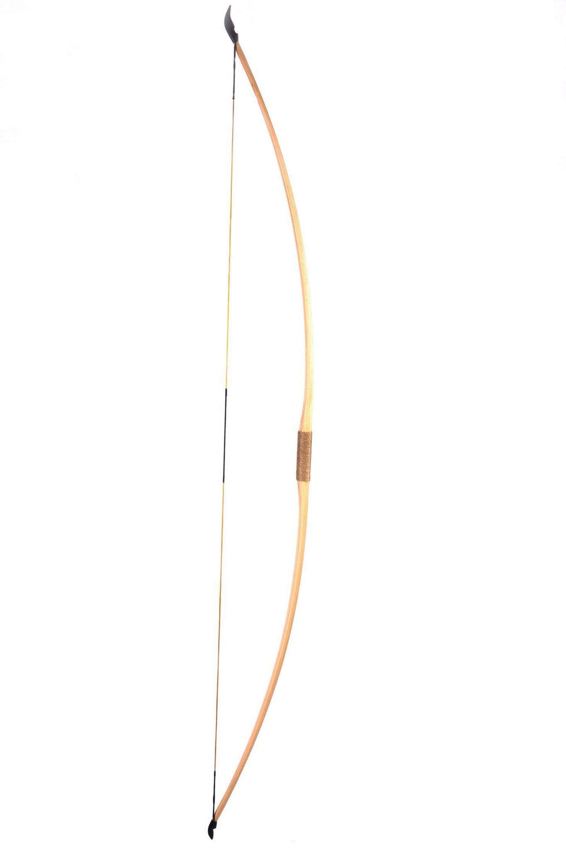
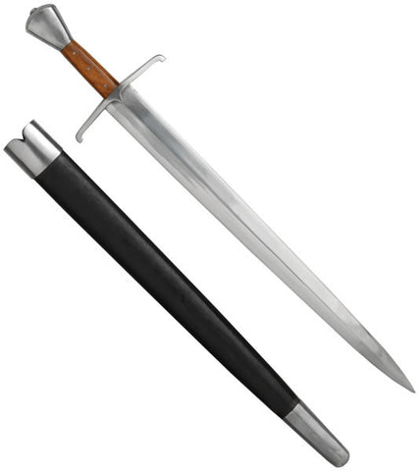
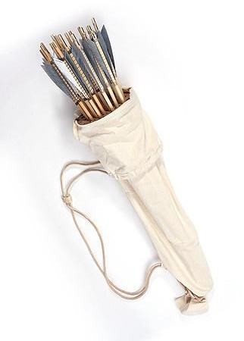
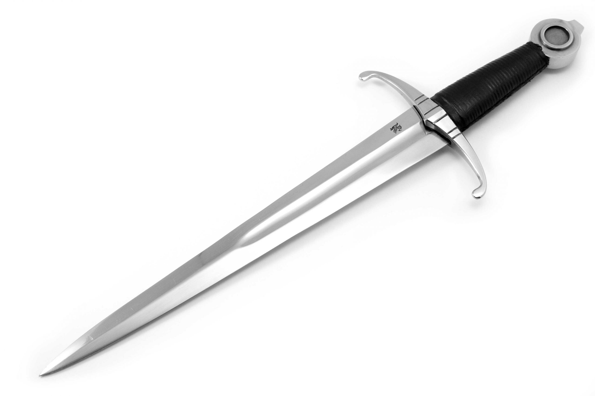
Weapons used
Longbowman
English Longbow and Arrow Quiver
Sword and Dagger
Notes:
Along with these weapons longbowmen could have also carried other small weapons such as axes and clubs which were used to hammer in the wooden stakes before the battle. Used by both sides

Slide 8
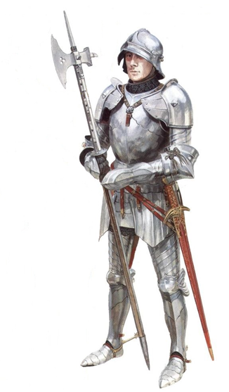
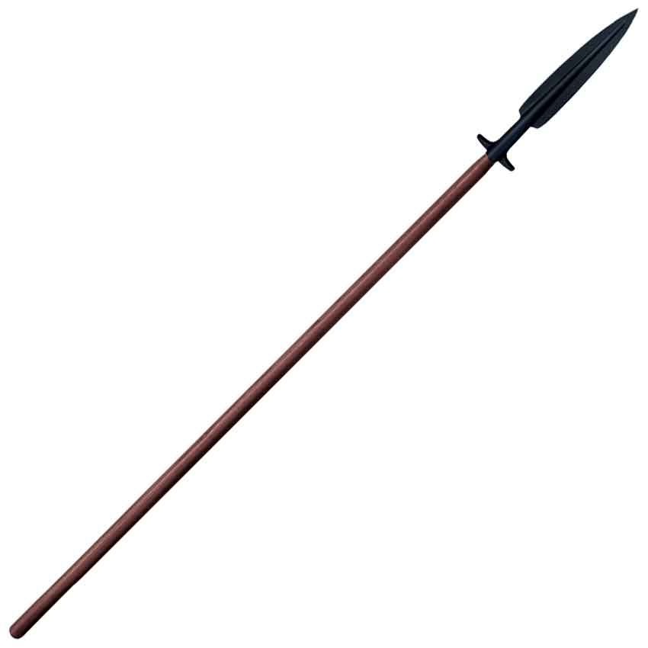
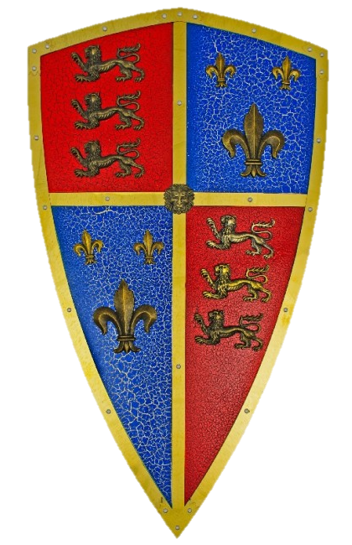
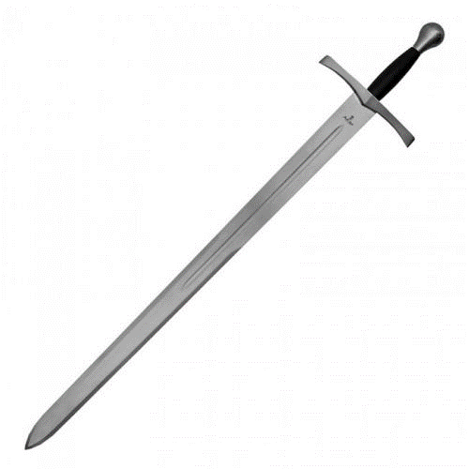
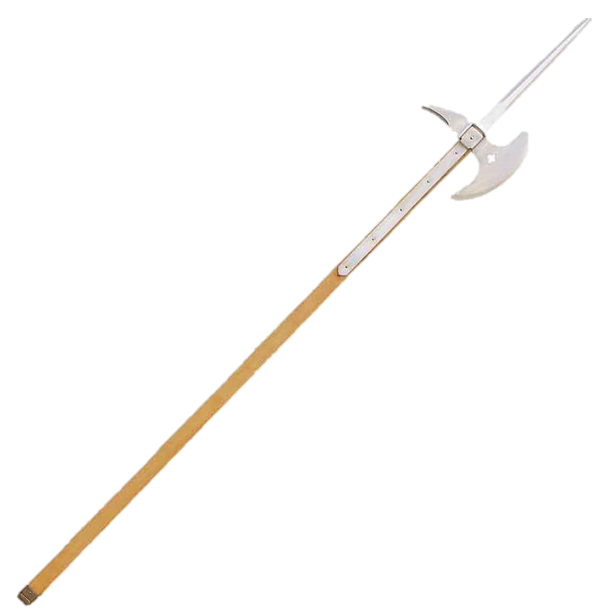
Weapons used
Men-at-Arms and Armed Servants
Poleaxe and Spear
Sword and Shield
Notes:
Men-at-arms, knights and other foot soldiers such as armed servants would have all carried similar weapons with quality depending on wealth, poorer solider were less likely to use large swords an instead used pole arms such as halberds and pole axes. Other weapons used would include maces and battle axes. Used by both sides.

Slide 9
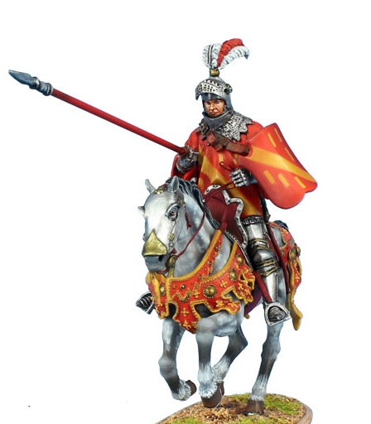
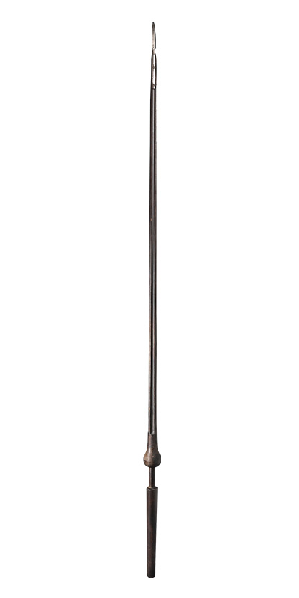
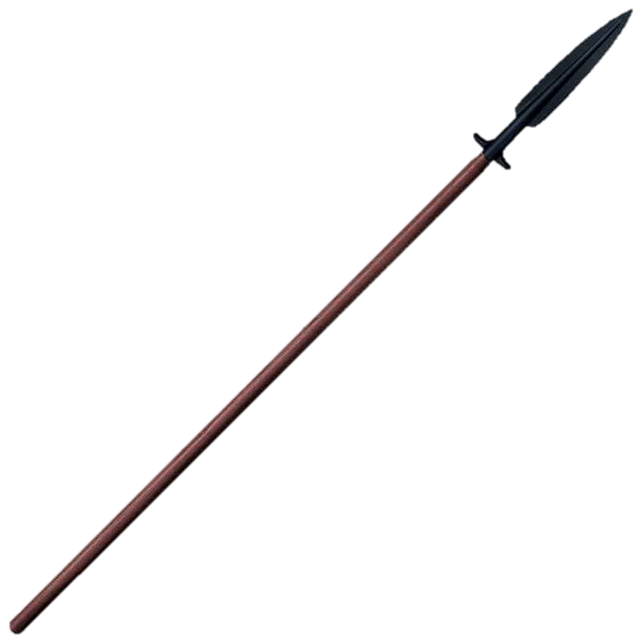
Weapons used
Cavalry
Lance and Spear
Sword and Shield
Notes:
Cavalry used long lances and spears unlike jousting lances they had sharp mental heads before switching to swords. Only used by French in this battle

Slide 10
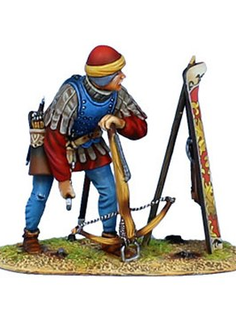
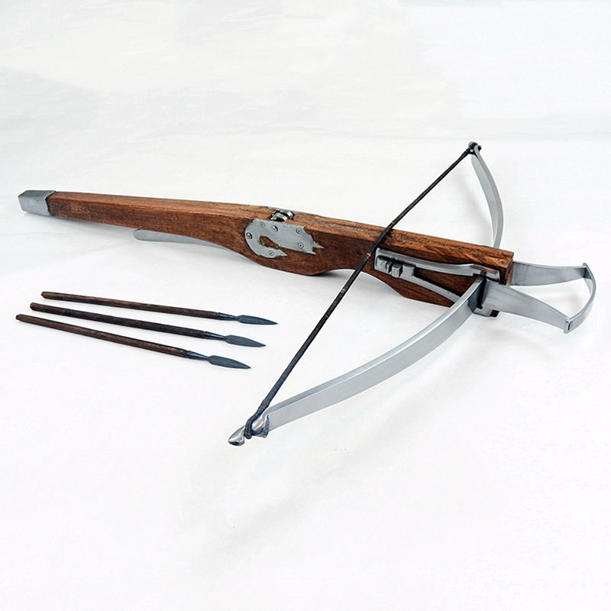
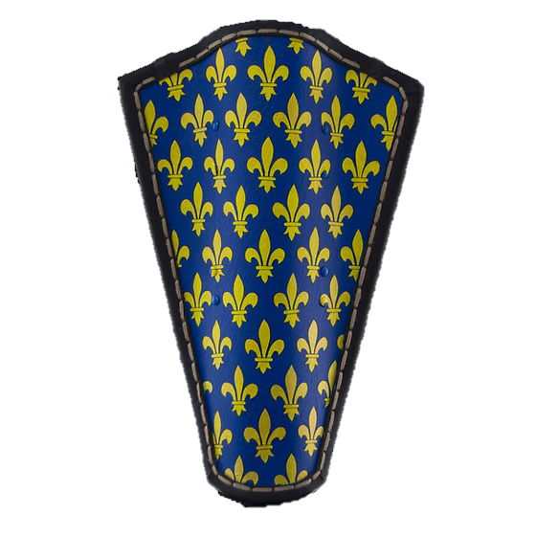
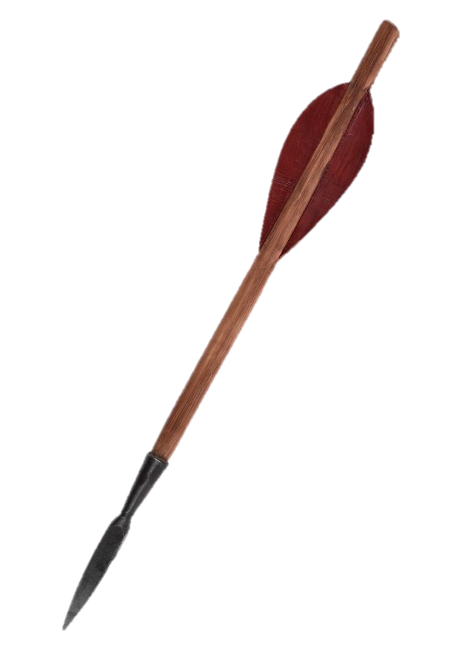
Weapons used
Crossbowmen
Crossbow and Bolts
Sword and Pavise Shield
Notes:
Crossbows used shorter projectiles then longbows and had less distance, the shield these crossbowmen used were larger then others and could be used for cover when reloading. A crossbow is easier to use but takes longer to fire then a longbow.

Slide 11
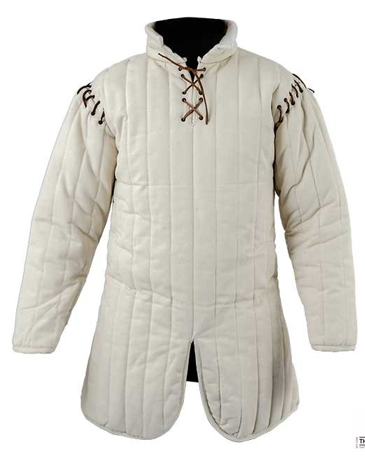
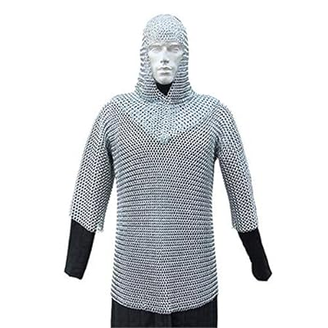
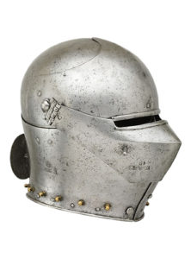
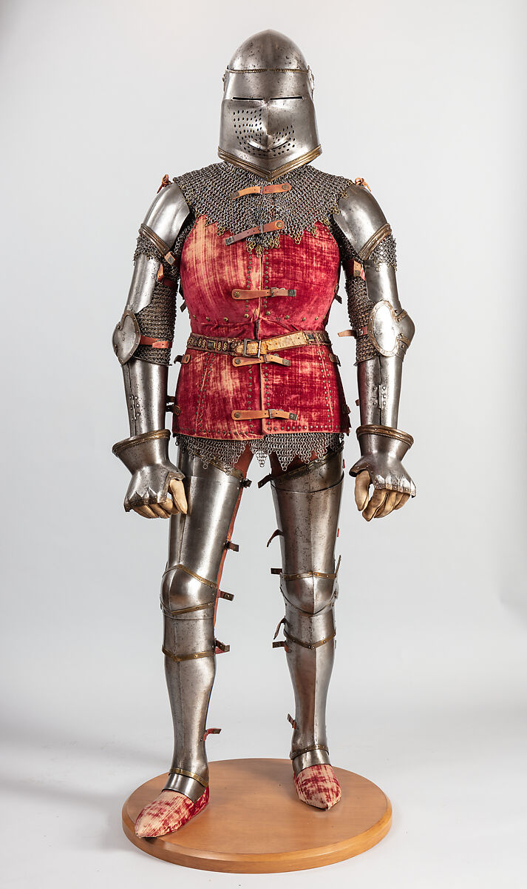
Armour used
Men-at-arms
Under Armour padding
Chainmail
Armet or bascinet Helmet
Full Plate armour
Notes:
Men-at-Arms and the armed servants that accompanied the French would have all worn similar armour to this with a richer and nobles having better plate armour then the others. All met at arms were expected to have full plate armour covering the chest, legs, shoulder and arms of the soldier.

Slide 12
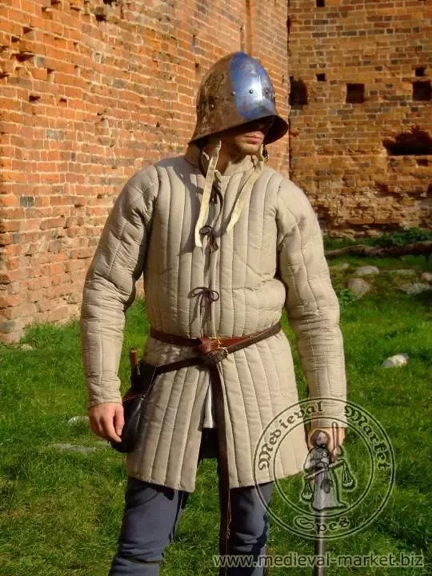
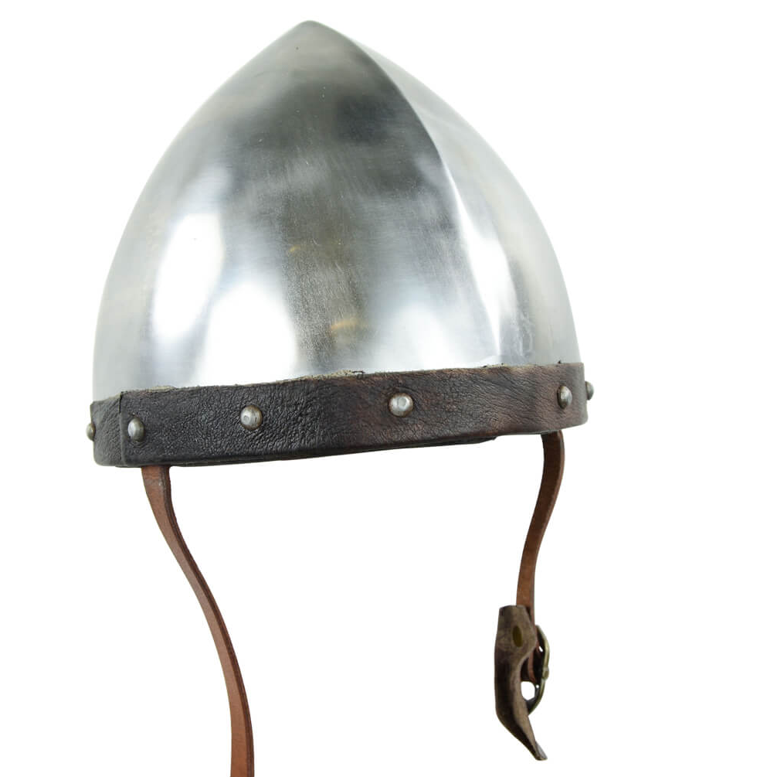
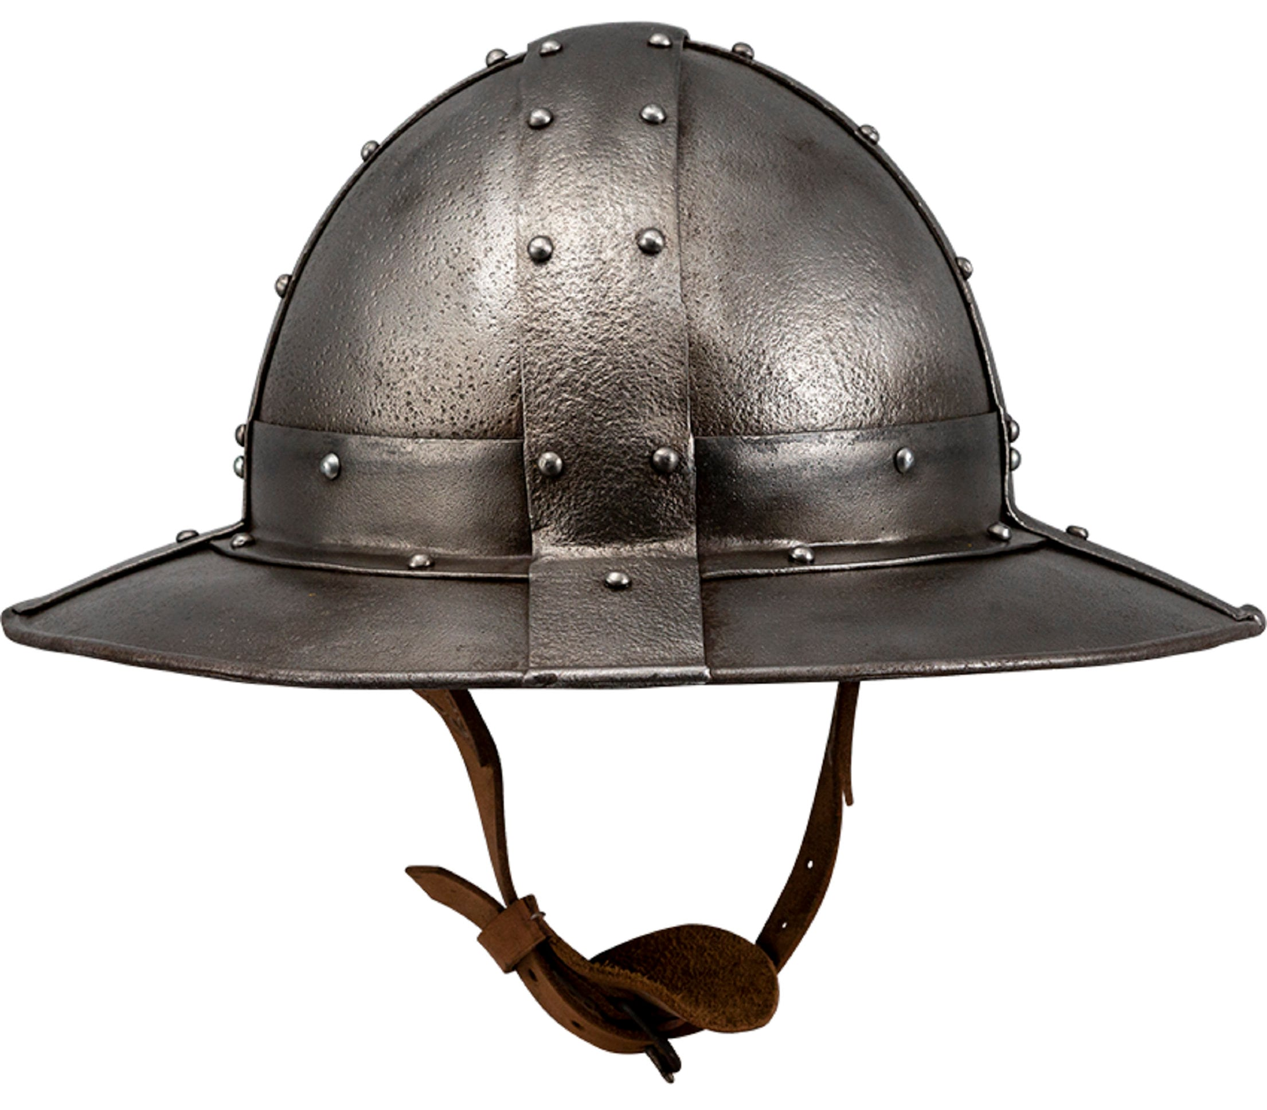
Armour used
Longbowmen and Crossbowmen
Chainmail
Over chain mail padding
Domed or Kettle Helmet
Notes:
Longbowmen and Crossbowmen would have typically worn chainmail and additional padding for a light armour that allowed movement, the domed helmet and kettle helmet also offered protection while giving better visibility.

Slide 13
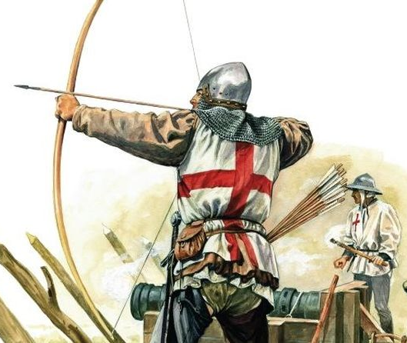
Influence of the longbow
The English longbow was just over 6ft in length Had a draw weight of over 140lbs.
The English trained from the age of 7 to fire the longbow and Carried around 24-72 arrows to the battle.
They could Fire an arrow every 5 seconds compared to a crossbow 1 bolt every 2 minutes.

Slide 14
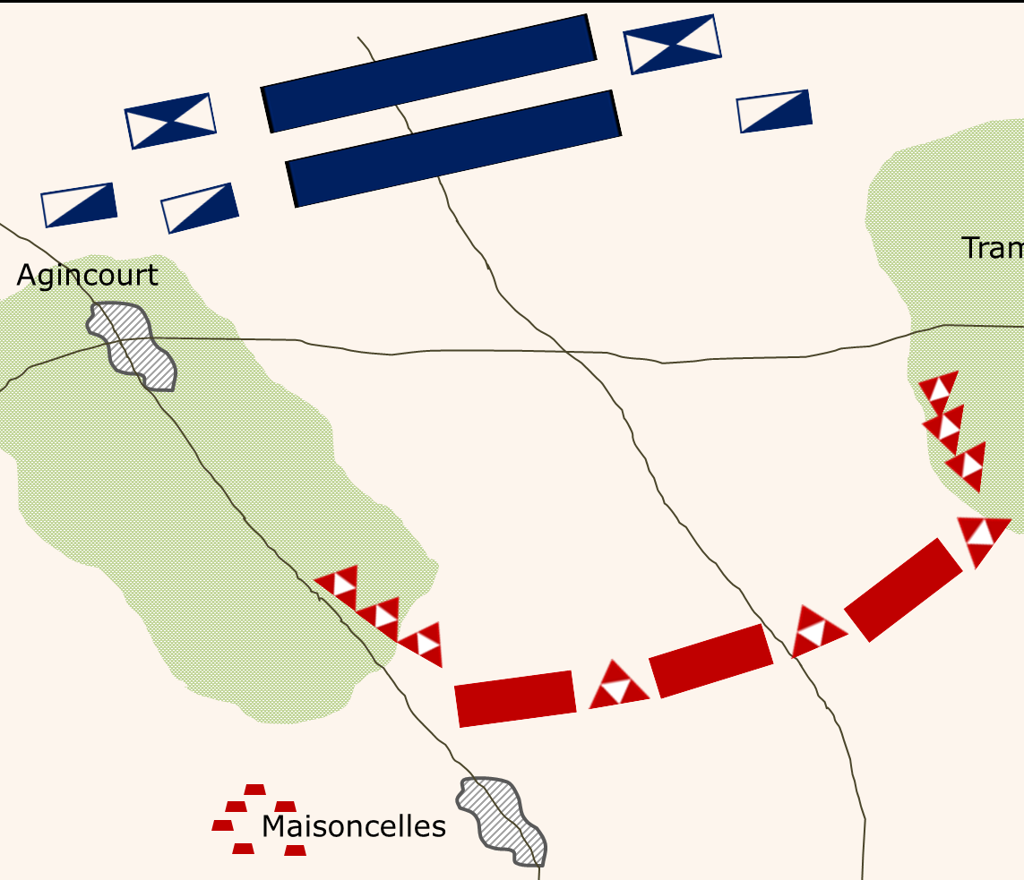
Layout of the battle
English formations
Finding themselves at the bottom of a hill the English places their Men-at-Arms in the centre shoulder to shoulder rows deep.
The English archers took position on the flanks of the centre and hammered wooden stakes Infront of them.
The baggage train containing supplies stayed behind the army.

Slide 15
Layout of the battle
French formations
The French had taken position on top of a hill waiting for the English to arrive.
Because of the narrow field surrounded by woods the French could not use their full number instead breaking into 3 battle groups.
The French vanguard at the front had about 4,800 men, the main battle group 3,000, and a cavalry force of around 1,000 men.
Because of the limited space the French moved remaining troops to the rearguard including the crossbowmen as they were seen as unnecessary.
Notes:
The army sent to the rear guard had no clear leadership as it was assumed the first two lines would be sufficient, the plan was originally to have archers and crossbowmen on the flanks of the main force however there was not enough space. The French also sent a small force to attack the baggage train of the English from behind.

Slide 16
Battle Overview
At the start of the battle Henry leading the English from the centre ordered his army forward and stopped when the longbowmen were in range.
The French then attempted to defeat the English longbowmen with cavalry however they were blocked by the wooden stakes.
The English longbows were not effective against plate armour of the cavalry however the horses were easily killed.
This resulted in a failure of the charge with many riders being crushed or thrown from their horses. With many horses running back to the French lines causing chaos.

Slide 17
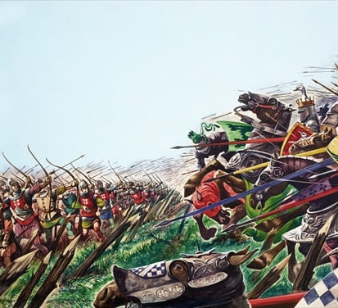
Battle Overview
The French vanguard force then began advancing however the freshly ploughed clay field quickly turned into deep mud due to heavy rain from the previous 2 weeks.
As the French forced advanced they quickly became tired all the time being pelted by thousands of English arrows.
The French vanguard wearing heavy armour was exhausted by the time they reached the English lines and were then engaged by the English Men-at-arms.
In the opening minute of the battle, it was estimated the English fired 60,000 arrows.

Slide 18
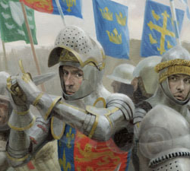
Battle Overview
While the French plate armour offered great protection against arrows there were weak points around the shoulders and groin.
The French Men-at-Arms were forced to pull the visors of their helmets down to protect their face making visibility poor.
Because of these there is reports that many French drowned in the mud after failing and being unable to get up.
After the English longbowmen had exhausted their supply of arrows they then join in the fight with melee weapons.

Slide 19
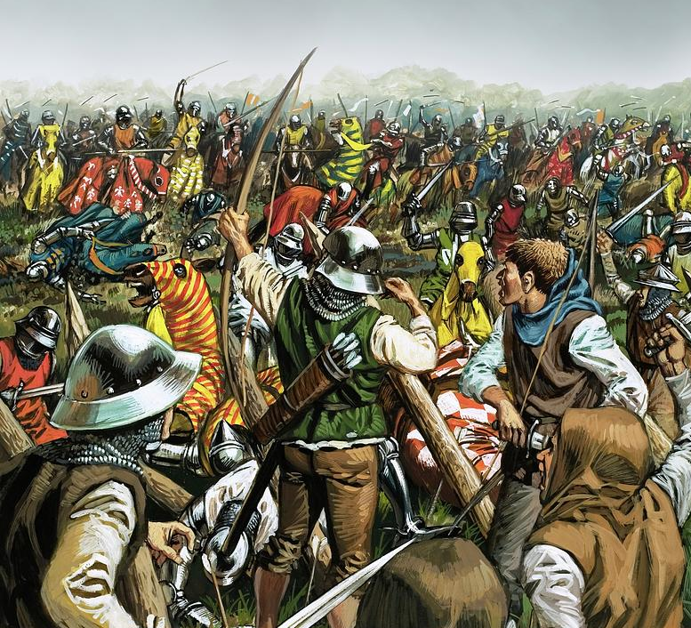
Battle Overview
The English archers had much less armour on and could therefore move much quicker than the French Men-at-Arms
The main battle group tried to join in the battle however because of the limited space they were unable to reach the English and added to the crush of the other French troops.
At this point, the battle had turned in the favour of the English and many surrendered.
At this point a small force then attacked the English baggage train which lead henry to order the execution of many French prisoners. This led to a French retreat.

Slide 20
Battle outcome
After the French retreat Henry ordered the executions of prisoner stop with most estimates being around 200 prisoners executed.
The French had suffered a major defeat with around 6,000 men lying dead on the field.
To add to this major loss the commander of the French army and around 100 great lords had been killed.
Because of the nobles fighting many of the future leaders of France had been killed.

Slide 21
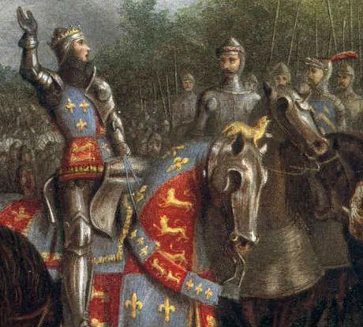
Battle outcome
In comparison it is estimated that the English army had only suffered 400 deaths.
This allowed Henry to continue his march to Calais returning to London.
In the following years henry returned to France and signed a treaty with the king making him hair to the French throne and marrying the Kings daughter.
However, Henry would never claim the throne as soon after he died soon after and his son was then crowed King of France and England.

Slide 22
Factors for victory
Terrain
English Longbows
Longbowmen
The terrain of the battle prevented the French from using their greater numbers.
The woods surrounding the battlefield allowed the English conceal some of their archers.
The muddy field gave weakened the heavy armoured French.
The English Longbows superior range allowed them to force the French to attack.
The faster firing time allowed for the French to be overwhelmed.
The Longbow with the bodkin arrows allowed for poorer quality plate armour to be defeated and any light armoured soldiers.
The longbowmen themselves were used to great effect with lighter armour being able to attack the exhausted French men at arms.
The cavalry attacks could have changed the entire battle but were stopped by the longbowmen using wooden defensive steaks.

Slide 23
French Errors
Overconfidence
Lack of leadership
Poor battlefield
The French by some sources were already celebrating victory before the battle as they assumed it would be easy.
Many French troops including all archers and crossbowmen were left at the back lines unable to fight as they were deemed unnecessary.
The French nobles all sought glory and pushed to the front of the vanguard disrupting formations.
Organising the army took too long resulting in not all the cavalry charging.
The rearguard troops had no leadership structure and could not effectively join the battle.
The French chose a poor battlefield waiting for the English on a field too small to use their full numbers.
The freshly ploughed field after 2 weeks of rain should have been avoided due to the risk of deep mud.

Slide 24
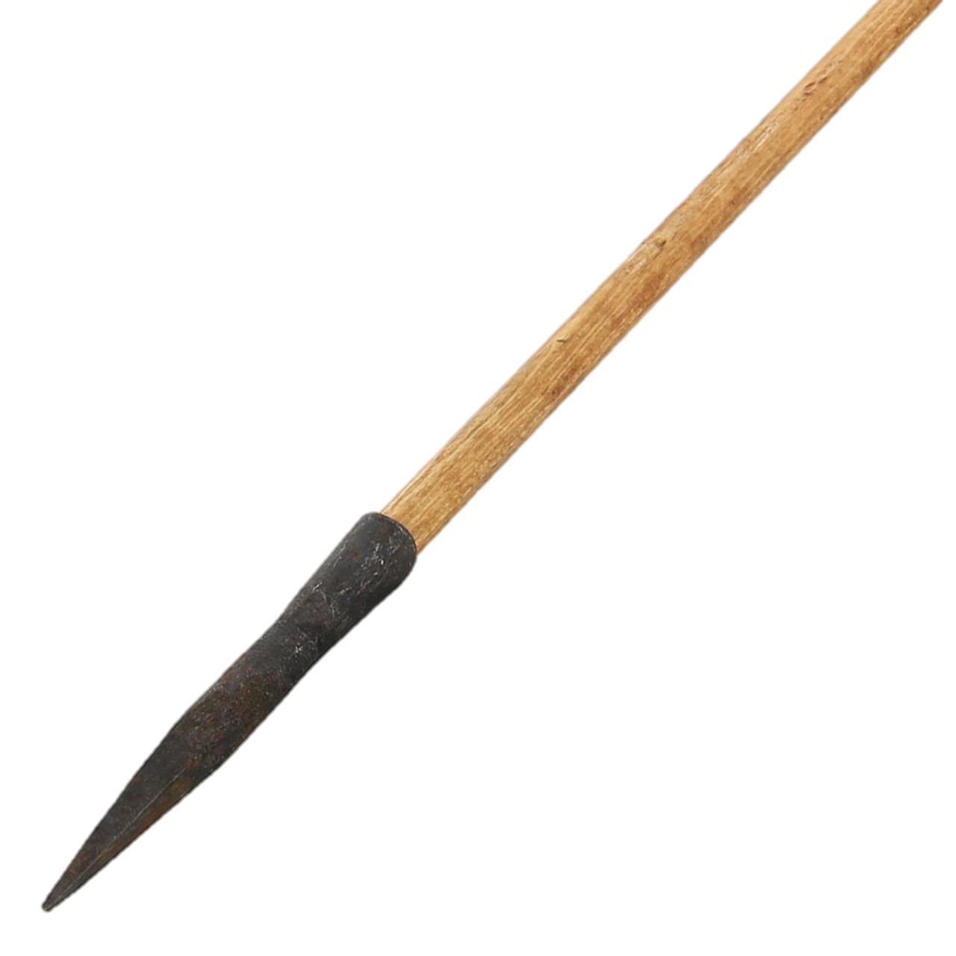
Calculations
Rate of fire
Because English longbowmen carried around 24-72 arrows into battle and could fire them at a rate of 1 every five seconds, we can calculate the following.
Higher Estimate of Longbowmen 7,000
504,000 arrows
6 Minutes firing time
Lower estimate of Longbowmen 5,000
120,000 arrows fired
2 minutes of firing
Notes:
Might not fire at full speed all the time so could be up to 10 minutes before joining the fight.

Slide 25
My opinion
Use of Longbowmen
Narrow Terrain
Overconfidence
The longbowmen forced the French to advance and stopped the cavalry charge.
Could not easily kill a well armoured Man-at-Arms but from shear number some weak spots would be found.
Lightly armoured attack after the initial charge was crucial to victory.
Allowed the English longbows to be used to full effect.
Prevented the English from being flanked.
Prevented the greater French numbers from being used.
The fight was assumed to be easy, and a poor plan was made.
All of the nobles pushing to be at the front disrupted French lines.
Not using French archers and crossbows was a major mistake.
With most of the nobles at the front there was nobody to lead the army when they were killed.

Slide 26
Summary
The battle of Agincourt was a complete disaster for the Kingdom of France.
English longbowmen played the most important part of the French defeat.
While the Bodkin arrow could not penetrate Most plate armour poorer quality armour and weak spots could be exploited.
The overconfidence of the French and the poor planning was also a key part to their defeat.

Slide 27
References
Medieval Lance,” medievalbritain.com, [Online]. Available: https://medievalbritain.com/type/medieval-life/weapons/medieval-lance/.
J. Barker, Agincourt the King the Campaign the Battle, ABACUS, 2006.
Britannica, “English longbow,” [Online]. Available: https://www.britannica.com/technology/English-longbow.
Dispelling Some Myths: Would Mediaeval archers really shoot 12 arrows a minute?,” Tastes Of History, [Online]. Available: https://www.tastesofhistory.co.uk/post/dispelling-some-myths-archers-shooting-twelve-arrows-a-minute.
The Longbow and its Impact on the Battle of Agincourt,” kingjohn, [Online]. Available: https://kingjohnshouse.org.uk/the-longbow-and-its-impact-on-the-battle-of-agincourt/.
British Battles, “Battle of agincourt,” [Online]. Available: https://www.britishbattles.com/one-hundred-years-war/battle-of-agincourt/
C. Johnston, “Anniversary of the Battle of the Agincourt,” 18 10 2021. [Online]. Available: https://www.veteranshearing.org.uk/news/anniversary-of-the-battle-of-the-agincourt/.

Slide 28
Any Questions

