Slide 1
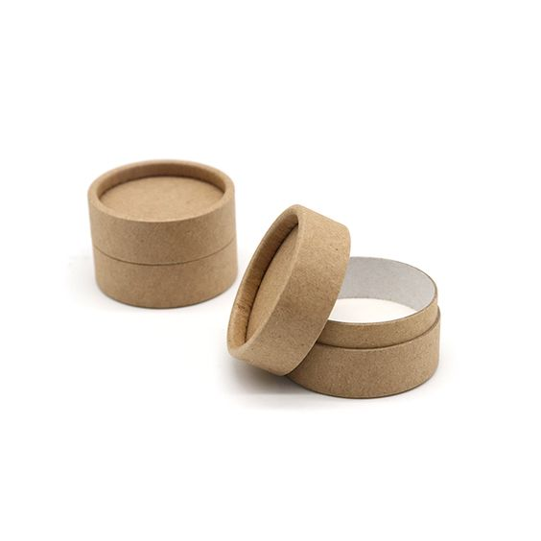

Eco Blend Beauty Pods: Revolutionizing Sustainable Beauty
Student Name: Roxana-Ioana Ciubotariu
Student ID:2115139
Modul Name: Development of innovative
product OR unique service
proposition
Code Module:BMSW6102
Lecturer Name: Rexon Nting
Date:11/12/2023

Slide 2
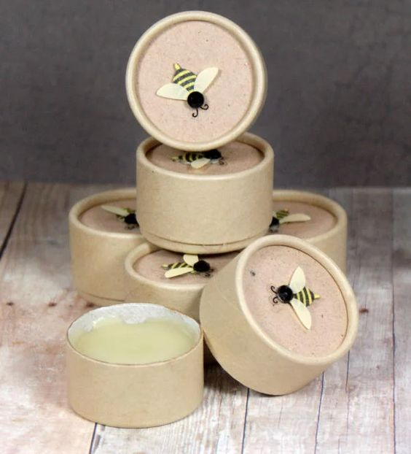
Eco Blend's Mission in Sustainable Innovation
Brand Essence:Enter Eco Blend's core mission
Values at the forefront
Sustainable Beauty Impact
Catalyst of Innovation
Customer-Centred Focus
Visual appeal

Slide 3
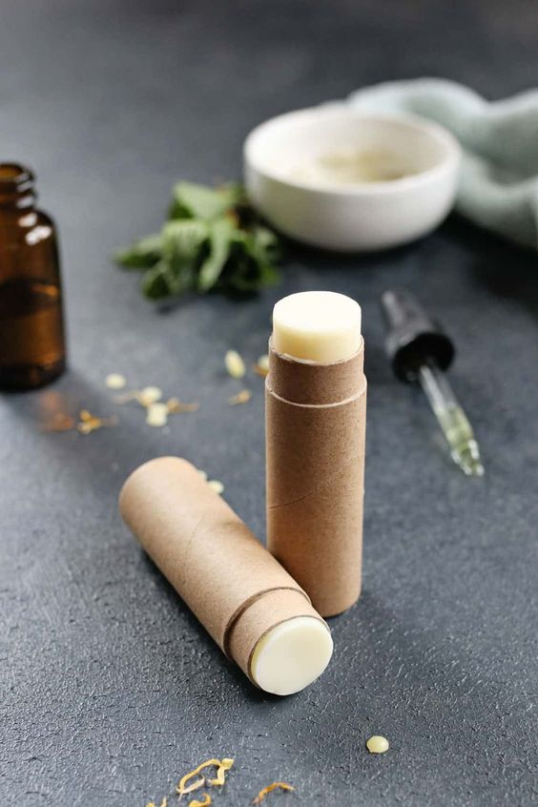
EcoBlend Beauty Pods: Creating beauty, redefining the standard
Bio-Compatibility Brilliance:
Customization Unleashed
Beauty Pod Printer Revolution
Innovative Ingredients
Visual appeal
User-friendly interface

Slide 4
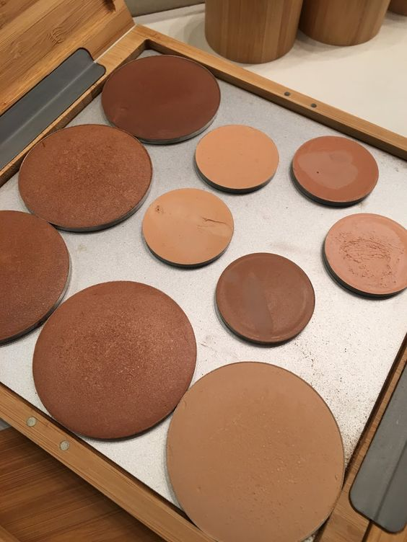
Privacy : Eco Blend's commitment to excellence in data protection
GDPR Compliance Framework.
Data Protection Act 2018 Facts
PECR Compliance Snapshot
Customer-Centric Consent
Opt-out Mechanisms
Ensuring the right to erasure
Security Fortifications.

Slide 5
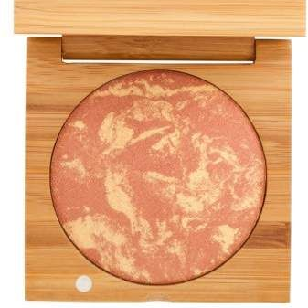
Marketing Strategy
Identify target customers: environmentally conscious, tech-savvy individuals.
Strategies for social media (Facebook), paid search (Google) and influencer collaborations.
Emphasize community building and educational content

Slide 6
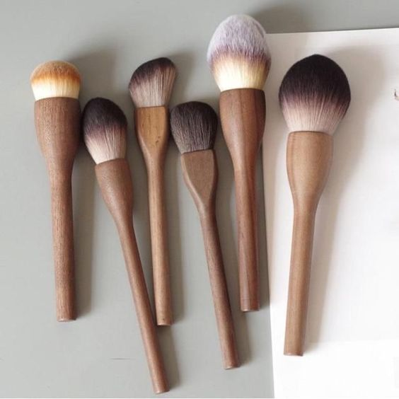
E-Commerce Platform
Discuss online platform features and user experience.
Highlight personalized recommendations, eco-friendly practices, and the Beauty Pod printer.

Slide 7

Environmental engagement
Detail eco-friendly packaging, sustainable practices, and partnerships with environmental organizations.
Highlight your contributions to environmental causes

Slide 8
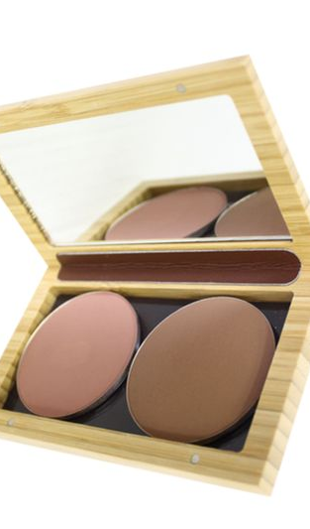
Customer Journey
Discuss the customer journey from awareness to acquisition and advocacy.
Focus on personalization and engagement at every stag

Slide 9
Constant innovation
Emphasize the importance of continuous innovation in product development.
Feature partnerships and collaborations with experts in the beauty and sustainability industries.

Slide 10
Culminating and connecting : embracing the future with Eco Blend
Eco Blend's commitment to sustainable innovation, bio-compatibility, and personalized beauty experiences.
Eco Blend through social media, encouraging likes, shares, and participation in community discussions.
Feedback to continually improve and refine Eco Blend's offerings based on customer preferences and evolving industry trends.
Provide clear and accessible contact information for customer inquiries, collaborations, or partnership opportunities.
Includes email addresses, customer support details, and relevant contact persons.
Feature links to Eco Blend's social media profiles, directing the audience to stay connected, follow updates, and participate in online communities

Slide 11

Thank You!
Any Question?

Slide 12
Reference
Rocca, R., Acerbi, F., Fumagalli, L., & Taisch, M. (2022). Sustainability paradigm in the cosmetics industry: State of the art. Cleaner Waste Systems, 3, 100057. https://doi.org/10.1016/j.clwas.2022.100057
Soegoto1, D. S. (2018, November 1). IOPscience. IOP Conference Series: Materials Science and Engineering. https://iopscience.iop.org/article/10.1088/1757-899X/434/1/012164
Lord, E. (2022, October 20). Privacy policies for Ecommerce stores. Free Privacy Policy. https://www.freeprivacypolicy.com/blog/privacy-policy-ecommerce-stores/
Spotify marketing strategy: How Spotify won the market by vouching for “music for everyone.” buildd. (n.d.). https://buildd.co/marketing/spotify-marketing-strategy
11 best ecommerce platforms for your business in 2024. Shopify. (2023, November 23). https://www.shopify.com/blog/best-ecommerce-platforms
Pin by Sofia Bolino on make up: Eco Makeup, organic makeup, clean makeup. Pinterest. (2022, July 28). https://www.pinterest.com/pin/make-up--3096293487057712/
Riley, J. E. (2009). The eco-narrative and the enthymeme: Form and engagement in environmental writing. Interdisciplinary Literary Studies, 10(2), 82–98. https://doi.org/10.2307/41210021

