Slide 1







SIX PANEL DMAIC Project Review
Energizer label supply optimisation and management
Energizer
 |  |  |  | Project Charter
 |  |  |  | Problem Statement and area of Opportunity
 |  |  |  | Currently, the business continuously runs short of self adhesive labels for certain products. We currently purchase labels on an ad-hoc basis as and when required for the manufacturing plan
 |  |  |  | Business need and justification
 |  |  |  | The business needs to ensure that labels are available for the complete run and are on site prior to the run starting. Having inventory available for adapting to order priority changes.
 |  |  | Risks and Issues |  |  |  | Assumptions and dependencies
 |  |  | Failure to produce enough product to satisfy customer demand. Delays to production, not using up all surplus inventory made in preparation for the manufacture, causing choke point. Inaccurate stock recording practices showing more labels on the system than are actually available (data depends on base information being accurate i.e. GIGO) |  |  |  | Requires procurement to agree a new way of working with the label supplier. Assume that we can change to a new way of working with the supplier.
 |  | Project Ownership / Approval
 |  | Project Champion : Mark Thomas |  |  |  | Project managers : Thomas Chimes & Jamie Lee
 | Financial Benefits |  |  |  | Estimated Expenses / Investment |  |  |  | Schedule
 |  | Goal | Actual |  |  | Goal | Actual |  |  | Goal | Actual
1 | Gaining lost sales Reduce waste on Raw materials not packed | 5% |  |  |  |  |  |  | Measure | 23-Dec
2 | Profitability | 5% |  | 1 | Incremental to Operating budget | 0 |  |  | Analyse | 22-Jan
3 | Payback Period | 0 |  | 2 | Capital | 0 |  |  | Improve | 26-Feb
4 | Annual Savings | 1% |  | 3 | Other | 0 |  |  | Control | 26-Mar
1 - Becky / Laura lost sales from lack of stock |  |  |  |  |  | 1- Operating budget reduced overall (Raw material waste reduction)
2 - Ceri / Karthi for cost per product / waste |  |  |  |  |  | 2- Stock and Serve system allows for capital not held up in stock
3 - No cost immediate payback |  |  |  |  |  | 3 - N/A
4 - Lost sales + Profitability (work as %)
Notes:
Highlights several progressive potential defects and charts it along the supply chain (Methods -> Materials & Machines -> Manpower)

Slide 2
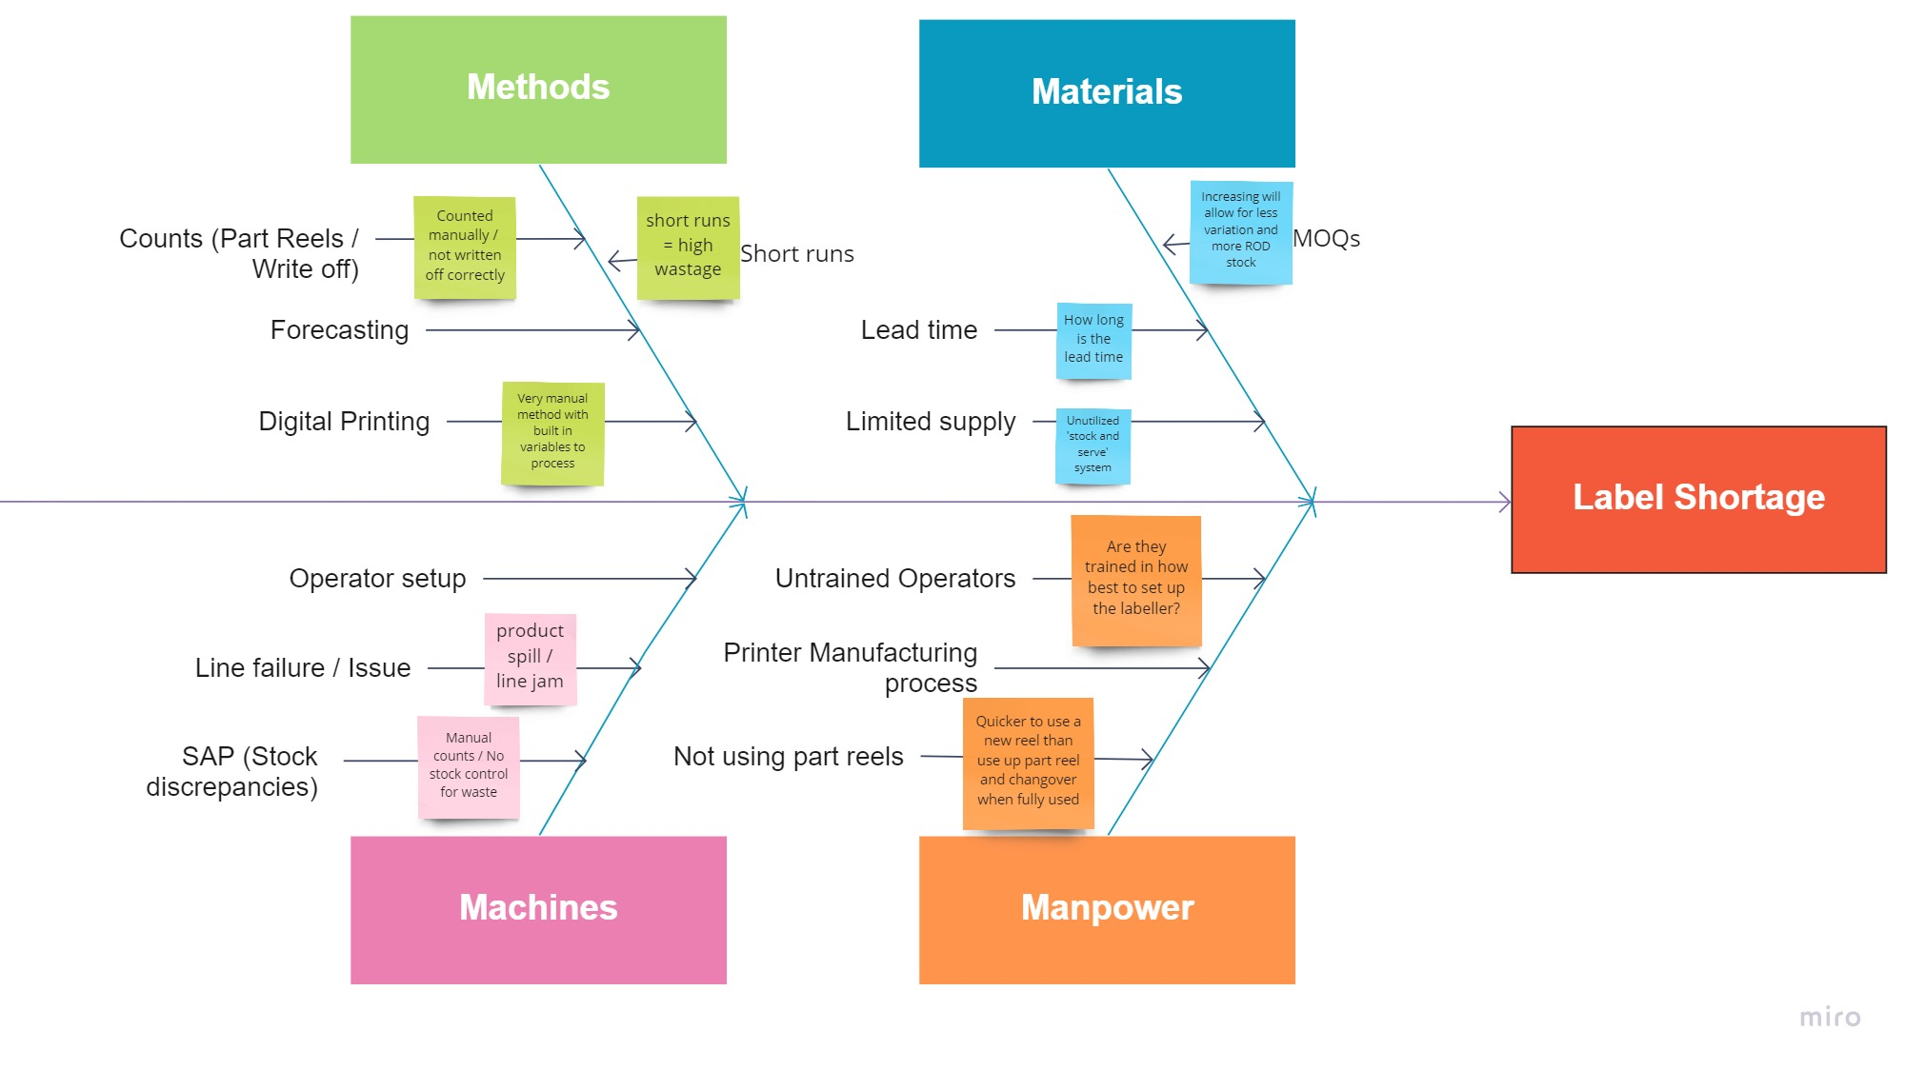
SIX PANEL DMAIC Project Review
Energizer label supply optimisation and management
Energizer
Notes:
Highlights several progressive potential defects and charts it along the supply chain (Methods -> Materials & Machines -> Manpower)

Slide 3
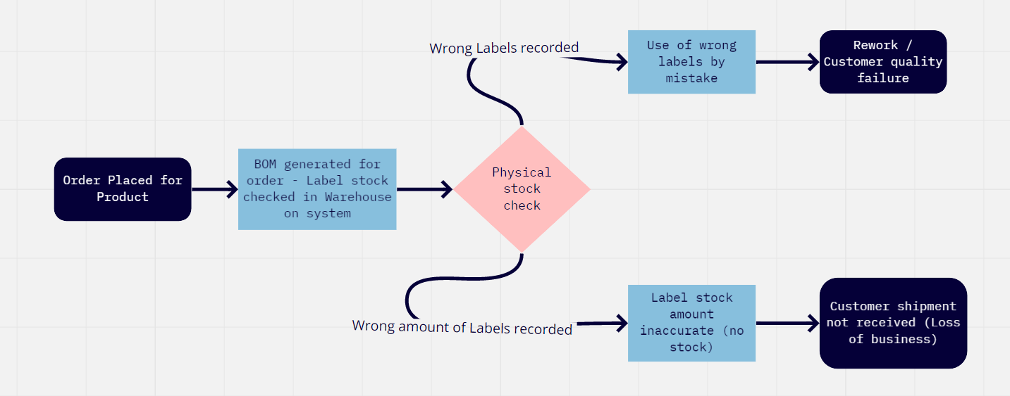
SIX PANEL DMAIC Project Review
Energizer label supply optimisation and management
Energizer

Slide 4
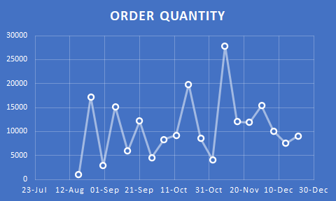
SIX PANEL DMAIC Project Review
Energizer label supply optimisation and management
Energizer
Notes:
Note the peaks and troughs in conjunction with the pareto chart below allows for an accurate picture at when the defects tend to occur that lead to missed shipments *And notes the direct loss of shipment therefore payment and customer relationship.

Slide 5
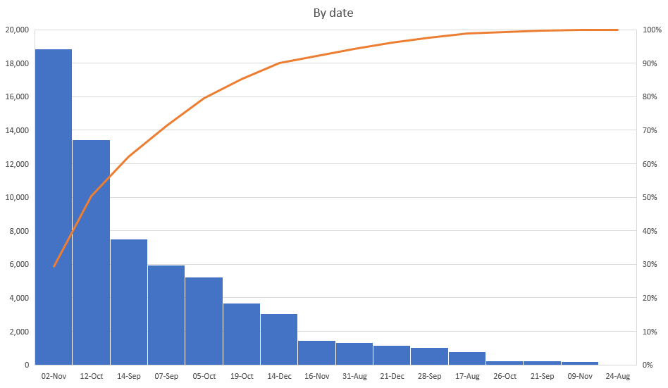
SIX PANEL DMAIC Project Review
Energizer label supply optimisation and management
Energizer
Notes:
Note – Primarily surrounding the start and mid month period, reading as the highest points of defects listed. Highlights a potential area of interest surrounding forecasting. I.e. is the forecasting done too late for the start of each months orders, only catering for a small period of time before again running short.

Slide 6
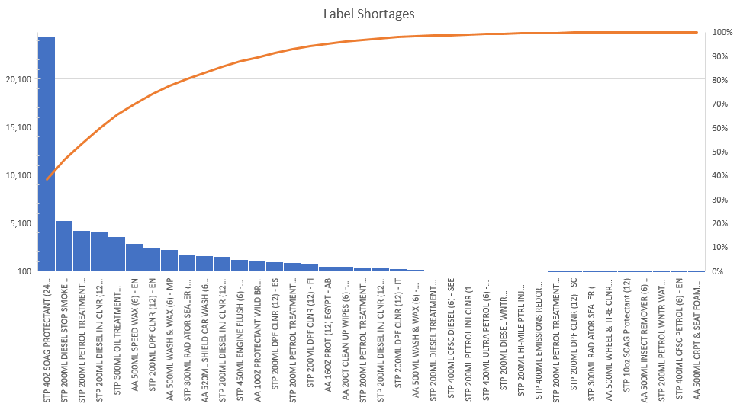
SIX PANEL DMAIC Project Review
Energizer label supply optimisation and management
Energizer
Notes:
This Pareto helps lead to the root of what product experiences this defect the most.

Slide 7
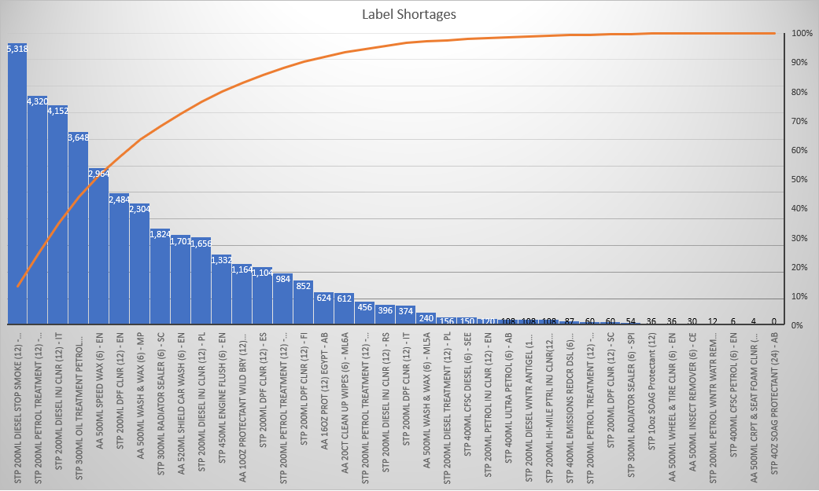
SIX PANEL DMAIC Project Review
Energizer label supply optimisation and management
Energizer
Notes:
This Pareto helps lead to the root of what product experiences this defect the most

