Slide 1










Are students confident in using technology to collaborate?
Lecturer: Mathew Brian
Module: Digital Skills and Research Methods
Module code: LCHS4002
Presented to you by
Margarita: 2211612
Shammela: 2212992

Slide 2
Introduction:
Are students confident in using technology to collaborate?
We as a group believe that not all students are confident in using all technology to collaborate due to our experience with different age group students in the classroom.
We believe that in our research we will find what the impact of technology has on student confidence levels using collaborative work. Sourced materials will be provided in the rationale.
By Shamela, Margarita

Slide 3
What is collaborative technology?
Collaborative technologies (CT) helps bring workers, remote workers and industries into a virtual teams online to execute variety of tasks (Samara, 2006). Workplaces, school colleagues and classmates from all around the world can connect and have the possibility to interact with each other, share work and the progress at any time.
For the people that collaborate through technology , a basic grasp of collaboration needs to be understood.
Know-how collaboration depends on an individual's ability to communicate the ideas they have and share them with the group members to achieve the result. (Zhang, Venkatesh and Brown, 2011)

Slide 4

Collaborative Work Pros
One of the benefits of collaborative work could be role distribution. Students that are participating within a shared activity are given roles to perform to aid the teams progress. The idea of role distribution breaks down the components of the work and makes it easier as work is being shared evenly throughout the group.
Another added benefit would be shared accountability. The idea of shared accountability stems from the groups capacity to share accountability for the progress of the work being undertaken. This will in turn motivate the members of the group to make sure work is structured and composed with statistical facts to further strengthen their view.

Slide 5

Collaborative Work Cons:
Brain Storming: Brain Storming could be an advantage however the mix of many ideas may confuse the members in a group. Deviation from the question may arise due to conflicting material being sourced and added to the conversation.
Role Ambiguity: Role ambiguity may arise due to collaborative work. This may come about due to confusion of a role being given to a person. The consequence of this could be the loss of time and annoyance as someone may not be happy with the amount of work they have been given compared to their peers

Slide 6

Impact of Technology on Collaborative Work & Confidence levels in students
These days technology has a huge impact on a day-to-day basis.
Finite studies are focusing on collaborative technology supported critical thinking methods to improve students' success and engagement in a sense of vocational and technical education.
Collaborative learning gives students a way to develop critical thinking skills as well as improves academic skills making sure students are involved in every step of the learning process this way of learning gives students gives students a way to feel at ease and lower their anxiety levels as well as improve their self-esteem.

Slide 7
Conclusion of the research
In conclusion from our research, we found that the impact collaborative technology has on people varies and it depend on how you deal with workload and your skill level.
For students to succeed in collaboration with other students you need have certain knowledge about technologies .
Collaboration gives you a responsibility to carry as your group work depends on each other’s efforts.

Slide 8
Rationale:
Taha Ahmed Khan (2019). Trust Radius. [online] Trust Radius Buyer Blog. Available at: https://www.trustradius.com/buyer-blog/how-technology-improves-education.
How Do Students Use Their Technology to Collaborate. [online] Available at: https://www.displaynote.com/blog/how-do-students-use-their-technology/.‌
Viviedu, Collaborative Technology Tools for Students : A World of Possibilities. (2022) https://www.vivi.io/collaborative-technology-tools-for-students/
B. Kvavik, Robert (2022). “EDUCAUSE Homepage.” Www.educause.edu, www.educause.edu/?url=https%3A%2F%2Fwww.educause.edu%2Fresearch-and-publications%2Fbooks%2Feducating-net-generation%2Fconvenience-communications-and-control-how-students-use-technology.
Neil Abegg et al, (2011). Collaborative technology - Southern Illinois University Edwardsville
https://www.siue.edu/~hbutler/documents/CMIS342Report.pdf

Slide 9

Proposed method:
For out proposed method we used Microsoft forms to collect our data about our classes confidence in using collaborative technologies.
In this research we found out that half of the class might not be very confident in using collaborative technologies as only 8 students out of 19 did the questionnaire.
That means 58% of the class is not confident or just struggled to find the email with the form.
By Margarita; 2211612

Slide 10
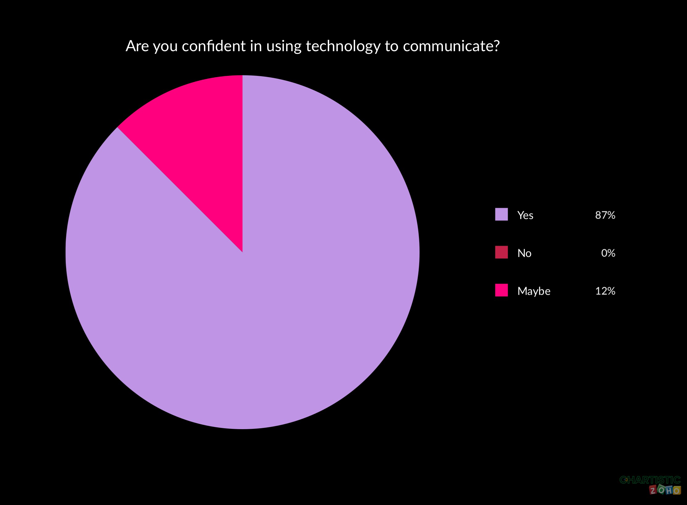

Slide 11
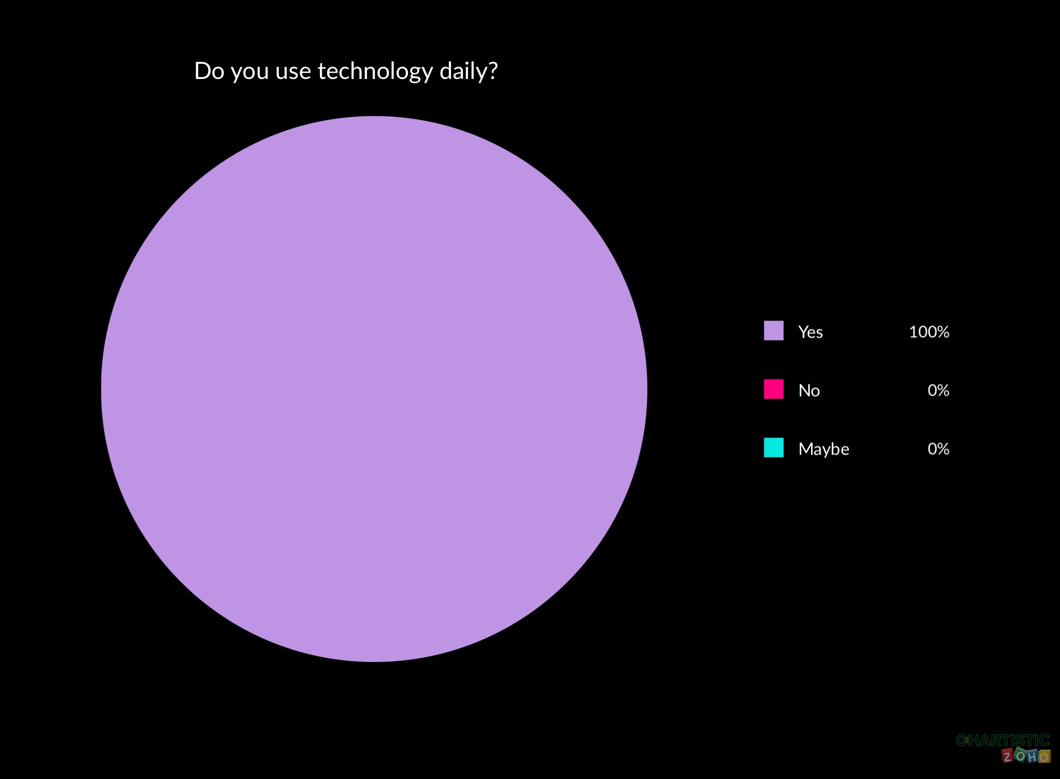

Slide 12
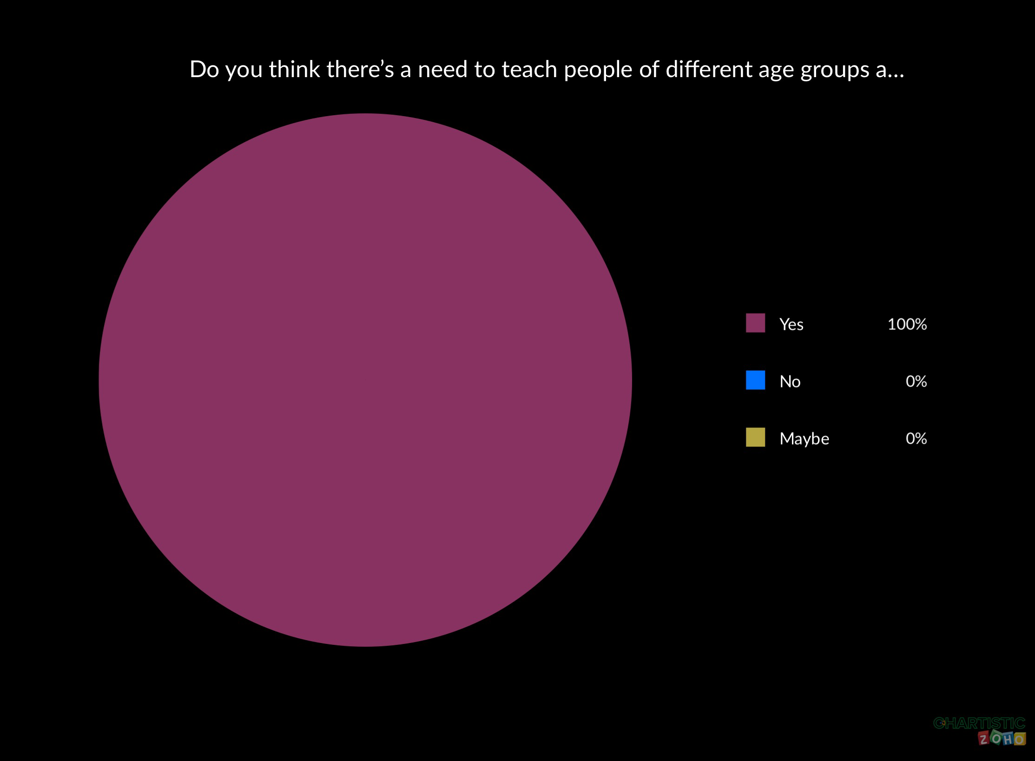

Slide 13
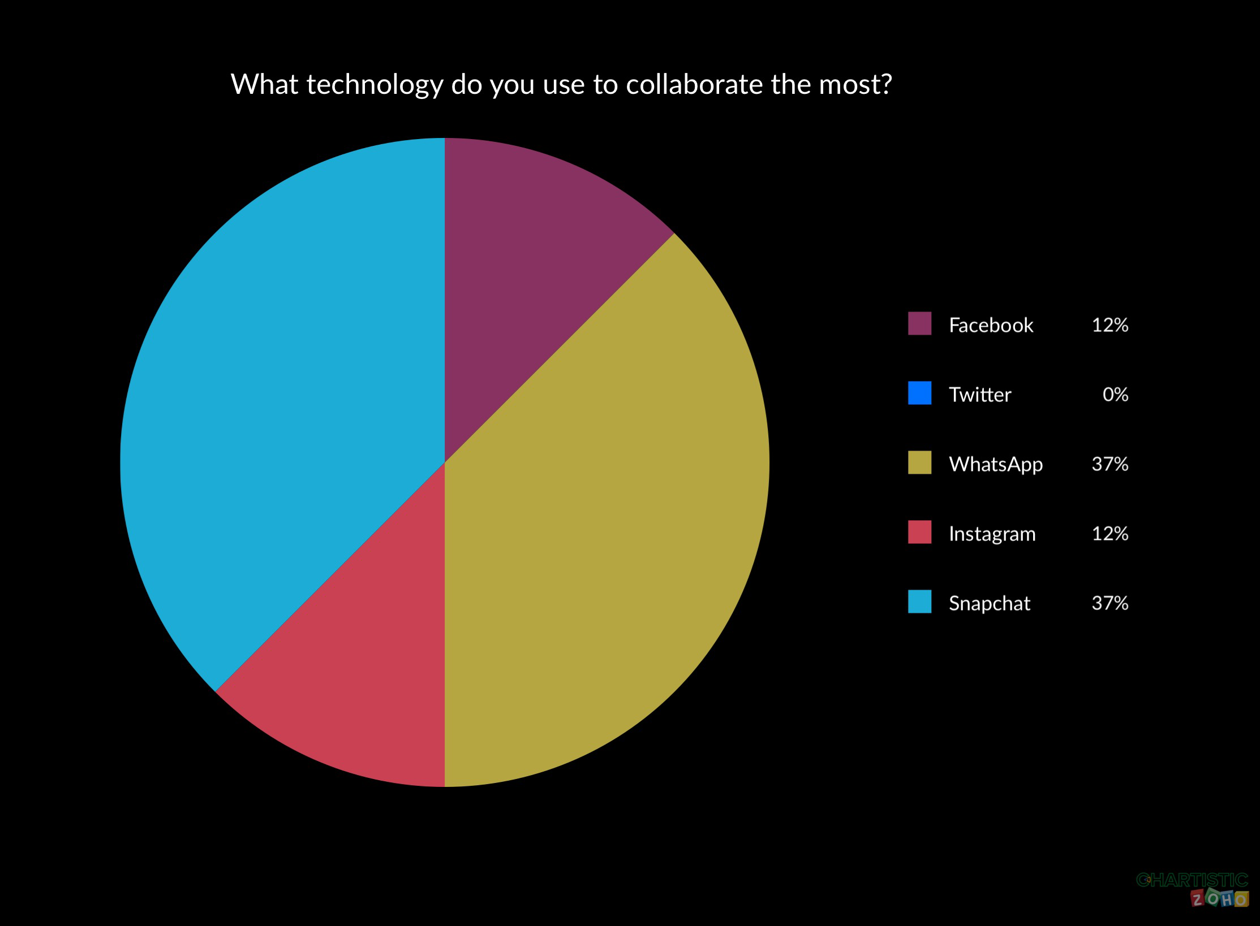

Slide 14
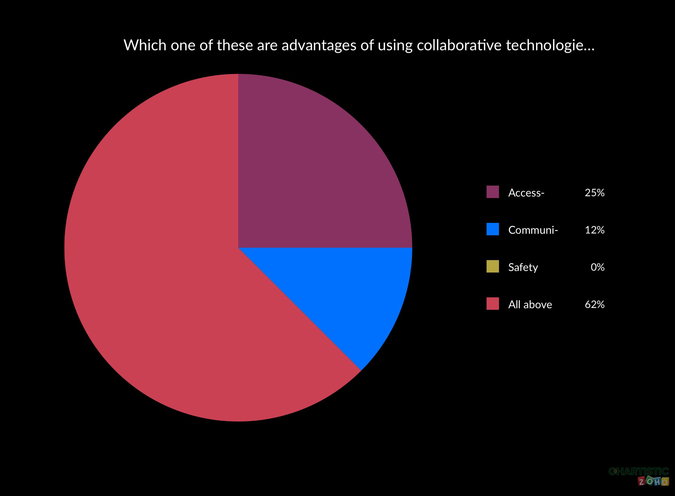

Slide 15
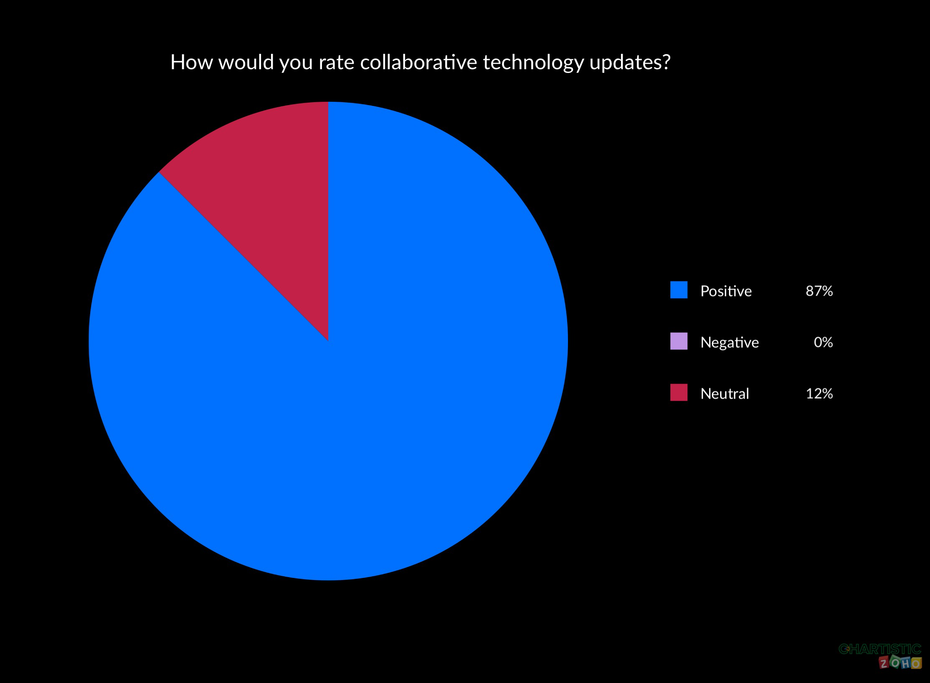

Slide 16

Conclusion of the questionnaire
Since more than half of the class did not do the questionnaire we cannot say that we were right in our prediction.
Although we can see that the result show that most of the people that done the quiz are confident in using collaborative technology.
So in conclusion we were some what proven wrong.

Slide 17
Ethical considerations:
Ethical research is making sure our information is correct and to determine that hasn’t been a violation of guidelines set by words.
Ethical considerations are also important in research because they allow participants to take part in a research study voluntarily.
By shammela 2212992

Slide 18
Research timeline:
Week 3: we brought together the chosen sources.
Week 1: we discussed how to make the PowerPoint.
Week 2: we researched for our sources.
Week 4: we planned and made the powerpoint together.
Week 5 we did the questionaire and got our classmates to complete it.
Week 6 we are ready to deliver our presentation!
By Shammela: 2212992

Slide 19

Thank’s for listening !!

