Slide 1

Assignment 2:
Personal development plan
(PDP) whitney otchere id:2536752
Learning in the digital ERA- ACCA4025
Certhe computing skills for workplace
13/07/2026

Slide 2
Contents
1.
2.
3.
4.
5.
6.
7.
8.
Self evaluation
Plan
Goal progress
Unit 4- Becoming a life long learner
Summary
contents
Thank you
welcome

Slide 3
Self evaluation
According to the ‘self assessment tool’ used on moodle these are my strengths, traits and weaknesses based on my answers given;
Strengths: Team Player, Analytical Thinker, Creative Problem-Solver, Self-Motivated and Independent Worker, Detail-Oriented and Precise, Strong Leadership Qualities
Weaknesses: Struggles with public speaking, Needs Improvement in Time Management
Traits: Introverted: Reflective and Thoughtful, Moderate Stress Handler, Preferred Learning Style: Visual, Prefers Group Study, Does Not Prefer Solo Study
While understanding the the strengths, weaknesses and trait given, when evaluating your progress, it can help to ask yourself, What?, So what? And Now what?. This helps to dive into the specifics of what you’ve learnt, how you have progressed and help to produce your goals clearly.
What-
During time at University, I managed to complete my assignment, meet deadlines and contribute to group discussion and teamwork. I also took on new challenges, collaborated effectively with others and sought time to research to improve my skills and knowledge
So what-
These experiences helped me strengthen my computer skills and technical skill, improve my problem-solving abilities and build confidence in handling more complex tasks.
Now what-
Going forward I plan to continue building on my, Strengths and weaknesses while focusing on areas for growth. I will seek additional learning resources and opportunities, proactively request feedback, improve efficiency and take on greater responsibilities where possible.

Slide 4
plan
What are your long-term goals? | What are your specific career goals? | What are the key skills needed for each one of your goals? | What skills do you need to work on? | What actions are you going to take? | When are you going to complete your training by?
Web design | Completing level 4 computing | Pass assignments, understanding of learning in the digital era, Ref works | Time management, attention to detail, | Dedicate set goals and timeframes when work should be complete by | 8 months
 | Programs used in web design | Use of wix, webflow, squarespace, layout design User experience | Computing skills, website building, problem solving , | Learning the basics of each website to know what works best for me | 12 months
 | Professional web design portfolio | Problem solving, attention to detail, research, constructive criticism | Obtaining relevant information, coding, visual layouts and user interference | Creating a portfolio, starting web design templates | 2 years
 | Earning relevant qualifications | Knowledge of web design, time management, motivation | Studying, time management, dedication, | Completing ‘learning in the digital era’ if I pass will continue further education . | 3 years
Above it a SMART table provided from moodle.

Slide 5
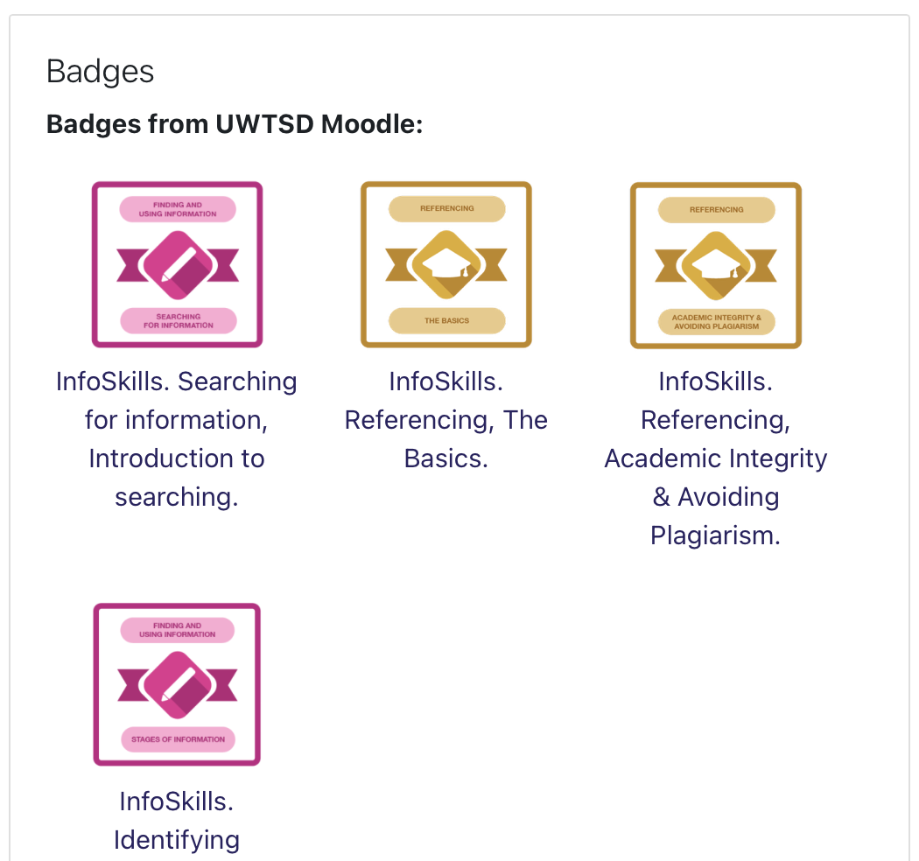
Goal progress
To the side are my badges obtained by completing homework

Slide 6
Unit 4- topic 1 becoming a lifelong learner
Habits –These can be things that we have learnt or picked up good or bad. While studying its important to foster the habit of studying by, having or becoming close with people that share the same thoughts, beliefs or targets, enables all to achieve goals faster. Adopting different interpretations of the same subject gives a broader range of knowledge.
Agile learning- Learning agility is the combination of motivation and skill. The drive component empowers you to step confidently into confusing or unfamiliar situations while remaining deeply engaged instead of backing down. Meanwhile, the skill component allows you to rapidly analyze the results of your actions, determine what worked, and instantly decide on your next move to ensure continuous growth.

Slide 7
summary
Moving forward to advance in web design, remembering the use of tools such as canva, excel and word would be beneficial. Also, by taking advantage of the universities resources to further my knowledge in computing overall. Setting aside the right time and space will enable me to complete assignments to the best of my ability and will be implemented going forward. Meeting new people of the same interest and having discussions really helped me to gain new ideas that I can use in the future. Realising this I now know that I could improve on independent studying to collect or find information detailed to my own work. Having deadlines for assignments that need to be met, required good time management in which I feel could be better by organising my day more efficiently.
Being surrounded by others that are working towards the same target, having to dedicate time to attend lessons and complete assignments, to learning the basics of Ref works, producing academic posters and researching I feel studying ‘learning in the digital era’ has enabled me to come out of my shell a lot more. This enabled me to communicate efficiently with others and working in a team, as well as gaining interpersonal knowledge and skills.
My goal is to contribute more to the team while developing new skills that enhance my knowledge in computing overall. I am committed to continuous learning, embracing new challenges and collaborating with others in order to produce work to a high standard. By focusing on future improvement and commitments, I aim to balance both my academic life and social life to achieve the necessary qualifications Id need to be successful in web design.

Slide 8
Thank you for listening to my presentation

