Slide 1
Astudiaethau Cwricwlwm
Curriculum Studies
ECES6013/C
Darlithwyr / Lecturers:
Alison Murphy
Alison Baggott

Slide 2
Learning Outcomes
Deilliannau Dysgu
Discuss and demonstrate critical understanding of philosophical, sociological, economic and professional factors associated with development & implementation curriculum
Trafod ac arddangos dealltwriaeth feirniadol o ffactorau athronyddol, cymdeithasol, economaidd a phroffesiynol yn gysylltiedig â datblygu a gweithredu cwricwlwm

Slide 3



Nod/aims
To consider the impact of PISA on education policy
To consider variations between the different curriculum within the UK
Focus on Wales, England and Scotland
Ystyried impact PISA ar bolisi addysg
Ystyried y gwahaniaethau rhwng wahanol cwricwlwm o fewn y DU
Ffocws ar Gymru, Lloegr a’r Alban

Slide 4
Polisi addysg
Education policy
Bates et al. (2011 pg 54 cited in Bartlett and Burton pg. 146) define education policy as ‘The raft of laws and initiatives that determine the shape and functioning of educational systems at both national and local level’
Curriculum is an important part of education policy
Mae Bates et al. (2011 pg 54 dyfynnwyd yn Bartlett and Burton tud. 146) yn diffinio polisi addysg fel ‘The raft of laws and initiatives that determine the shape and functioning of educational systems at both national and local level’
Mae cwricwlwm yn rhan bwysig o bolisi addysgol
Notes:
In any society like minded people come together and form their policy based on their ideological beliefs about how society should develop. These groups may be political parties and their policies will be developed and refined througj argument and debate.
As education is so impt in any society it will form a major part of any gov plans. It is likely that due to changes in social and economic sircumstances these policies will be amended or adapted.
Why do new governments feel the need to review education policy and ‘reform’? For example a new government might change the content or assessment of the school curriculum and also the structure of secondary school. Also they have to react to external events e.g. banning the cane/corporal punishment in schools as a result of European ruling on human rights rather than beliefs of sitting conservative english gov.
The study of ed. Policy to a large extent involves examining the intent and actions of governments their ability to implement their particular policies and the effects of that implementation.
What does word reform suggest about the change? Things getting better – this is because each new government assumes that its approach to education will change things for the better.
When looking at ed policy therefore we have to consider the broader political ideology – recap from last year – what happened in school policy in 1980s onwards – marketisation. Why? Cons thought encouraging competition would drive up standard.

Slide 5
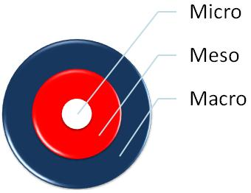
Polisi addysg Education policy
Micro, Meso, Macro
We can view policy changes in terms of Micro, Meso and Macro
These terms have no fixed definition and vary according to the context.
When considering education policy changes in the UK what what would the micro, meso and macro look like?
Gallwn ystyried polisi yn nhermau’r Micro, Meso a’r Macro
Nid oes gan y termau hyn ddiffyniad penodol ac maent yn amrywio yn ôl y cyd-destun
Wrth ystyried men polisi addysg yn y DU sut fyddai’r micro, meso a macro yn edrych?
Notes:
prefixes which indicate scale: largest, medium, smallest. Their application depends on context.

Slide 6
Tasg grwp
Group Task
Identify some of the events, policies, ideas and processes that may have had an impact on the education systems in England, Wales, Scotland or Northern Ireland over the past years
Are these global, local or national in origin?
What has been their impact?
Feedback
Ystyriwch rhai o’r digwyddiadau, polisiau, syniadau a phrosesau sydd wedi cael impact posib ar system addysg Cymru, Lloegr, Yr Alban neu Gogledd Iwerddon dros y blynyddoedd diwethaf
A yw rhain yn fyd-eang, lleol neu cenedlaethol mewn tarddiad?
Beth oedd eu heffaith?
Adborth
Notes:
Encourage groups to draw the circles on the flipchart and write in events, policies ideas and processes had an impact over past decade.
Start the discussion by giving a few examples – a very recent one will be welsh government indicating that they want 1milion welsh speakers by 2050.
Since 1999, the way the United Kingdom is run has been transformed by devolution - a process designed to decentralise government and give more powers to the three nations which, together with England, make up the UK.
14/7/17 - The government is planning to spend around £10 million on recruiting and training hundreds of foreign physics, maths and language teachers.
This is to meet the increasing demand for new school staff in England.
From exploring ancient Egypt, to walking around the human body, Virtual Reality is increasingly being used in schools to add another dimension to learning. Education Business looks at this growing technology trend. Within schools, virtual reality is increasingly being seen as a clever tool to enhance teaching and learning. It allows teachers to create immersive learning experiences, such as allowing students to interact with 3D objects and environments in science or to recreate historic sites in history lessons.
Global – PISA - A new scheme to improve how maths is taught in Schools in Wales is set to be launched.
The education secretary Kirsty Williams will announce the National Network for Excellence in Mathematics at a school in Cardiff alongside maths expert Dr Hannah Fry, who will talk about how to make maths more compelling for pupils.
Just over £3 million is being invested by the Welsh government into the network.
It will involve schools, colleges and universities and the four regional education consortia - working together to improve the teaching and learning of mathematics and numeracy in Wales, in support of new curriculum developments.
obesity

Slide 7


PISA (Programme International Student Assessment)
One international development that has had a huge impact on education policy in recent years has been the PISA test results
Watch the following clip and consider how this can be a catalyst for curriculum change
What else is prompting change?
Un datblygiad rhyngwladol sydd wedi cael impact anferth ar bolisi addysg yn y blynyddoedd diwethaf yw canlyniadau profion PISA
Gwyliwch y clip canlynol ac ystyriwch pam fod gan hyn rôl mewn newid y cwricwlwm
Beth arall sy’n ysgogi newid?
Notes:
Reflect on the clips
Scores of Welsh students in science, reading and maths were below the average of 72 countries and economies taking part in a major study of educational performance.
Welsh students also did worse than their counterparts in England, Scotland and Northern Ireland.
The Pisa tests are taken by 15-year-olds every three years.
This is the fourth time Wales has done worse than the other UK nations.
The latest results show:
In maths, Wales scored 478, below England and Northern Ireland which both scored 493 and Scotland which scored 491
In reading, Wales once again came last in the UK with 477, England scored 500, Northern Ireland 497 and Scotland 493.
In science, Wales scored 485, England scored 512, Northern Ireland 500 and Scotland 497.
First Minister Carwyn Jones admitted in a heated session of the assembly on Tuesday that the results make for "uncomfortable reading".
By emphasising a narrow range of measurable aspects of education, Pisa takes attention away from the less measurable or immeasurable educational objectives like physical, moral, civic and artistic development, thereby dangerously narrowing our collective imagination regarding what education is and ought to be about.
As an organisation of economic development, OECD is naturally biased in favour of the economic role of public [state] schools. But preparing young men and women for gainful employment is not the only, and not even the main goal of public education, which has to prepare students for participation in democratic self-government, moral action and a life of personal development, growth and wellbeing.
While standardised testing has been used in many nations for decades (despite serious reservations about its validity and reliability), Pisa has contributed to an escalation in such testing and a dramatically increased reliance on quantitative measures.
Now in its 13th year, Pisa is known around the world as an instrument to rank OECD and non-OECD countries (60-plus at last count) according to a measure of academic achievement of 15-year-old students in mathematics, science, and reading. Administered every three years, Pisa results are anxiously awaited by governments, education ministers, and the editorial boards of newspapers, and are cited authoritatively in countless policy reports. They have begun to deeply influence educational practices in many countries. As a result of Pisa, countries are overhauling their education systems in the hopes of improving their rankings. Lack of progress on Pisa has led to declarations of crisis and "Pisa shock" in many countries, followed by calls for resignations, and far-reaching reforms according to Pisa precepts.( the guardian, 2014)

Slide 8
Beirniadaeth o PISA
Criticism of PISA
‘There is no question that PISA has led to massive changes in global education but there is the question that whether these changes have made or will make education better in the world. PISA critics would agree with its proponents that the program has been a success, but argue that the success has not made, and will not make, education better. In fact, many have pointed out that PISA has successfully made education worse. It has wrecked havoc in the world of education in a number of signifcant ways.’ (Zhao, 2020)

Slide 9
Beirniadaeth o PISA
Criticism of PISA
Homogenizing education
Stifing innovation
Propagating harmful half‑truths
Glorifying authoritarian education
(Zhao, 2020)
Homogeneiddio addysg
Atal arloesi
Annog cred mewn straeon sydd a hanner gwirionedd yn unig
Rhoi clod i systemau addysg awdurdodol
(Zhao, 2020)

Slide 10

In your own time read the article by Zhao (2020) – Link on Moodle
Yn eich amser eich hun darllenwch yr erthygl gan Zhao (2020) –cyswllt ar Moodle
Notes:
Egan: After PISA A way forward for Education in Wales. In essence, this led to Wales becoming part of what Pasi Sahlberg has called ‘the GERM’: the Global Education Reform Movement, with its emphasis on performativity and accountability.8 PISA, with its focus on standardised tests and national performance tables, is a fundamental part of the GERM.
The first period of education policy-making in Wales under devolution was heavily influenced by the principles set out in The Learning Country of 2001. Following the PISA results of 2009/10 the Welsh Government undertook a ‘policy turn’ under the influence of what is known as the Global Education Reform Movement (the GERM).
This has led to an accountability-driven form of school improvement which, whilst it has contributed to ongoing progress in educational achievement in Wales, has significant perverse consequences which make it unsuitable for creating the education system envisioned in The Learning Country.
The major challenge faced by the Welsh education system is the impact which poverty has on educational achievement and the slow progress we are making in overcoming this situation.
We should, therefore, return to the principles and policy approaches of The Learning Country with a renewed emphasis on a made-in-Wales approach to school improvement, a new approach to ensuring education works in partnership with communities and a relentless focus on improving equity.
The new approach to education and community partnership should draw upon the increasing knowledge we have about the importance of families and communities in influencing educational achievement and be influenced by emerging practice and models from Wales, the UK and internationally.
If Wales is to save the devolution project in education in the face of current uncertainties and political posturing, it is essential that we forge a new strategy for the future based on these principles.

Slide 11
Beirniadaeth o Pisa o’r safbwynt Cymraeg
Criticism of Pisa from the Welsh perspective
Read the executive summary (pg. 2) of Egan’s report (2017) https://www.bevanfoundation.org/wp-content/uploads/2017/01/After-PISA-Report.pdf
What are the main points Egan makes about the impact of PISA on Wales’ education system?
Do you agree with him?
Darllenwch y crynodeb (tud. 2) o adroddiad Egan (2017) https://www.bevanfoundation.org/wp-content/uploads/2017/01/After-PISA-Report.pdf
Beth yw’r prif bwyntiau mae Egan yn ei wneud am impact PISA ar system addysg Cymru?
Ydych chi’n cytuno gydag ef?

Slide 12

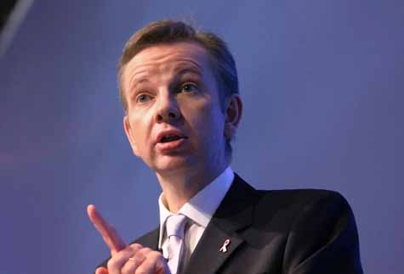
Lloegr
England
Curriculum review introduced by the coalition government in 2011
New curriculum introduced in stages September 2014 and 2015
Aim – to give schools greater freedom over the curriculum
Arolwg cwricwlwm yn cael ei gyflwyno gan y llywodraeth clymbleidiol yn 2011
Cwricwlwm newydd yn cael ei gyflwyno mewn camau Medi 2014 a 2015
Nod – rhoi fwy o ryddid i ysgolion dros y cwricwlwm
Notes:
Coalition Cons and Lib Dems – review of curriculum 5-16 yr olds. Gove said
‘we have sunk in international league tables and the NC is substandard. Meanwhile pace of economic and technological change is accelarating and our children left behind. The previous curriculum failed to prep us for the future. We must change course.
3 aims of review:
Replace current substandard curriculum with one based on the best school systems in the world, providing a world-class resource for teachers and children
Consider what subjects should be compulsory at what age
Consider what children should be taught in the main subjects at what age.
An expert panel commissioned under Tim Oates and they produced a new curriculum in 2013 for implementation in stages – Sept 2014, 2015. This is the version currently being delivered
The government says the new curriculum does not tell teachers "how to teach", but concentrates on "the essential knowledge and skills every child should have" so that teachers "have the freedom to to shape the curriculum to their pupils' needs". (BBC)

Slide 13
‘The national curriculum provides pupils with an introduction to the essential knowledge that they need to be educated citizens. It introduces pupils to the best that has been thought and said; and helps engender an appreciation of human creativity and achievement’ (DfE 2013, Para 3.1).Clip
From these aims what do you perceive to be the key aspects of this curriculum?
O’r nod yma beth gredwch chi yw agweddau allweddol y cwricwlwm hyn?
Notes:
Ask students to reflect on citation
Feedback and then show clip
Make the point that there is a focus on core subject knowledge with a stronger emphasis on skills such as essya writing and prob solving.
Their brief was to emulate the world's most successful school systems, including those in Hong Kong, Singapore, the Canadian state of Alberta and the US state of Massachusetts, in international tests.
The aim was to combine best international practice with best practice from schools in England.(BBC)

Slide 14

Beth yw’r prif nodweddion?
What are the main features?
  Less overall content than previous curriculum but more challenging
  Focus on core subject knowledge with stronger emphasis on skills such as essay writing and problem solving
  Additional content in the primary key stages
  ‘new’ subject – computing replaces ICT across key stages with the shift from handling data and operating programmes to programming itself
Llai o gynnwys na’r cwricwlwm cynt ond yn fwy heriol
Focws ar wybodaeth pynciau craidd gyda phwyslais cryf ar sgiliau fel ysgrifennu traethawd a datrys problem
Cynnwys ychwanegol yng nghyfnodau allweddol cynradd
Pynciau ‘newydd’ – cyfrifiadura yn lle TGCh gyda newid o ddelio a data a gweithredu rhaglenni at greu rhaglenni
Notes:
Pupils expected dto be able to do more at an earlier age.in science there is a shift towards hard facts and ‘scientific knowledge’ with new additional content in the primary key stages.
In English curriculum Shakespeare becomes more prominent, with pupils between age of 11 and 14 expected to have studied two of his plays. History – largely British based including Euro and world events from 1901.
New subject of computing replaces ICT across all key stages and is counted as a science for English Baccalaureate purposes. This subject switch is a radical shift from focusing on the handling of data and operating programmes to programming itself, an aspect not previously widely studied by pupils as it was considered too specialised. L
Learning a foreign language now becomes compulsory in primary at KS2.

Slide 15
Beth yw’r prif nodweddion?
What are the main features?
Assessment has changed with levels abolished and from 2016 outcomes for each pupil reported as a scaled score for each core subject.
This will be measured in relation to average pupil progress
Subject based curriculum.
Key stage 1 and 2 include core subjects: English, Maths, Science
Asesu wedi newid gyda lefelau’n cael ei dileu ac o 2016 canlyniadau i bob plentyn yn cael eu hadrodd fel sgor ar raddfa am bob un o’r pynciau craidd
Bydd hwn yn cael ei fesur yn erbyn cynydd cyfartalog plant
Cwricwlwm wedi selio ar bynciau
CA 1 a 2 yn cynnwys pynciau craidd: Saesneg, Mathemateg a Gwyddoniaeth
Notes:
Levels abolished and from 2016 outcomes to be reported for each pupil as a scaled score for each core subject.
Individual pupil progress measured in relation to average pupil progress on the same baseline.
All schools teach RE at all key stages
Core subjects: Eng, maths, science
Foundation subjects: art and design, computing, DT, Langua (KS2), Geog, Hist, Music, PE

Slide 16
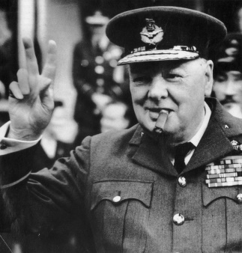
Beirniadaeth o’r newidiadau
Criticism of the changes
Pupils having to cover some topics eg. In maths and science, far earlier than previously.
This could cause difficulty with conceptual understanding and lead to pupils becoming confused at an early age.
History curriculum too narrowly British based.
A very traditional curriculum
Disgyblion yn gorfod edrych ar rhai testunau llawer gynt nag yn y gorffennol ee. Mathemateg a gwyddoniaeth
Posiblrwydd o hyn yn achosi anhawster cysyniadol gan arwain at ddisgyblion yn drysu ar oed cynnar
Cwricwlwm hanes yn rhy gul a gormod o sylw ar Brydain
Cwricwlwm traddodiadol iawn
Notes:
http://www.telegraph.co.uk/education/educationnews/10166020/Michael-Gove-new-curriculum-will-allow-my-children-to-compete-with-the-very-best.html
Coalition gov present themselves as saviours of failing ed system which would address failing economy. Showing the international comparisons and saying england falling behind global competitirs. No recognition of the limitations of these comparisons
Strong focus on conservative traditionalism. But it is difficult to say that this is a nationally coherent curriculum as academies and free schools (which make up most of eng secondary and an increasing amount of primary schools) don’t have to follow it.
Under the new maths curriculum, five-year-olds in their first year of school will be taught to read and write numbers up to 100, count in multiples of ones, twos, fives and 10s, and learn addition and subtraction. Year 1 pupils will also be expected to do basic fractions, two years ahead of the existing curriculum, and algebra is to be taught from age 10.
Courtney said not enough effort had been made to design a curriculum for lower-attaining children or children with special educational needs. "Teachers have concerns about whether this curriculum is right for children with special educational needs, who form 20% of the student population, and should not be an afterthought," he said. (the guardian)
Organisations such as the English Association and the United Kingdom Literacy Association claimed that ministers were overemphasising rote learning and factual recall at the expense of teaching for deeper understanding, meaning learning standards could fall. (the telegraph)

Slide 17
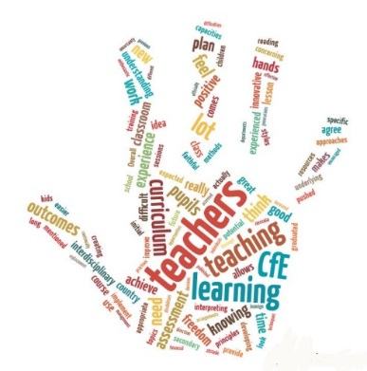
Yr Alban
Scotland
Education is a devolved issue
Introduced ‘Curriculum for Excellence’ in 2010
Designed to develop skills rather than specific knowledge
Learners will be:
  Confident individuals
  Responsible citizens
  Effective contributors
  Successful learners
Addysg yn fater sydd wedi datganoli
Cyflwyno ‘Curriculum for Excellence’ yn 2010
Wedi dylunio i ddatblygu sgiliau yn hytrach na gwybodaeth penodol
Y nod fydd i gael dysgwyr:
  Unigolion hyderus
  Dinasyddion cyfrifol
  Cyfranogwyr effeithiol
  Dysgwyr llwyddiannus
Notes:
The principle behind CfE is to support the young person to develop skills as a learner. Class brings different skills together eg. using maths in sport. Emphasis on self-discovery and move away from rote learning.
Since 2002, Scottish schools have engaged with policy designed to bring about curricular and pedagogical innovations that proponents have hailed as new and radical. According to its architects, CfE is ‘one of the most ambitious programmes of educational change ever undertaken in Scotland’ (Scottish Government 2008, p.8),
CfE can also be claimed to be distinctive in terms of the nature of learning itself. This relates to the balance between knowledge and skills and the centrality of the learner. In both respects, CfE is in fact fairly typical of worldwide trends to be less prescriptive in content. Such trends have been subject to critique; various writers (e.g. Young, 2008; Wheelahan, 2011; Yates and Collins, 2010; Priestley, 2011) have drawn attention to a worldwide trend for new curricular models to downgrade knowledge. This is largely justified within policy and by proponents as enhancing curricular flexibility to address the demands of a fast changing world, where workers and citizens will need the skills to quickly acquire new knowledge, as existing knowledge forms become rapidly obsolete. There are two main facets to this curricular shift.
This discourse shift is accompanied by a growing incidence in policy documents of references to active learning - CfE is replete with such references – and the increased popularity of methodologies such as cooperative learning in schools. One issue is that the theoretical underpinnings of such pedagogy are rarely made explicit in CfE; policy tends to exhort teachers to utilise active forms of learning, while not articulating any form of learning theory, including the social-constructivism upon which they implicitly draw
University of Glasgow research (Baumfield et al., 2010) similarly highlighted the difficulties faced by teachers in taking advantage of the autonomy afforded by CfE. A major problem lies in the accountability practices - including use of attainment data and internal inspections - that continue to accompany the new curriculum despite the renewed emphasis on teacher autonomy, and the cultures of performativity that have been shown to develop in schools as a result of these practices (Cowie, Taylor & Croxford, 2007).

Slide 18
Beth yw’r prif nodweddion?
What are the main features?
Schools can make their own decisions on what to teach pupils.
There are three core subjects that schools must ensure are taught: health and wellbeing, literacy and numeracy. Other than that, they’re free to:
  introduce projects that use skills and knowledge from more than one subject
  teach about people and places from their local area
  ask pupils about areas they’re interested in studying
Mae ysgolion yn gallu bod yn hyblyg ar yr hyn sy’n cael ei ddysgu i’r plant.
Mae yna dri pwnc craidd sydd rhaid dysgu: iechyd a lles, llythrennedd a rhifedd. Arwahan i hynny, maent yn rhydd i gyflwyno:
  Projectau sy’n defnyddio sgiliau a gwybodaeth wrth mwy na un pwnc
  Dysgu am bobl a llefydd yn eu hardal leol
  Gofyn i fyfyrwyr beth mae ganddynt ddiddordeb astudio
Notes:
In primary these areas of study are often mixed, eg. the class topic will bring together literacy, numeracy, art etc. During the “broad general education” children will do a bit of everything and in S3 choose which subjects they want to focus on in S4
In a review of CfE for the Scottish educational review there was mixed reaction from teachers about the new curriculum. This was largely linked to teacher autonomy. For a number of interviewees, CfE’s lack of prescription was widely welcomed, particularly after what was perceived to be the overprescribed nature of the 5-14 Curriculum. These teachers appreciated the flexibility brought by CfE; there was a sense from some that it had rejuvenated their teaching, and allowed them to enjoy teaching again. They spoke of being able to ‘go off on tangents’, to be creative.
Moves towards topic-based and thematic learning were described as taking teaching ‘back to what we used to do long ago’, according to a highly experienced teacher, making learning more relevant for children. A primary teacher said her identity as a teacher had changed as a result of CfE, shifting from being an imparter of knowledge to a facilitator of learning.
students. However, a number of interviewees (both primary and secondary) lacked the confidence to be able to adapt to new ways of teaching. One teacher described the new curriculum as having moved ‘from extreme prescription to extreme woolliness’.
http://www.scotedreview.org.uk/media/scottish-educational-review/articles/355.pdf

Slide 19
Criticism of the Curriculum for Excellence
Watch the following Youtube clip
https://www.youtube.com/watch?v=-tfhk_mlvl8
and read the blog by Patterson https://blogs.lse.ac.uk/politicsandpolicy/curriculum-for-excellence/
What are some of the criticisms levelled against the reformed curriculum?
Are these points fair?
Gwyliwch y clip Youtube canlynol a darllen y blog gan Patterson
Beth yw’r beirniadaeth o’r cwricwlwm yn yr Alban?
Ydy’r pwyntiau hyn yn deg?

Slide 20
Natur y dysgu
The nature of learning
Balance between knowledge and skills
less prescriptive in content
Learner centred
Young and Wheelahan, (2008) note how downgrading knowledge is a worldwide trend and is justified by saying that the curriculum needs to be flexible to address demands of fast changing world.
Cydbwysedd rhwng gwybodaeth a sgiliau
Llai penodol yn y cynnwys
Plentyn canolog
Young a Wheelahan, (2008) yn nodi bod diraddio gwybodaeth yn duedd byd-eang ac yn cael ei gyfiawnhau trwy ddweud bod angen cwricwlwm hyblyg er mwyn ymateb i newidiadau cyflym yn y byd
Notes:
Many teachers’ understanding of CfE centred around the idea of the ‘grouping’ or ‘bringing together’ of subjects, and of helping children to ‘see the links between things’. By ‘broadening’ education in this way teachers said they hoped CfE would have the potential to remove boundaries and allow children to see cross-curricular links
Not everyone in favour of skills over content: Concerns were raised by some teachers that there is too much emphasis on soft process outcomes, group learning and active learning at the expense of content, as shown by this response to the survey:
“IT’S NOT WHAT WE LEARN BUT HOW WE LEARN". Who coined that disaster? In order for there to be any meaning in the acquisition of knowledge then what we learn HAS to be as vital and important as how we learn
“We don’t propose scrapping it altogether. But we do have to challenge the prevailing orthodoxy which has led to this collapse in standards - which thinks of facts and knowledge as of secondary importance, puts the latest fashionable theory before the basic need for a teacher to teach, and which has left a generation of teachers, parents and pupils utterly confused about what is going on, or what Curriculum for Excellence even is.” Ruth Davidson (conservative leader in Scotland has asked for a review into the curriculum) The review will be led by Tory education spokeswoman Liz Smith MSP, who is expected to consult education experts, before reporting by the end of the year.
A spokesman for Education Secretary John Swinney said: “There already has been an independent review of CfE carried out by the Organisation for Economic Co-operation and Development - not a hand-picked Tory party commission - who considered it to be a bold and a successful reform that was delivering a broadened education experience for young people.

Slide 21
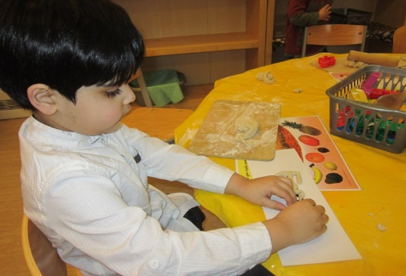
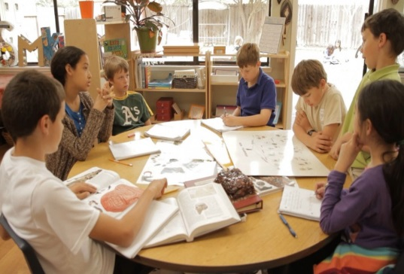
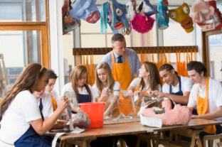

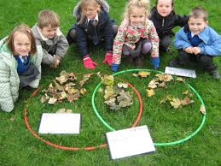
Arddull dysgu
Styles of teaching
Active learning
Cooperative learning
Project based learning
Teachers as facilitators
Dysgu gweithredol
Dysgu cydweithredol
Dysgu wedi selio ar broject
Athrawon yn hyrwyddo’r dysgu
Notes:
In the past schools would have the teacher at the front asking questions and the children answering. This still happens in school but now there is more of a move away from this to ensure that all children are involved in the learning, this helps to embed the learning
Group learning- given a task to research and find out about (useful life skill too)
Play- particularly for younger children play is an important way of learning- this child is making their name in playdough, developing letter recognition and developing the hand skills to be able to write in the future
Experiments- children shown what to do and then get a chance to put learning into practice
Outdoor learning- children getting to go outside more, helps them to stay active, engage with nature
What are the criticism of project based learning
Substantial reports warn us that educational attainment at all levels is declining in English-speaking countries (Stopgradeinflation.ie; OECD Reports 2007 and 2014). A UK maths primary teacher delegation recently visited Shanghai to investigate why Chinese children score 30 per cent higher on international tests than children in the UK. The teachers reported that much of China’s success is down to its teaching methods, methods the UK and Ireland have moved away from over the past 40 years. The research I have read indicates that newer teaching methods are sharply inferior to the older teaching methods they supplanted.
China uses the traditional whole-class teaching method, in which the teacher stands at the blackboard, teaches the whole class the established body of knowledge, tests the children with questions and ensures a disciplined class environment
(the Irish times, 2015)

Slide 22
Tasg grwp
Group task
Research the English and Scottish curriculum and consider similarities and differences between them
What can we learn about the way the curriculum can be organised and taught from the above examples?
Ymchwiliwch i gwricwlwm Lloegr a’r Alban ac ystyriwch yr hyn sy’n debyg a gwahanol amdanynt
Beth allwn ni ddysgu am y ffordd mae’r cwricwlwm yn gallu cael ei drefnu a’i dysgu o’r enghreifftiau yma?

Slide 23

Cwricwlwm Cymru
The Welsh Curriculum
What do you remember about Donaldson’s review Successful Futures and the new Welsh curriculum that we looked at last year?
Note points on your ‘post its’
Feedback
Beth ydych chi’n ei gofio am adroddiad Dyfodol Llwyddiannus Donaldson a’r cwricwlwm newydd i Gymru a astudiwyd llynedd?
Nodwch bwyntiau ar y ‘post its’
Adrodd nôl

Slide 24
Y cwricwlwm newydd
The new curriculum
A new curriculum is being developed for settings and schools in Wales.
The aim is that it will be used throughout Wales by 2022.
What are the main features?
Mae cwricwlwm newydd yn cael ei ddatblygu i ysgolion Cymru.
Y bwriad yw y fydd yn cael ei ddefnyddio trwy Gymru gyfan erbyn 2022
Beth yw’r prif nodweddion?
Notes:
Watch clip. Students to make notes
Feedback
Ask how they think some of these features will be achieved e.g. ethical, informed citizens
Ambitious capable learners etc

Slide 25


Beth sy’n newid?
What’s changing?
More emphasis on skills and applying knowledge
More emphasis on digital competence
Teachers will have more freedom in the way they teach
Formative assessment and assessment for learning
Mwy o bwyslais ar sgiliau a defnyddio gwybodaeth
Mwy o sylw ar gymhwysedd digidol
Mwy o ryddid i athrawon yn y ffordd maent yn dysgu
Asesu ffurfiannol ac asesu ar gyfer dysgu
Notes:
A particular risk lies in direct teaching being caricatured as didactic, whole-class instruction. However, Hattie powerfully defines direct teaching as follows: ‘The teacher decides the learning intentions and success criteria, makes them transparent to the students, demonstrates them by modelling, evaluates if they (the students) understand what they have been told by checking for understanding, and re-telling them what they have been told by tying it all together with closure’47. Its essence lies in clear purposes and success criteria, modelling and practice, and regular and insightful feedback. In this way, direct teaching involves the active engagement of the teacher in ‘scaffolding’ learning. Creating contexts within which learners can demonstrate the ability to apply learning independently in unfamiliar settings is an important part of that scaffolding.
Pedagogy that makes full use of wider skills within and across each Area of Learning and Experience, particularly problem solving, creative and critical thinking, is likely to activate such powerful learning for children and young people.
OECD suggests that the problem-solving process involves ‘exploring and understanding’ the problem and its context; ‘representing and formulating’
information gathered to create hypotheses; ‘planning and executing’ investigations, identifying success criteria; and ‘monitoring and reflecting’ on progress and outcomes49. Creative and critical thinking are an essential part of problem solving50, providing processes for analysis, synthesis and evaluation of ideas and products, and making unique connections between or among them. Such creativity relies heavily on access to high-quality authentic information from a range of subject disciplines that act as a catalyst for innovation

Slide 26
Beth sy’n newid?
What’s changing?
4 purposes of the curriculum:
ambitious, capable learners, ready to learn throughout their lives
enterprising, creative contributors, ready to play a full part in life and work
ethical, informed citizens of Wales and the world
healthy, confident individuals, ready to lead fulfilling lives as valued members of society.
4 pwrpas i’r cwricwlwm
ddysgwyr uchelgeisiol, galluog sy’n barod i ddysgu drwy gydol eu hoes
cyfranwyr mentrus, creadigol sy’n barod i chwarae eu rhan yn llawn yn eu bywyd a’u gwaith
dinasyddion egwyddorol, gwybodus yng Nghymru a’r byd
unigolion iach, hyderus sy’n barod i fyw bywyd gan wireddu eu dyheadau fel aelodau gwerthfawr o gymdeithas.

Slide 27
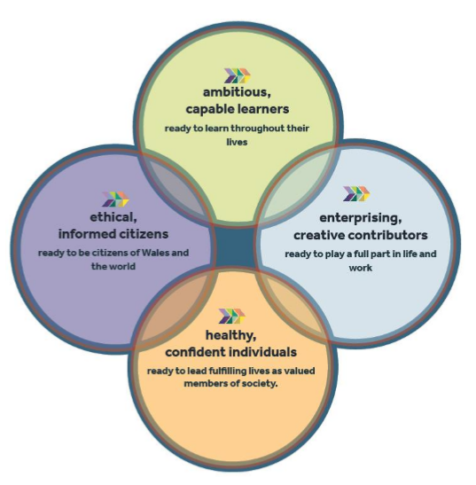
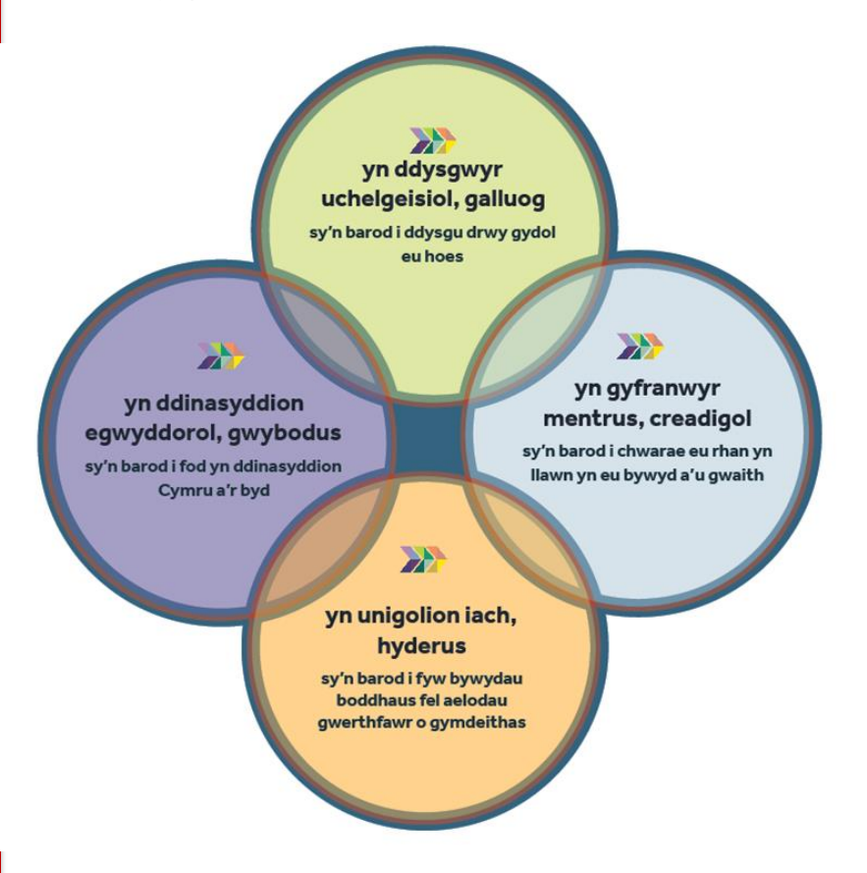
(Donaldson, 2015)

Slide 28
Beth sy’n newid?
What’s changing?
It will have six ‘Areas of Learning and Experience’.
Expressive arts.
Health and well-being.
Humanities (including RE which should remain compulsory to age 16).
Languages, literacy and communication (including Welsh, which should remain compulsory to age 16, and modern foreign languages).
Mathematics and numeracy.
Science and technology.
It will also include three cross-curricular responsibilities: literacy, numeracy and digital competence.
Bydd iddo chwe ‘Maes Dysgu a Phrofiad’.
Celfyddydau mynegiannol.
Iechyd a lles.
Dyniaethau (gan gynnwys addysg grefyddol a ddylai barhau'n orfodol hyd nes y bydd dysgwyr yn 16 oed).
Ieithoedd, llythrennedd a chyfathrebu (gan gynnwys y Gymraeg, a ddylai barhau'n orfodol hyd nes y bydd dysgwyr yn 16 oed, ac ieithoedd tramor modern).
Mathemateg a rhifedd.
Gwyddoniaeth a thechnoleg (gan gynnwys cyfrifiadureg).
Bydd hefyd yn cynnwys tri chyfrifoldeb trawsgwricwlaidd: llythrennedd, rhifedd a chymhwysedd digidol.

Slide 29
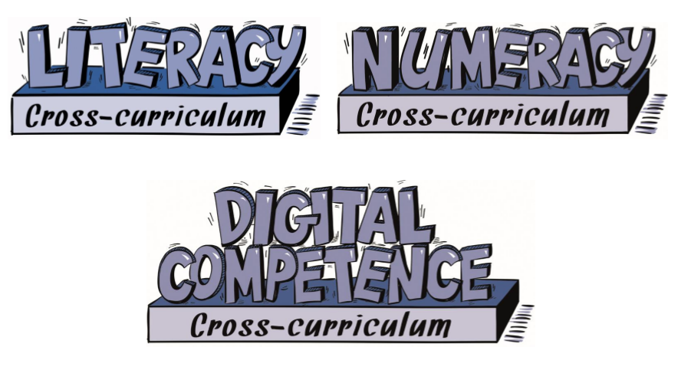
Cyfrifoldebau traws –gwricwlaidd
Cross –curricular responsibilities
Llythrennedd
Rhifedd
Cymhwysedd digidol

Slide 30
Tasg
Task
How does the new curriculum for Wales compare to the English and Scottish curriculum?
Sut mae cwricwlwm newydd Cymru yn cymharu a chwricwlwm Lloegr a’r Alban?

Slide 31
Lawrence Stenhouse – Model cwricwlwm proses
Process curriculum model
He was critical of the ‘objectives’ curriculum model whereby the teacher was expert and the student a passive partner in the learning.
The process model concentrates on the learning experience
Focus on learning skills which can be trasferable to other subject and for life in general.
Critical of demise of teacher professionalism and of ‘teacher proof curriculum package’ presented in the objectives model.
Roedd yn feirniadol o fodel y cwricwlwm lle bod ‘nod’ penodol a’r athro fel arbennigwr
Roedd yn credu yn y model proses sy’n canolbwyntio ar y profiad dysgu’n well
Ffocws ar ddysgu sgiliau sy’n gallu cael eu trosglwyddo i bynciau eraill a’i defnyddio i fywyd yn gyffredinol
Beirniadol o’r tuedd i israddio arbennigedd profesiynol yr athro ac o becynau cwricwlwm wedi eu paratoi eisoes.
Notes:
For steinhouse the process model fostered learner empowerment and emancipation and gave teachers the freedom to improve their professional practice thruough research and evaluiatoin
He was critical of limitations to teacher role. He said that teachers could be restricted professional or extended professional.
Restricted prof was competent, adept at working with chidren, engaged in short training courses and evaluated own classroom perf.
Extended prof did all this as well as skills and values which involve engagement with curriculum development and research. The seek synergy between theory and practice, consider issues of school and community participate in wide range of prof activity
But what problem might this cause?
Critics say if teachers do not have the flexible skills needed for class discussion that the student centred approach called for they will not have the back up of the direction and accompanying resources available with the objectives curriculum model.

Slide 32
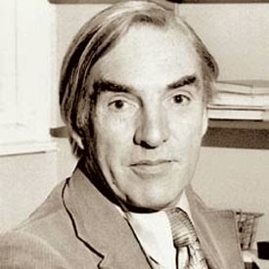
Lawrence Stenhouse - Process model curriculum
He did not see teachers as being the experts who deliver knowledge – he saw their role as providing access to knowledge and skills
‘teaching by discovery or inquiry methods rather than by instruction’ (Stenhouse, 1975, pg. 91 cited in Aubrey and Riley pg. 129
Teacher’s role should also be to create an environment that promotes co-operation and discussion between pupils
Active learning as opposed to passive learning
The teacher allowing fellow teachers to observe them and discuss findings to develop their professional practice
Nid oedd yn gweld athrawon fel arbennigwyr yn oll wybodus – roedd yn gweld eu rol i ddarparu mynediad at wybodaeth a sgiliau
Rol yr athro yw i greu amgylchedd sy’n annog cyd-weithrediad rhwng disgyblion
Dysgu gweithredol yn hytrach na goddefol
Awyrgylch o arsylwi cyfoedion a thrafod y canlyniadau er mwyn datblygu’n broffesiynol
Notes:
He did recognise the imptce of exams in modern society and admitted that most teachers would shape their teaching towards giveint their students a greater opportunity for success in hteir exams.
Another problem with the process curriculum model is that it relies heavily on teachers. If they don’t have flexible skills it could be difficult and nothing to back them up.

Slide 33
Lawrence Stenhouse – Model cwricwlwm proses
Process curriculum model
Which one of the below statements sums up this approach:
A. The tutor says: "You are all heading for different destinations. You may need different maps. I'll teach you map-reading skills.“
B. The tutor says: "You are all heading for the same destination. I've got the map. Stick close to me and I'll get you there."
Which aspects of the different curriculum connect to these ideas?
Pa un o’r ymadroddion canlynol sy’n cwmpasu’r ymagwedd hyn:
A. Athro yn dweud ‘Rydych chi oll yn mynd I gyfeiriadau gwahanol. Efallai bydd angen map gwahanol. Mi wna i’ch dysgu i ddarllen map’
B. Athro yn dweud: ‘Rydych chi oll yn teithio i’r un cyfeiriad. Mae gen i’r map. Dilynwch fi.’
Pa agweddau o’r wahanol cwricwlwm sy’n cysylltu a’r syniadau hyn?

Slide 34
Rhestr gyfeirnodi
Reference list
Aubrey, K. and Riley, A . (2017) Understanding and Using Challenging Educational Theories. Sage: London
Bartlet, S. and Burton, D. (2016) Introduction to Education Studies. Sage: London
BBC news (2015) What does Curriculum for Excellence mean for pupils, teachers and parents? Available online: http://www.bbc.co.uk/news/uk-scotland-35113801 (accessed 11/7/17)
Dominiczak, P. (2013) The Guardian: Michael Gove: new curriculum will allow my children to compete with the very best. Available online: http://www.telegraph.co.uk/education/educationnews/10166020/Michael-Gove-new-curriculum-will-allow-my-children-to-compete-with-the-very-best.html (accessed 11/7/17)
Donaldson, G. (2015) Successful Futures. Available online: http://gov.wales/docs/dcells/publications/150225-successful-futures-en.pdf (accessed 11/7/17)
Priestley, M. and Minty, S. (2013) Curriculum for Excellence: ‘A brilliant idea, but…’ Scottish Educational Review 45, pg.39-52. Available online: http://www.ser.stir.ac.uk/pdf/355.pdf (accessed 11/7/17)
Scottish Government (no date) Curriculum for Excellence. Available online: http://www.gov.scot/Topics/Education/Schools/curriculum (accessed 11/7/17)
Steer, J. (2014) International Journal of Art & Design Education Reforming the School Curriculum and Assessment in England to Match the Best in the World – A Cautionary Tale http://web.b.ebscohost.com/ehost/pdfviewer/pdfviewer?vid=1&sid=0e9d61dd-52fb-4686-86e9-6061d41f12ec%40sessionmgr103
The SchoolRun (no date) An overview of the Scottish education system. Available online: https://www.theschoolrun.com/overview-scottish-education-system (accessed 11/7/17)
Welsh Government (2017) New School Curriculum. Available online: http://gov.wales/topics/educationandskills/schoolshome/curriculuminwales/curriculum-for-wales-curriculum-for-life/?skip=1&lang=en (accessed 12/7/17)
Images
http://3.bp.blogspot.com/-Ac7EHHhLREk/U3oQobNEp0I/AAAAAAAAAHg/xEnH4xHPhJI/s1600/022-laurence-01.jpg (accessed 12/7/17)

