Slide 1

IMPACT OF TECHNOLOGY ON EDUCATION

Slide 2
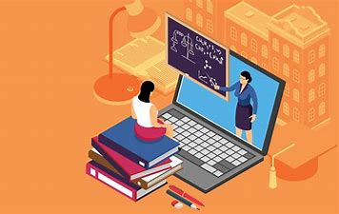
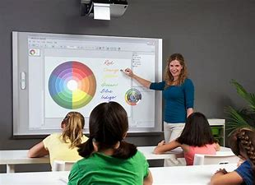
NEW EDUCATION
Technology in the new education system has reduced the need of paper, therefore, decreasing deforestation which ultimately an aid to the fight against climate change. Technology has helped with the crackdown on plagiarism making coursework's as authentic as possible. It has helped with keeping track of students attendance leaving for no human error.
Online Education:
Technology makes life easier for students studying during a world crisis, for example during the pandemic in lockdown students were still able to study online, for example, using apps like teams, google meets, and zoom making life easier for schools to manage students through a pandemic.
Interactive Boards:
Interactive Boards have shown to be a game changer technology in the education system, making lessons easier for the teacher where they have an inexhaustible amount of resources for their lessons. It makes learning more enjoyable for students on top of that offering an engaging experience. It as well accommodates different learning types, a advanced whiteboard accommodates a lot of learning styles whereas traditional education tools are often quite limiting.

Slide 3
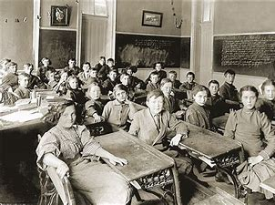
OLD EDUCATION
Boring Lectures or Interactive Learning:
The old education system was mainly focused on teaching students through books and knowledge, some would argue the old education system is solely based on long chapter-wise lectures and evaluations through examinations, making it hard for a student to concrete during lessons making it worse if it’s long. The old education was totally based on memorizing the teacher’s teaching and memorizing from books that most of the time were outdated.

Slide 4
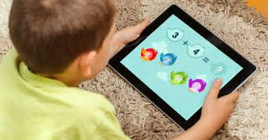
GOOD AND BAD IMPACTS TECHNOLOGY HAS HAD ON EDUCATION
Good Impacts:
Unlike the old education system where it was limited of who it can reach, the modern education system evolves to serve on a mass scale reaching most people across the globe. That thanks to current technology, not only has modern technology helped reach education across struggling parts of the world it also showed us we don’t need to rely on human minds and books to get information. We can just go on the ever-developing internet and get information with a click of a finger. (Miller, 2020)
Another good impact technology has had on education it makes students especially younger people have more of an enjoyable, interactive, experience than the traditional way of learning which is books and human knowledge. More schools offer a variety of learning beyond classrooms, books and lectures.
Bad Impacts:
There's some bad impacts technology has had on education, for example research has shown due to excessive usage of internet learning, the writing skills of today’s generation has declined massively. The children of this day and age heavily rely on internet communication and learning, which conveying the lack of grammar skills in today’s youth. (Inder,2014). Another bad impact technology has had on today’s new education system is that further research has shown students often using computers are not socially interactive leading them to be antisocial.

Slide 5
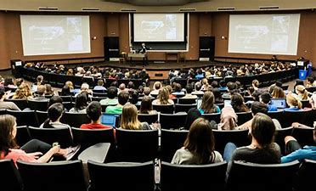
CONCLUSION
At the end of the day technology has had a more positive impact than negative on today’s generation. Opening more doors for people and making it more enjoyable and fairer for people from all backgrounds. Without technology I believe a lot of stuff we are seeing today would not exist for example smartphones etc, because to be inventing huge stuff you need bright minds and if your limited only by books and human minds you’ll not get far.

Slide 6
LIST OF REFERENCES
https://ceoworld.biz/2020/03/18/old-education-system-vs-new-schools-what-is-better/ by Ryan Miller March 18 2020
https://www.whiteboardsandpinboards.com.au/benefits-of-interactive-whiteboards-in-classroom/#:~:text=What%20Are%20the%20Benefits%20of%20Interactive%20Whiteboards%20in,whiteboards%20do%20not%20need%20any%20of%20these%20 by SevenDev
https://www.slideshare.net/maninmax/impact-of-technology-on-education-34470659 by Max Inder May 9 2014

