Slide 1
BA Applied Leadership and Management in the Workplace
Module: BMSK5012
Understanding & Engaging in the Customer Experience

Slide 2
Blended Learning ​
Session 5

Slide 3


Understanding & Engaging in the Customer Experience
Aims & Outcomes/Assignment
Some more thoughts…
Customer Experience
Emotions and Rationality
The Intuitive and the Rational
Habits!
Research & Reading

Slide 4
Aim & Learning Outcomes
Remember These!!!
AIM(S)
  To instil a critical understanding of quality systems and controls for customers.
LEARNING OUTCOMES
Upon the successful completion of this module, the student should be able to demonstrate the ability to:
  evidence a critical understanding of quality process in the workplace;
  analyse the customers’ experience of an organisation;
  critically evaluate the benefits and challenges of developing and maintaining good customer relationships.
INDICATIVE CONTENT
  Quality modules and standards.
  Customer service.
  Customer centrality.
  Value and purpose of customer relationship management (CRM).
  Buyer seller relationships.
  Managing customer expectations.
  Buying decision making process: ethical considerations such as fair-trade, sustainable resources.
  Appreciation of the importance of quality control.
  Customer value.

Slide 5
Understanding the Customer Experience
Critically analyse the factors that impact on your organisations ability to maximise customer value
What is criticality?
What factors?
Who said what about factors?
What maximises customer value?
What is customer value? Who said?
Where does your own organisation fit in?
Demonstrate critical understanding of organisations quality processes and its effectiveness in meeting customer requirements.
What is Critical Understanding?
What quality systems do your organisation and
others have?
How do they work? Do they work? Are they
effective?
What do the customers want?
Who are your customers?
Common Assessment Criteria
Engagement with Literature Skills. 20
Knowledge and Understanding Skills 30
Cognitive and Intellectual Skills 30
Practical Application Skills 10
Transferable Skills for Life and
Professional Practice 10

Slide 6
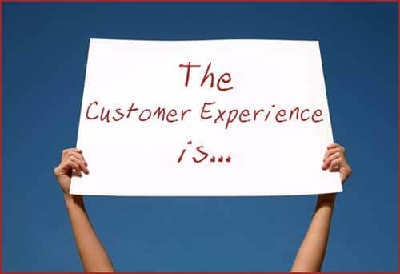

Some more thoughts……
Old thinking…
      Quality
      Product
      Price
      Place
      Promotion
New thinking…
      The Customer Experience
Notes:
Old thinking – the What New thinking – the HOW!

Slide 7
A new definition…
‘A customer experience is a customer’s perception of their rational, physical, emotional, subconscious, and psychological interaction with any part of an organisation.
These perceptions influence customer behaviours and build memories, which drive customer loyalty and thereby affect the economic value an organisation generates.’ (Shaw, C. & Hamilton, R. 2016 p.195)
Shaw, C. & Hamilton, R. (2016). The Intuitive Customer. London: Macmillan Publishers Ltd.

Slide 8
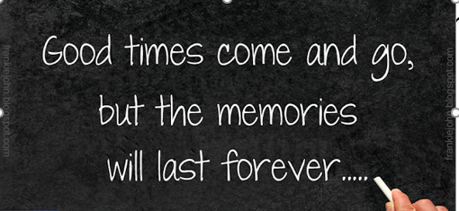
Seven Customer Experience Imperatives
Recognise that customers decide emotionally and justify rationally
Embrace the all-encompassing nature of customers’ irrationality
Understand that customers’ minds can be in conflict with themselves
Commit yourself to understanding and predicting customer habits and behaviours
Uncover the hidden causes and unintended consequences of customers wanting things to be easy
Accept that apparently irrelevant aspects of your Customer Experience are sometimes the most important aspects
Realise the only way to build customer loyalty is through customer memories.

Slide 9
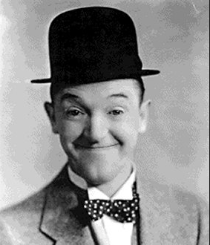
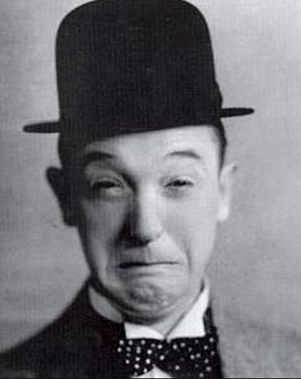
Emotions
Destroying Cluster
Advocacy
Cluster
Drives
Long-term
Value
Happy Pleased
Recommendation Cluster
Trusting Focused Cared for
Safe Valued
Attention Cluster
Drives
Short-term
Value
Interested Exploratory Stimulated
Energetic Indulgent
Irritated Unhappy Disappointed
Hurried Dissatisfied Frustrated
Stressed Neglected
Hierarchy Of Emotional Value

Slide 10
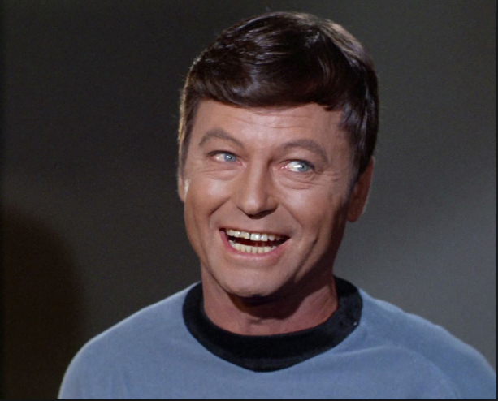
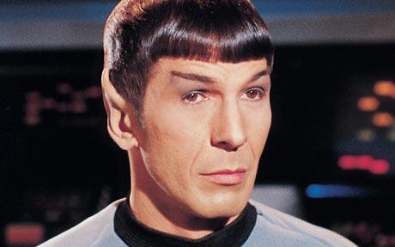
Emotion and Rationality
‘…..the customer’s interpretation of why he or she made a decision is often wrong. It’s wrong because they do not realise their decision was emotional. They honestly BELIEVE their rational justifications’.
What are the implications of this? Discussion….

Slide 11

The Intuitive and the Rational
Intuitive | Important And Emotional | Rational
Quick Decisions | Buying a Wedding Dress, First House, Car | Deliberate decisions
Low Involvement Decisions | Deciding which College to attend, Person to date, Job to take | Motivated decisions
Deciding When Distracted | ‘My Car Story’ – Preferred Brand Based decisions | Well informed decisions
Deciding When Tired |  | Decisions not under time pressure
Habitual Decisions |  | Long-term investment planning
Emotional Decisions |  | Wary decisions
Deciding When Brand Loyal |  | Complex decisions
 |  | High Profile decisions (B2B)

Slide 12


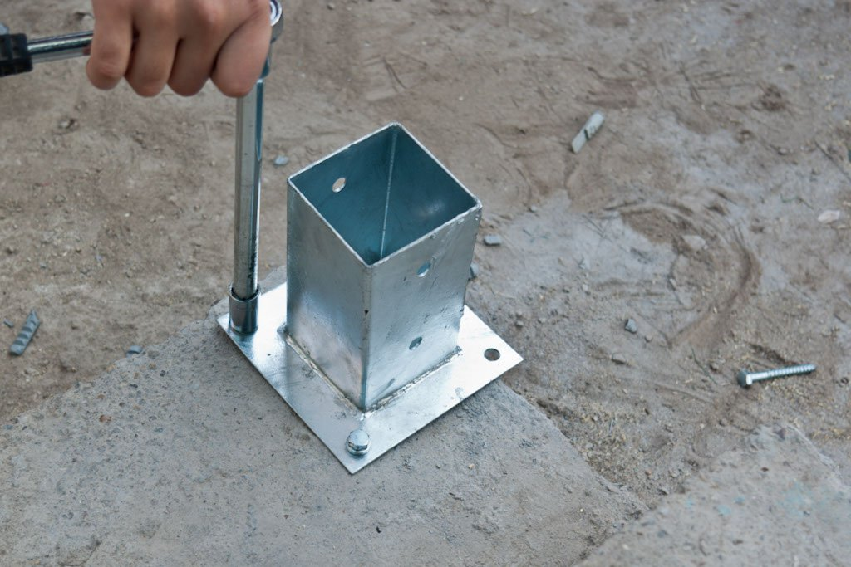
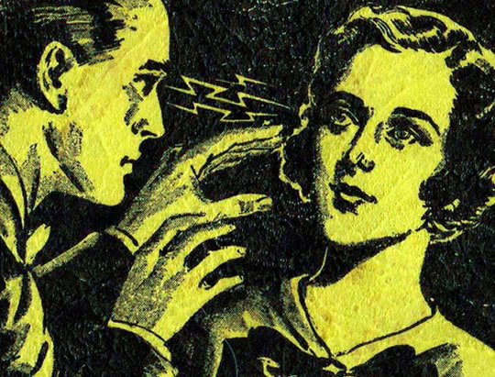

Intuitive/Rational interaction…
Approval
Neglect
Override
Influence
Anchoring

Slide 13
Understanding & predicting customer habits and behaviours
Changing behaviour is difficult
Pulling the ‘trigger’ on habits
Trigger
Outcome
Behaviour

Slide 14
Loyalty or Habit?
No Loyalty Market pricing | True Loyalty Intense Emotional Engagement Customers actively choose your organisation even though others provide the same product Customers advocate your services proactively
Mistaken Loyalty Inertia – People buy a thing because they always have Habit – Their purchase is routine | Untested Loyalty Potentially low level of emotional engagement Customers feel emotional engagement to your organisation but this is not tested in a competitive situation
Effective Monopoly Highly Competitive
No Engagement Emotional Engagement

Slide 15
Building intuitive behaviour
1. Recognition
2. Learning
3. Repetition
4 Intuition
I recognise I
do not
understand
I learn how to do this
I do it many times
I do it automatically

Slide 16
Heuristic V Systematic
Habits
Intuitive and
Rational
Systems
Combined
Intuitive System
Rational System
Heuristics

Slide 17
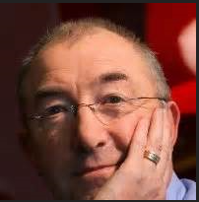
The Only Way to build customer loyalty is through customer memories
Chris Daffy

Slide 18
What really drives value for customers?
SUBCONSCIOUS Not desired but drives value | CONSCIOUS Desired and drives value
INVISIBLE Not desired and doesn’t drive value | DECEPTION Desired and does not drive value
DRIVES
VALUE
DOESN’T
DRIVE VALUE
LOW DESIRE HIGH DESIRE

Slide 19

Review
Take 5 minutes to reflect upon today’s key learning…

