Slide 1
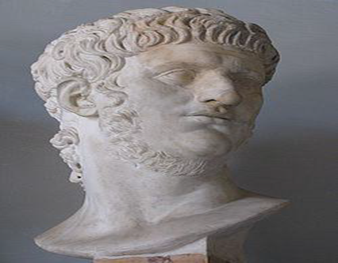
Literature and Culture in the Reign of Nero
CLCS5010
NERO IN THE ANCIENT HISTORICAL SOURCES

Slide 2
Vespasian’s Career under the Julio-Claudians
Proposed that special games should be held for Gaius victories in Germany and that the bodies of conspirators should be refused burial.
Vespasian indebted to Narcissus for command of a legion in Germany under Claudius, also part of campaigns in Britain.
Under Nero was a governor in Africa, and toured Achaia (Greece) as part of Nero’s company (though offended him and fell out of favour).
Sent to Judaea to put down Jewish rebellion.

Slide 3
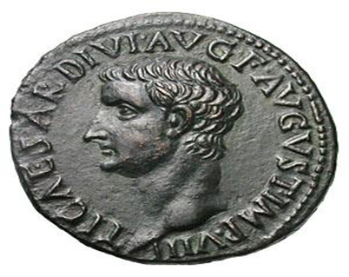
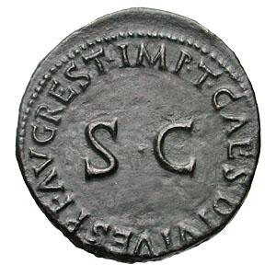
Denigration of Nero’s Memory (1)
Hostile treatment in histories produced in the Flavian period (contra Otho and Vitellius).
New dynasty that needs to present Nero as an aberration to the principate (Claudius’ memory treated more favourably).
“On the tour through Greece, among the companions of Nero, he bitterly offended the emperor by either going out often while Nero was singing, or falling asleep, if he remained. Being in consequence banished, not only from intimacy with the emperor but even with his public receptions, he withdrew to a little out‑of-the‑way town, until a province and an army were offered him while he was in hiding and in fear of his life.” – Suetonius Divus Vespasianus 4.4.
Tiberius Restoration AE As, RIC 432 (RIC [1962] 211) (Titus); BMC 284.

Slide 4
Historical Tradition
Cluvius Rufus, connection to Nero’s circle
Fabius Rusticus, friend of Seneca
Pliny the Elder, part of Flavian court
Tacitus, Annals - c. late AD 110s to early 120s ?
Suetonius c. Hadrianic period
Likely
Possible?
Cassius Dio, writing in Severan period
Historical sources mentioned by Tacitus - Cluvius Rufus, Pliny the Elder, and Fabius Rusticus; also the memoirs of Corbulo, the acta senatus, and the testimony of those that survived the Pisonian conspiracy.
Tacitus, Suetonius and Dio most likely using these earlier sources, rather than being mutually dependent upon each other.
“The 1st book is the Preface of the Work, dedicated to Titus Vespasian Caesar.” – Pliny NH preface.

Slide 5
Denigration of Nero’s Memory (2)
Hostility expressed in Flavian period poetic and literary works – notably Statius, Martial and the tragedy know as the Octavia.
“…you visit Tartarus and hear far away the whipping of the guilty and behold Nero pale at the sight of his mother's torch…” – Statius Silvae 2.7.
“What is worse than Nero, and better than Nero’s Baths?” – Martial Epigrams 7.34.

Slide 6
Stoic Hostility
“Body, soul, intelligence: to the body belong sensations, to the soul appetites, to the intelligence principles. To receive the impressions of forms by means of appearances belongs even to animals; to be pulled by the strings of desire belongs both to wild beasts and to men who have made themselves into women, and to a Phalaris and a Nero…” - Marcus Aurelius The Meditations book 3.

Slide 7
Judaeo-Christian Hostility
Nero appears in the Jewish Sibylline Oracles, c. AD 80, as a figure who is concealed in the land of the Parthians but will return to stir up a universal war.
Later Christian writes condemn Nero as the first persecutor of the Christian Church, the emperor who had St Peter and St Paul put to death, and sometimes appears as an “Anti-Christ” or an associate.
“Thus publicly proclaiming himself as the first among God's principal enemies, he was led on to slaughter the apostles. It is, therefore, recorded that Paul was beheaded in Rome itself, and that Peter likewise was crucified under Nero.” - Eusebius Ecclesiastical History 2.25.5.

Slide 8
The Historical Presentations of Nero and the Julio-Claudian Dynasty

Slide 9
Questions to Consider
Identify some of the key negative characteristics attributed to the Julio-Claudian emperors. Are there any patterns you notice? If so do they represent the “generic” attributes of a tyrant?
Do some authors seem more balanced and “objective” than others?
What impression do you get about the nature of the principate in this period from the sources?
How are threats to the position of the emperor dealt with?
What are the problems with getting an “accurate” picture of what happened in this period?

