Slide 1
Module Title: Professional Career Development within H&SC
Module Number: LCHS 4009 (LON)
Assignment No: ASSIGNMENT 1
Student Name: FOLASHADE OYEOGBE
Student ID: 2421280
Lecturer’s Name: Sohan Sadiq

Slide 2
Acknowledge use of AI
No AI has been used.

Slide 3
There are many opportunities in health and social care. Health and social care are diverse, including direct support roles like care assistant, mental health workers, and professional roles such a doctors, nurses, social workers, and allied professional like physiotherapists.

Slide 4
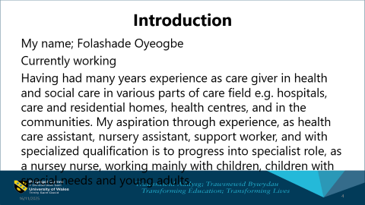
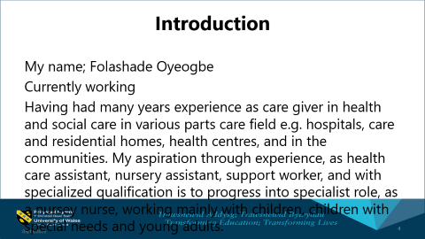
Introduction
My name; Folashade Oyeogbe
Currently working
Having had many years experience as care giver in health and social care in various parts of care field e.g. hospitals, care and residential homes, health centres, and in the communities. My aspiration through experience, as health care assistant, nursery assistant, support worker, and with specialized qualification is to progress into specialist role, as a nursey nurse, working mainly with children, children with special needs and young adults.

Slide 5
What is a SWOT Analysis and why is it important to your personal and professional development?
Swot analysis is strategic planning tool that identifies Strengths, weaknesses, opportunities, and Threats, to assess a situation, whether for a business or an individual. It is crucial for personal and professional development, helps individuals understand their internal qualities and external factors, enable them to leverage strengths, improve weaknesses, capitalize on opportunities, and mitigate threats, ultimately leading to more effective goal setting,and carrer growth.

Slide 6
Describe your own Strengths, Weaknesses, Opportunities, and Threats
OPPORTUNITIES
.learn or being given opportunities of having new experience,
.Training
.Exploring on new ideas or knowledge different from my usual routine or my job role.
.opportunities of creativity
THREATS
. Time
. Family commitment
. Financial commitment
. Health
. Lack of opportunities
.lack of support

Slide 7
Using examples: Explain how you could leverage your strengths to overcome your weaknesses and minimise threats
. Start in time to get any obstacles that may not allow me to focus on my plans or target out of the way.
.Develop plans, strategies and time to start and expected time to finish or achieve my goals.
. Deal with any threats that arise immediately and accordingly.
.Try to work against or minimise any weaknesses that could hinder or be of threaths to my plans or goals.

Slide 8
What opportunities are available to you, and how do you utilise them with your strengths?
.Utilize opportunities available for me pursue new skills, enhance my career, develop plans to mitigate or avoid any weaknesses.
Identify my unique talents that makes me fulfilled. And recognise the areas that I need to invest in myself for personal growth.
Develop strategies to achieve more realistic goals, self awareness, objective audit of my current situation.
Help me to understand what I do well, and where I need to improve.

Slide 9
Professional career development in health and social care is a continuous, life long process involving formal and informal learning to improve the quality of care, enhance skills, and open up opportunities for advancement. It is crucial due to the sector’s constant evolving nature, driven by new technologies, policies, and an aging population needs.

Slide 10
References List
https://www.careersmarter.com//swot-analysis-for-personal-development/?
https//performanceandimprovement-nhswales/functionsquality-safetyandimprovement-cymru-academy/resource-library

