Slide 1
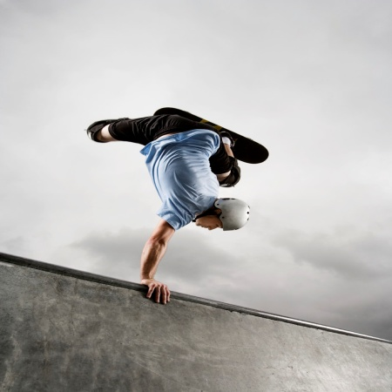
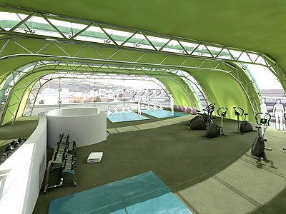

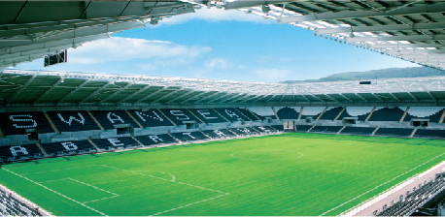

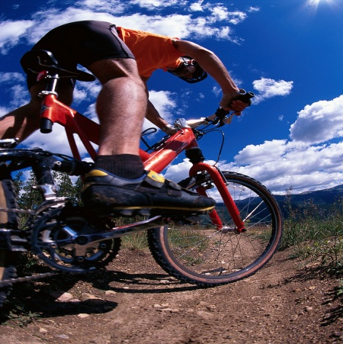
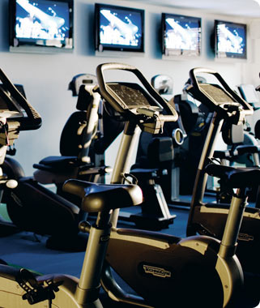
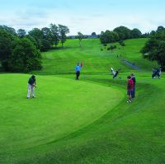
Coaching and Elite
Sport Performance

Slide 2
National Governing Bodies
There are over 300 National Governing Bodies (NGBs) recognised by the Sports Councils.
Over 100 sports in the four home countries of the United Kingdom

Slide 3
Local Authority
NGB
Courses
Clubs
Holiday Camps
Clubs
Social
Inclusion
Junior
Programme
Fitness
CORE
National
Education
Recreational
Competitions
COLD
Coach Education
5x60
HE/FE
Dragon Sport
PE Curriculum

Slide 4

What is an NGB?

Slide 5


Slide 6
3.2 What is a Governing Body?
NGB as an organisation which carries out most, if not all, of the following:
Prepares and implements a vision and strategic plan for the sport;
Promotes the sport;
Manages the rules and regulations of the sport, including anti-doping;
Administers officials of the sport;
Maintains links with the international governing body /federation;
Encourages participation;
Develops talent;
Develops elite athletes; and
Organises and hosts competitions.

Slide 7
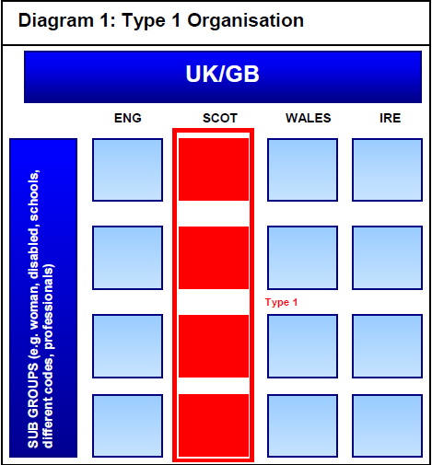
Most NGBs tend to differentiate themselves along home country lines a
They may or may not have a UK NGB.
In these cases the level of local representation may be strong
Essential to ensure that there is maximum collaboration between each of the Home Country NGBs,
A need for one common view on the development of the sport and contributions

Slide 8


Slide 9
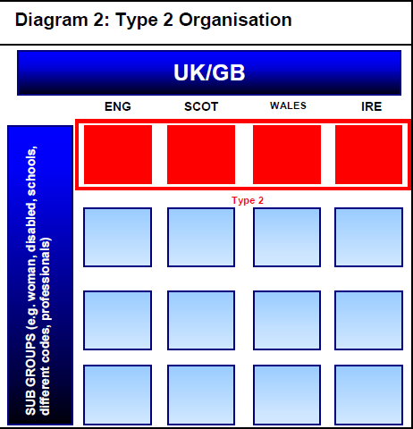
Differentiate themselves by sporting function
They represent one code across all four home countries.
Single, UK wide, NGB model.
Most efficient structure for the sport.
Single body is effective, particularly in representing the views, needs and requirements of all of its members and participants throughout the UK.

Slide 10


Slide 11
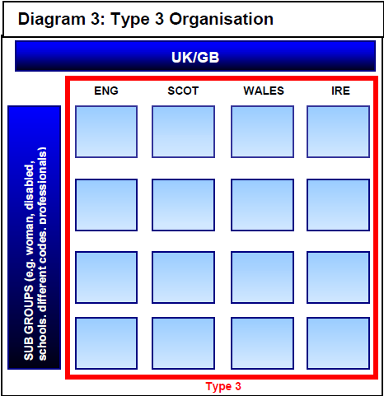
Does not differentiate by either country or code.
Usually a federation, e.g. British Equestrian Federation.
Where a number of NGBs come together, to share common resources and to speak with one.
Voice on matters relevant to the sport.
In these structures it is important to find a balance such that the views of all groups are adequately represented.
organisation develops a consistent and common purpose

Slide 12


Slide 13
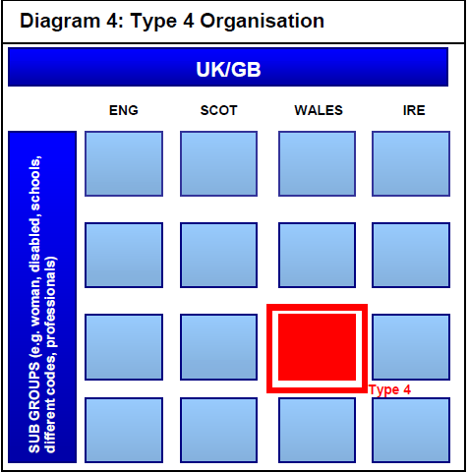
Differentiates by both country and code giving rise to a plethora of NGBs for one sport
Examples of this are Bowls and Golf.
These organisations constrain the sport from speaking with one voice
Can lead to duplication of effort and resources

Slide 14


Slide 15
What is an NGB?
Partners that.......
Fund
Influence
Deliver

Slide 16


Slide 17
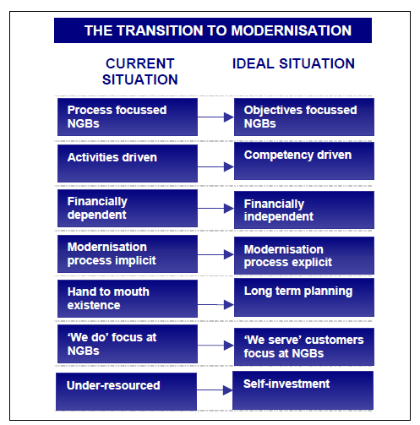

Slide 18
What is an NGB?

Slide 19
Key Outcomes
Modernisation
Partnership
Development
Development
Financially Independent
Clear communication plan
Increased Participation
Financial stability & Income
Strong Vision & Action Plan
Strong/Effective Partnerships
Strong Infrastructure
Clear operational/ equity plans
Customer focused
Clear commercial plans
Clear Pathways
Effective info management
Core Functions
Sports Administration
Partnership
Development
Management
Manage Rules & Regulations
Establish & maintain link with
International NGB’s
Promotion of Sport
Financial stability & Income
Membership Programme
Manage operations
Manage officials
Establish links with Education
Participation/ Retention
Discipline/ dispute resolution
Volunteer management
Equal access
Establish links with UA’s
Statutory requirements
Development of talent
Equity & Ethics
Establish links with
Commercial providers
Development of Elite athletes
Organise & host competitions
Information Management
Developing coaches
Foundations
Values
Strategy
People
Systems
Professionalism
Strategy Setting
Key Staff
Accountability
Commercialism
Evolution
Training
Collaboration
Priority & Focus
Volunteers
Technology
Autonomy
Inclusion
Self Investment
Communication

Slide 20


