Slide 1

Title: Supporting Early Childhood Development through Bowlby’s Attachment Theory: A Case Study of Amira
Module: Psychology in Health and Social Care

Slide 2
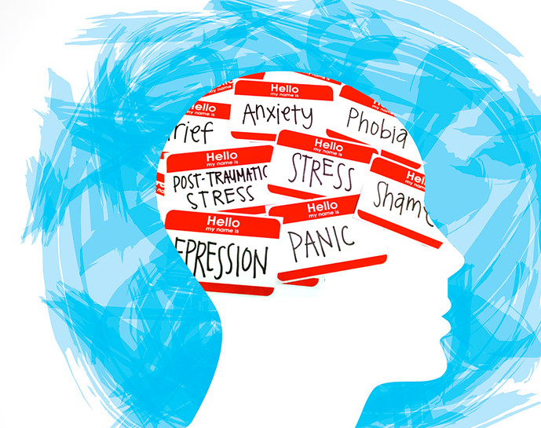
Introduction
Focus: Supporting a 3-year-old (Amira) in nursery
Signs: anxiety at separation, limited speech, poor group play
Aim: apply Bowlby’s Attachment Theory to understand and support her development
Notes:
This presentation discusses how Bowlby's Attachment Theory can be used in making sense and working with a 3-year-old girl named Amira, who has been presenting with separation anxiety from her carers and social interaction difficulties. It is concerned with explaining her behaviour from a developmental psychology perspective and suggesting how to promote her emotional, social, and cognitive development. We can use Bowlby's theory to explain how Amira's early attachment experiences impact her development and how social and health care practitioners can facilitate secure early childhood relationships (Bretherton, 2019).

Slide 3

Overview of Bowlby’s Theory
Developed in the 1950s; updated by Ainsworth (1978)
Attachment: an innate emotional bond between child and caregiver
Secure attachment → confidence and exploration
Insecure attachment → anxiety and withdrawal
Relevance: key for emotional regulation and social learning
Notes:
John Bowlby (1969) suggested that children are evolutionarily equipped to develop attachment as a means of survival. Children grow up securely attached and emotionally secure and inquisitive when parents are responsive (Bretherton, 2019). Care that is inconsistent or unresponsive produces insecure attachments, which generate anxiety or avoidance (Howe, 2021). Ainsworth's Strange Situation also differentiated attachment patterns secure, avoidant, and ambivalent in helping us make sense of behaviours like Amira's distress at being left behind by her carers. Bowlby's model remains at the core of early childhood and social care provision (Prior & Glaser, 2020).

Slide 4
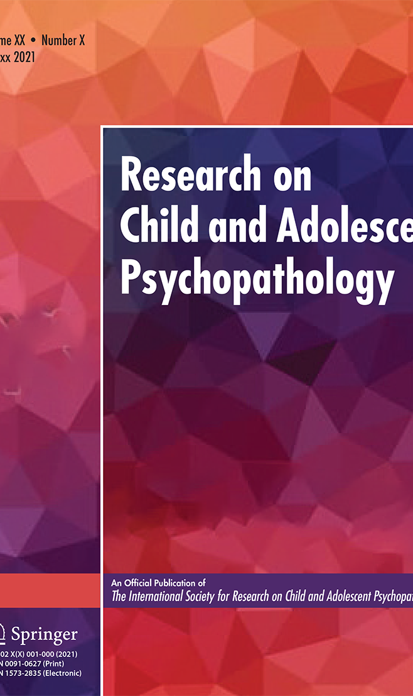
Applying Bowlby’s Theory to Amira
Amira’s anxiety reflects possible insecure attachment
Limited speech = emotional distress, not lack of ability
Difficulty in group play = low social confidence
Need for stable key-person relationships in nursery
Notes:
Amira's upset when removed from her carers indicates separation anxiety, which is a characteristic of disturbed or insecure attachment (Howe, 2021). Her restricted communication may show emotional tension instead of intellectual delay (Pearson et al., 2018). She may feel threatened in new contexts, so it will be hard for her to relate with peers. The establishment of a secure key-person relationship can encourage security and constancy, so Amira can learn trust and confidence. Consistency is the foundation of Bowlby's theory of a secure base enabling exploration and social development after emotional needs are met (McLeod, 2023).

Slide 5
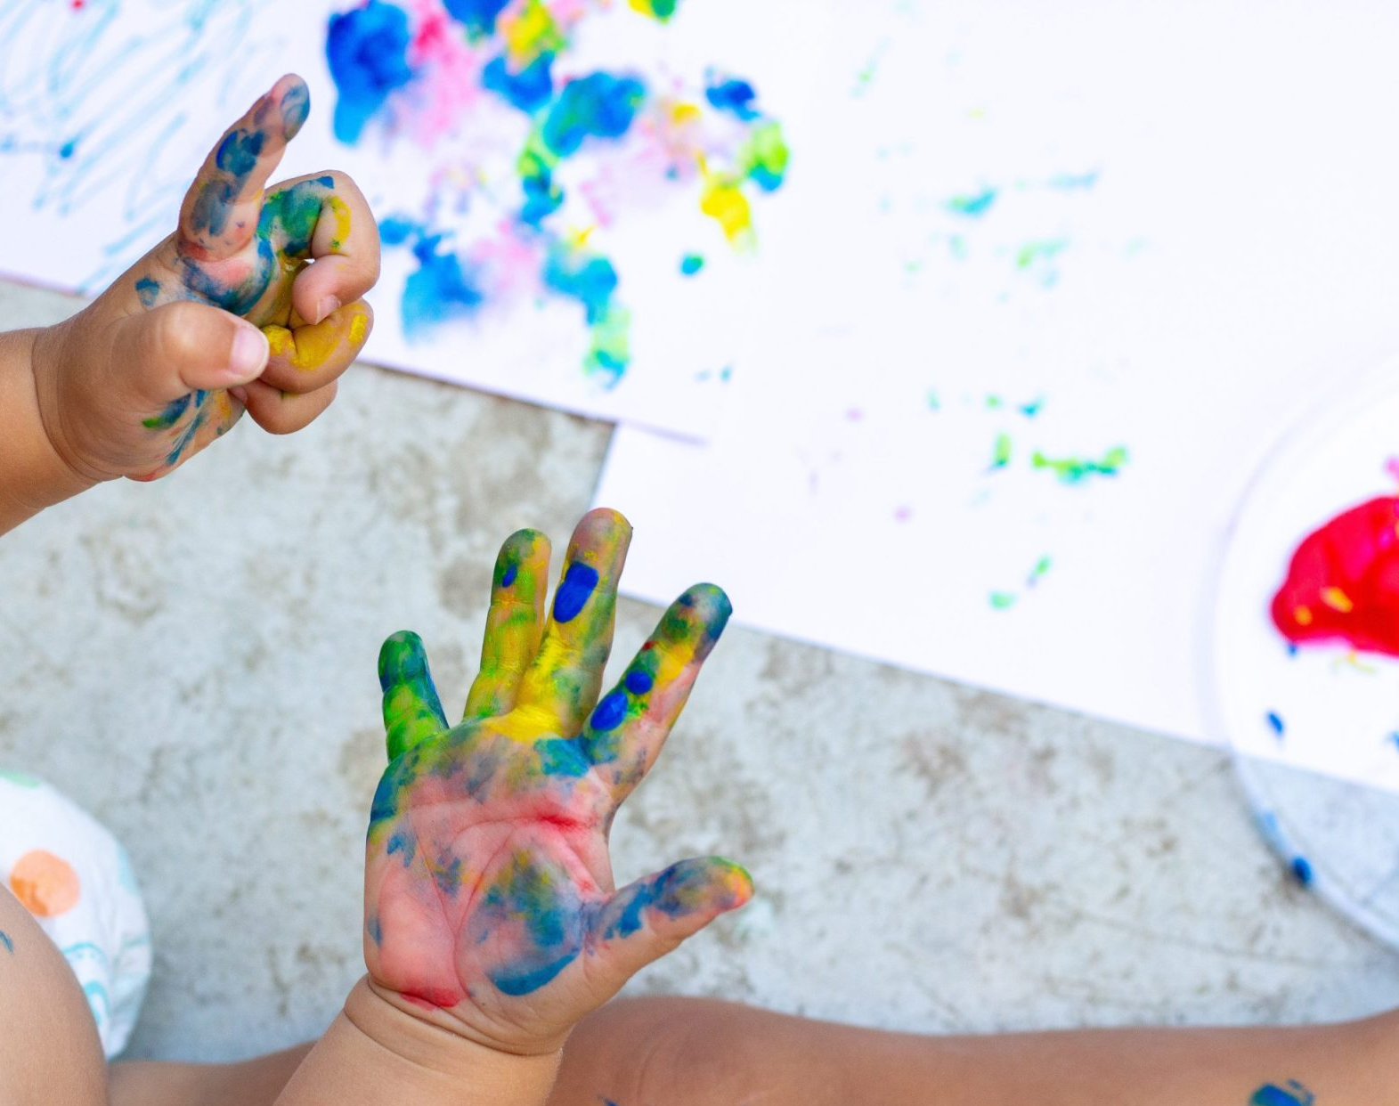
Emotional and Social Development
Secure attachment promotes empathy and cooperation
Emotional regulation develops through responsive care
Peer interaction improves via trust and modelling
Anxiety can block social learning
Notes:
Children such as Amira require emotional reassurance prior to social interaction being able to thrive. Secure attachment assists children in managing emotions, communicating needs, and making friends (Prior & Glaser, 2020). With no security, there is fear and withdrawal, promoting low-level social play. Professionals working with children in early years need to provide warmth, routines, and encouragement. For Thompson (2019), warm relationships encourage emotional literacy so that children can manage anxiety and be able to communicate effectively when working in groups.

Slide 6
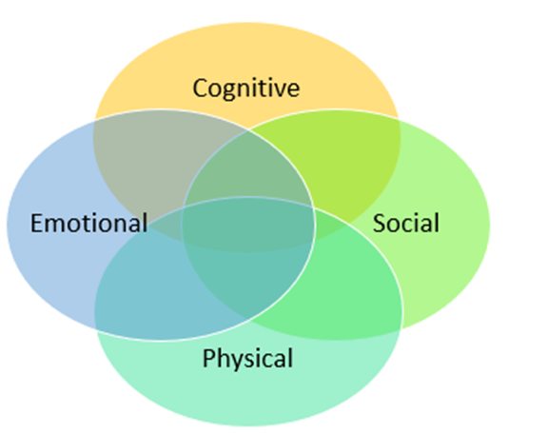
Cognitive and Language Development
Emotional security supports curiosity and learning
Attachment linked to language development (Sroufe, 2016)
Stress hinders concentration and memory
Supportive relationships boost verbal interaction
Notes:
Bowlby stressed that attachment facilitates cognitive development. When a child feels safe, they will investigate more, and this promotes brain growth (Sroufe, 2016). Fear triggers the stress response, which lowers memory and attention (Howe, 2021). In Amira, reassuring her continually and reading to her in one-to-one stories can activate speech by feelings. Communicating by play activates trust and word development. Whitebread (2019) uncovers that adult responsive interaction encompasses maximum language acquisition and curiosity and forms the building block for success in future learning.

Slide 7
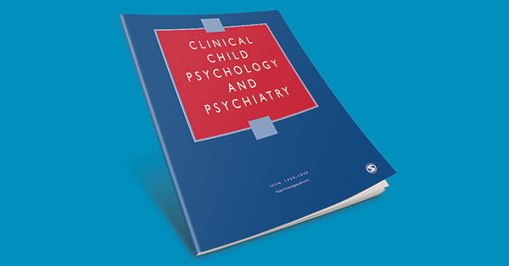
Nature and Nurture
Bowlby acknowledged biological drives (“nature”)
Environment and caregiver response (“nurture”) shape outcomes
Secure attachment possible with consistent care
Genetic and environmental factors interact
Notes:
Bowlby's model incorporates both nature and nurture. He suggested that attachment behaviours are biologically programmed to promote survival (Bowlby, 1969). However, the quality of care defines the pattern of attachment (McLeod, 2023). Both genetic risk and erratic nurturing experience can be the cause of Amira's behaviour. Even when anxiety is temperamentally rooted, secure attachment can be encouraged by consistent and sensitive care in the nursery. Training caregivers in emotional atonement and predictable routines can thus recast developmental outcomes for the better (Thompson, 2019).

Slide 8
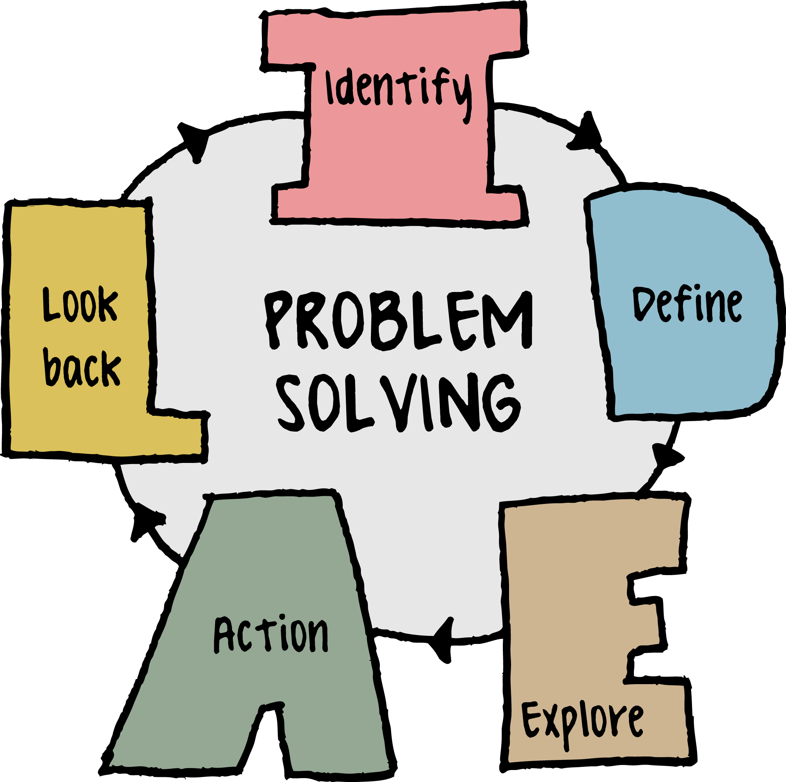
Strategies to Support Amira
Assign consistent key person in nursery
Create calm, predictable routines
Gradual separation from parents
Encourage emotional expression through play and storytelling
Positive reinforcement and peer modelling
Notes:
Practical strategies from Bowlby's work include a secure base in the nursery. Consistency of emotions and familiarity are from a key person. Predictable, soothing routines minimize anxiety (Howe, 2021). Gradual separation staying close until Amira is secure is accessible to parents and practitioners. Emotional play, e.g., puppet story, enables verbal and emotional communication. Praise and small success must be reinforced to consolidate resilience. As Prior and Glaser (2020) explain, secure caregiving and sensitivity can turn insecure attachments into secure ones, in a manner that enhances emotional and cognitive development.

Slide 9
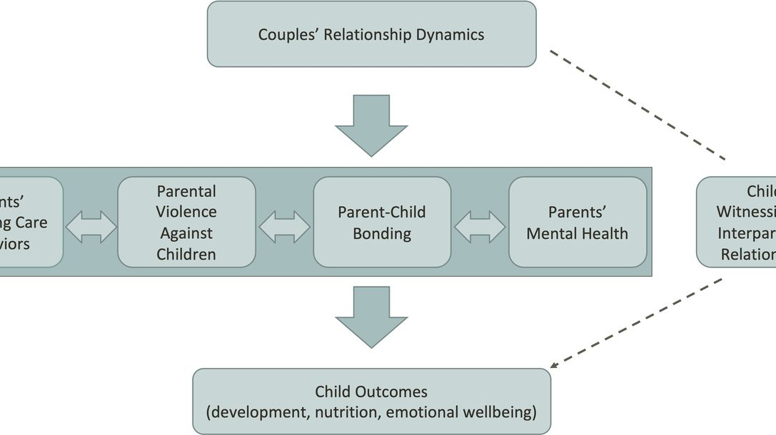
Evaluation: Usefulness of Bowlby’s Theory
Highlights importance of early relationships
Influences key policies: EYFS, attachment-based practice
Guides interventions for emotional and social development
Supported by neuroscience and contemporary research
Notes:
Bowlby's theory is very influential in early childhood and social care today. It underpins the Early Years Foundation Stage (EYFS) and impacts safeguarding policy. Contemporary neuroscience validates the theory that early attachment influences brain structure and regulation of emotion (Bretherton, 2019). The theory provides a clear framework for interpreting Amira's emotional needs and influencing practitioner response (Whitebread, 2019). The theory is underpinned by evidence-based early intervention programs focusing on sensitive caregiving.

Slide 10
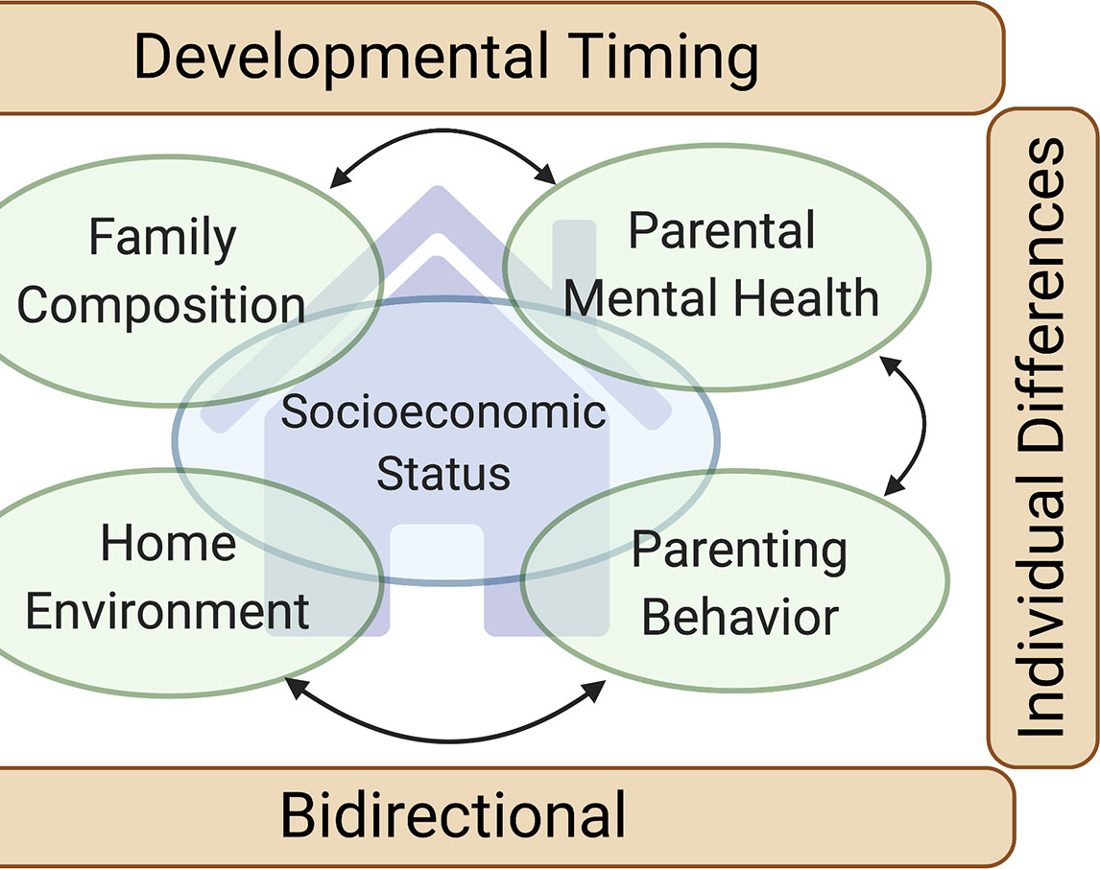
Evaluation: Limitations of Bowlby’s Theory
Criticised for overemphasising mother–child bond
Underestimates cultural and social diversity
Attachment styles not fixed – can change
Later research integrates wider family and peer influences
Notes:
While influential, Bowlby's theory has limitations. It centres extremely strongly on the mother-child relationship, ignoring the role of fathers and other caregivers (Howe, 2021). Some would say that attachment is culturally relative: in collectivist cultures, there are multiple caregivers who share caring roles (Prior & Glaser, 2020). Attachments also are not fixed secure attachments can develop later in life based on positive experience (Thompson, 2019). Thus, while Bowlby's model can be a useful guide, practitioners need to consider broader social and cultural impacts on development.

Slide 11

Conclusion
Amira’s behaviour explained by insecure attachment
Consistent relationships can rebuild trust
Secure attachment supports all developmental domains
Bowlby’s theory valuable but must be applied flexibly
Notes:
In brief, Attachment Theory from Bowlby explains Amira's wariness and restricted participation as reactions to insecure attachment. Establishing secure, reliable relationships in her nursery will build up trust, language proficiency, and social skills confidence. The emphasis of the theory upon emotional relationships provides valuable insight into early years practice. But used flexibly with cultural and family diversity respected it provides cohesive, ethical, and responsive care (Howe, 2021). Facilitating Amira's emotional safety is at the heart of promoting lifelong wellbeing and learning achievement.

Slide 12
Reference
Bretherton, I. (2019) Attachment theory: Retrospect and prospect. Developmental Psychology, 55(6), pp. 1246-1258.
Bowlby, J. (1969) Attachment and Loss: Vol. 1 – Attachment. New York: Basic Books.
Howe, D. (2021) Attachment Across the Lifecourse. 3rd ed. London: Palgrave Macmillan.
McLeod, S. (2023) Bowlby’s Attachment Theory. Simply Psychology. Available at: https://www.simplypsychology.org/
Pearson, R.M. et al. (2018) ‘Maternal sensitivity and child communication outcomes,’ Journal of Child Psychology and Psychiatry, 59(7), pp. 773-781.
Prior, V. & Glaser, D. (2020) Understanding Attachment and Attachment Disorders. 2nd ed. London: Jessica Kingsley.
Sroufe, L.A. (2016) The place of attachment in development, Developmental Review, 39, pp. 301-307.
Thompson, R.A. (2019) Social and Personality Development. 7th ed. Belmont: Cengage Learning.
Whitebread, D. (2019) Teaching and Learning in the Early Years. 5th ed. London: Routledge.
EYFS (2023) Statutory Framework for the Early Years Foundation Stage. London: Department for Education.
Notes:
Bretherton, I. (2019) Attachment theory: Retrospect and prospect. Developmental Psychology, 55(6), pp. 1246-1258.
Bowlby, J. (1969) Attachment and Loss: Vol. 1 – Attachment. New York: Basic Books.
Howe, D. (2021) Attachment Across the Lifecourse. 3rd ed. London: Palgrave Macmillan.
McLeod, S. (2023) Bowlby’s Attachment Theory. Simply Psychology. Available at: https://www.simplypsychology.org/
Pearson, R.M. et al. (2018) ‘Maternal sensitivity and child communication outcomes,’ Journal of Child Psychology and Psychiatry, 59(7), pp. 773-781.
Prior, V. & Glaser, D. (2020) Understanding Attachment and Attachment Disorders. 2nd ed. London: Jessica Kingsley.
Sroufe, L.A. (2016) The place of attachment in development, Developmental Review, 39, pp. 301-307.
Thompson, R.A. (2019) Social and Personality Development. 7th ed. Belmont: Cengage Learning.
Whitebread, D. (2019) Teaching and Learning in the Early Years. 5th ed. London: Routledge.
EYFS (2023) Statutory Framework for the Early Years Foundation Stage. London: Department for Education.

Slide 13


