Slide 1
Empirical Project Lecture
Results Section
Dr. Ceri Phelps

Slide 2
A note about Preparing data for analysis
Remember to follow the processes/protocols set out through ethics
Think about what you can do throughout the data collection process to help prepare your data for analysis
Do not take short cuts – spending time ensuring data collected is good, clean and stored correctly makes data analysis and write up simpler and stronger

Slide 3
Preparation before running the analysis
Read journal articles that have employed the same approach/design as your study
  Read the results section to get an idea of the type of analyses they have conducted and the manner in which they report the findings.
Make sure you are doing the correct analysis
  Read back through your research questions/hypotheses
Allow plenty of time – analysis cannot be rushed
  You may also have to conduct many different types of analyses to answer different research questions.

Slide 4
Analysis
Quantitative analysis
  Design of questionnaire/experiment will influence type of analyses possible
  Basic descriptive statistics: means, standard deviation, ranges, percentages, total scores
  Inferential statistics: compare responses between groups or across the same participants over time, or look for a relationship between scores?
    (E.G., T-test, ANOVA, correlation, regression)

Slide 5
Analysis
Qualitative analysis
  The way you have worded your questions will influence the type of data you get back
  Follow the correct analysis for your approach (e.G., IPA, thematic analysis).
  Look beyond the basics for a more nuanced “interpretation” – the essence or theme
  Good balance of narrative interpretation (your “findings”) and your supporting quotes (your “data”).

Slide 6
The Results Chapter
Complete
NOT
Complex

Slide 7
Coming out of the Method Chapter
You have set the scene
  Who you ran the study on (participants)
  What you did and how you did it (materials and procedure)
  How you are going to analyse it (design)

Slide 8
Going into the Discussion
Discussing your results and what they mean
Linking your results back to the prior literature
  Do they agree or disagree with previous study findings? Why? Why not?
  What, does your study add to this existing literature?
Evaluating the strength of your research findings – demonstrating your ability to critically evaluate your own research (just as you would others)

Slide 9
So… your Results Section needs to…
Reflect your Methodology
Be structured around research questions/hypotheses
Provide evidence for the Discussion
Present findings in a clear and unambiguous manner
Be written in proper English using sentences!

Slide 10
Quantitative Studies
Descriptive statistics (always come first)
  The data relating to YOUR sample
    Ns, means, sds, etc.
    Simple but clear presentation
Inferential statistics
  Statistical analysis of the data
    Correlation, t-test, ANOVA, chi-square, etc.

Slide 11
Results Chapter write-up
Report your findings in a clear, concise and systematic way:
State which hypothesis you are discussing.
What you have done prior to analysis (if not covered in methods).
  Basically discuss the treatment of the data – what did you do to get it ready to be inputted into spss?
  Any reverse or recoding of questionnaire data necessary in spss?
  Did you need to work out the sample average then divide participants into high/low groups?
Then present the descriptive statistics
Then describe the analysis you performed and why.
Then describe what the result was – appropriately reported
State whether the outcome was ‘significant’ or ‘not significant’.
State whether the hypothesis is accepted or rejected

Slide 12
Results Chapter write-up
For each result, explain what this actually means in terms of your hypotheses and overall study aims, but only do so in brief.
For example:
from this significant finding we can conclude that the British in general hold less favourable attitudes towards the European union than the germans in general do.
You will then discuss your findings in more detail in the discussion section.

Slide 13
Results Chapter write-up
DO NOT cut and paste output from SPSS into your results section!!!!
Create your own meaningful tables where necessary to demonstrate that you understand and are able to interpret your results.
Avoid repetition and redundancy in your reporting
Do not forget about conventions for reporting (e.g., the M, SD, t, F, p, etc. should be in italics)…..

Slide 14
Example write-up from inferential statistics
It was hypothesised that winning the ‘bet’ results in higher arousal, or that there will be a significant difference in the mean arousal levels for participants who won their bet to those who lost. An independent samples t-test was conducted to compare arousal levels. There was no significant difference in scores for winning (M = 6.9, sd = 2.9) and losing (M = 7.16, sd = 2.8), t (64) = -.376, p > .05.

Slide 15
A chi-square test of independence was performed to examine the relationship between gender and level of sensation seeking. The relationship between these variables was significant X² (1, N=66) = 9.46, p < .005, phi = -.38. The hypothesis that males are more likely to be higher sensation seekers than females can be accepted. Figure 1 shows the percentages of sensation seeking levels for each gender.
Independent samples t-tests of the two separate subscales also revealed that there was a significant difference in levels of novelty seeking for males (m = 29.95, sd = 3.54) and females (M = 25.83, sd = 4.03), t (64) = 3.883, p < .001. There was also a significant difference between genders on the intensity subscale; males (M = 30.05, sd = 3.34) scored significantly higher than females (M = 25.91, sd = 4.17), t (64) = 3.845, p < .001.

Slide 16
Figure 1: Graph showing percentages of male and female levels of sensation seeking
Total Percent (%)

Slide 17
The interaction effect between age and level of sensation seeking was significant, F (1,58) = .84, p = .005. The effect size was large (partial eta squared = .127). The interaction means show that adult high sensation seekers became more aroused than low sensation seekers, but emerging adult high sensation seekers were less aroused than low sensation seekers (see column means in table2). These results assert that the significant effect of high sensation seeking on arousal is only true for adults. The interaction between age and sensation seeking is displayed in figure 2.

Slide 18
Figure 2: Graph showing the interaction between age and sensation seeking on arousal.

Slide 19
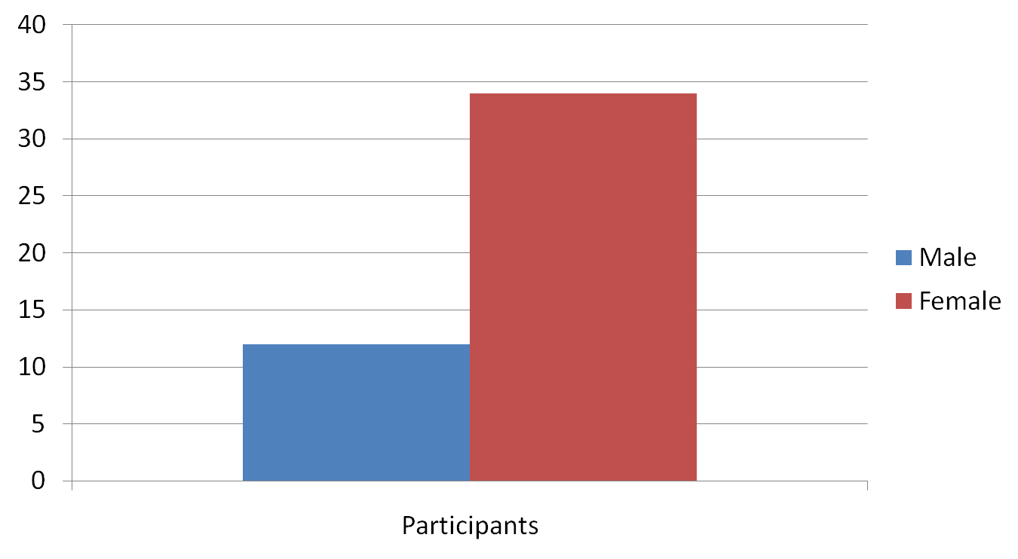
How To Annoy Your Examiner

Slide 20
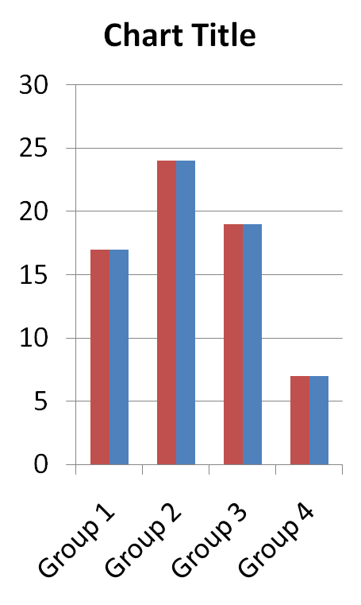
How To Annoy Your Examiner

Slide 21
How To Annoy Your Examiner
Group | Score 1 | Score 2 | Score 3
A | 10 | 15 | 20
B | 5 | 10 | 15

Slide 22
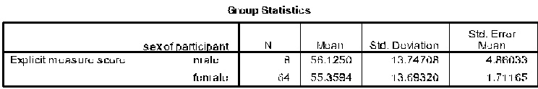
How To Annoy Your Examiner

Slide 23
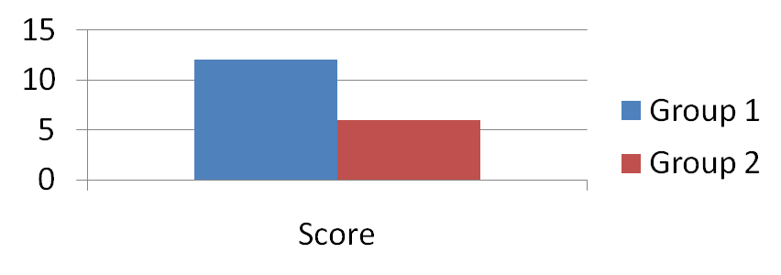
How to annoy your examiner
The t-test showed that there was no significant difference between Group A and Group B, t(43) = 0.12, p = .6. However, Group A did score more than Group B, as predicted, therefore we can say that the hypothesis is supported.
< .05 = significant effect
.05 - .1 = marginal effect
>.1 = no effect
And that is it!

Slide 24
E.g., Reporting ANOVA statistics
ANOVA will analyse:
  Interactions (combined effects of more than one IV)
  Main effects (effects of one IV in isolation)
  F-value, degrees of freedom, p-value (sig. value)
    F-value equating to the t-value in the t-test
    Sig. Value used in exactly same way as t-test (p < 0.05 is significant)
  All showing whether (or not) there are significant differences (and to what degree) between the means in each grouping of data
    As shown in a t-test

Slide 25
Interpretation of Output from ANOVA
Treatment of data
Report descriptives
Check levene’s test of equality of error variances
  Needs to be greater than .05
Report interaction effects
Report main effects
Report effect size
Report post-hoc tests (if needed)

Slide 26
Results Chapter
Main points to take away
Most of your results are written
  Can use figures/tables to convey multiple values
Do not repeat information from a table/figure into a sentence as well (should be either/or)
Uniformity of reporting
  Write the important means/statistical analyses when you talk about comparisons
  Descriptives first, then inferentials
  Inferentials: interactions, main effects, post hoc - in that order

Slide 27
Interpretation of statistical analysis output
Use your SPSS stats book and figure it out
  This is the only way you will understand it for yourself!
Tells you exactly what to interpret and how to report this...
Always check that the assumptions of the particular analysis you are conducting have been met.
  Spss stats book will tell you assumptions for different analyses.
Just make sure you have selected the correct test!
Remember – it does not matter if your results are not significant

Slide 28
Qualitative Studies
A structured narrative based around key themes and supported by quotes
Your quotes are your “data” – the data needs to be summarised and interpreted, just as with quantitative designs
Different analytical approaches have different analytical frameworks – ensure you follow the correct one for your methodology!

Slide 29
Writing up a qualitative study
Researcher must choose which story to tell and how best to tell it – subjective interpretation
What is the storyline?
  What is your research question?
The important ideas will not be ‘in’ the data themselves
  They are there to think about and interpret

Slide 30
Focus groups – How does the group construct an account?
  Points/arguments
  Dominant themes and/or similarities and differences
Interviews – specific ways in which the participants answer questions/tell their story
  Similarities and differences in themes across participants/groups

Slide 31
Qualitative data: A “nuanced” analysis:
Consider
  Is there consensus regarding a theme/subtheme?
  Are some themes/subthemes present in some accounts but absent from others?
  Are some present in more than one account but spoken about differently?

Slide 32
Use data selectively to exemplify, illustrate or illuminate what you are trying to tell us about your topic of study
  Does not mean cherry picking the most extreme or dramatic examples
  Sometimes what appears to be mundane can tell us much about how people feel/think
You decide how best to present the themes

Slide 33
Interpretation of qualitative data
Use your qualitative analysis book
  This is the only way you will understand it for yourself!
Tells you exactly what to interpret and how to report this...
Just make sure you have selected the correct analytical technique!
  Does it match what you said you were going to do in the methods section?

Slide 34
Remember…….
Results sections take time
Need to be simple to follow
Need to be informative
Need to avoid repetition
Presentation is extremely important
Accuracy is extremely important
As was the case for the method, the write-up of the results should enable someone else to come along and prepare the data then run the analysis in exactly the same way as you did.

Slide 35
Remember….
Your dissertation is not about producing a study that works
  It is about accurately reporting a study
Your results section is not about reporting what you wanted to happen
  It is about accurately reporting what did happen
Make sure what you write makes sense!

Slide 36
Remember….Learning Outcomes
In order to pass the dissertation you must demonstrate the ability to:
1. generate appropriate hypotheses and research questions;
2. use evidence-based reasoning to explore relevant practical, theoretical and ethical issues associated with a specific research question;
3. carry out an empirical study involving primary data collection using appropriate tools;
4. analyse data using appropriate quantitative and/or qualitative methods; and
5. present research findings appropriately.

Slide 37
Draft Chapter Submission
See Moodle page for date & TurnItIn Portal
Make use of this opportunity
One submission per chapter
Feedback returned within one working week

Slide 38
Key Reading
Research methods textbooks (e.g., Coolican)
Statistics textbooks (e.g., Pallant/Brace et al.)
Extensive use of academic journals!
Appropriate sources for key theories
No Gross, Wikipedia or Cosmopolitan!!

Slide 39
READ THE HANDBOOK FOR FURTHER GUIDANCE ON WRITING-UP THE RESULTS CHAPTER!!!!

